Slide 1
Meeting - 12/05/2025

Slide 2
Fixed number of random training points
Previously, I have been using randomly generated points for every iteration
This prevented overfitting, but it is hard for the model to learn since the points will change in every iteration
So I used 64 different sets of random points and trained the model
This made the training easier while preventing overfitting

Slide 3

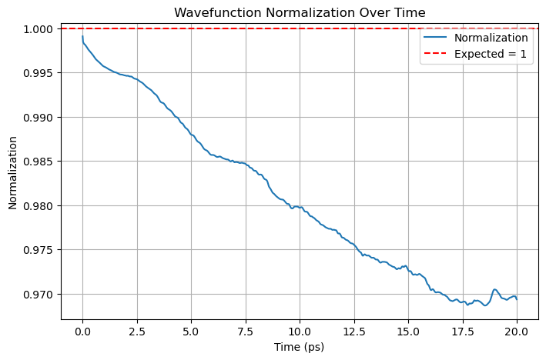

Slide 4
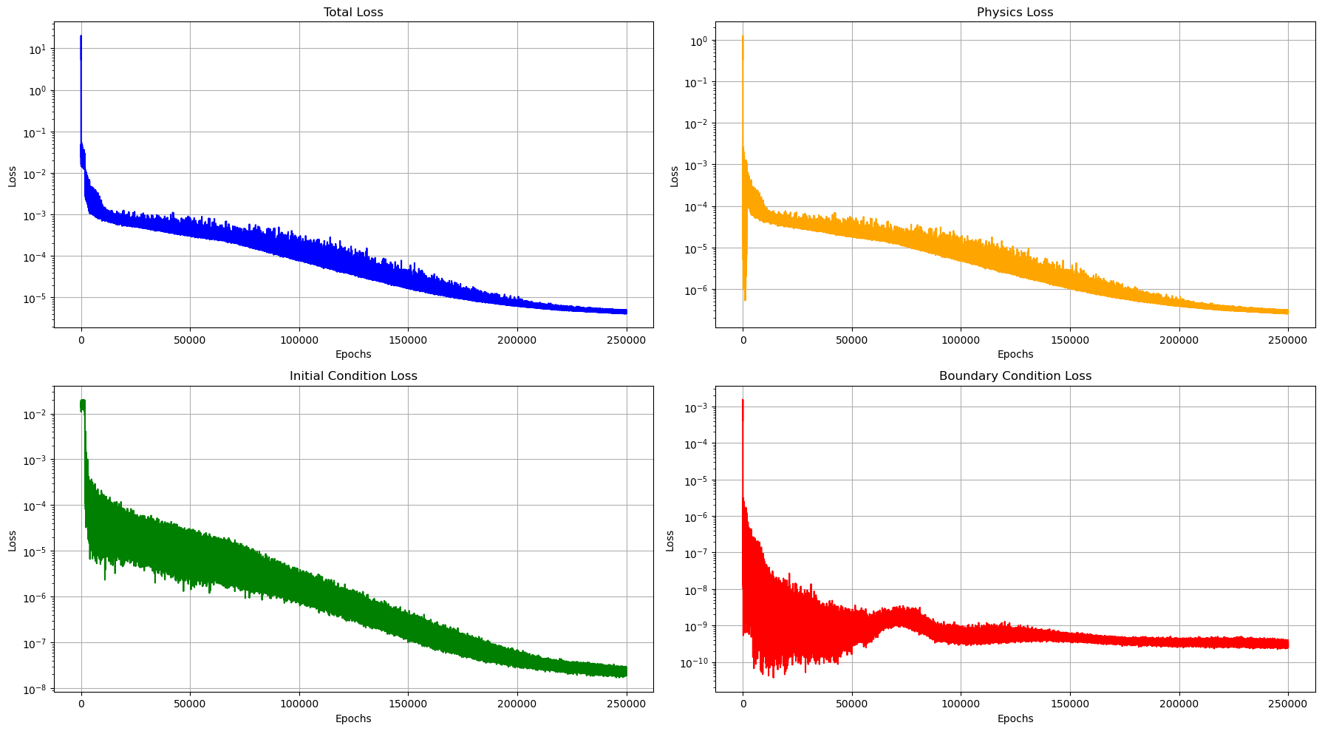

Slide 5
PINN vs Analytical methods
Feature | PINNs | Analytical Methods
Grid-Free | Yes | No
Handles higher dimensions | Better | Poor (exponential scaling)
Accuracy | High (If well trained) | Limited to grid resolution
Computational Efficiency | Training takes time | Efficient for lower dimension
Generalisation | Yes | No

Slide 6
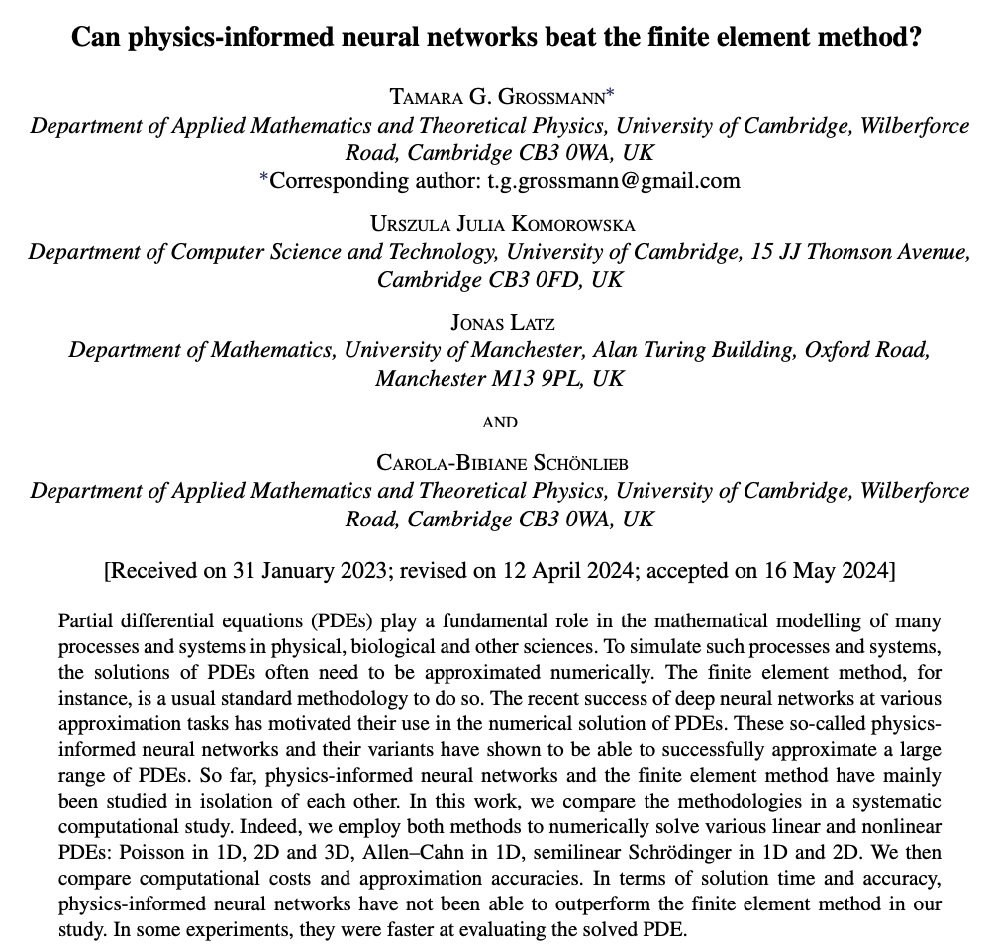

Slide 7
Key Findings from the paper
FEM consistently outperformed PINNs in terms of both solution accuracy and computation time across all cases
PINNs handled higher dimensional problems without a noticeable increase in computational burden
Advantages of PINNs:
  Good for higher dimensional PDEs
  Mesh-free
  Generalisation

Slide 8
vQD as input
Trained for vQD in the range [10, 20]

Slide 9
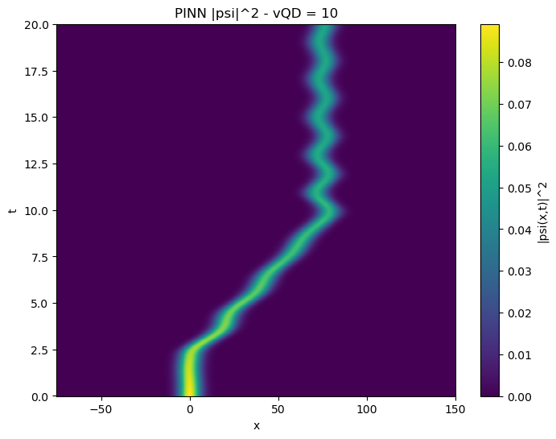
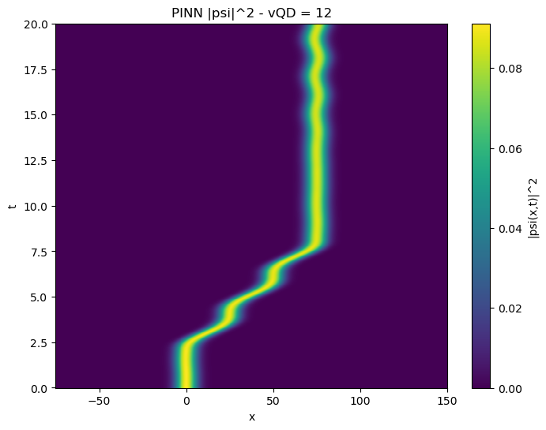
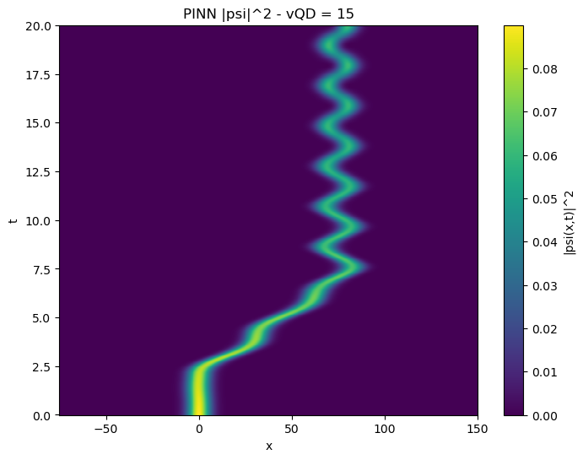

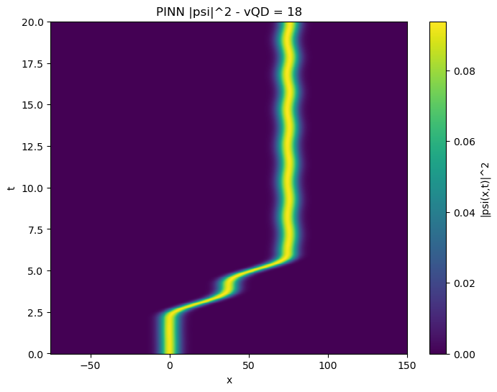
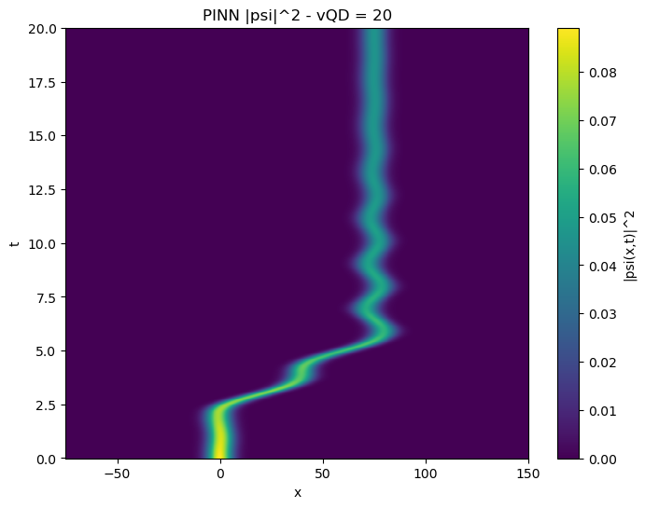

Slide 10
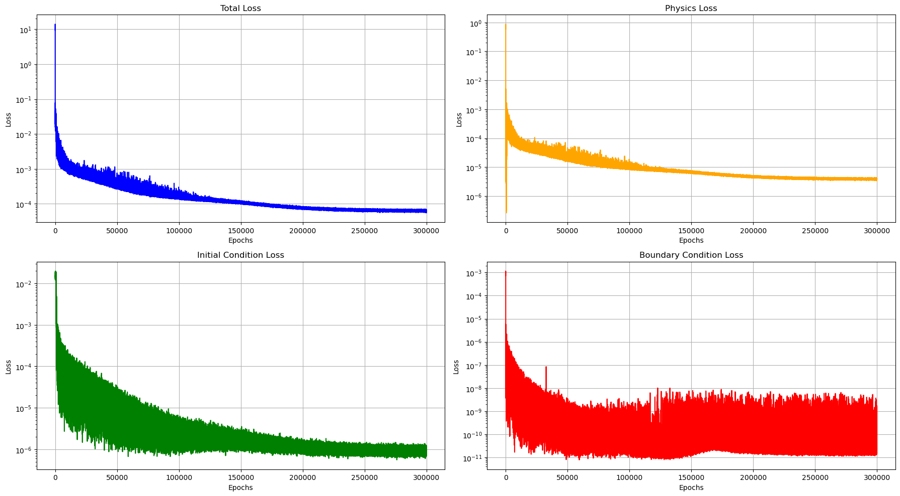

Slide 11
ω as input
Trained for ω in the range [1/hbar, 2/hbar]

Slide 12
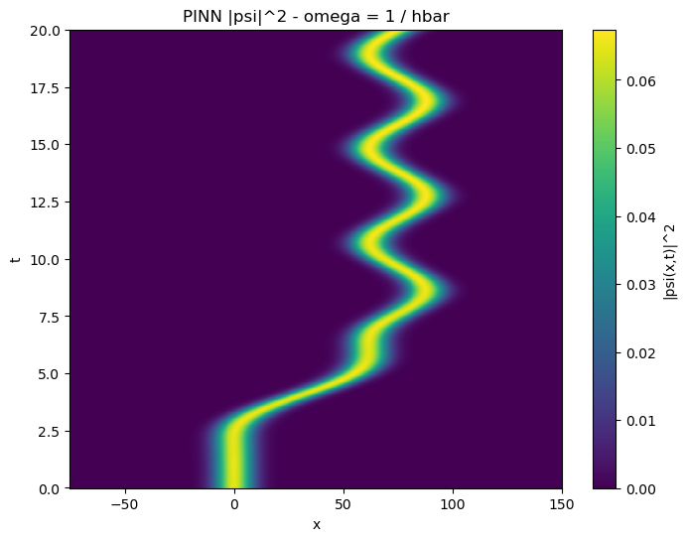




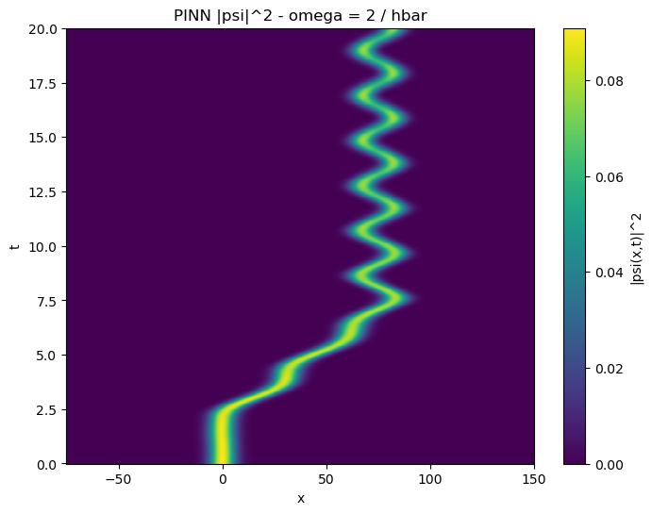

Slide 13
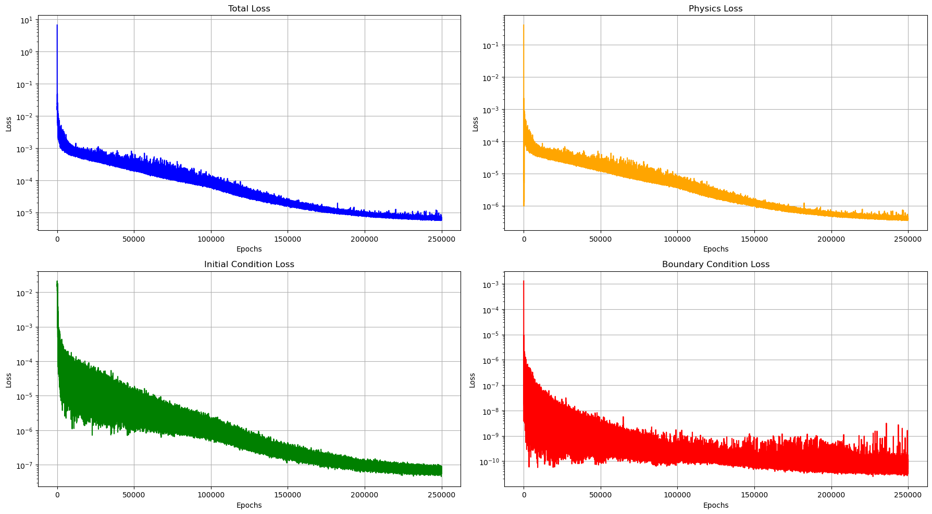

Slide 14
.end

