Slide 1
Meeting - 24/03/2025

Slide 2
TDSE Quantum Dot – Crank Nicholson

Slide 3
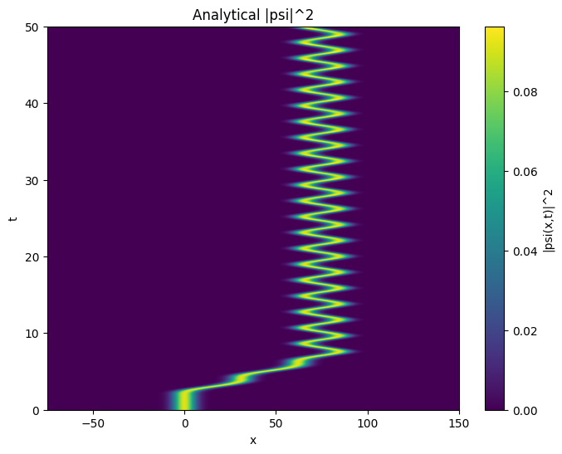

Slide 4


