Slide 1
Meeting - 19/05/2025

Slide 2
Hybrid Model – vQD as input
Same model from last week
Comparison with Crank Nicholson

Slide 3
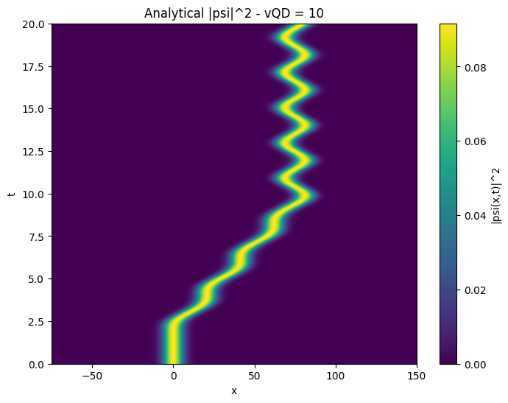
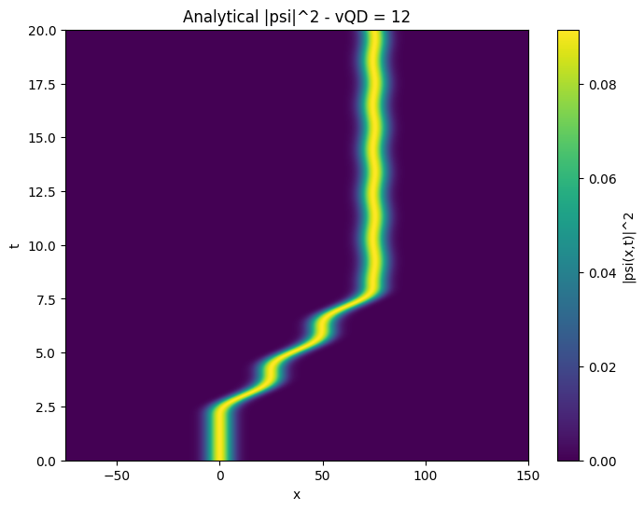
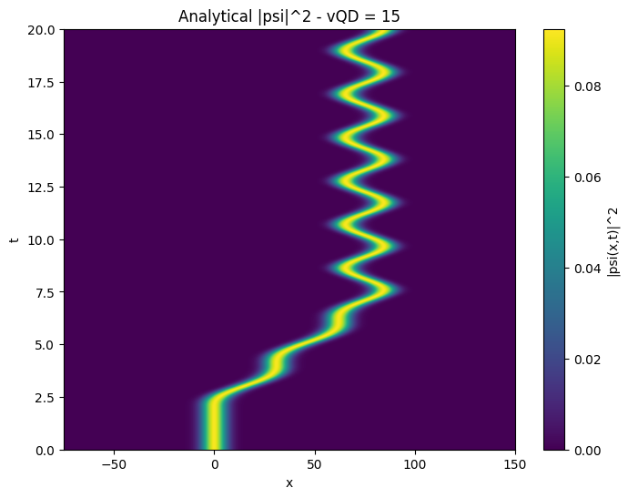
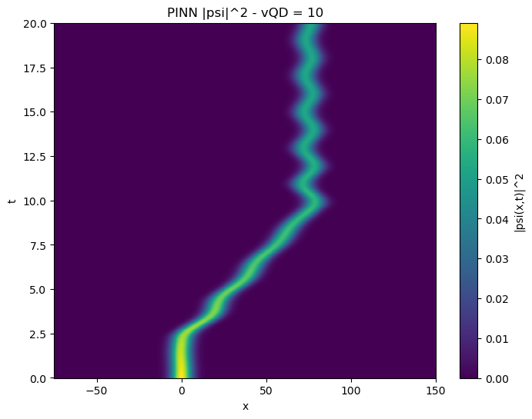

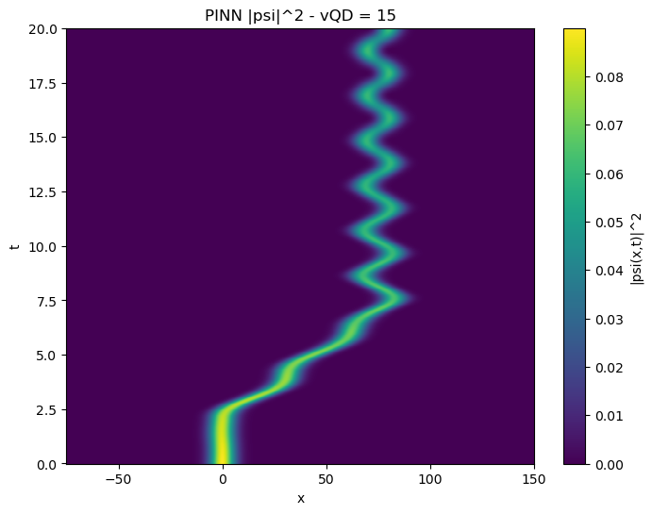

Slide 4
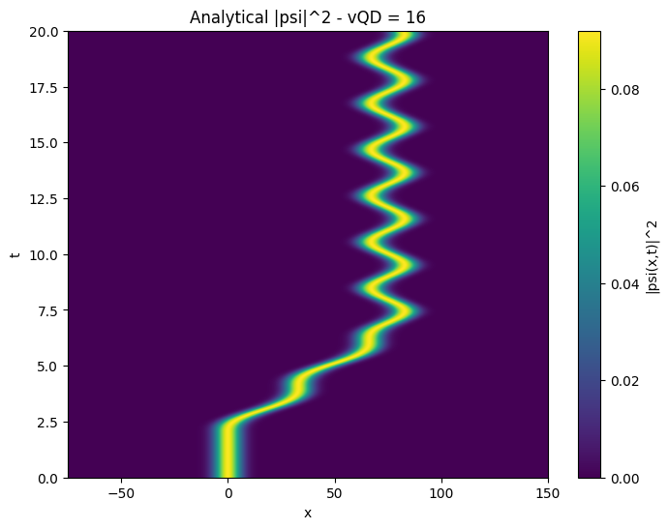
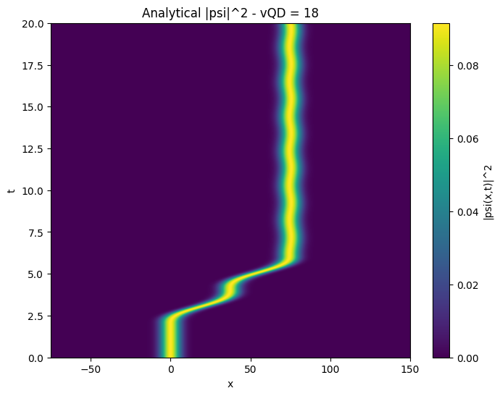
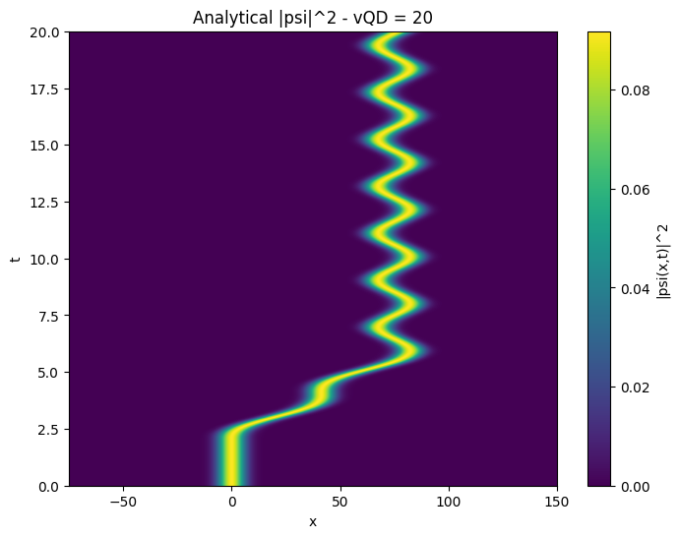

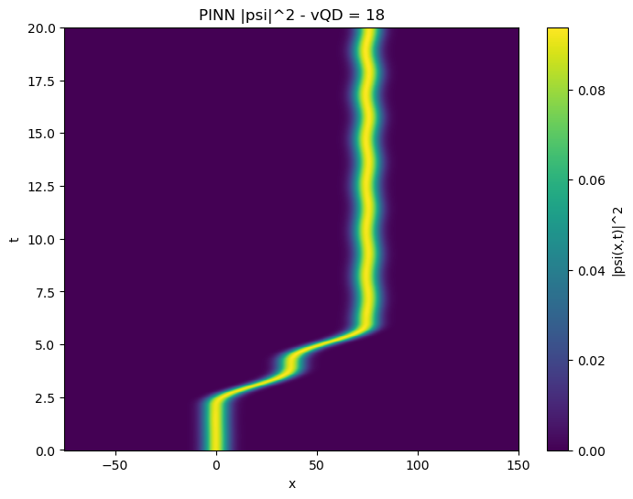
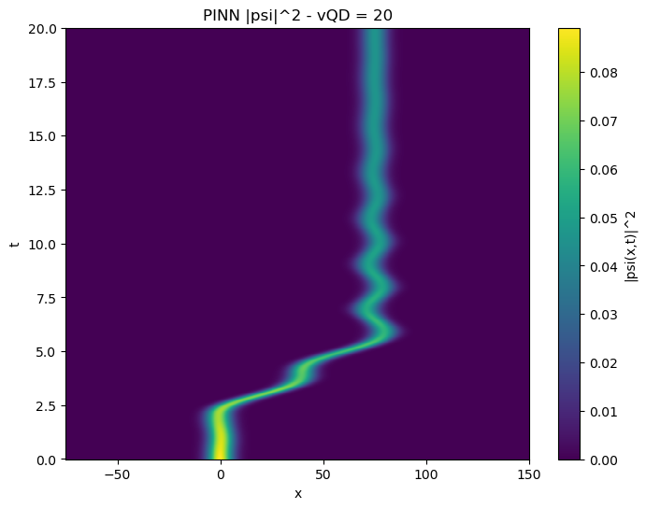

Slide 5
Hybrid Model – ω as input
Same model from last week
Comparison with Crank Nicholson

Slide 6
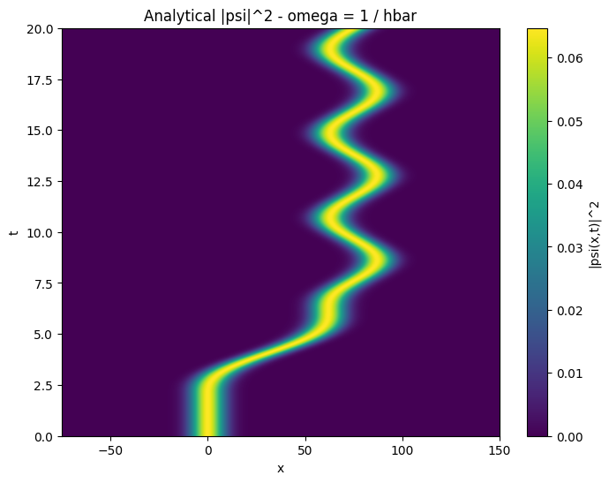






Slide 7




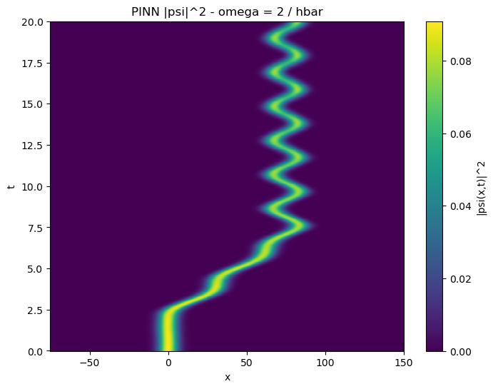

Slide 8
Normalization Loss
Included an additional loss function with normalization enforcement
Model 1: Initiated a single random point in the time domain and 4000 points in the x domain
Model 2: Initiated uniform fixed points in the time domain (0, 2, 4, .. 20)
Monte-Carlo estimate for integral

Slide 9
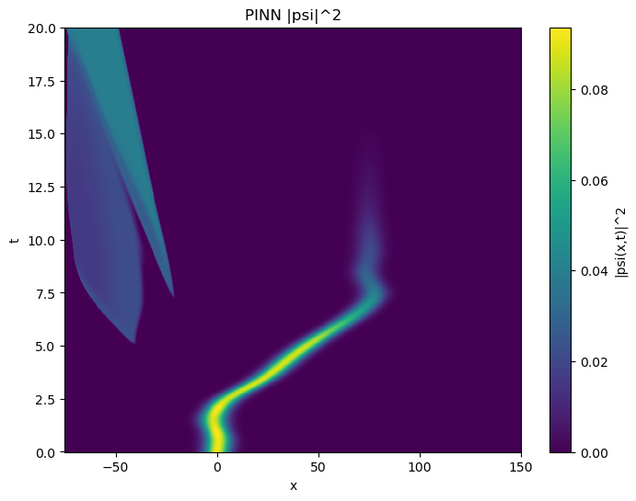
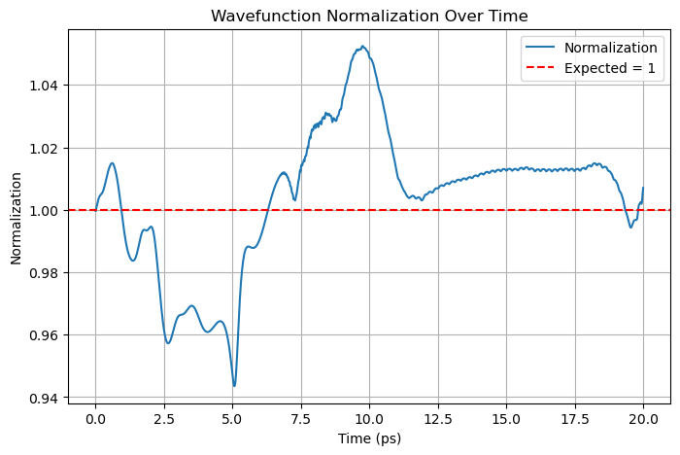

Slide 10
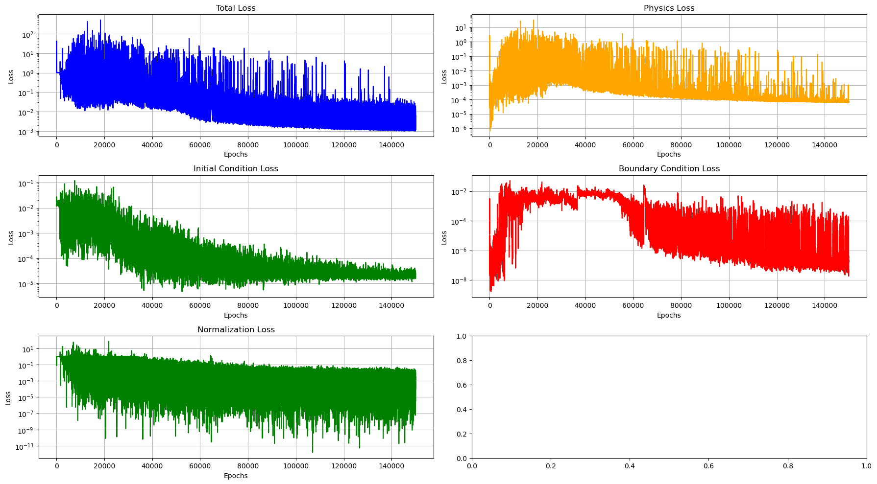

Slide 11
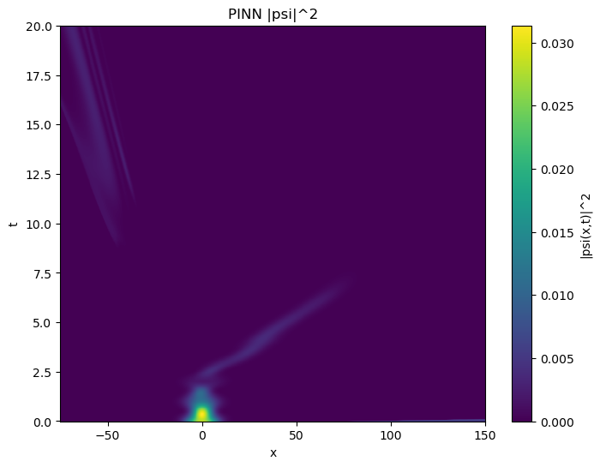
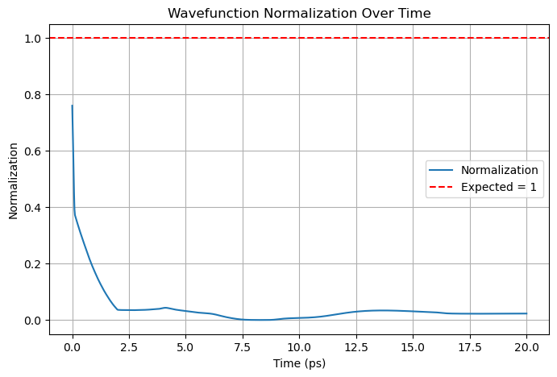

Slide 12
Causality
Divided the time domain into equal segments
Loss of one segment is the cumulative losses from all previous segments
Such as:
  L1 = L1
  L2 = L1 + L2
  L3 = L1 + L2 + L3

Slide 13
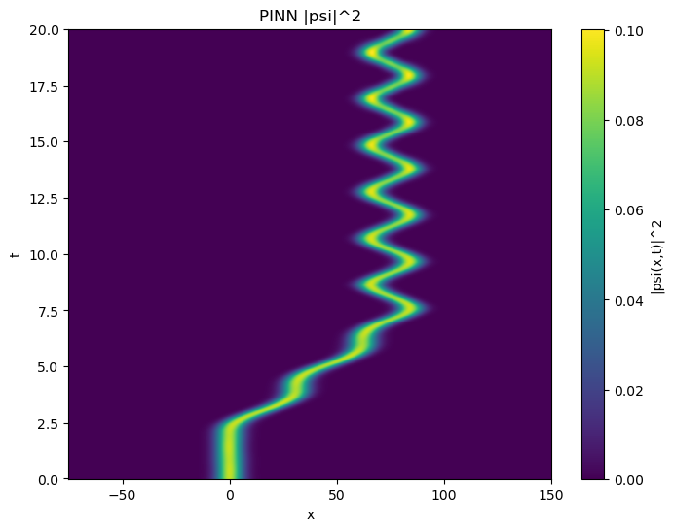

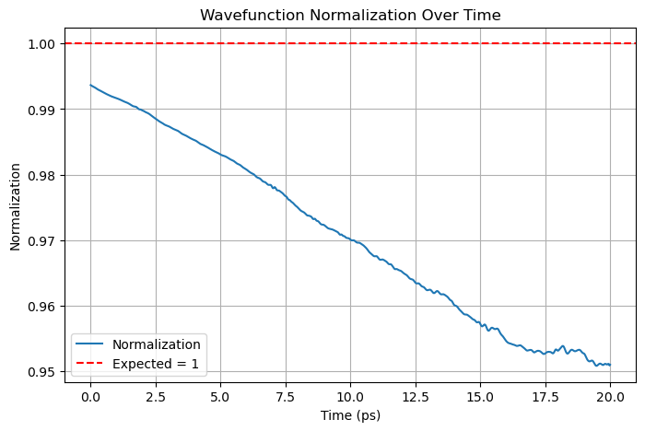
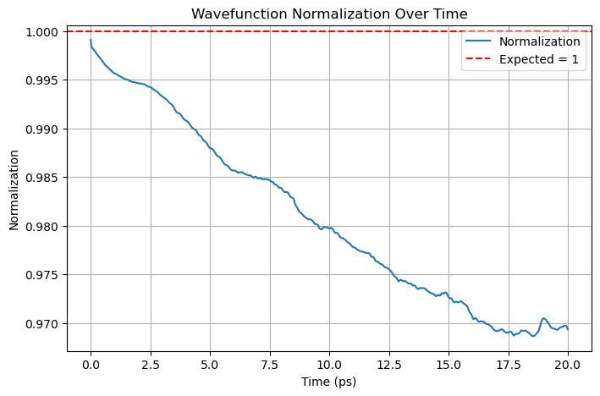

Slide 14
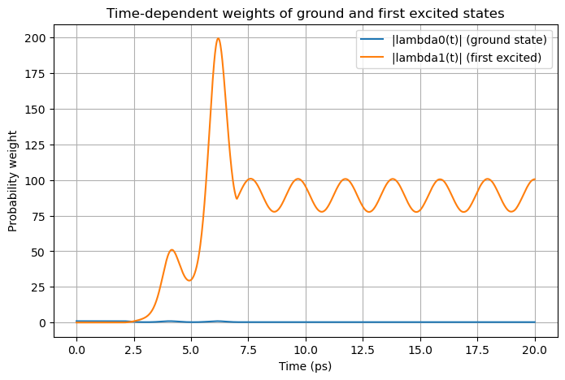
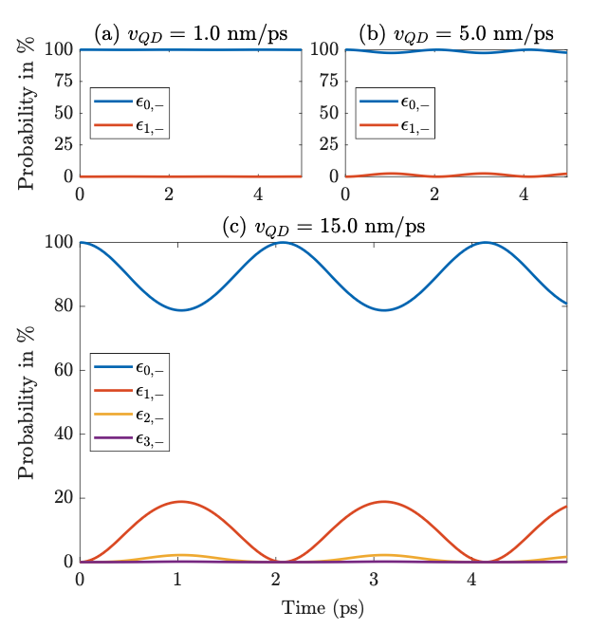
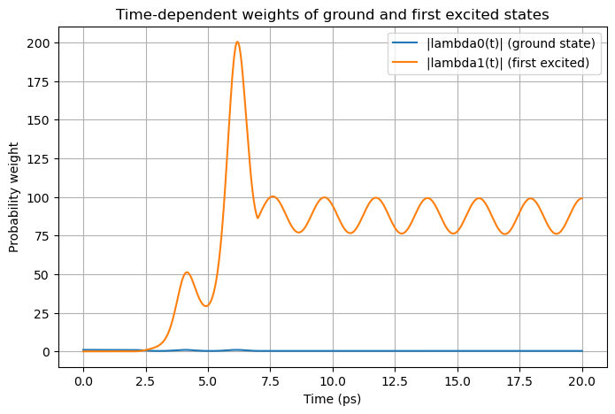

Slide 15
.end

