Slide 1
Meeting - 23/06/2025

Slide 2
Cumulative Norm Loss
I tried to calculate the norm loss the same way I calculated causality
The loss of one segment will be the cumulative loss of previous segments
L1 = l_1
L2 = L1 + l_2
L3 = L1 + L2 + l_3

Slide 3
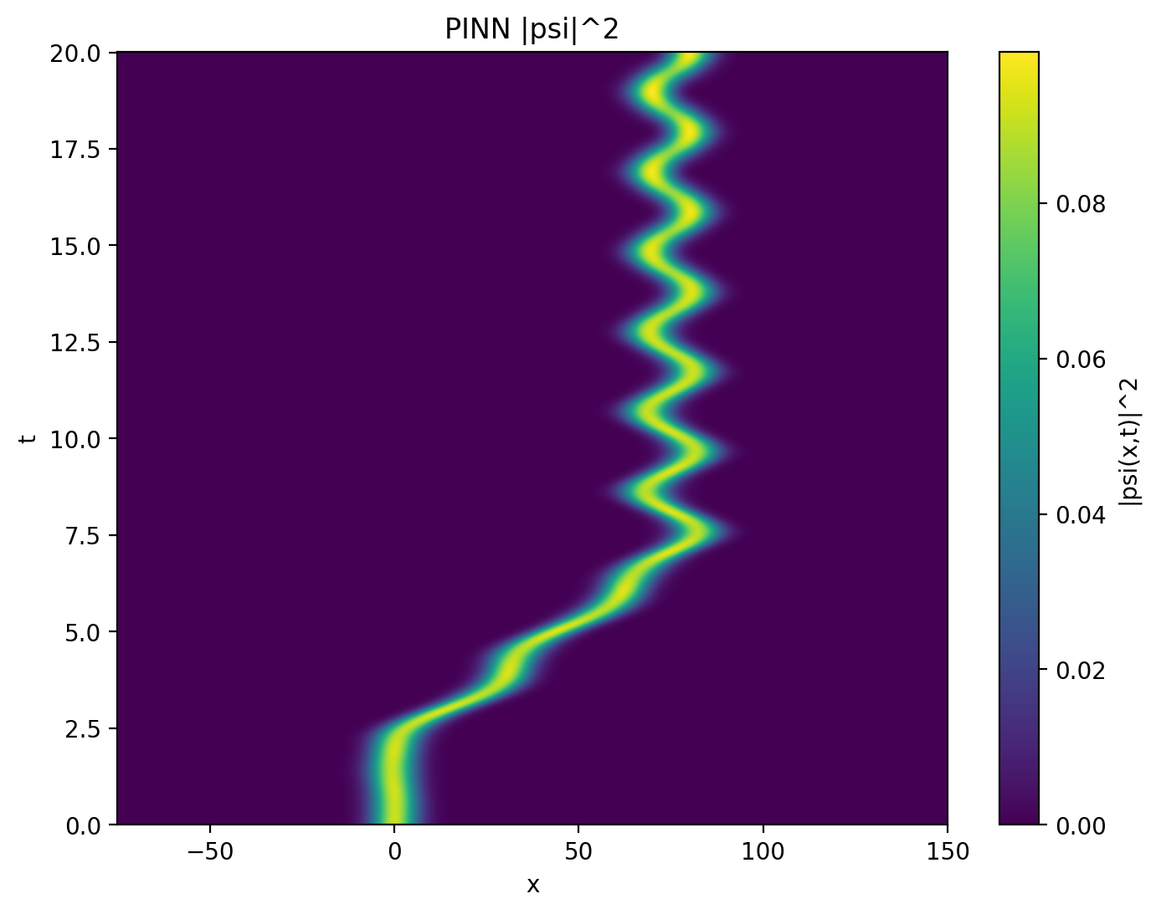
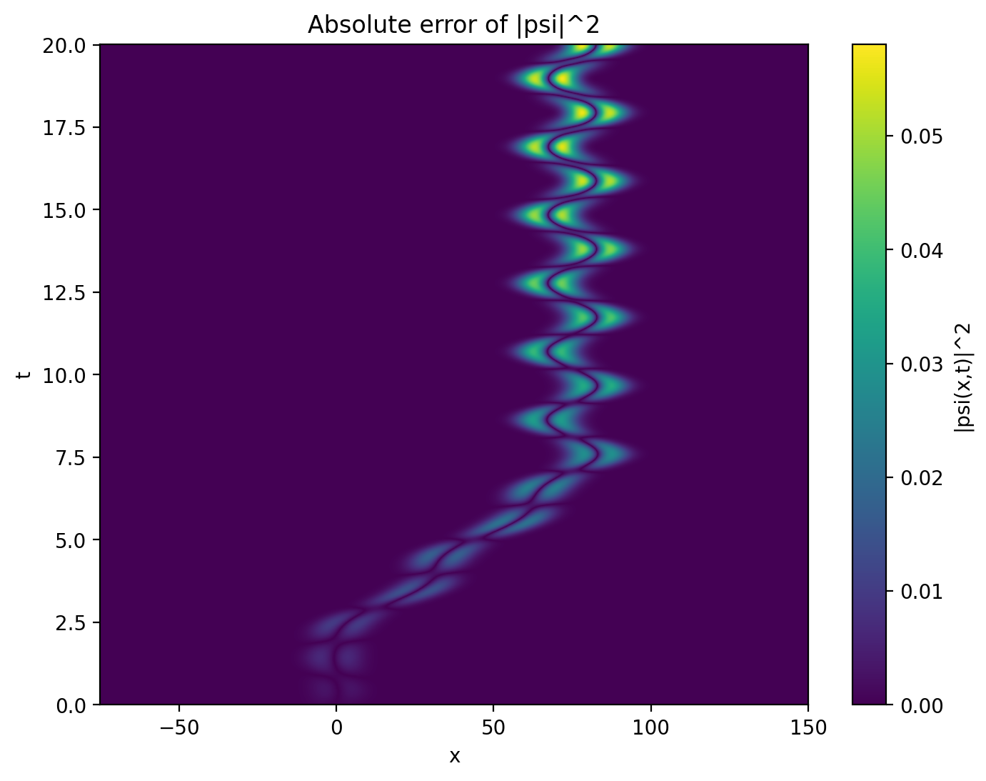

Model 1 – 20 segments

Slide 4
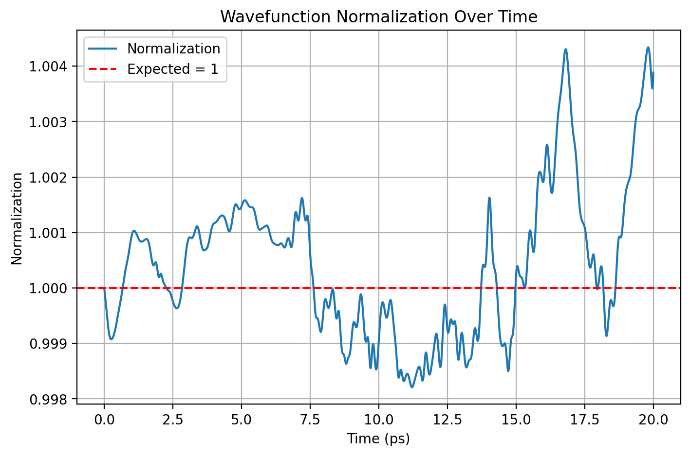


Slide 5
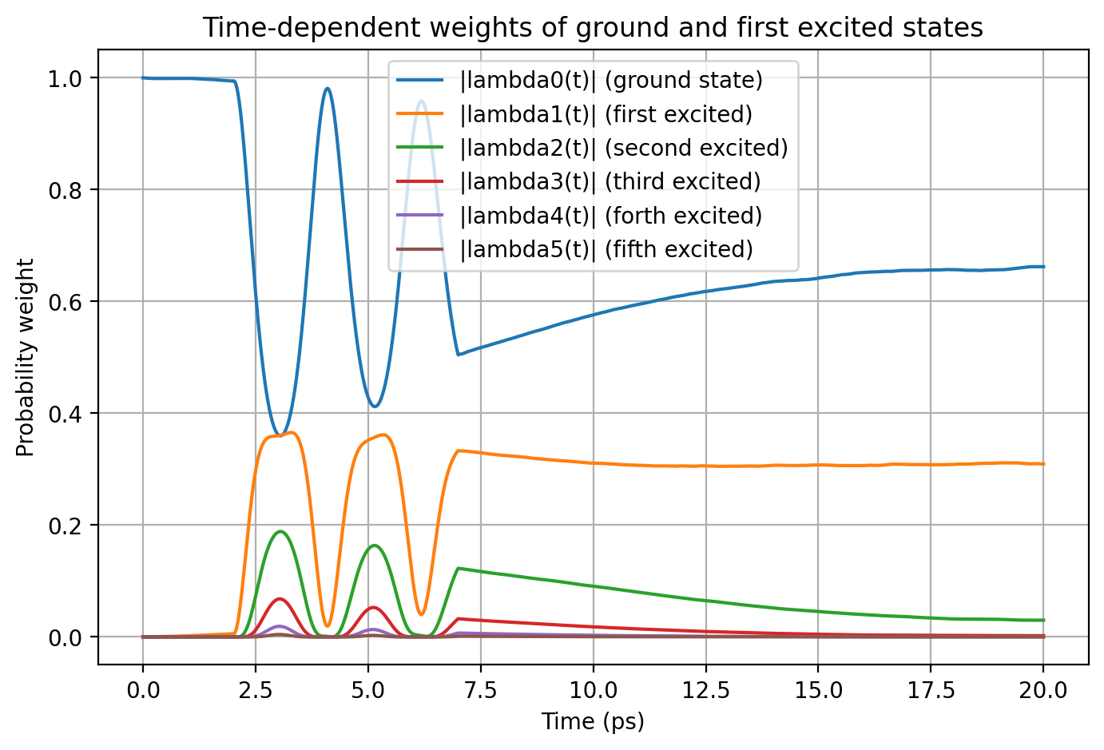
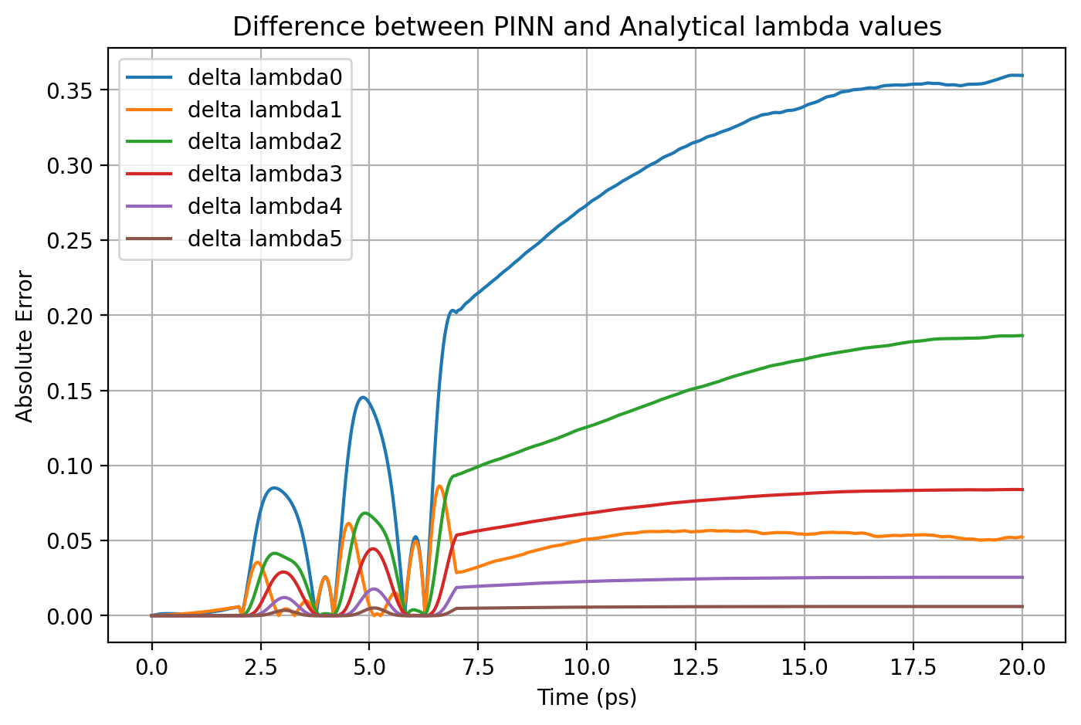
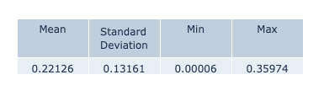

Slide 6

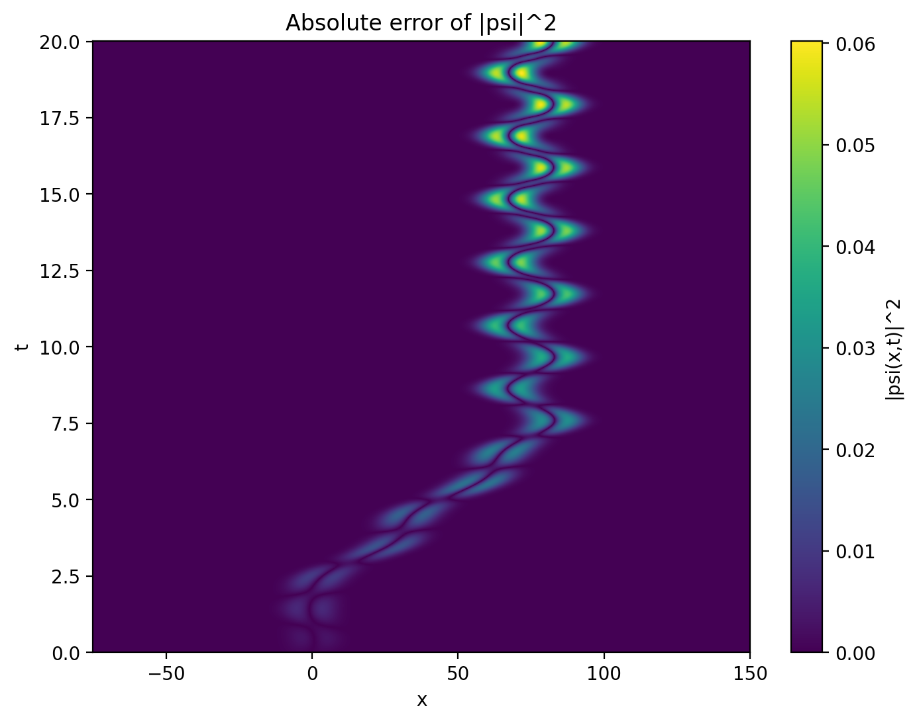

Model 2 – 10 segments

Slide 7
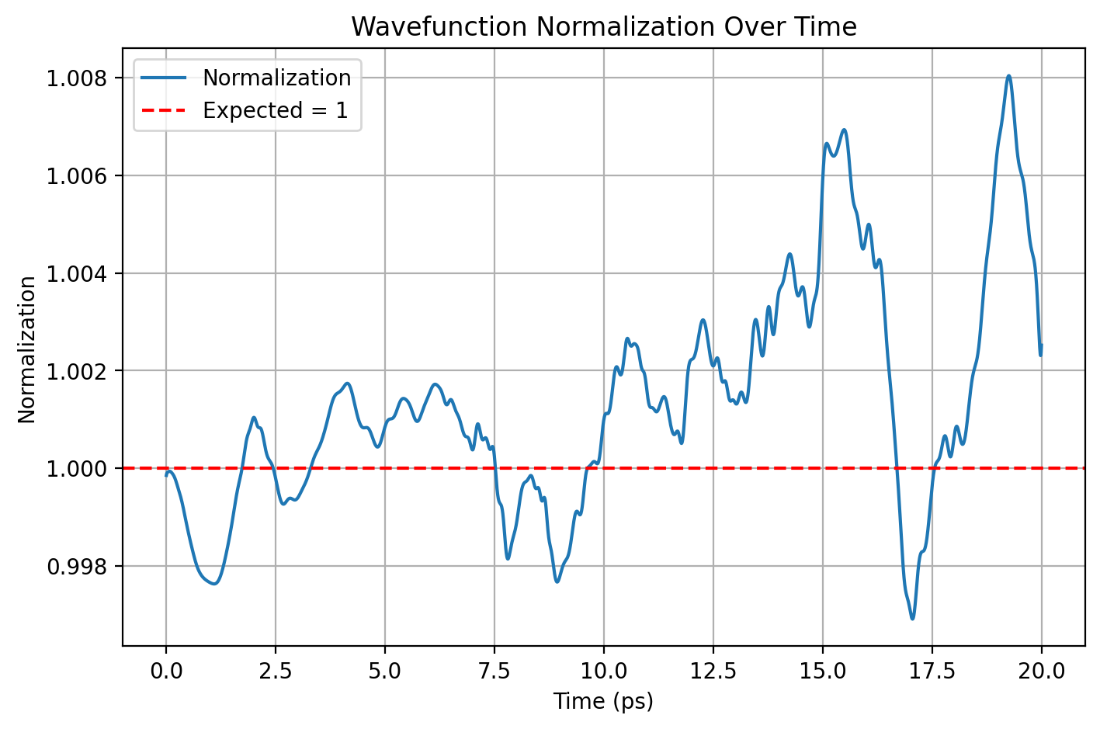
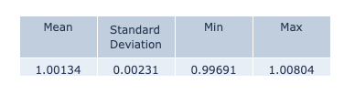

Slide 8
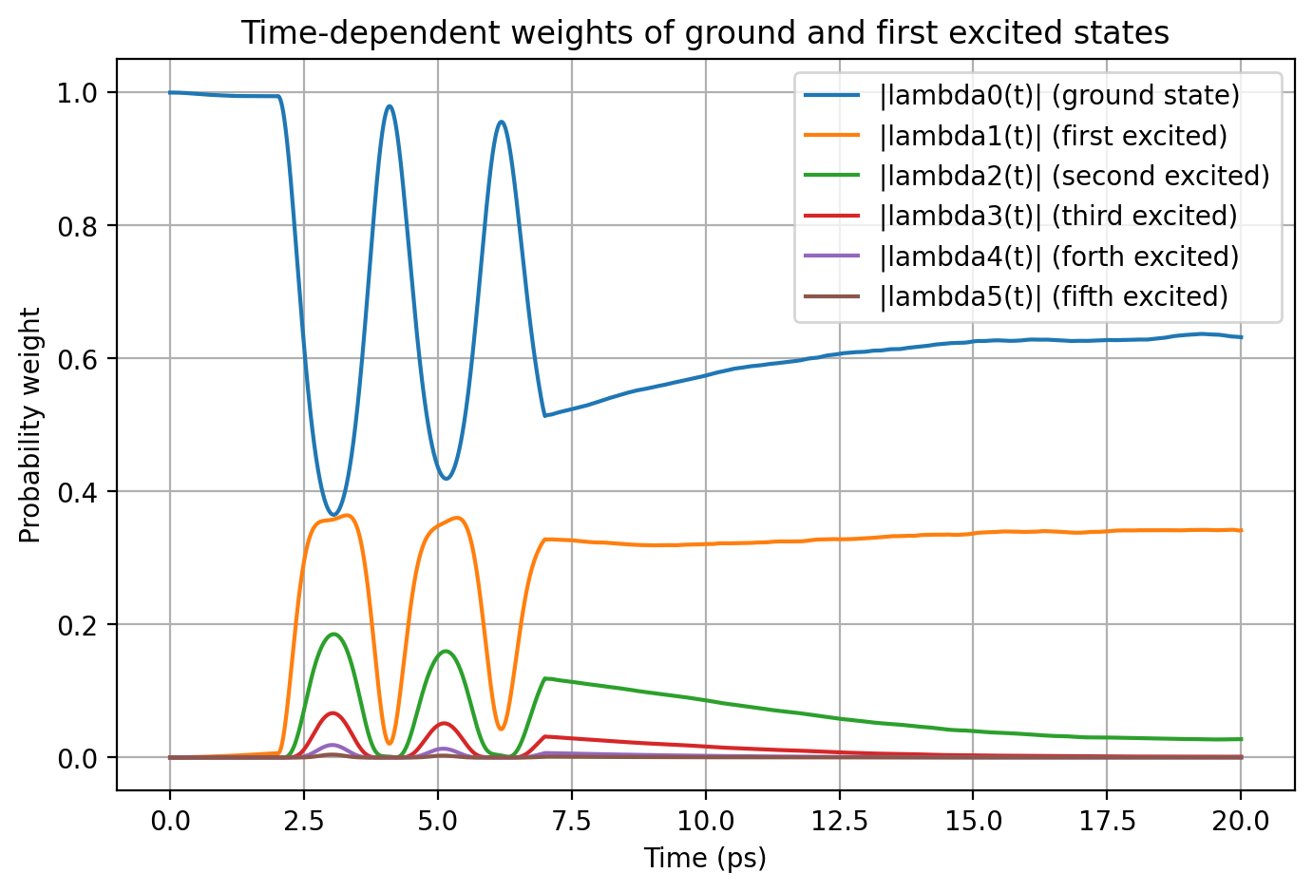
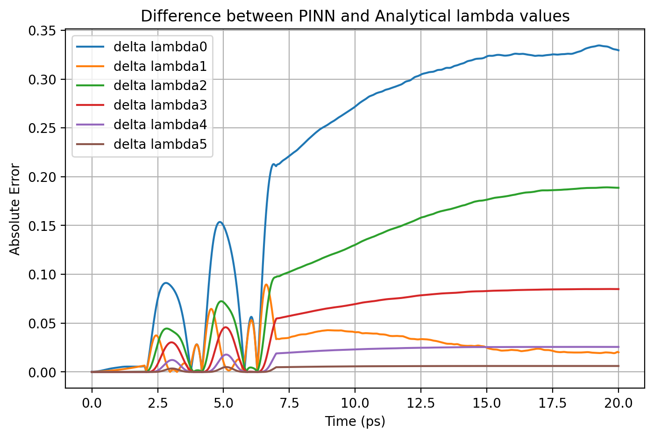
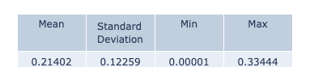

Slide 9

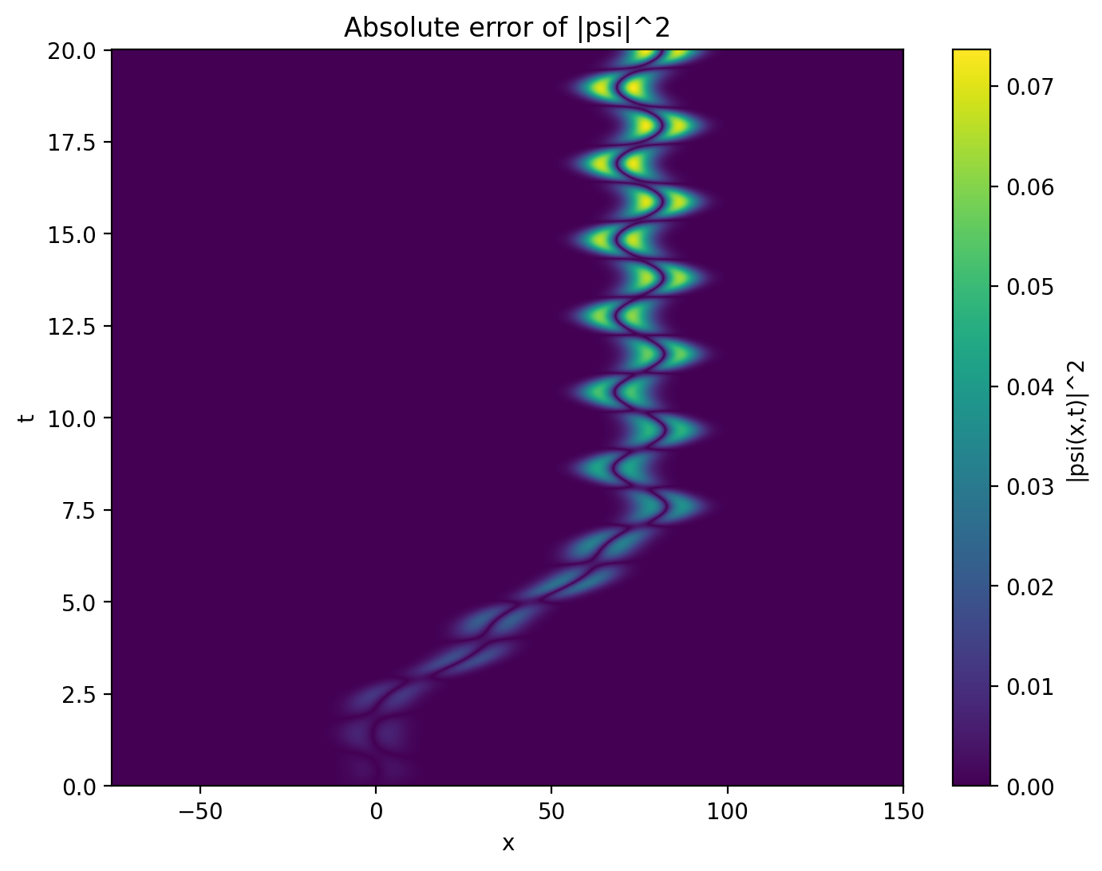
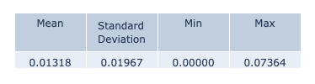
Model 3 – 100 segments

Slide 10
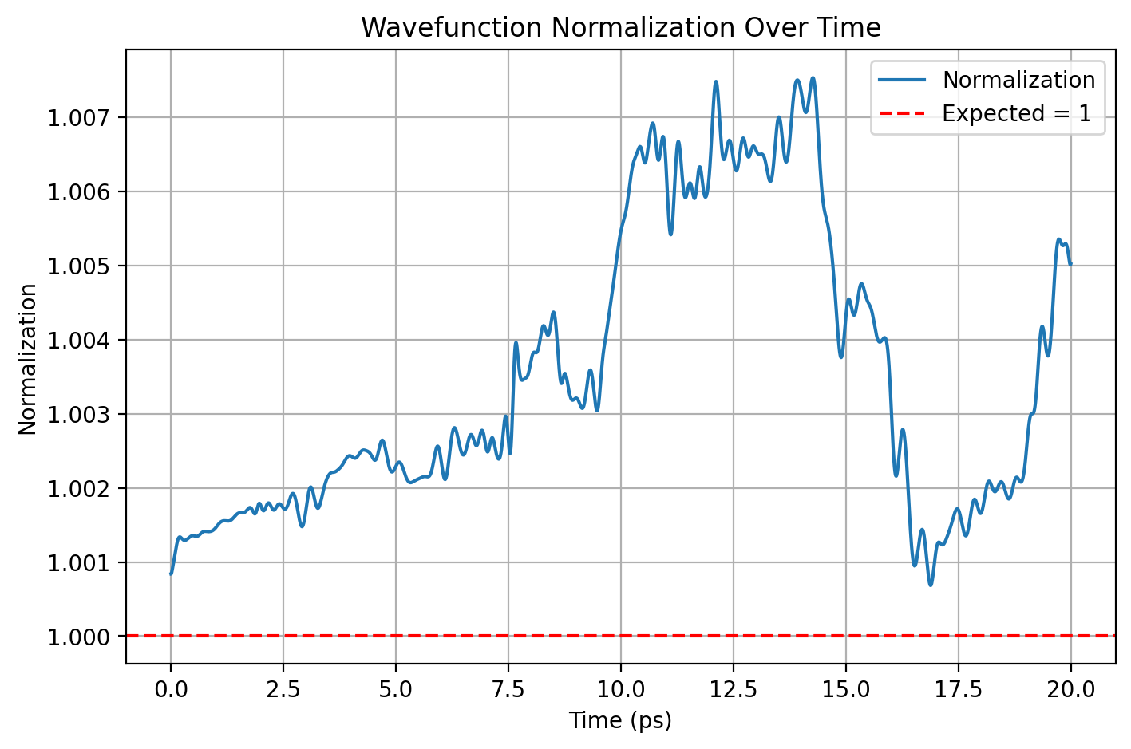
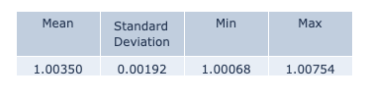

Slide 11
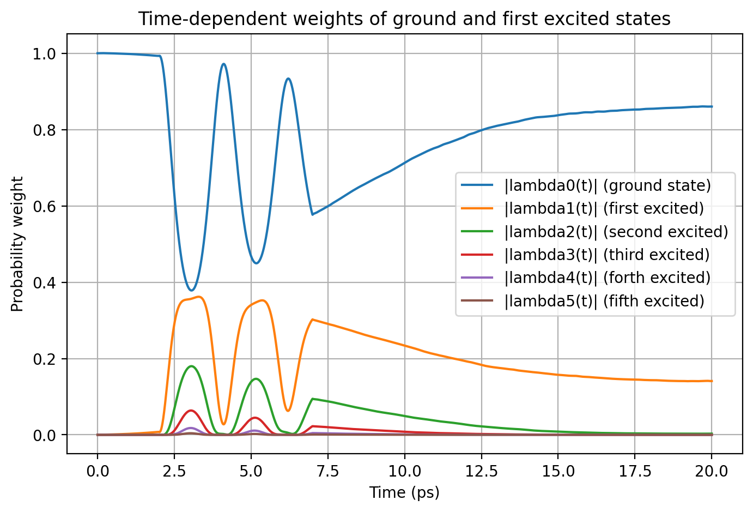
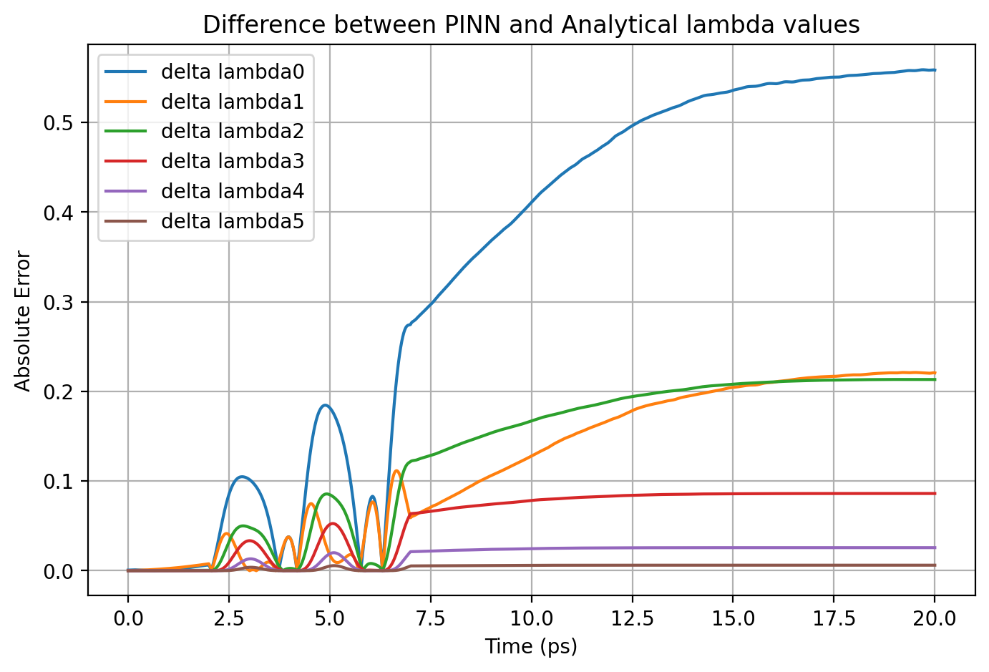
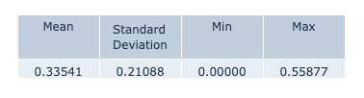

Slide 12
Result Comparison
 | ΔΨ² - max | norm - mean | norm - std | Δλi - max
Model 1 | 0.05801 | 1.00041 | 0.00134 | 0.35974
Model 2 | 0.06020 | 1.00134 | 0.00231 | 0.33444
Model 3 | 0.07364 | 1.00350 | 0.00192 | 0.55877

Slide 13

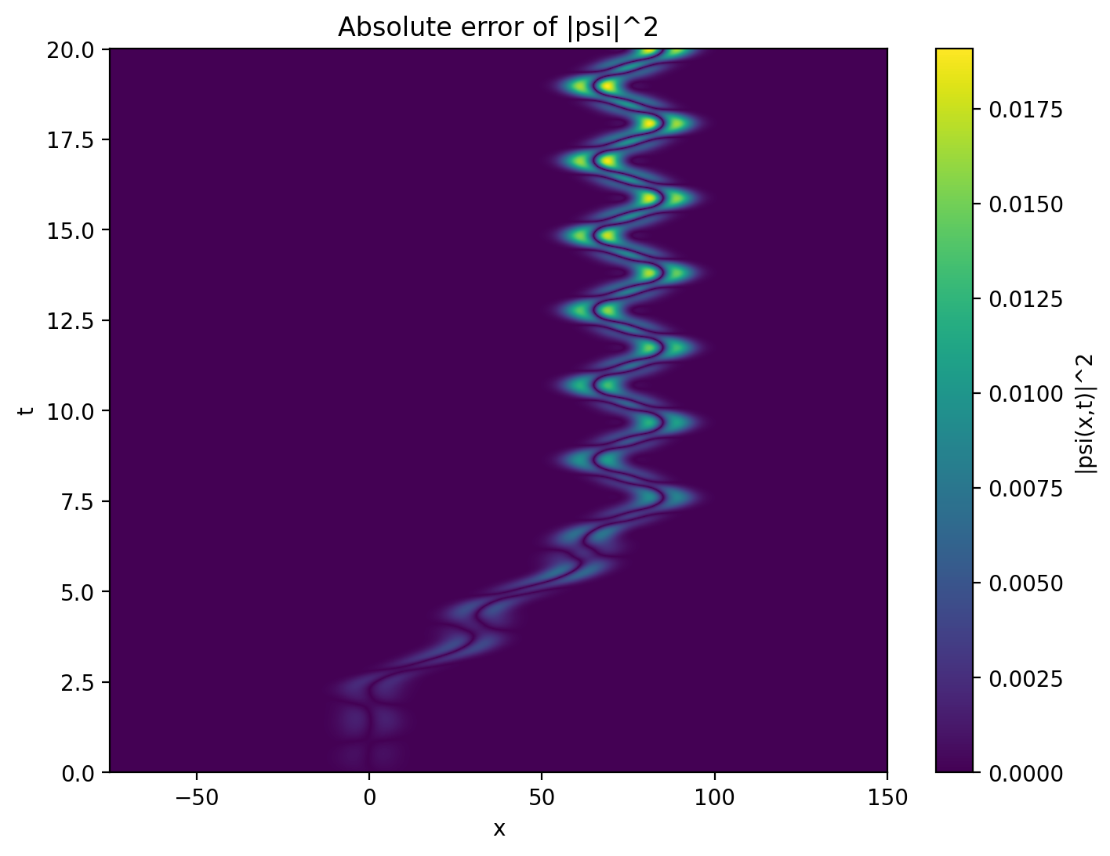

Revisiting Norm Model

Slide 14
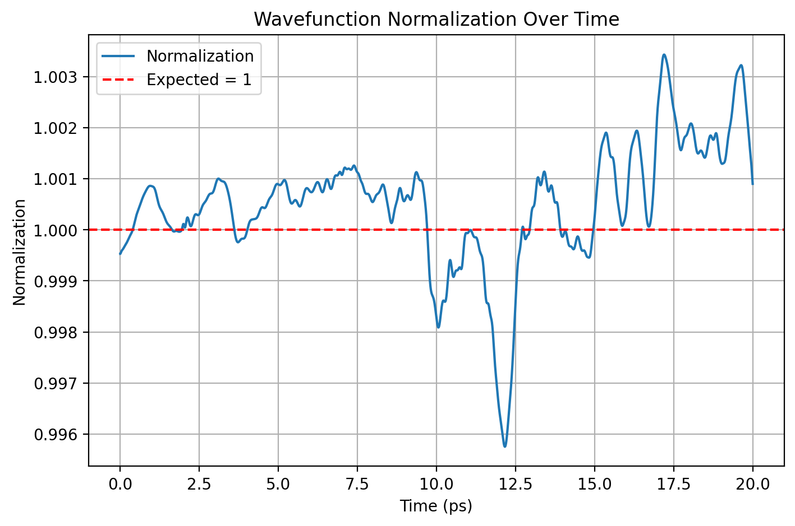
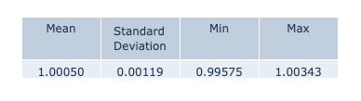

Slide 15
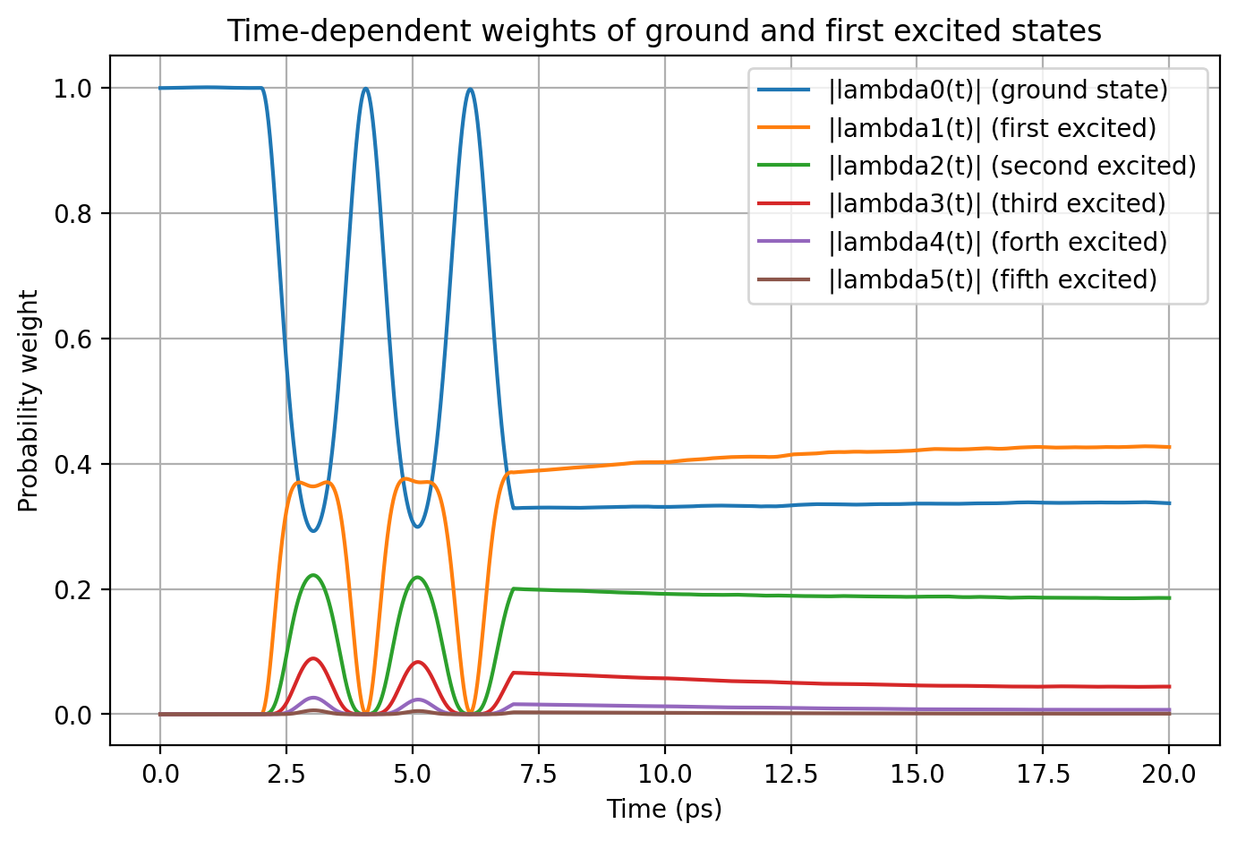
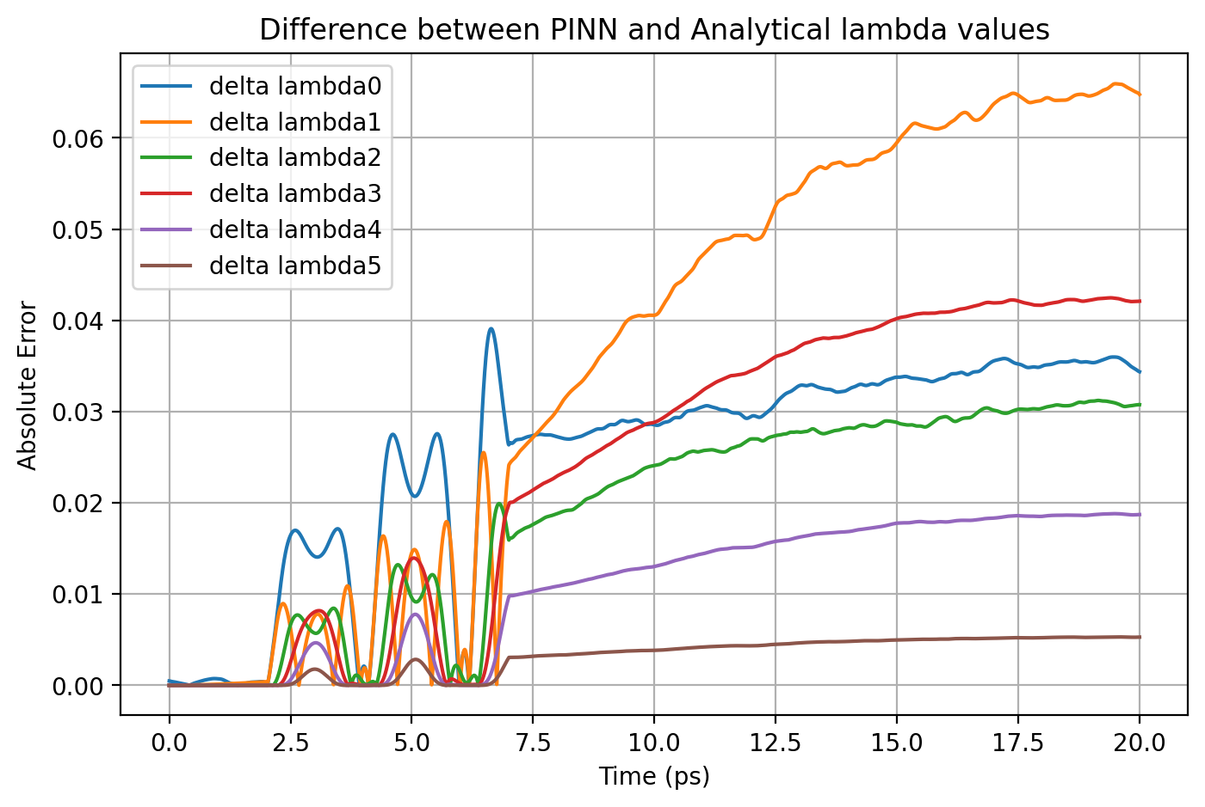
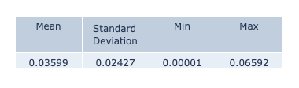

Slide 16
Result Comparison
Model | ΔΨ² - max | norm - mean | norm - std | Δλi - max | Runtime
With norm | 0.01908 | 1.00050 | 0.00119 | 0.06592 | 4:00:00
Without norm | 0.03888 | 0.86932 | 0.05807 | 0.12216 | 3:15:00

Slide 17

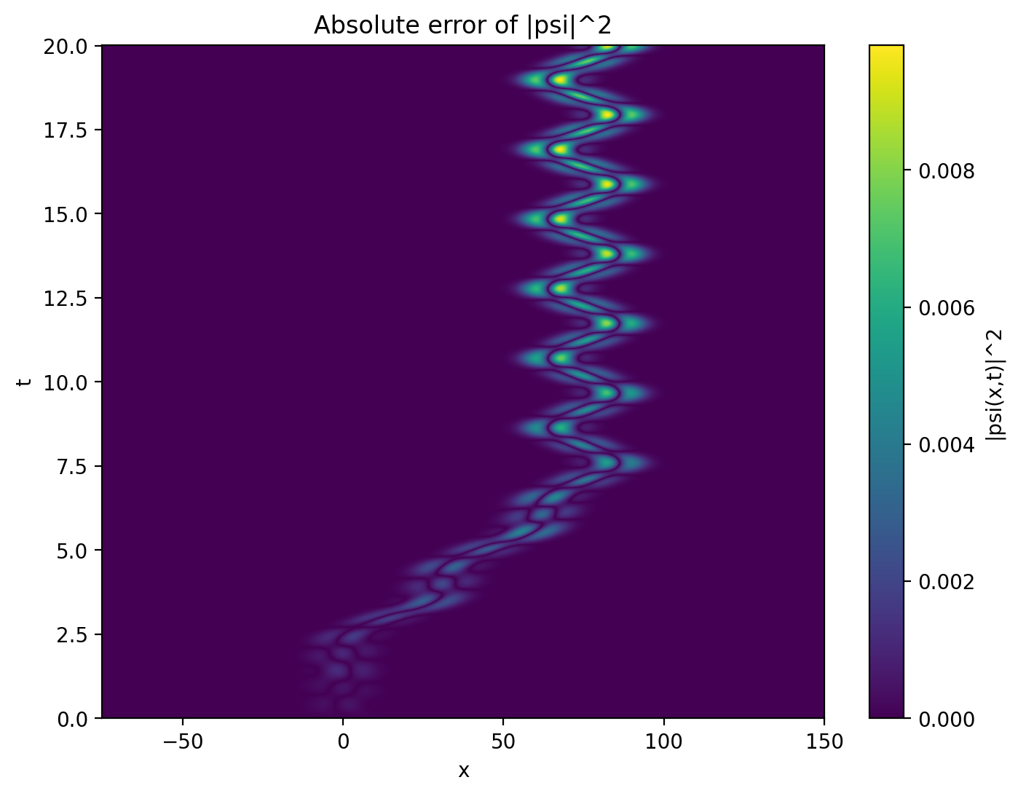

Current Best Norm Modal

Slide 18
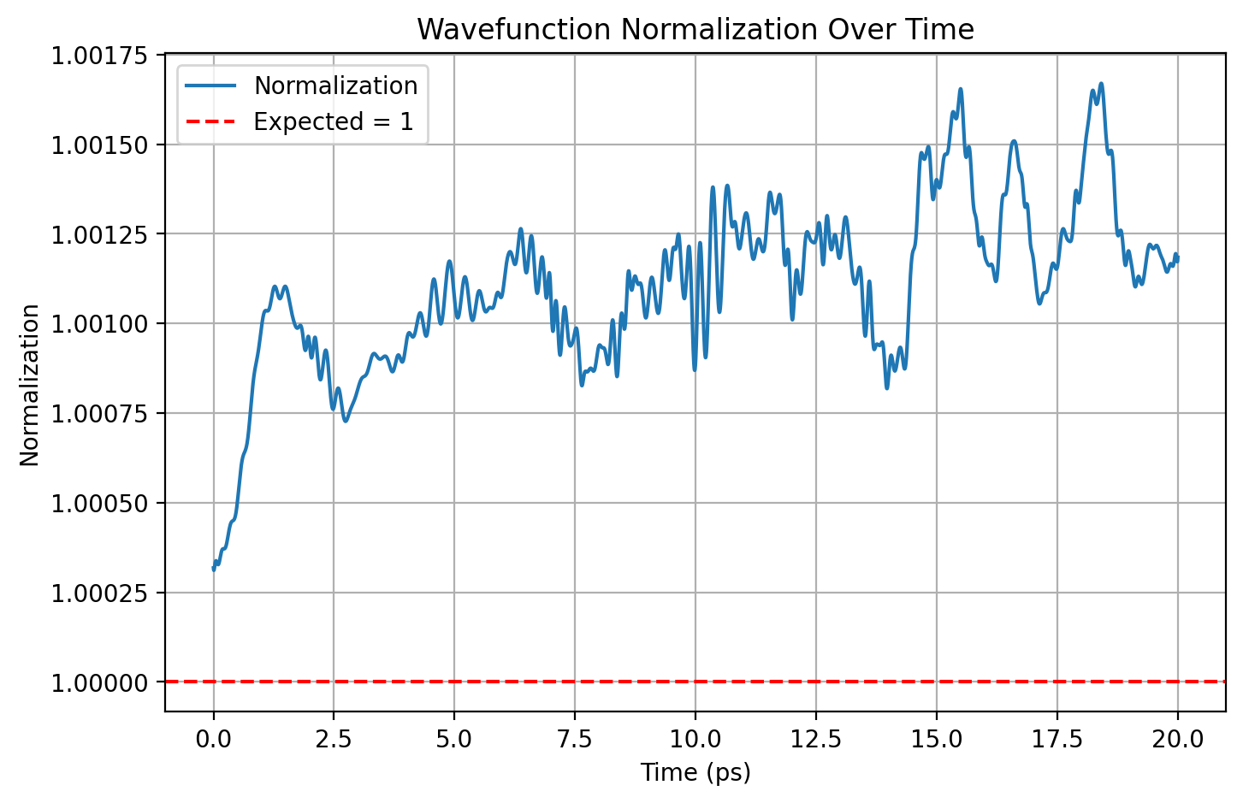


Slide 19
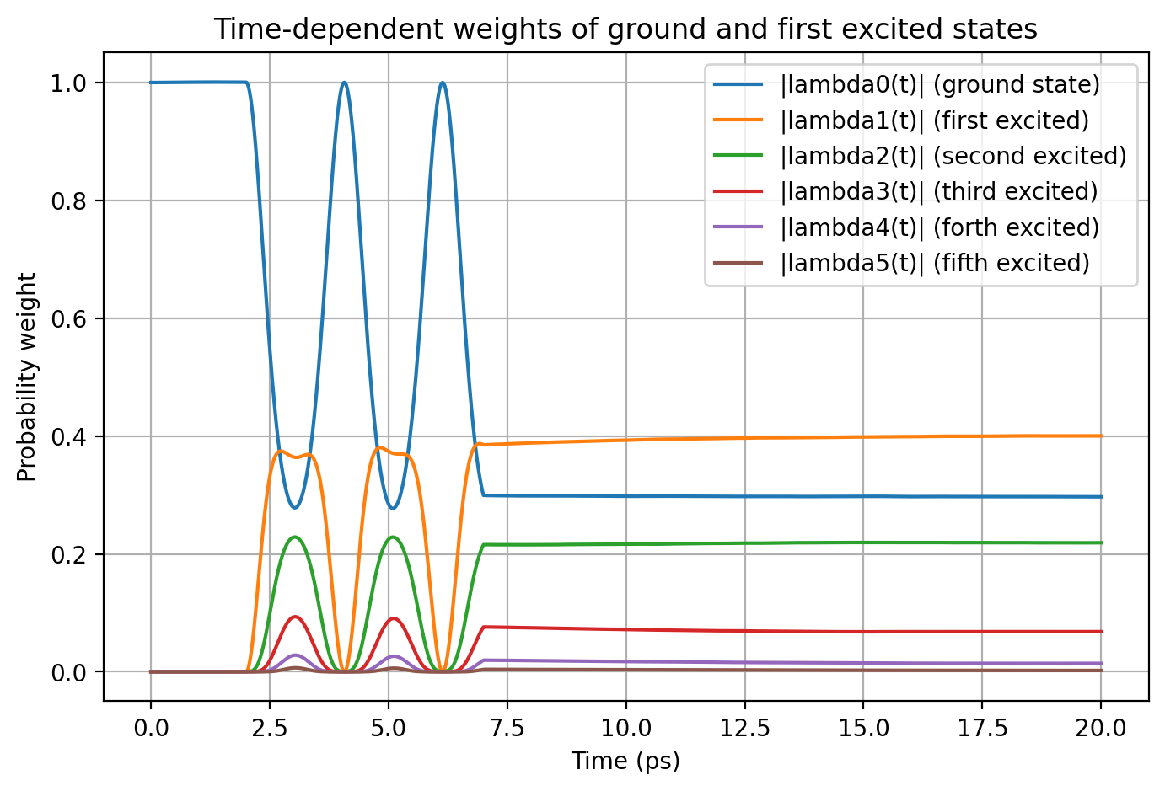
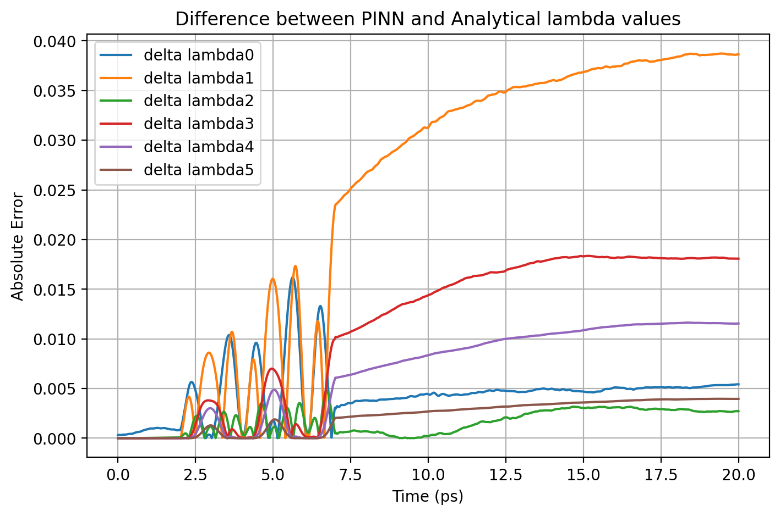
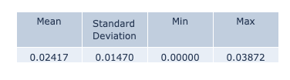

Slide 20
Result Comparison
Model | ΔΨ² - max | norm - mean | norm - std | Δλi - max | Runtime
With norm | 0.00982 | 1.00111 | 0.00023 | 0.03872 | 08:12:00
Without norm | 0.03409 | 0.90468 | 0.04191 | 0.10055 | 06:34:00

Slide 21
.end

