Slide 1
Physics-Informed Neural Networks to Solve the Time-Dependent Schrödinger Equation
Presented by,
Afthash Sahal Ubaid Puzhakkal
a1913863

Slide 2
Introduction
The Schrödinger equation is a fundamental equation in quantum mechanics that describes how the quantum state (wavefunction, Ψ) of a physical system evolves over time and space
Traditionally, Schrödinger equation can be solved using analytical methods for simple systems or numerical techniques like finite difference or Crank–Nicolson methods for more complex systems
In this project, I am trying to solve the Schrödinger equation using Physics-Informed Neural Network (PINN), which are a type of neural network that learns to solve PDEs by embedding the relevant equations into its loss function
The advantage of using PINN is that, since we are directly trying to satisfy the physical equation through loss function, we do not require large labelled datasets for training

Slide 3
Methods
In this presentation, I will explain the two methods I have introduced to improve my model from last trimester
Enforcing Causality: In our context, causality means that the neural network should learn the wavefunction step by step in time, making sure that what happens later depends on what happened earlier, just like in real quantum systems
Enforcing Normalization: Normalizing the Schrödinger equation ensures that the wavefunction represent a valid probability distribution. Which means find a particle anywhere in the domain should stay at 1

Slide 4
Causality
To enforce causality, First I divided the time domain into n segments with equal width
During model training, the loss at one segment will be the cumulative sum of all the losses from the previous segments
Doing this will ensure that model will have to learn earlier segments properly in order to learn later segments

Slide 5
Causality
Total PDE loss can be written as,
Where,
  Nseg = Number of segments
  Li, Lk = PDE Loss at segment i, k respectively

Slide 6

Crank Nicholson

Slide 7
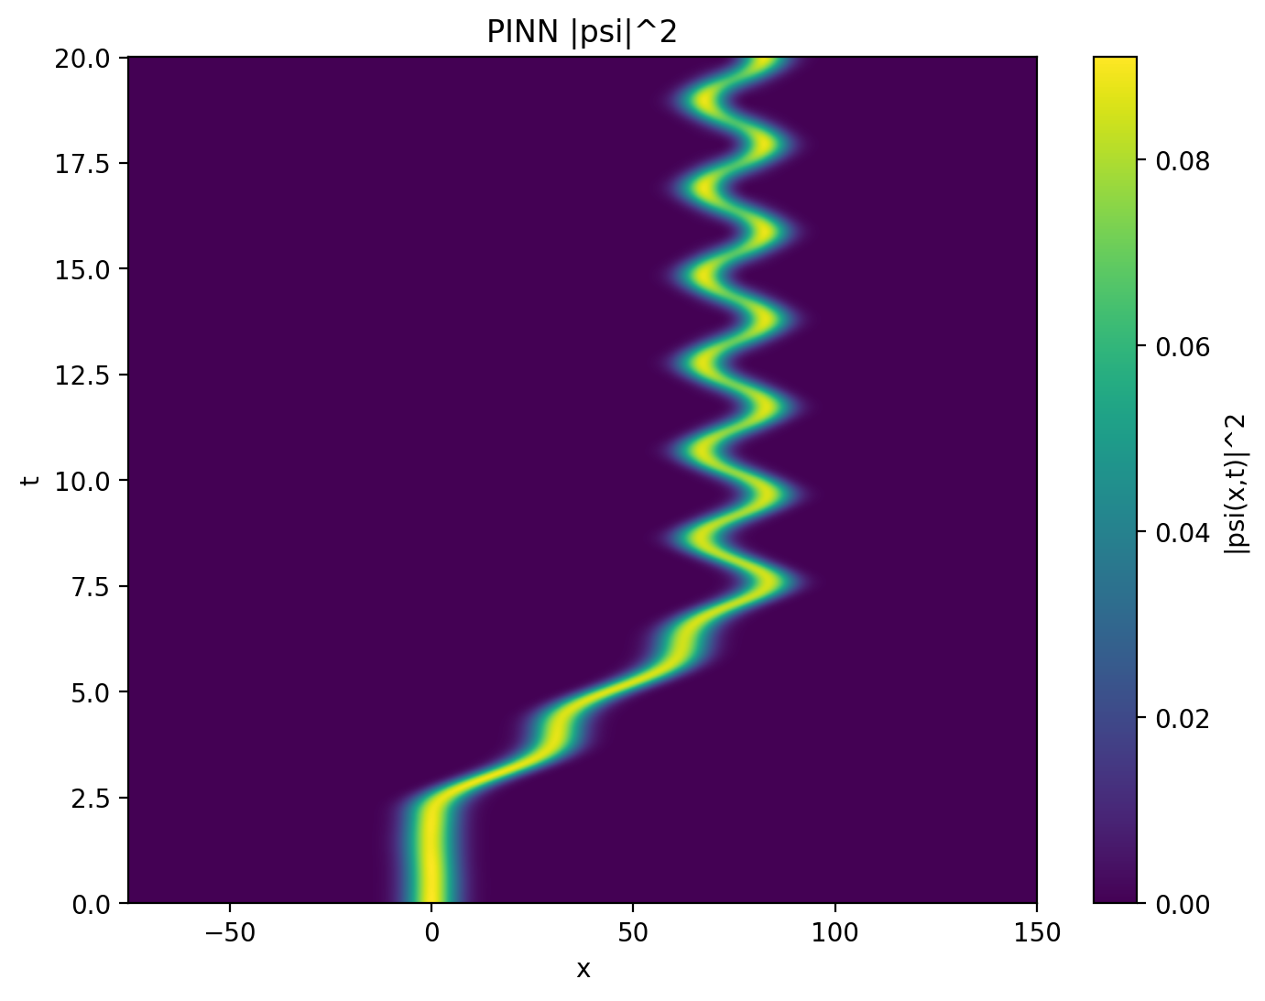

Base Model
Causal Model

Slide 8
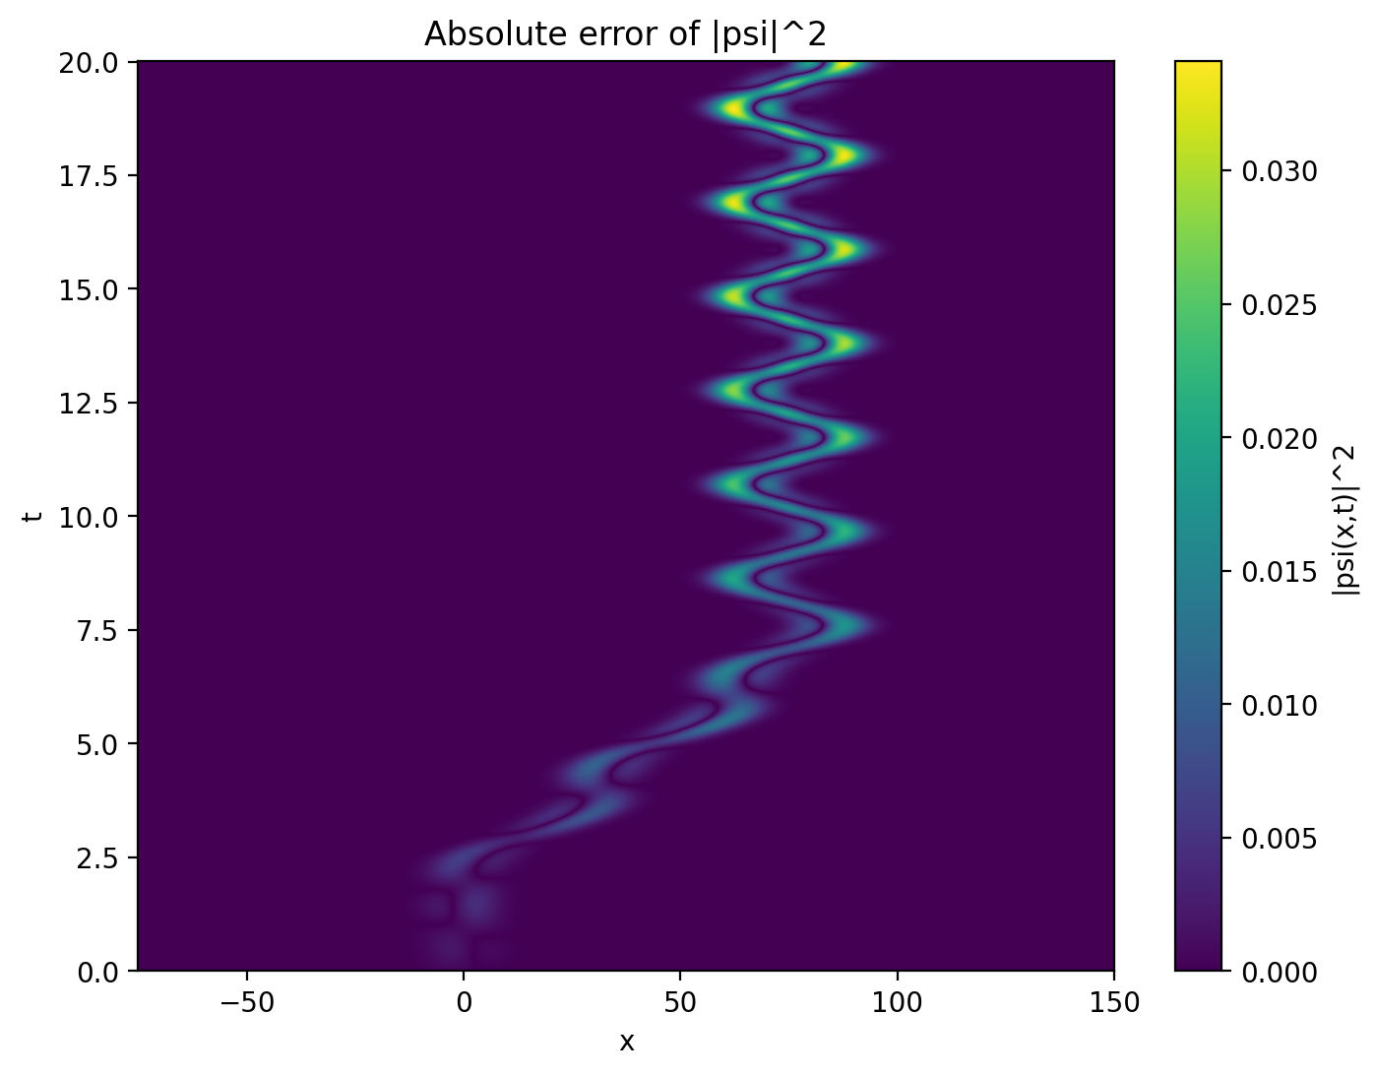
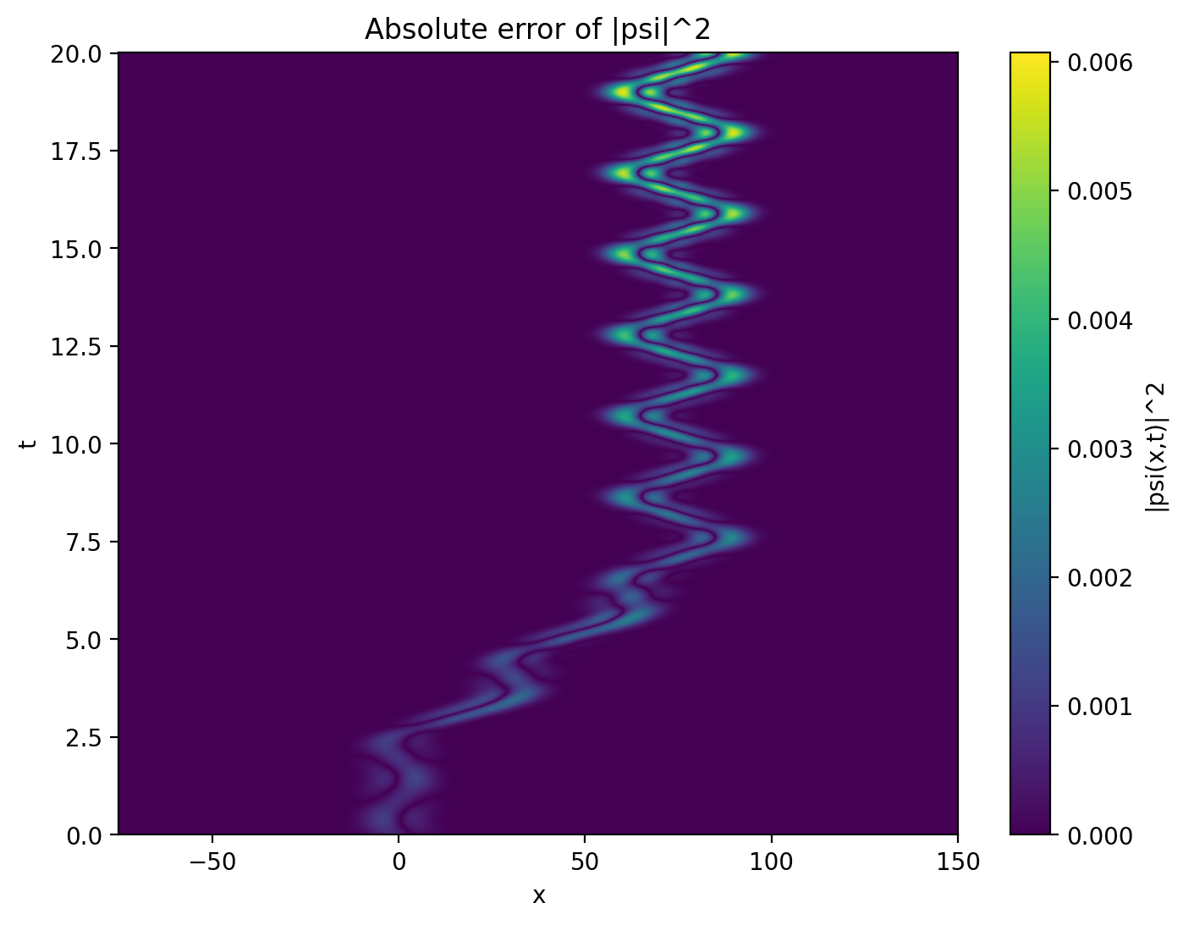


Base Model
Causal Model

Slide 9
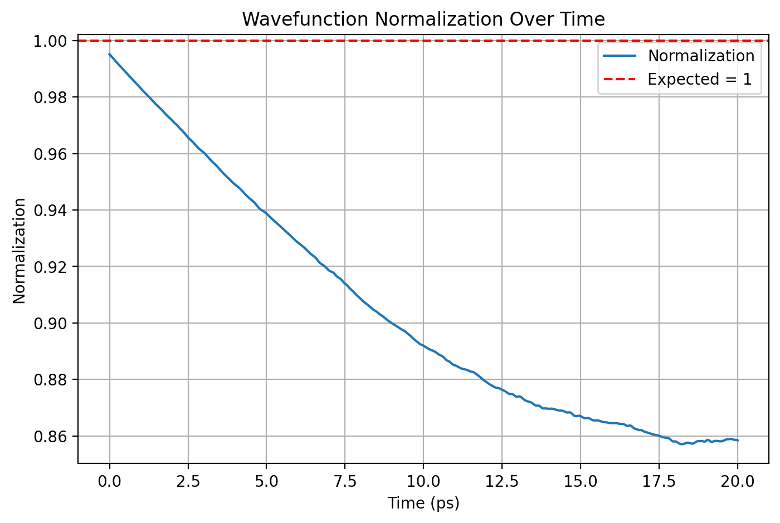
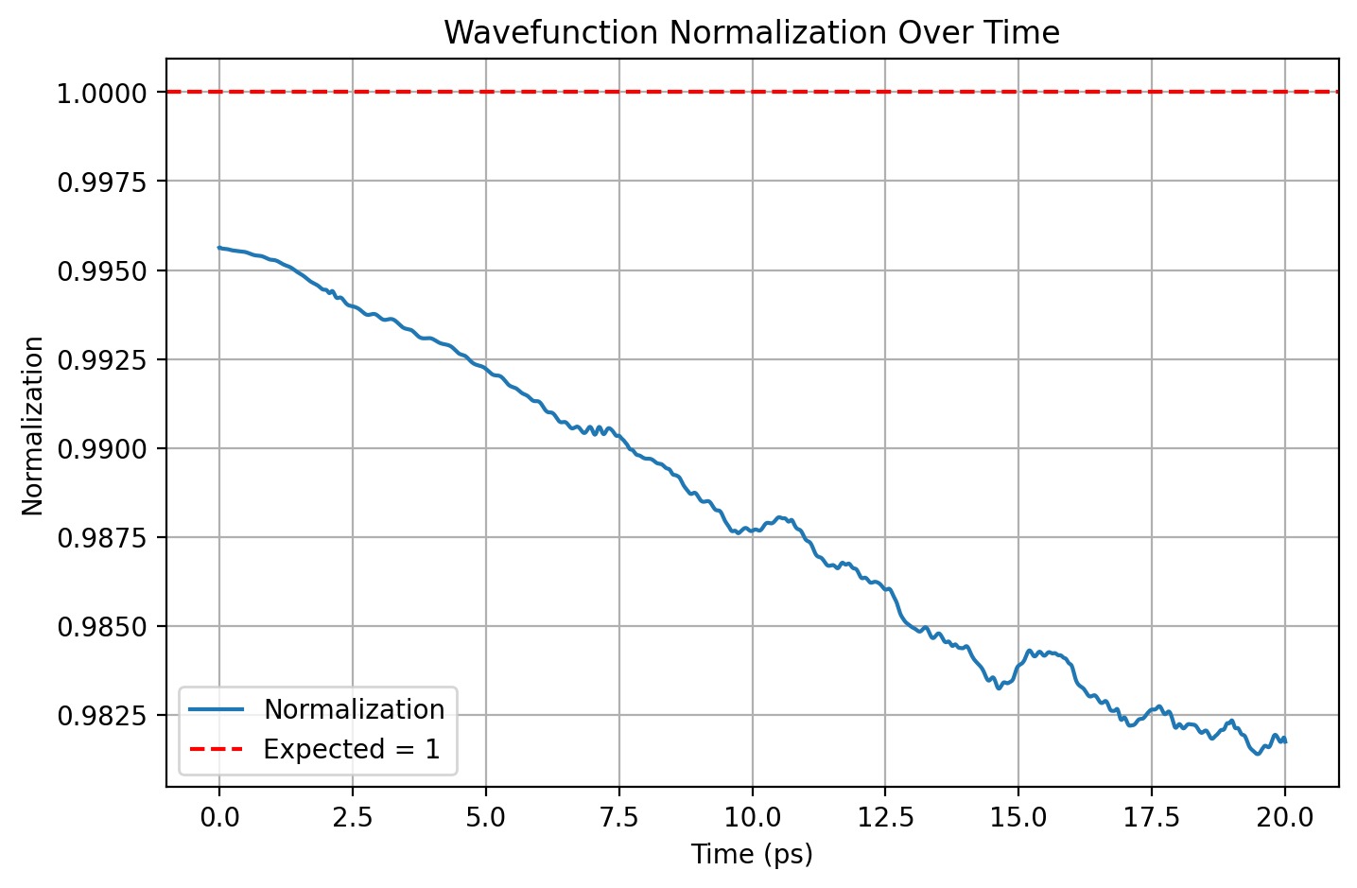


Base Model
Causal Model

Slide 10
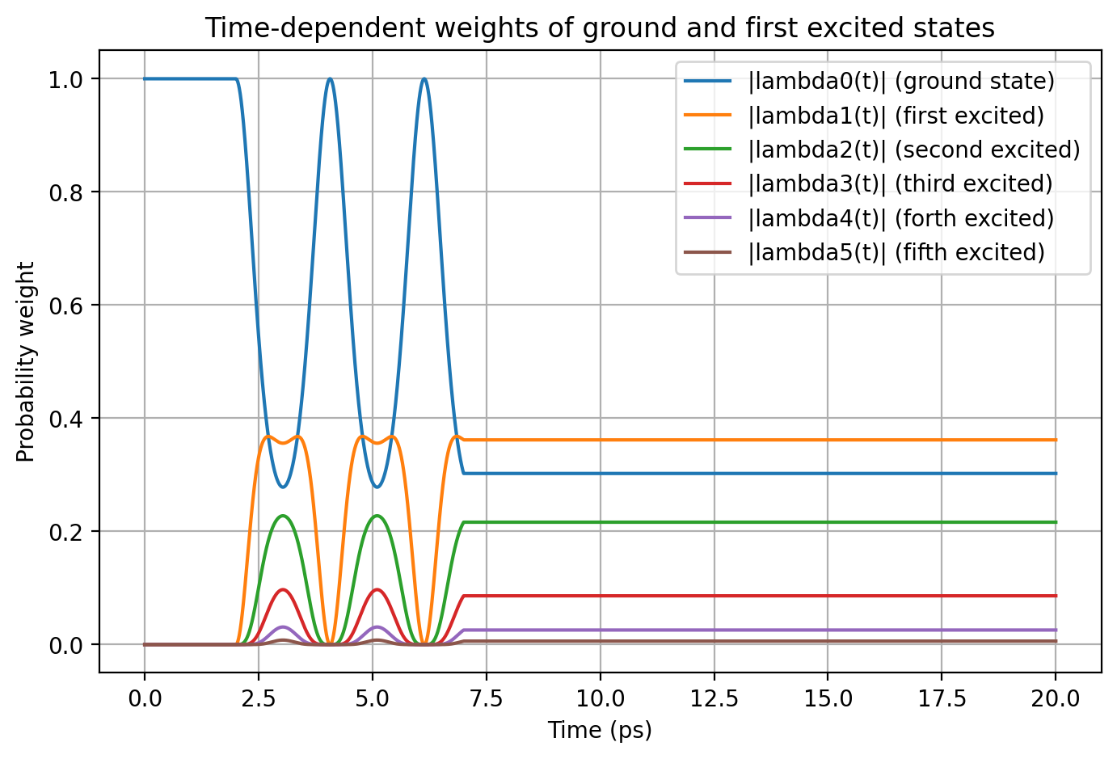
Crank Nicholson

Slide 11
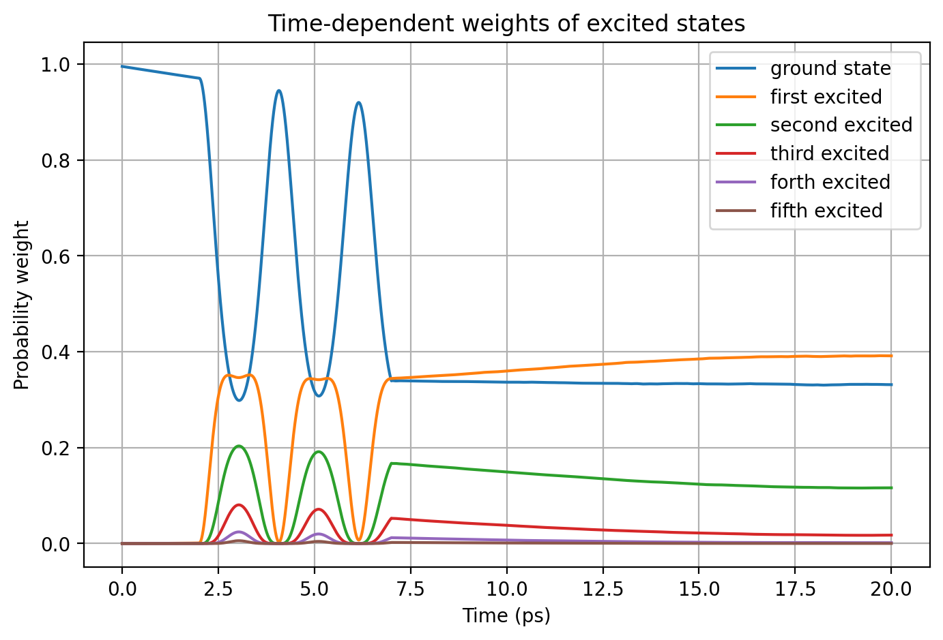
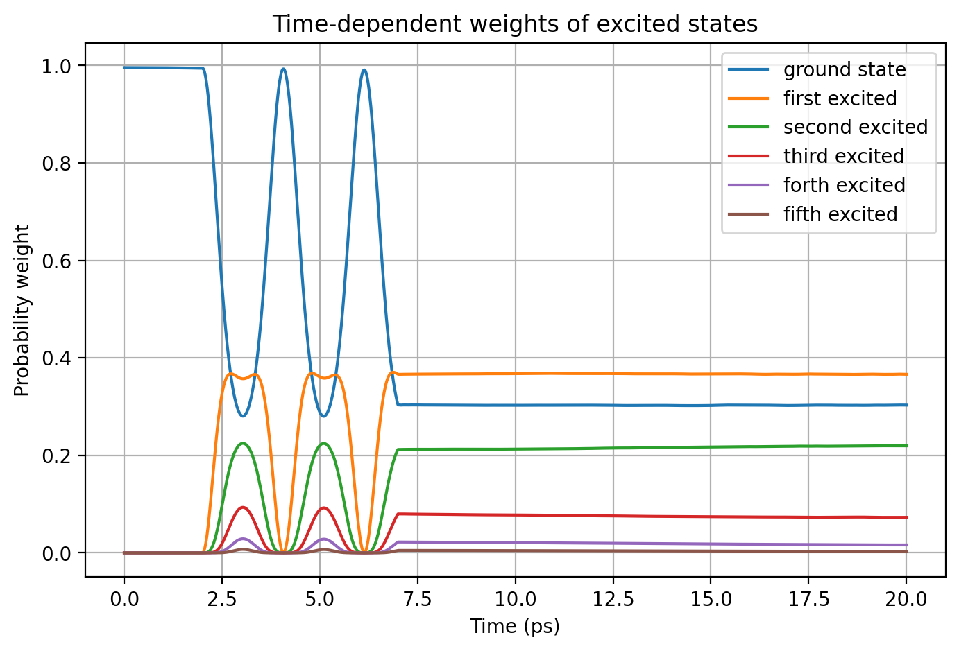
Base Model
Causal Model

Slide 12
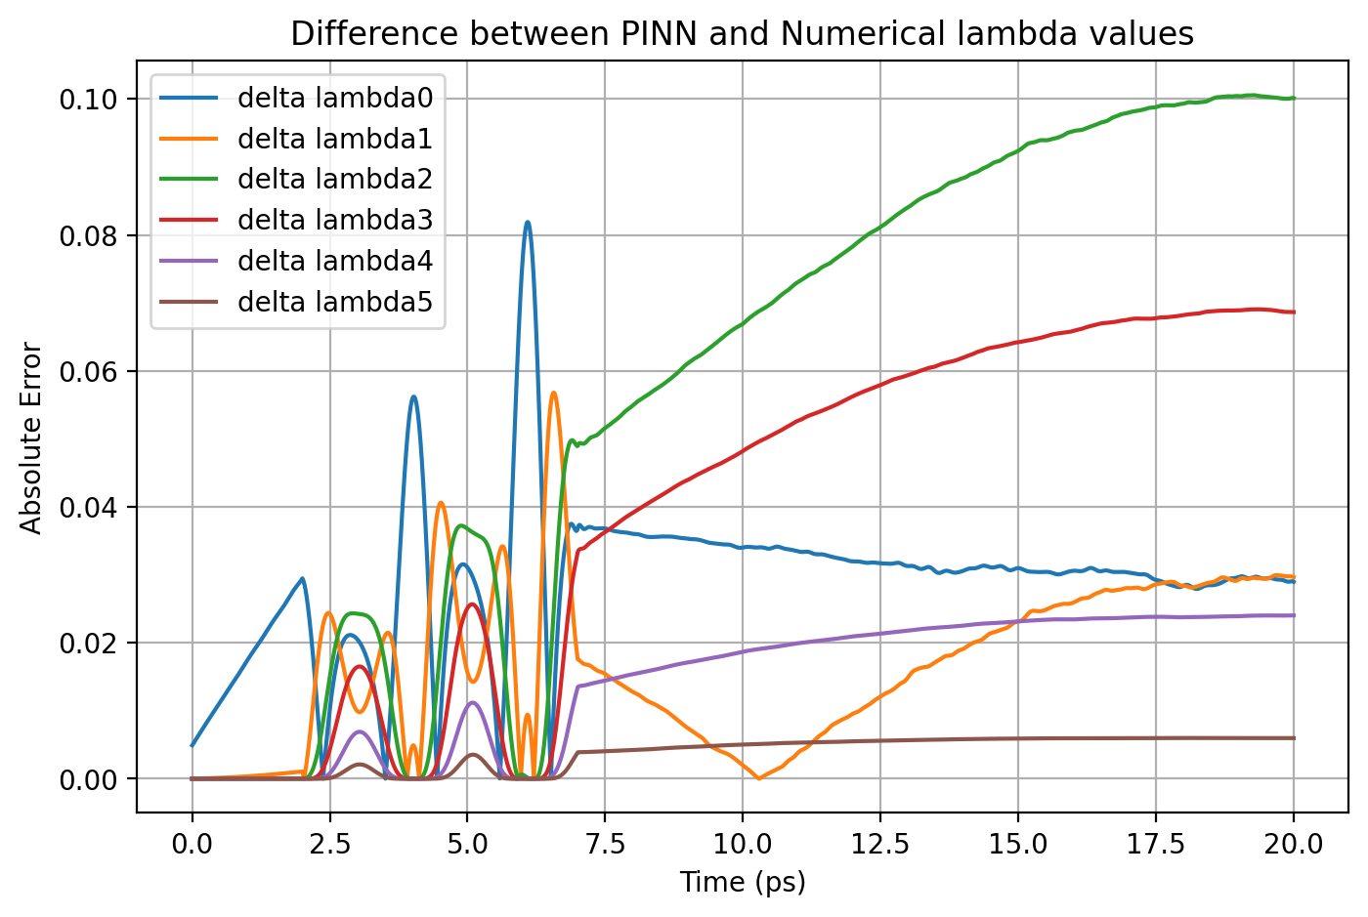
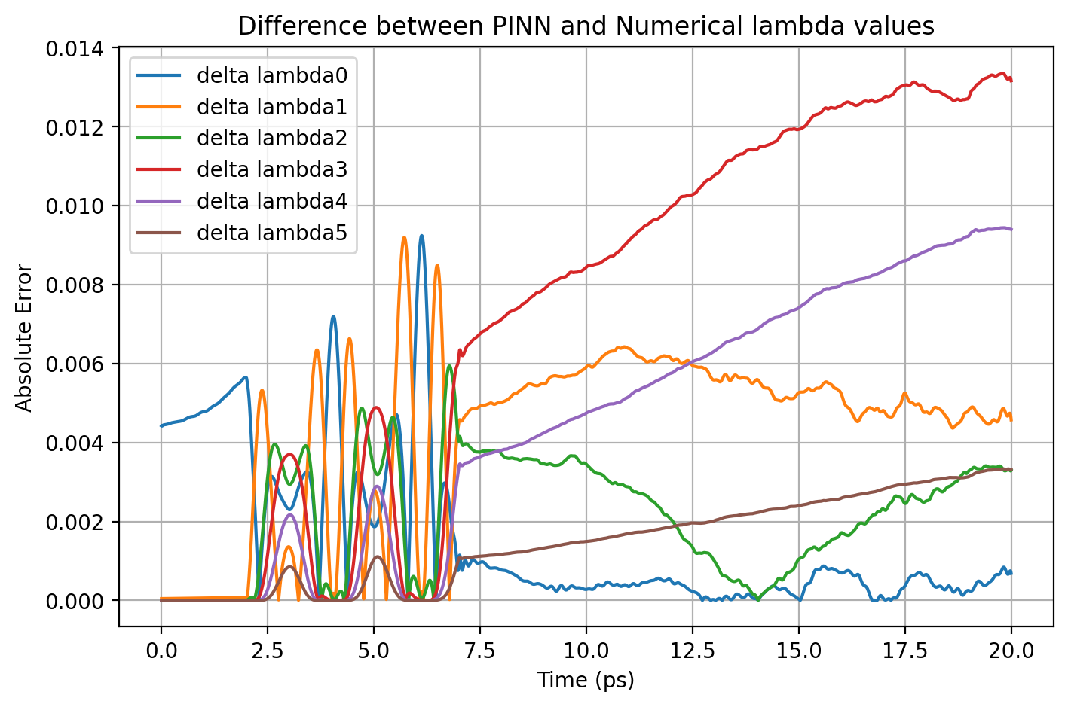

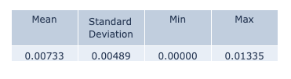
Base Model
Causal Model

Slide 13
Result Comparison
 | ΔΨ² - max | norm - mean | norm - std | Δλi - max
Base Model | 0.00607 | 0.98813 | 0.00447 | 0.01335
Causal Model | 0.00523 | 1.00133 | 0.00125 | 0.01207

Slide 14
Normalization
When solving the Schrödinger equation, normalization will make sure the wavefunction represents a valid probability distribution, which means the probability of finding a particle anywhere is exactly 1.
If we are solving the problem using PINNs, by default we do not normalize the wavefunction, but expect the probability of finding the particle anywhere at a given instance of time to be closer to 1 when the model learned the problem correctly.
But when I tried to enforce wavefunction normalization during training as an additional loss function, I saw a clear improvement in the overall model performance

Slide 15
Normalization
The probability of finding a particle can be found from this equation:
We use Monte-Carlo approximation to find this integral during training:

Slide 16

Base Model
Norm Model

Slide 17
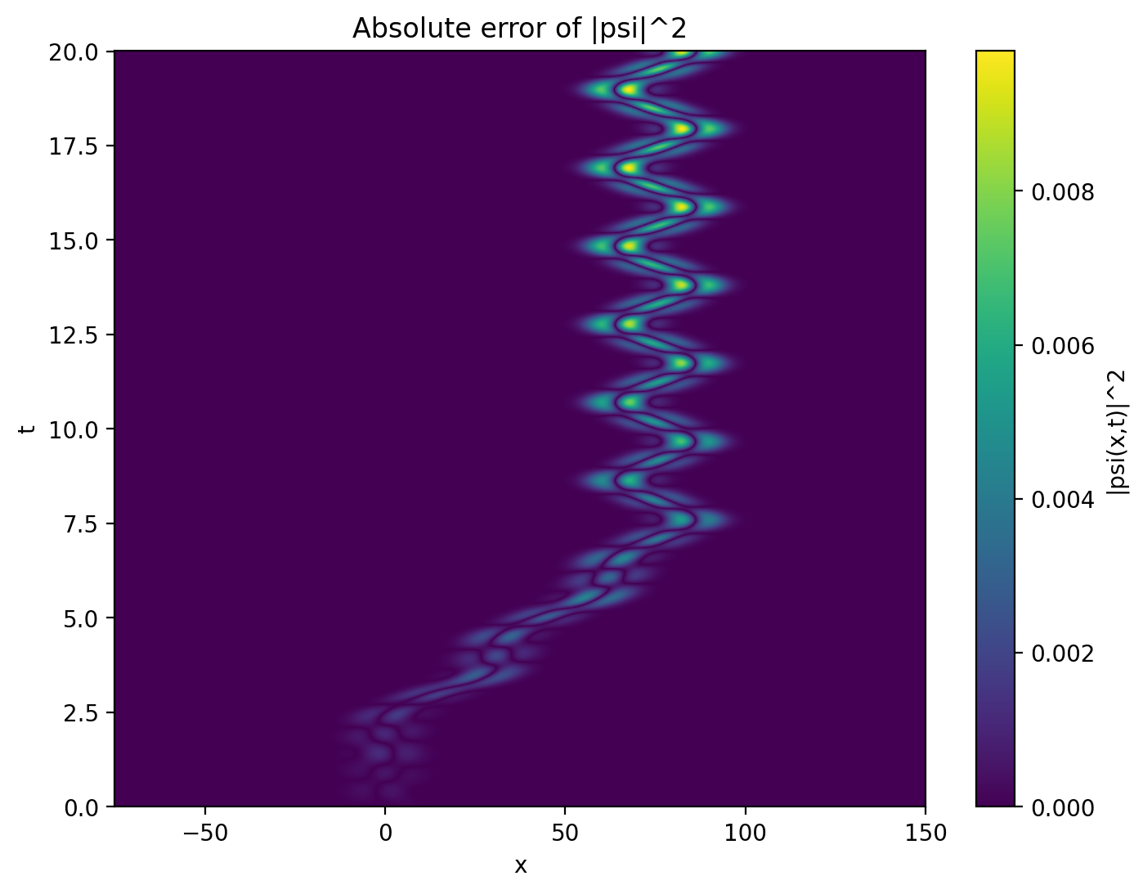

Base Model
Norm Model

Slide 18
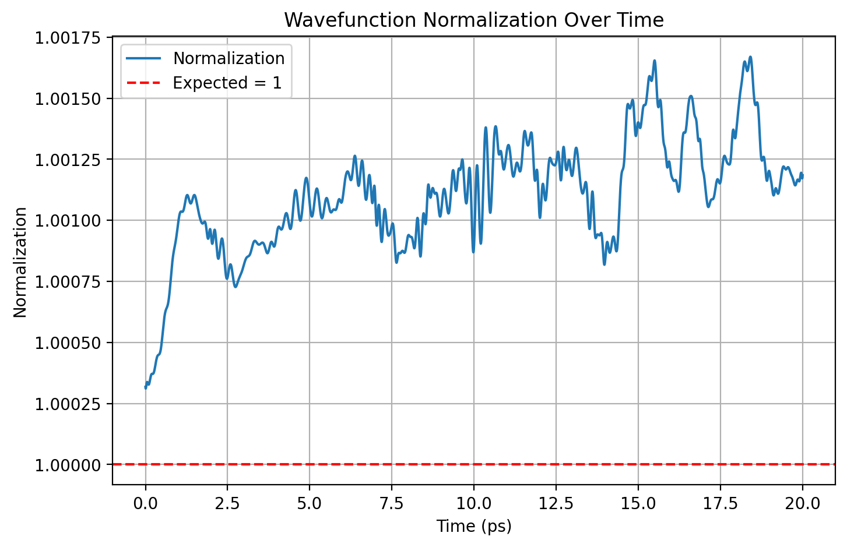

Base Model
Norm Model

Slide 19
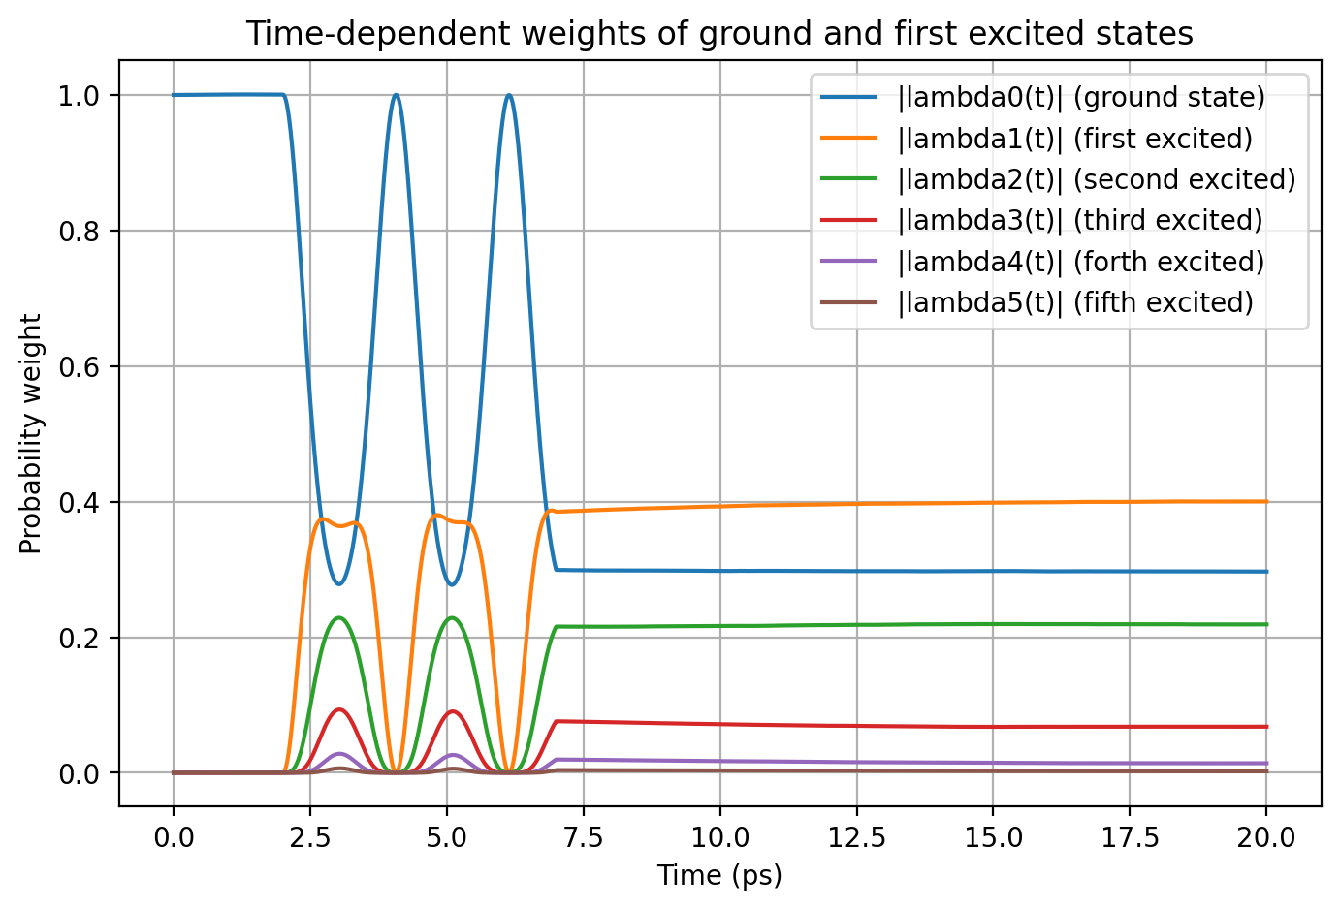
Base Model
Norm Model

Slide 20
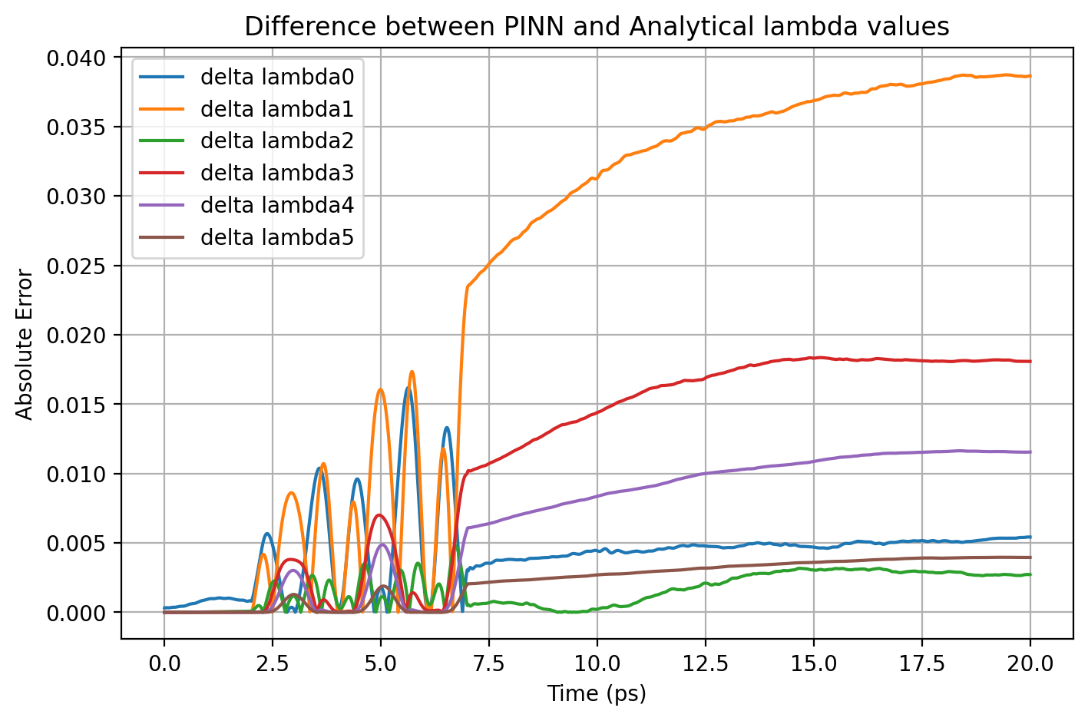

Base Model
Norm Model

Slide 21
Result Comparison
 | ΔΨ² - max | norm - mean | norm - std | Δλi - max
Base Model | 0.00607 | 0.98813 | 0.00447 | 0.01335
Norm Model | 0.00523 | 1.00133 | 0.00125 | 0.01207

Slide 22
Next Steps
To

Slide 23
Thank You

