Slide 1
Meeting - 28/07/2025

Slide 2
vQD models
Compared the time-dependent movement of systems with different vQDs

Slide 3
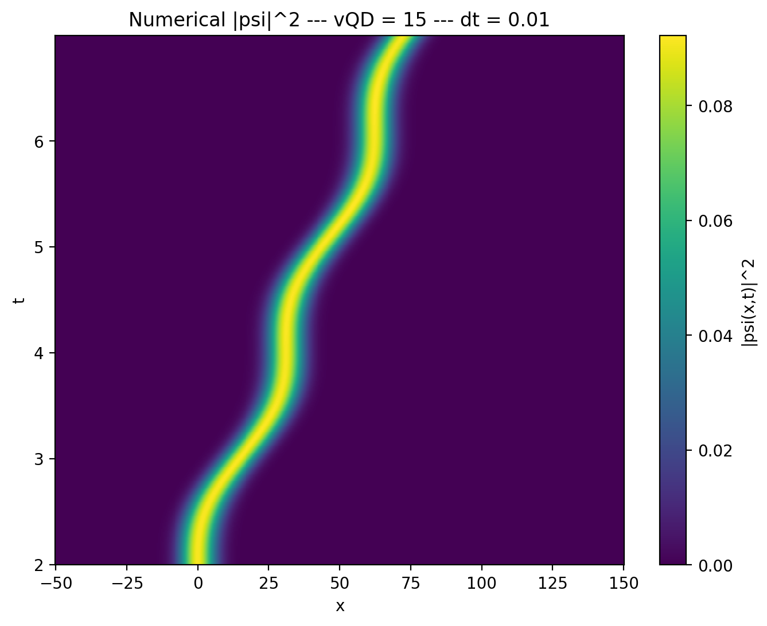
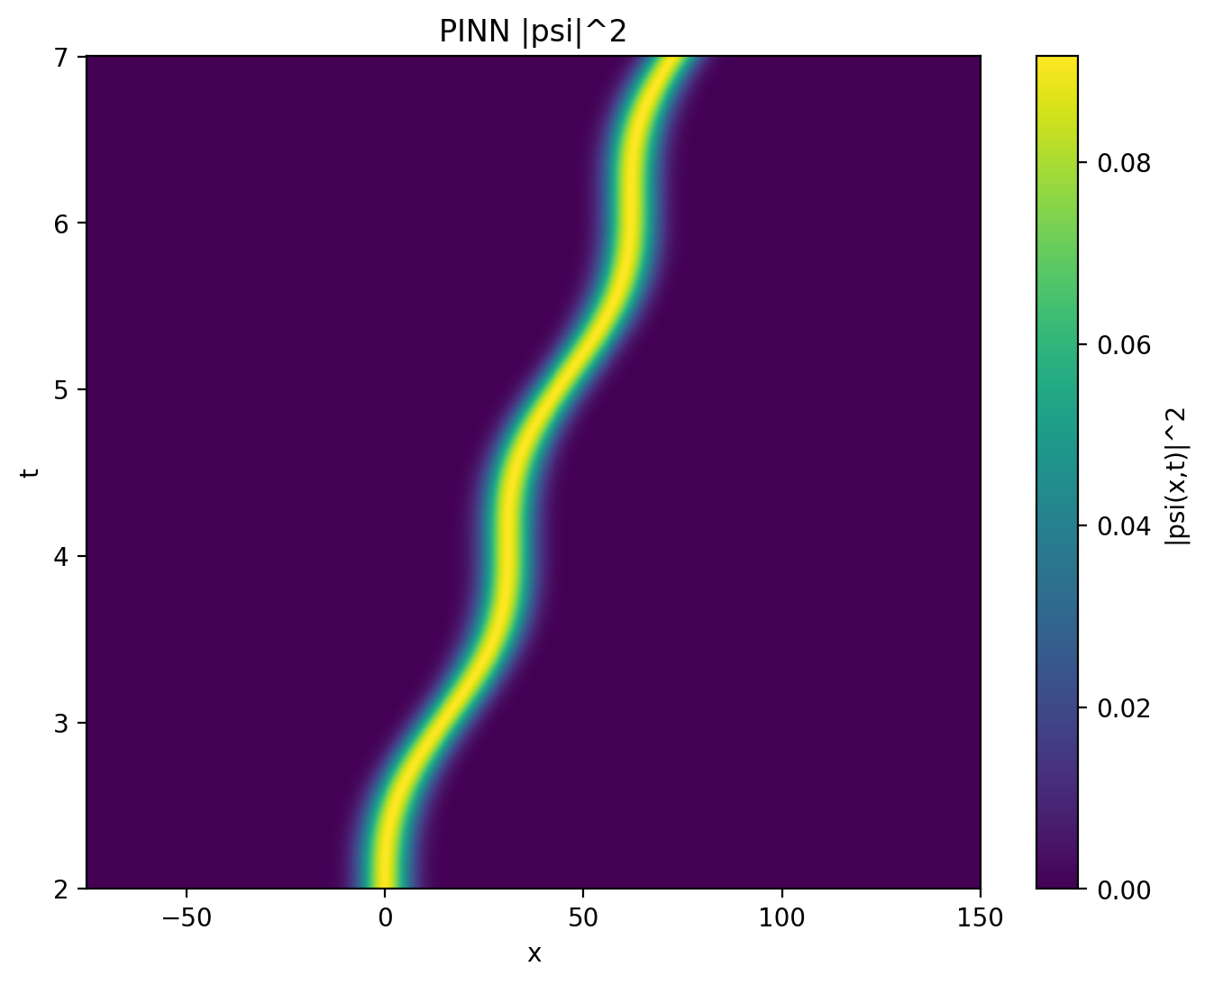
vQD = 15

Slide 4
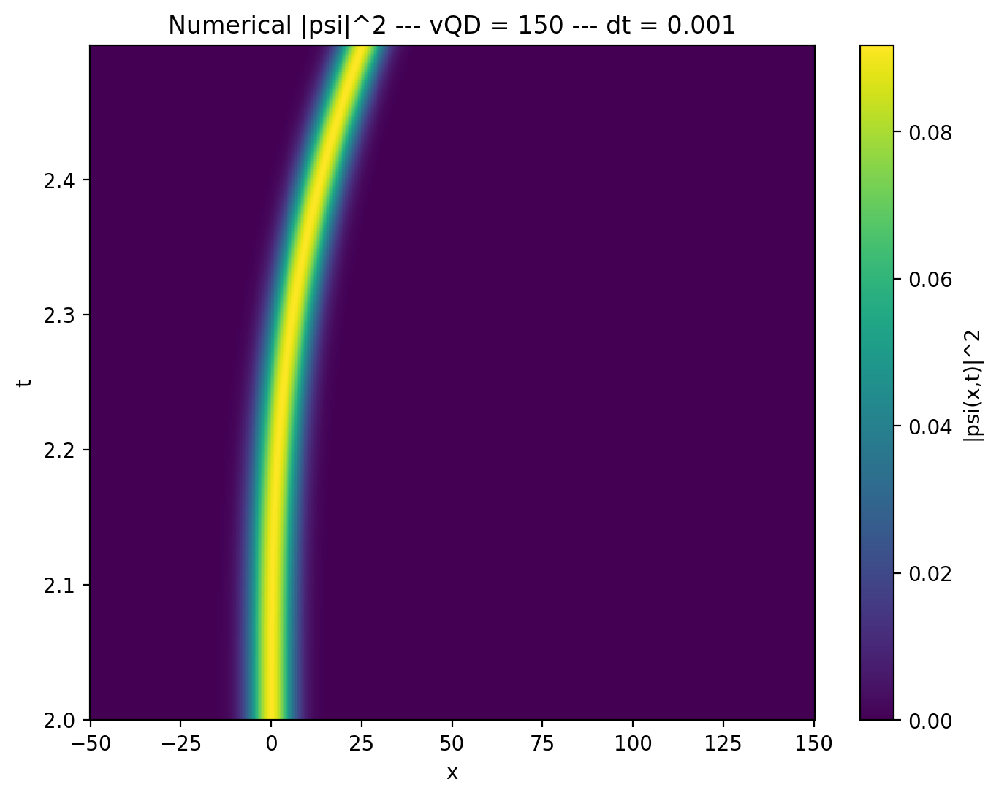
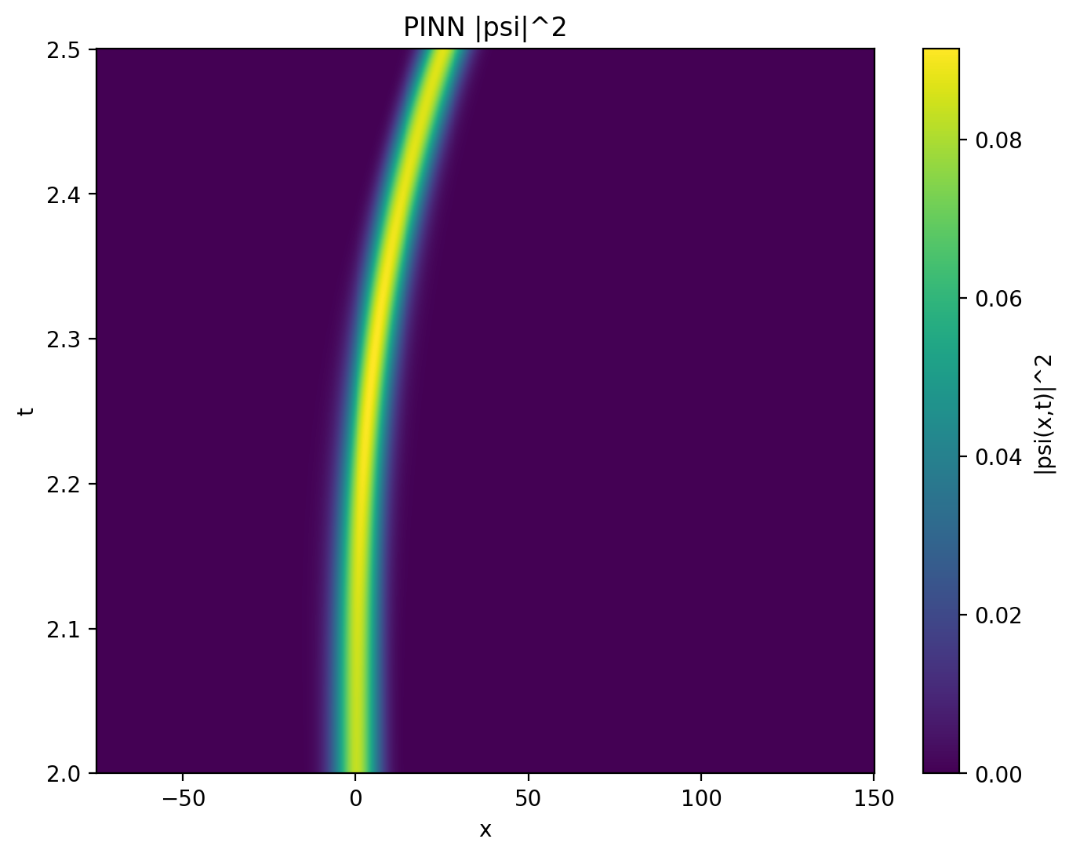
vQD = 150

Slide 5
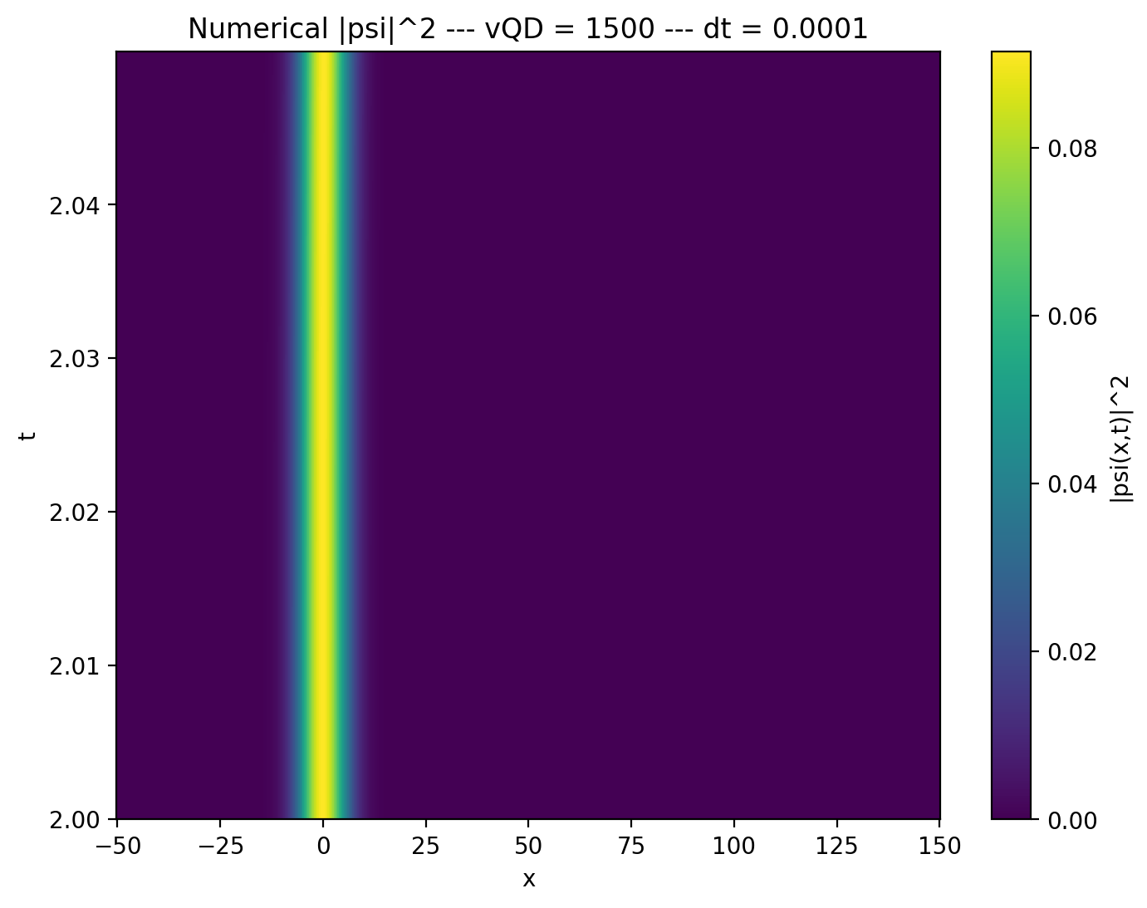
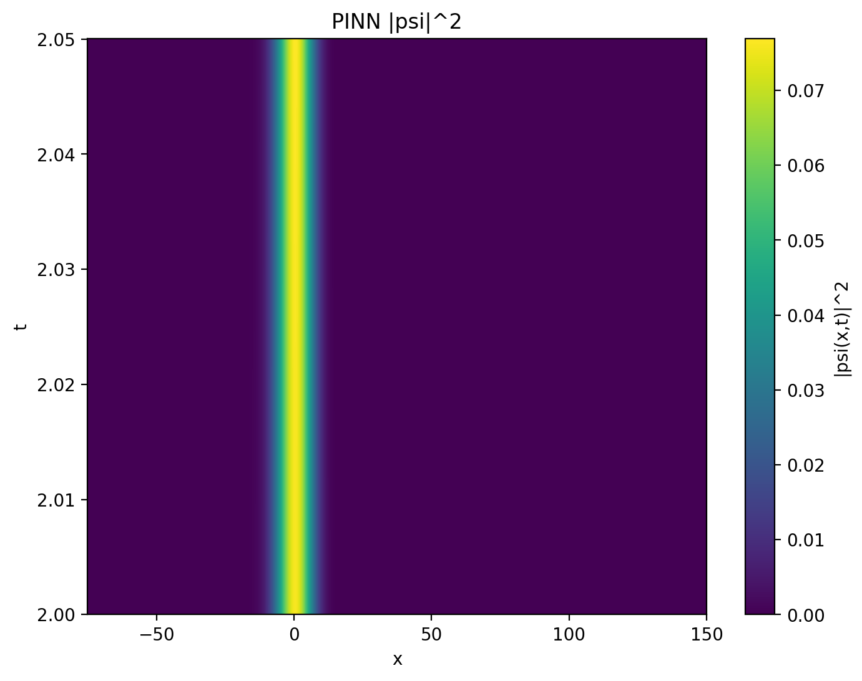
vQD = 1500

Slide 6
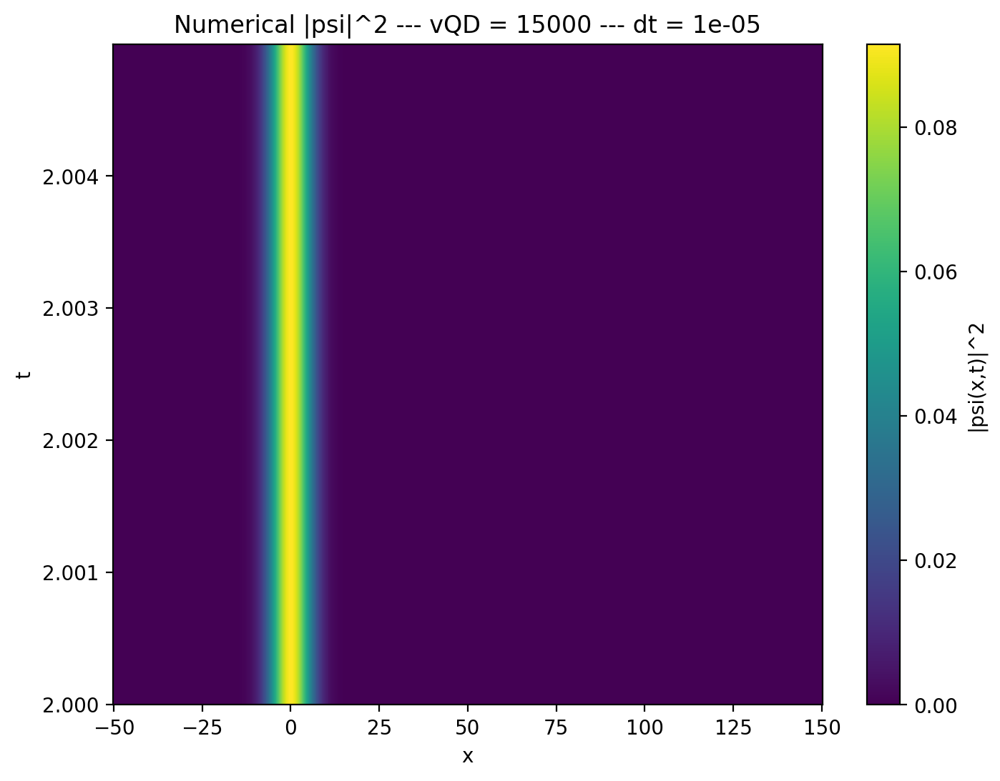
vQD = 15000

Slide 7
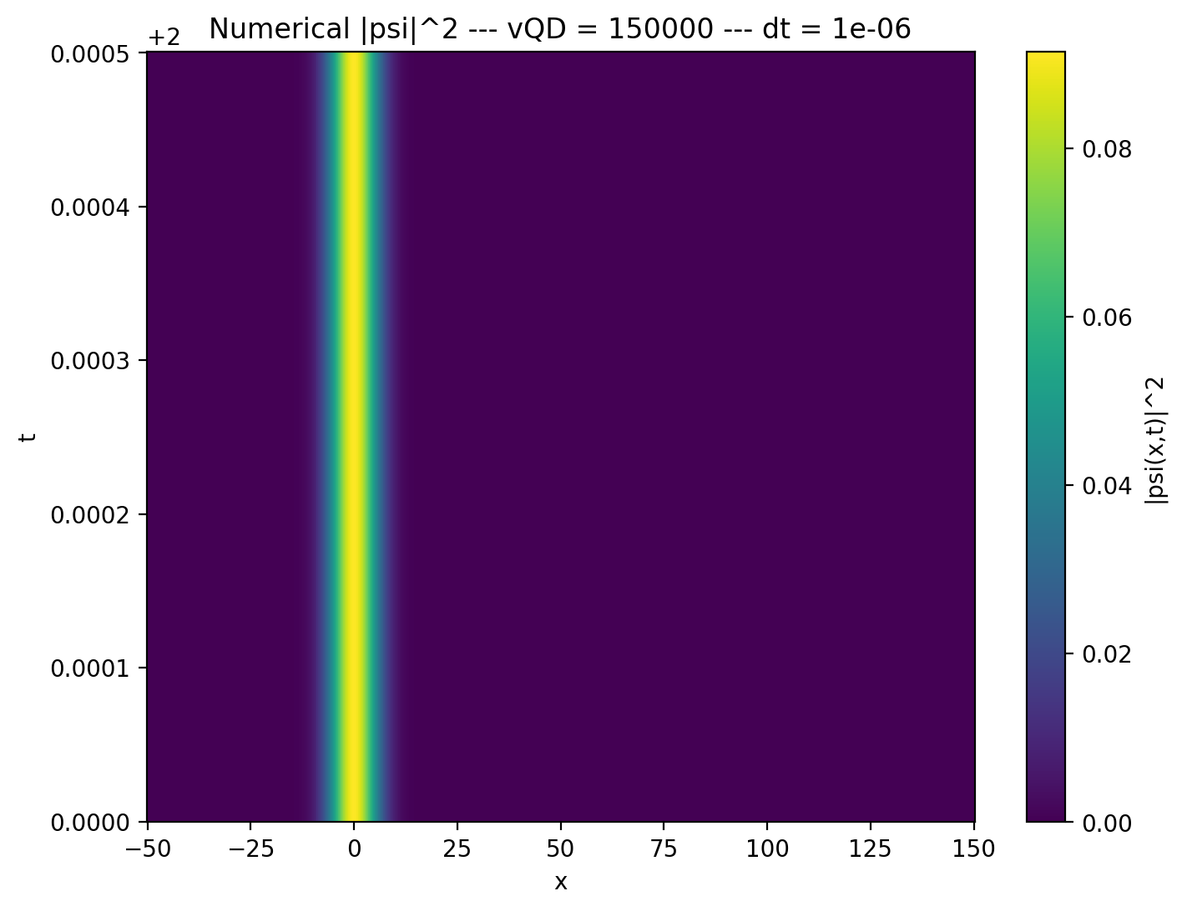
vQD = 150000

Slide 8
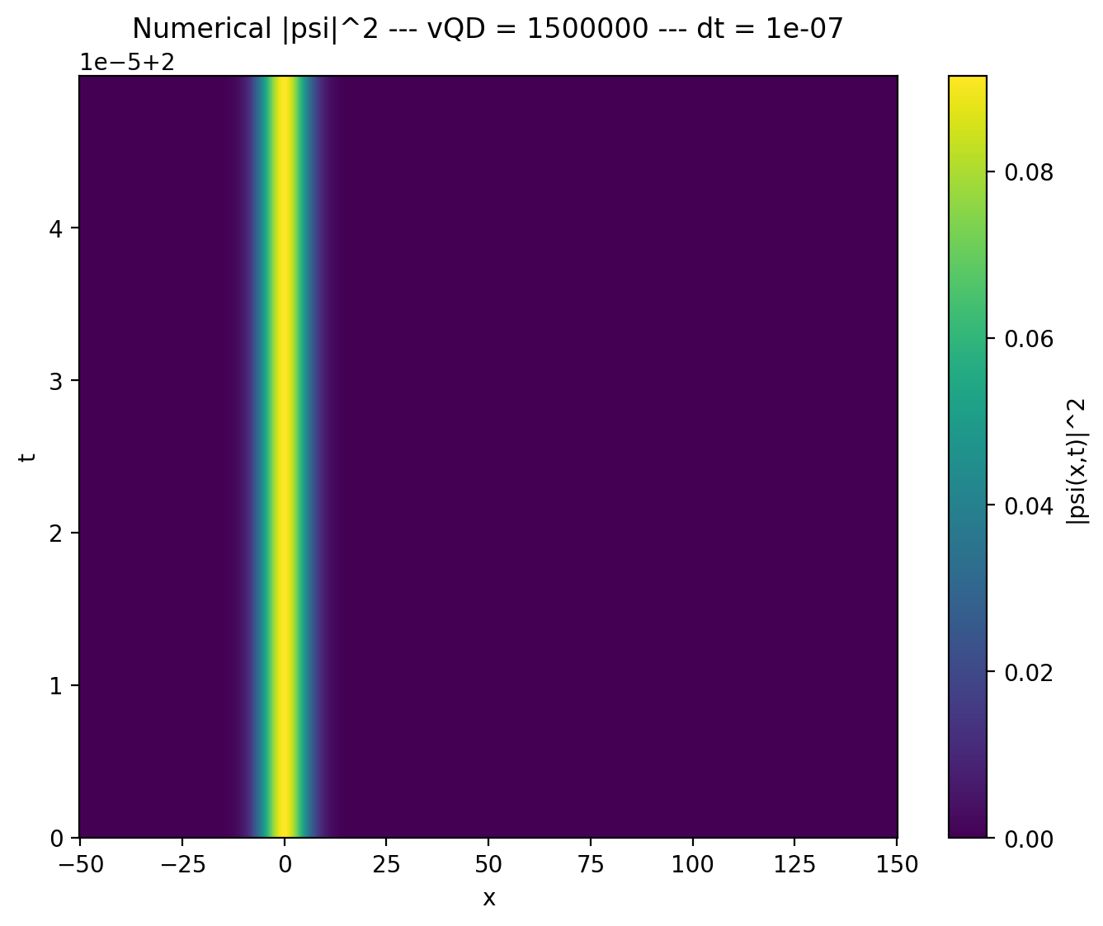
vQD = 1500000

Slide 9
vQD | dt | grid | time
15 | 0.01 | 500 x 500 | 0.3s
150 | 0.001 | 500 x 500 | 0.3s
1500 | 1 x 10⁻⁴ | 500 x 500 | 0.3s
15000 | 1 x 10⁻⁵ | 500 x 500 | 0.3s
150000 | 1 x 10⁻⁶ | 500 x 500 | 0.3s
1500000 | 1 x 10⁻⁷ | 500 x 500 | 0.3s

Slide 10
2-D PINN
6 HL
150k epochs ≈ 3 hours
300k epochs ≈ 6 hours
Crank-Nicholson ≈ 7 hours

Slide 11
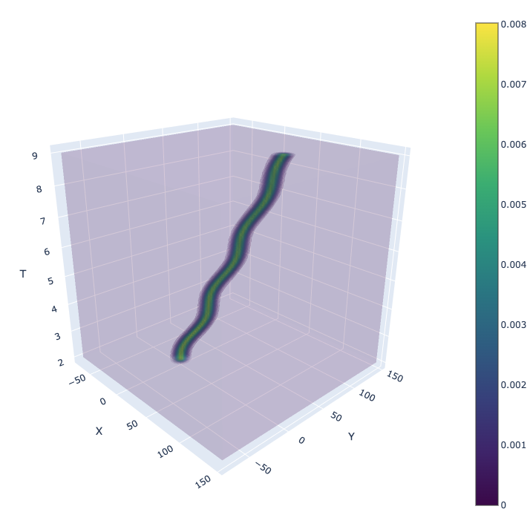
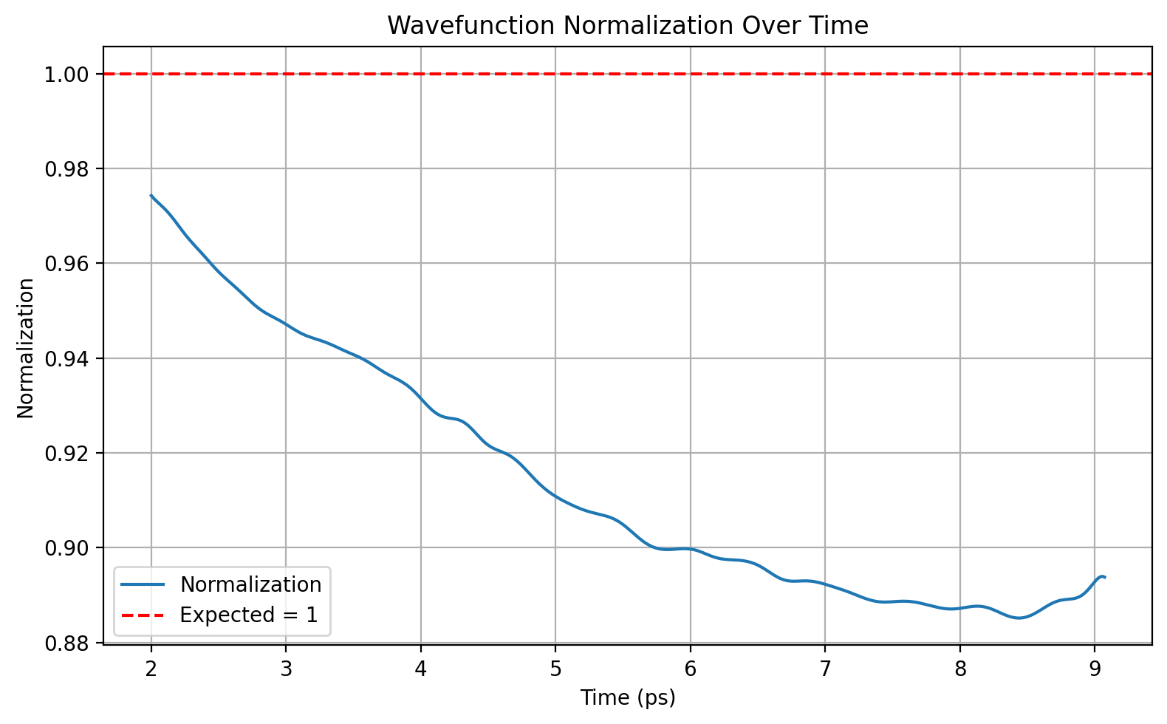

Slide 12
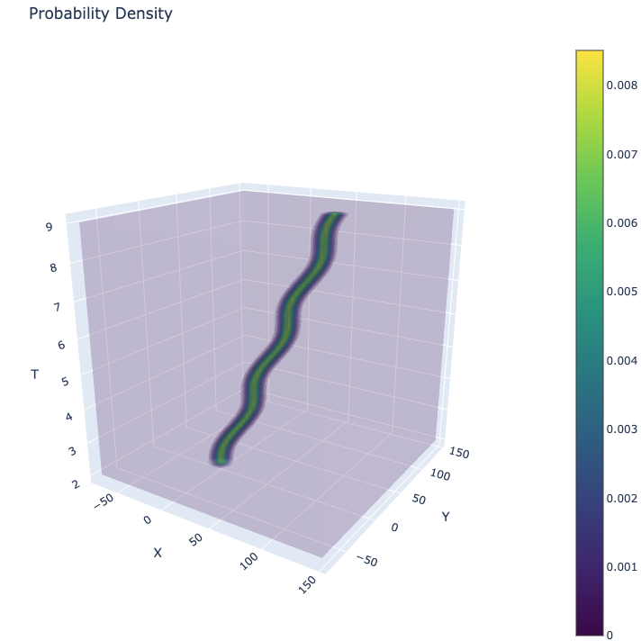
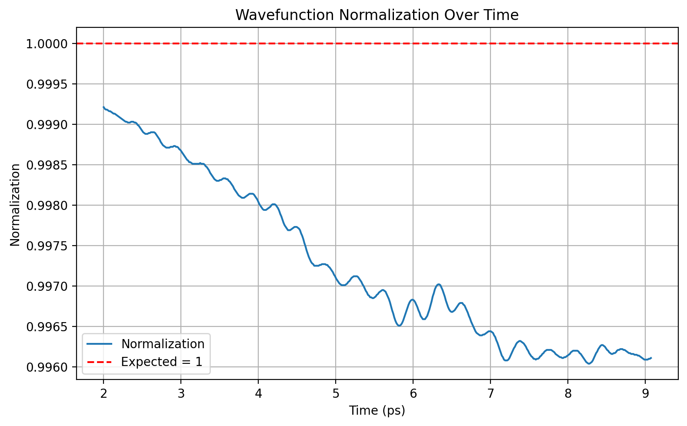

Slide 13
Assumptions
Distance between starting and ending point of q-dot movement
Analytical initial condition
Boundary condition points generation
Monte-Carlo integral error
Q-dot movement equation

Slide 14
.end

