Slide 1
Meeting - 31/03/2025

Slide 2
Static Spatial Domain
Here I increased the total number of points to 25000 instead of 5000
Runtime > 6 hours
Highly inefficient model

Slide 3
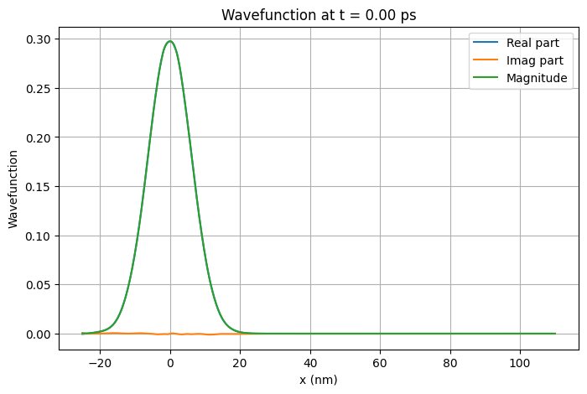

Slide 4
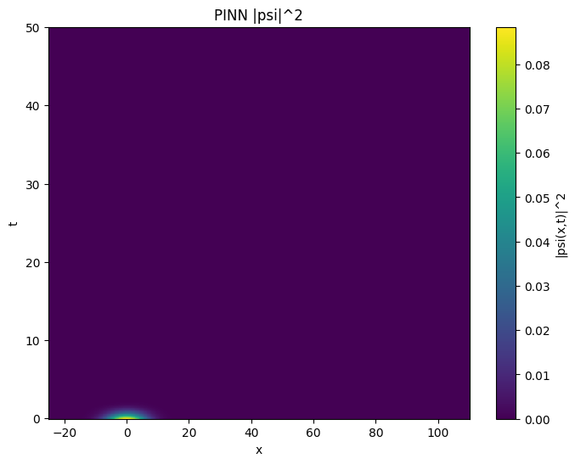
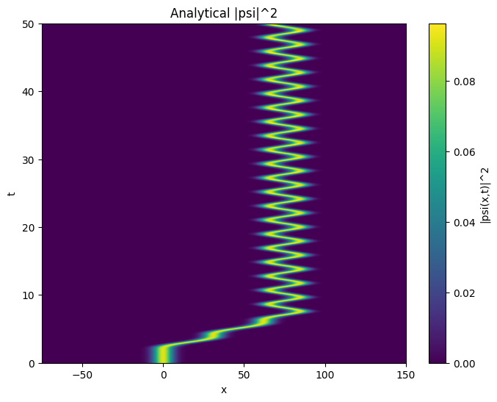

Slide 5
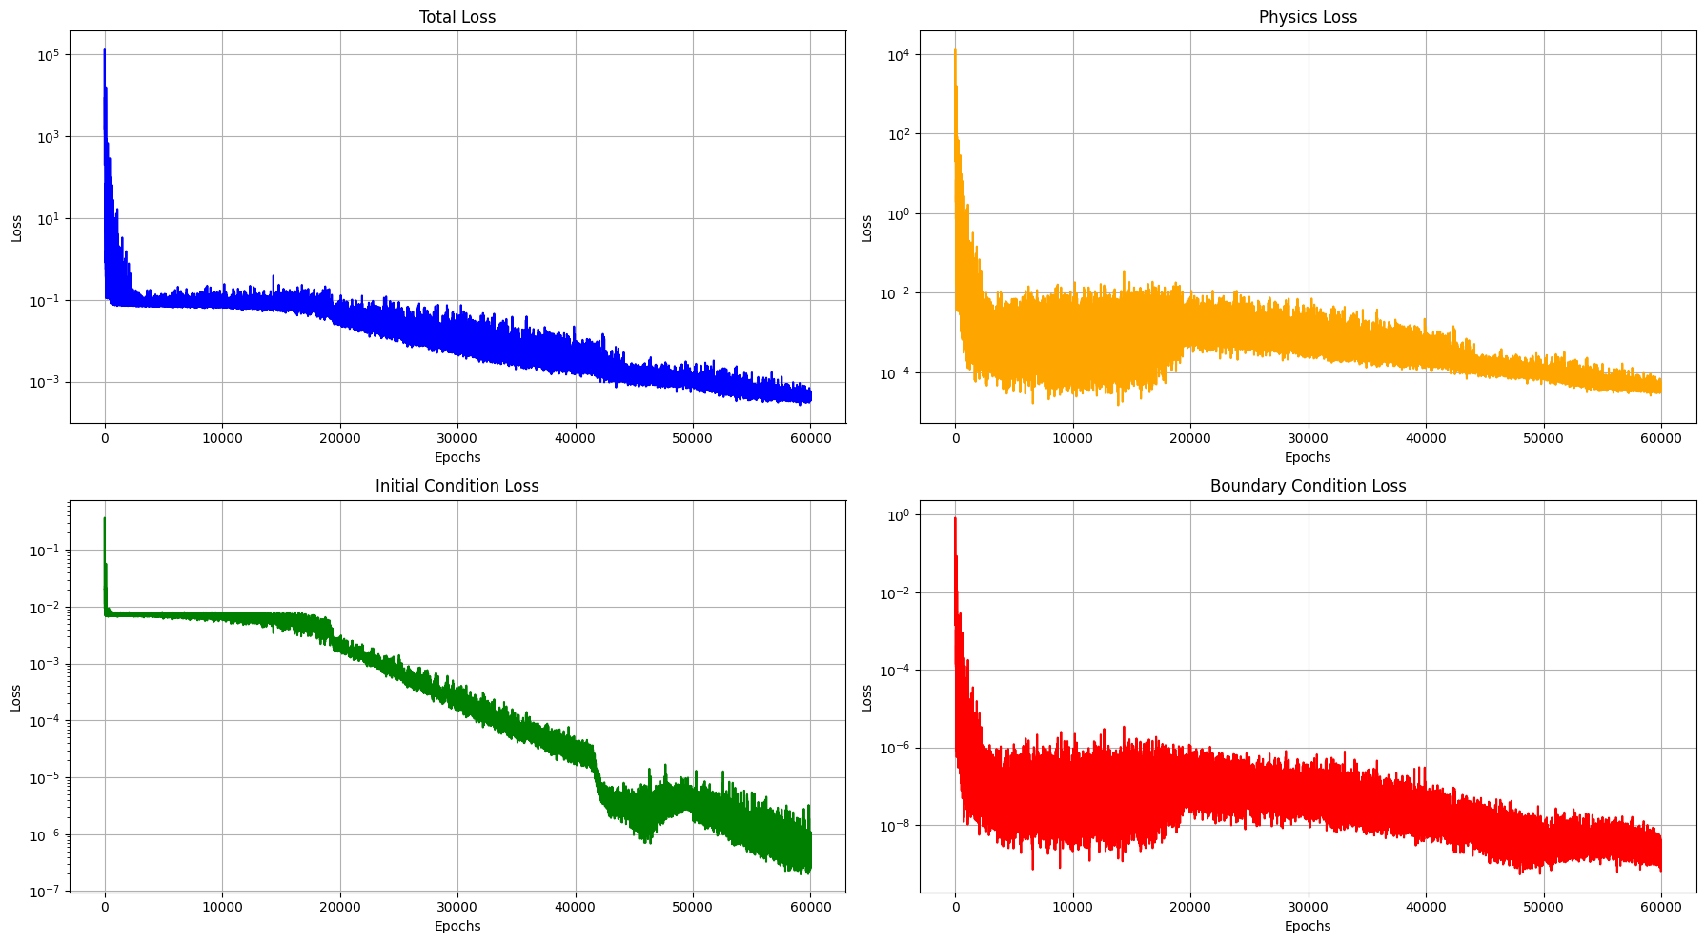

Slide 6
Dynamic spatial domain
Here I used normal distribution to generate collocation points instead of uniform distribution
PDE loss during training is converging to ≈ 10⁻⁵ when run for about 3 hours
Convergence is slower

Slide 7
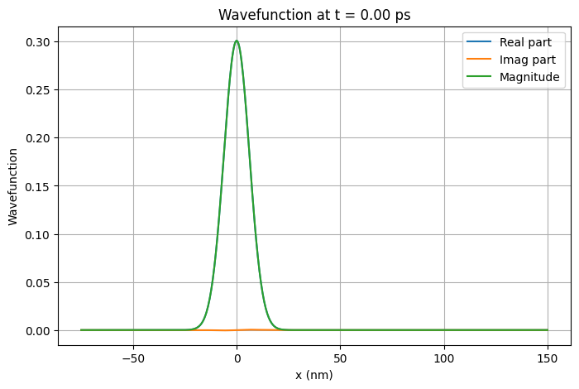

Slide 8
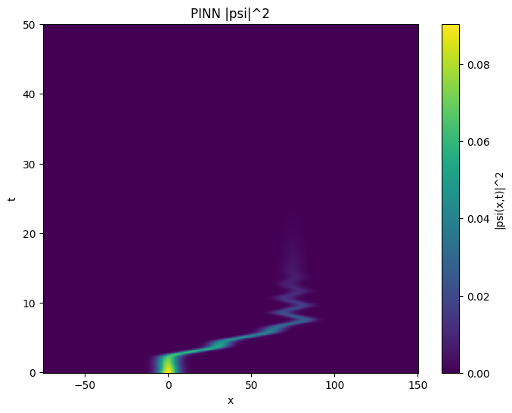

Slide 9
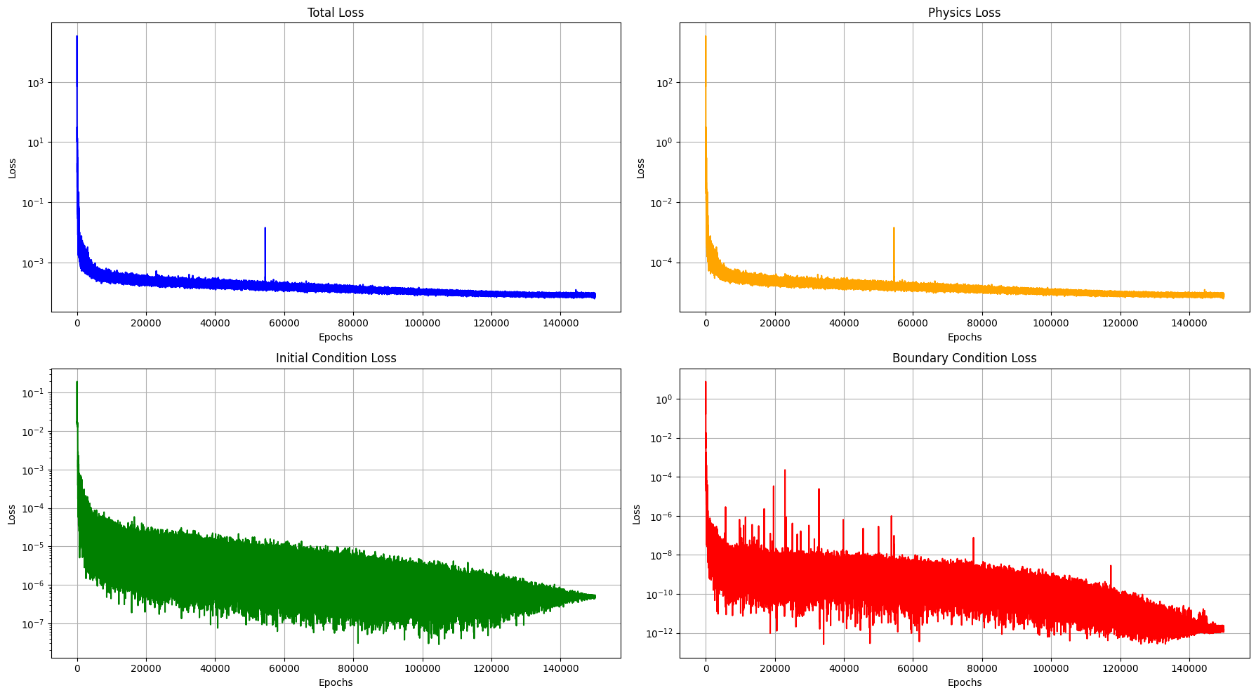

Slide 11
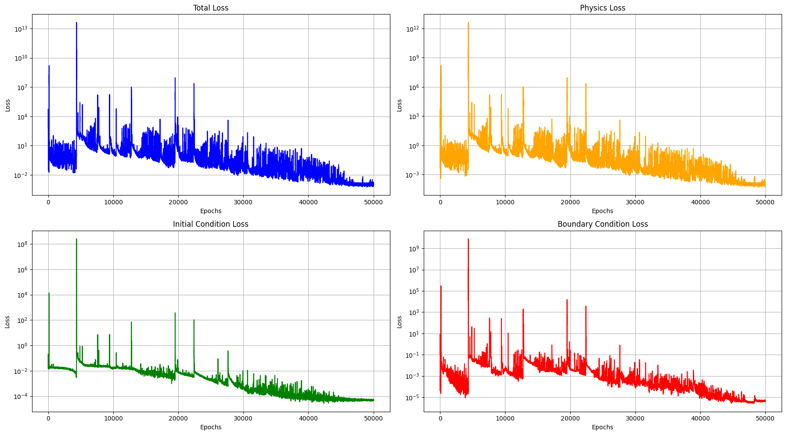

Slide 12
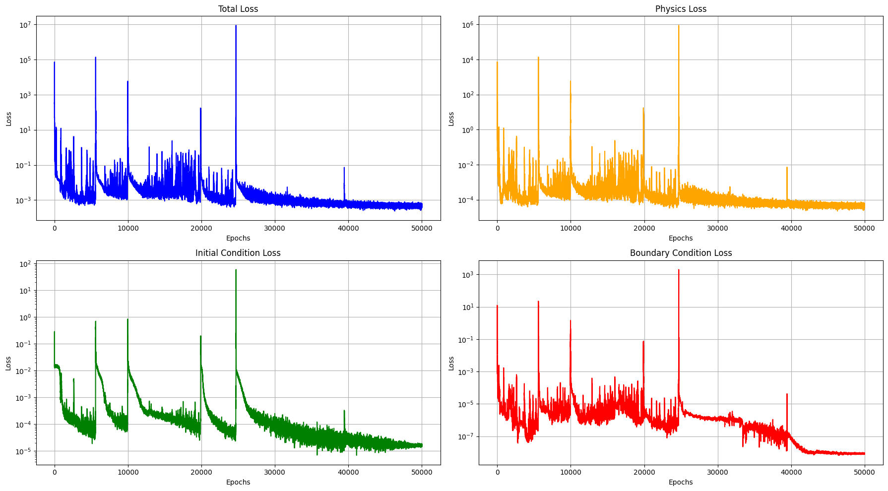

Slide 13
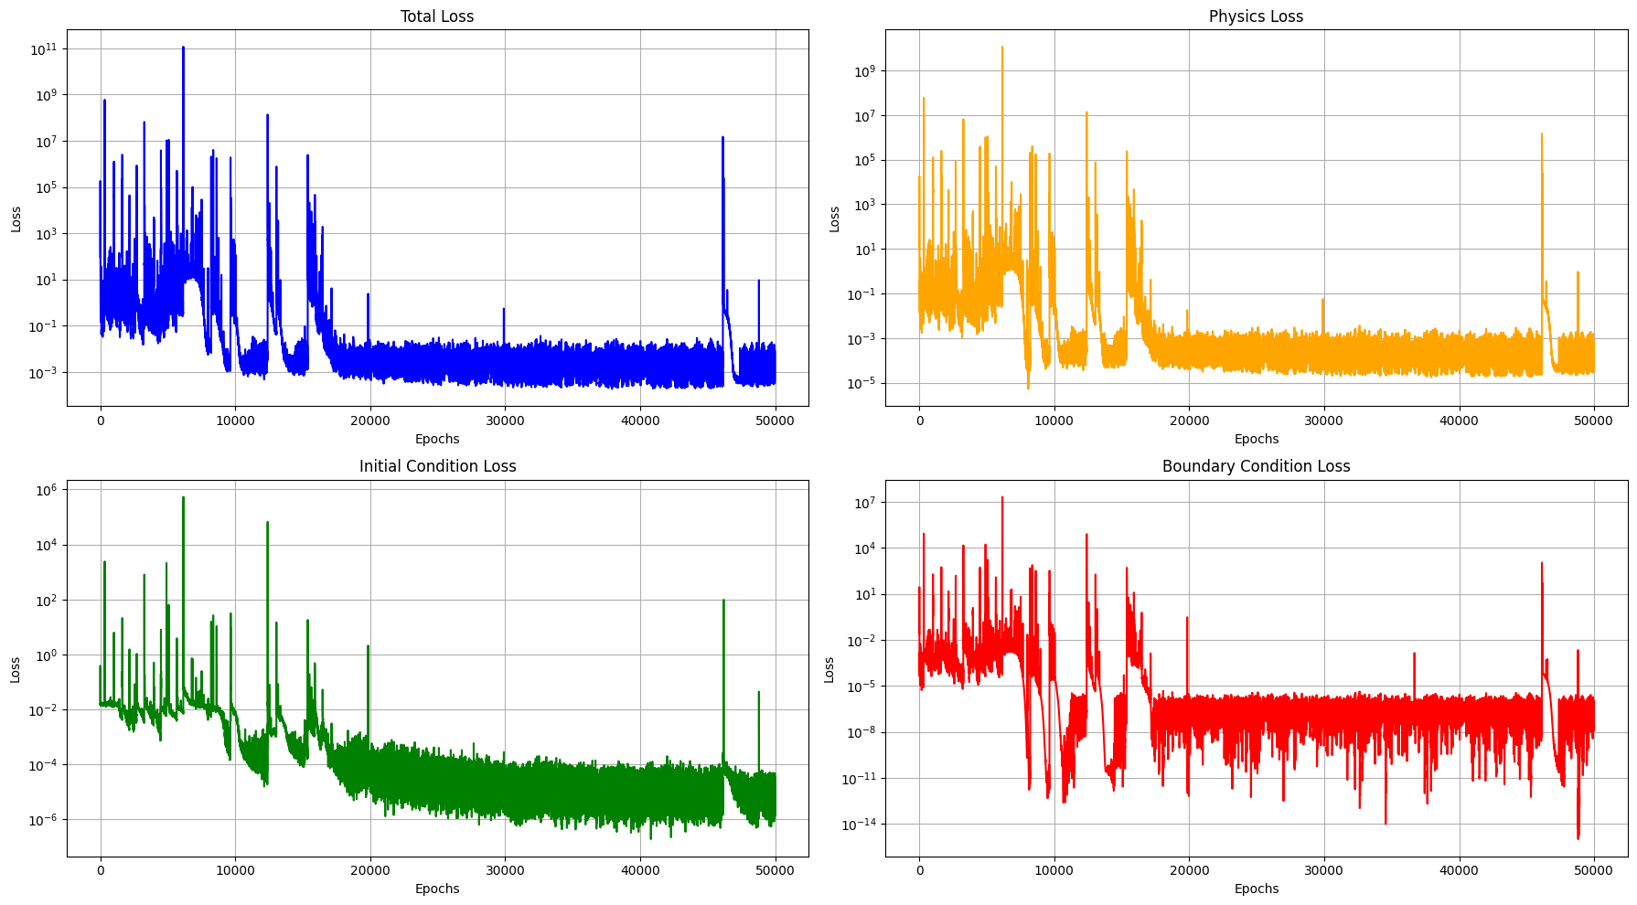

Slide 14
.end

