Slide 1
Meeting - 07/07/2025

Slide 2
Recap
Previously, I only enforced normalization only after 2/3 rd of the training is completed
I tried to enforce it from the start of training itself and I saw clear improvement over the same model without norm enforcement
I tried the same with a causal model and it indeed improved the causal model as well
Next I tried to find a way to get the optimal number of segments for calculating norm loss
I tried to see if there is any relation between ω and number of segments, but I couldn’t find any

Slide 3
Segment Number
I am trying to find a justification for the optimal number of segments of a model in calculating normalization loss
For this method: Initially define a variable t0, which is the time between two consecutive wave crest
Then a choose segment width in terms of t0, such as 0.25t0, 0.5t0, t0, 2t0
For example, if t0 = 4ps, segment width = 0.25 x t0 = 1ps, then number of segments will be equal to 20 ps / 1 ps = 20

Slide 4
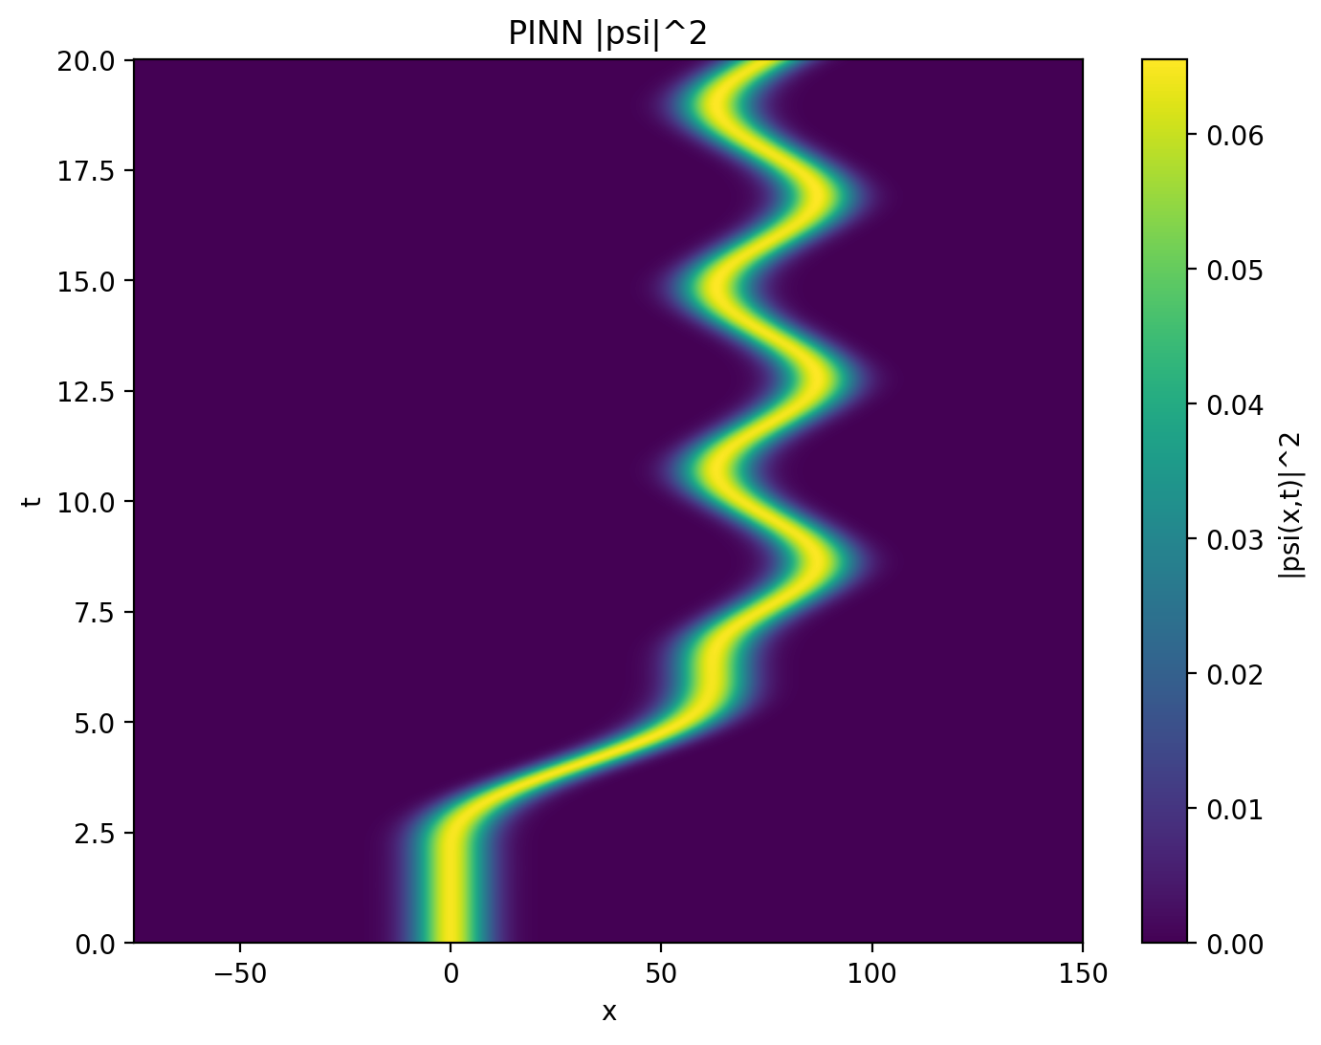
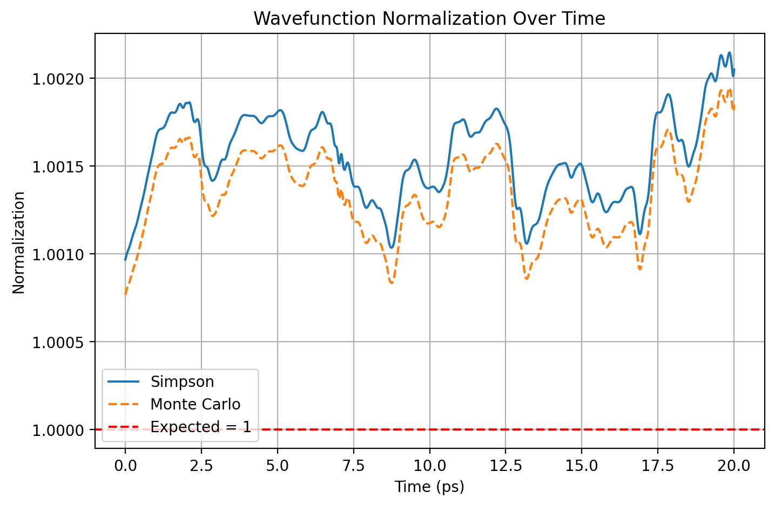

ω = 1 / ħ, nseg = 20

Slide 5
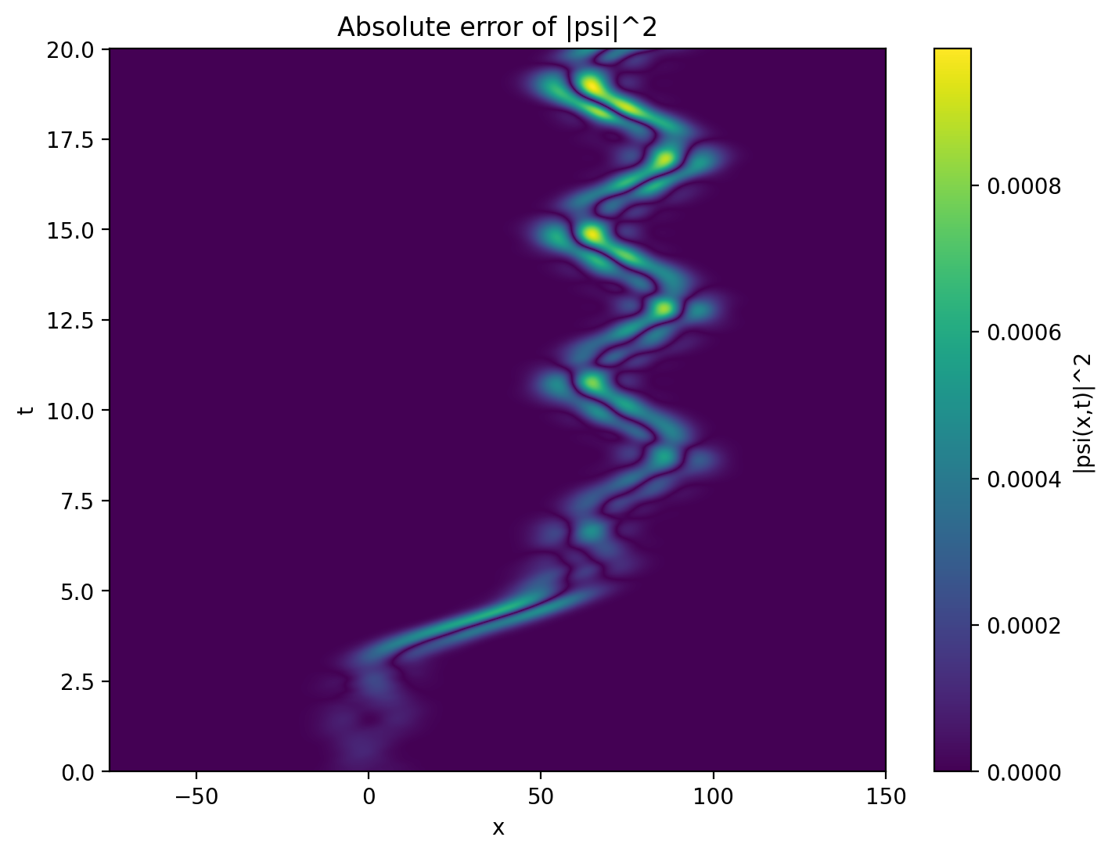
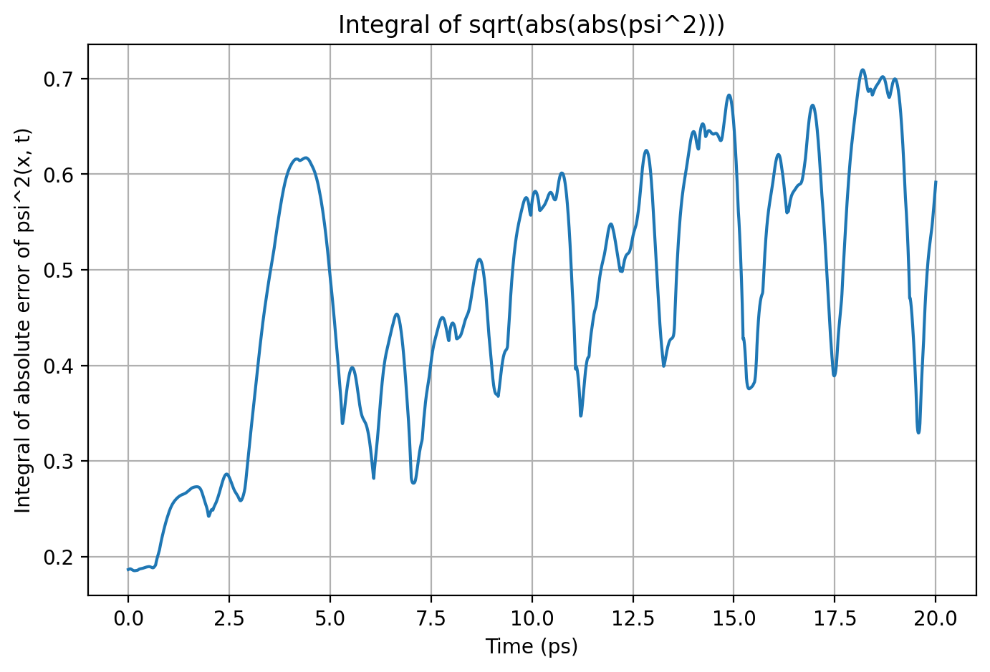


Slide 6
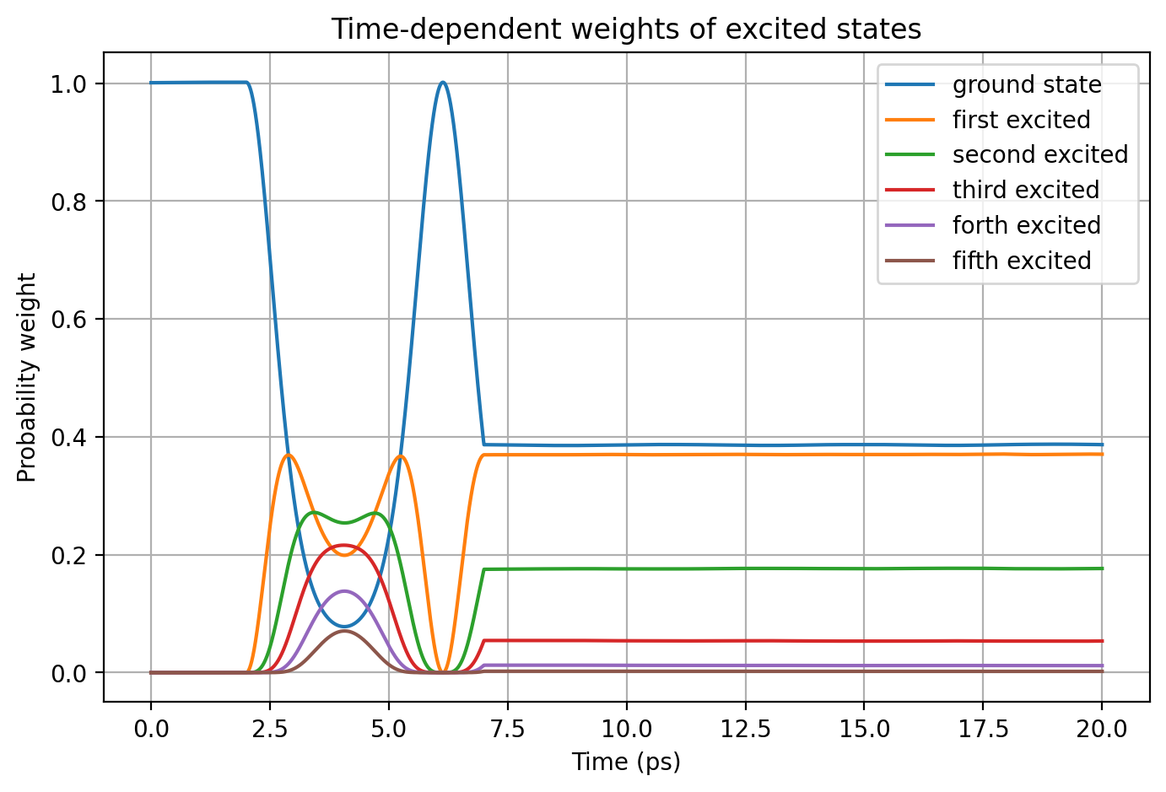
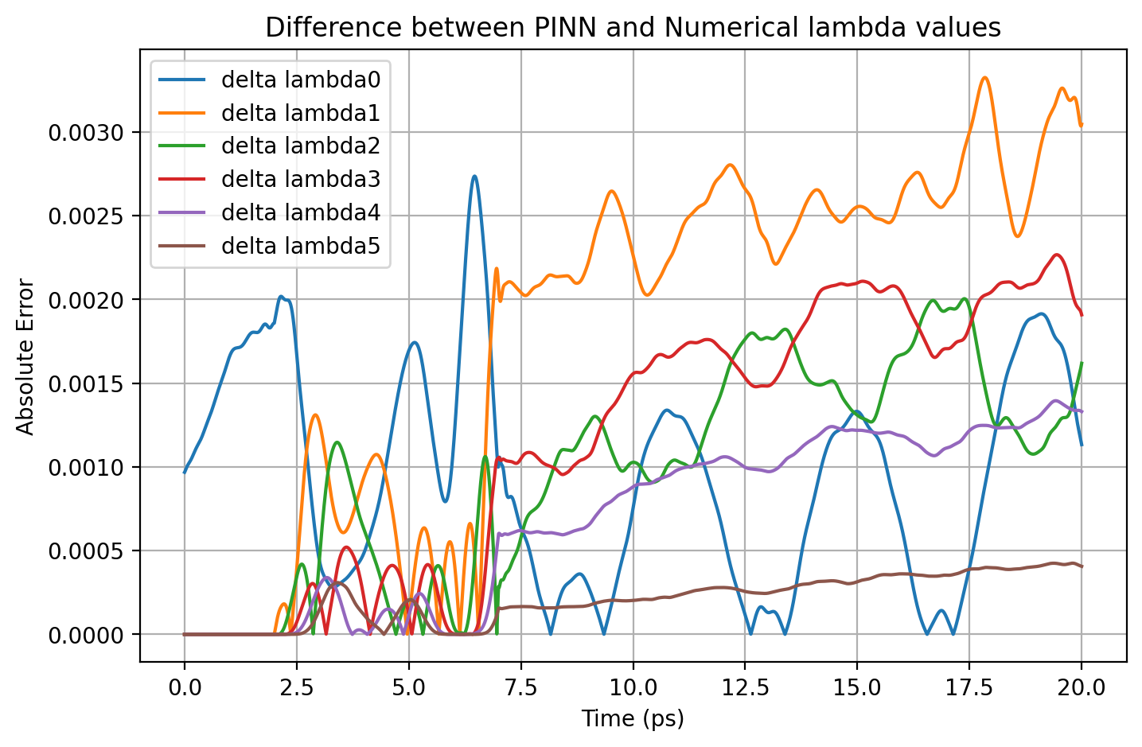


Slide 7
Table of ω = 1 / ħ → t0 = 4
Weight | ΔΨ² - max | norm - mean | norm - std | Δλi - max
2 x t0 = 8 → nseg = 2 | 0.03399 | 0.94426 | 0.04337 | 0.11030
t0 = 4 → nseg = 5 | 0.00500 | 1.00044 | 0.00086 | 0.01460
0.5 x t0 = 2 → nseg = 10 | 0.00149 | 1.00166 | 0.00029 | 0.00618
0.25 x t0 = 1 → nseg = 20 | 0.00099 | 1.00156 | 0.00025 | 0.00333

Slide 8
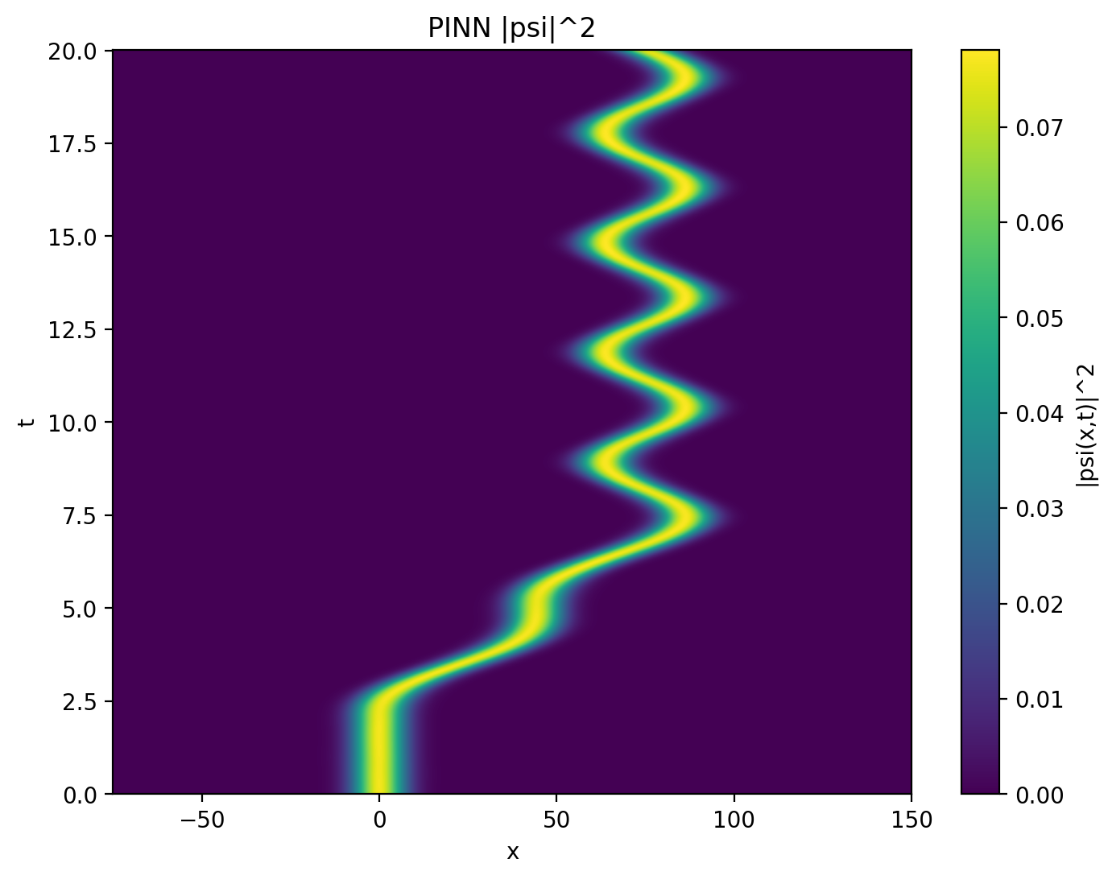
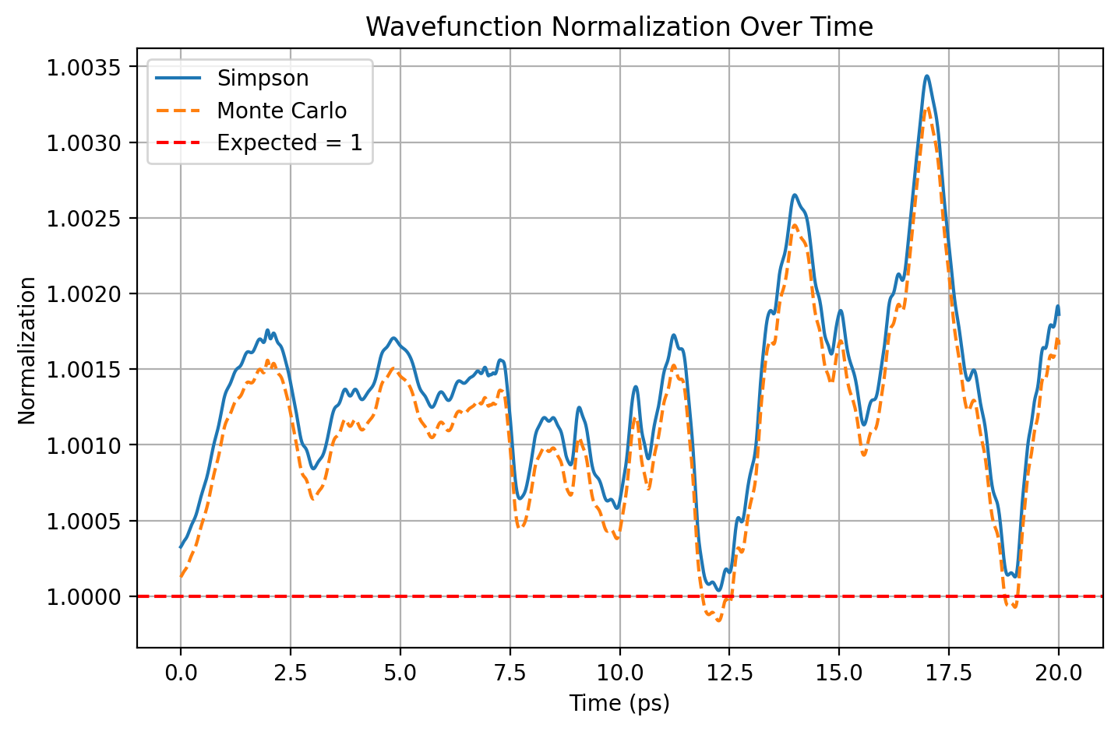

ω = 1.4 / ħ, nseg = 20

Slide 9
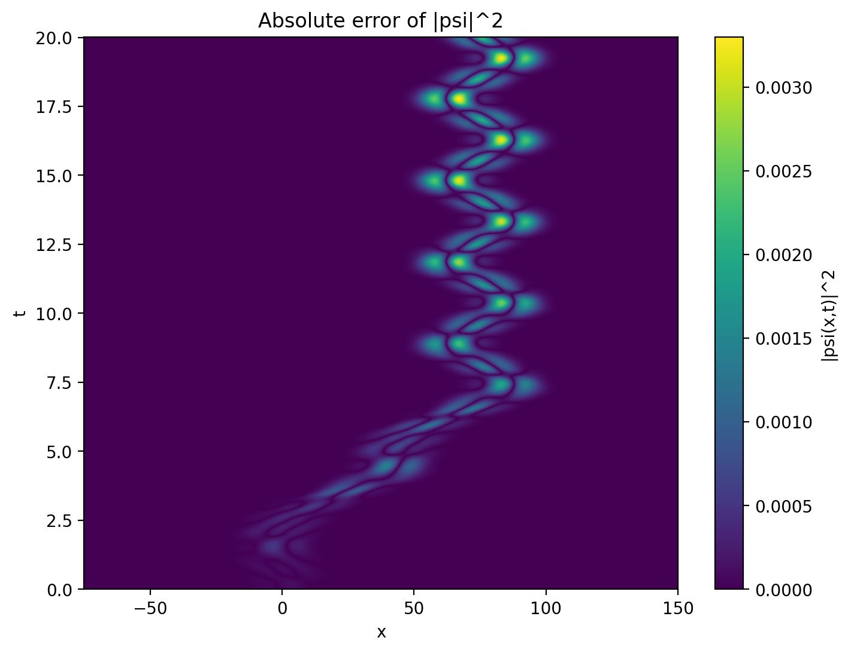
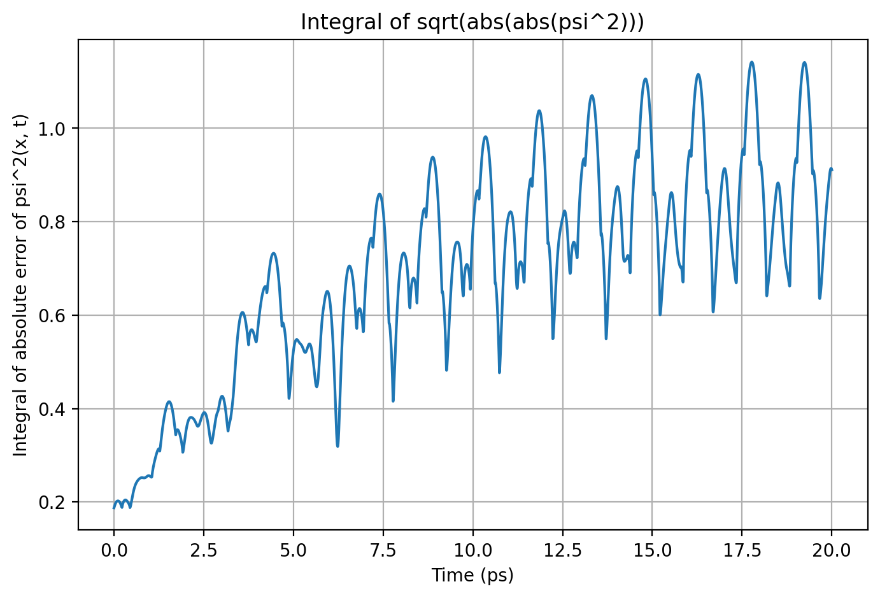


Slide 10
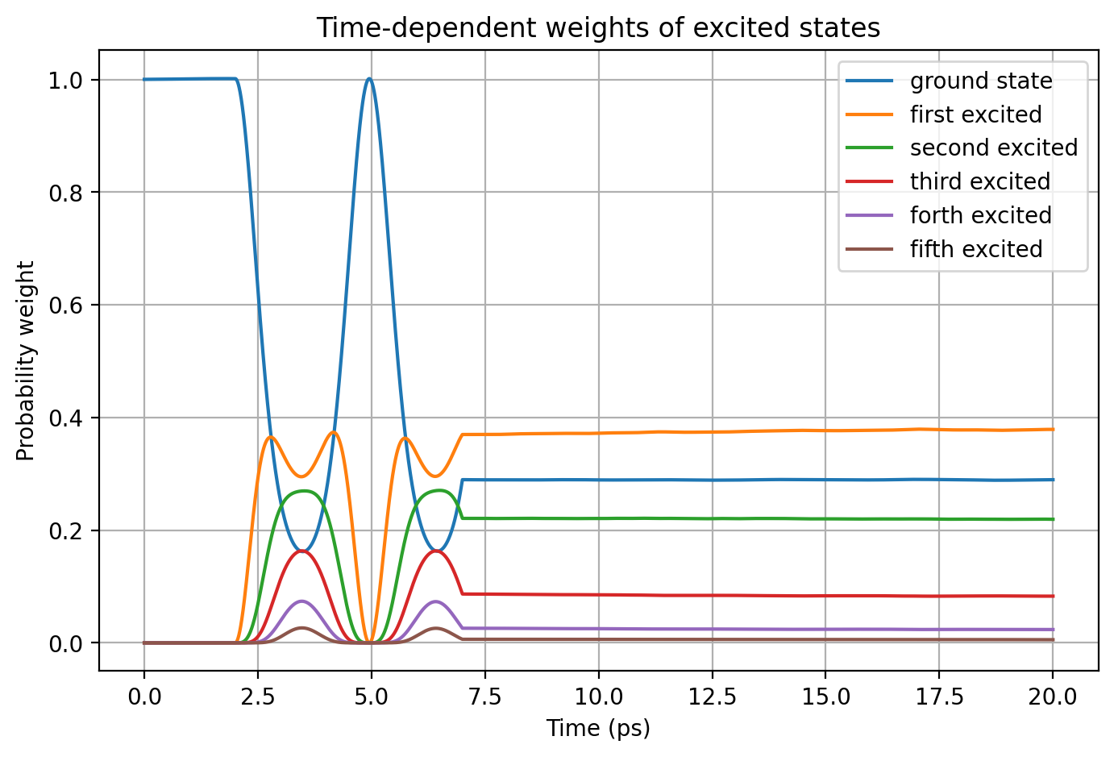
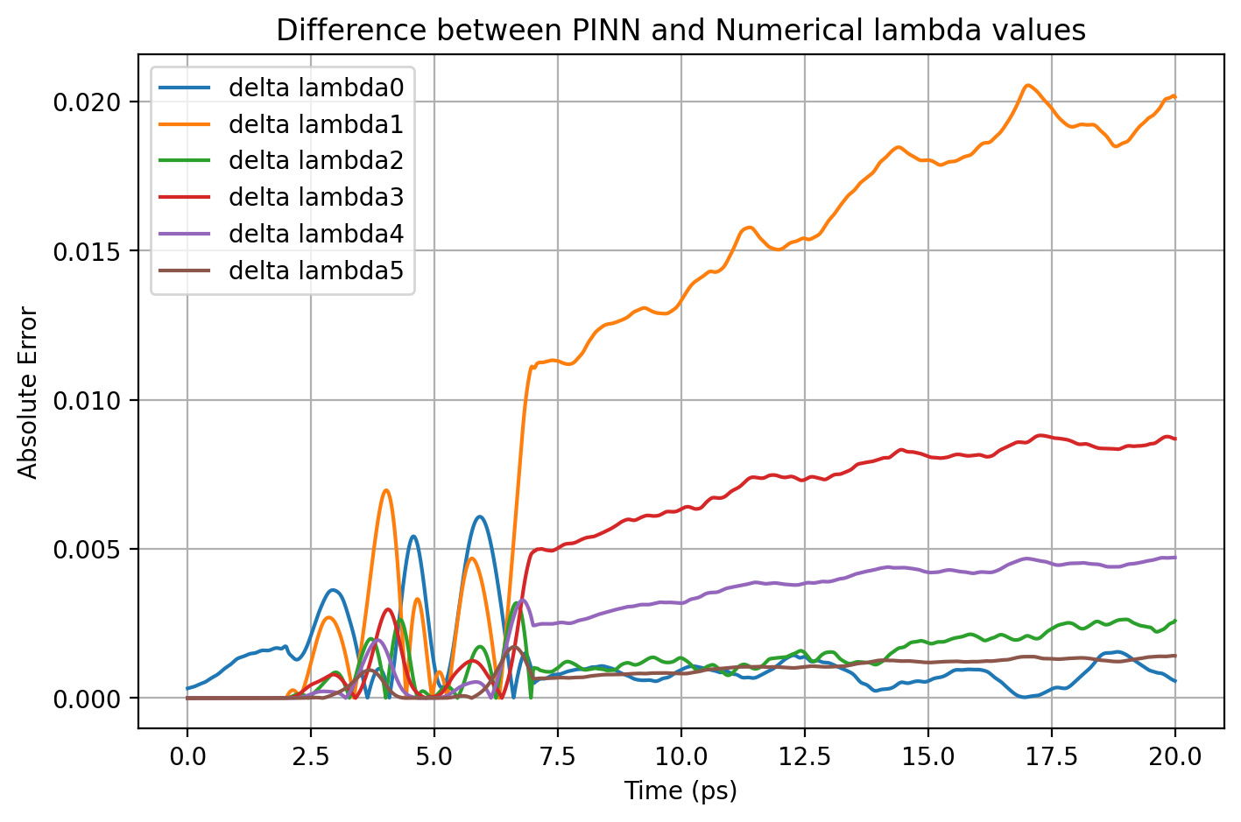


Slide 11
Table of ω = 1.4 / ħ → t0 = 3
Weight | ΔΨ² - max | norm - mean | norm - std | Δλi - max
2 x t0 = 6 → nseg = 3 | 0.00407 | 1.00119 | 0.00076 | 0.02108
t0 = 3 → nseg = 7 | 0.00625 | 1.00088 | 0.00141 | 0.01580
0.5 x t0 = 1.5 → nseg = 13 | 0.00391 | 1.00083 | 0.00069 | 0.01797
nseg = 20 | 0.00330 | 1.00135 | 0.00064 | 0.02054
0.25 x t0 = 0.75 → nseg = 25 | 0.00549 | 1.00104 | 0.00062 | 0.02250

Slide 12
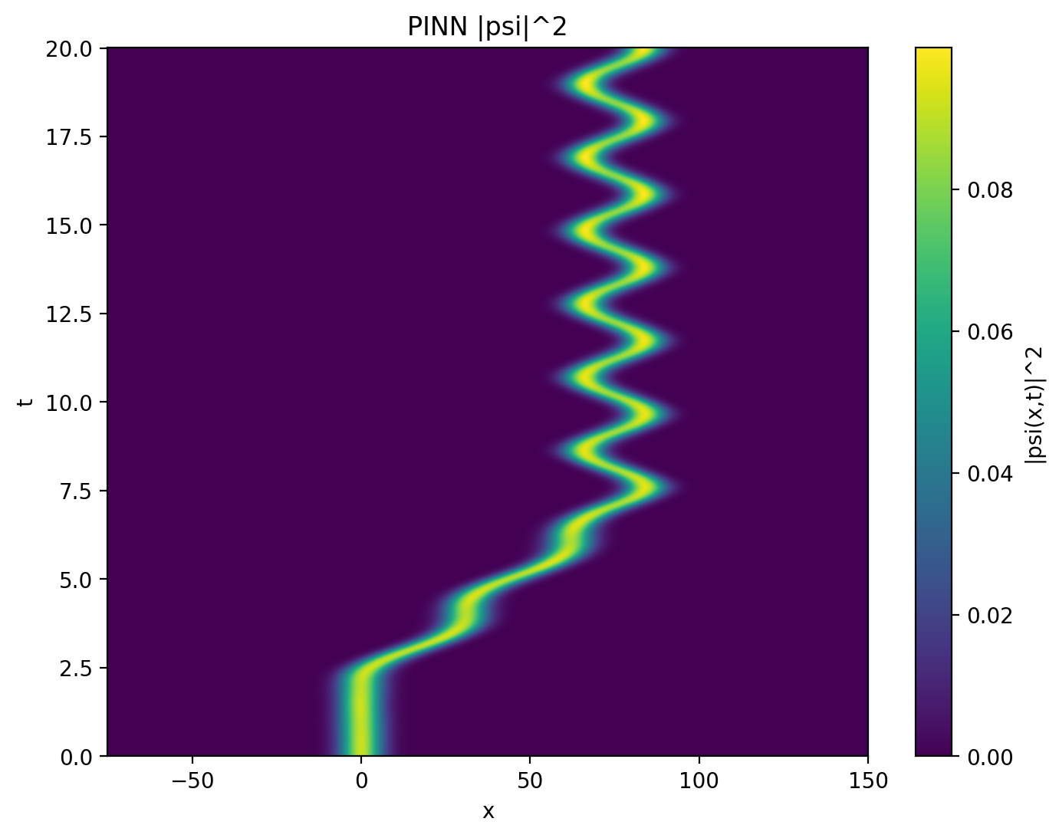
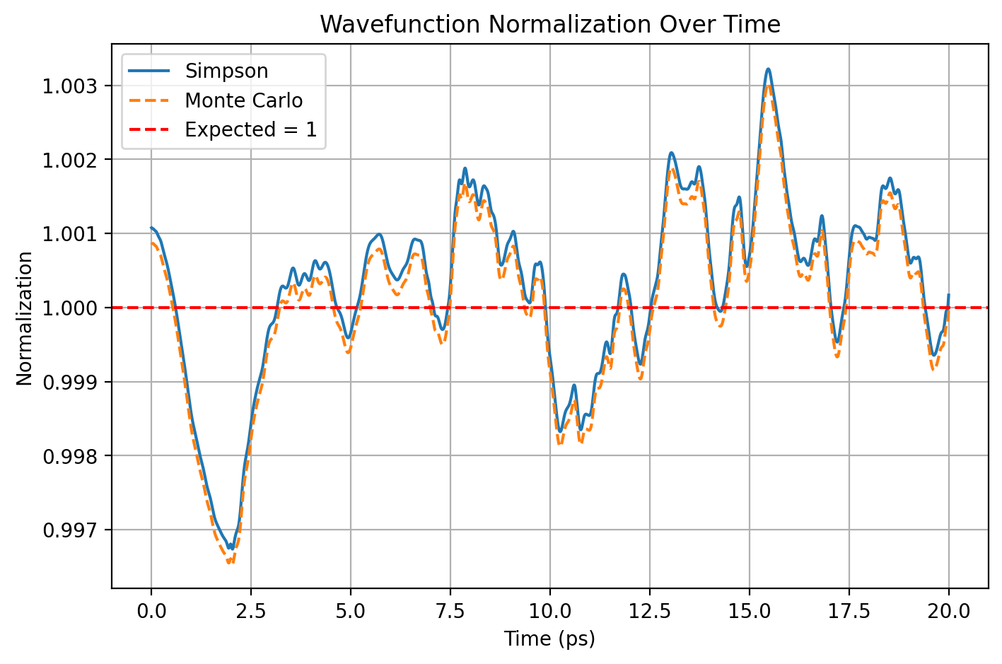

ω = 2 / ħ

Slide 13
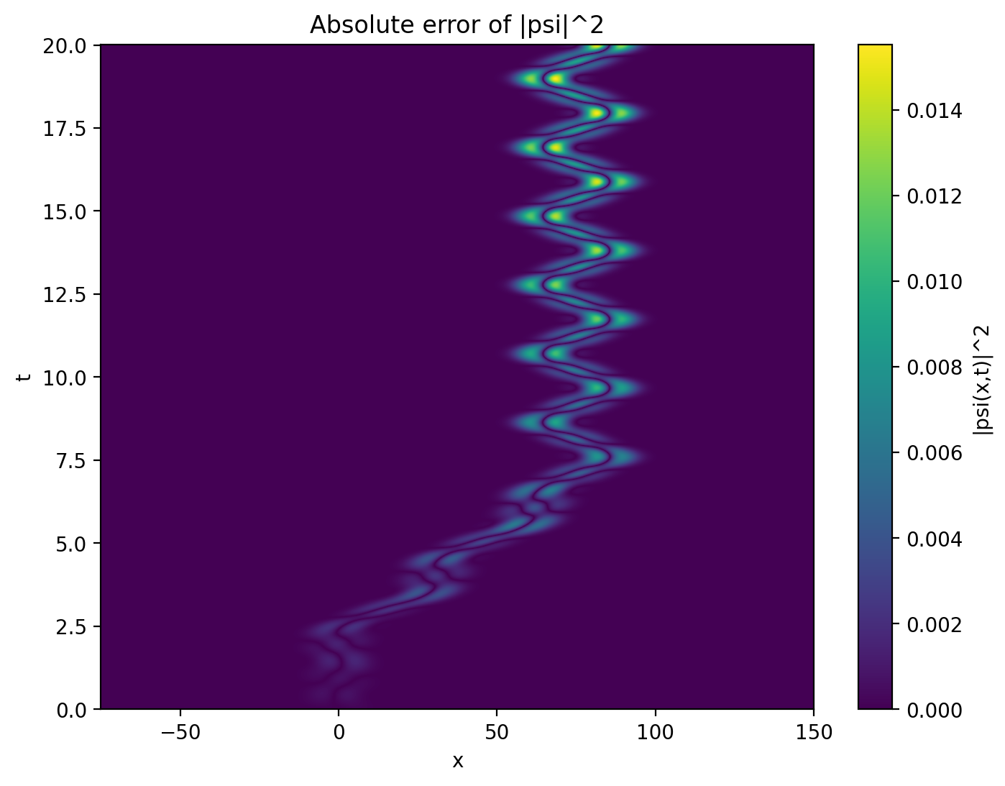
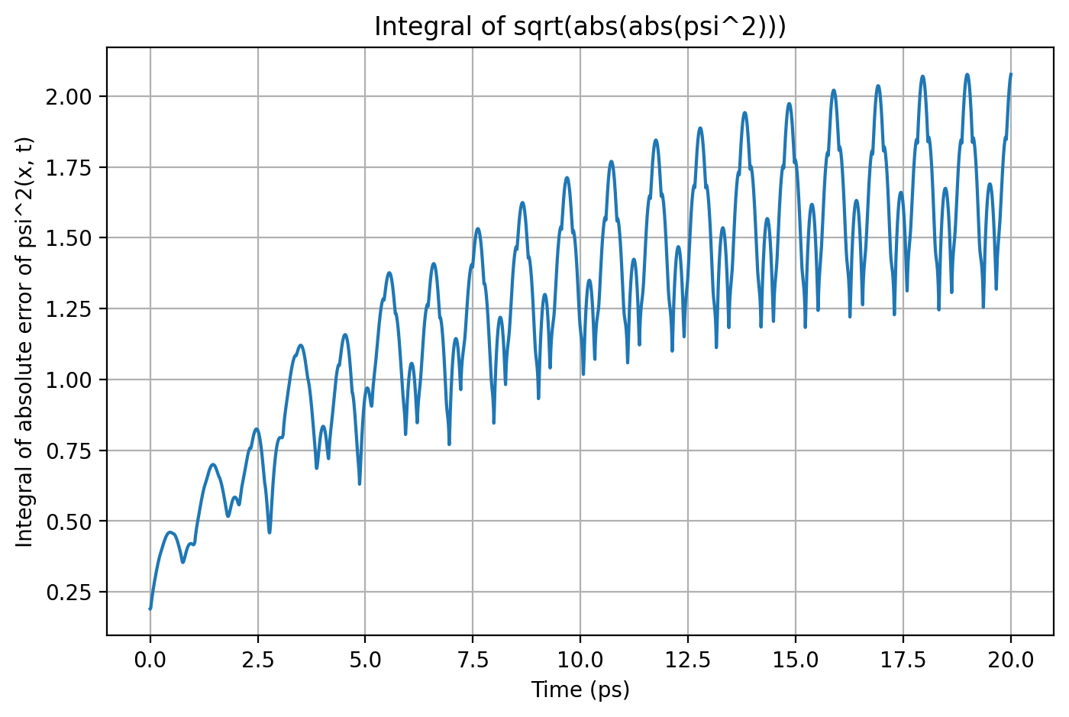


Slide 14
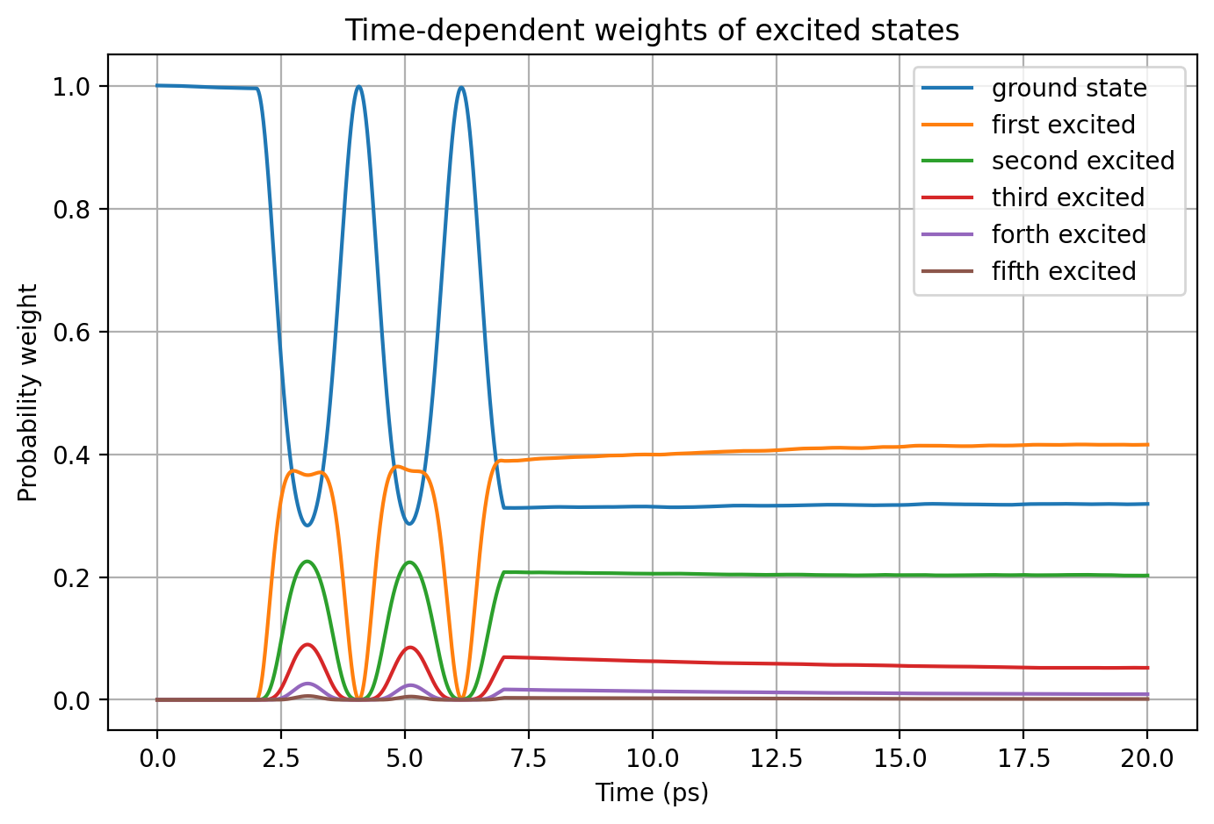
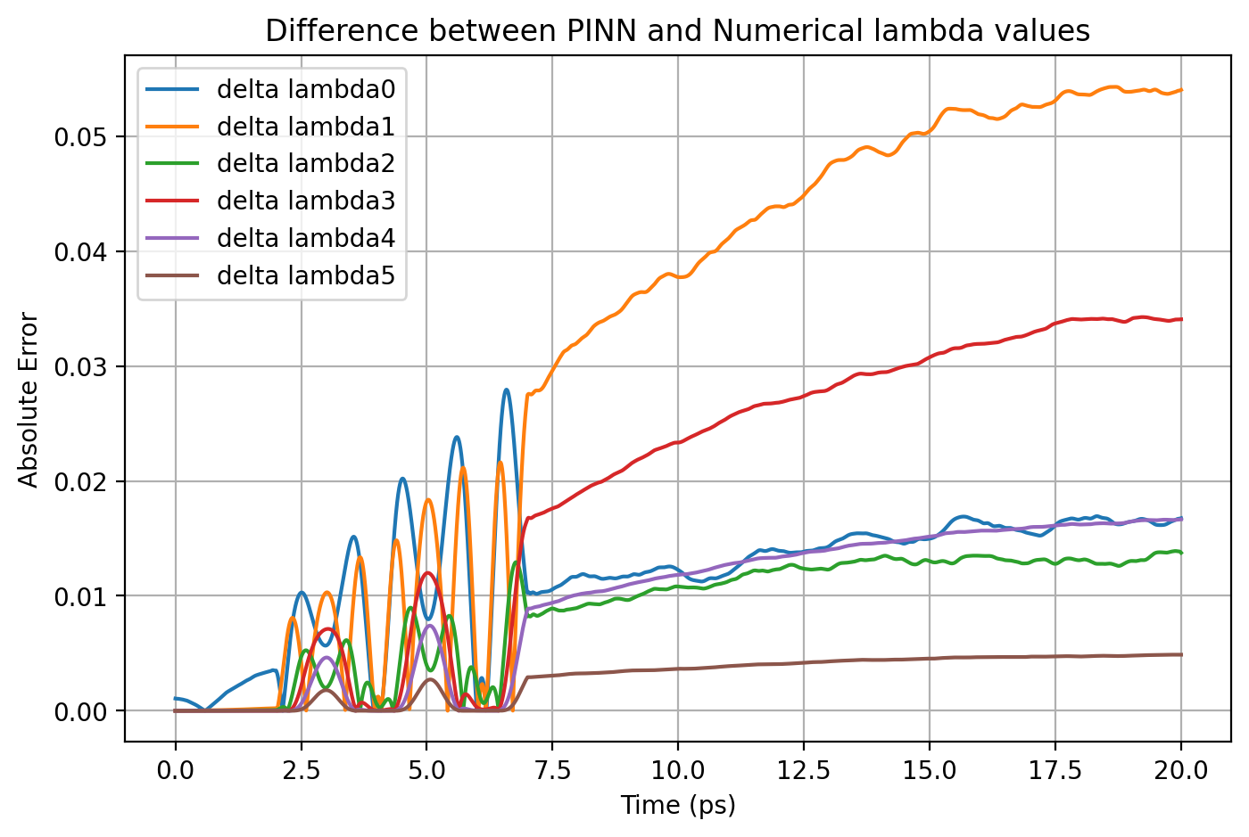


Slide 15
Table of ω = 2 / ħ → t0 = 2
Weight | ΔΨ² - max | norm - mean | norm - std | Δλi - max
2 x t0 = 4 → nseg = 5 | 0.01552 | 1.00028 | 0.00122 | 0.05429
t0 = 2 → nseg = 10 | 0.02014 | 1.00078 | 0.00118 | 0.07044
0.5 x t0 = 1 → nseg = 20 | 0.01908 | 1.00050 | 0.00119 | 0.06592
0.25 x t0 = 0.5 → nseg = 40 | 0.02068 | 1.00053 | 0.00080 | 0.08134

Slide 16
Model Trained up to 12.5 ps
I trained some models up to 12.5 ps instead of 20 ps and compare how much the error is increasing
I trained and compared:
  Vanilla Model
  Causal Model
  Norm Model

Slide 17
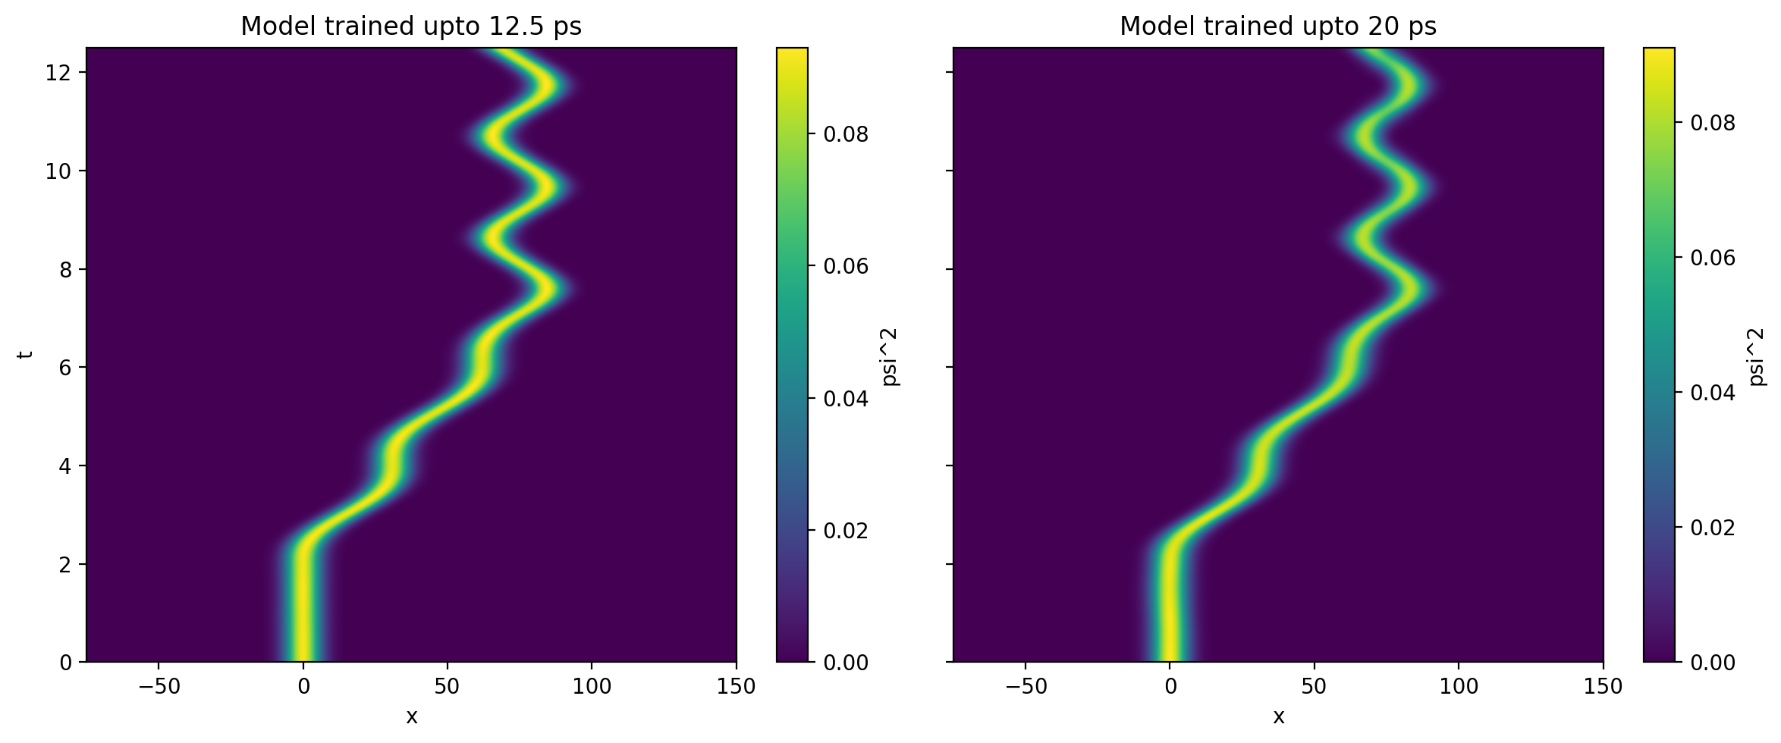
Vanilla Model

Slide 18
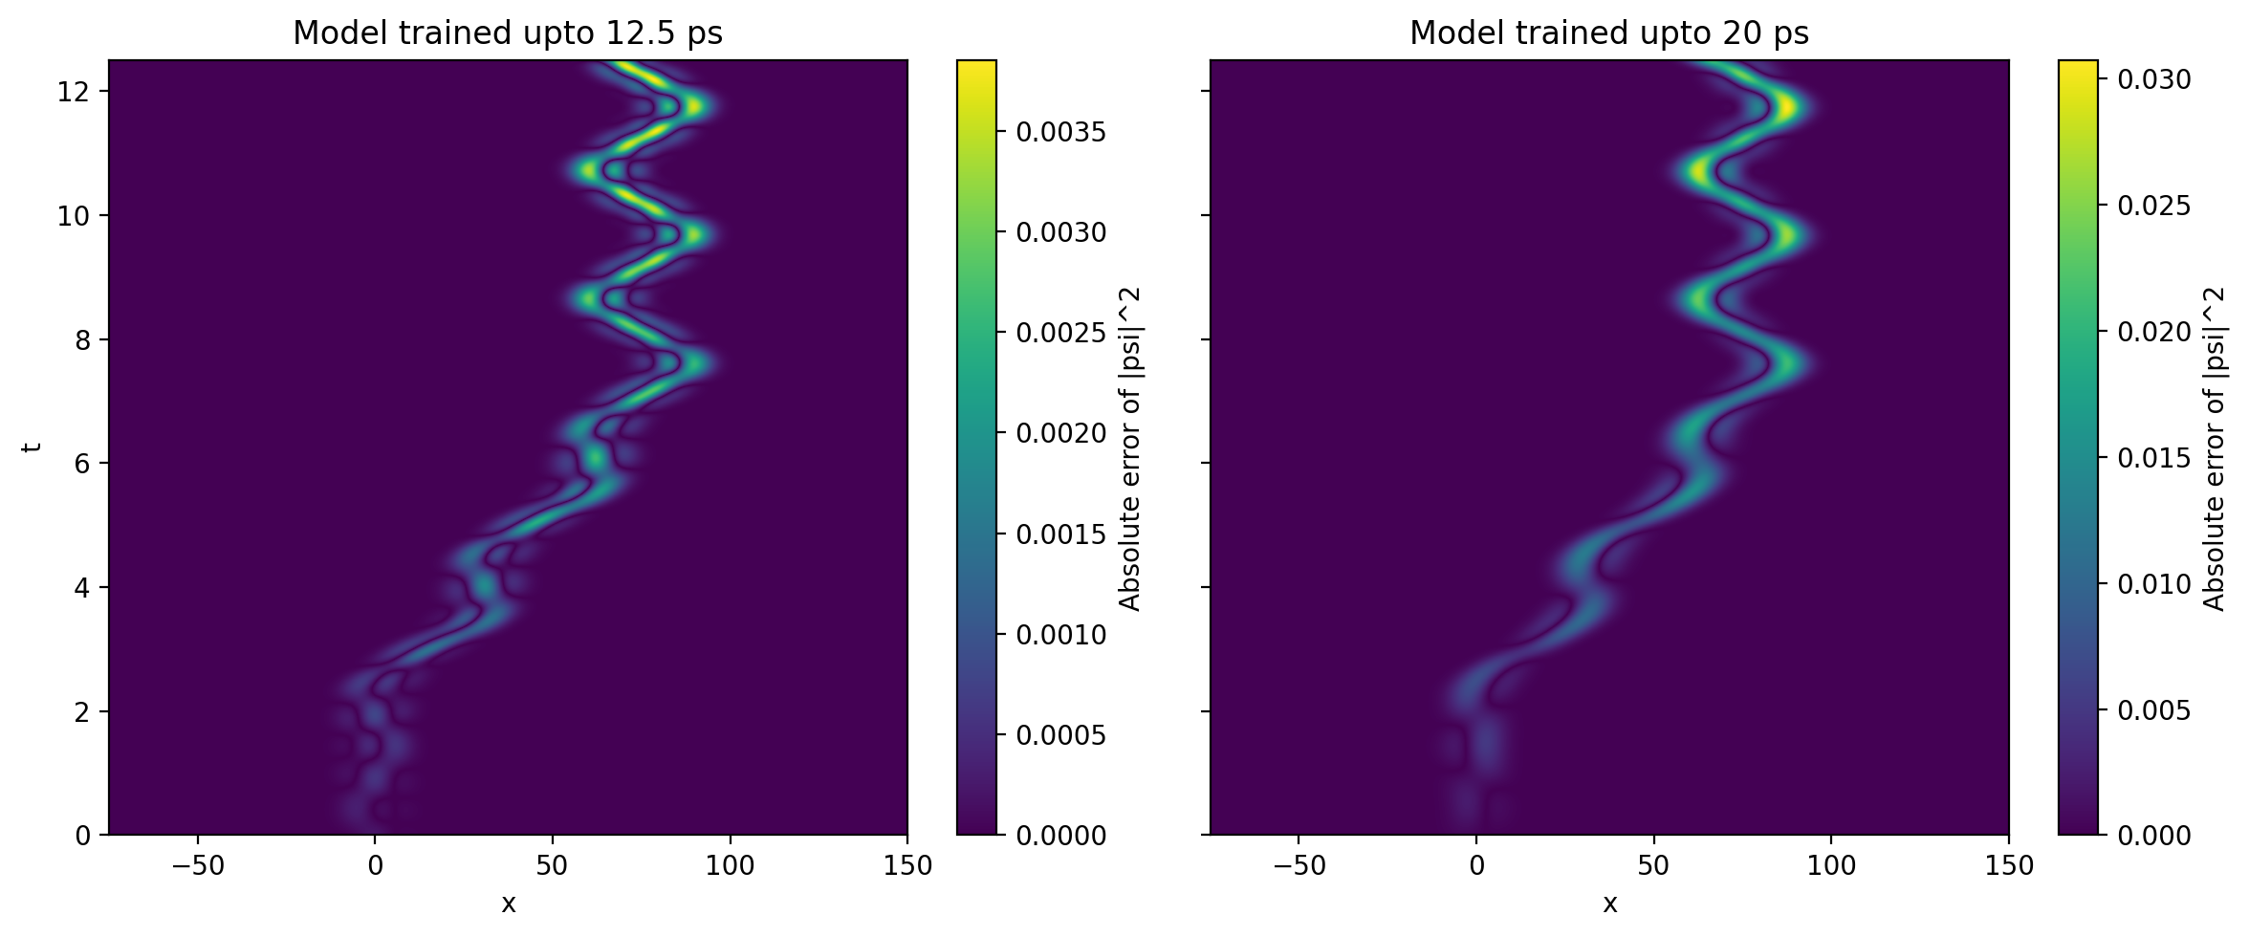



Slide 19
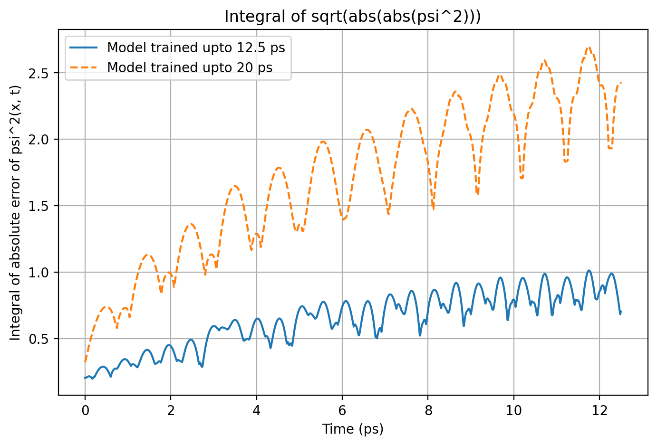

Slide 20
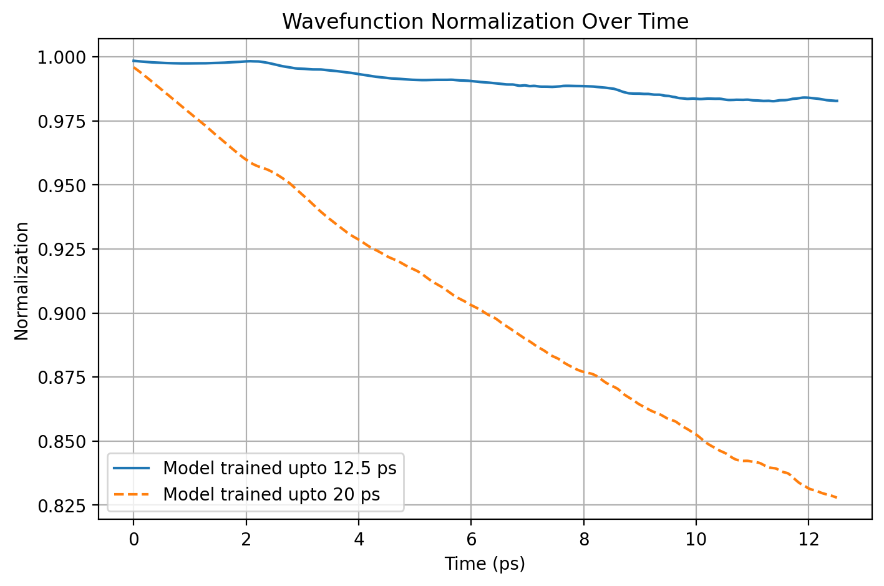



Slide 21
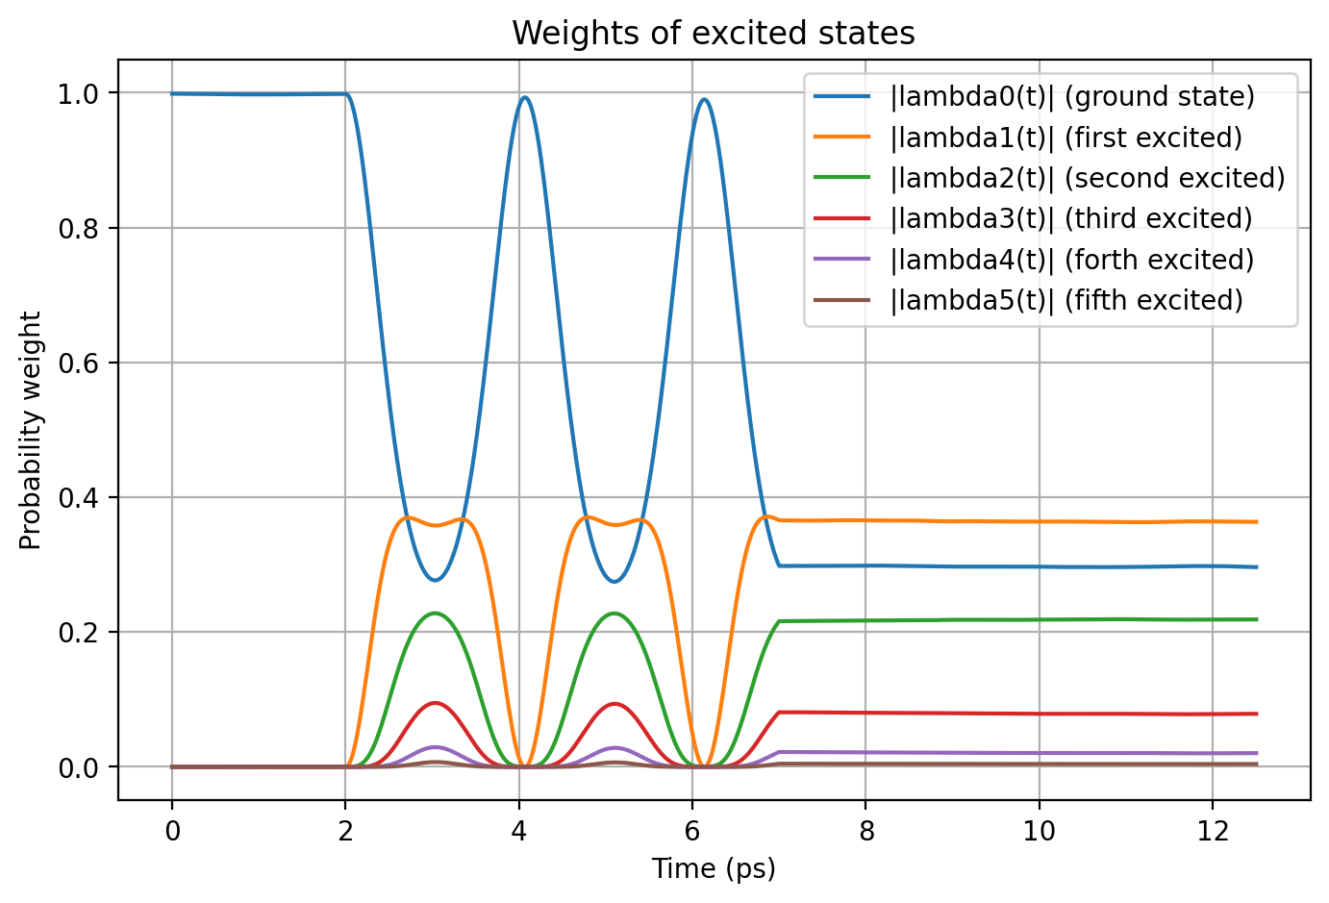
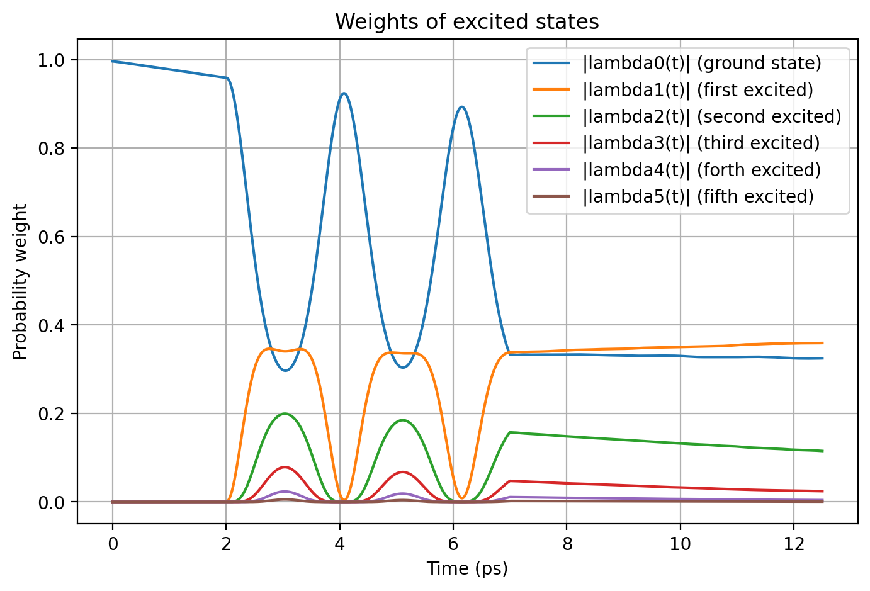

Slide 22
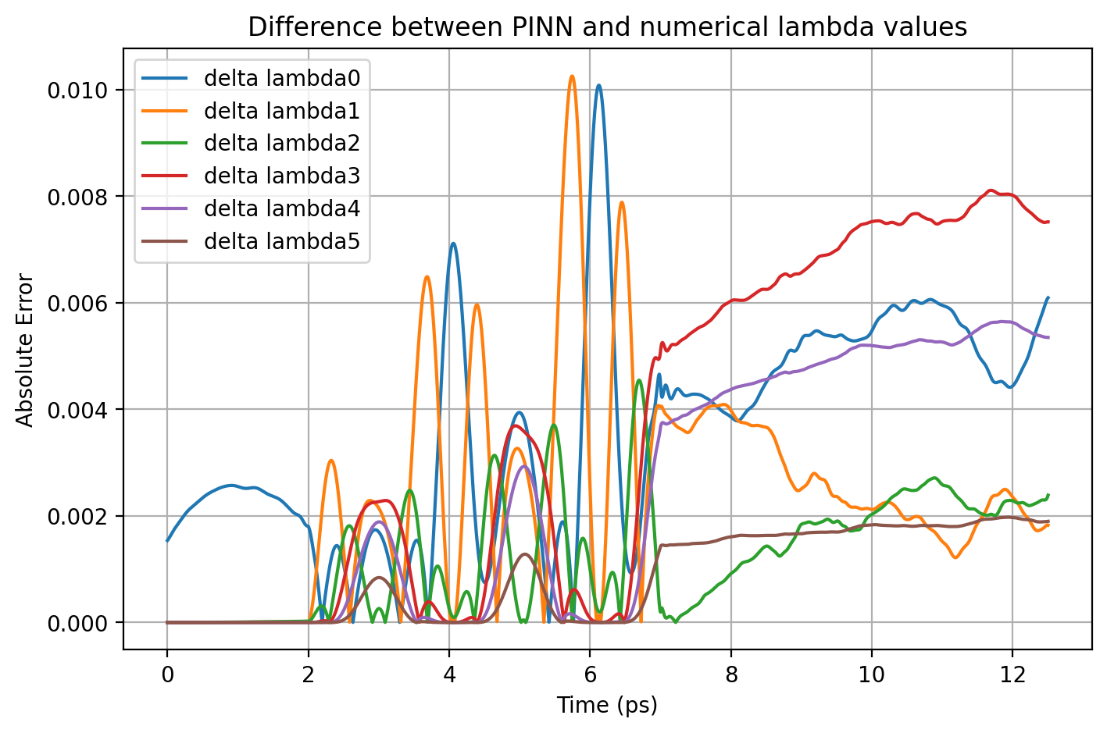
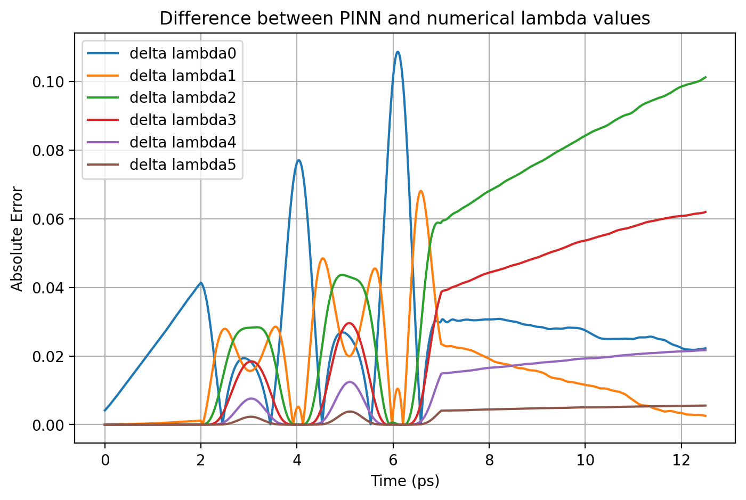

Slide 23
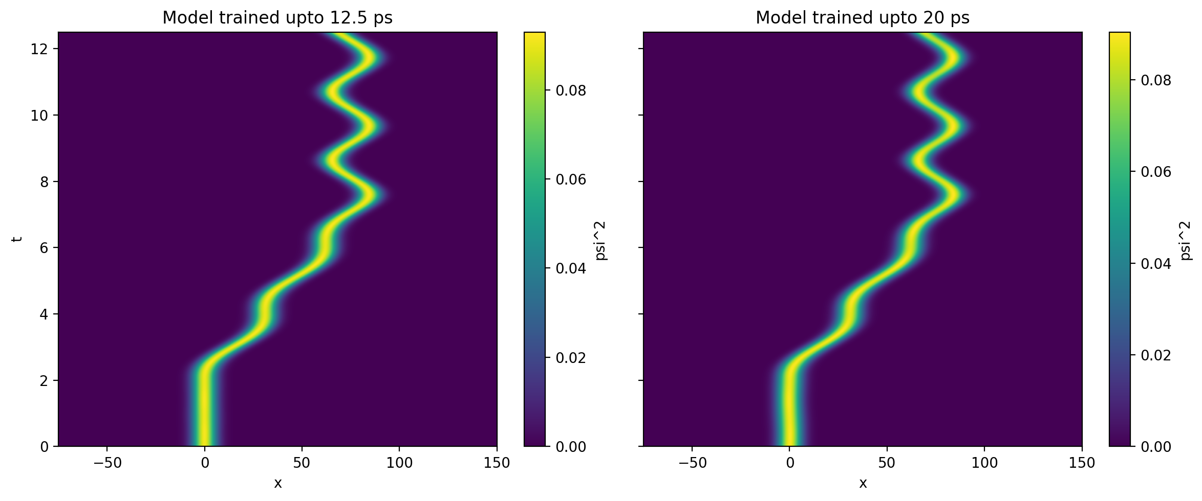
Causal Model

Slide 24
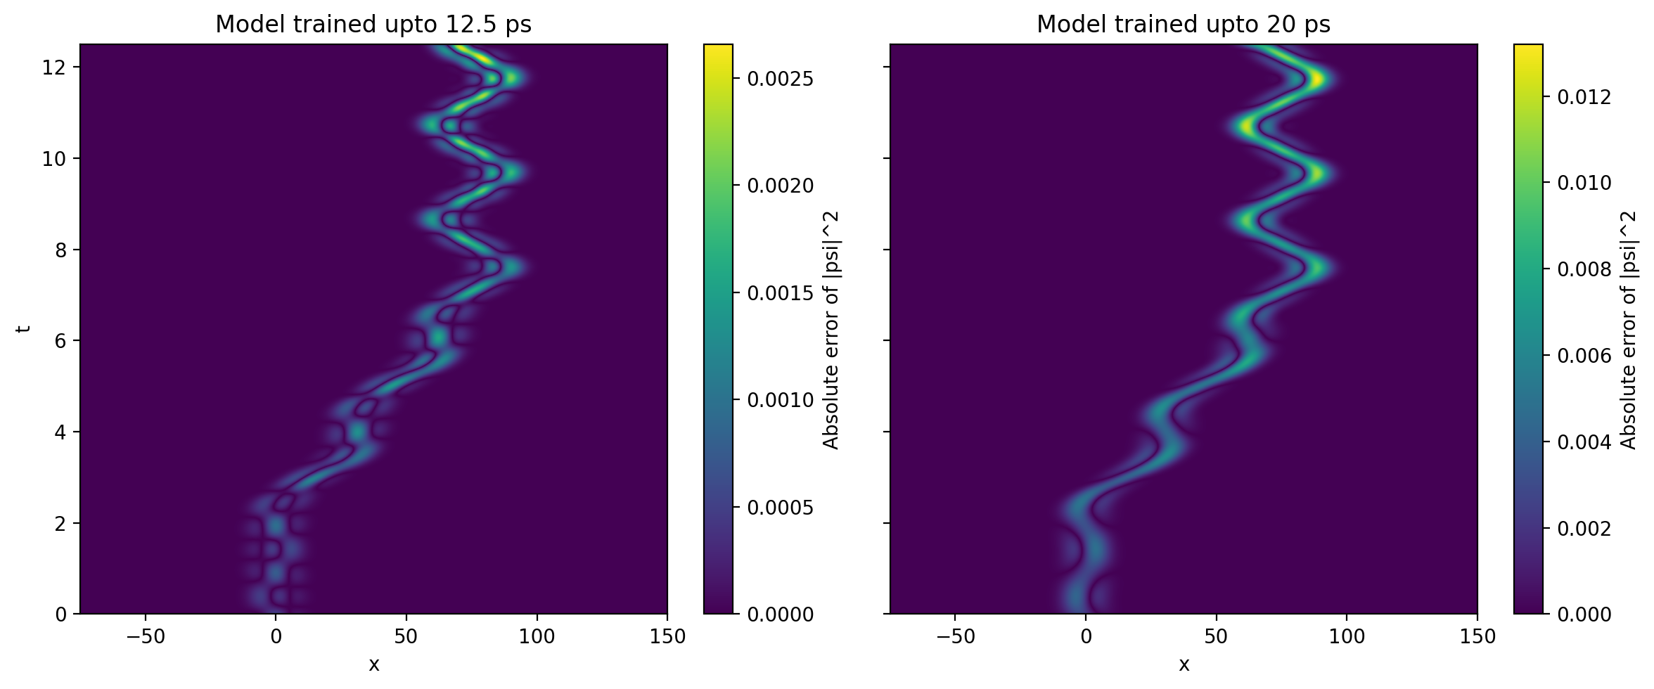



Slide 25
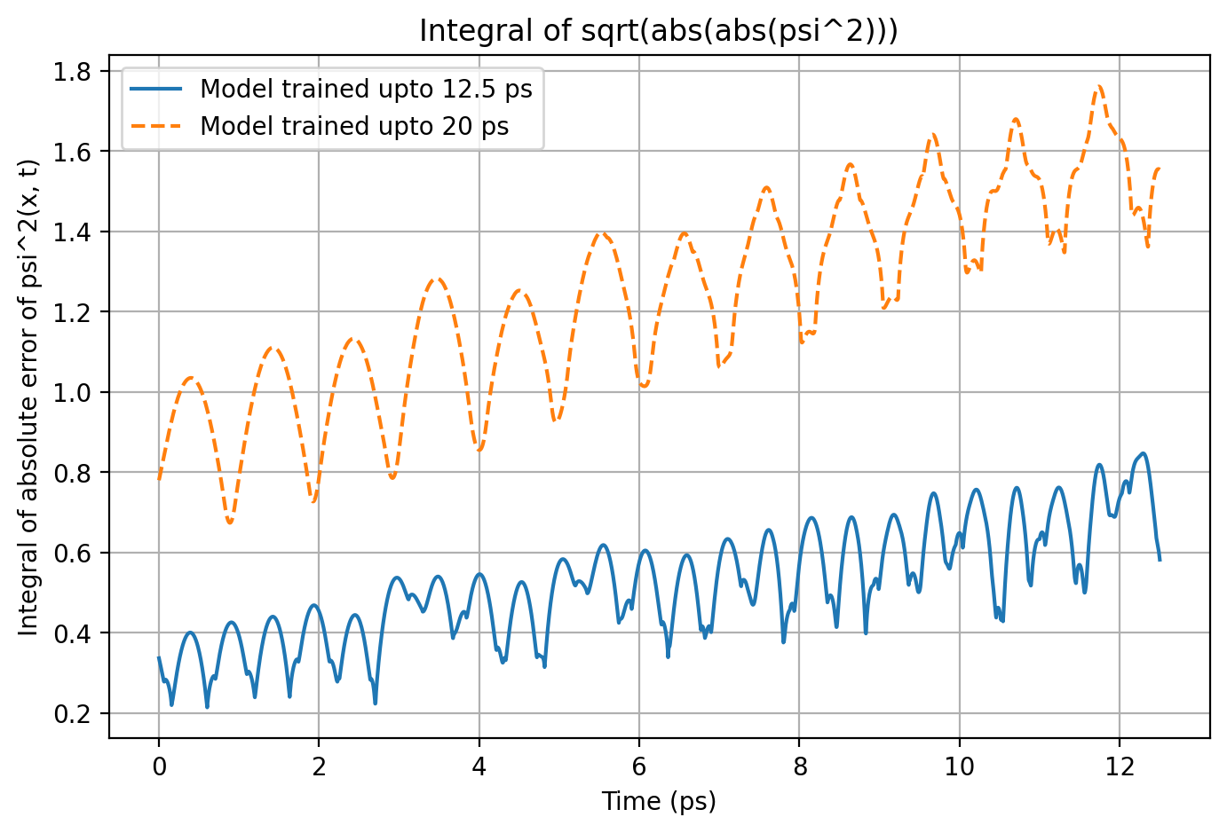

Slide 26
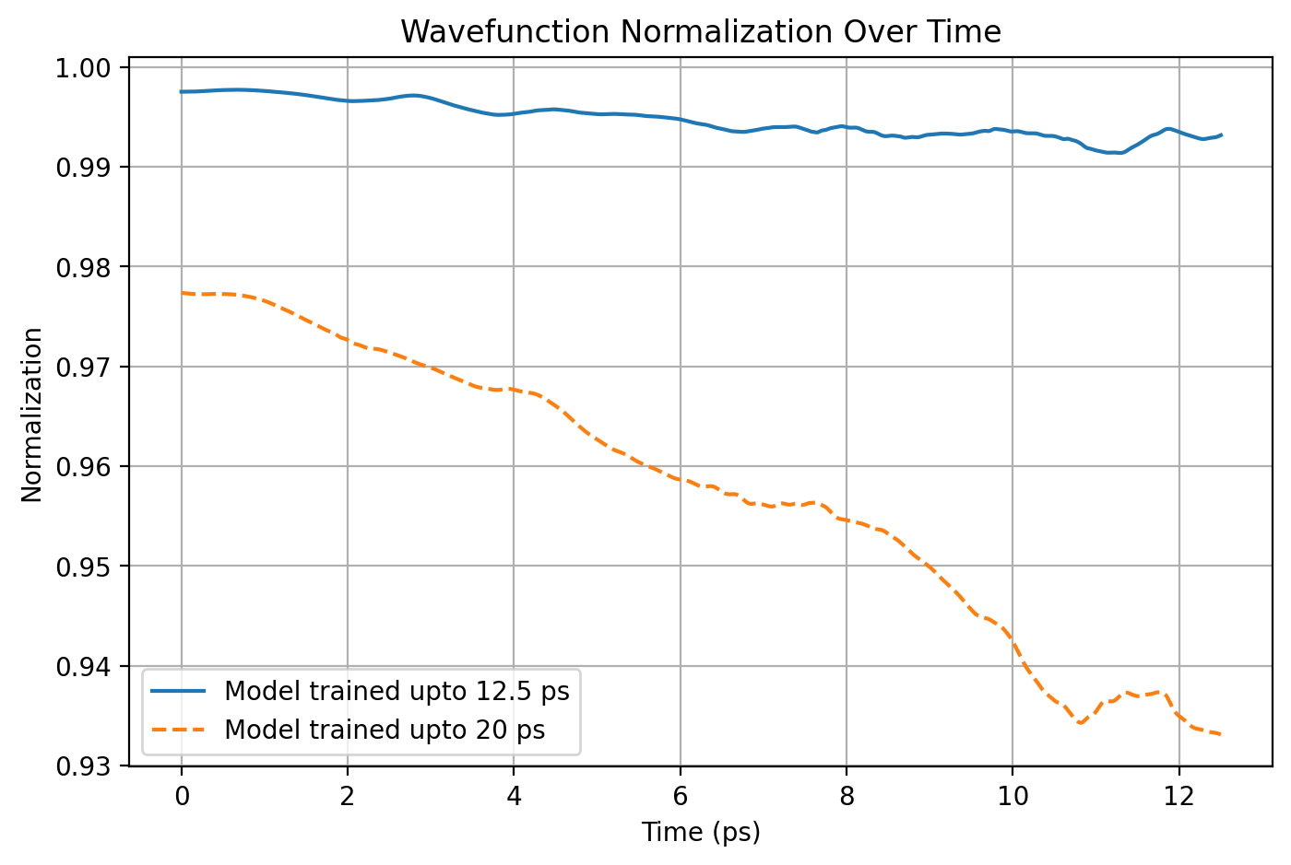



Slide 27



Slide 28
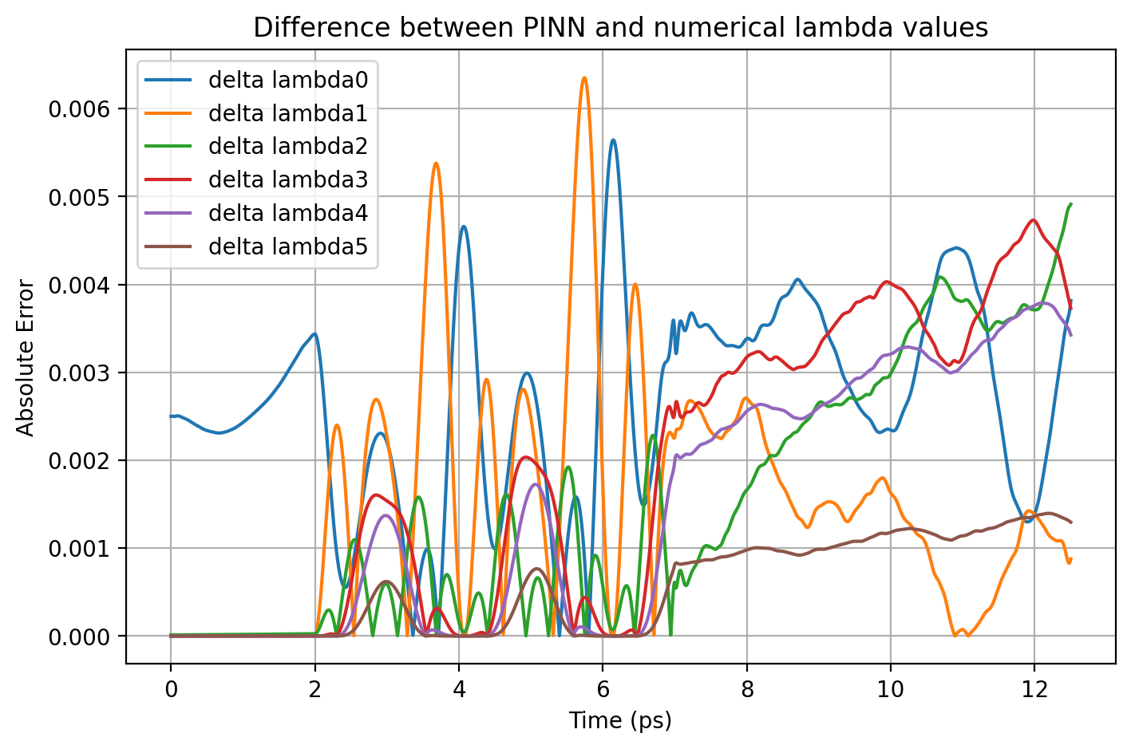
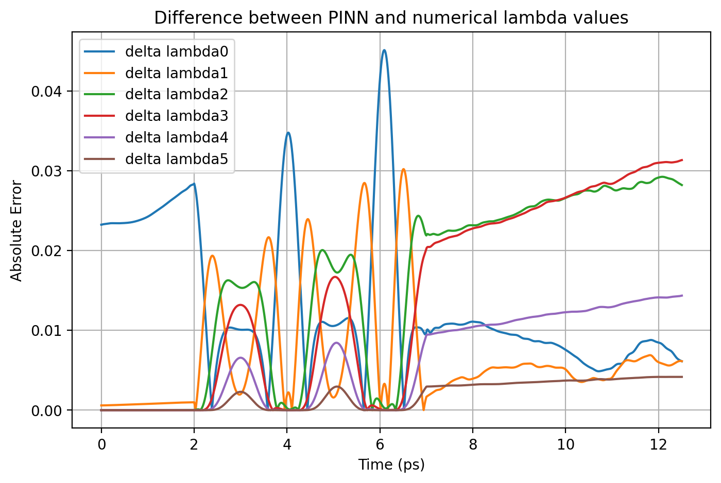

Slide 29

Norm Model

Slide 30
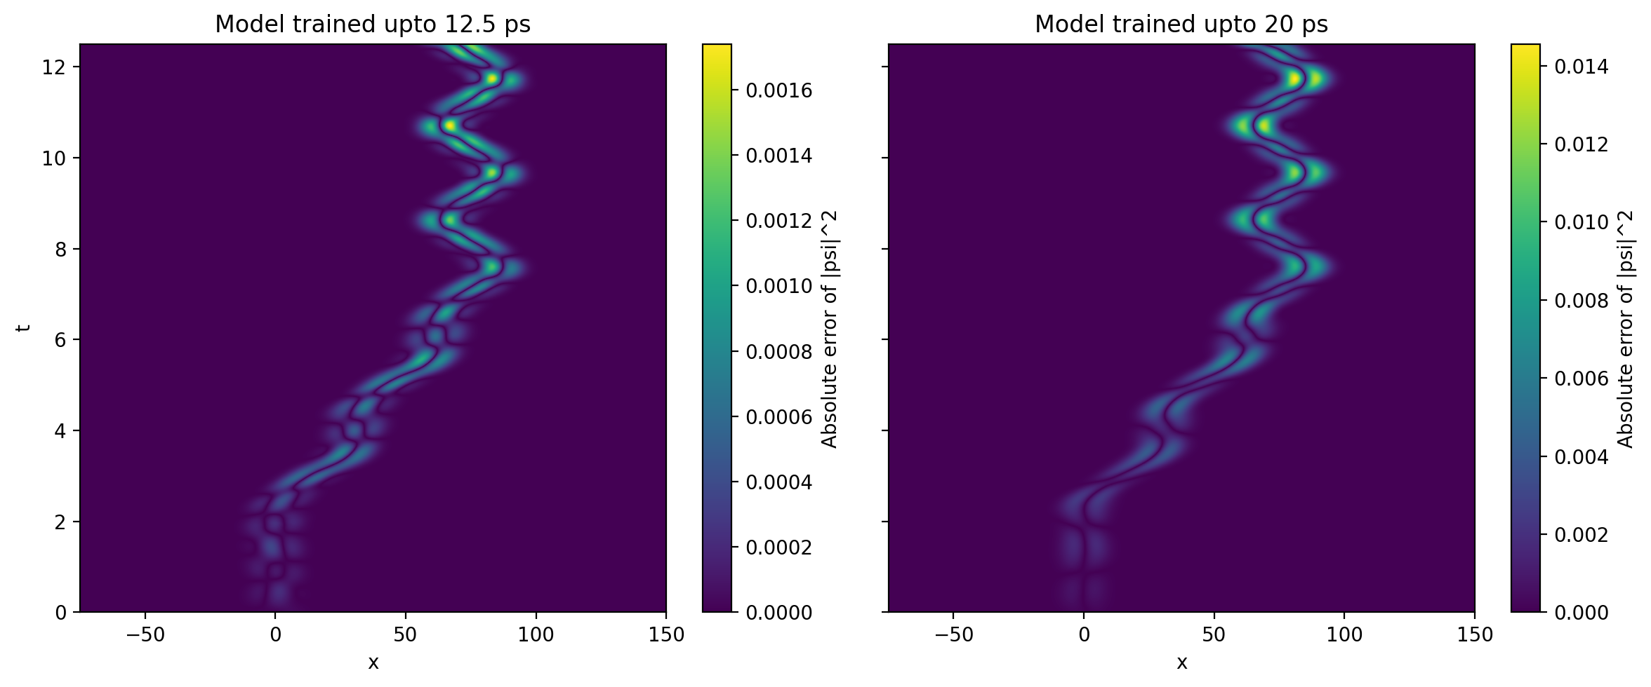



Slide 31
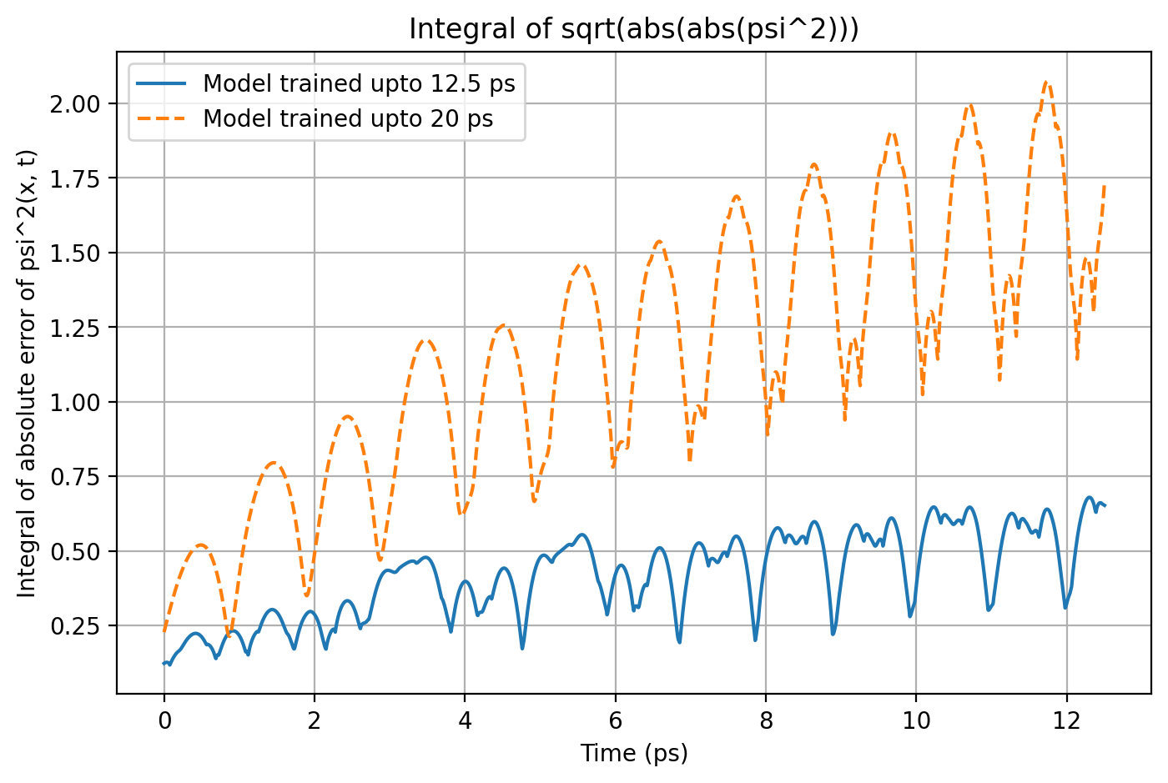

Slide 32
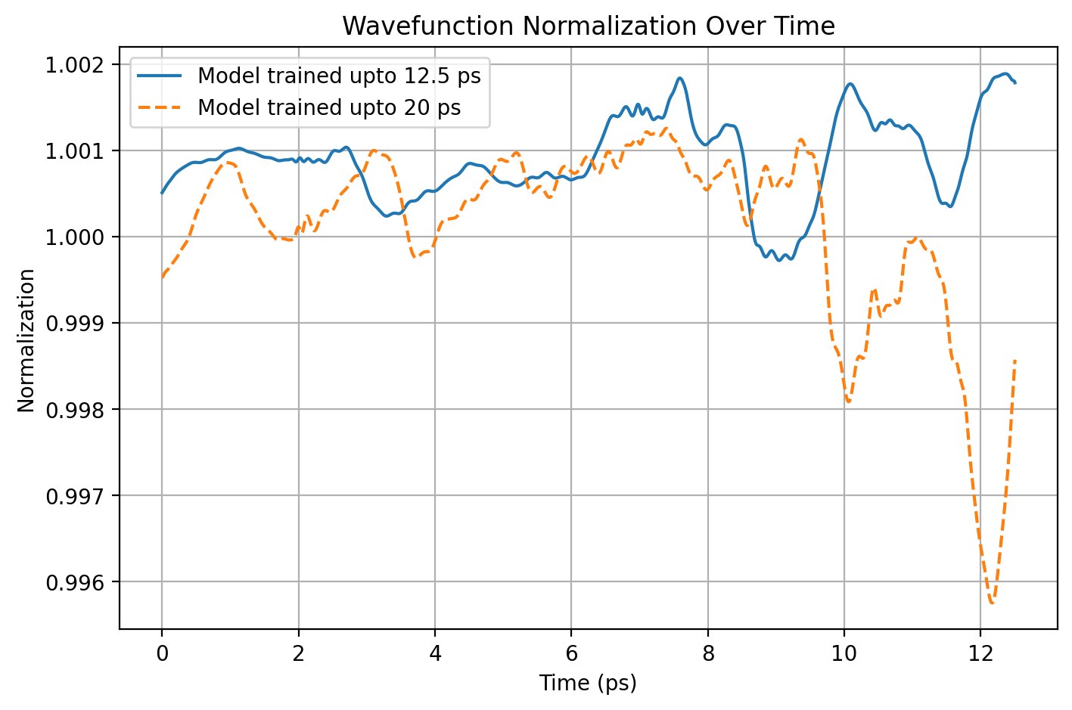



Slide 33



Slide 34
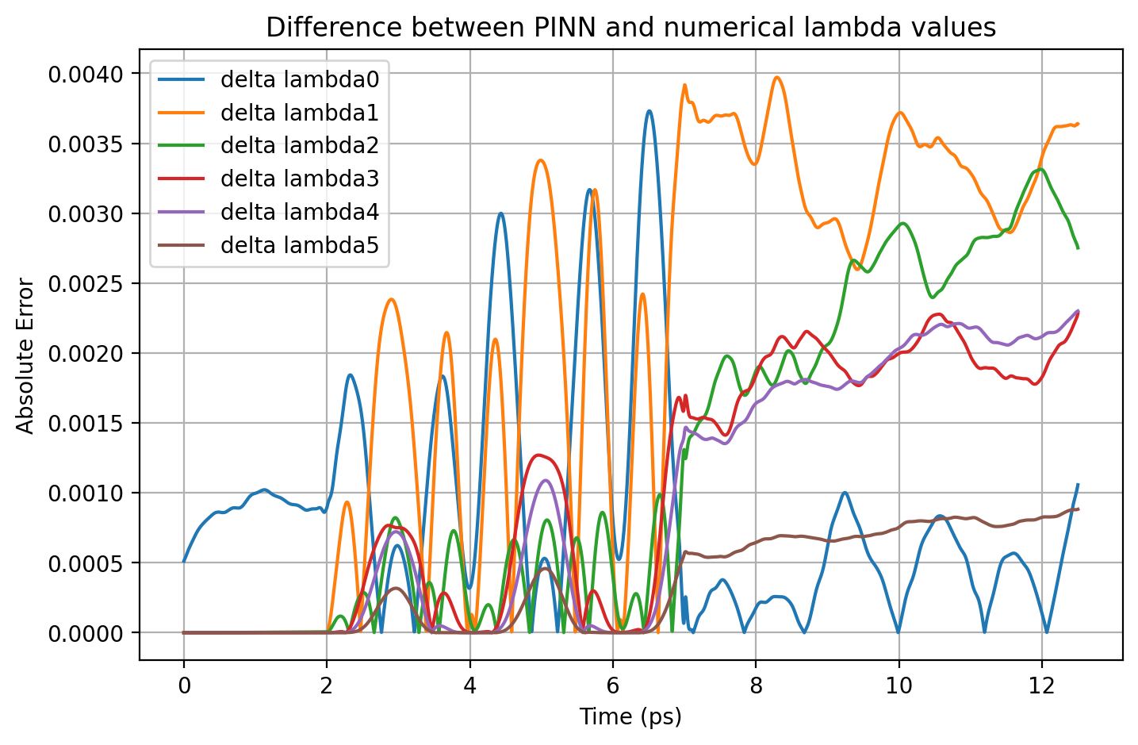
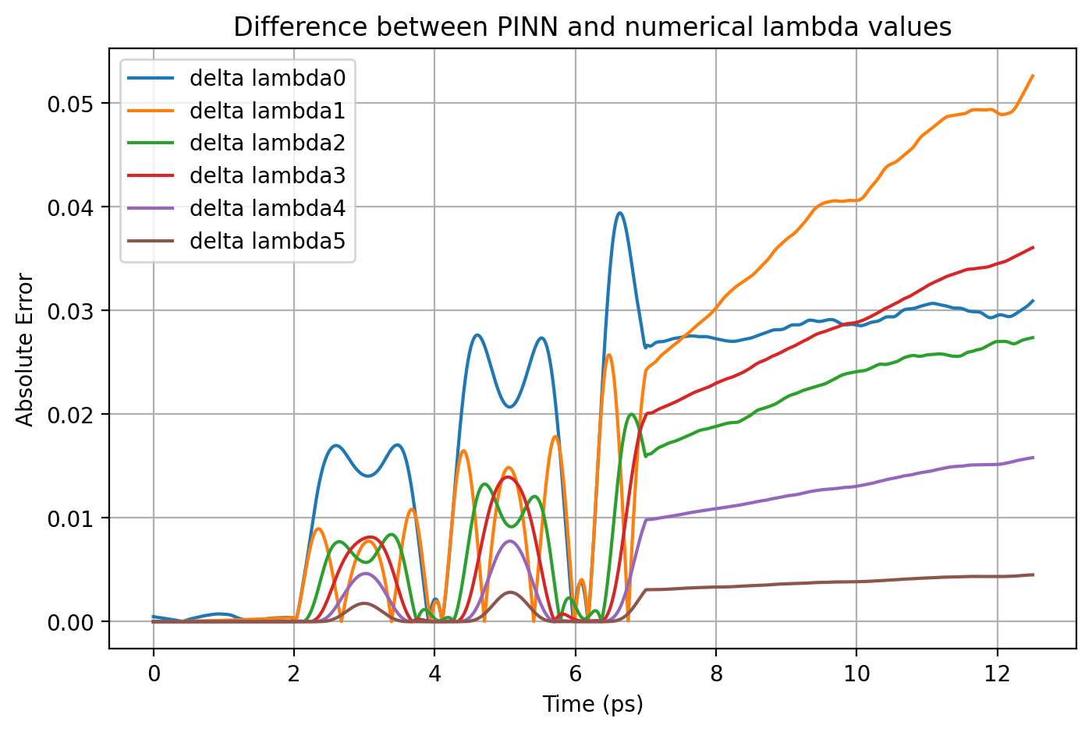

Slide 35
.end

