Slide 1
Meeting - 14/07/2025

Slide 2
Movement Models
I trained some models with time domain from t1 to t2
6 HL and 150K epochs
Runtime ≈ 2 hours

Slide 3
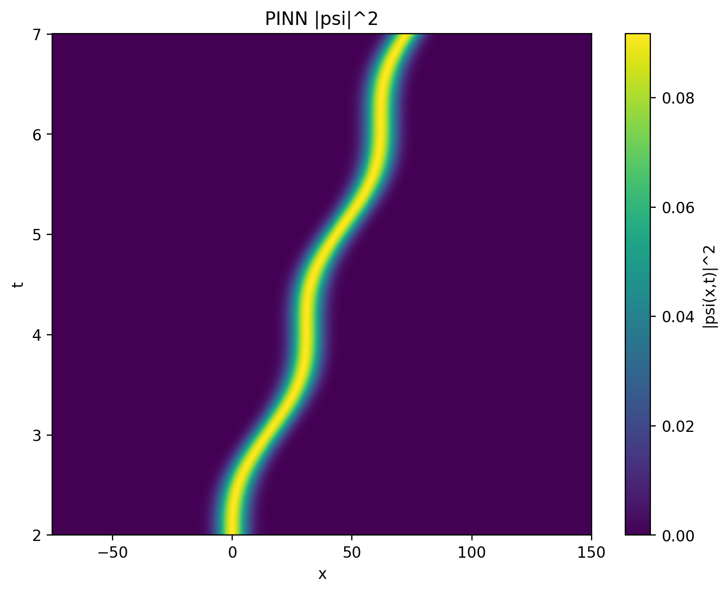
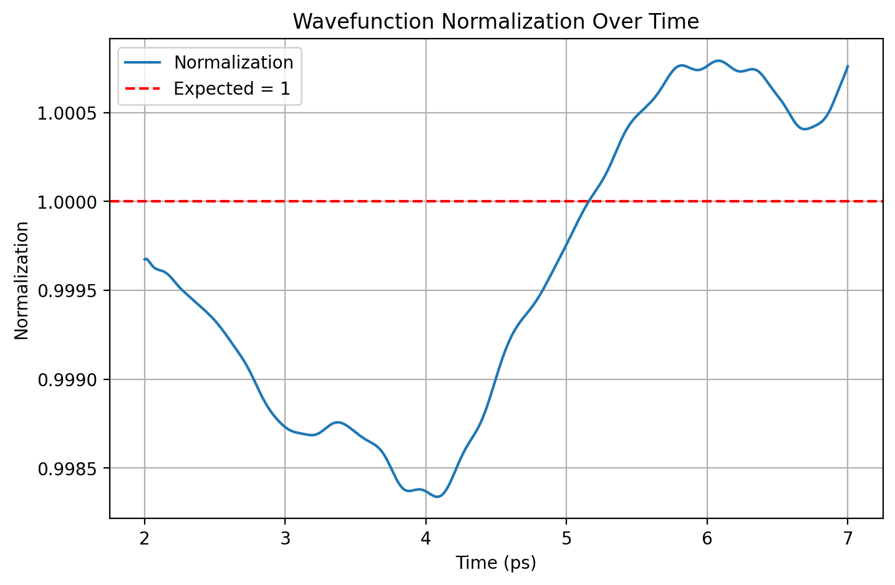

Base Model: ω = 2 / ħ

Slide 4
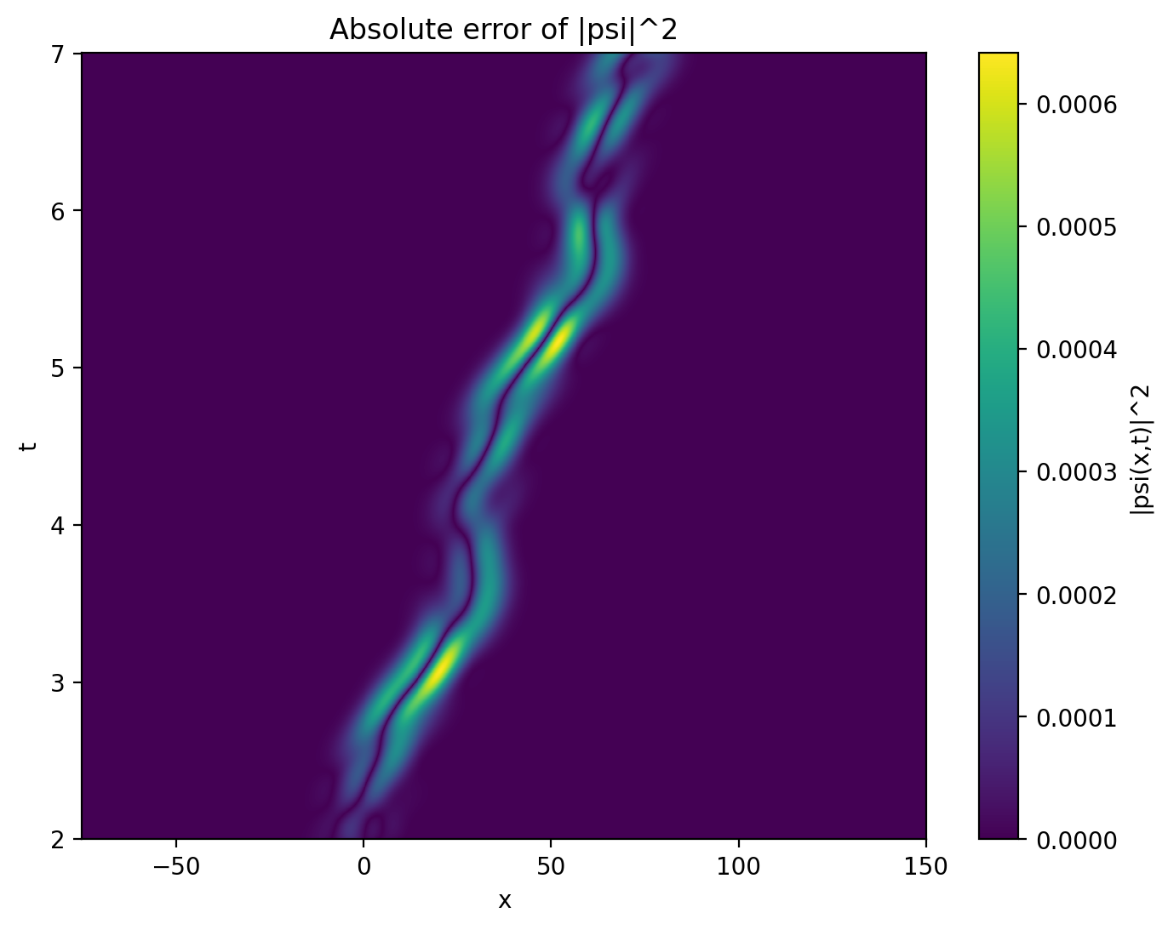
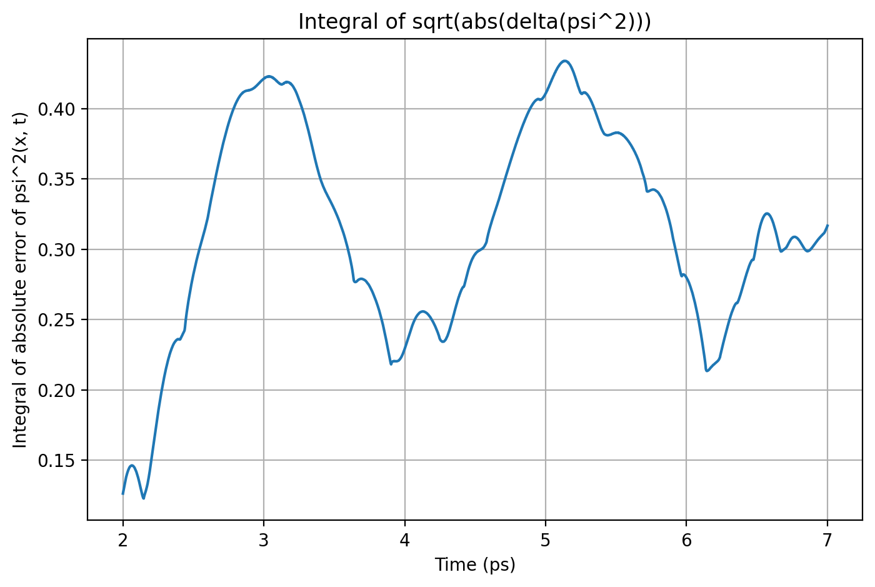
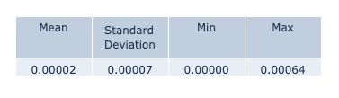

Slide 5
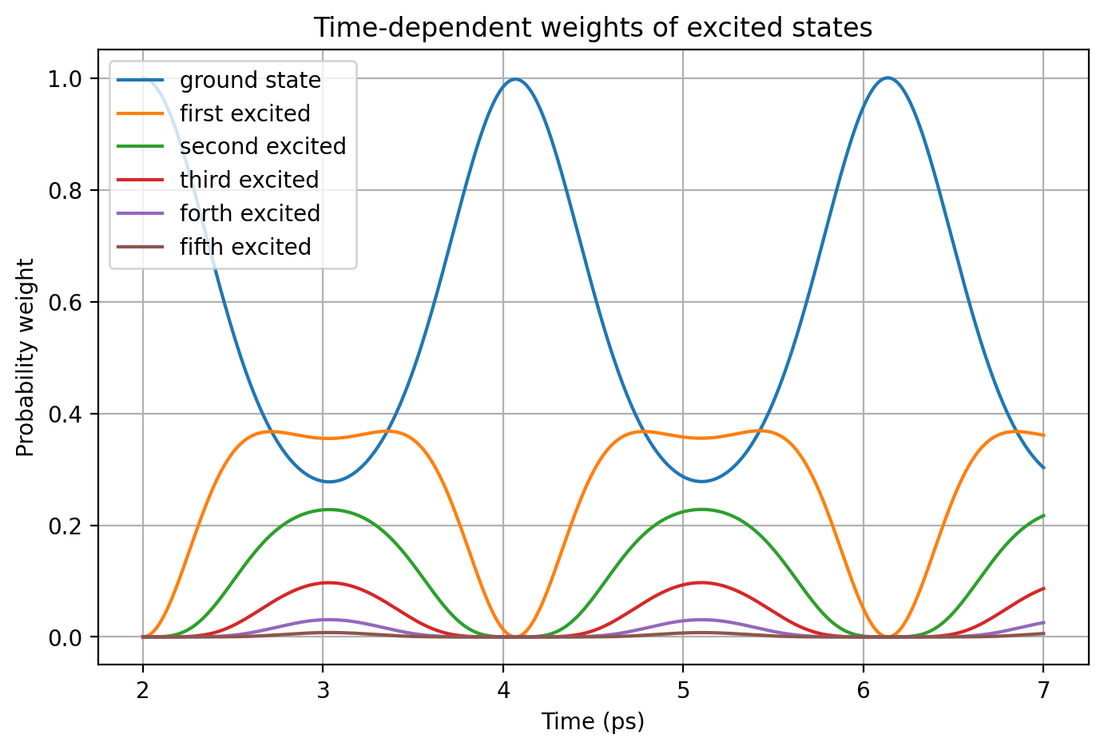
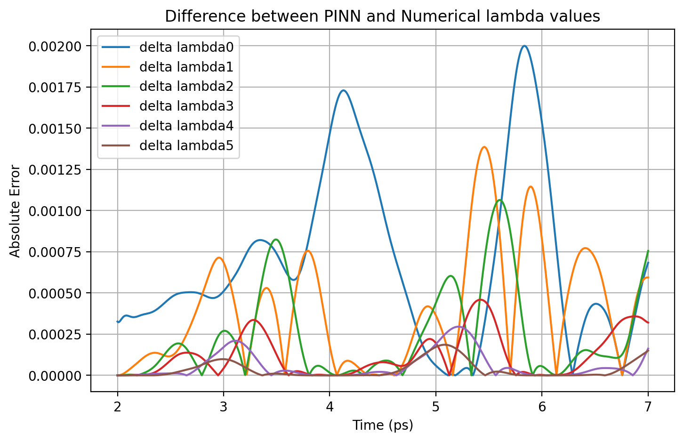


Slide 6
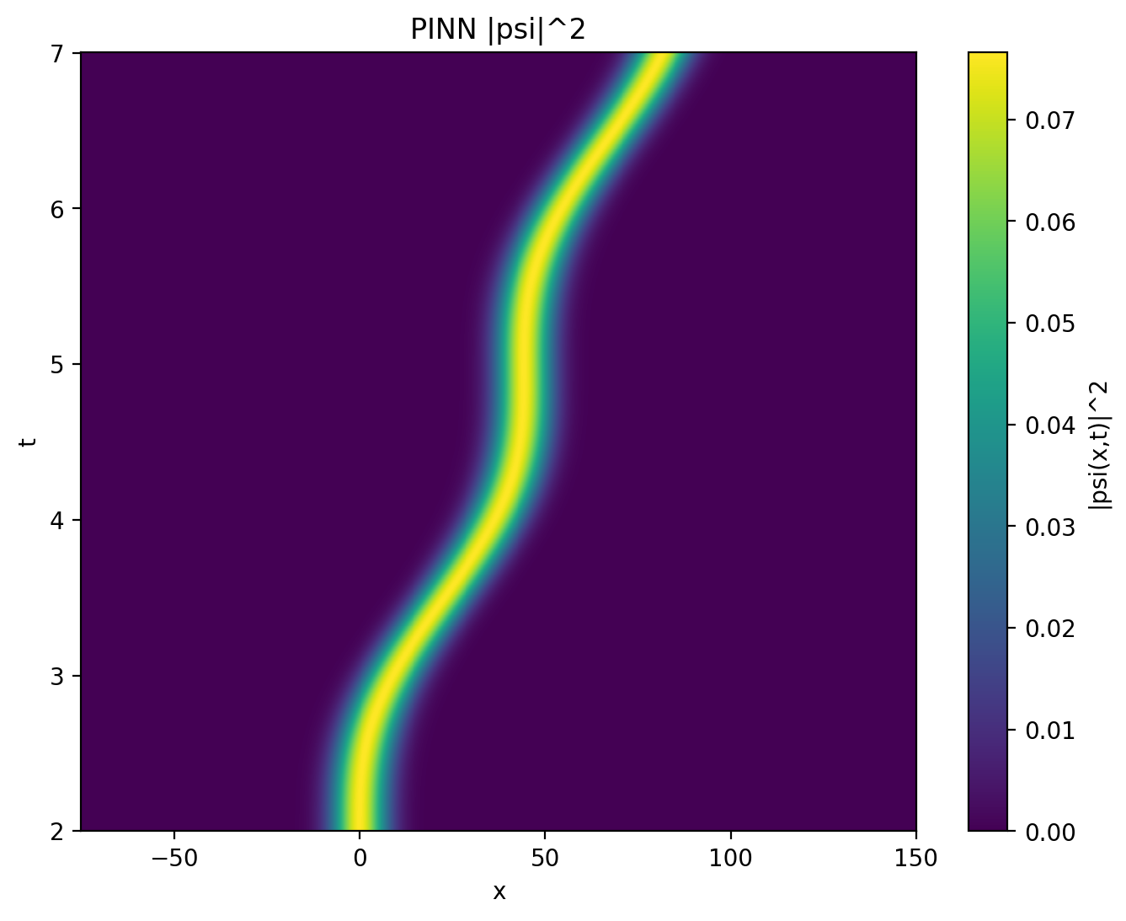
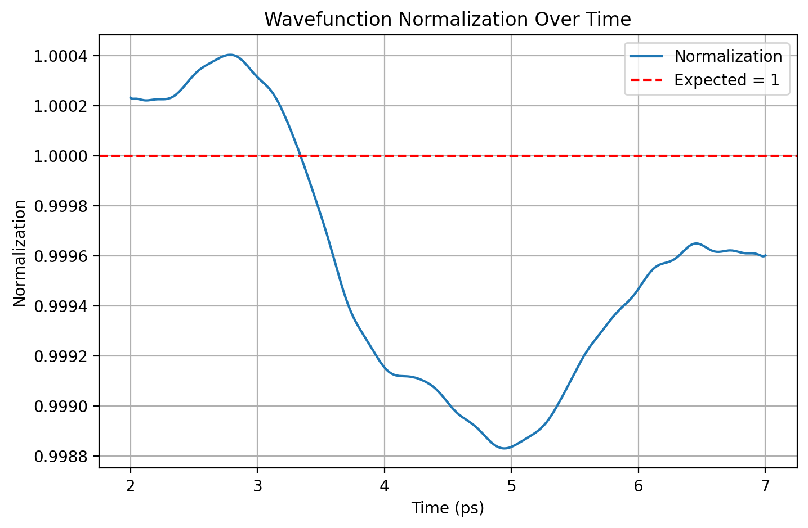

ω = 1.4 / ħ

Slide 7
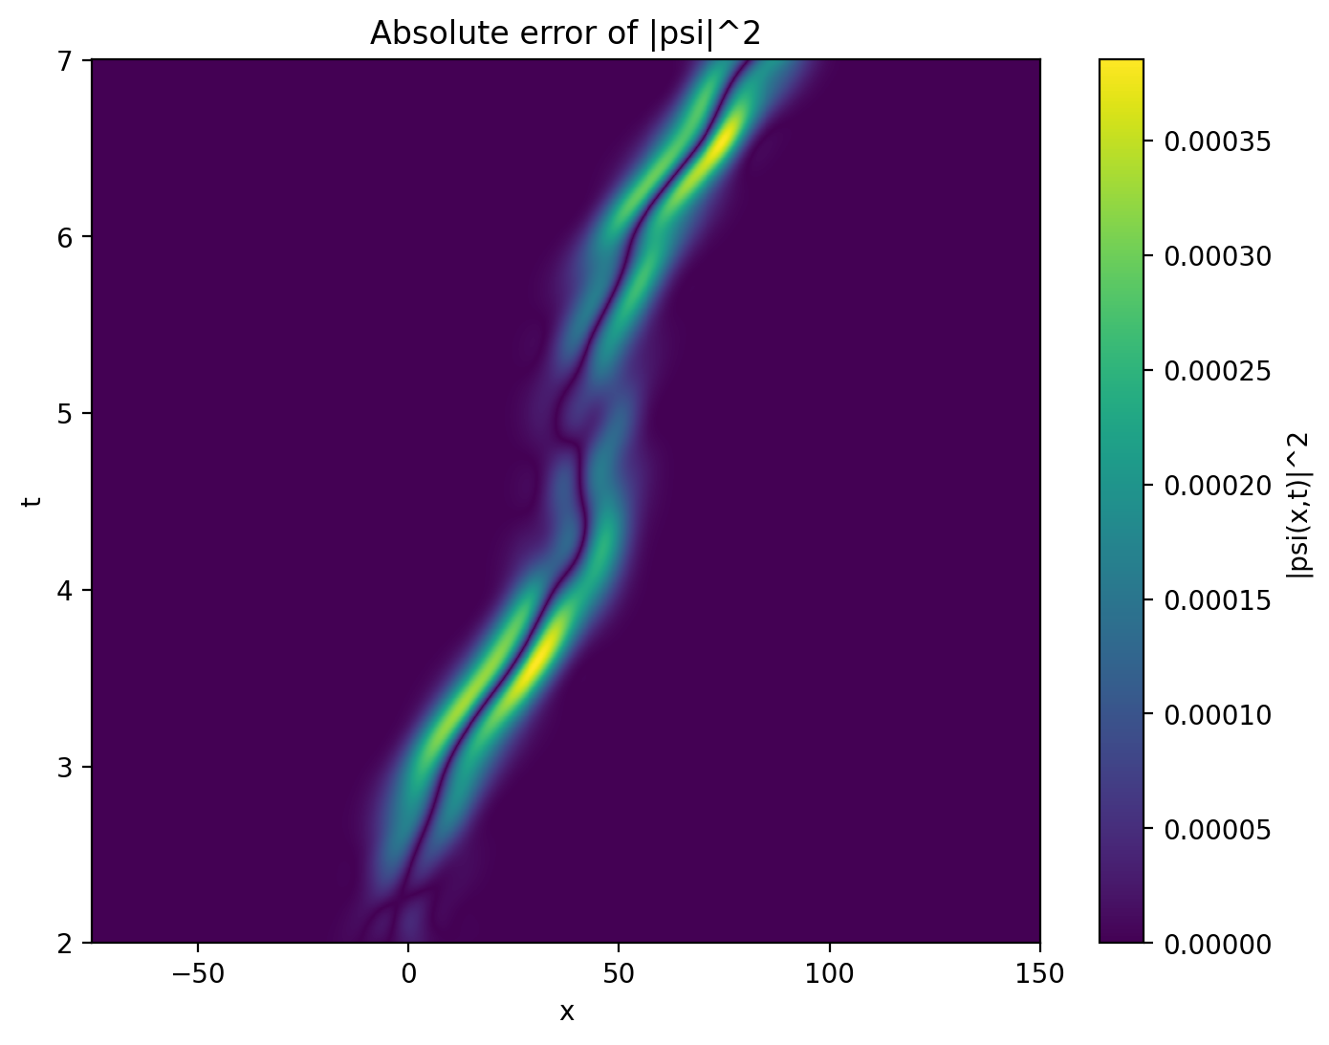
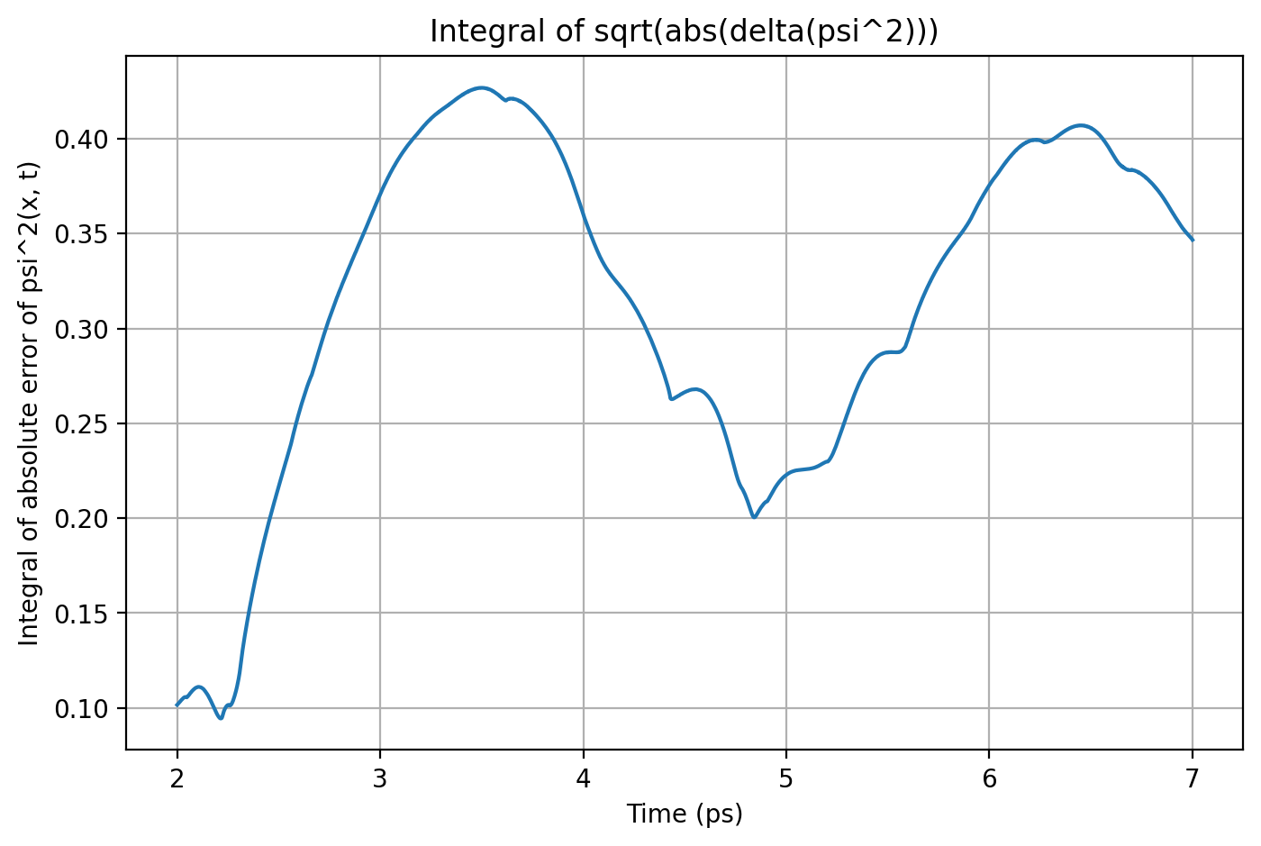


Slide 8
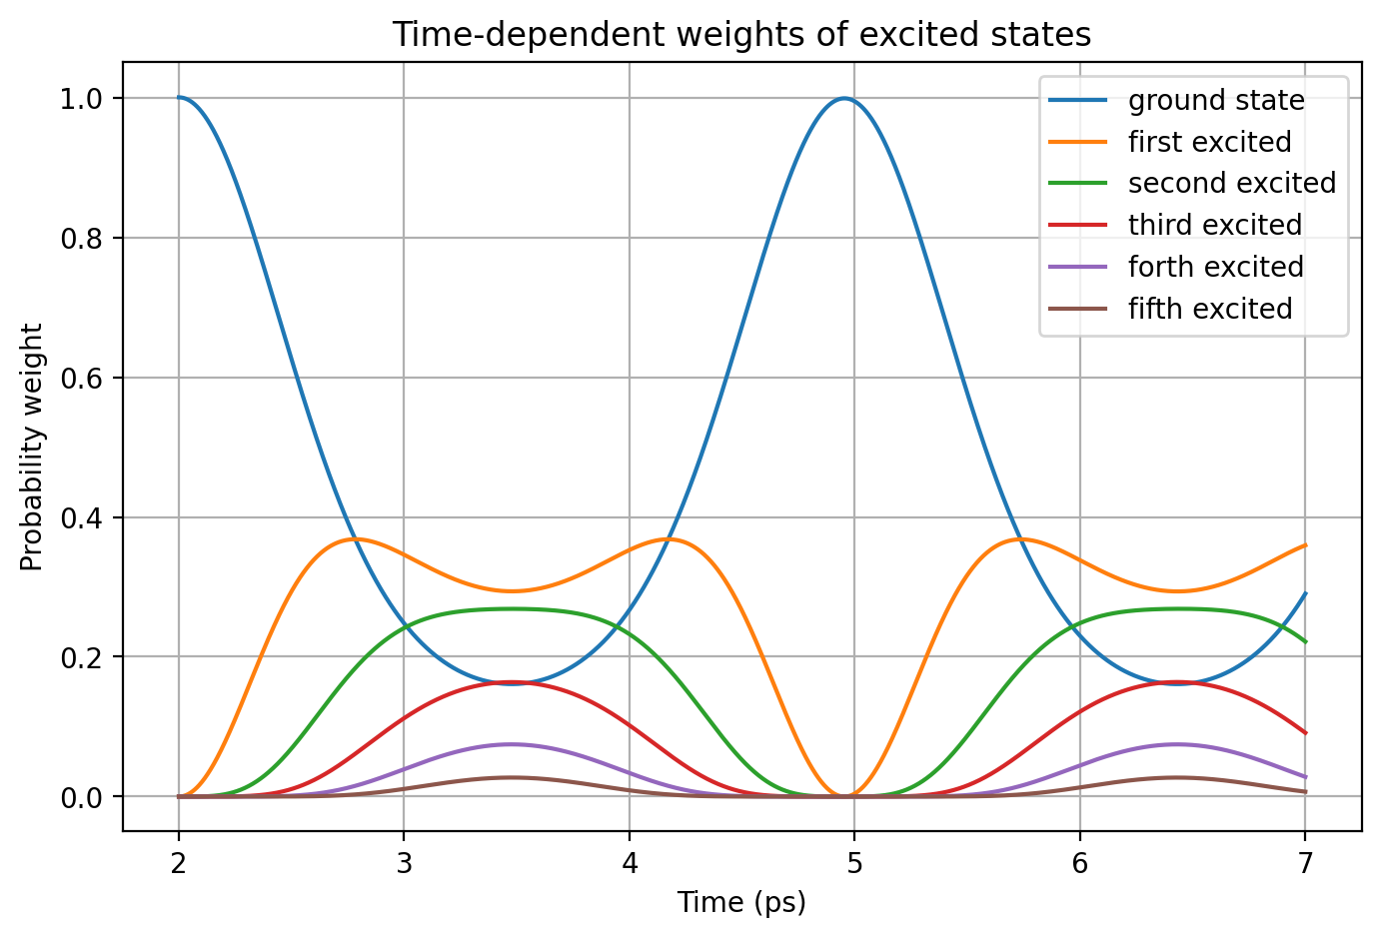
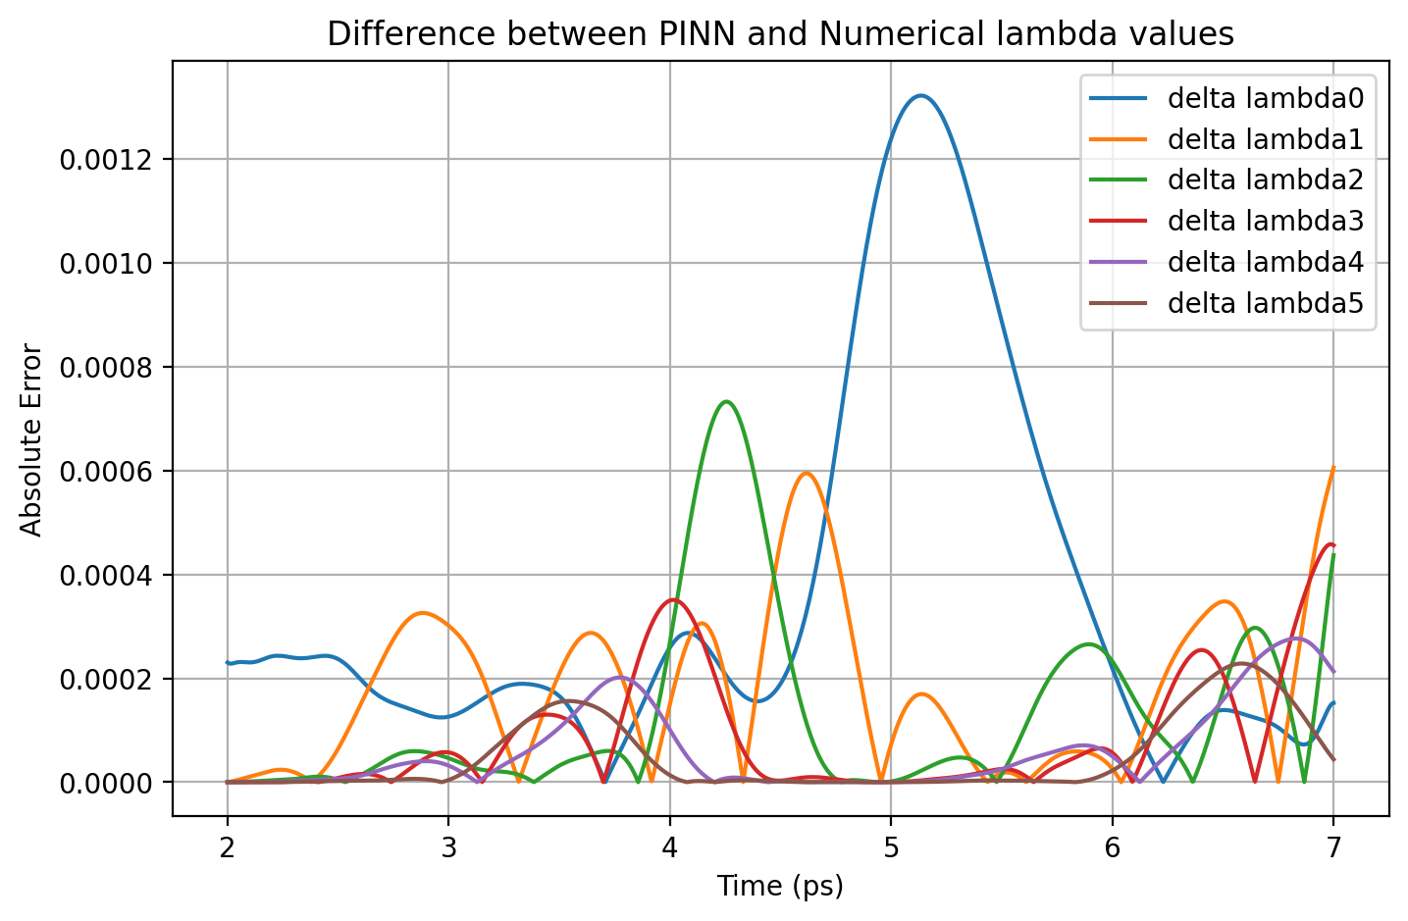


Slide 9
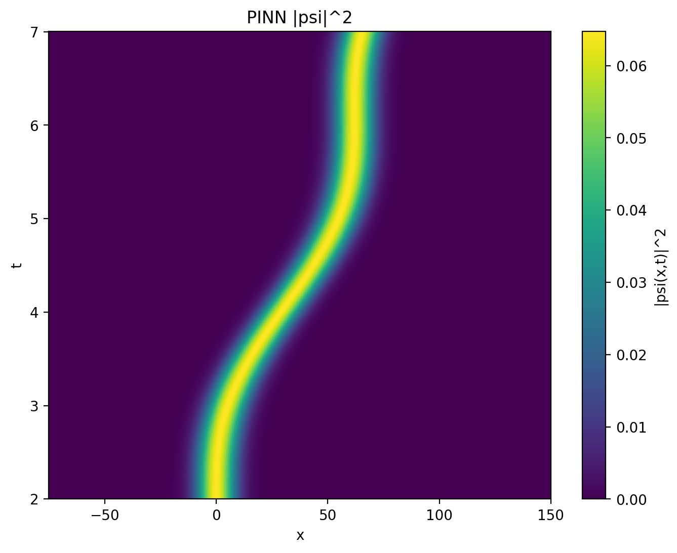
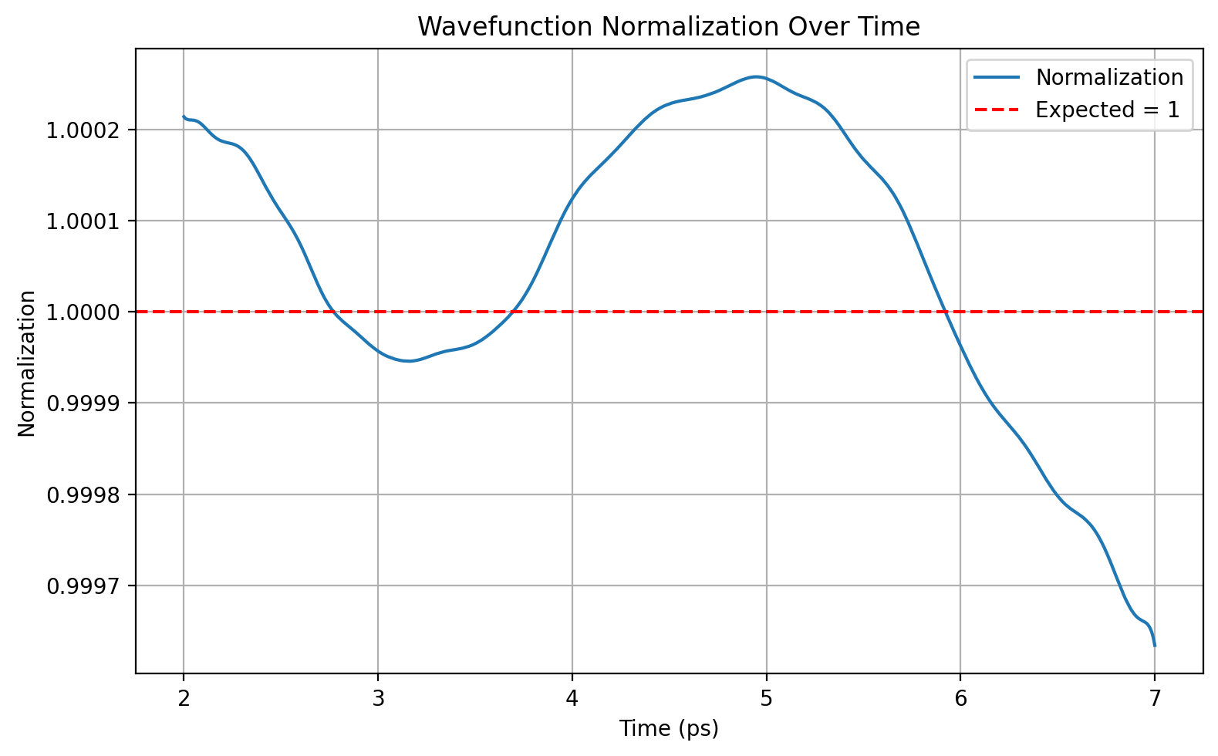

ω = 1 / ħ

Slide 10
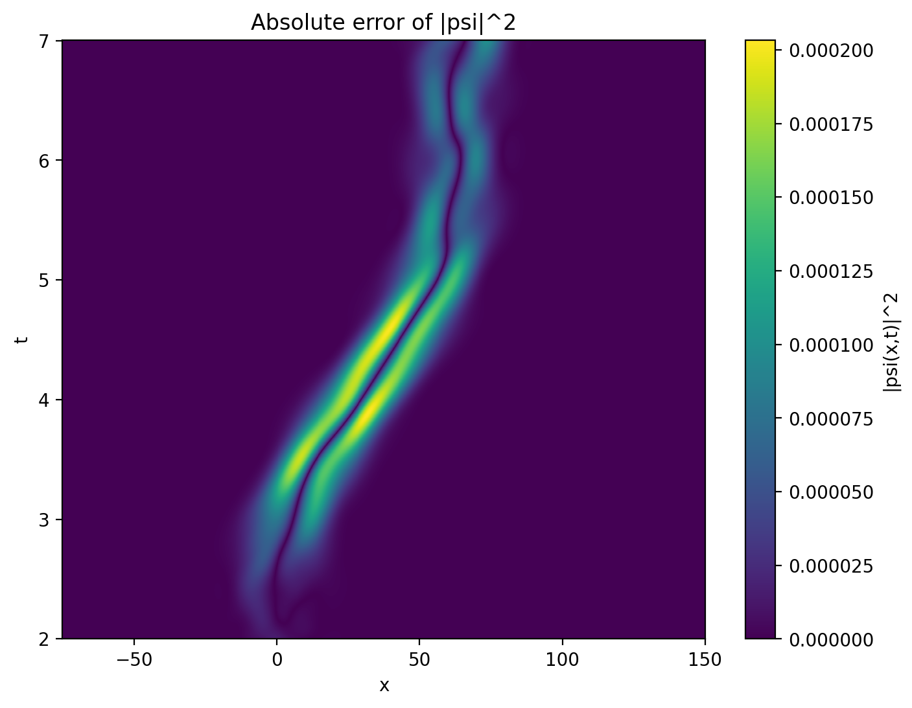
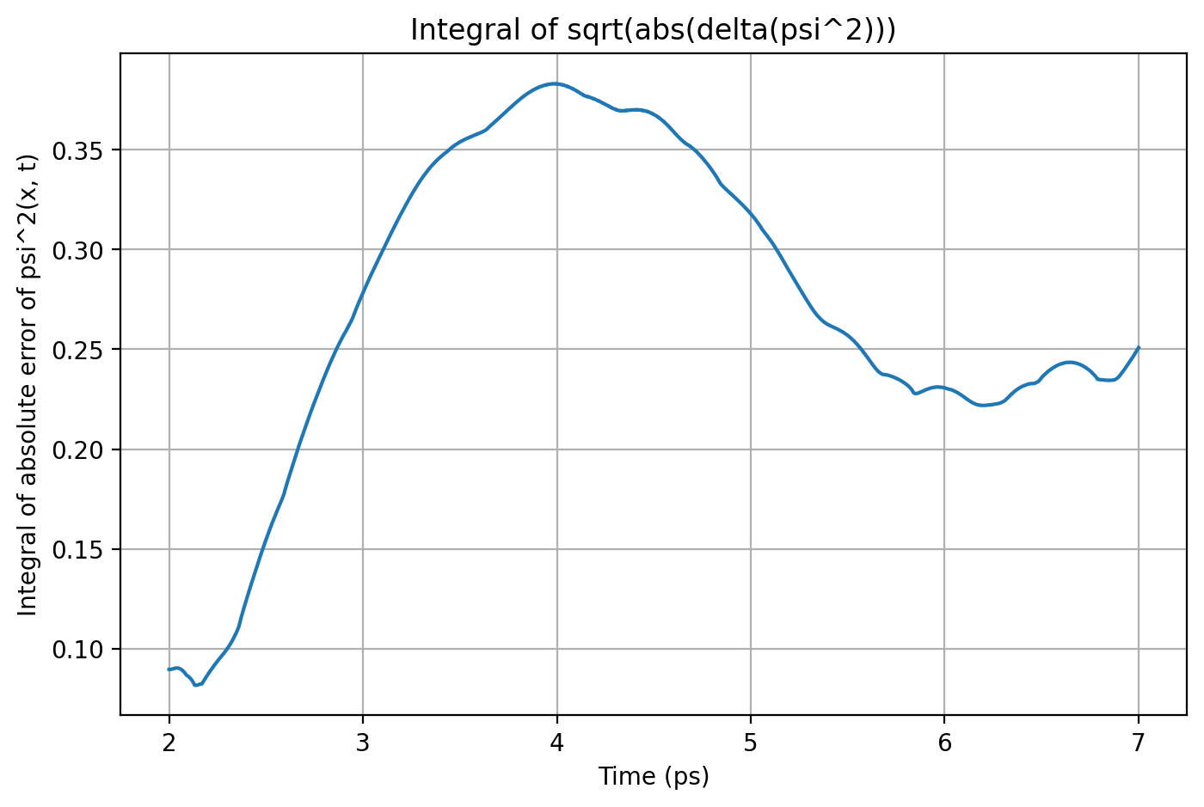


Slide 11
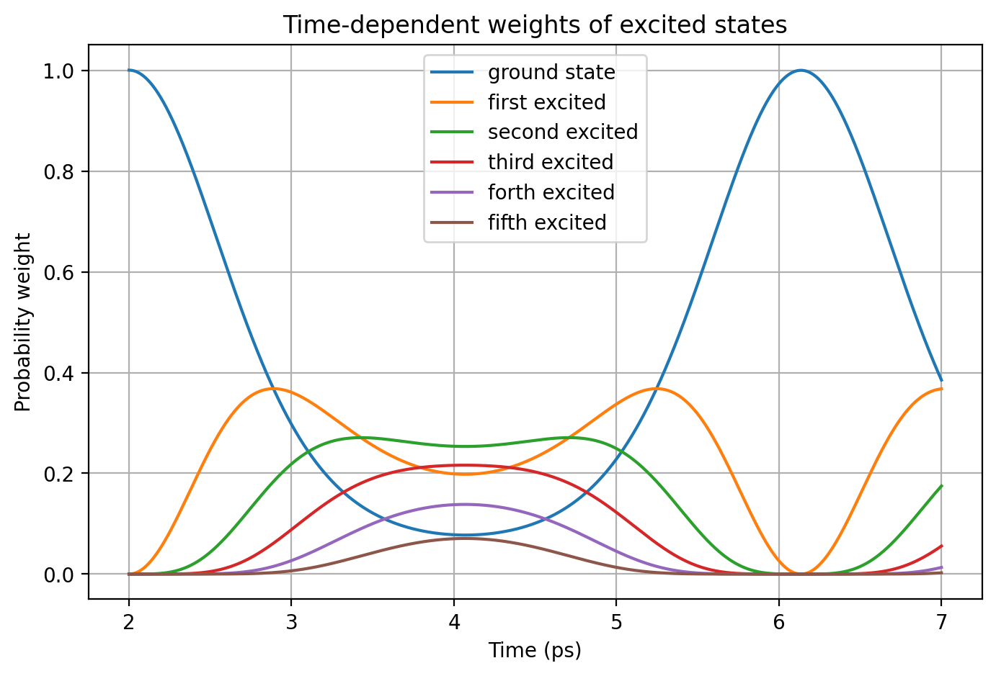
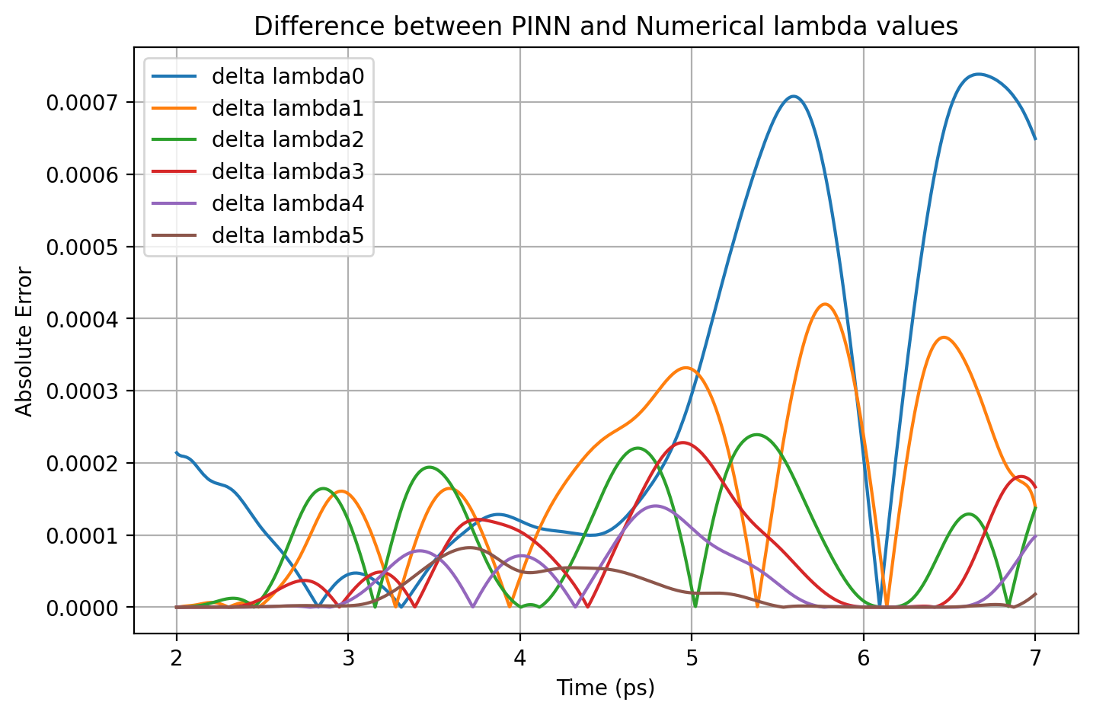


Slide 12
Result Comparison
Omega | ΔΨ² - max | Norm - mean | Norm - std | Δλi - max
ω = 1 | 0.00020 | 1.00005 | 0.00016 | 0.00074
ω = 1.4 | 0.00039 | 0.99956 | 0.00051 | 0.00132
ω = 2 | 0.00064 | 0.99958 | 0.00084 | 0.00200

Slide 13
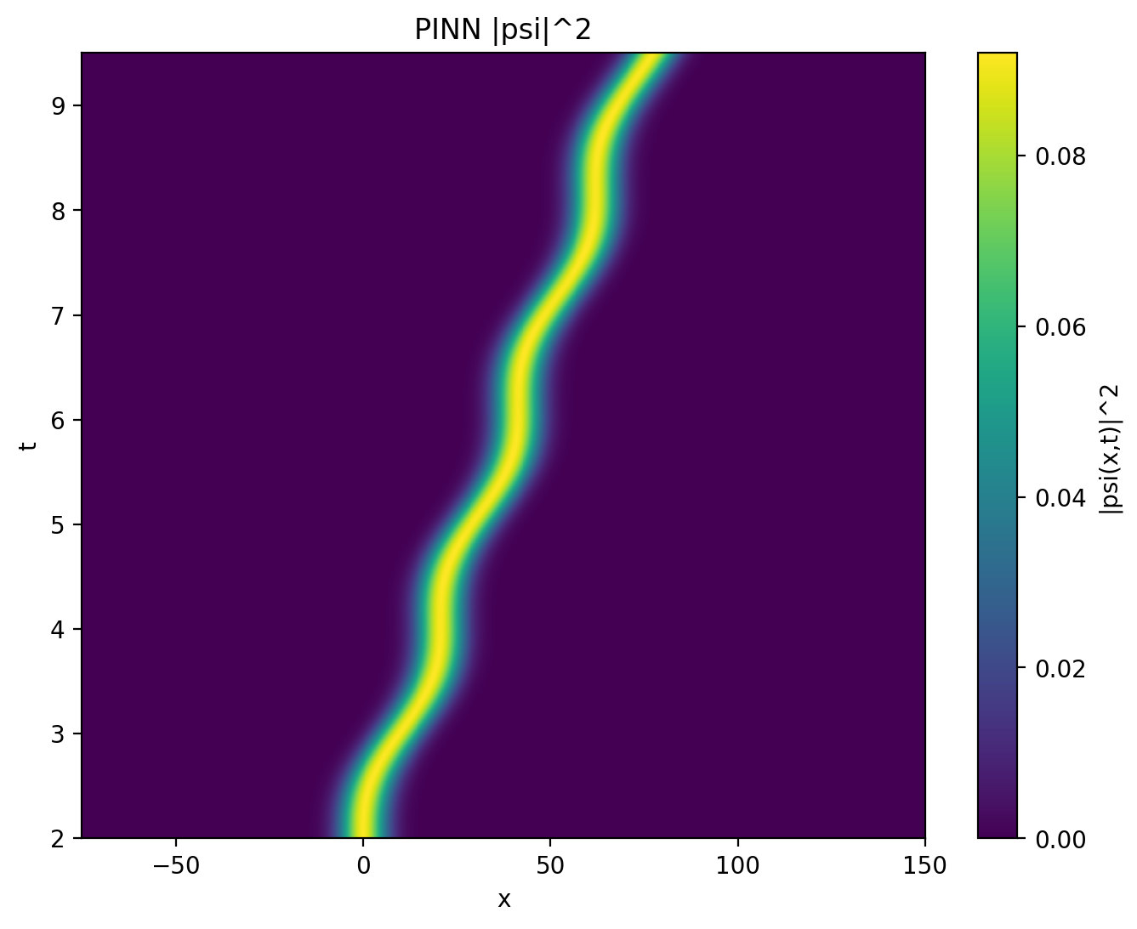
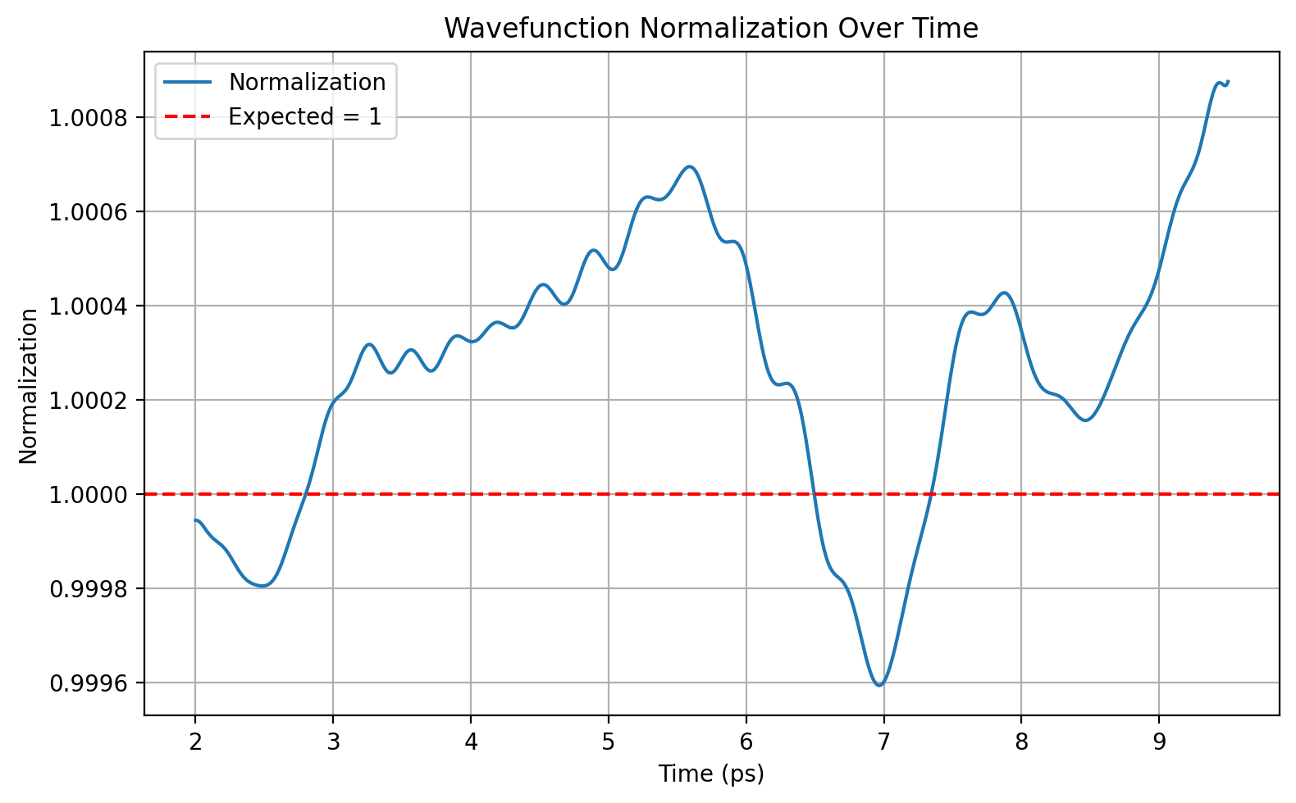

VQD = 10

Slide 14
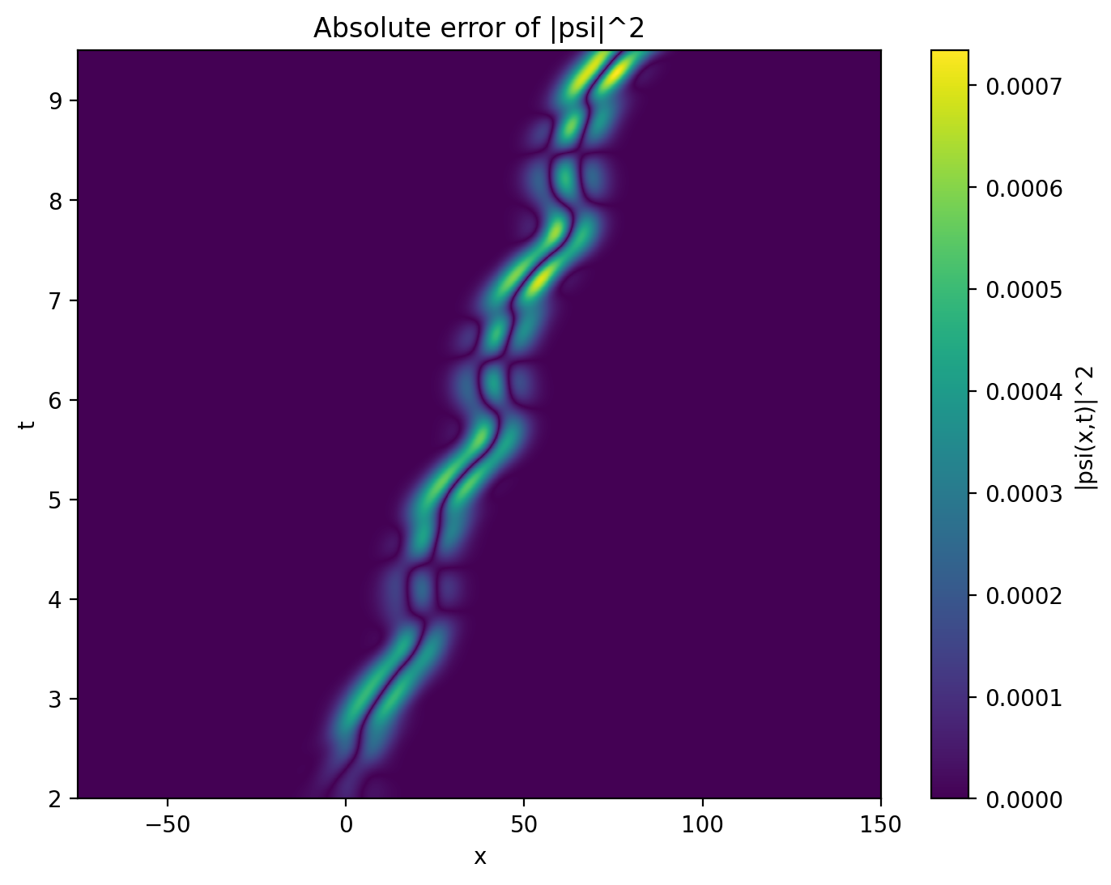
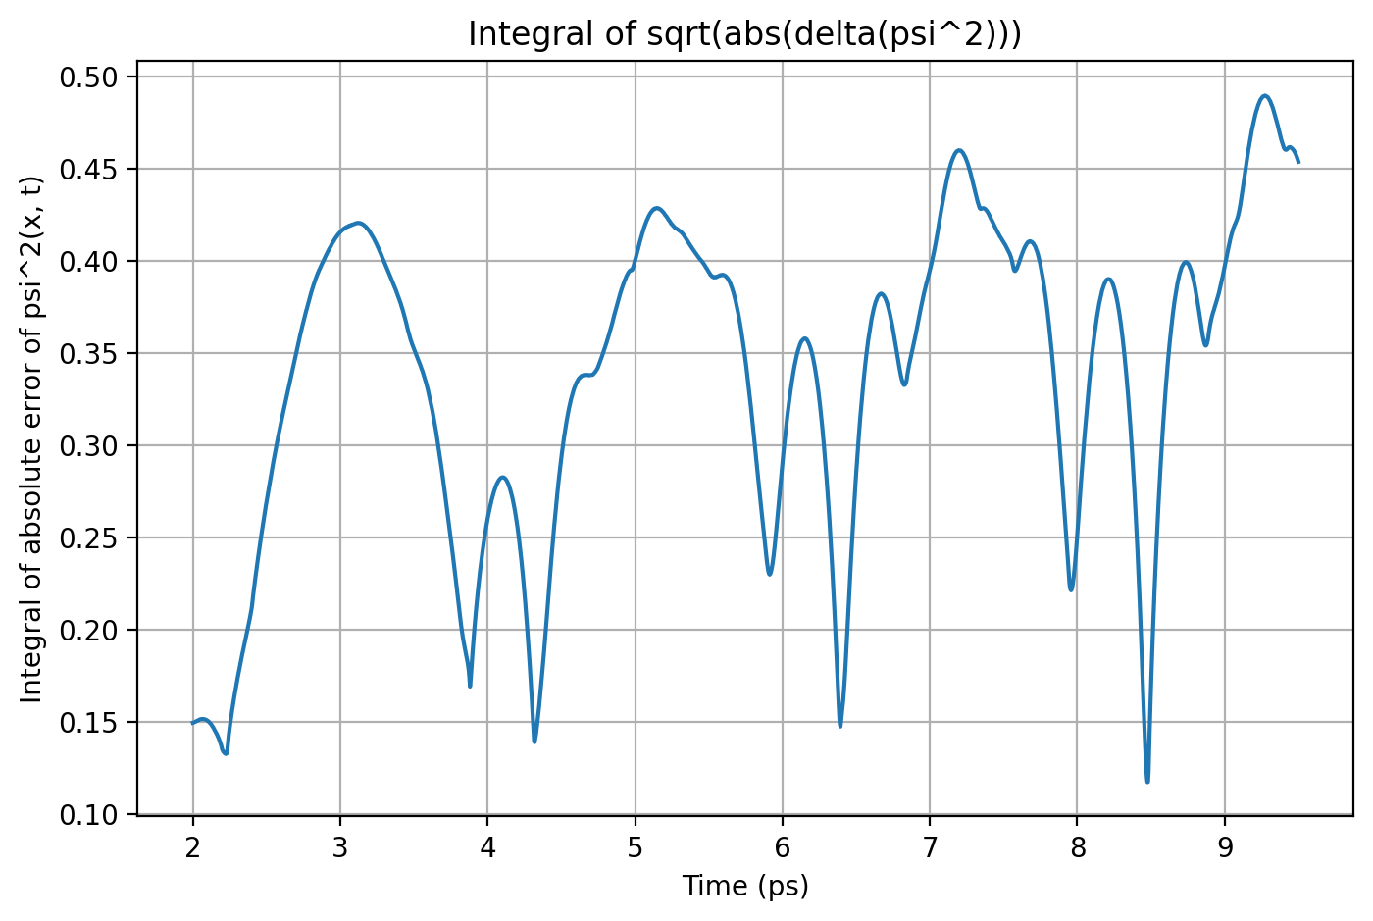


Slide 15
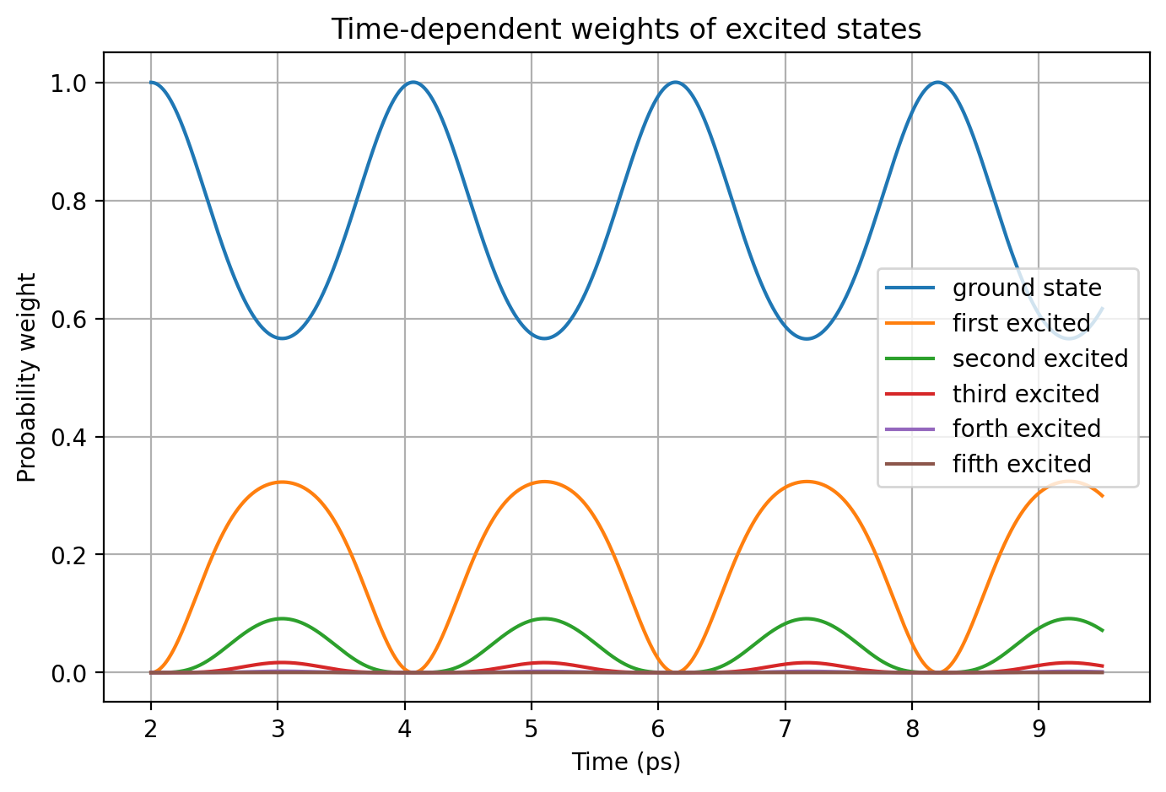
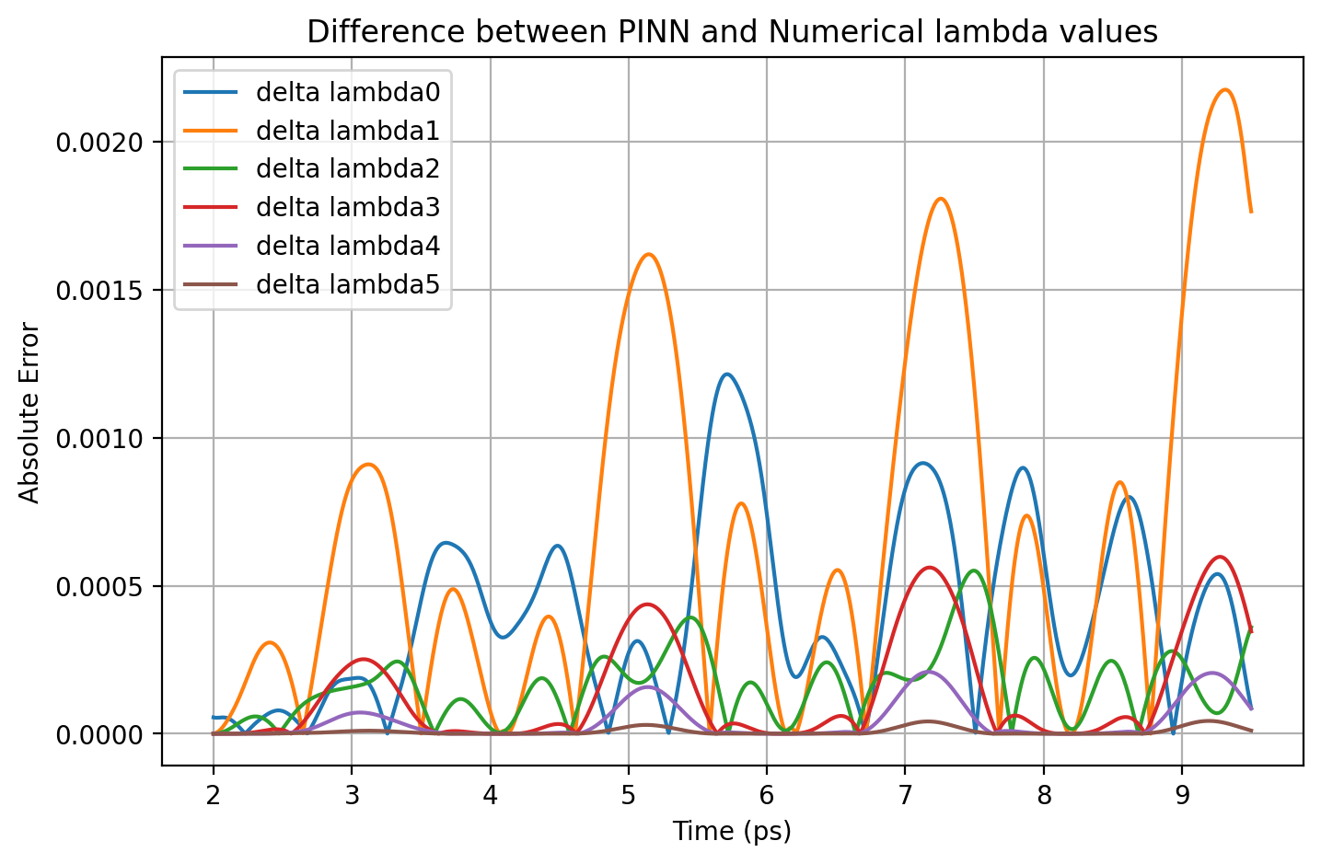


Slide 16
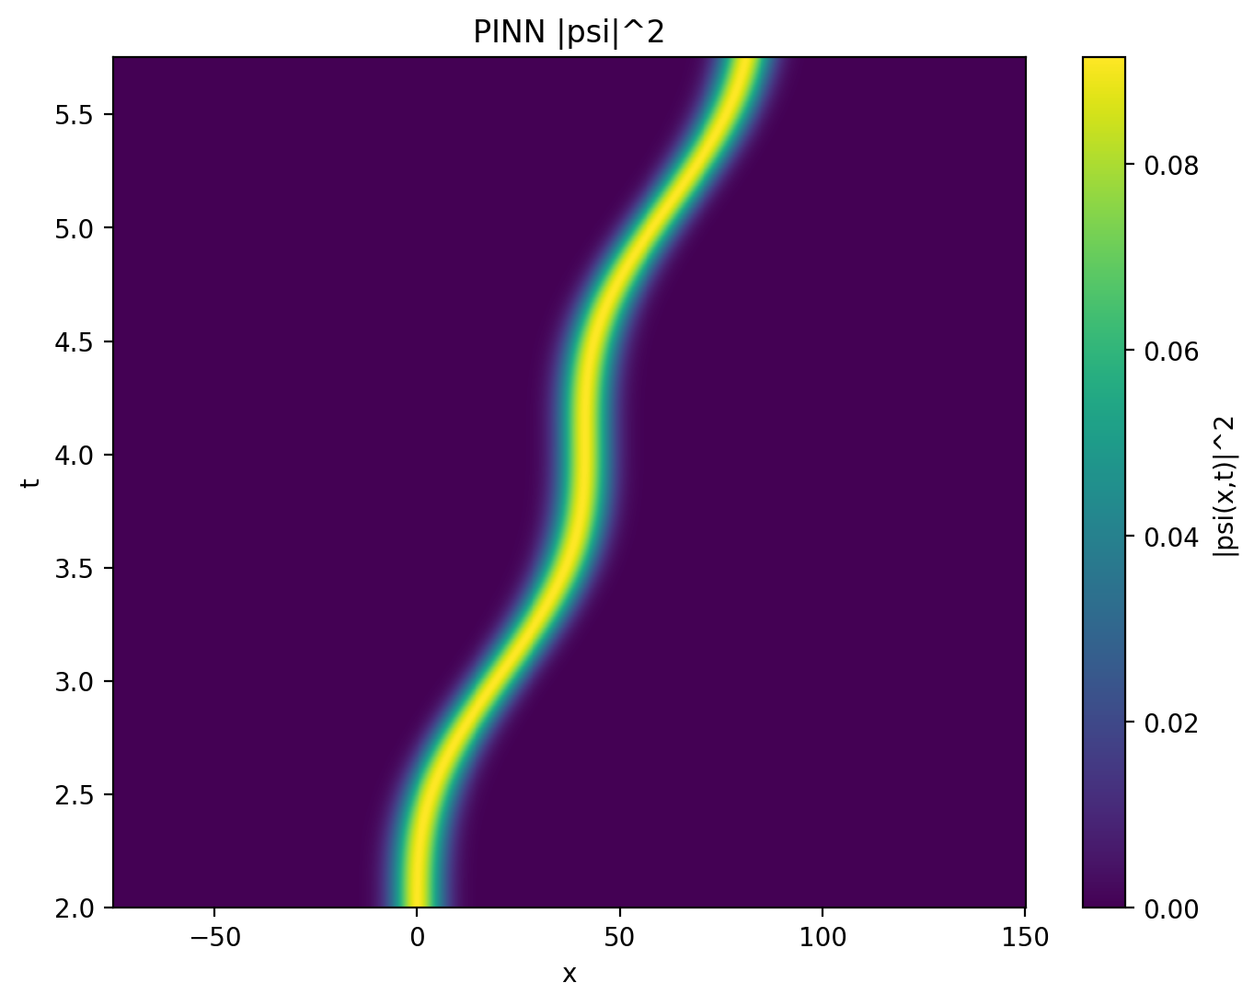
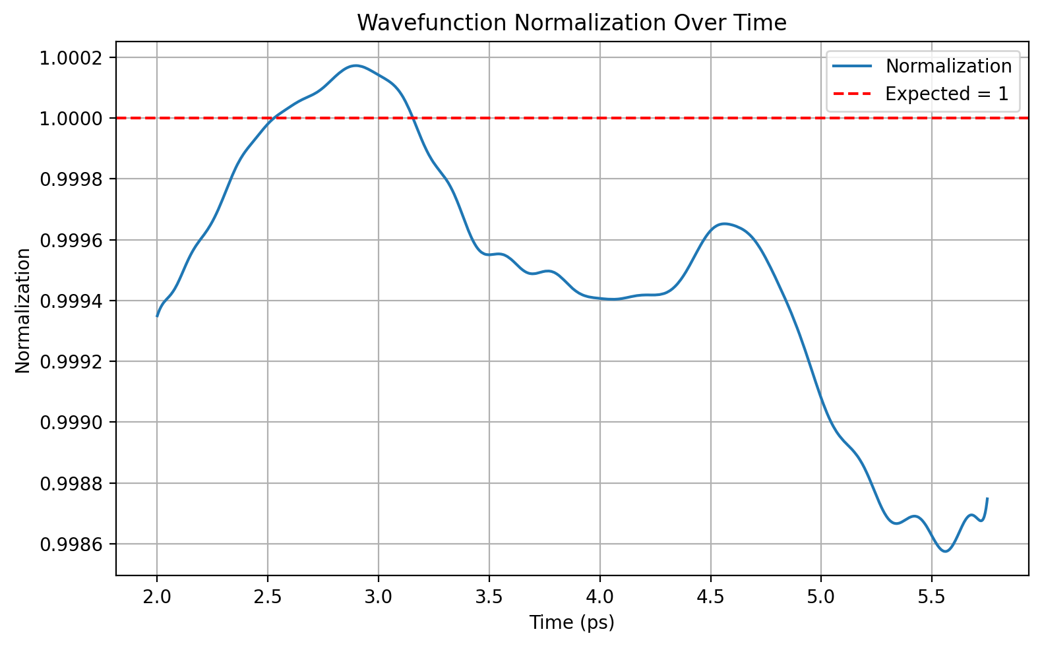

VQD = 20

Slide 17
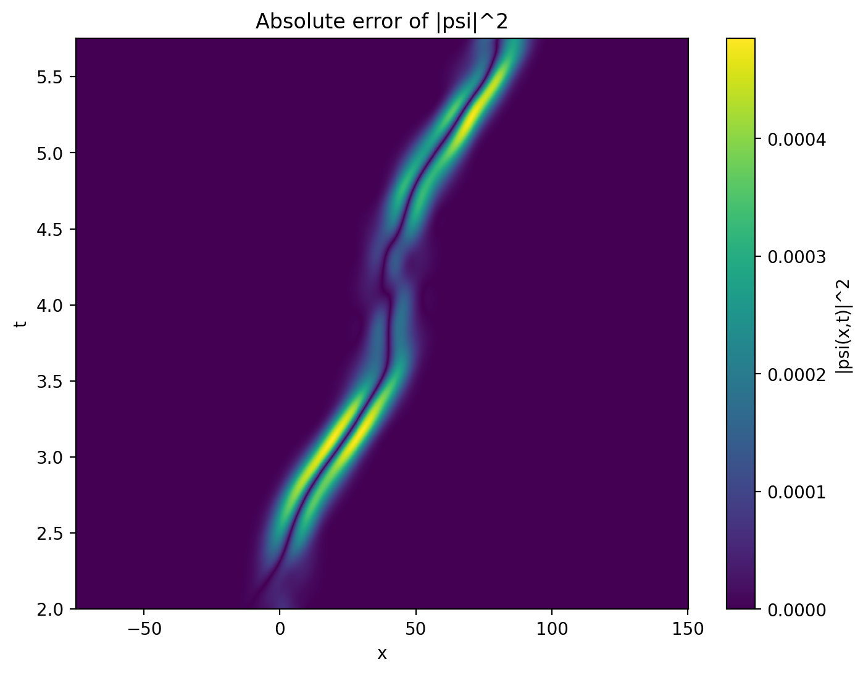
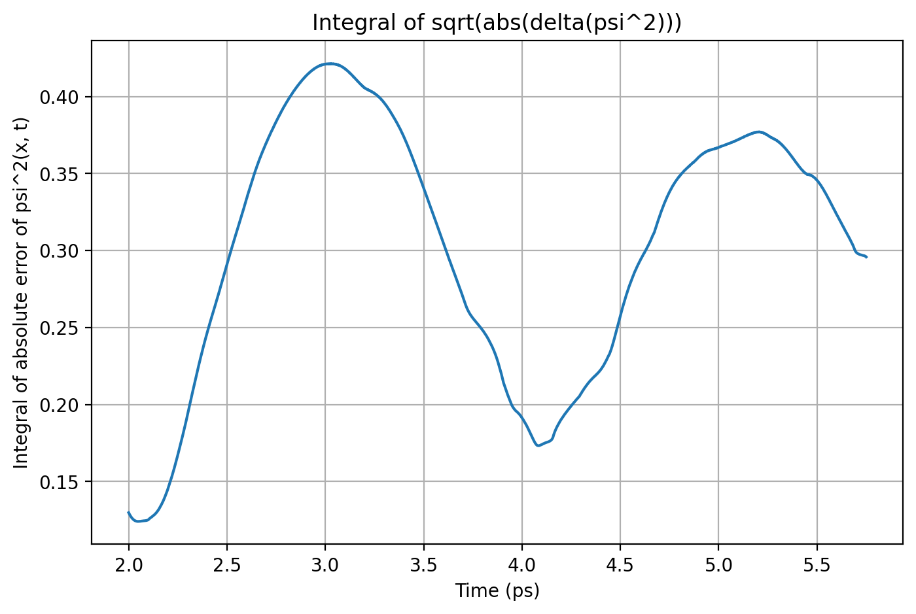


Slide 18
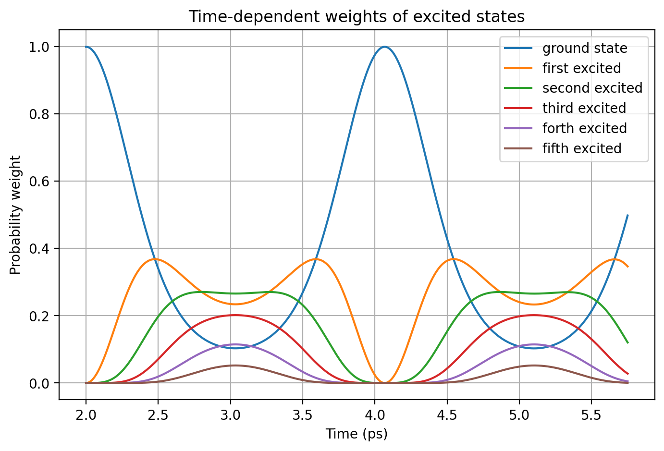
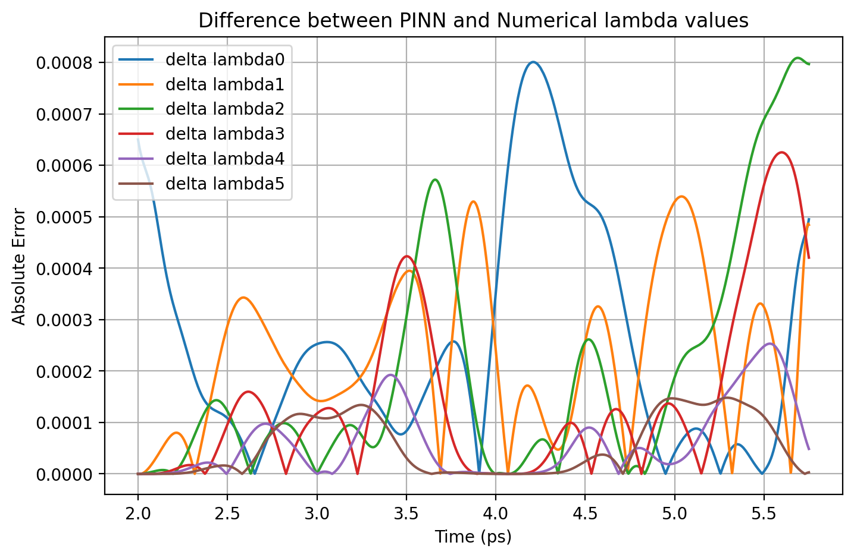


Slide 19
Result Comparison
Omega | ΔΨ² - max | Norm - mean | Norm - std | Δλi - max
VQD = 10 | 0.00078 | 1.00026 | 0.00029 | 0.00218
VQD = 20 | 0.00048 | 0.99949 | 0.00045 | 0.00081
VQD = 15 | 0.00064 | 0.99958 | 0.00084 | 0.00200

Slide 20

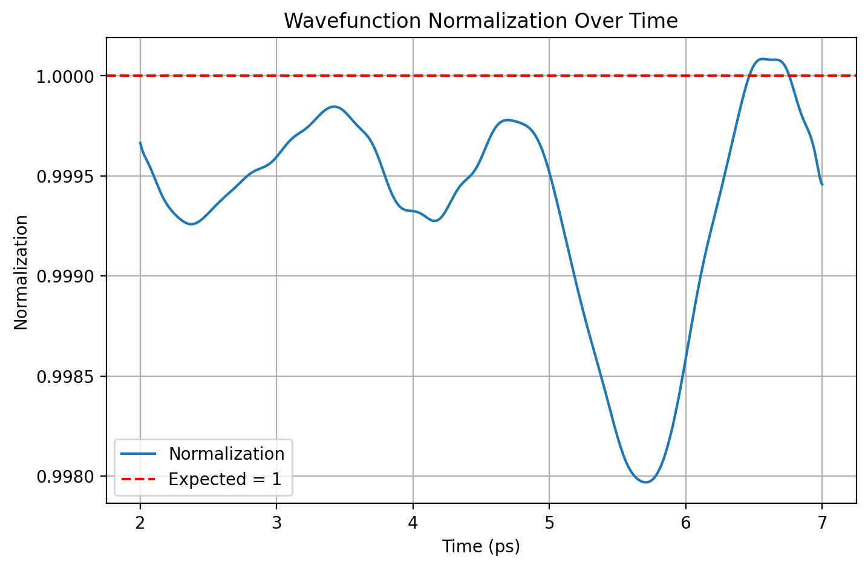

Causal Model – 5 segments

Slide 21
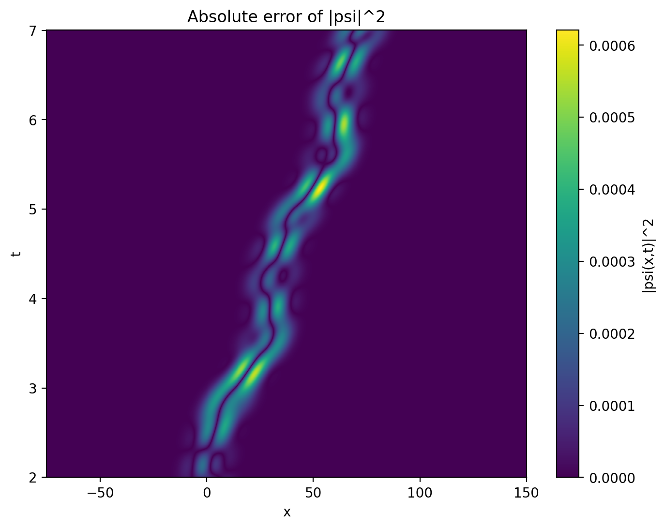
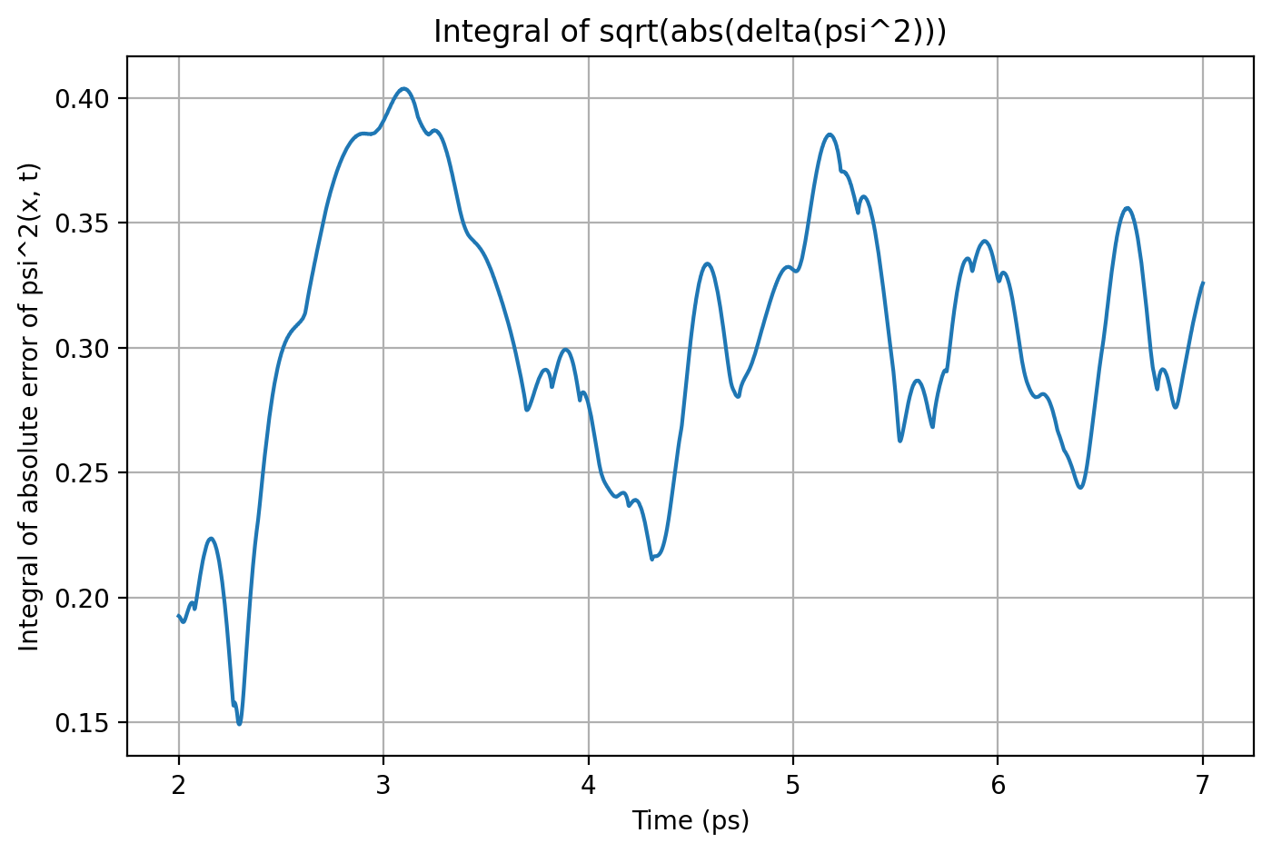


Slide 22
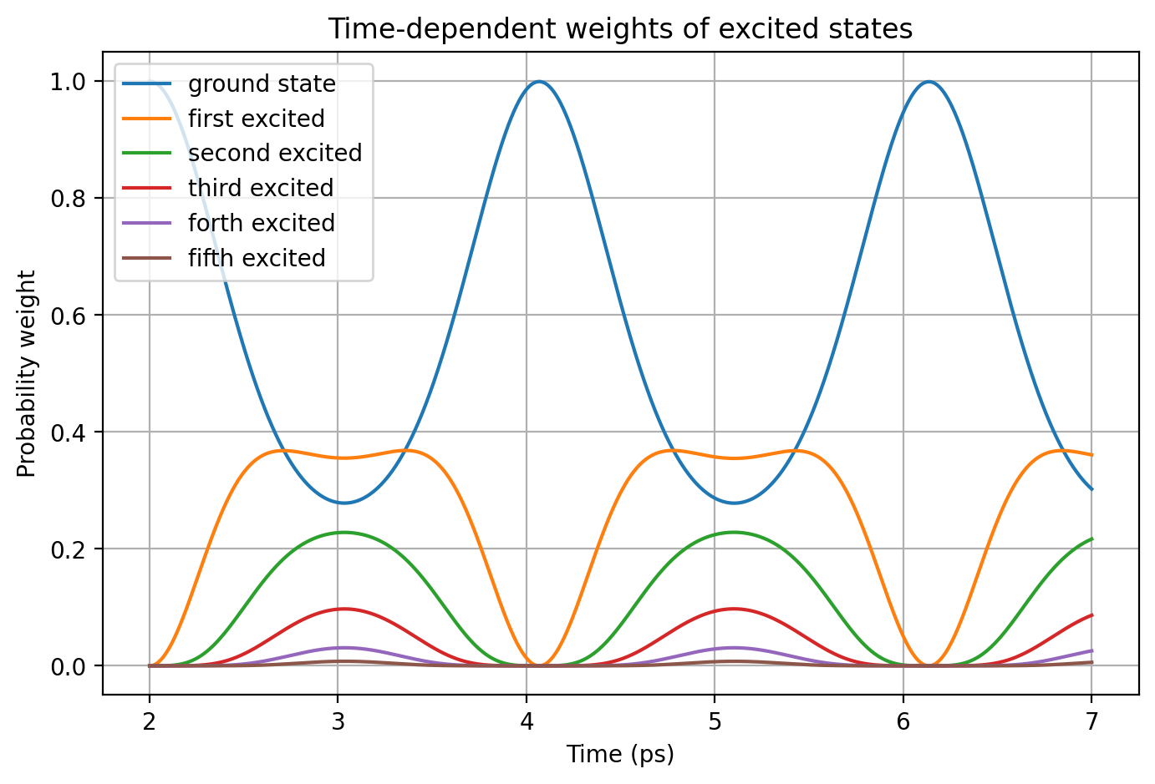
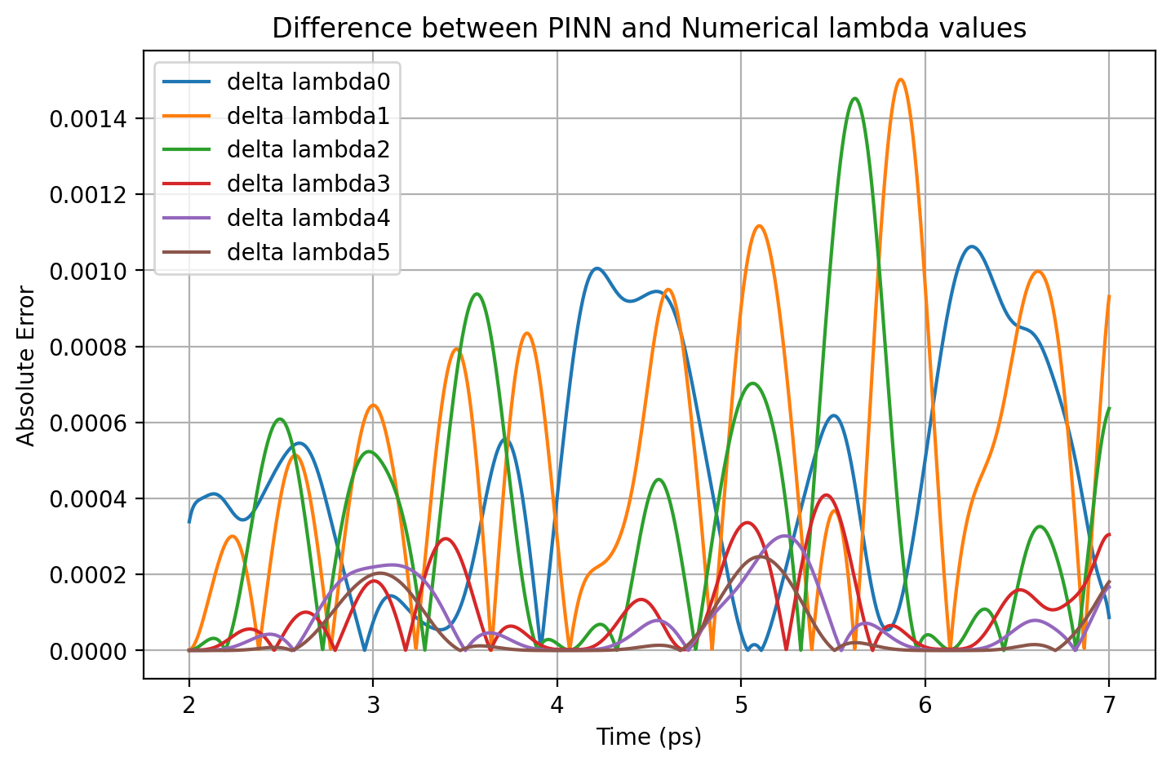


Slide 23

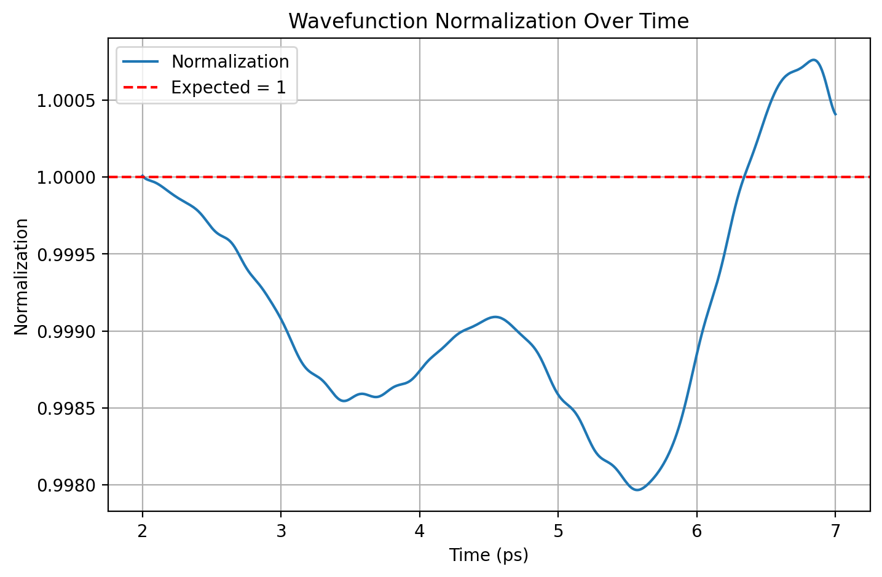

Causal Model – 20 segments

Slide 24
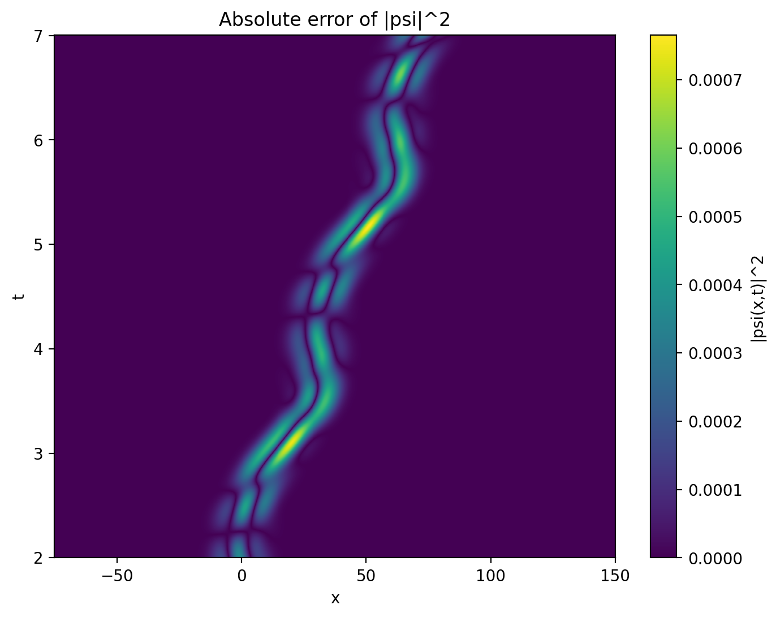
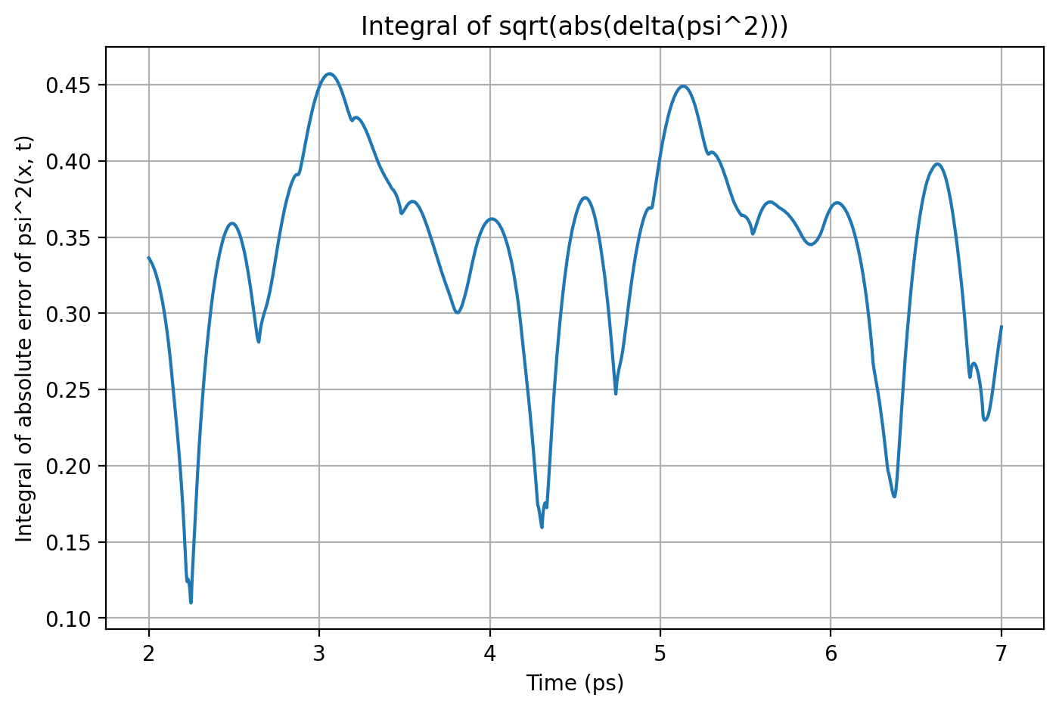


Slide 25

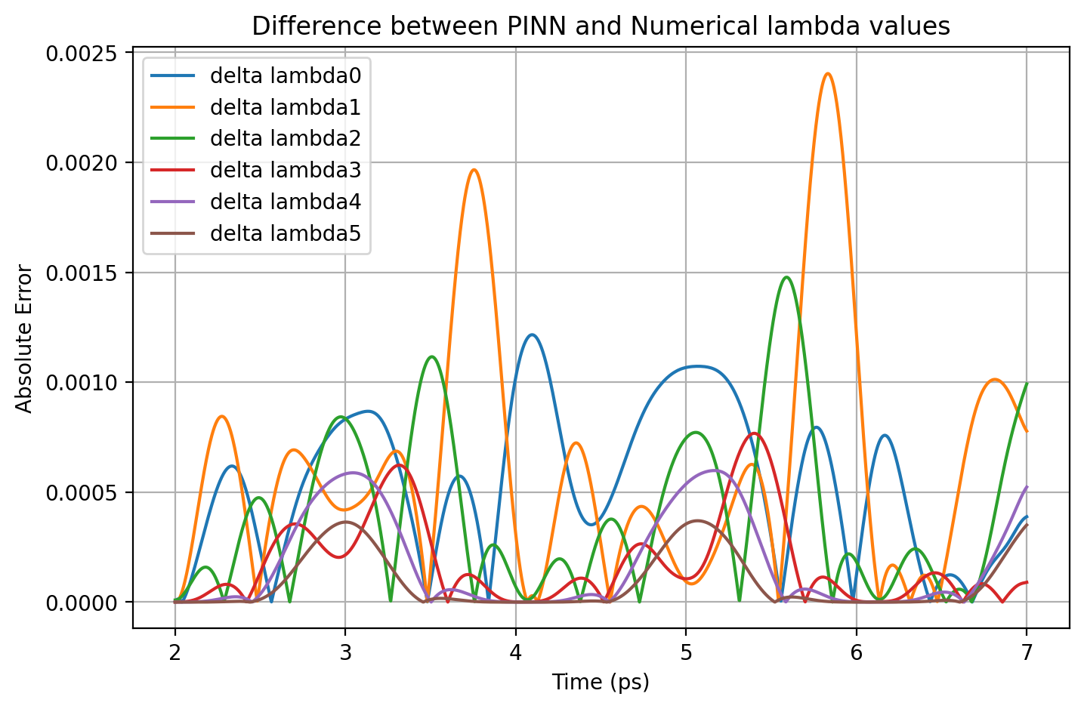


Slide 26

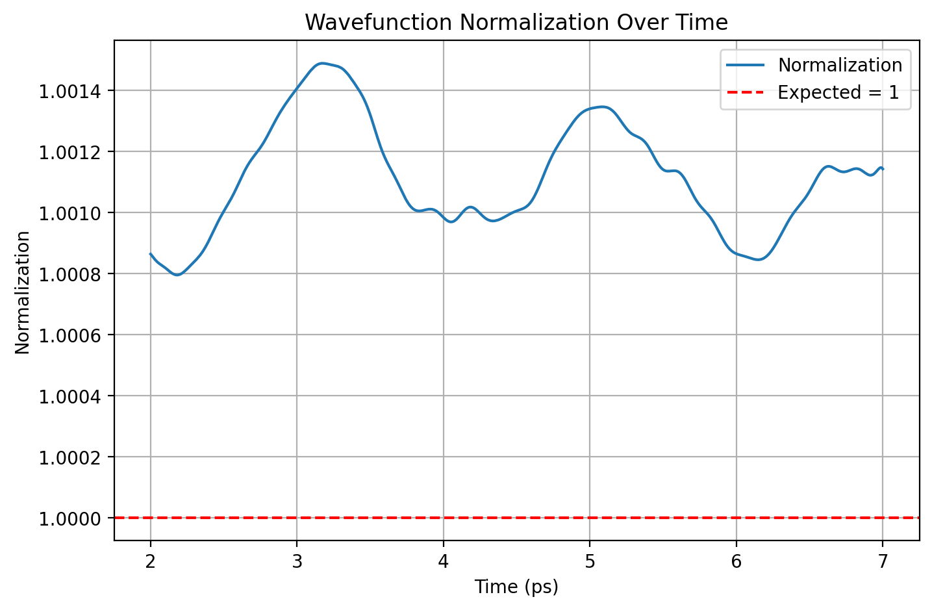

Norm Model – 5 time points

Slide 27
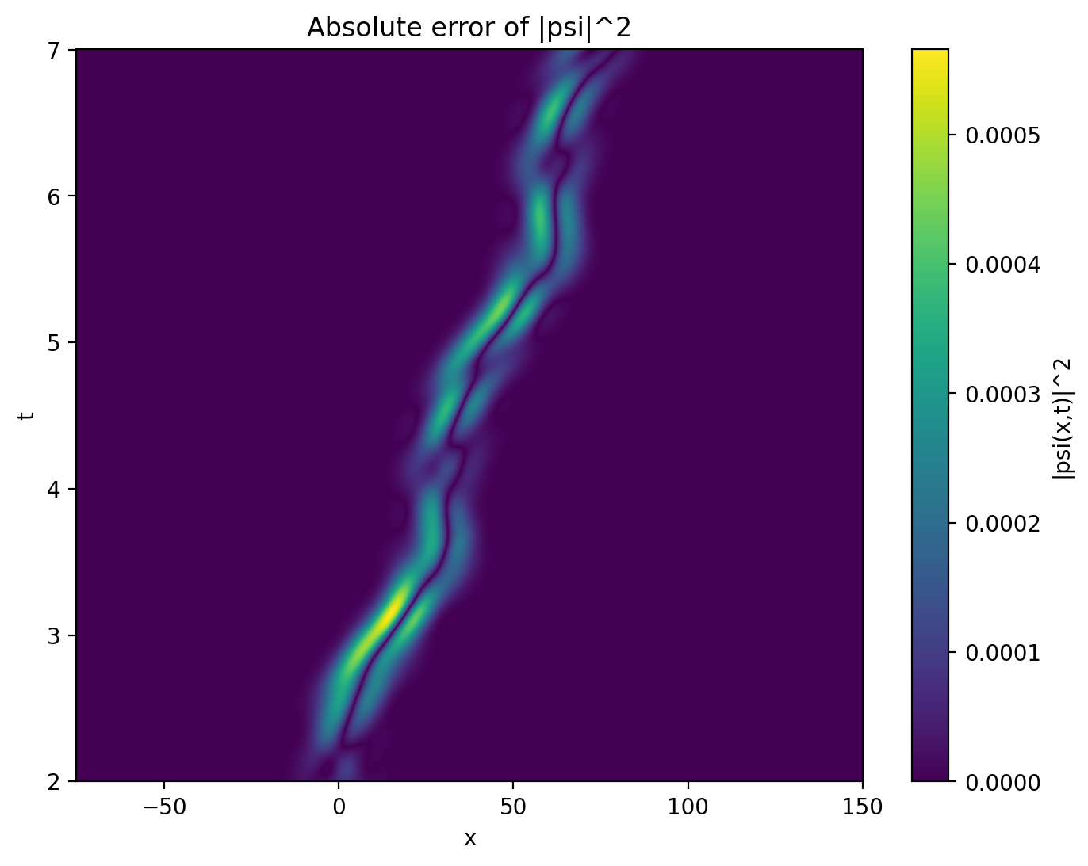
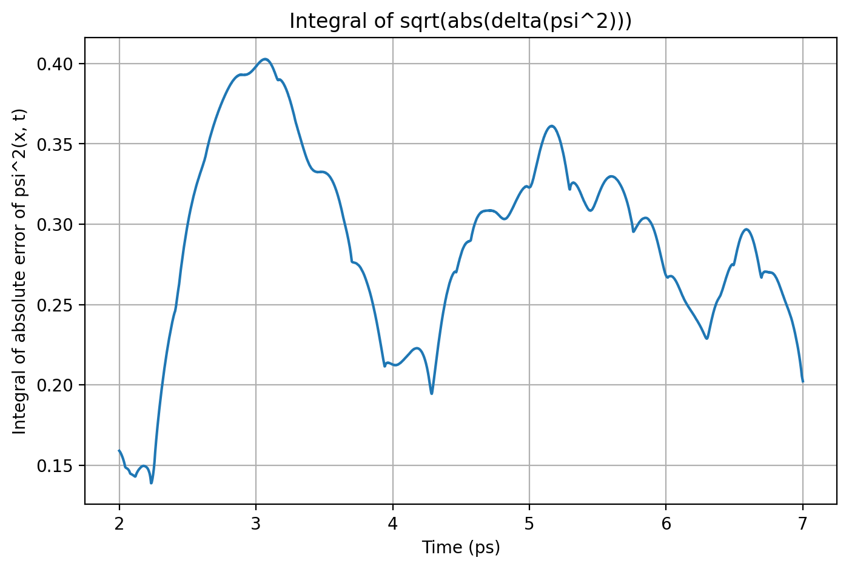


Slide 28

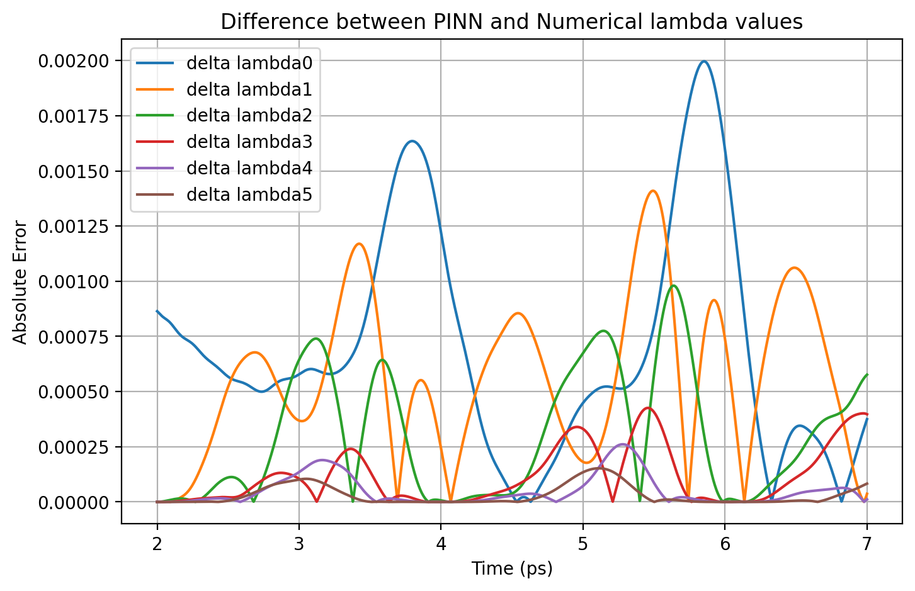


Slide 29

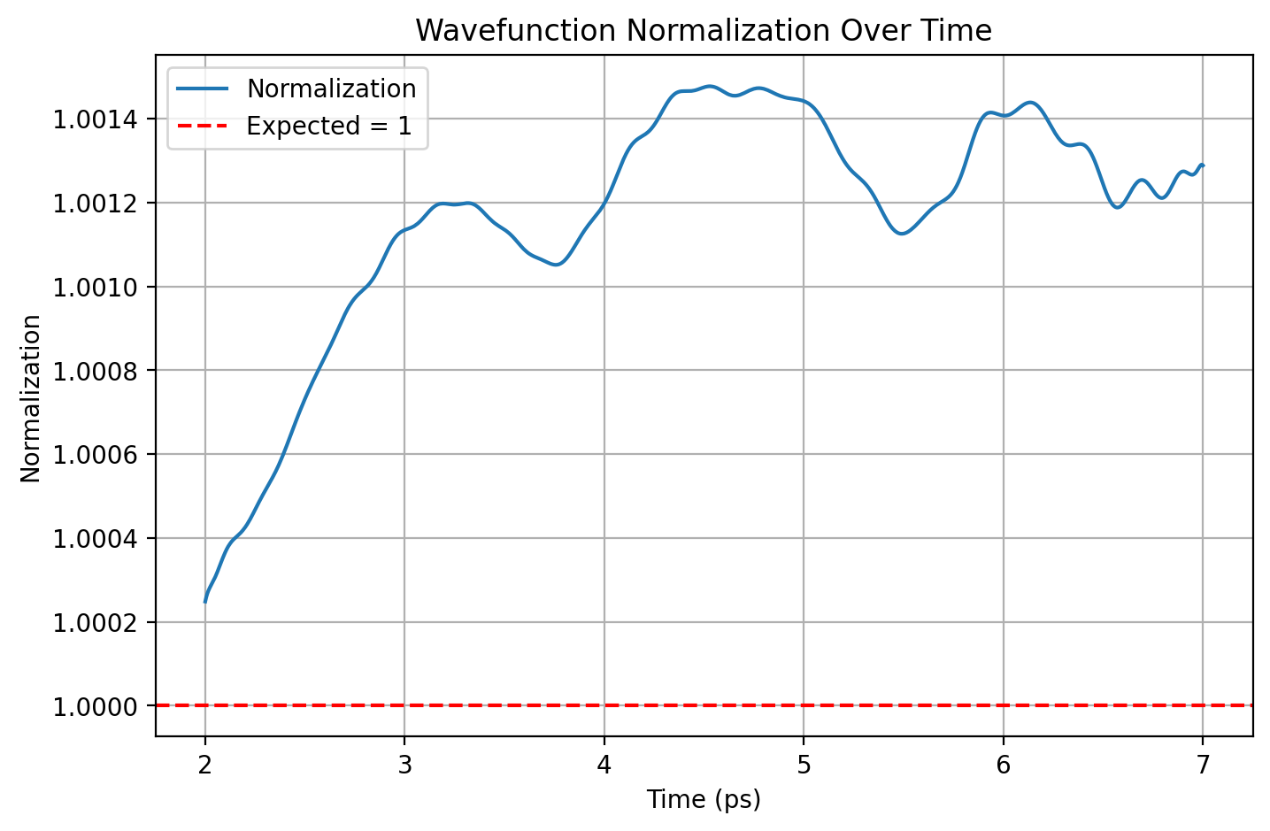

Norm Model – 20 time points

Slide 30

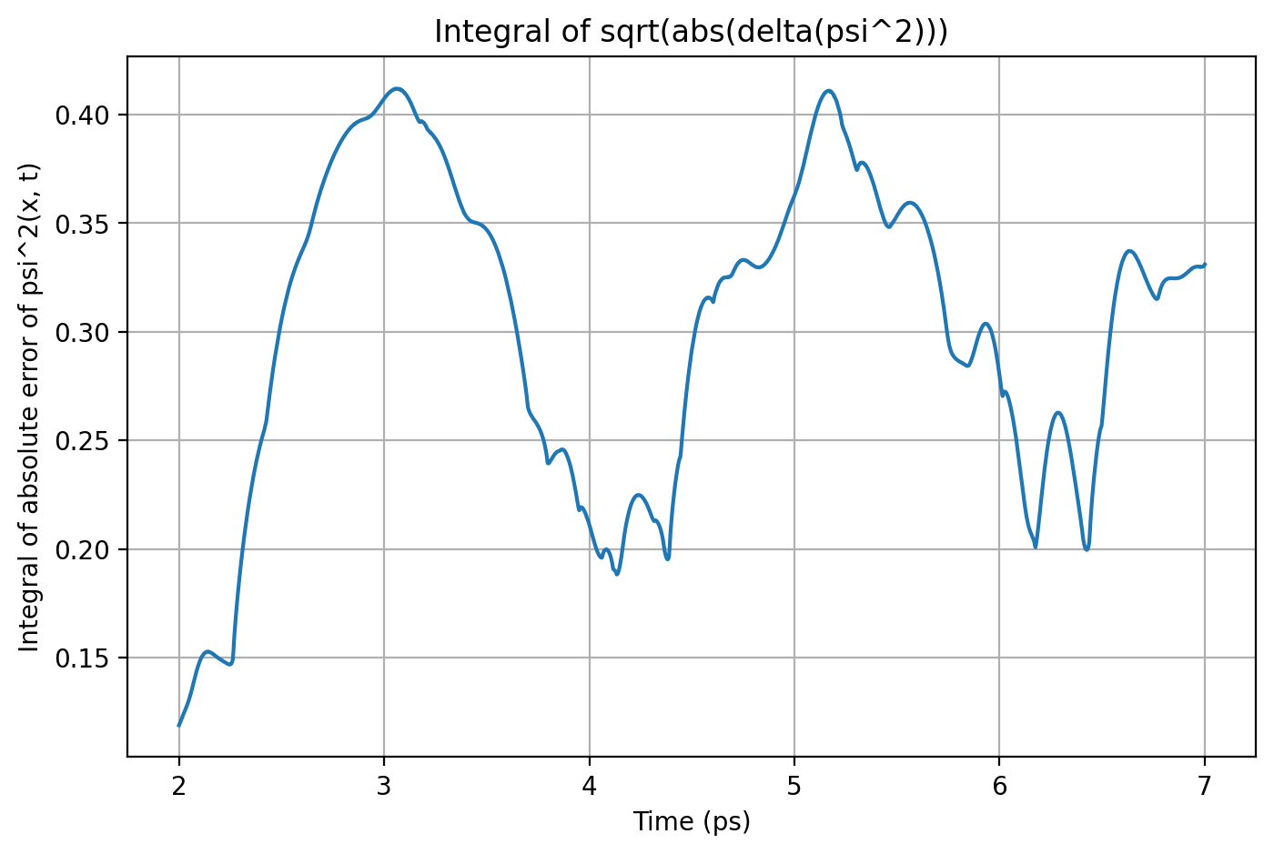


Slide 31

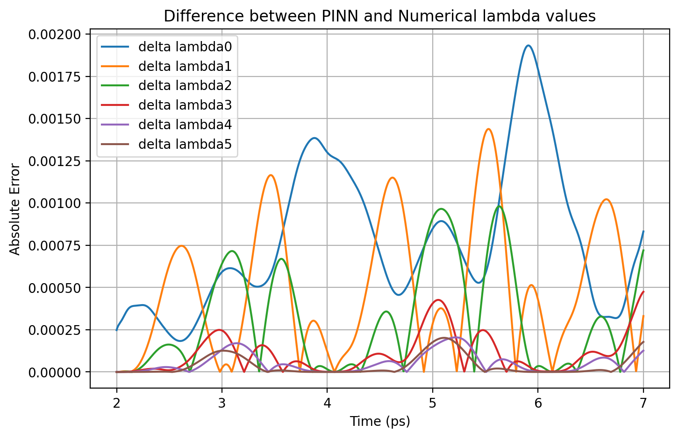


Slide 32
Result Comparison
 | ΔΨ² - max | Norm - mean | Norm - std | Δλi - max
Base Model | 0.00064 | 0.99958 | 0.00084 | 0.00200
Causal - 5 | 0.00062 | 0.99935 | 0.00054 | 0.00150
Causal - 20 | 0.00077 | 0.99913 | 0.00075 | 0.00240
Norm - 5 | 0.00057 | 1.00011 | 0.00018 | 0.00200
Norm - 20 | 0.00062 | 1.00117 | 0.00028 | 0.00193

Slide 33
Time-dependent Curvature
Crank Nicholson Results
t0 = 0 and t1 = 1, 2, 3, 4, 5

Slide 34
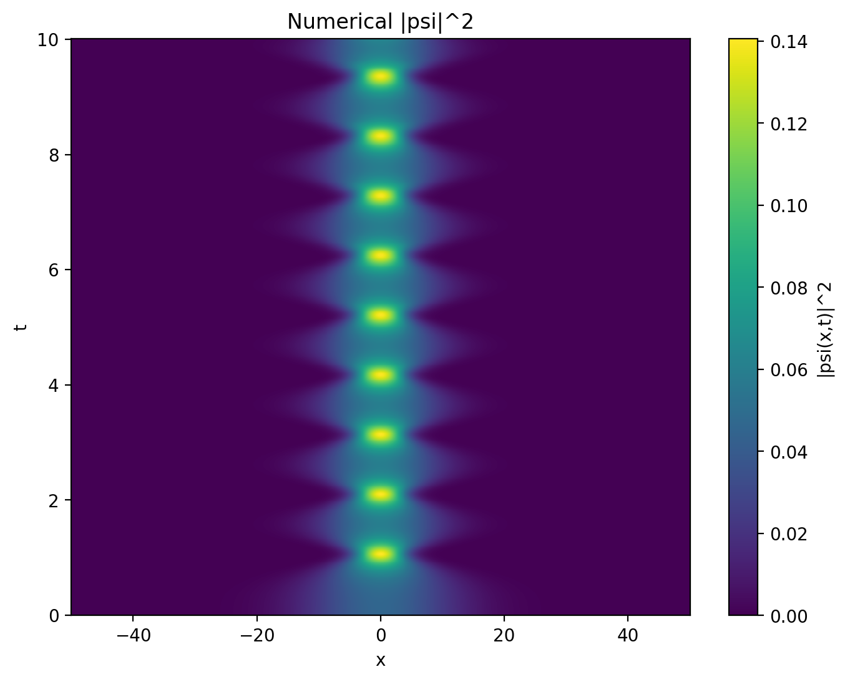
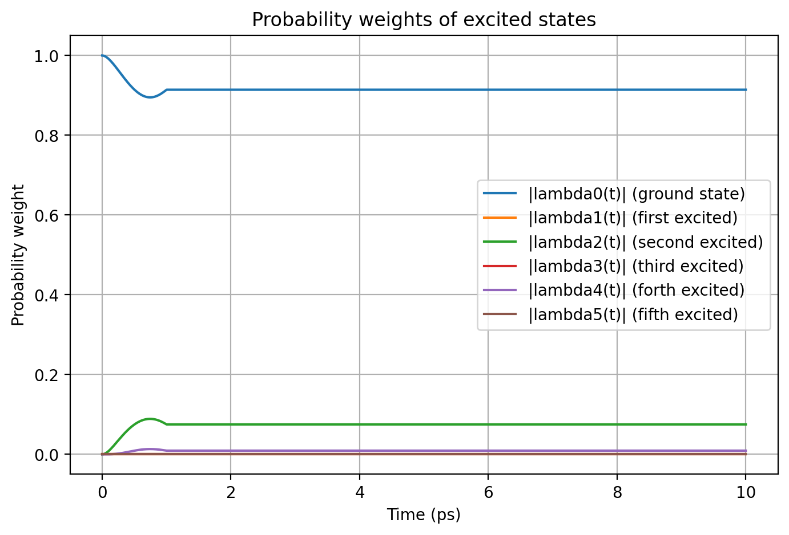
t0 = 0, t1 = 1

Slide 35
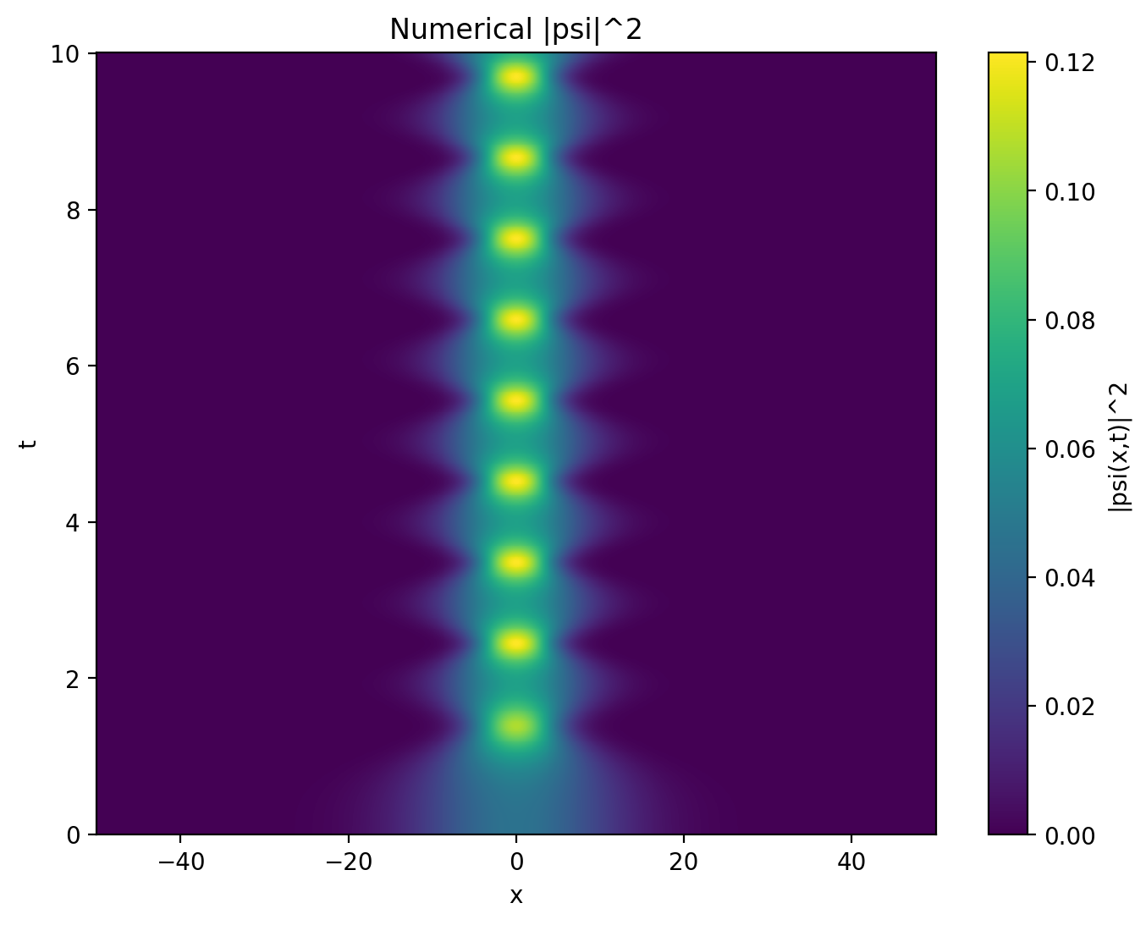

t0 = 0, t1 = 2

Slide 36


t0 = 0, t1 = 3

Slide 37


t0 = 0, t1 = 4

Slide 38


t0 = 0, t1 = 5

Slide 39
.end

