Slide 1
Meeting on 03/03/2025

Slide 2
Started using Pytorch
Experimented with a larger x boundary
Used random points for each training iteration
Implemented regularisation: Tried using weights for individual losses
MSE of |ψ|² = 2.11 x 10⁻⁵

Slide 3
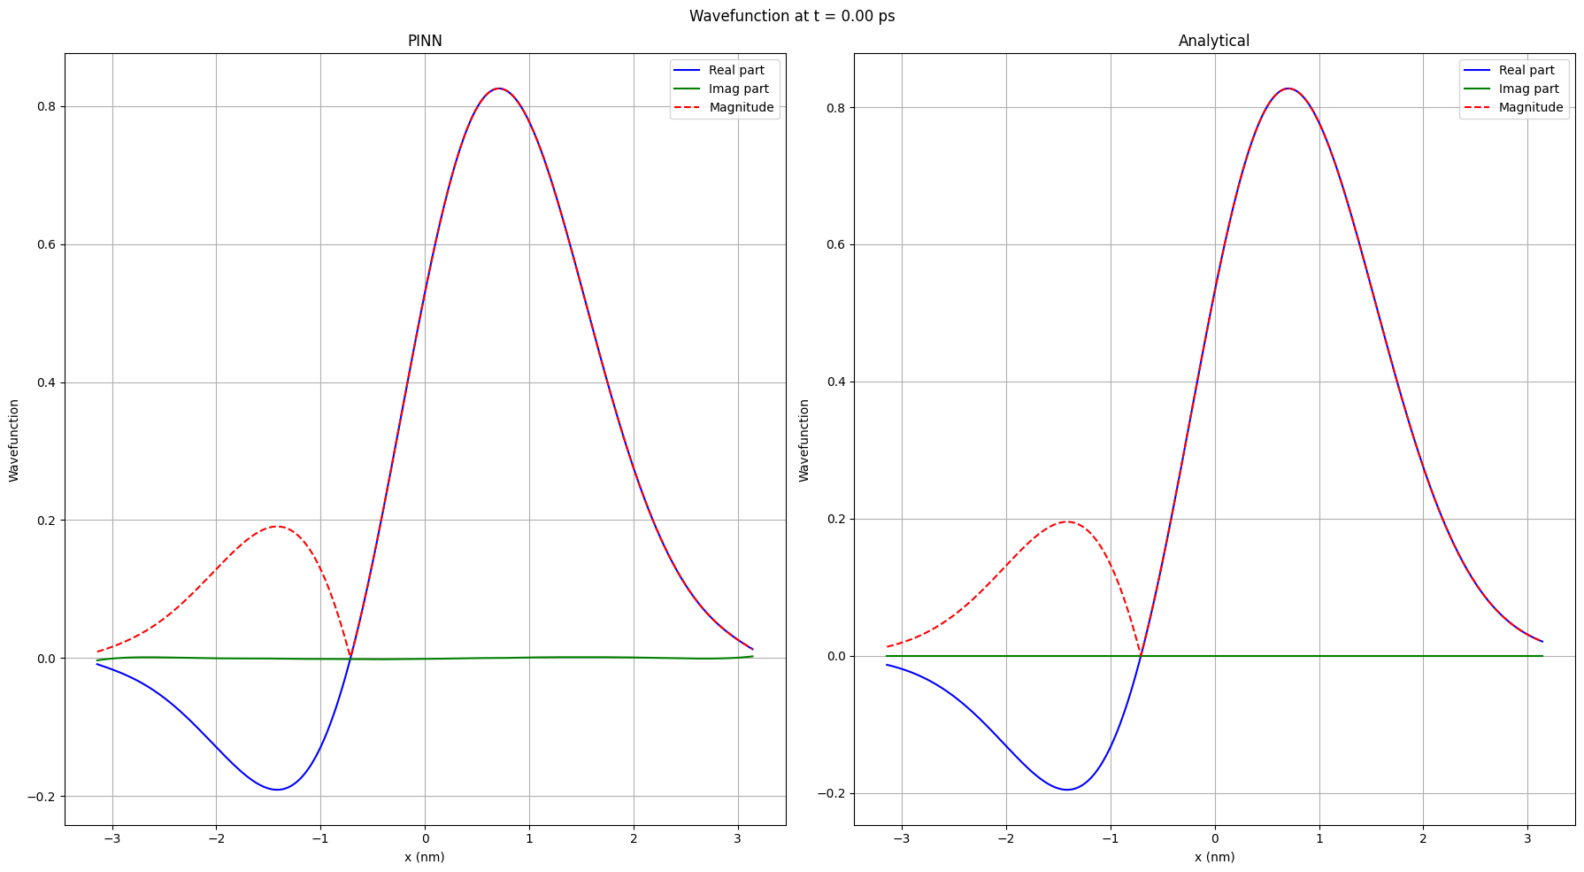

Slide 4
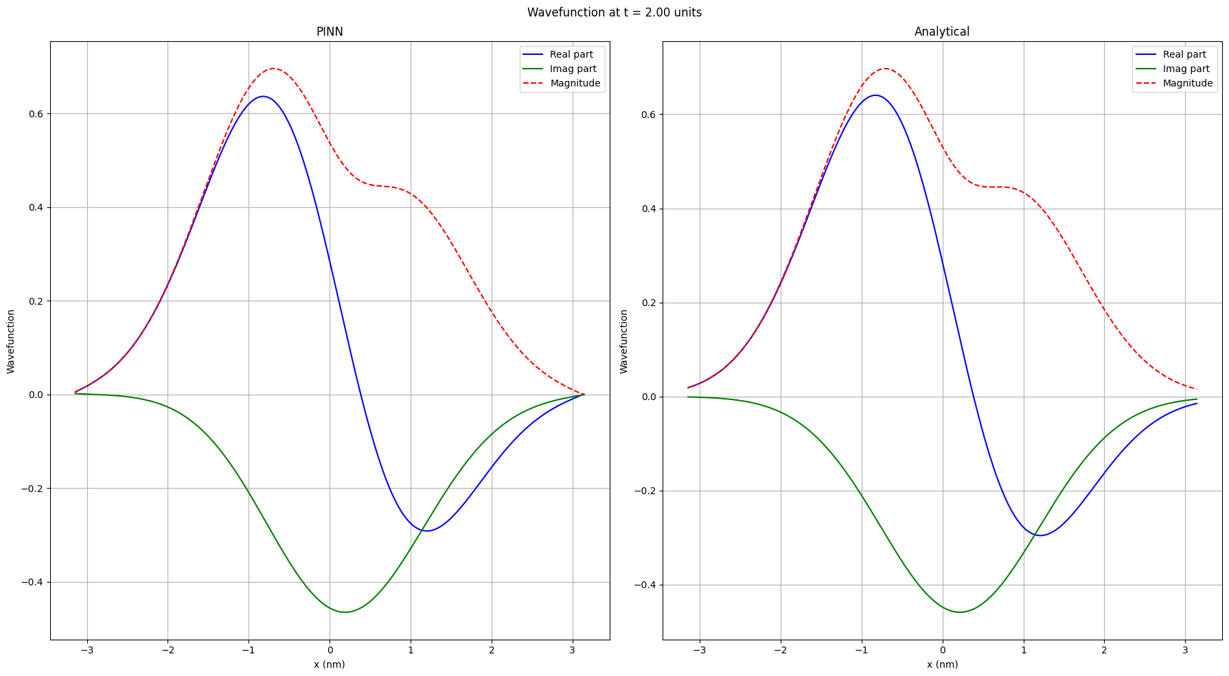

Slide 5
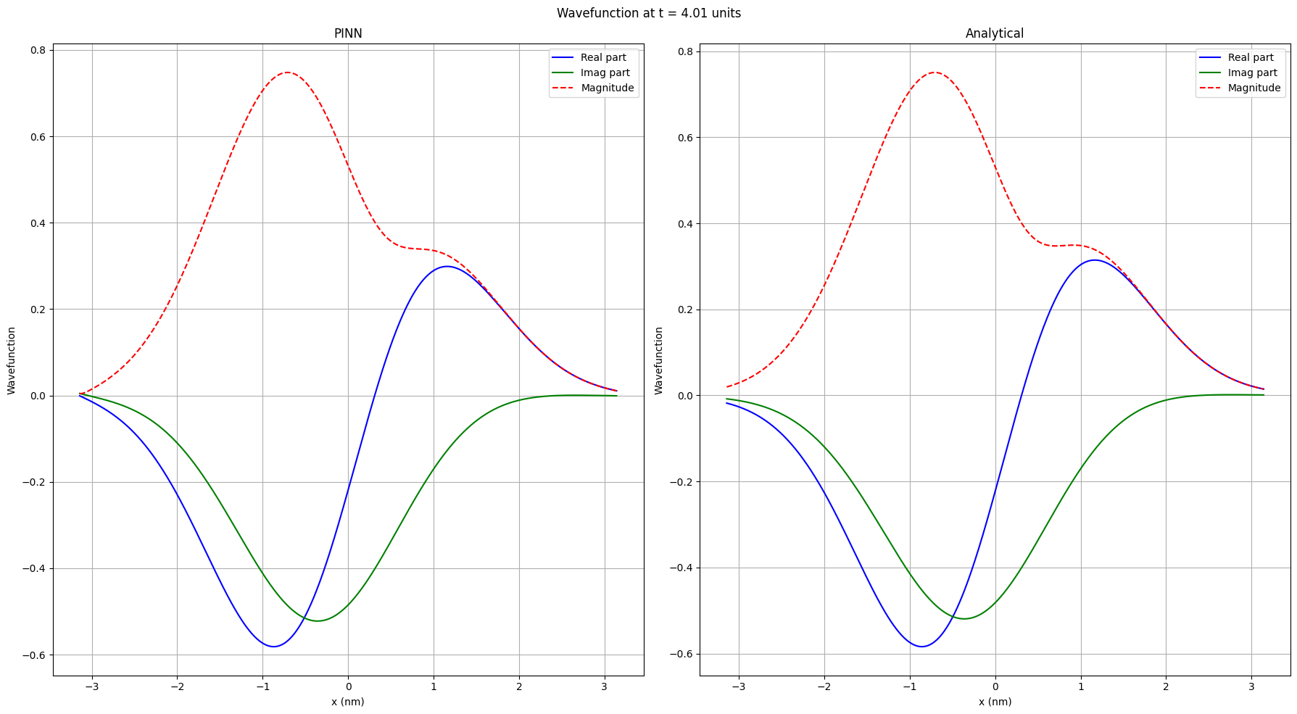

Slide 6
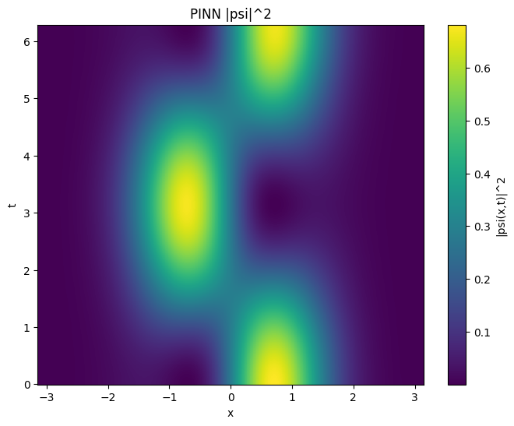


Slide 7
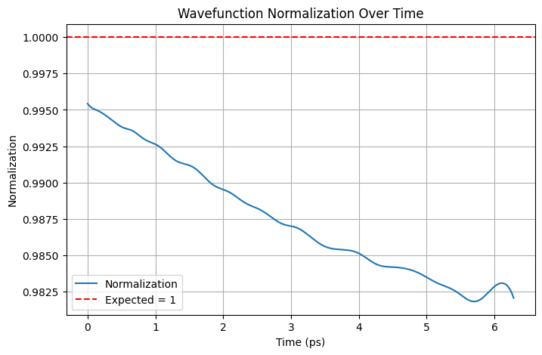

Slide 8
.end

