Slide 1
Meeting - 10/03/2025

Slide 2
Initial condition: Ground State
MSE = 3.991 x 10⁻⁸
Initial condition:
Analytical equation:

Slide 3
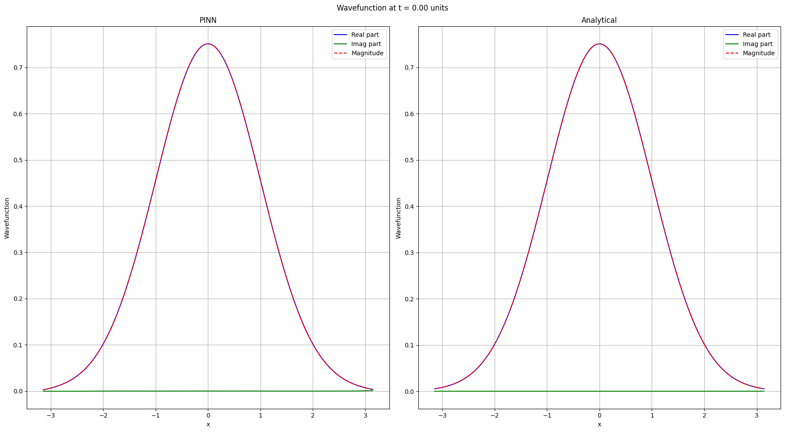

Slide 4
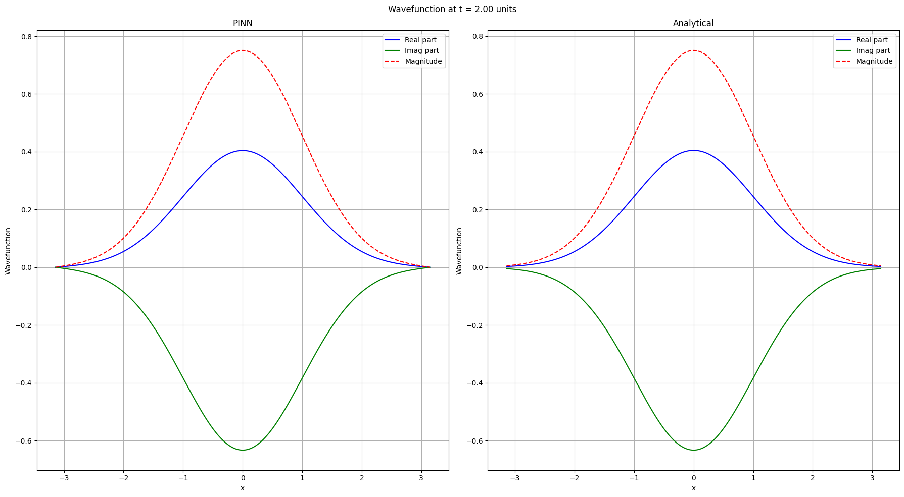

Slide 5
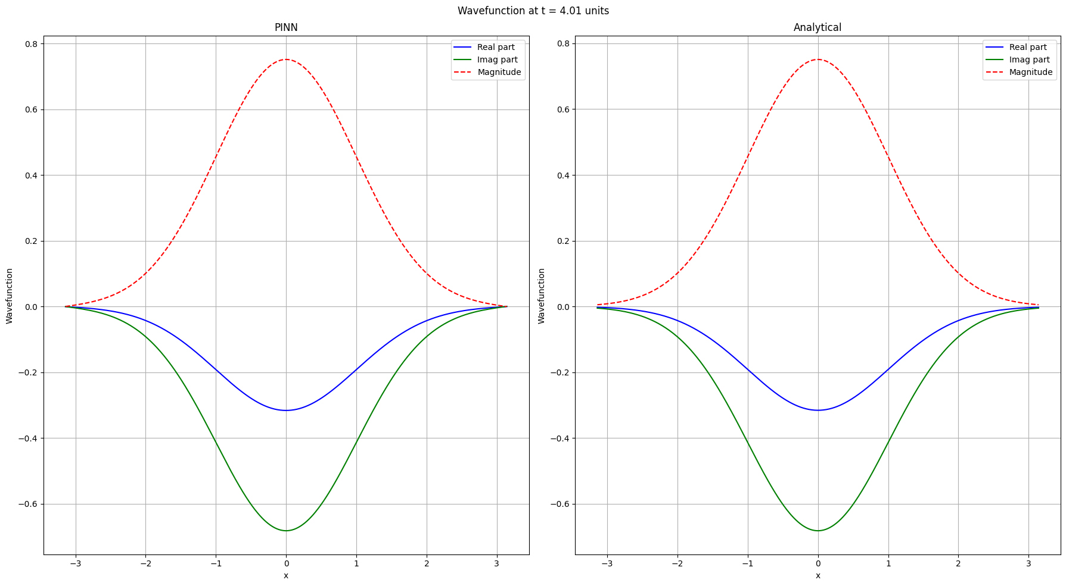

Slide 6
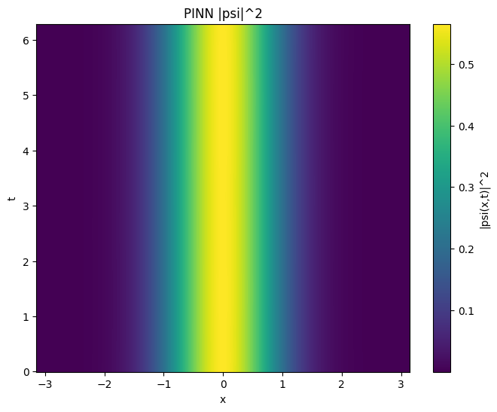
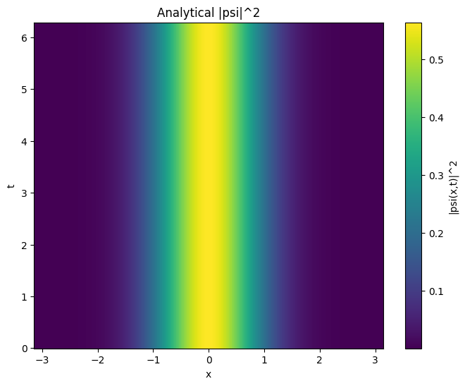

Slide 7
Initial condition: First Excited State
MSE = 5.851 x 10⁻⁵
Initial condition:
Analytical equation:

Slide 8
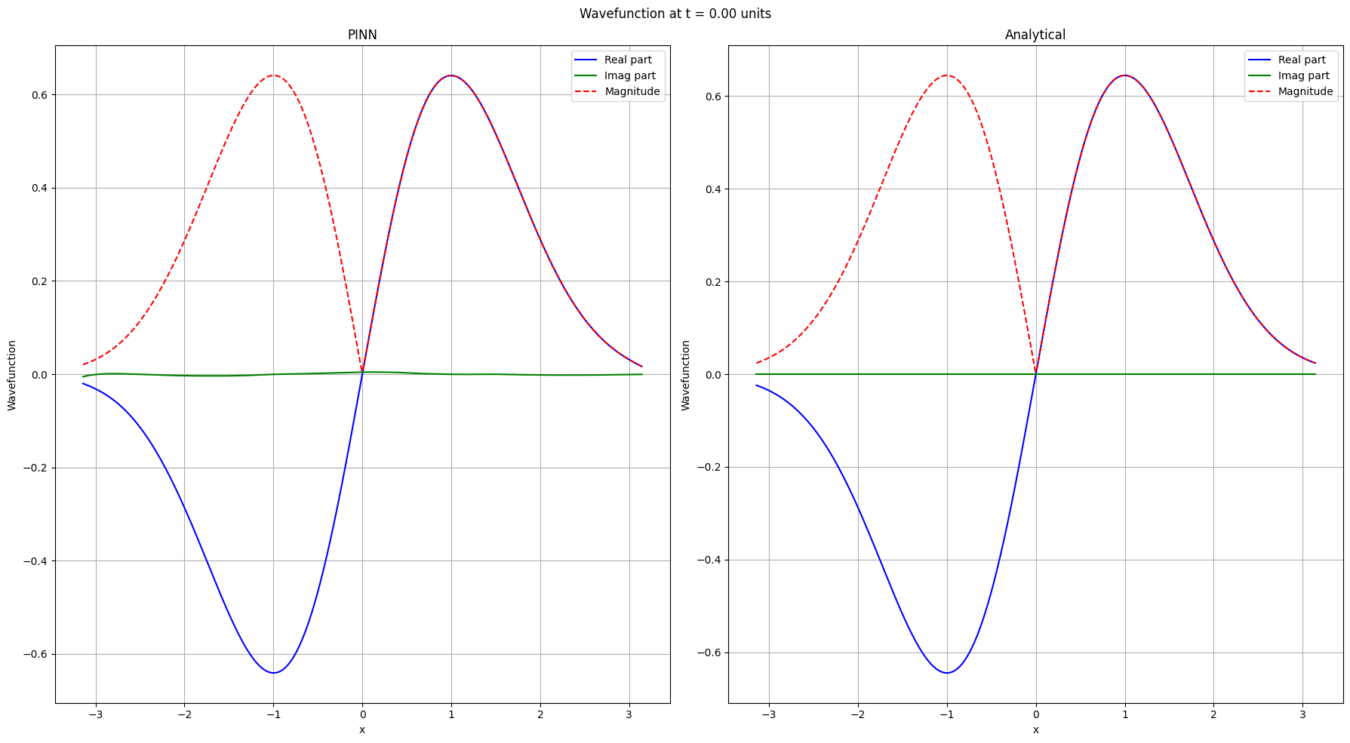

Slide 9
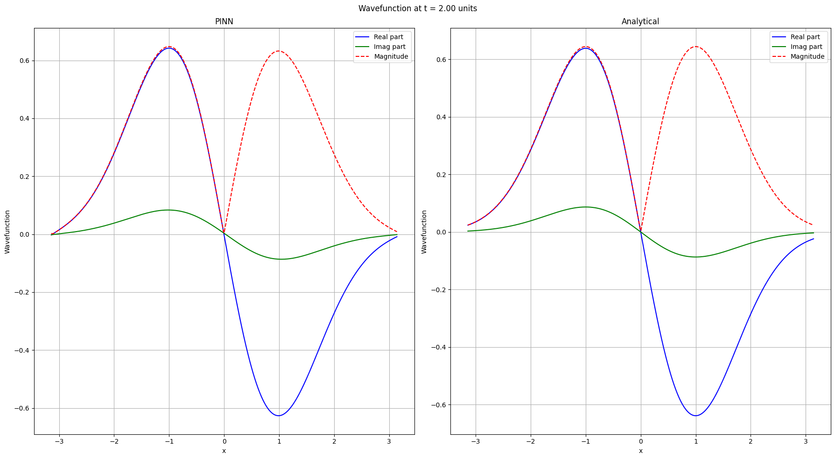

Slide 10
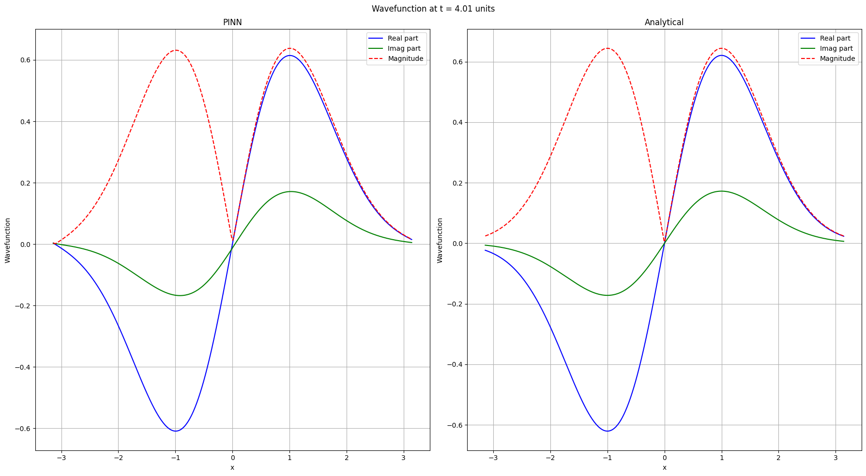

Slide 11
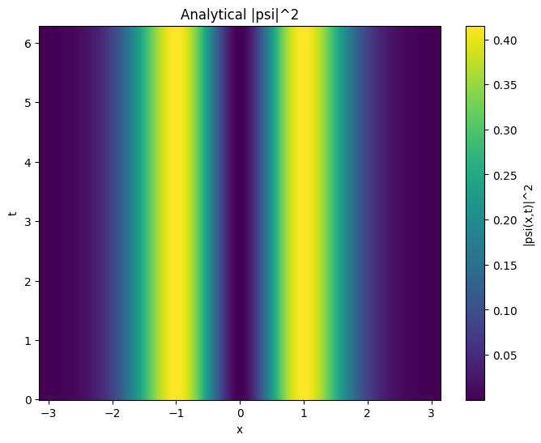
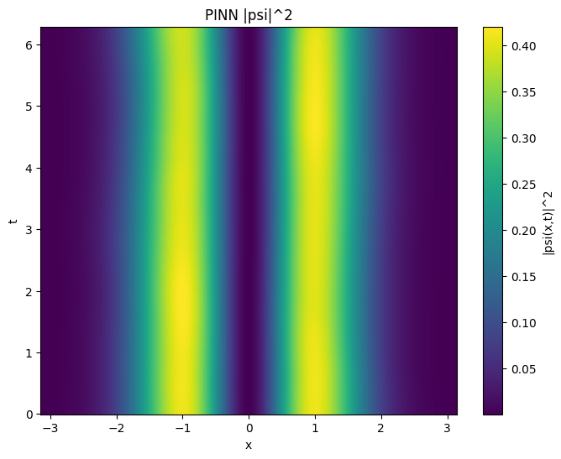

Slide 12
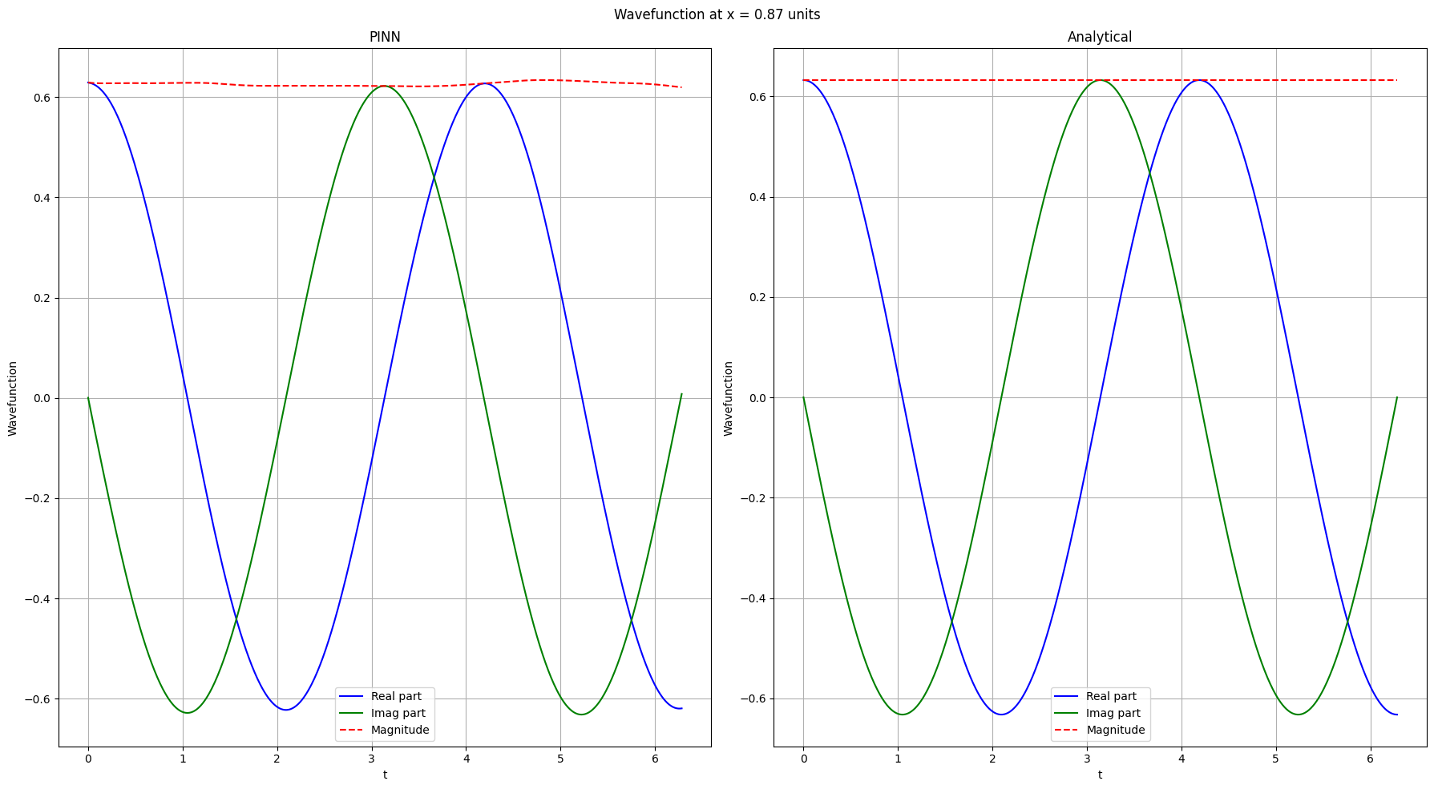

Slide 13
1e 1D model with actual units

Slide 14
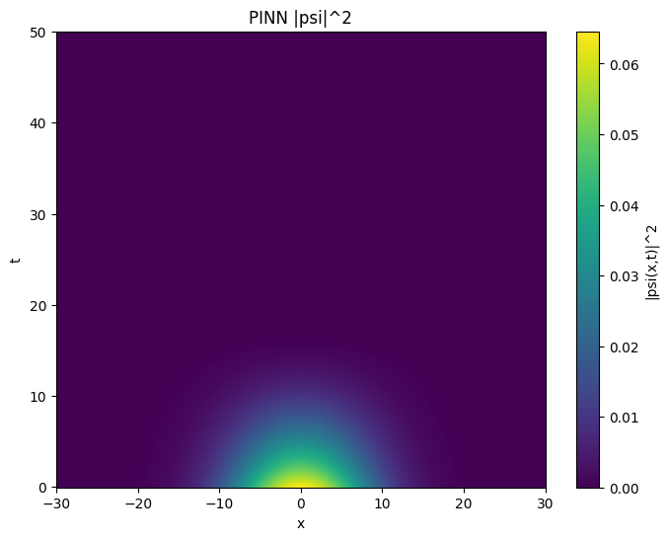
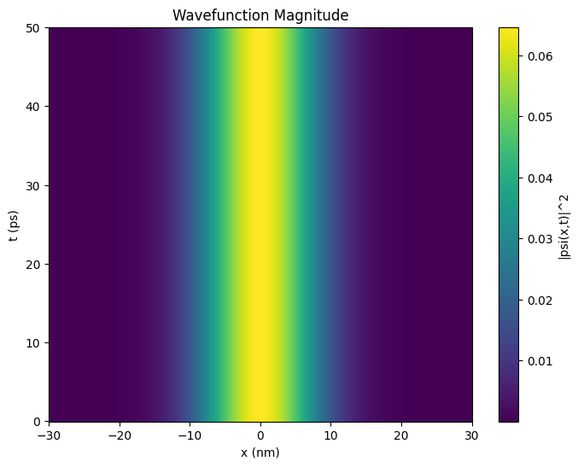

Slide 15
.end

