Slide 1
Meeting – 07/04/2025

Slide 2
Shorter time domain
In this method, I tried to decrease the time domain from 0 → 50ps to 0 → 20ps.
It is to check whether we were having the issue with “longer time domain”.

Slide 3
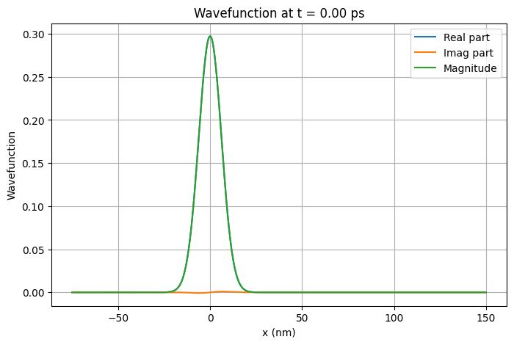

Slide 4
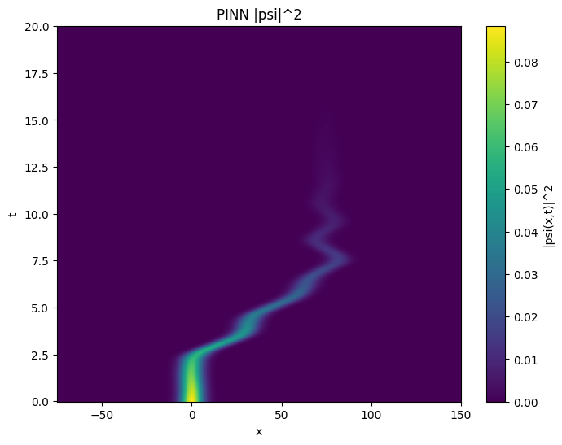
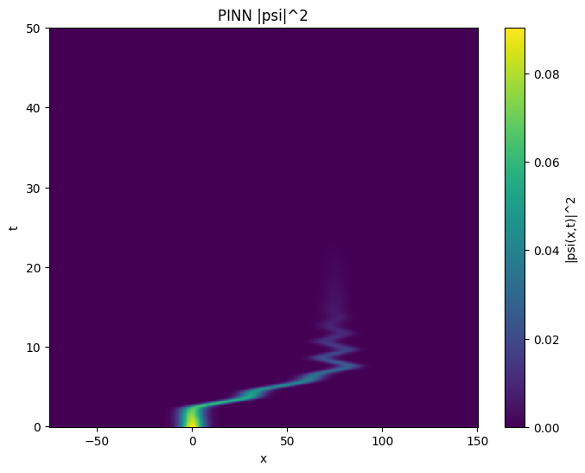

Slide 5


Slide 6
Dynamic Loss Weights
Till now, I have been using weights for individual losses,
  λPDE = 10
  λIC = 1
  λBC = 1
In this method, I started with λPDE = 1 and later increased to 10 and then 100 during mid training, while keeping the other two loss weights the same.

Slide 7
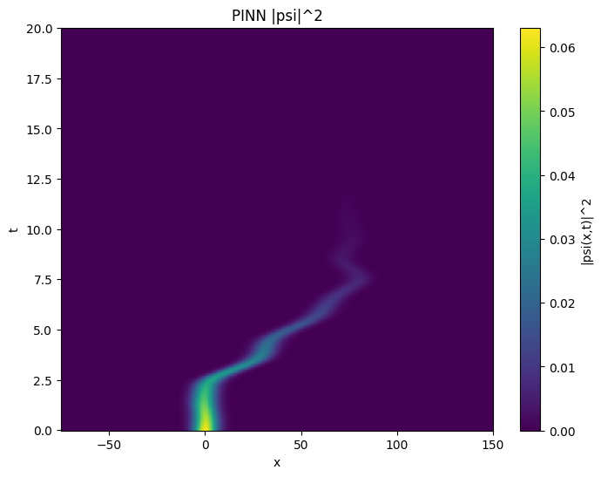

Slide 8
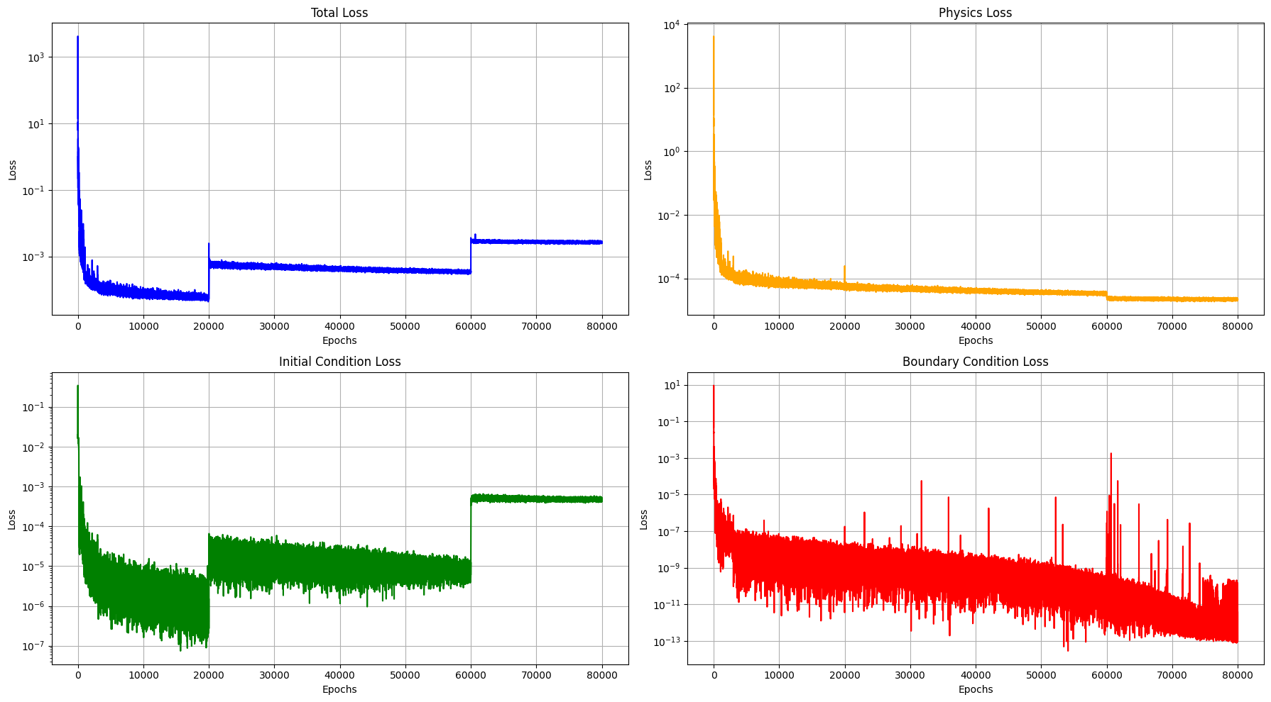

Slide 9
Dynamic t_max for training
In this method, I start by training the model from t_min = 0ps to t_max = t1.
Then increase t_max to t2 and later to 20ps midway through training.
Where,
  t1 = 2ps
  t2 = 7ps

Slide 10
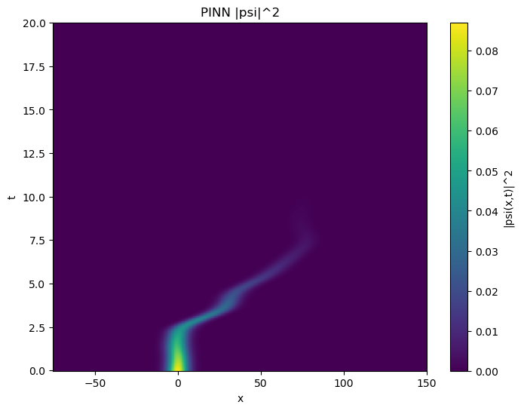

Slide 11
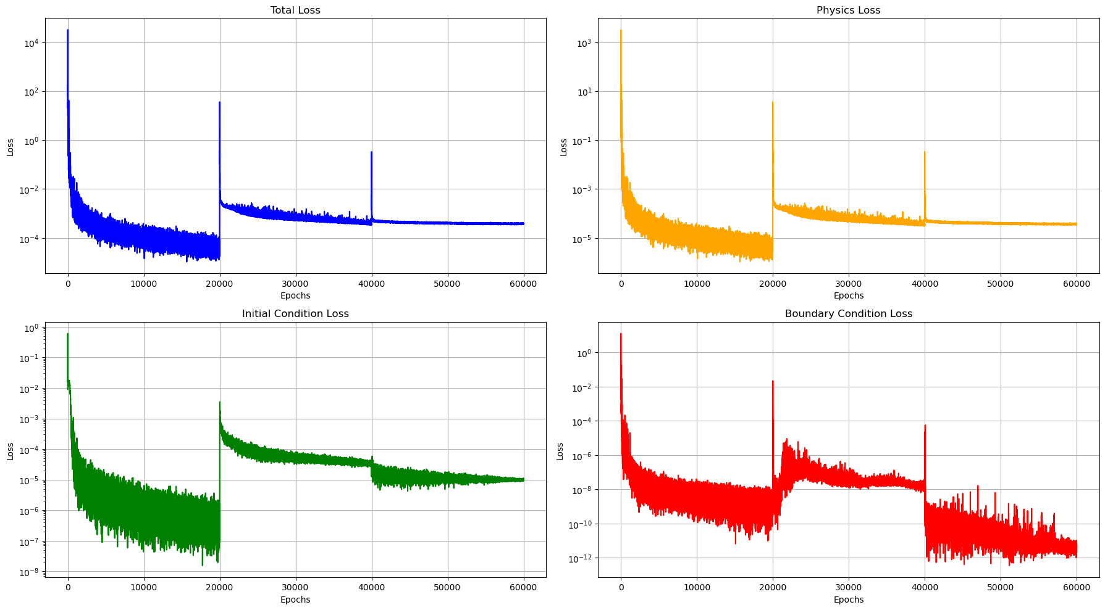

Slide 12
Training as multiple Models
In this method, I tried to train different model with different t_max
  t_max = t1 = 2ps
  t_max = t2 = 7ps
  t_max > t2

Slide 13
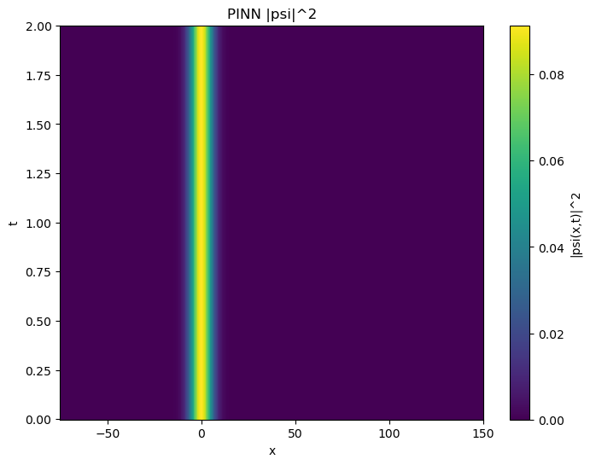

Slide 14
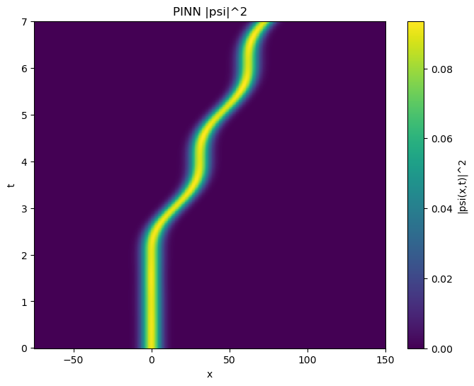

Slide 15
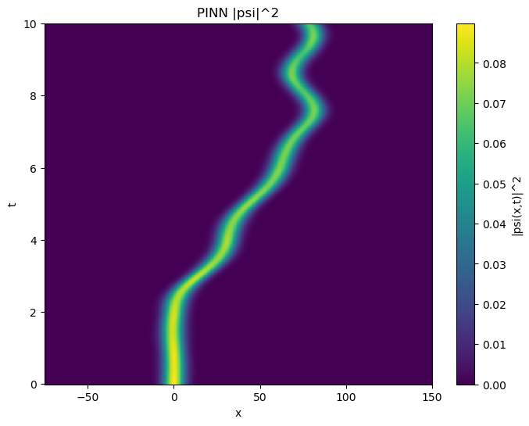

Slide 16
.end

