Slide 1
Physics-Informed Neural Networks for Many-Electron Time-Dependent Schrödinger Equation

Slide 2
Neural Networks
A neural network is a function approximation that maps an input x to an output y, learning patterns from data.
Mathematically:
  Single layer model:
  Multilayer model:
Single-layer networks can only learn linear functions while deep networks (multiple hidden layers) enable learning complex, nonlinear mappings.
Activation function: tanh →

Slide 3
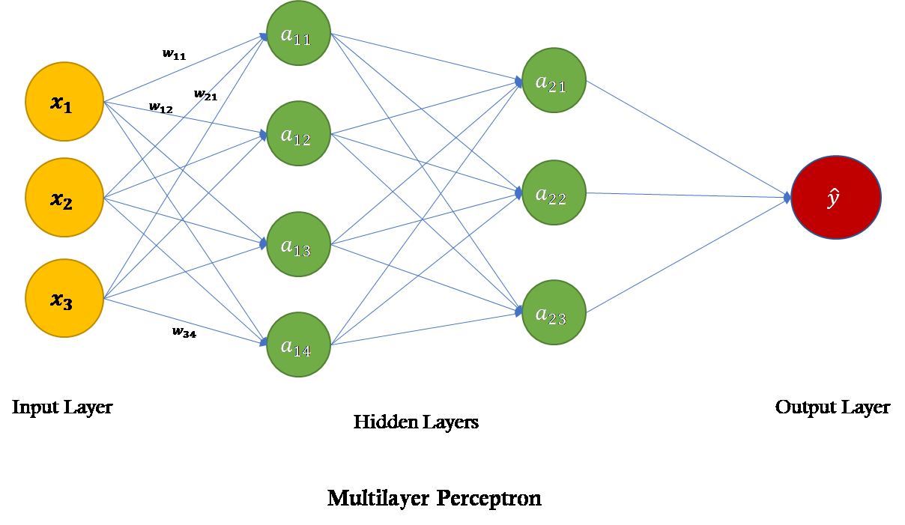

Slide 4
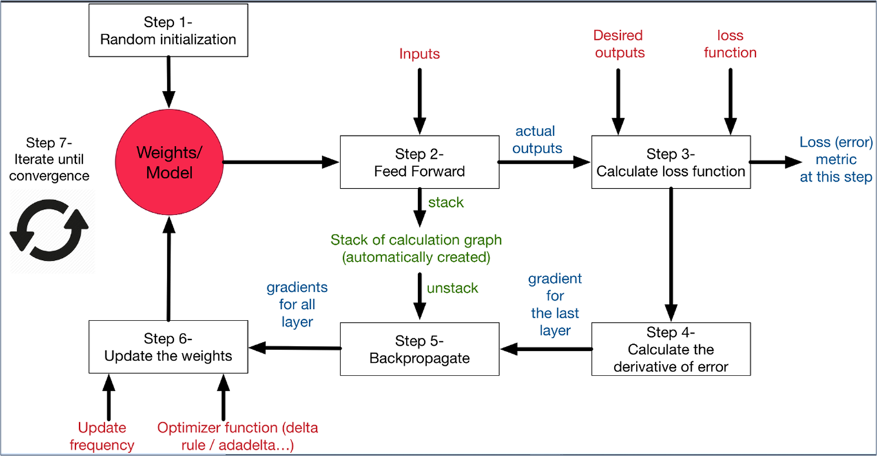

Slide 5
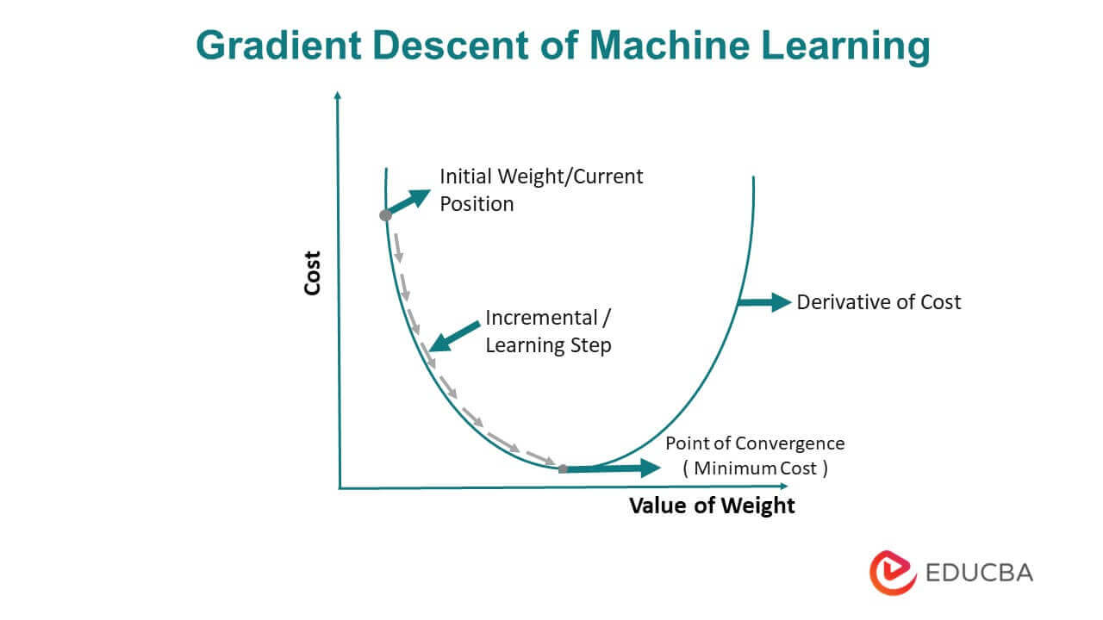

Slide 6
Physics-Informed Neural Networks (PINNs)
PINNs are neural networks trained to solve partial differential equations (PDEs) by introducing physical laws into their loss function.
Traditional numerical solvers can be computationally expensive for high-dimensional problems.
Instead of training purely on data, PINNs ensure that solutions satisfy the governing equations (e.g., Schrödinger equation) via loss terms.

Slide 7
How Do PINNs Work?
A neural network is trained to approximate the solution of a PDE.
Loss functions:
  Physics Loss ( LPDE )
  Initial condition loss ( Linitial )
  Boundary condition loss ( Lboundary )
  Total loss = LPDE + Linitial + Lboundary

Slide 8

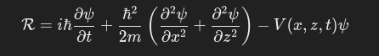
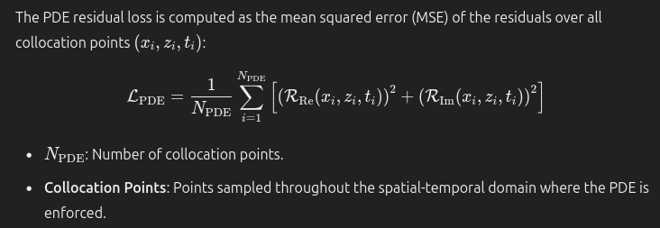

Slide 9
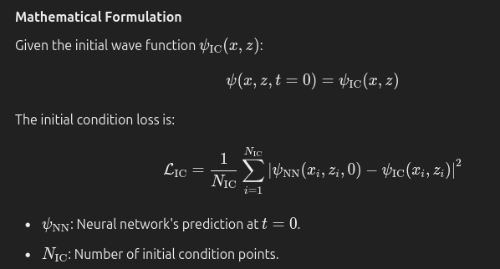

Slide 10
Physics-Informed Neural Networks for Many-Electron Time-Dependent Schrödinger Equation
Develop and apply PINNs to solve the many-electron time-dependent Schrödinger equation (TDSE).
Solving TDSE for many-electron systems is computationally intensive using traditional methods.

Slide 11
Research Project Roadmap
Single-electron time-independent one-dimensional model
Single-electron time-dependent one-dimensional model
  Moving quantum dot
  Double quantum dots with silicon charge qubits
Single-electron three-dimensional model
Many electron models
  Quantum dot array

Slide 12
Single-Electron Time-Dependent 1D Model
Why start with single-electron models?
  Serves as a benchmark for validating the PINN approach.
  Easier to compare with analytical and numerical solutions.
  Provides insights into training behaviour before scaling to multi-electron cases.
Time-Dependent Schrodinger equation for a single electron in 1D harmonic potential:

Slide 13
Neural Network Representation of the Schrödinger Equation
Neural Network Setup:
  Inputs: Position x and time t
  Outputs: Real and Imaginary part of ψ
  Activation functions: tanh
  Hidden Layers: 64, 128, 128, 64
  Optimiser: Adam

Slide 14
Neural Network Representation of the Schrödinger Equation
Loss Function:
  Physics loss:
    MSE of
  Initial condition loss:
    MSE of
  Boundary condition loss: MSE of ψ at spacial boundaries = 0

Slide 15
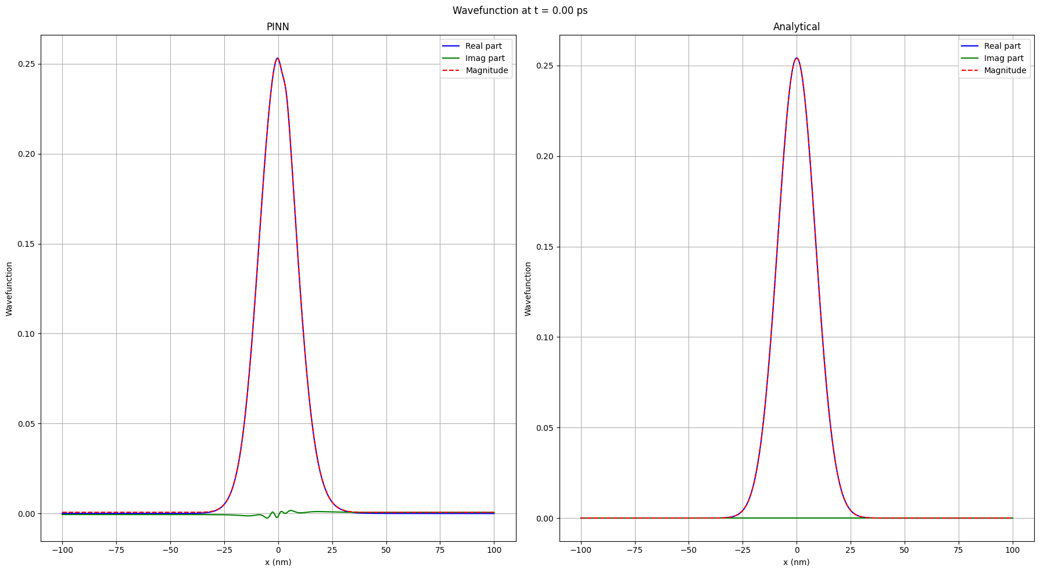

Slide 16
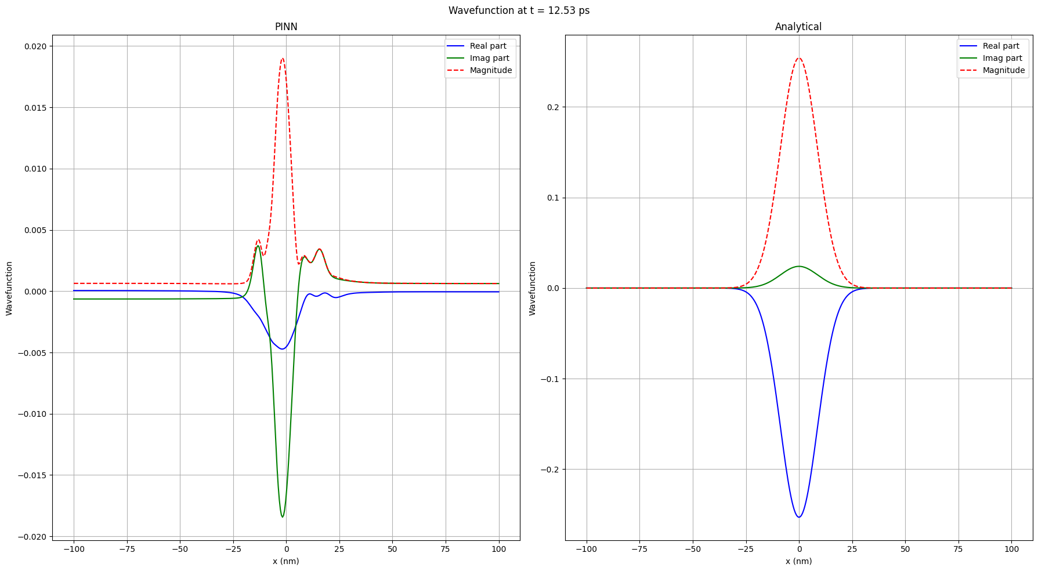

Slide 17
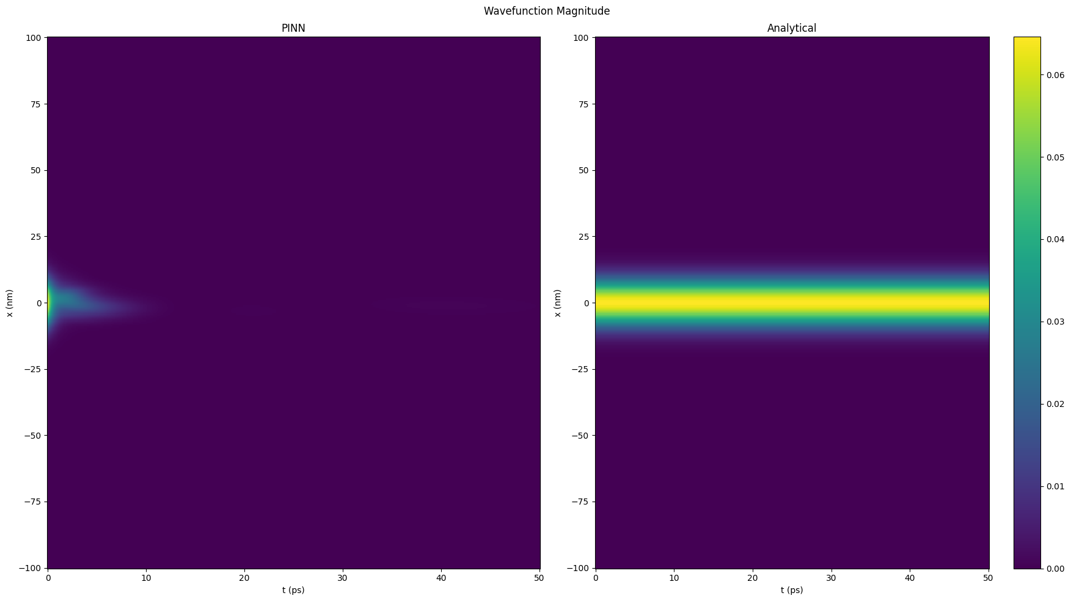

Slide 18
Reference Paper:PINN as Solvers for the Time-Dependent Schrödinger Equation
Demonstrates the use of PINNs for solving the 1D time-dependent Schrödinger equation (TDSE) on quantum harmonic oscillator dynamics.
Investigates generalisability, larger time domains, and higher energy states.
Baseline results:
  PINN accurately reconstructs superposition states of the harmonic oscillator.
  Mean Squared Error (MSE) ≈ 10⁻⁵ for probability density.
Their methodology and results might help guide my single-electron TDSE implementation.

Slide 19
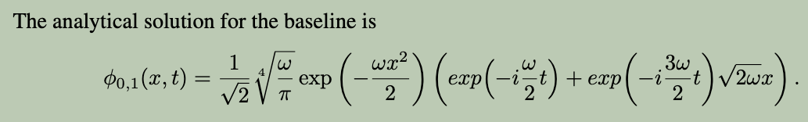
Reference Paper: Neural Network Architecture
They used a batch size of 3140 points for the interior, 200 points for the boundary conditions and 314 points for initial conditions.
A fully-connected network with 6 layers consisting of 512 neurons each.
We use the ADAM optimiser with ß1 = 0.09, ß2 = 0.999.
The learning rate is initialised at α0 = 0.001 with exponential decay rate γ = 0.9 at decay steps tγ = 2000 training steps with schedule αt = α0 γ^{t/tγ}

Slide 20
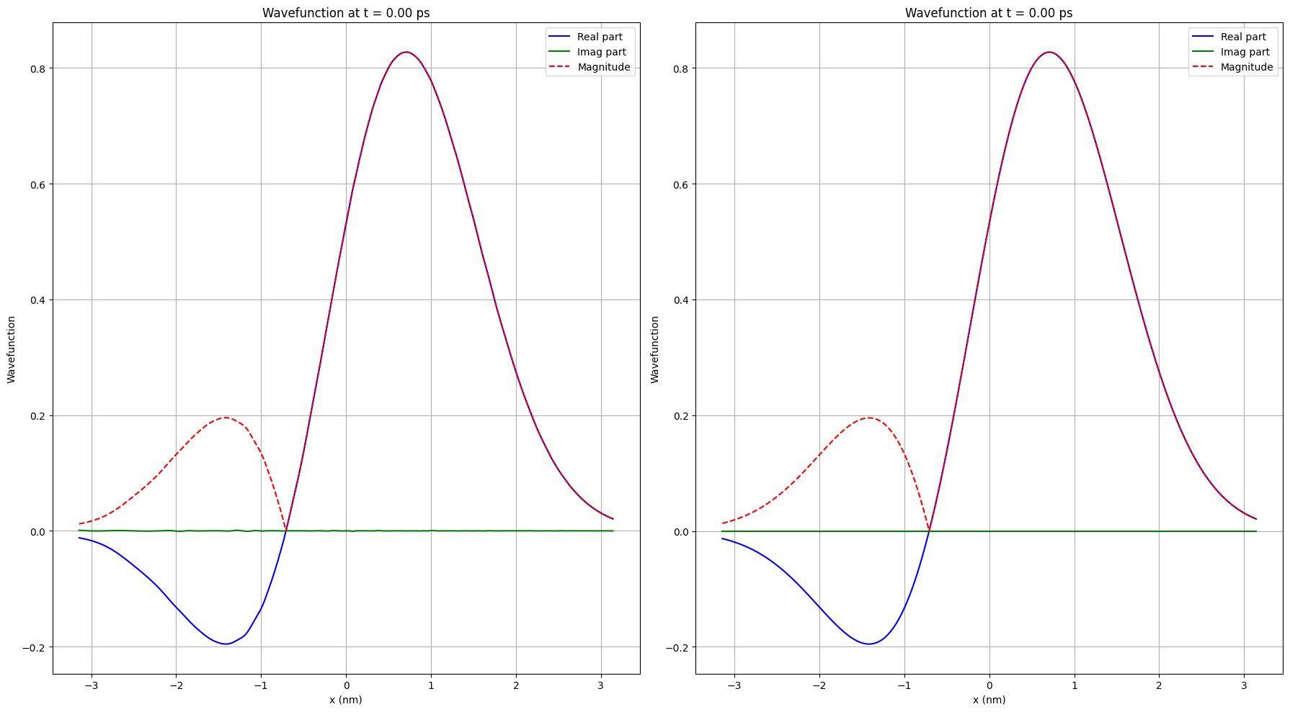

Slide 21
