Slide 1
Meeting - 30/06/2025

Slide 2
Causal + Norm (Base Model)
I implemented my current best normalization loss method with the causal model
Base Model – 10 HL and 150k epochs

Slide 3

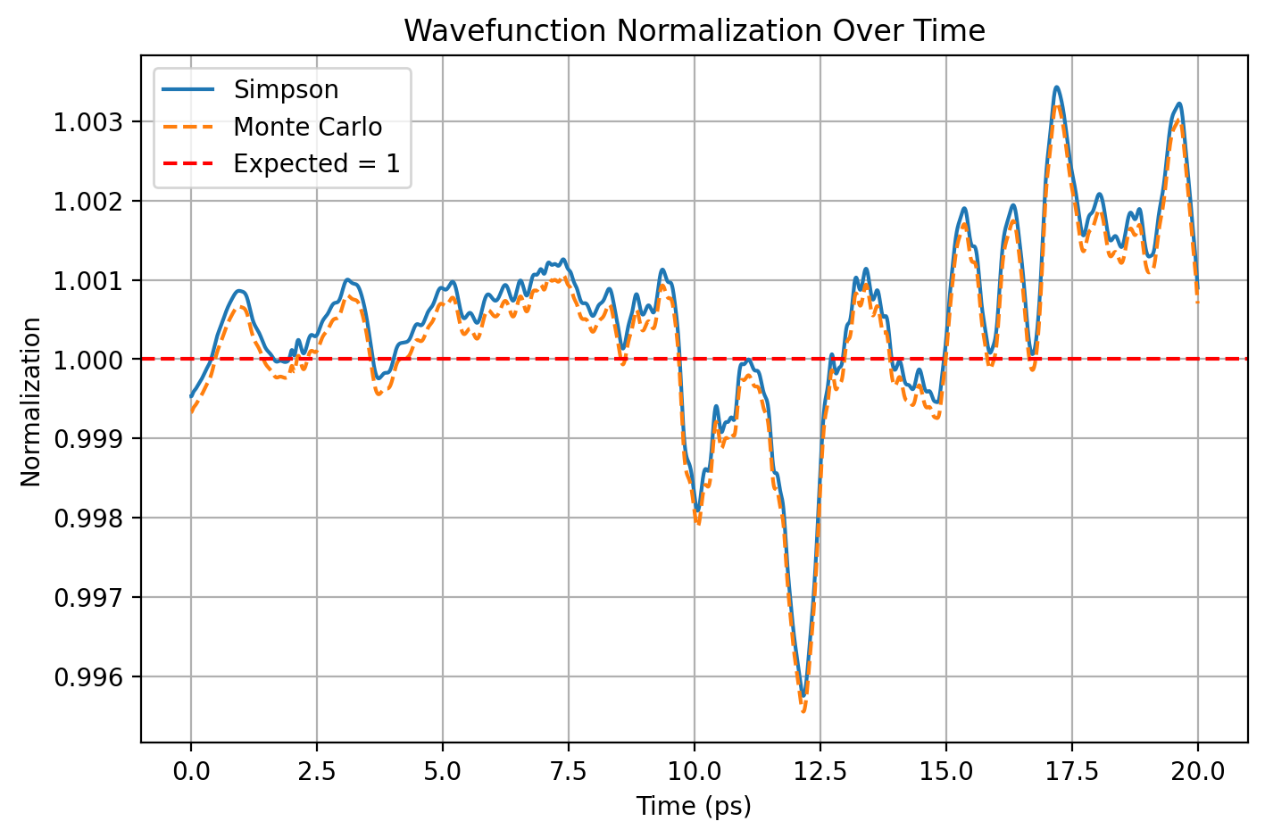


Slide 4
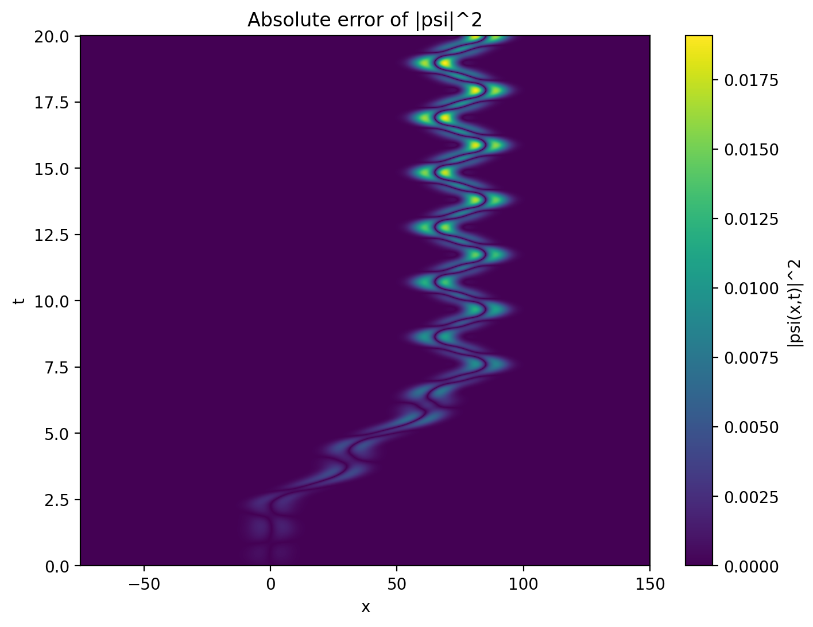
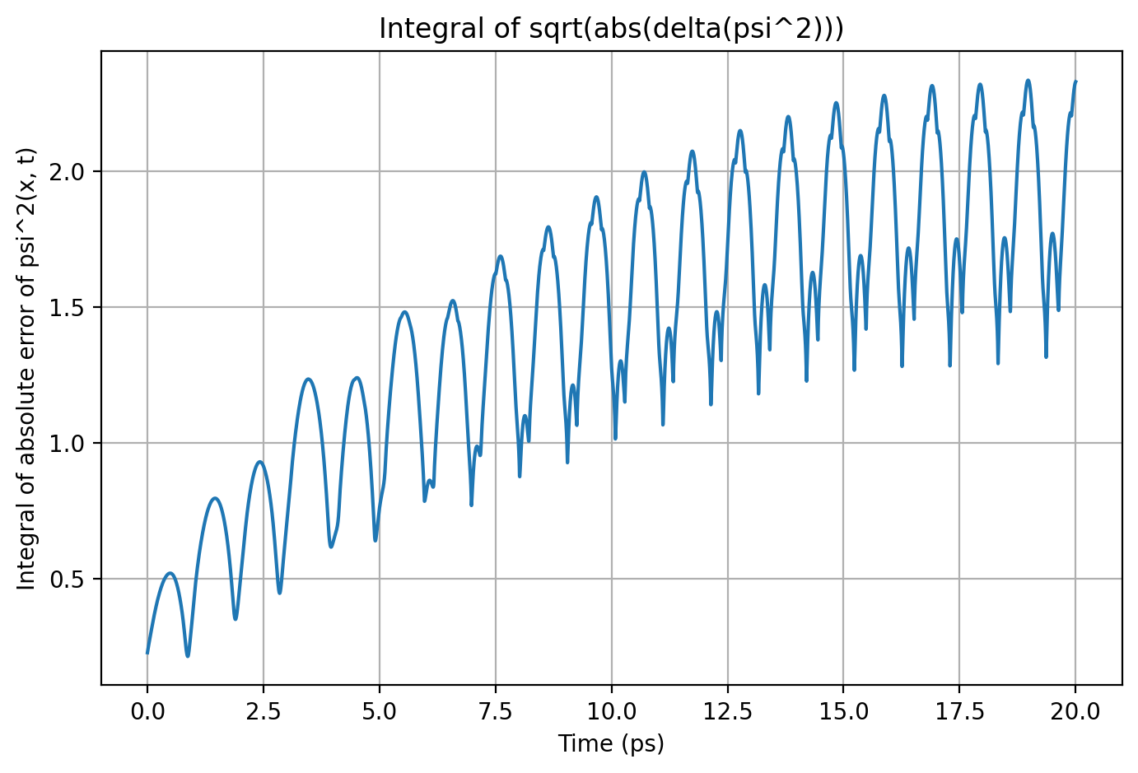


Slide 5
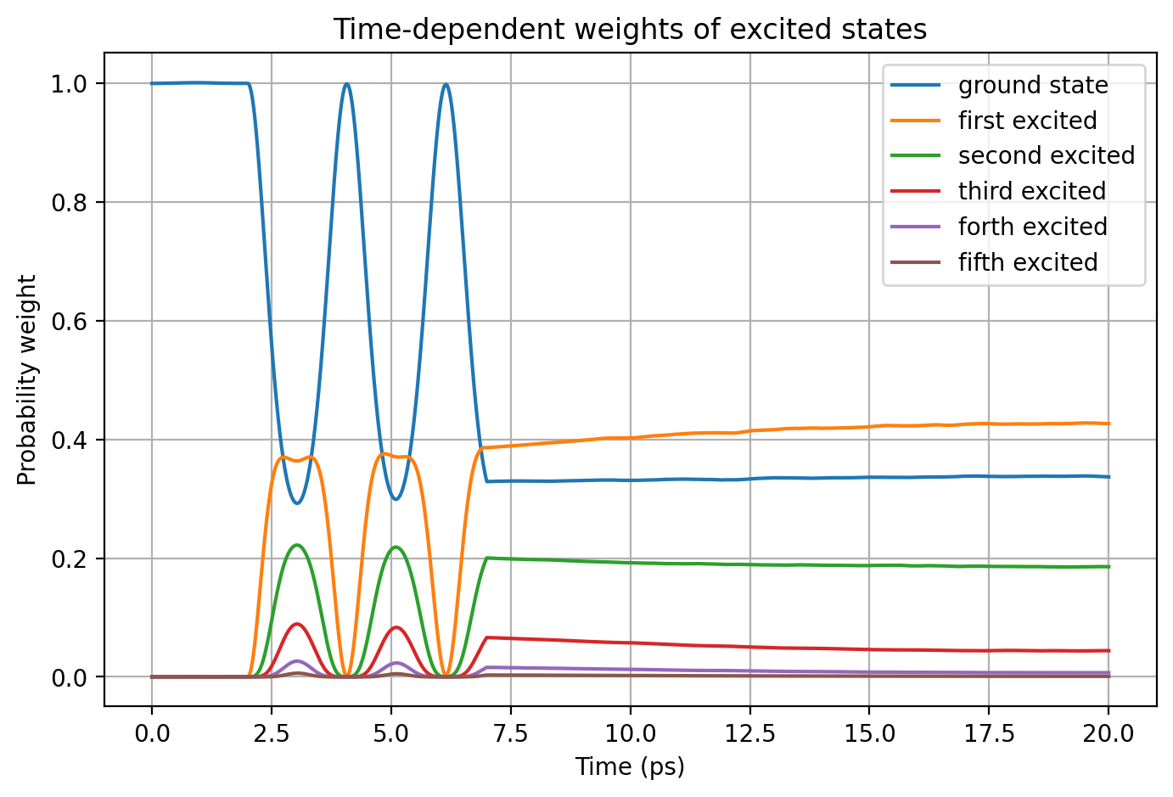
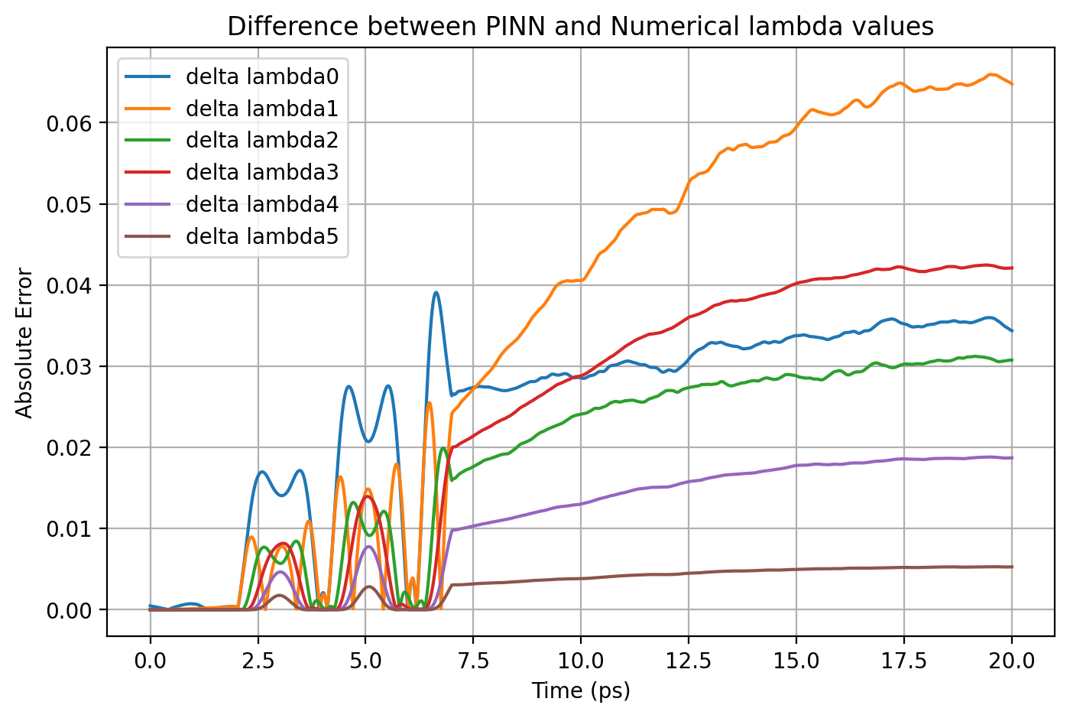


Slide 6
Result Comparison
 | ΔΨ² - max | norm - mean | norm - std | Δλi - max
Causal Model | 0.01846 | 0.94607 | 0.01861 | 0.04159
Causal + Norm | 0.01081 | 1.00133 | 0.00125 | 0.03506

Slide 7
Causal + Norm (Prime Model)
I implemented my current best normalization loss method with the causal model
Prime Model – 12 HL and 250k epochs

Slide 8

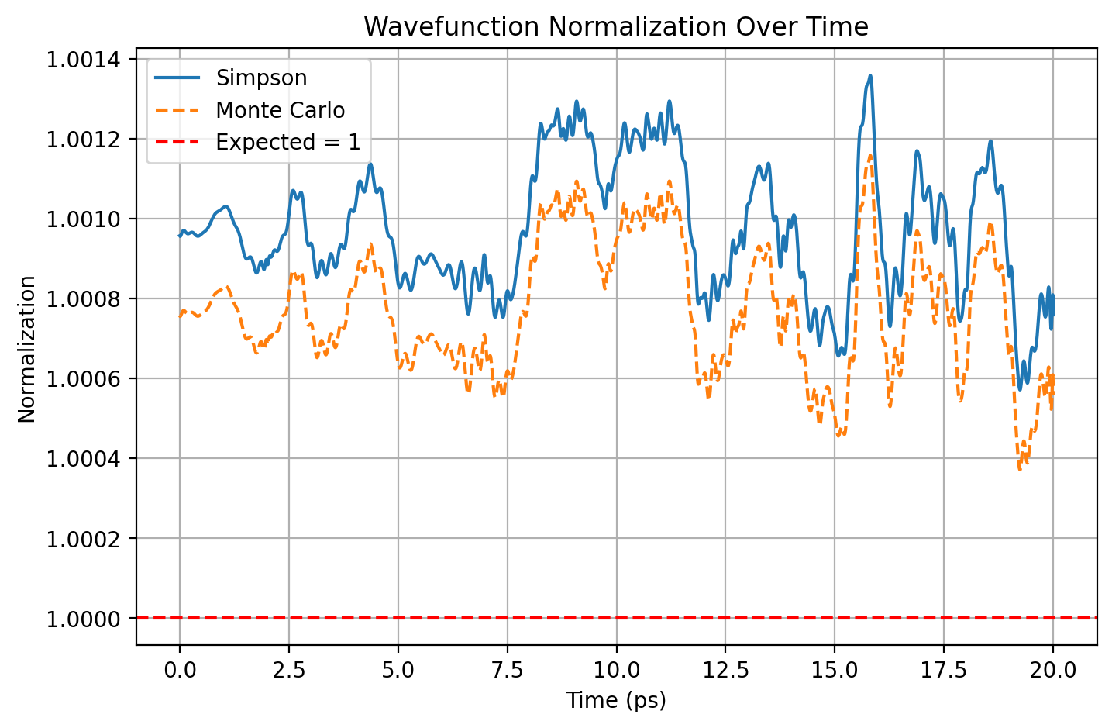


Slide 9
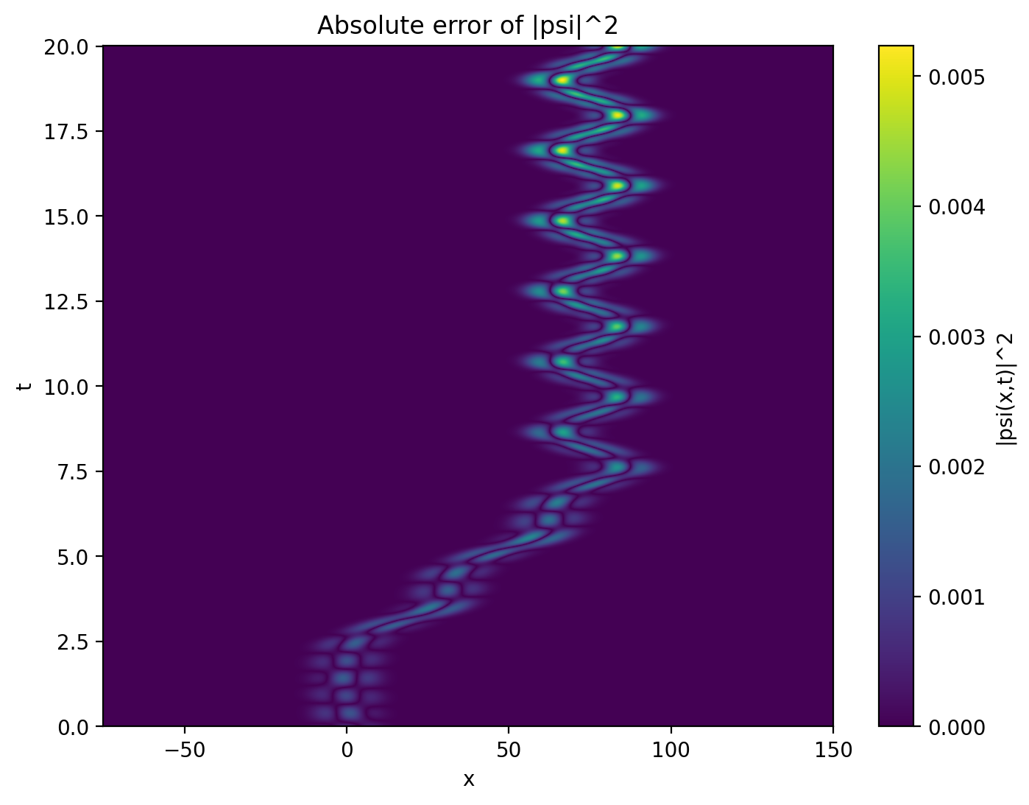
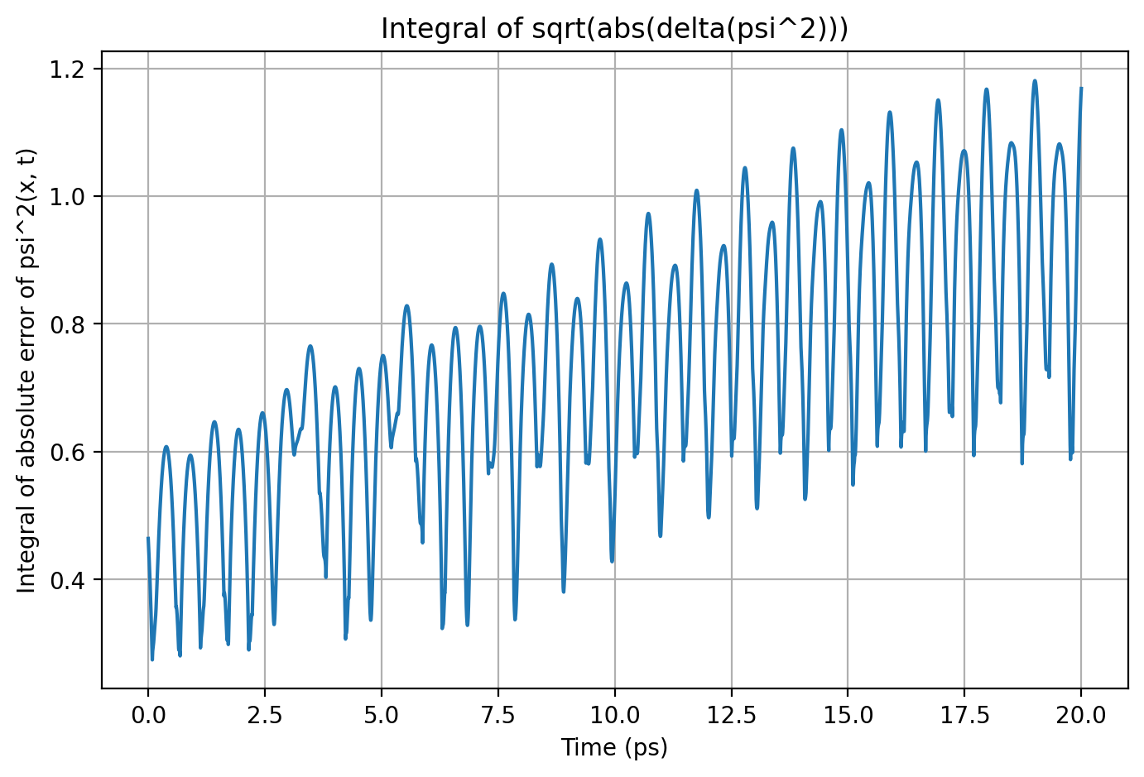


Slide 10
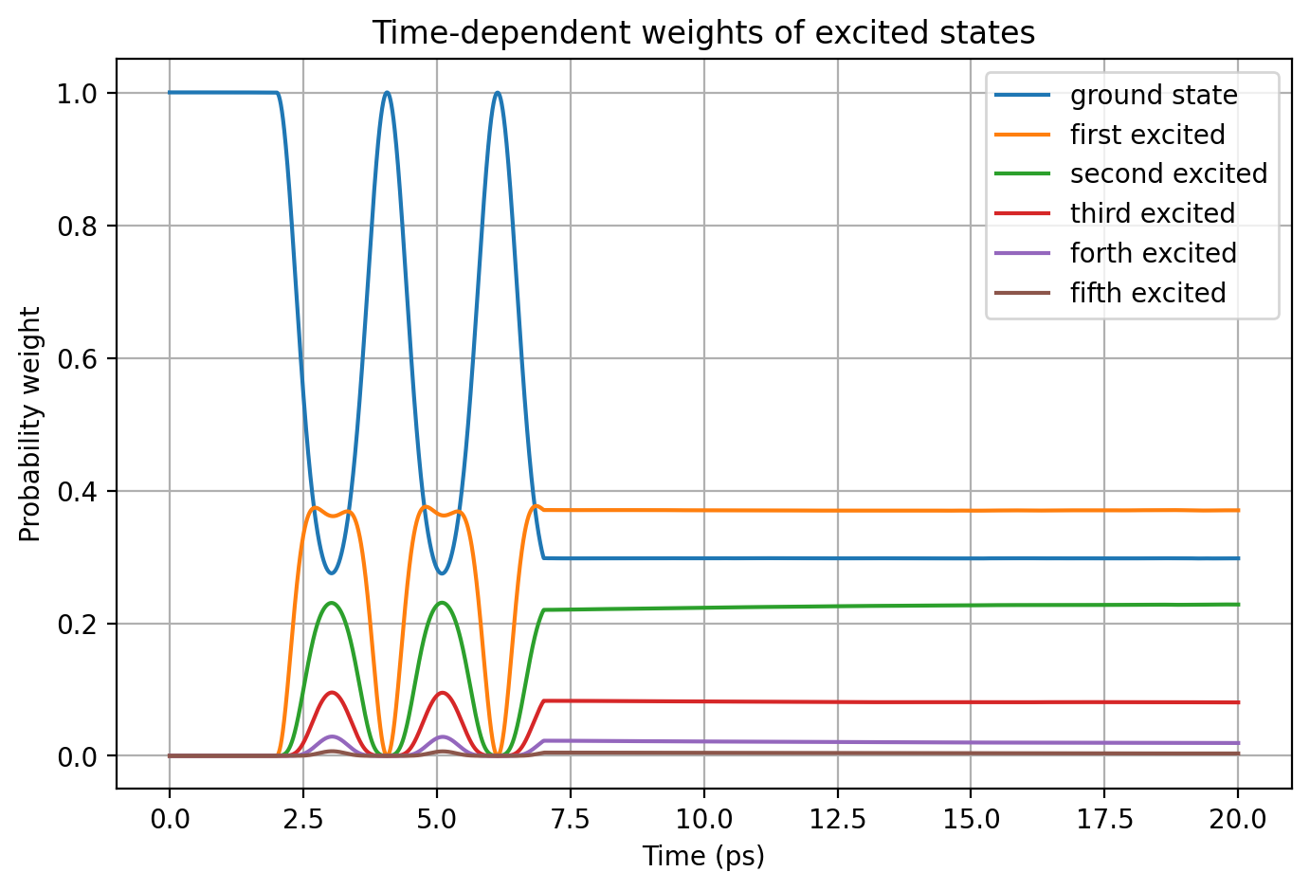
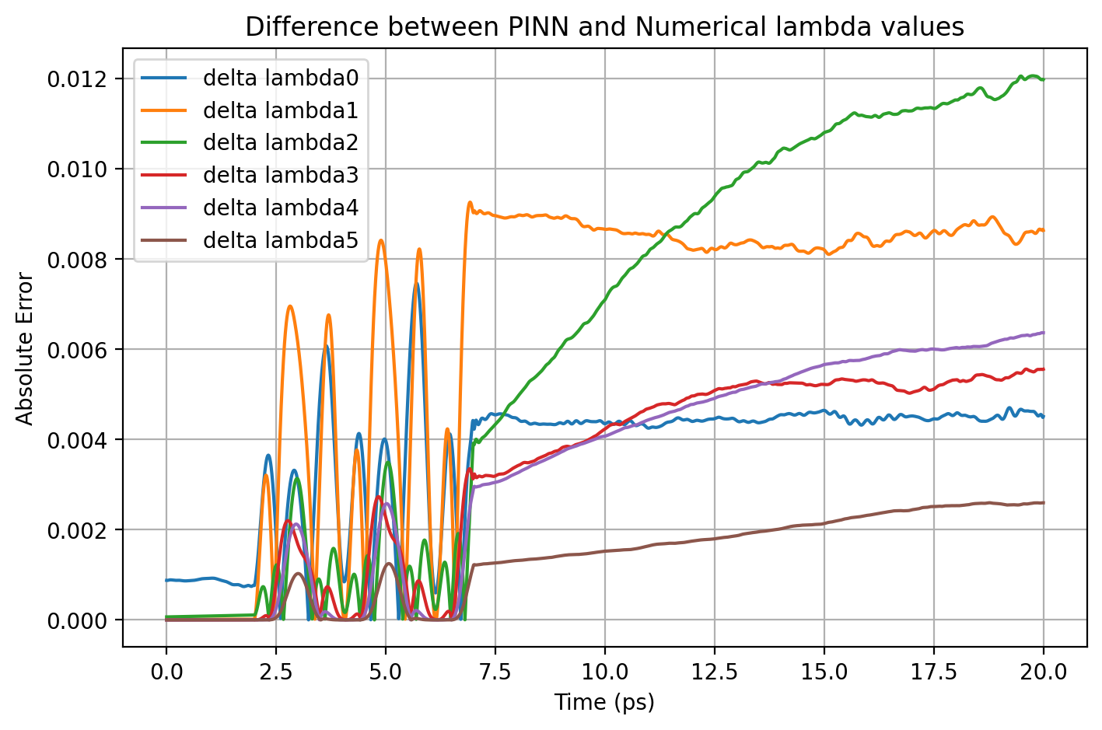


Slide 11
Result Comparison
 | ΔΨ² - max | norm - mean | norm - std | Δλi - max
Causal Model | 0.00607 | 0.98813 | 0.00447 | 0.01335
Causal + Norm | 0.00523 | 1.00133 | 0.00125 | 0.01207

Slide 12
Integrals Plot
I plotted:
Plots for four prime models

Slide 13
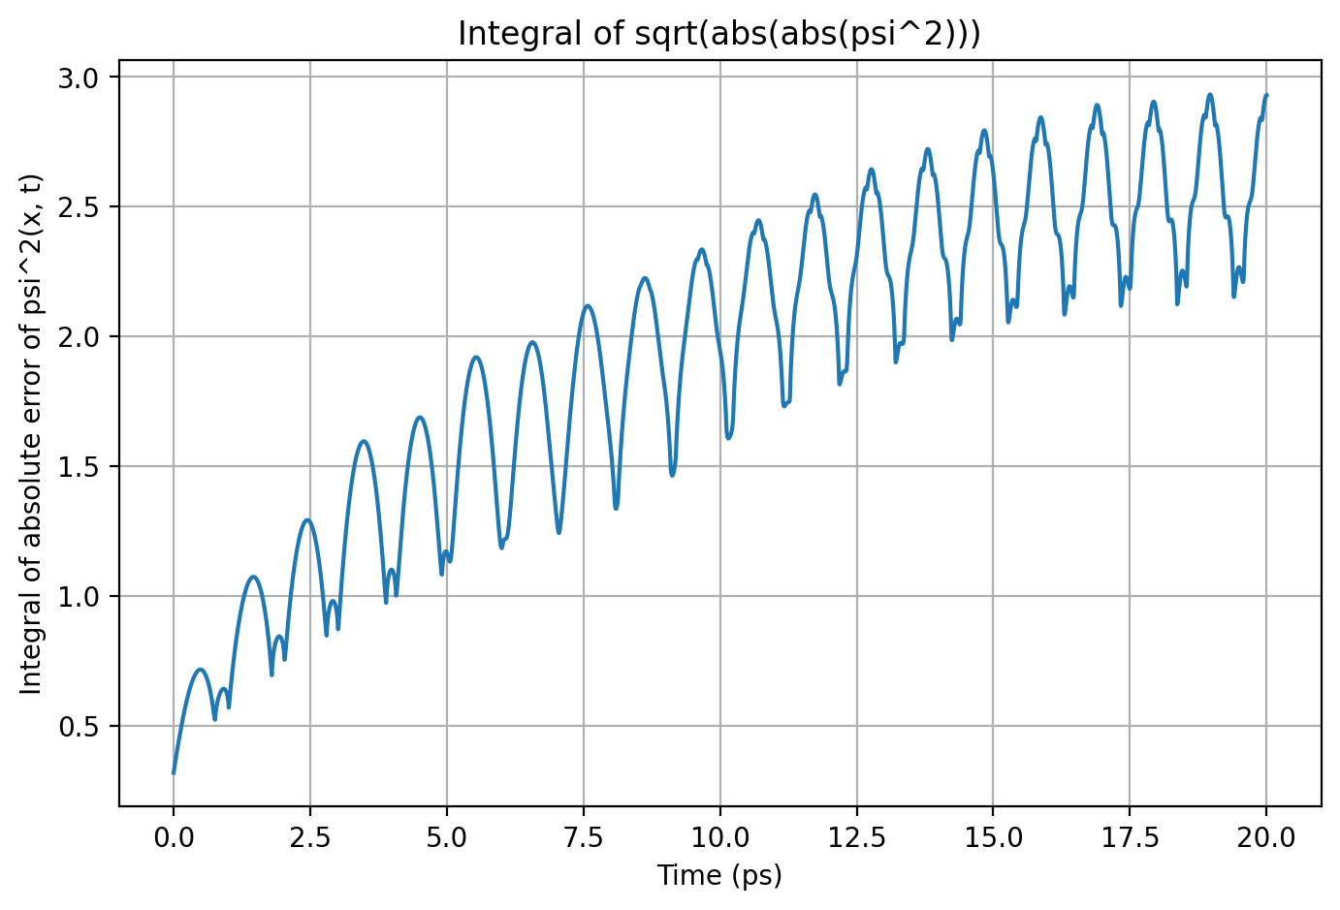
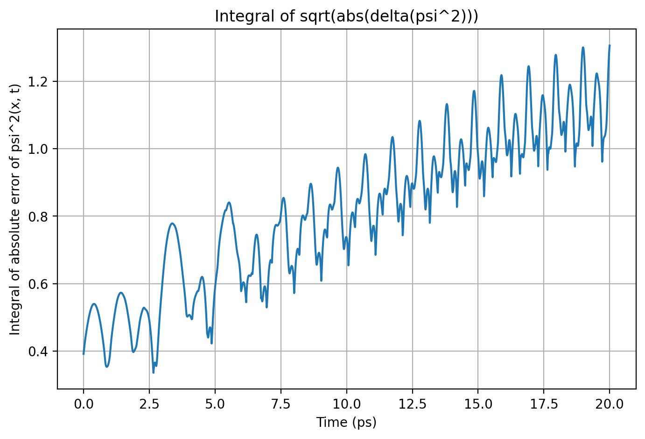
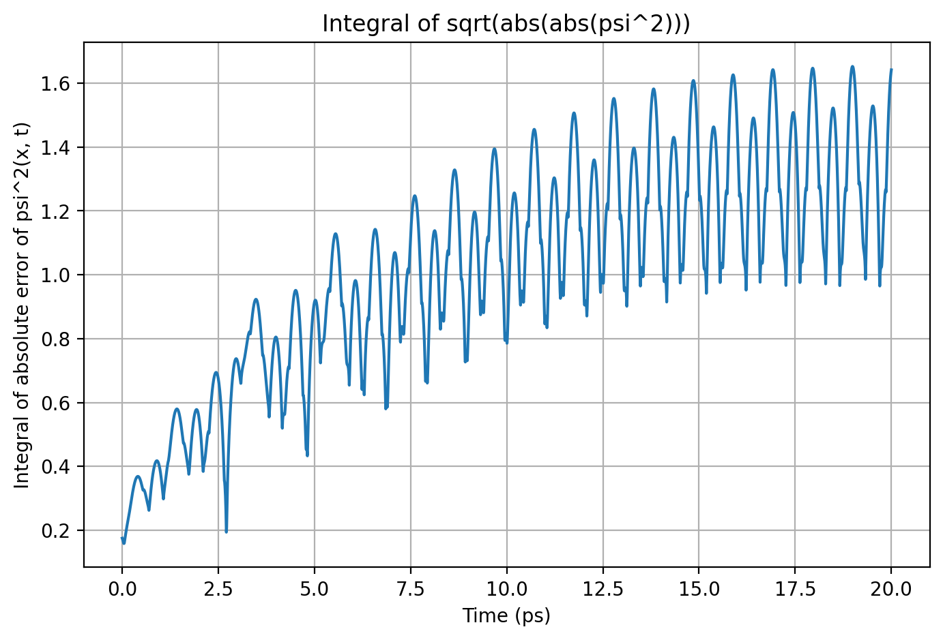
Vanilla model
Causal model
Norm + Causal
Norm model

Slide 14
Norm Loss Weights
Weight | ΔΨ² - max | norm - mean | norm - std | Δλi - max
1 | 0.01907 | 1.00050 | 0.00119 | 0.06592
2 | 0.02604 | 1.00105 | 0.00072 | 0.09001
0.1 | 0.01785 | 1.00112 | 0.00133 | 0.06216
0.01 | 0.02723 | 0.99842 | 0.00242 | 0.09585

Slide 15
Omega in Norm Models
I tried to find if there are any relation between the number of segments for optimal norm loss training and omega value
All base models
I tried:
  ω = 1 / ħ, nsegments = 5, 10, 15, 20
  ω = 1.5 / ħ, nsegments = 10, 15, 20
  ω = 2 / ħ, nsegments = 10, 20, 30, 40

Slide 16
ω = 1 / ħ
Weight | ΔΨ² - max | norm - mean | norm - std | Δλi - max
5 | 0.00500 | 1.00044 | 0.00086 | 0.01876
10 | 0.00149 | 1.00166 | 0.00029 | 0.00716
15 | 0.00179 | 1.00088 | 0.00033 | 0.00929
20 | 0.00099 | 1.00156 | 0.00025 | 0.00408

Slide 17
ω = 1.5 / ħ
Weight | ΔΨ² - max | norm - mean | norm - std | Δλi - max
10 | 0.00244 | 1.00076 | 0.00050 | 0.00920
15 | 0.00367 | 1.00103 | 0.00040 | 0.01535
20 | 0.00320 | 1.00065 | 0.00064 | 0.01267

Slide 18
ω = 2 / ħ
Weight | ΔΨ² - max | norm - mean | norm - std | Δλi - max
10 | 0.02014 | 1.00078 | 0.00118 | 0.07044
20 | 0.01908 | 1.00050 | 0.00119 | 0.06592
30 | 0.02005 | 1.00152 | 0.00097 | 0.06862
40 | 0.02068 | 1.00053 | 0.00080 | 0.08134

Slide 19
.end

