Slide 1
Meeting - 21/07/2025

Slide 2
Increasing VQD
I tried to increase the VQD of the 1D moving quantum dot model to check how the simulation time is increasing for Crank-Nicholson method
VQD = 50, 75, 100, 120

Slide 3
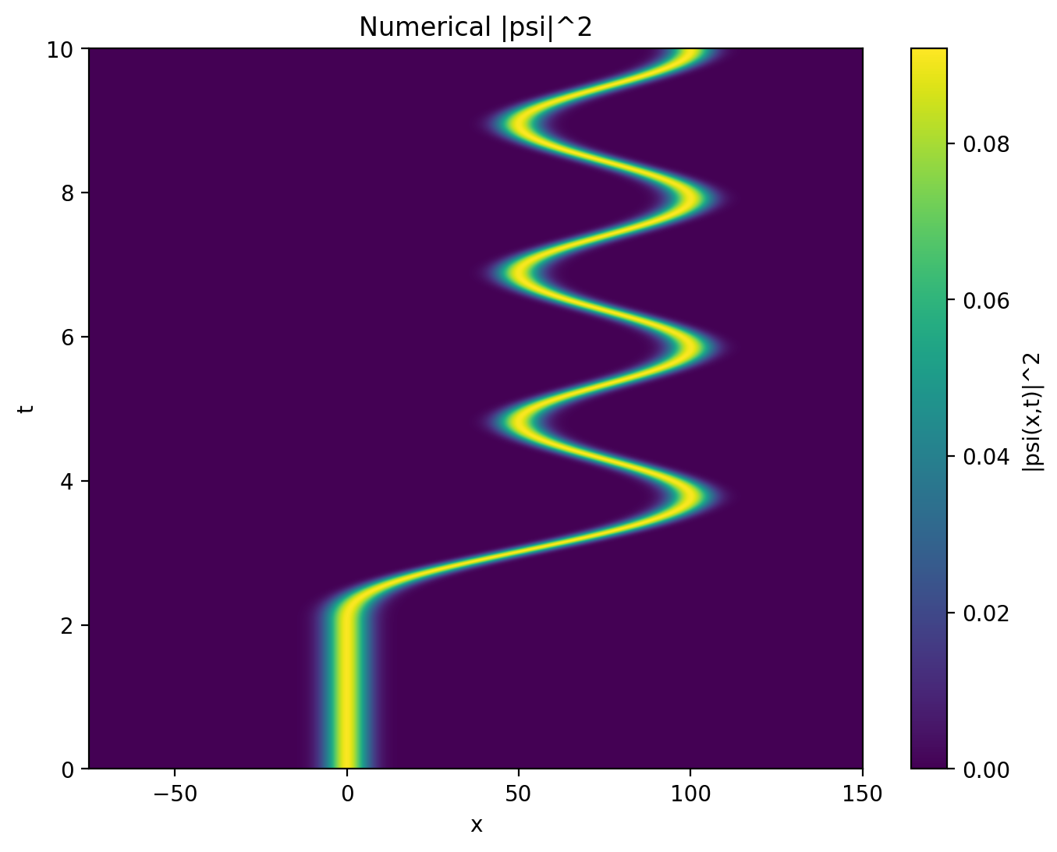
VQD = 50

Slide 4
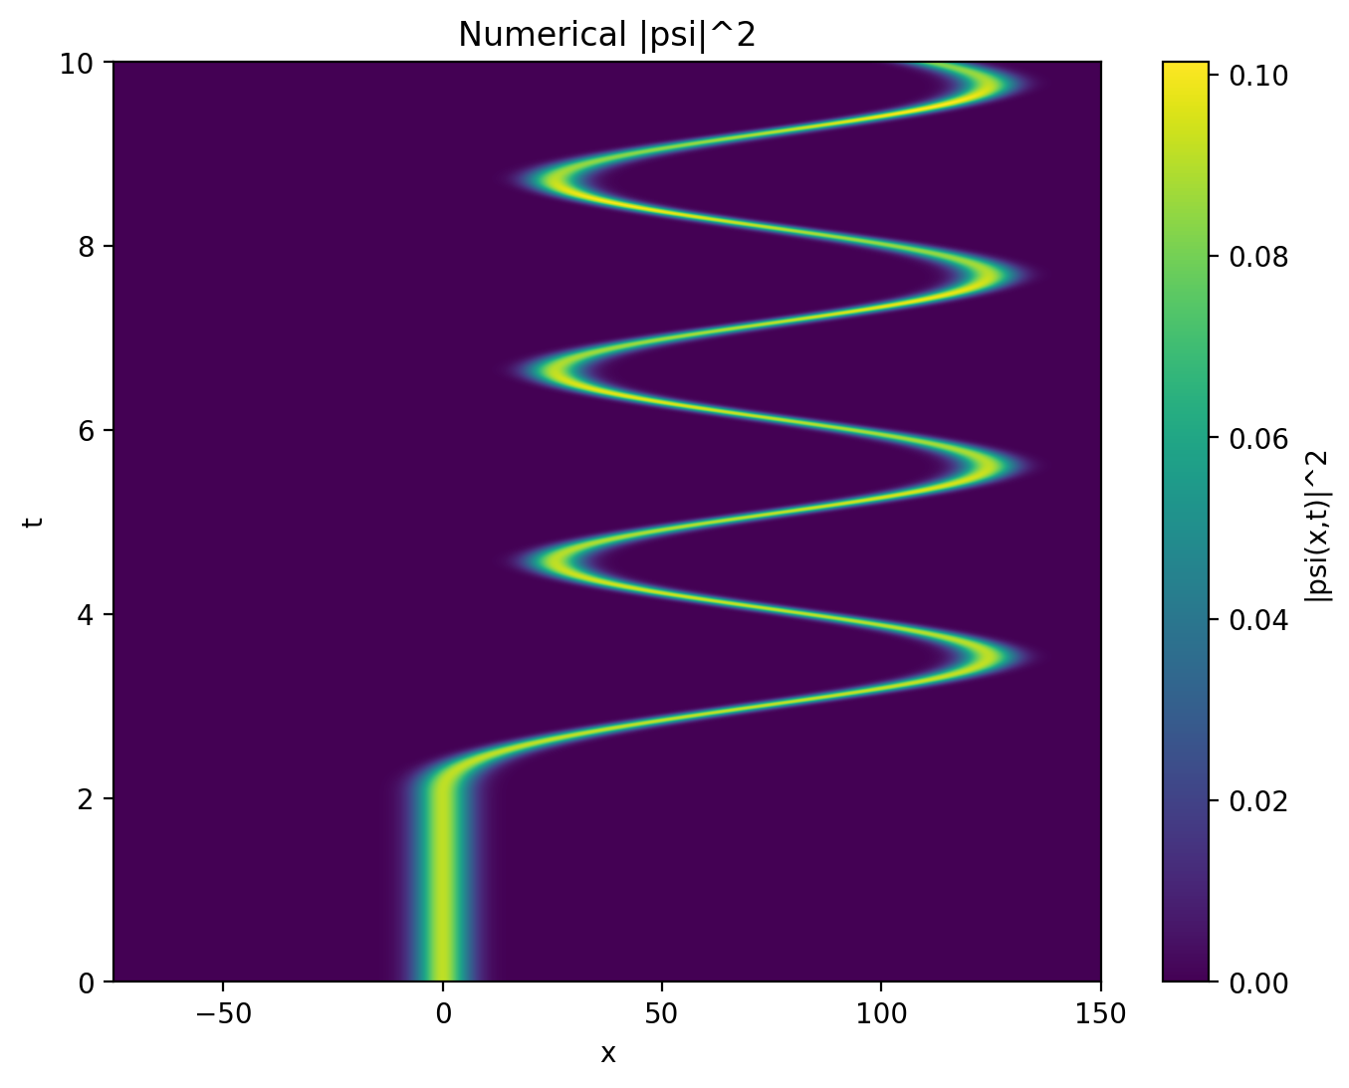
VQD = 75

Slide 5

VQD = 100

Slide 6
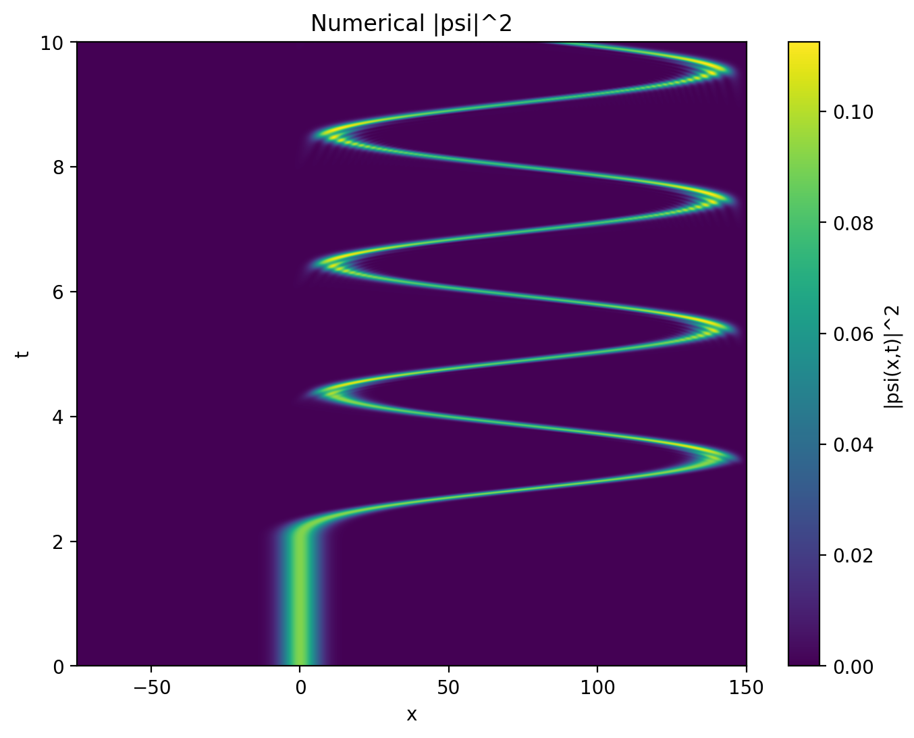
VQD = 120

Slide 7
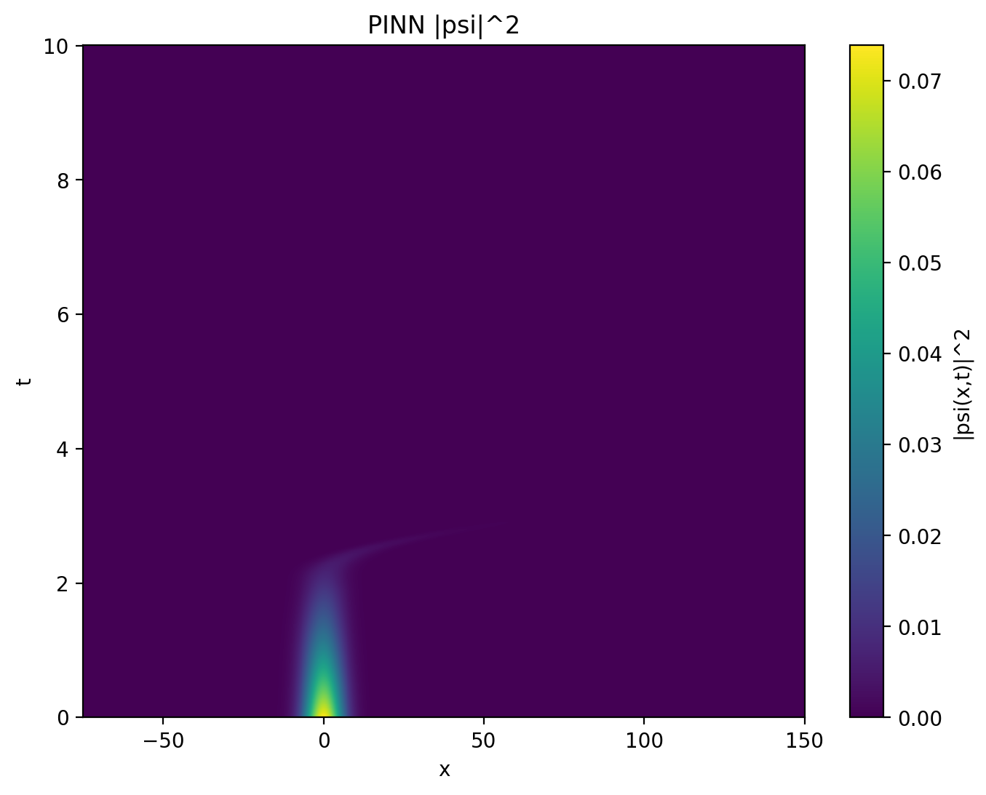
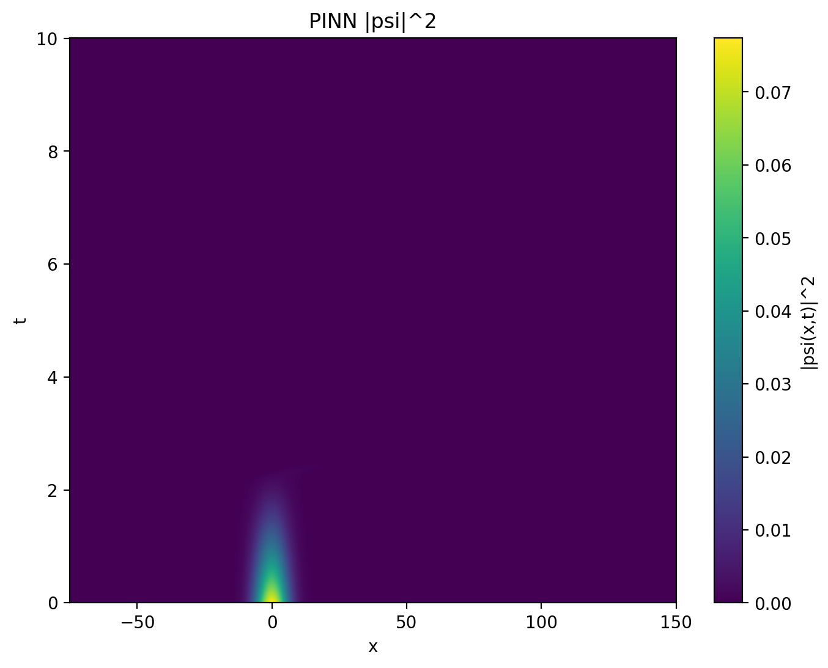
VQD = 50
VQD = 120

Slide 8
2D Quantum Dot
I simulated 2D moving quantum dot using Crank Nicholson
I used a 1000 x 1000 x 1000 grid
Simulation time > 7 hours
File size ≈ 14 GB

Slide 9
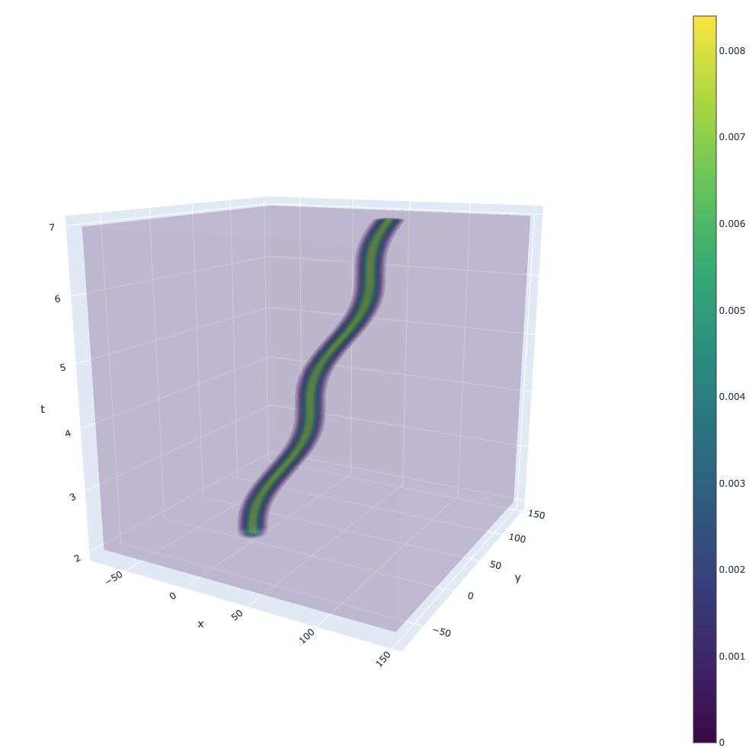

Slide 10
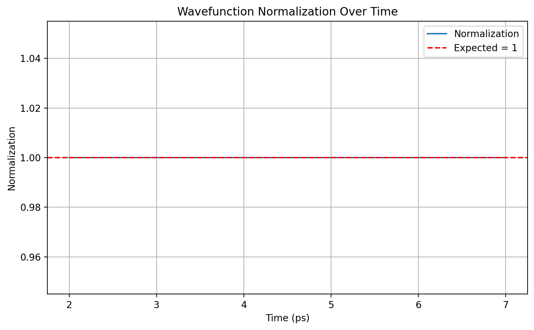

Slide 11
.end

