Slide 1
Physics-Informed Neural Networks to Solve the Time-Dependent Schrödinger Equation
Presented by,
Afthash Sahal Ubaid Puzhakkal
a1913863

Slide 2
Introduction
The Schrödinger equation: Fundamental equation in quantum mechanics that describes how the wavefunction, Ψ, evolves over time
Traditional Methods: Analytical methods for simple systems or numerical techniques like Crank-Nicholson method for complex systems
Project Goal: Solve the Time-Dependent Schrödinger equation (TDSE) using Physics-Informed Neural Networks (PINNs)
PINN: They are a type of neural networks that learns to solve Partial Differential Equations (PDEs) by embedding the relevant equations into its loss function

Slide 3
Introduction
Why PINNs?
  Grid-free solution
  No need for large labelled datasets for training
Research Problem: Solving TDSE is challenging and computationally expensive for higher dimensions when using numerical methods like Crank-Nicholson
Research Question: Can PINNs efficiently and accurately solve the TDSE?

Slide 4
Tasks
Solve Schrödinger equation for:
  Baseline model: Electron inside a 1D harmonic oscillator
  Quantum Dot model: Electron inside a time-dependent moving quantum dot
  Dynamic-Window model: Quantum dot model, but only the movement part
  2D Dynamic-Window model
Training Strategies:
  Causal Training
  Normalization Enforcement

Slide 5
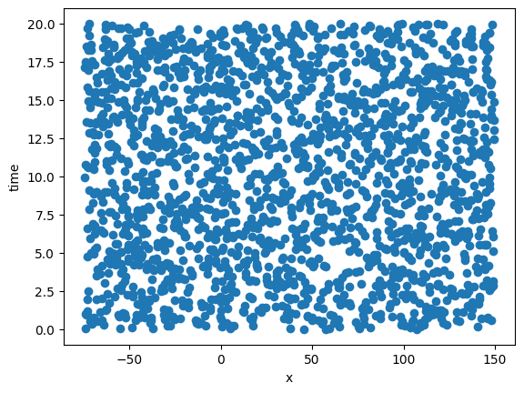
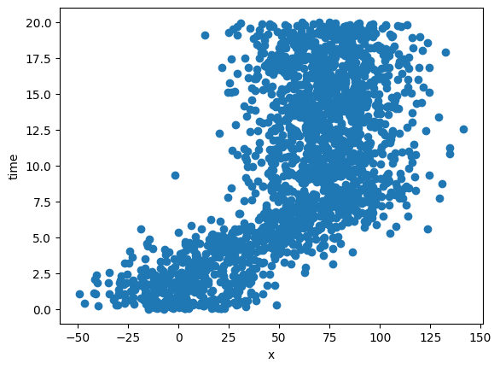
Dataset
Uniform Distribution
Training data was generated based on the problem domain
Time (t):
  Uniform distribution across the time domain
Position (x):
  Baseline model: Uniform distribution
  Moving quantum dot models: Normal distribution centred around the position of the quantum dot at the given time
Normal Distribution

Slide 6
Methodology
Problem Setup
PINN Model Architecture
Loss Function
Evaluation Metrics
Training Strategies

Slide 7
Problem Setup
The Schrödinger equation:
Where,
  For baseline model:
  For moving quantum dot model:
Goal: Predict the wavefunction, Ψ(x, t) using PINNs

Slide 8
PINN Architecture
Input: position x and time t
Output: real and imaginary part of the wavefunction, Ψ
Fully connected feed forward neural networks:
  Baseline model: 6 HL, 512 neurons each
  Moving Quantum Dot model: 12 HL, 512 neurons each
  Dynamic-Window model: 6 HL, 512 neurons each
Activation Function:
  First layer: tanh
  Rest: SiLU

Slide 9
Loss Function
Total loss,
Physics Loss (PDE loss), Lpde:
  Residual,
  Physics loss,
Initial Condition Loss, Lic
Boundary Condition Loss, Lbc

Slide 10
Evaluation Metrics
Probability Density, |Ψ|²
  ∆|Ψ|² = ||Ψpredicted|² - |Ψactual|²|
  ∆|Ψ|² (max)
Wavefunction Normalization,
  Mean
  Standard deviation

Slide 11
Training Strategies
Causal Training:
  The neural network should learn the wavefunction in a time-ordered manner
Normalization Enforcement:
  When solving the Schrödinger equation, normalization ensures the wavefunction represents a valid probability distribution
  Enforce wavefunction normalization during training

Slide 12
Results
Baseline
Moving Quantum Dot
  Vanilla model
  Causal model
  Normalization model
Dynamic-Window Model
2D Dynamic-Window Model

Slide 13
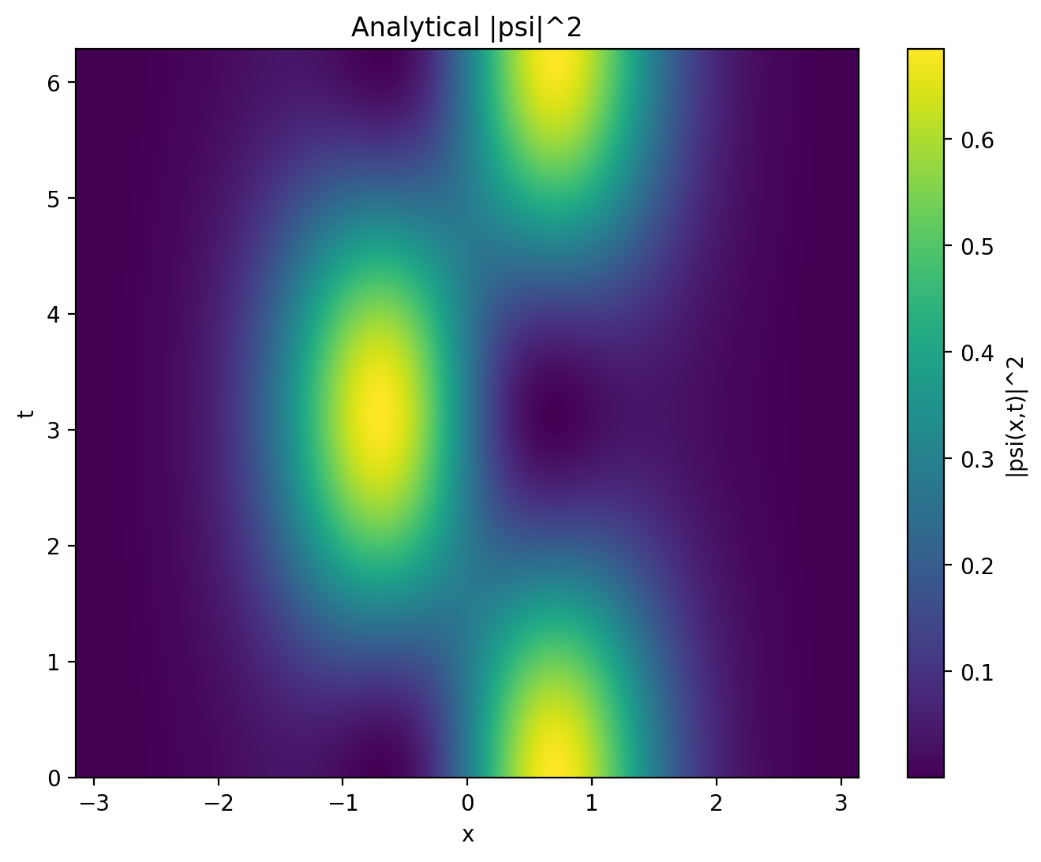

Baseline

Slide 14
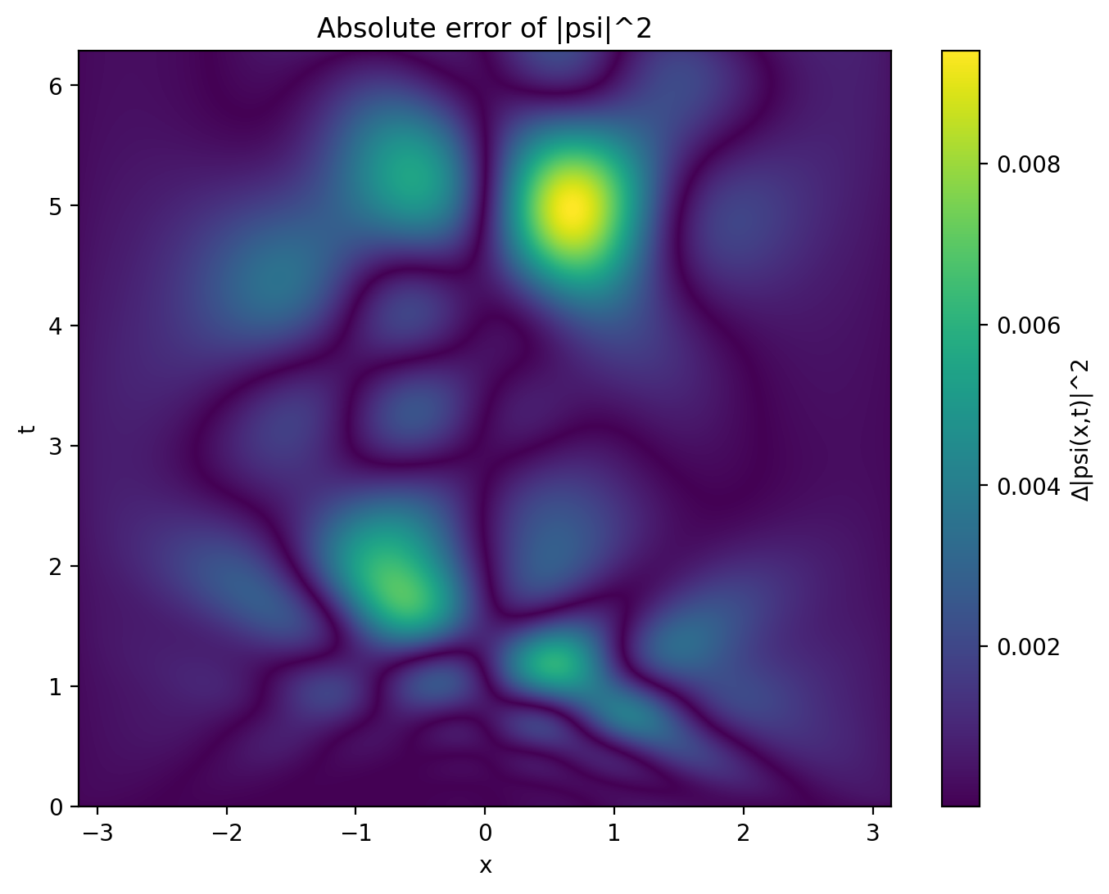
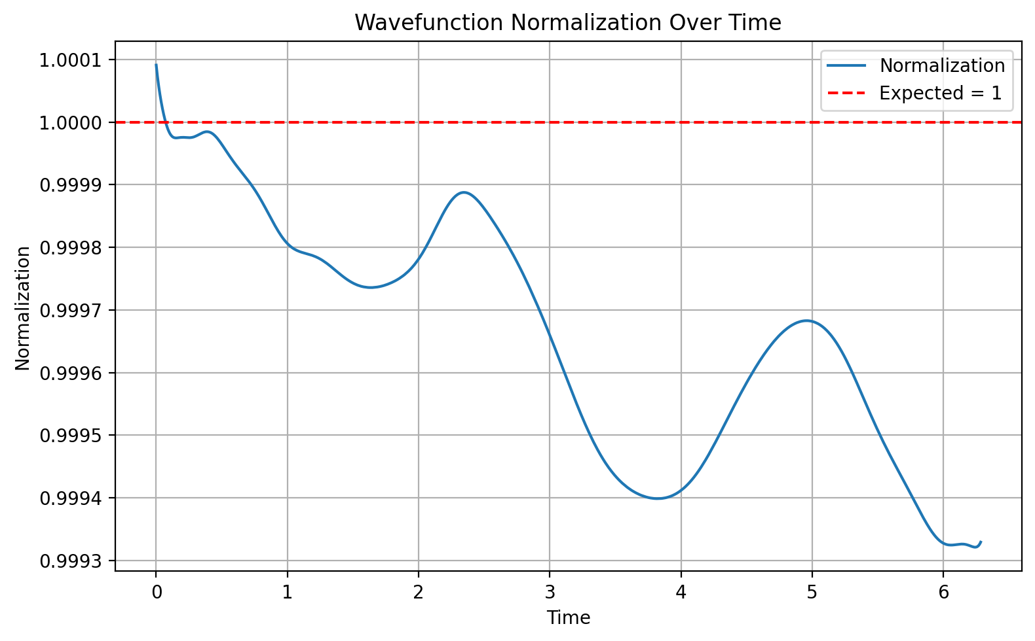

Slide 15
ΔΨ² (max) | Wavefunction Normalization
 | Mean | Standard deviation
0.00940 | 0.99966 | 0.00020

Slide 16
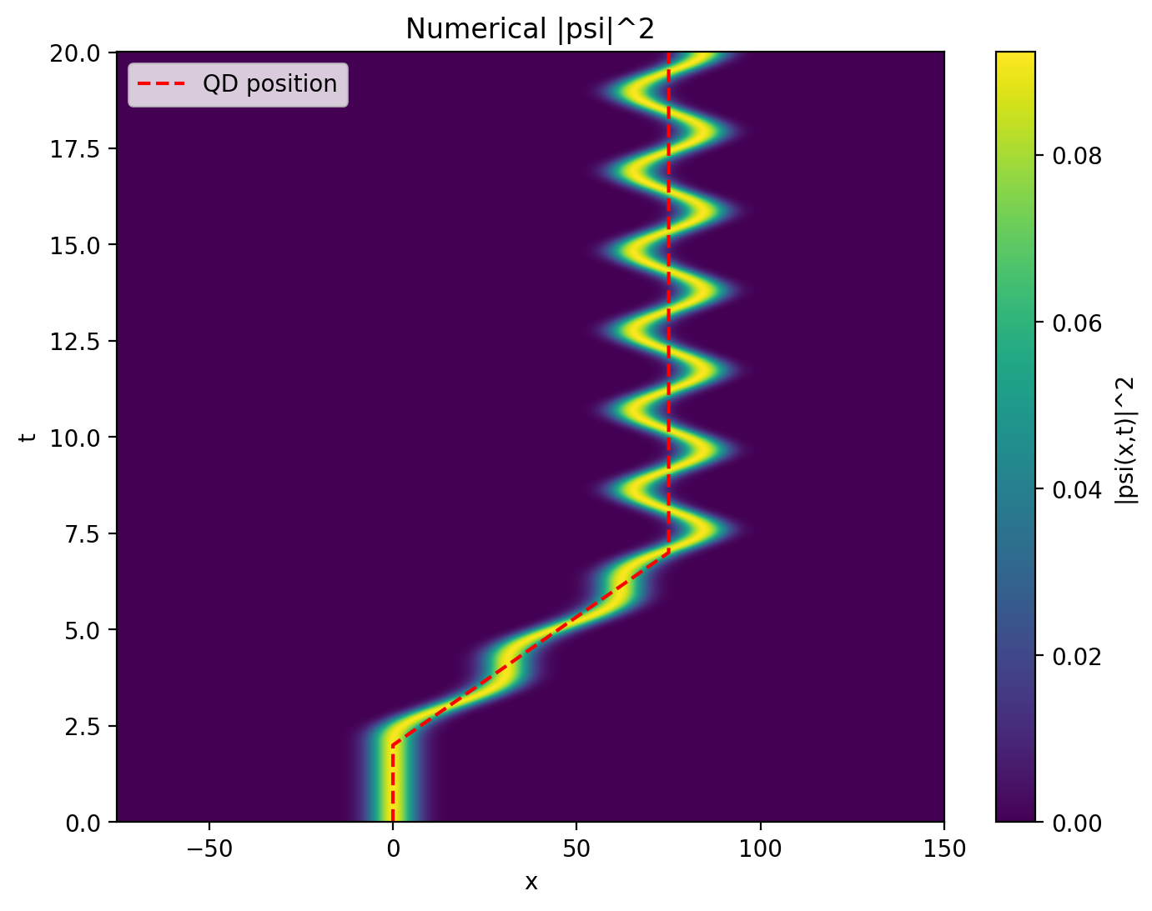
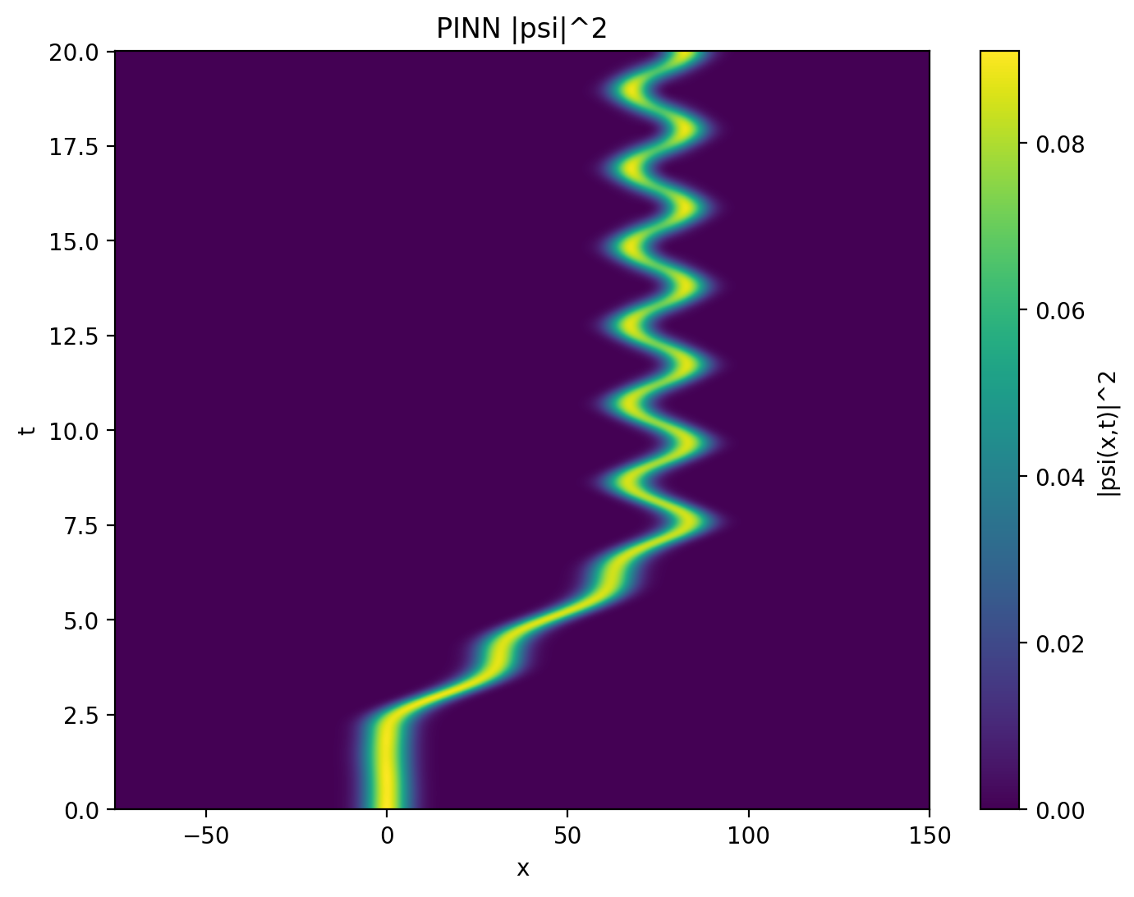
Moving Quantum Dot: Vanilla Model

Slide 17
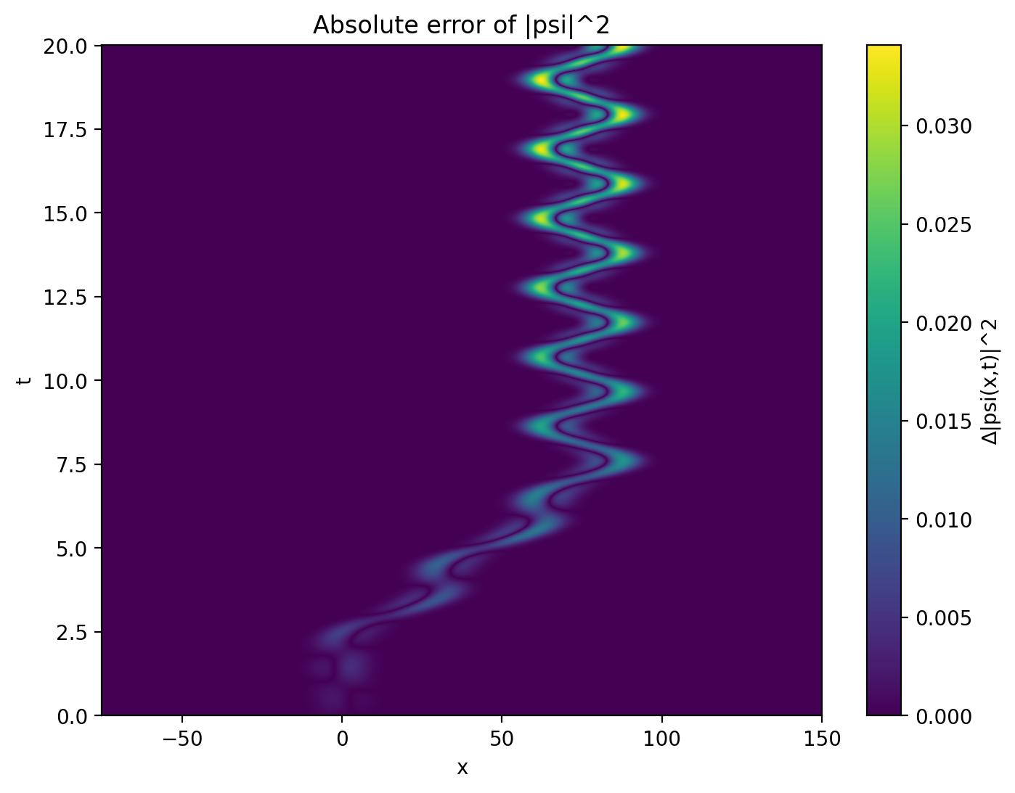
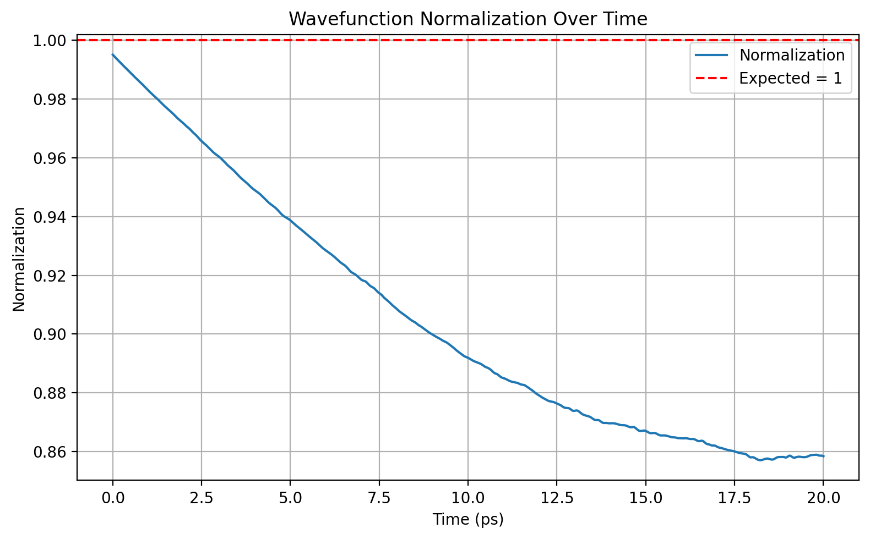

Slide 18


Moving Quantum Dot: Causal Model

Slide 19
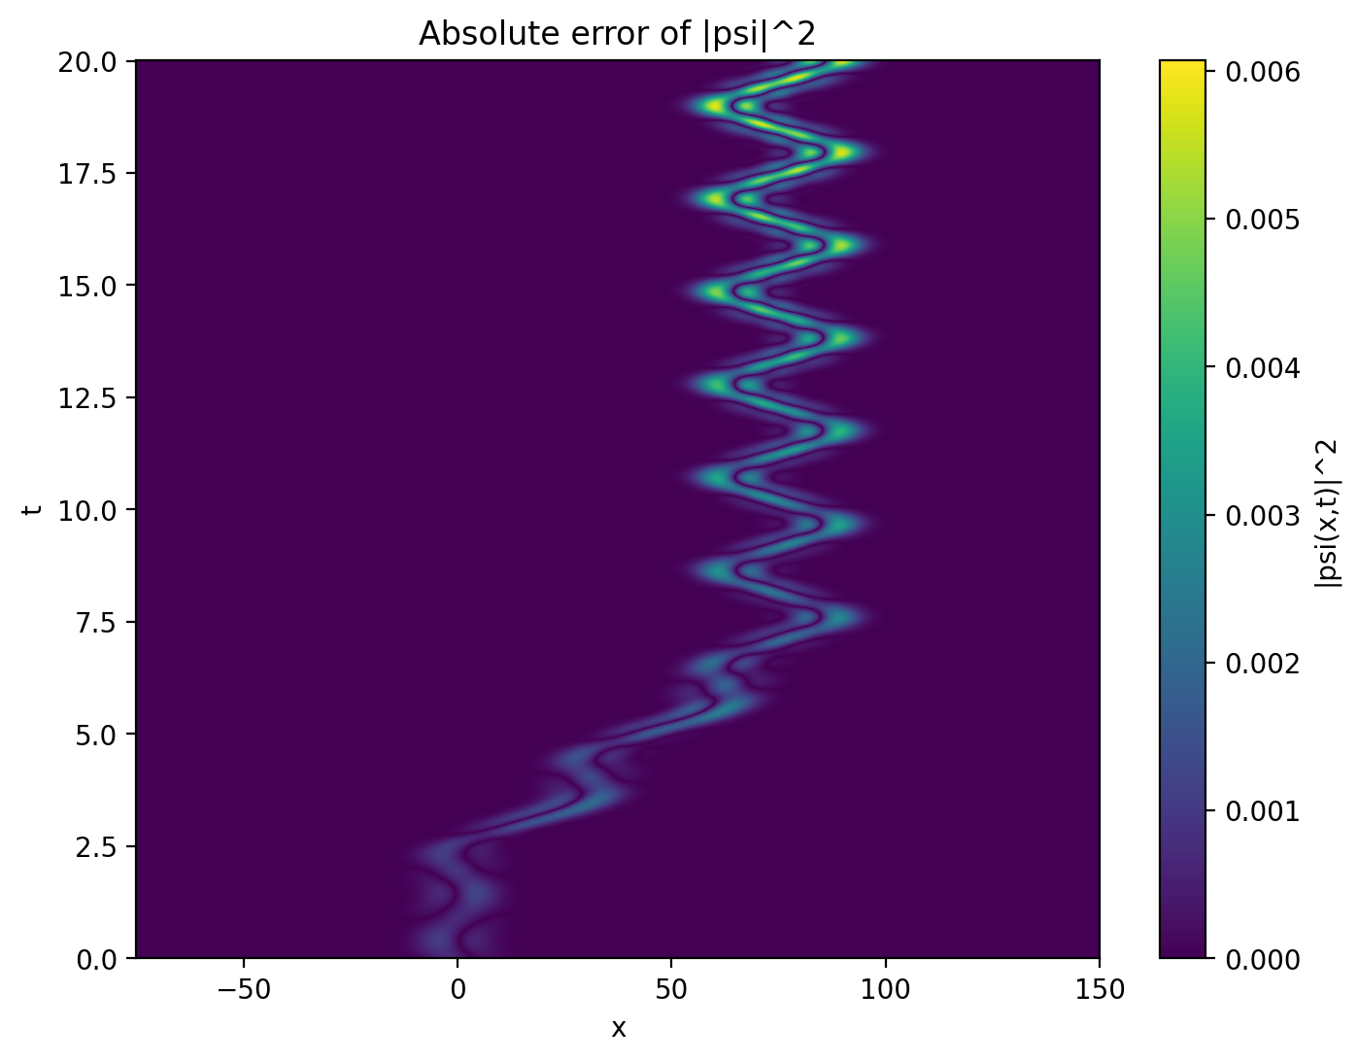
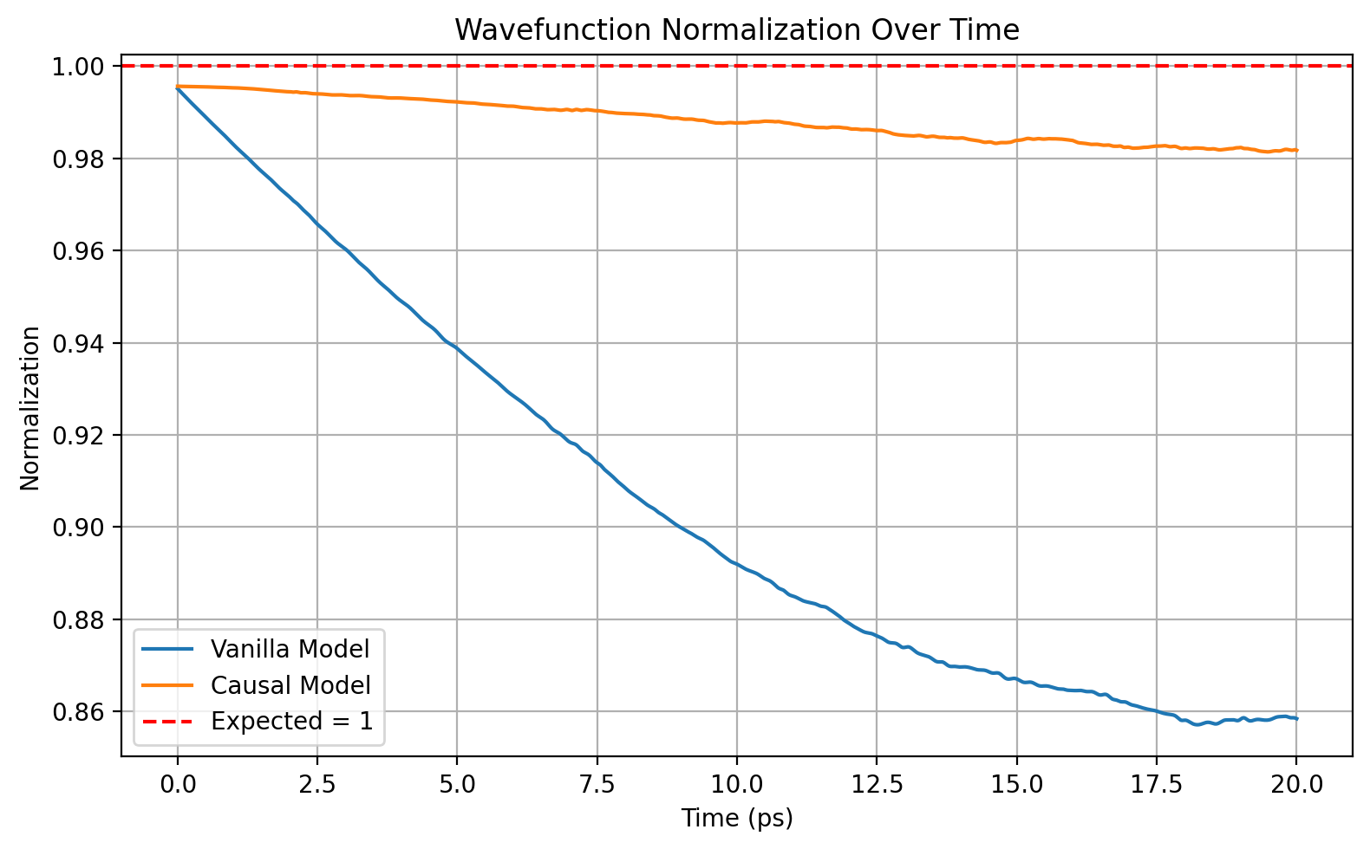

Slide 20

Moving Quantum Dot: Norm Model

Slide 21
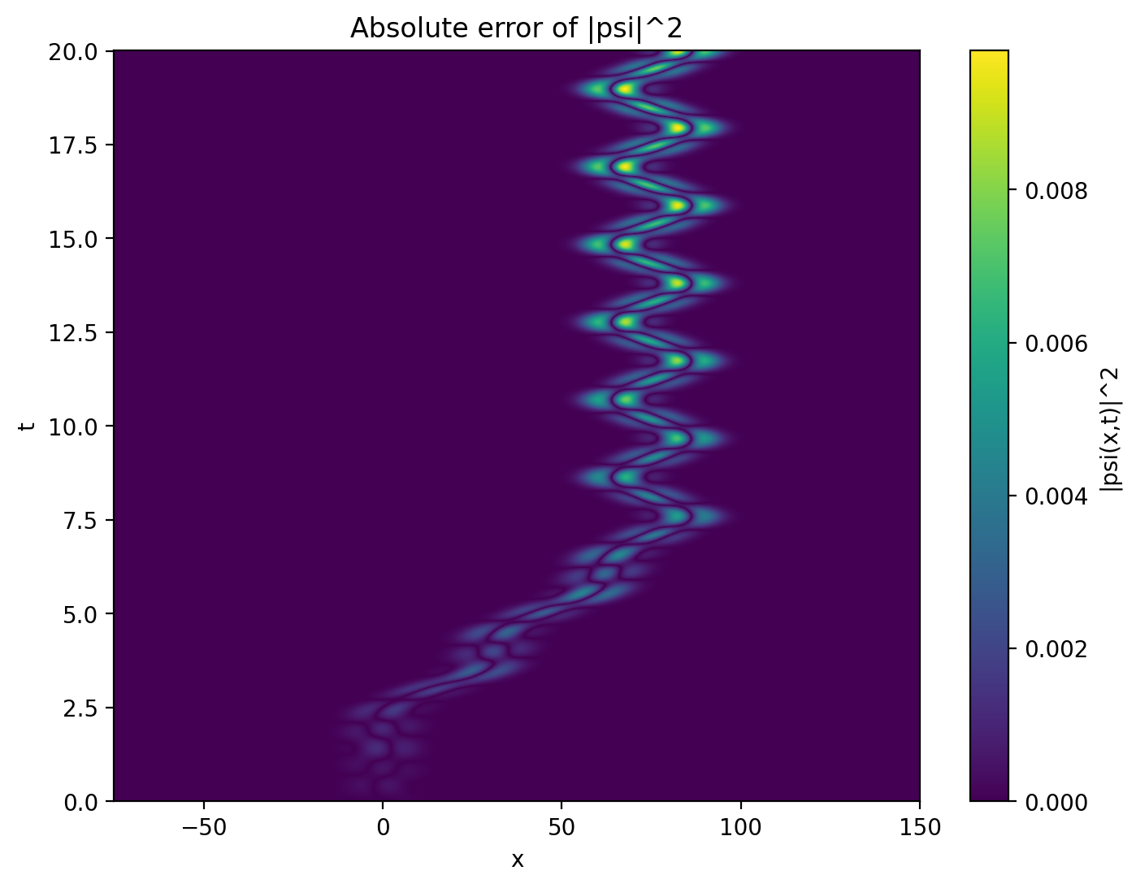
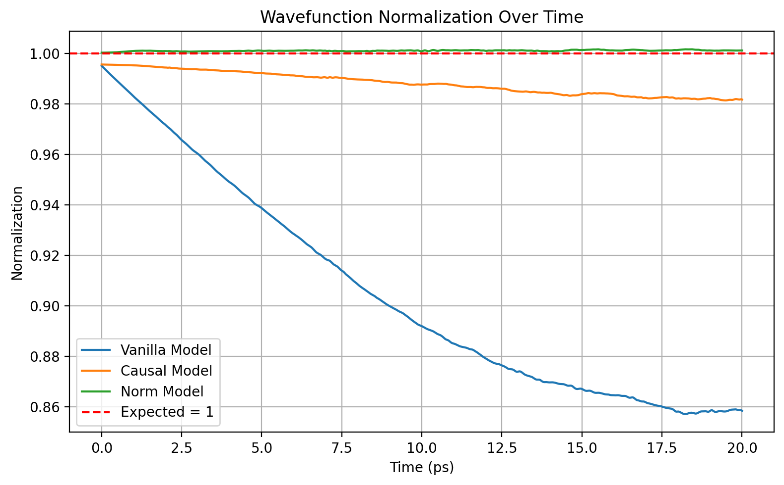

Slide 22
Moving Quantum Dot: Models Comparison
Moving QD Models | ΔΨ² (max) | Wavefunction Normalization |  | Training Time (minutes)
 |  | Mean | Standard deviation
Vanilla Model | 0.03409 | 0.90468 | 0.04191 | 394
Causal Model | 0.00607 | 0.98813 | 0.00447 | 381
Norm Model | 0.00982 | 1.00111 | 0.00023 | 492

Slide 23
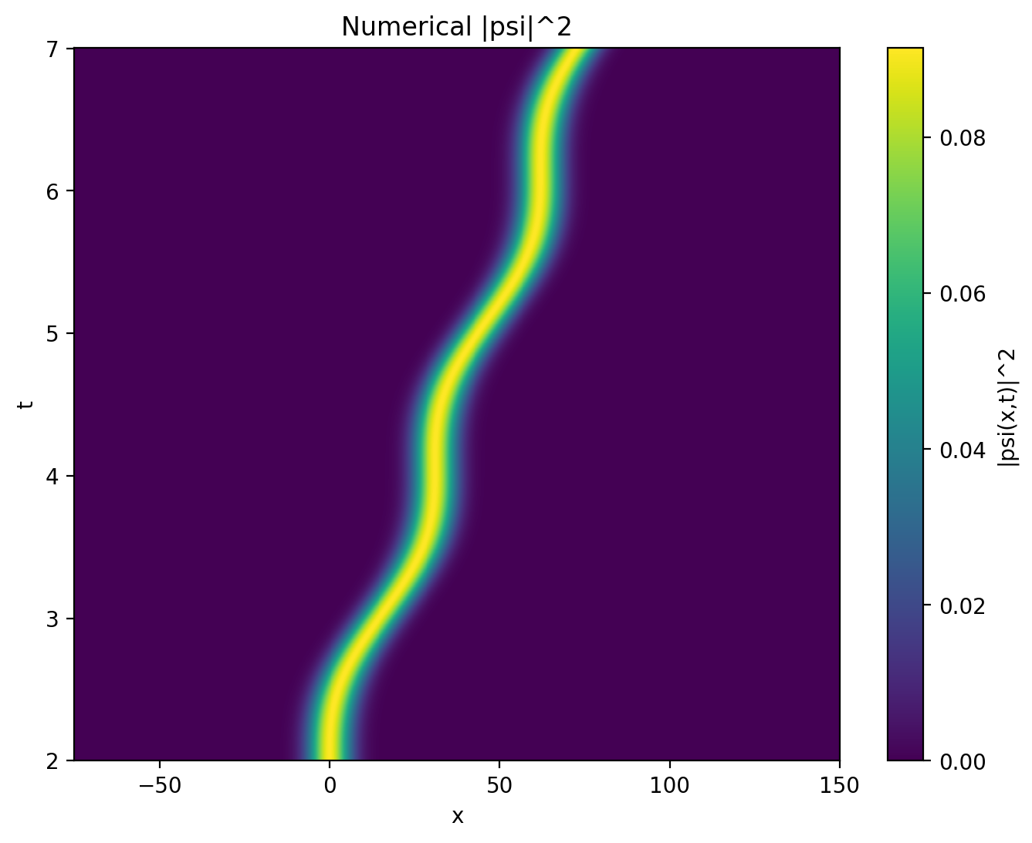
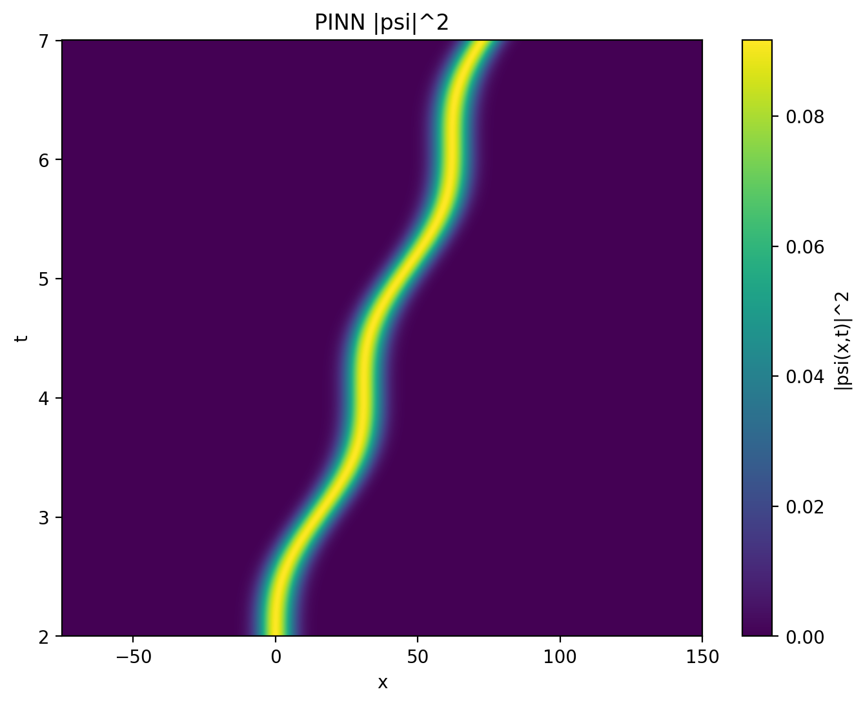
Dynamic-Window Model

Slide 24
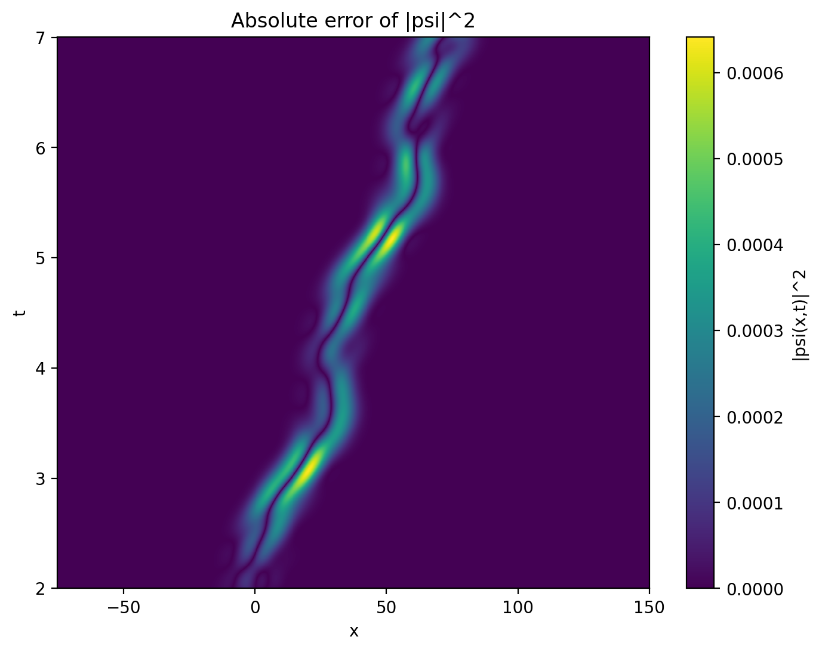
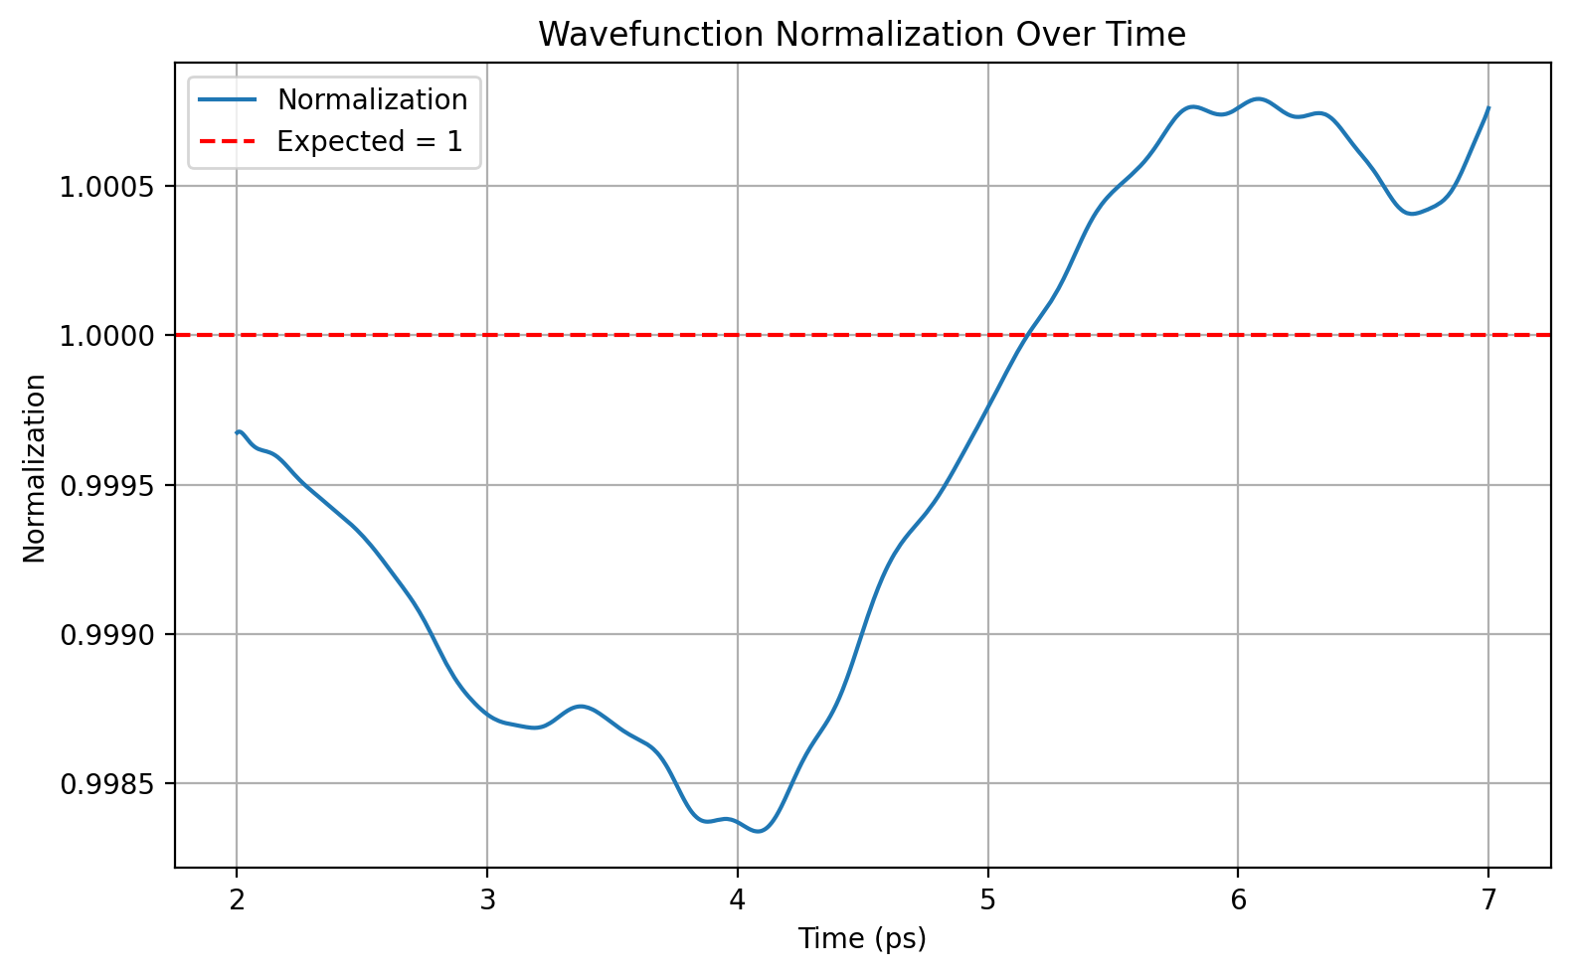

Slide 25
Moving QD Models | ΔΨ² (max) | Wavefunction Normalization |  | Training Time (minutes)
 |  | Mean | Standard deviation
Vanilla Model* | 0.01484 | 0.94422 | 0.01527 | 394
Dynamic-Window Model | 0.00064 | 0.99958 | 0.00084 | 110
*previous model only predicting the dynamic part

Slide 26
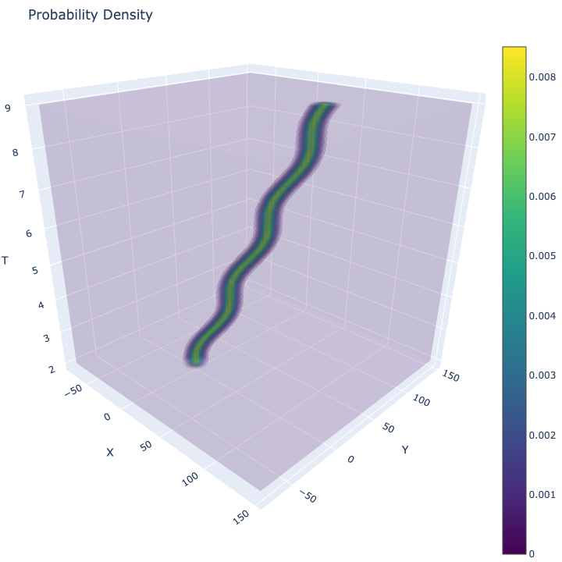
2D Dynamic-Window

Slide 27
2D Dynamic-Window | Training time (minutes) | Output file size
PINN | 385 | 5.1 MB
Crank-Nicholson | 443 | 15 GB

Slide 28
Discussion
PINNs are flexible but they need improvements in handling longer time evolution
Training strategies such as causal training and normalization enforcement improve the vanilla model
2D model showed promise for higher-dimensional problems
Challenges:
  Instability over time
  Training sensitivity to model architecture
  High computational cost for deeper networks

Slide 29
Conclusion
Summary: PINNs are capable of solving TDSE
Real-world use:
  Quantum computing
  Material design
Future works:
  Hybrid solvers: PINN + Crank-Nicholson
  Generalization: vqd, ω, V(x, t) etc as inputs

Slide 30
Thank You

