Slide 1
Physics-Informed Neural Networks to Solve the Many Electron Time-Dependent Schrödinger Equation
Presented by,
Afthash Sahal Ubaid Puzhakkal
a1913863

Slide 2
Introduction
The Schrödinger equation is a fundamental equation in quantum mechanics that describes how the quantum state (wavefunction, Ψ) of a physical system evolves over time and space
Traditionally, Schrödinger equation can be solved using analytical methods for simple systems or numerical techniques like finite difference or Crank–Nicolson methods for more complex systems
In this project, I am trying to solve the Schrödinger equation using Physics-Informed Neural Network (PINN), which are a type of neural network that learns to solve PDEs by embedding the relevant equations into its loss function
The advantage of using PINN is that, since we are directly trying to satisfy the physical equation through loss function, we do not require large labelled datasets for training

Slide 3
Project Recap
Successfully reproduced the baseline model of an electron in a 1D harmonic potential, based on the 2022 paper by Shah et al. [Shah et al., 2022].
Retrained the model using nanometer-picosecond (nm-ps) units instead of atomic units
Experimented with various initial conditions
Extended to a more complex problem: an electron in a moving quantum dot
Shah et al. 2022 – Karan Shah, Patrick Stiller, Nico Hoffmann, Attila Cangi, Physics-Informed Neural Networks as Solvers for the Time-Dependent Schrödinger Equation, 2022

Slide 4
Methods
In this presentation, I will explain the two methods I have introduced to improve my moving quantum dot PINN model developed during the last trimester
Enforcing Causality: In our context, causality means that the neural network should learn the wavefunction in a time-ordered manner, ensuring that what happens at later times depends on the learned behaviour at earlier times, just like in real quantum systems
Enforcing Normalization: Normalizing the Schrödinger equation ensures that the wavefunction represent a valid probability distribution. Which means the probability of finding a particle anywhere in the spatial domain should be 1 at all times

Slide 5
Causality
To enforce causality during training, I divided the time domain into n equally spaced segments
At each segment, the physics loss ( PDE Loss, LPDE ) is computed as the sum of current segment’s loss and the cumulative losses from all previous segments
This encourages the model to learn earlier segments accurately before learning later segments, satisfying causality

Slide 6
Causality
  Total PDE loss can be written as,
  Where,
    Nseg = Number of segments
    Li, Lk = PDE Loss at segment i, k respectively
  The expression expands to,
    L1 = L1
    L2 = L1 + L2
    L3 = L1 + L2 + L3
    L4 = L1 + L2 + L3 + L4

Slide 7

Crank-Nicholson Solution

Slide 8
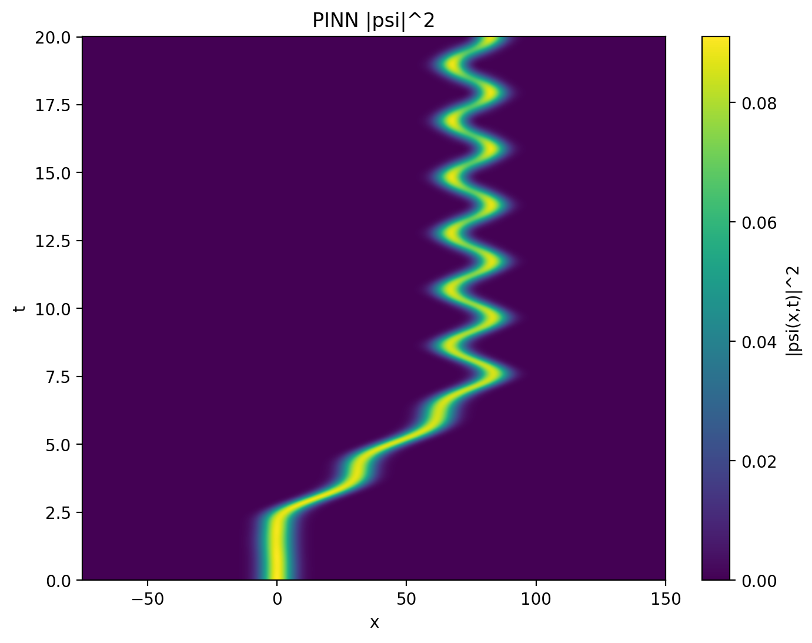

Results
Base Model
Causal Model

Slide 9
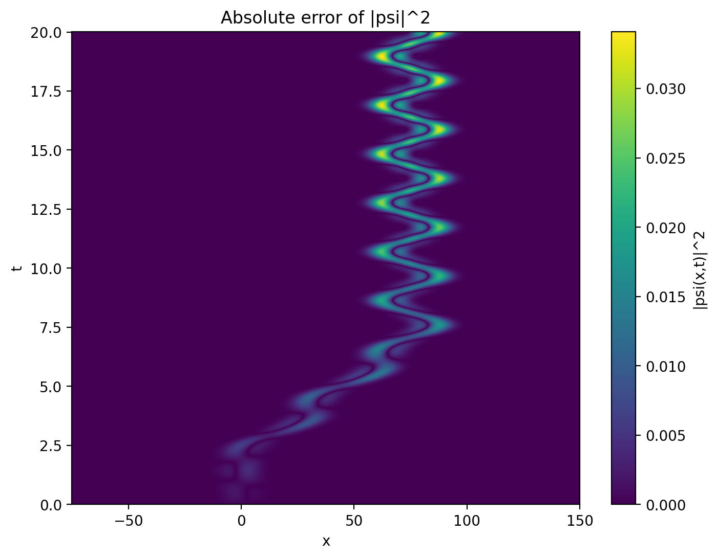
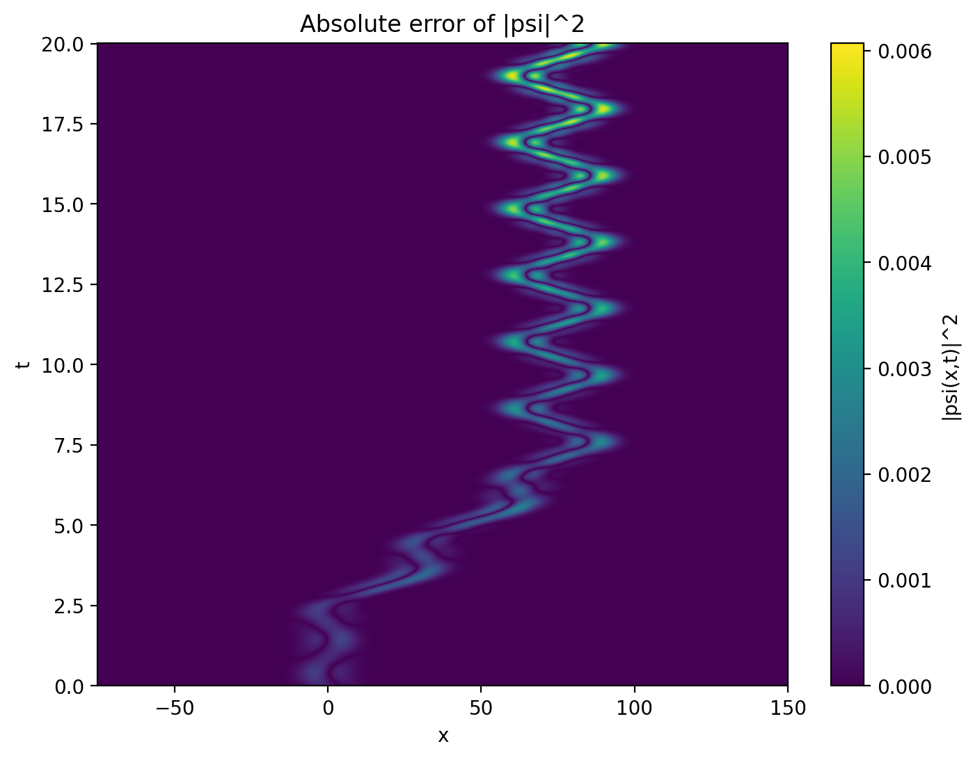


Base Model
Causal Model

Slide 10
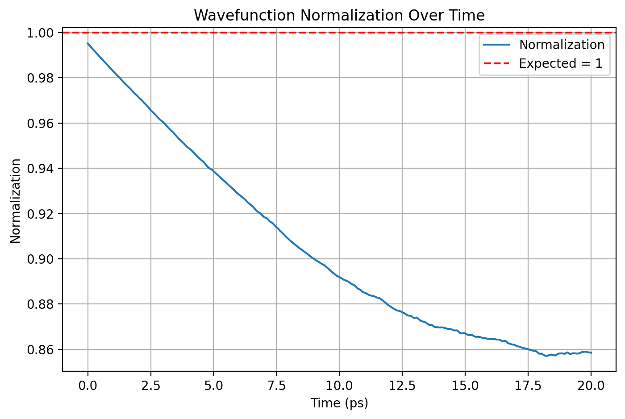
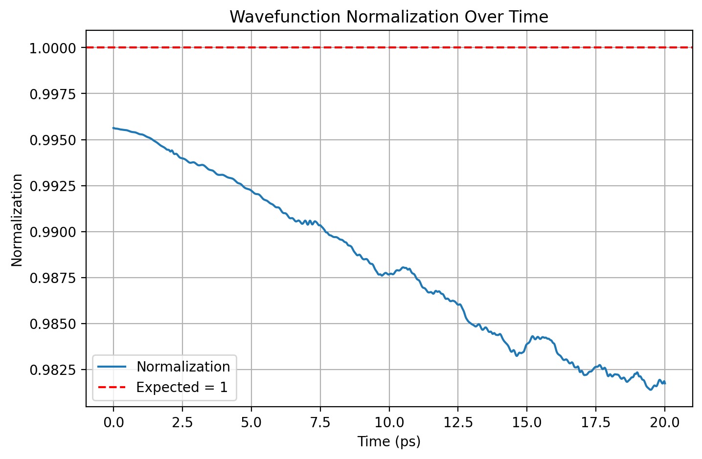


Base Model
Causal Model

Slide 11
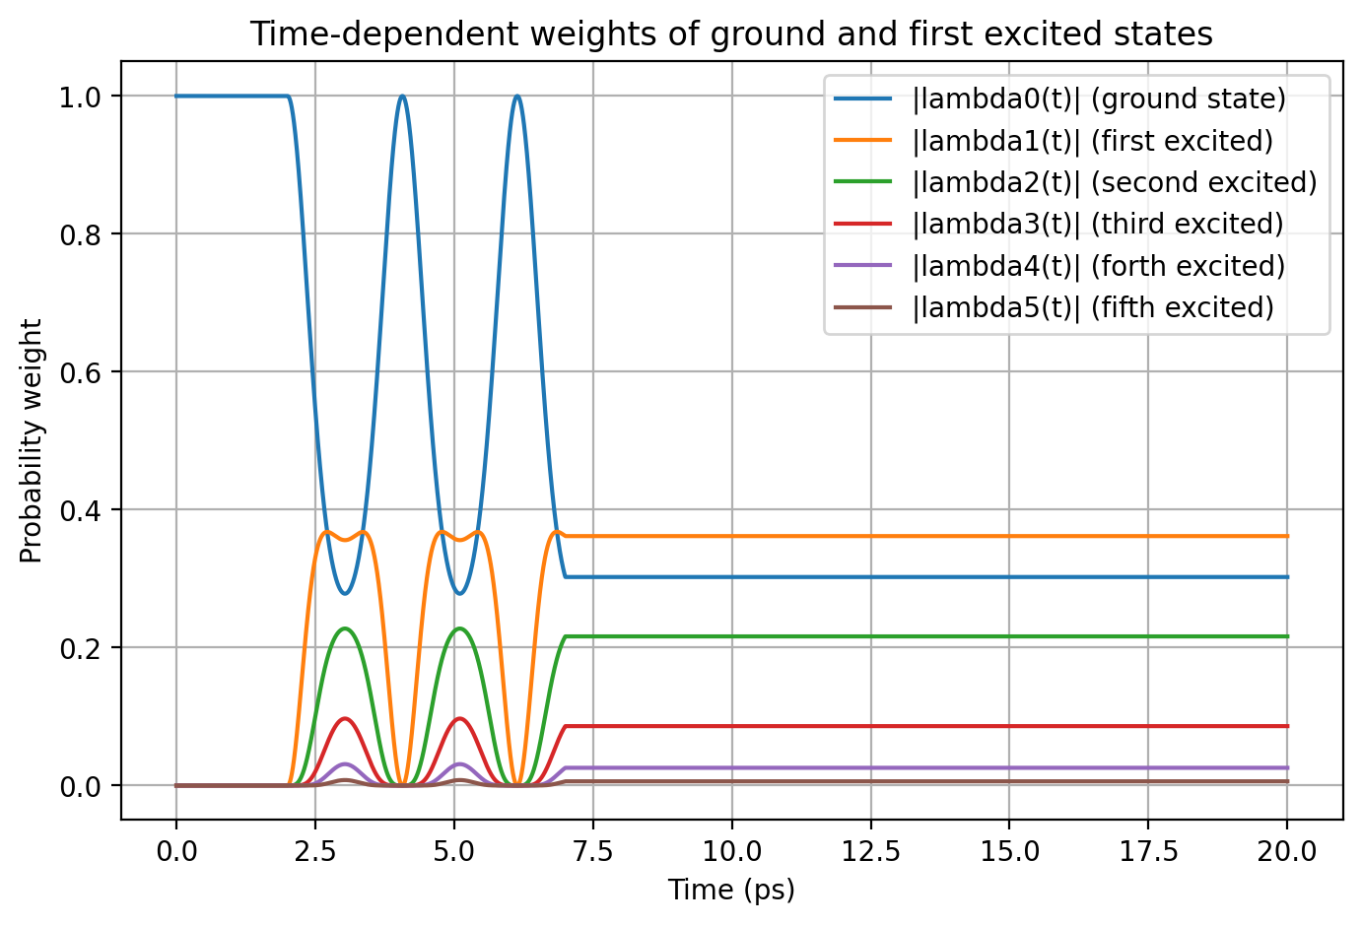
Crank-Nicholson Solution

Slide 12
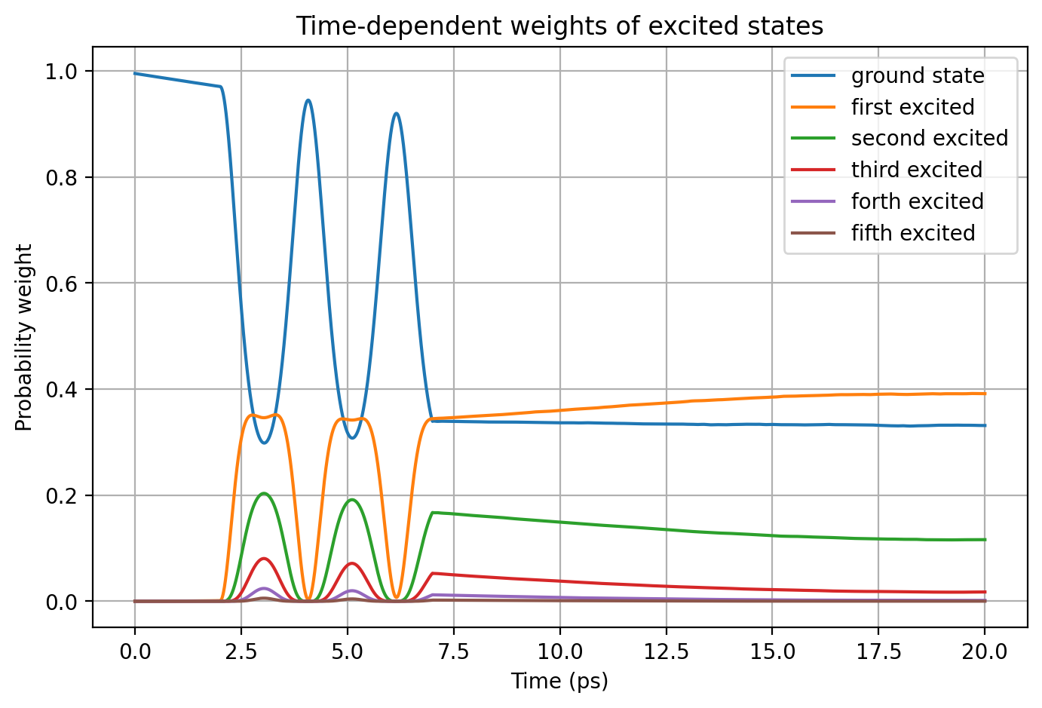
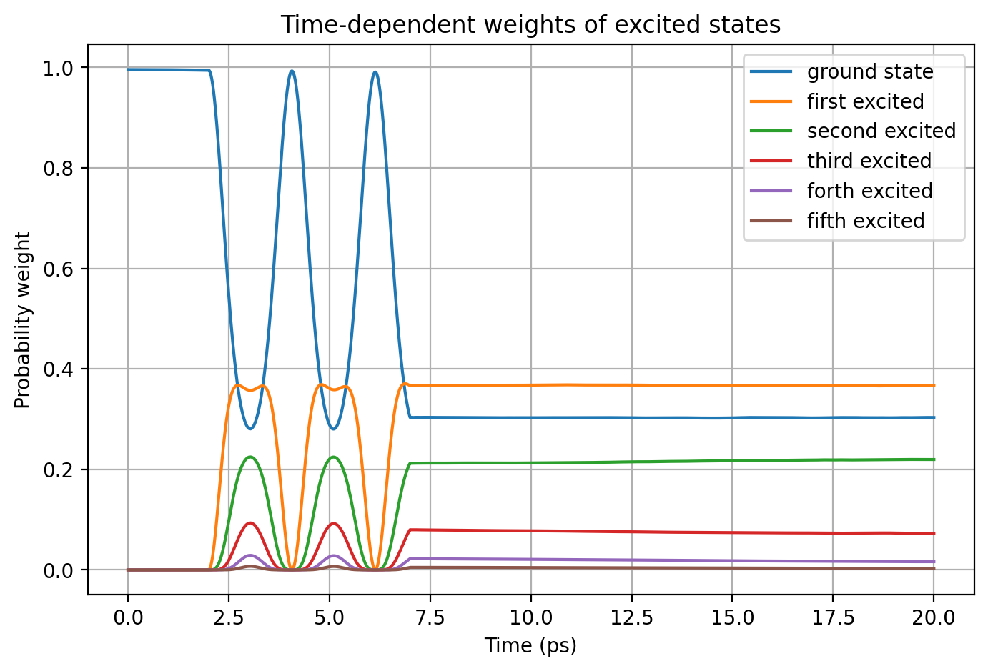
Base Model
Causal Model

Slide 13
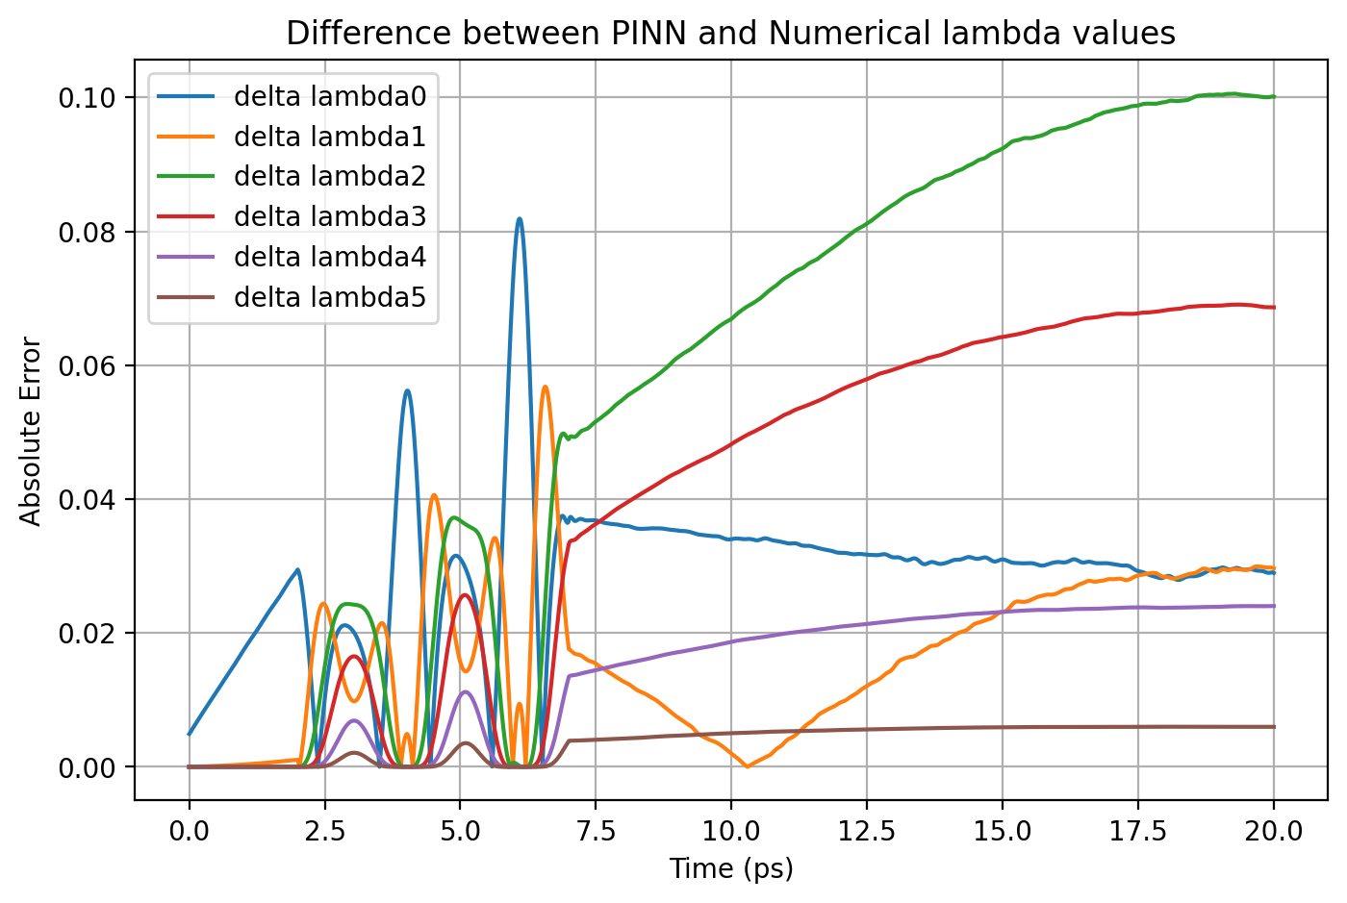
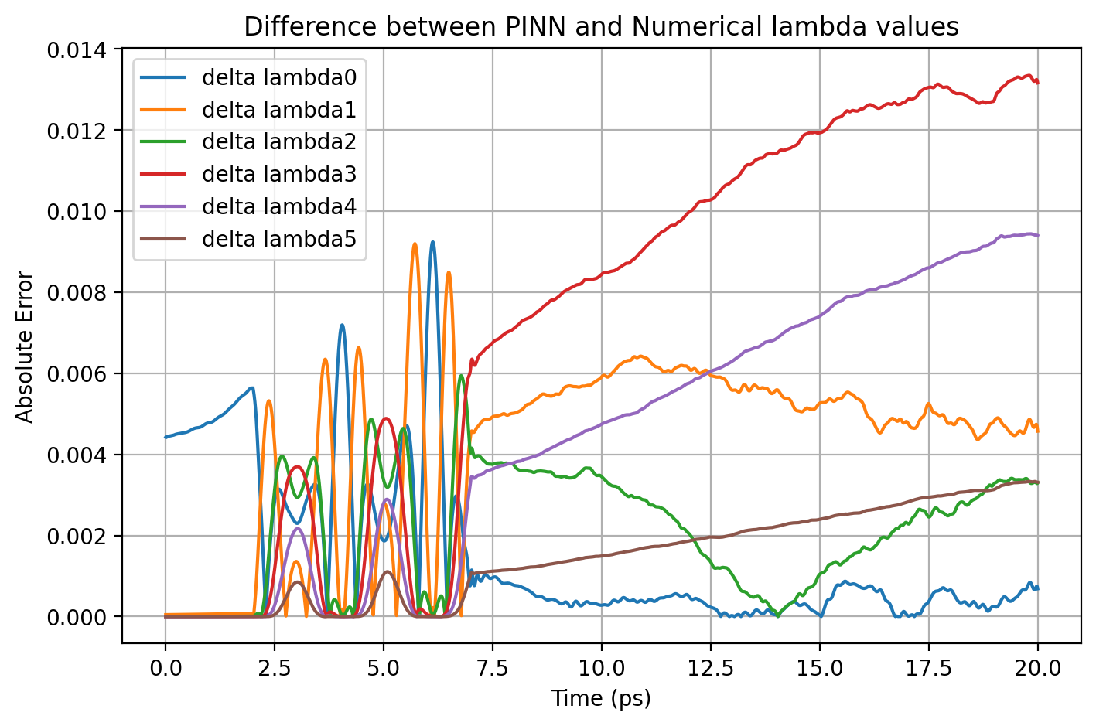

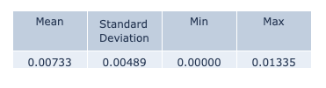
Base Model
Causal Model

Slide 14
Result Comparison
 | ΔΨ² - max | norm - mean | norm - std | Δλi - max
Base Model | 0.03409 | 0.90468 | 0.04191 | 0.10055
Causal Model | 0.00607 | 0.98813 | 0.00447 | 0.01335
ΔΨ² – max : Maximum deviation in the probability density ∣Ψ∣² between
the PINN and Crank–Nicolson solutions.
Norm – mean : Mean value of the wavefunction normalization over time, indicating how well probability conservation is maintained.
Norm – std : Standard deviation of the wavefunction normalization, reflecting fluctuations in total probability across time steps.
Δλi – max : Maximum difference in the weight coefficients λi between PINN and Crank–Nicolson solutions.

Slide 15
Normalization
When solving the Schrödinger equation, normalization ensures the wavefunction represents a valid probability distribution, which means the probability of finding a particle anywhere is exactly 1
In the context of solving using PINNs, the wavefunction is not inherently normalized during training, we expect the model to naturally approximate normalization as it learns the correct solution
However, by explicitly enforcing normalization as an additional term in the loss function, I observed improvement in the model performance

Slide 16
Normalization
The probability of finding a particle in space is given by the integral of the probability density:
We use Monte-Carlo approximation to find this integral during training:

Slide 17

Results
Base Model
Norm Model

Slide 18
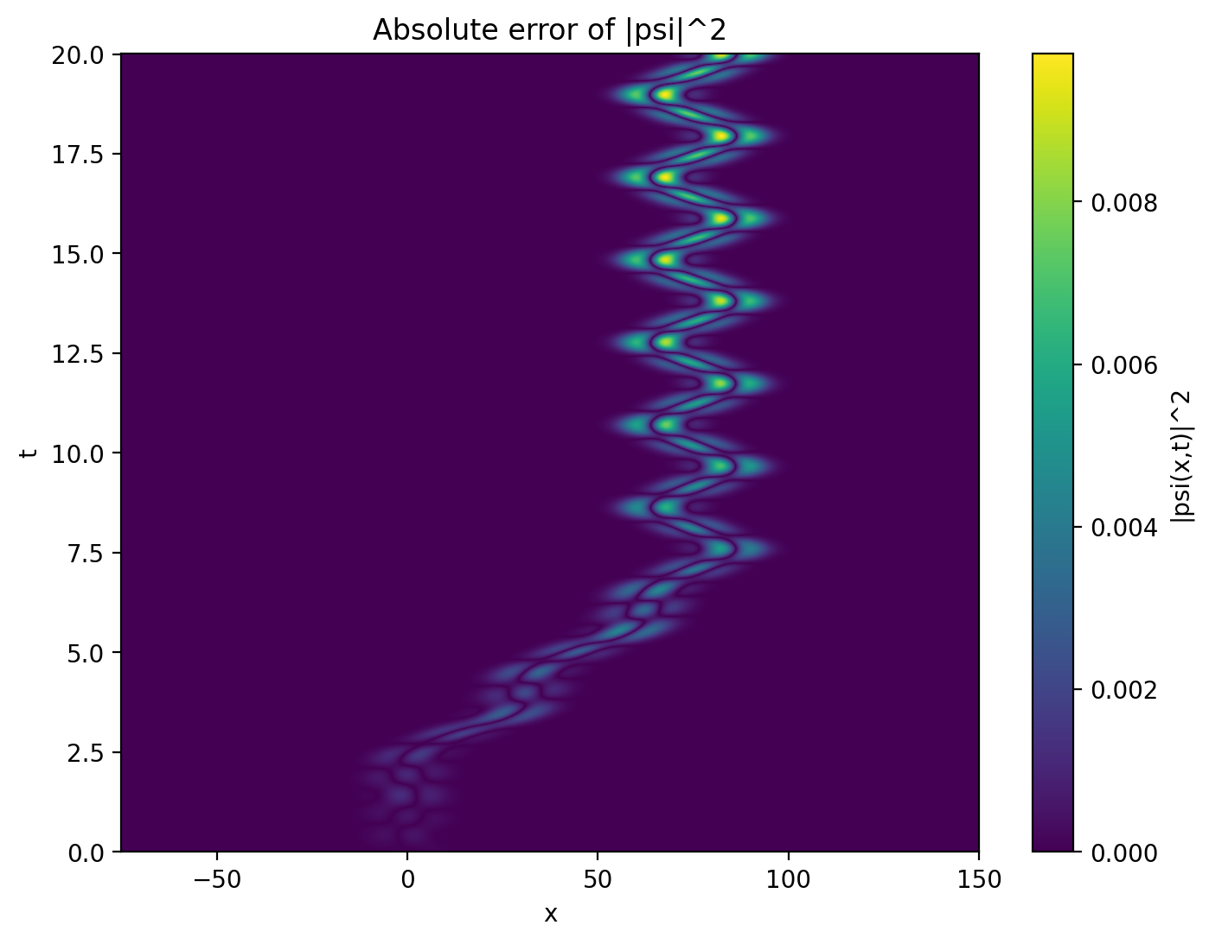

Base Model
Norm Model

Slide 19
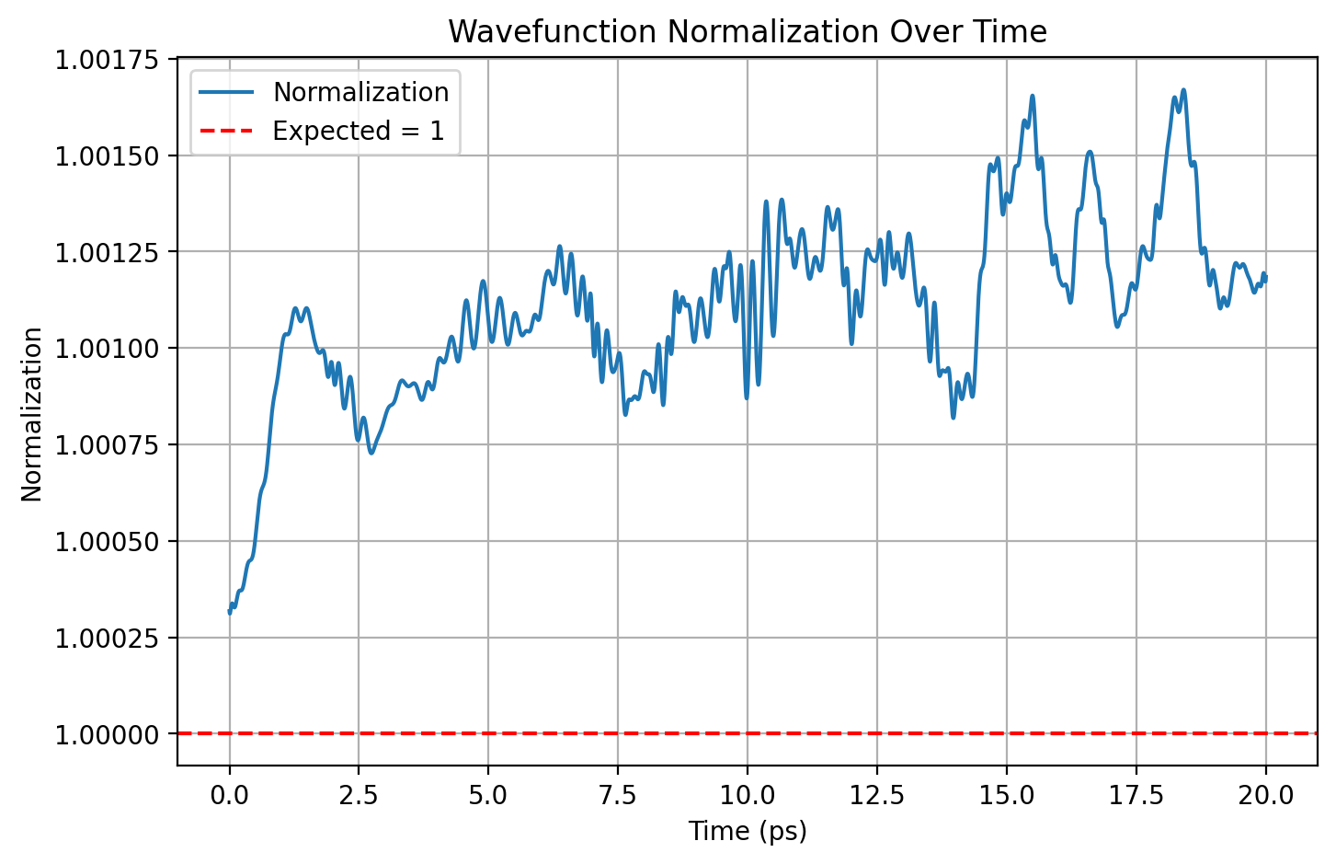

Base Model
Norm Model

Slide 20
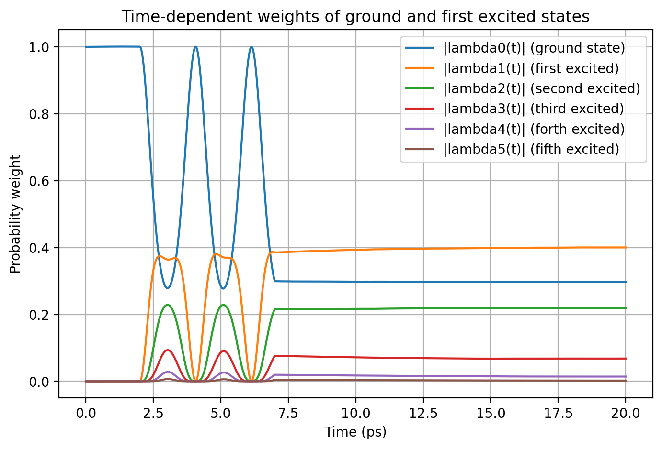
Base Model
Norm Model

Slide 21
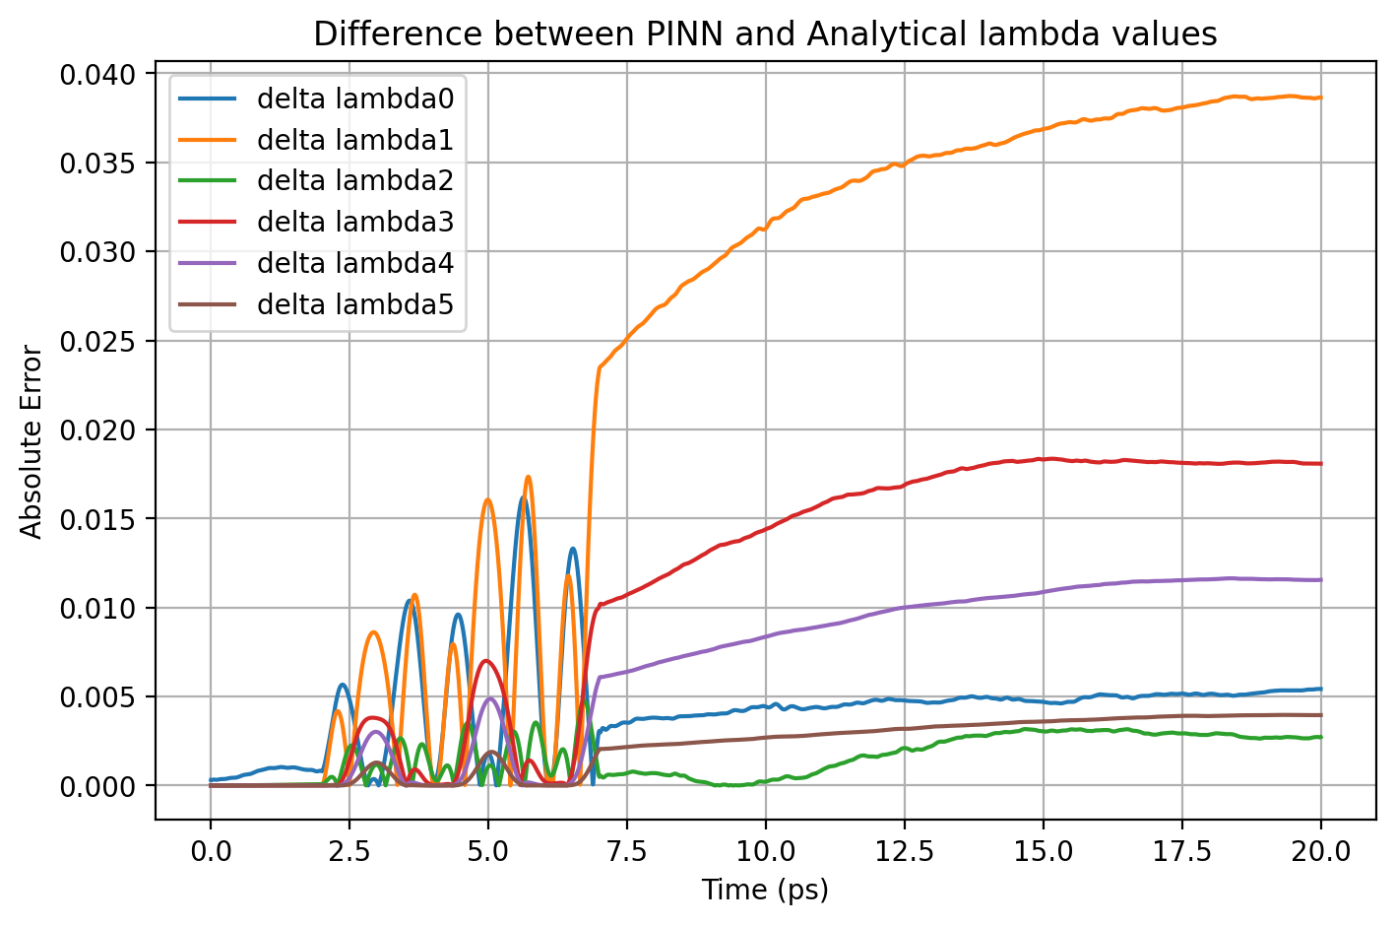

Base Model
Norm Model

Slide 22
Result Comparison
 | ΔΨ² - max | norm - mean | norm - std | Δλi - max
Base Model | 0.03409 | 0.90468 | 0.04191 | 0.10055
Norm Model | 0.00981 | 1.00111 | 0.00023 | 0.03872
ΔΨ² – max : Maximum deviation in the probability density ∣Ψ∣² between
the PINN and Crank–Nicolson solutions.
Norm – mean : Mean value of the wavefunction normalization over time, indicating how well probability conservation is maintained.
Norm – std : Standard deviation of the wavefunction normalization, reflecting fluctuations in total probability across time steps.
Δλi – max : Maximum difference in the weight coefficients λi between PINN and Crank–Nicolson solutions.

Slide 23
Conclusion
Introduced two key methods that improved the performance of the PINN model for a moving quantum dot
Enforcing causality made sure that model training respected the time-ordered nature of quantum dynamics during training, leading to improvement in performance
Normalization enforcement bought the total probability closer to one, stabilizing the wavefunction

Slide 24
Next Steps
Increase quantum dot speed: Speed up the quantum dot movement and compare how the complexity of PINN and Crank-Nicholson is increasing
Extend to 2D systems: Solve the TDSE for a electron in a two-dimensional quantum dot. Check if normalization and causality are improving the performance in higher dimensional models as well

Slide 25
Thank You

