Slide 1
Meeting - 09/06/2025

Slide 2
Base Norm Models
Trained different types of norm models
  20 equally spaced t points between 1 and 20 and 1000 x points
  Same as above, but with 10000 x points
  100 equidistant t points and 1000 x points
  10 equidistant t points and 1000 x points
  Model 1 with less weight for norm loss

Slide 3
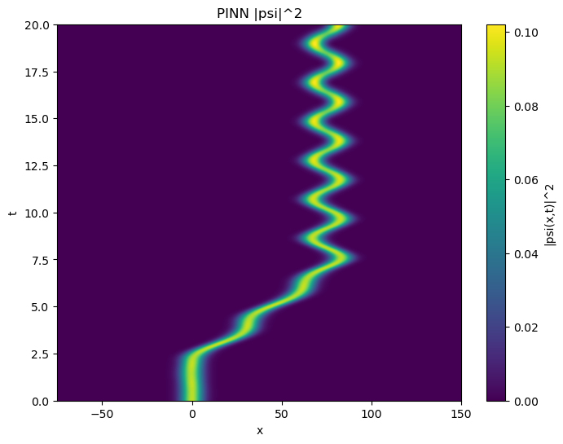
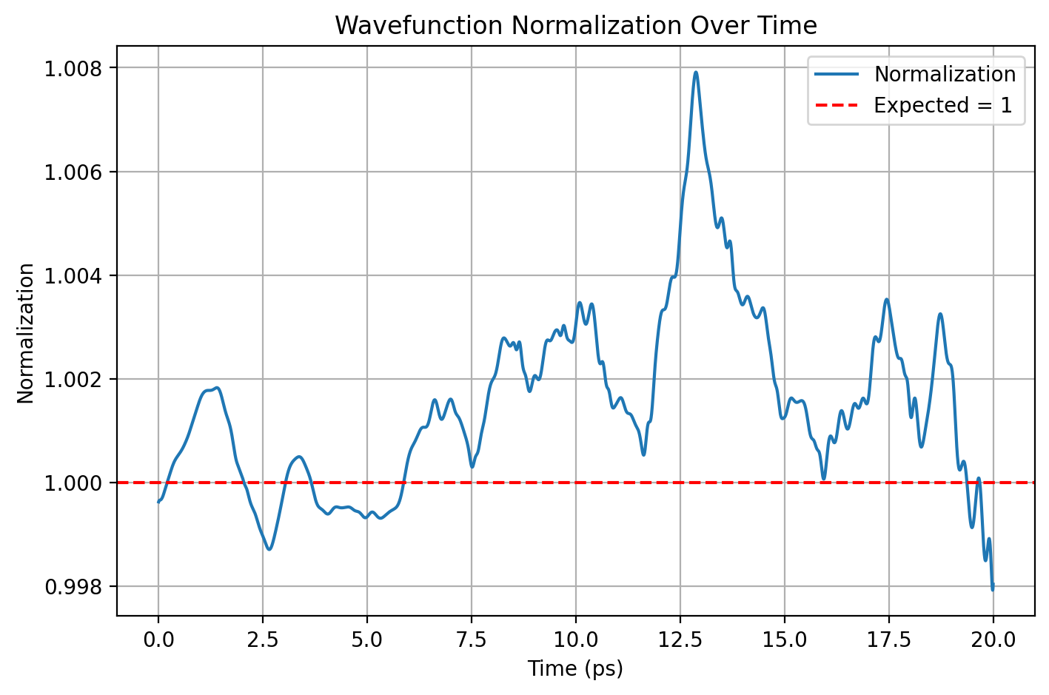
Model 1 – 20, 1000

Slide 4
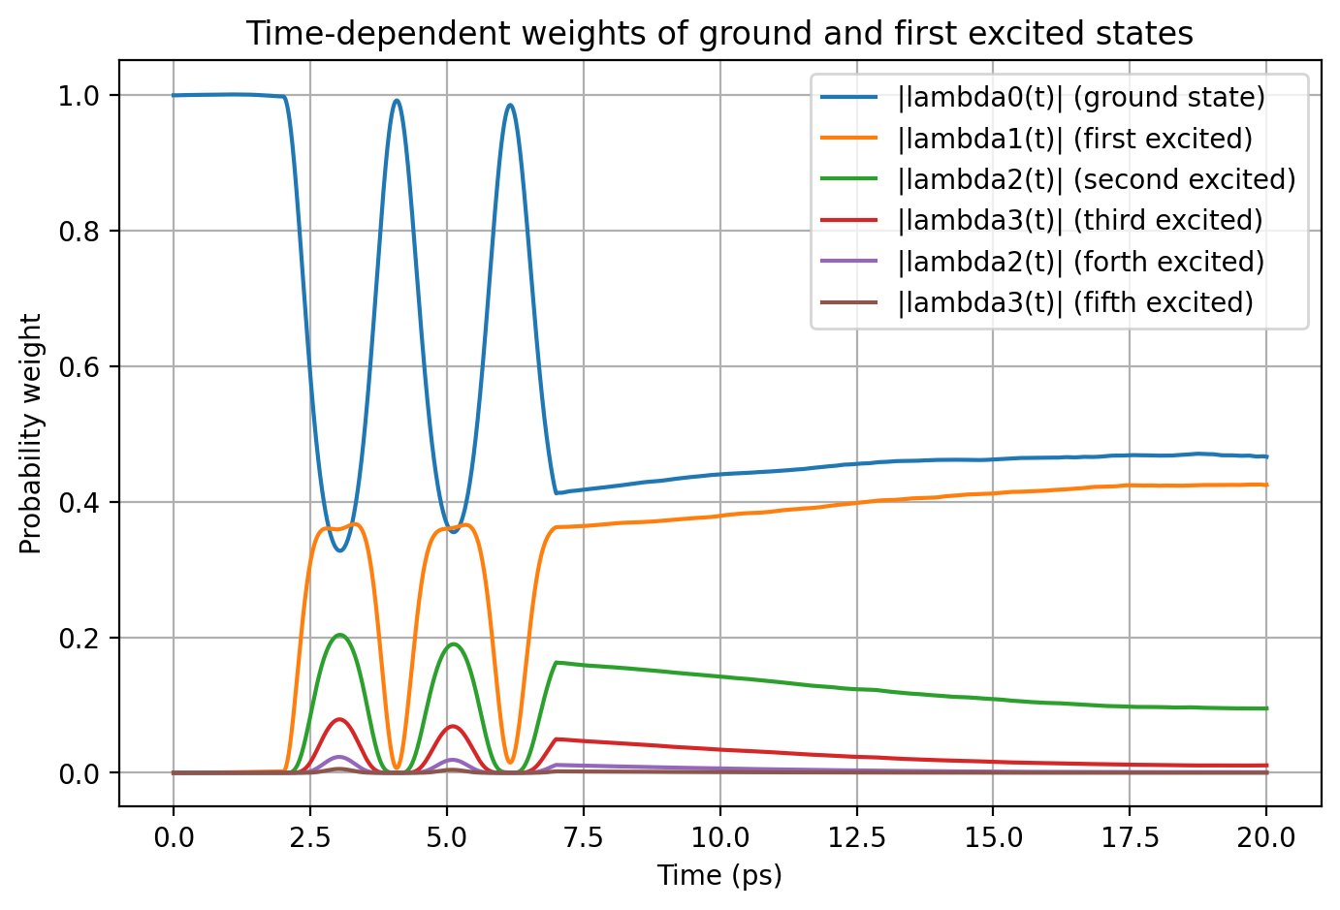

Slide 5
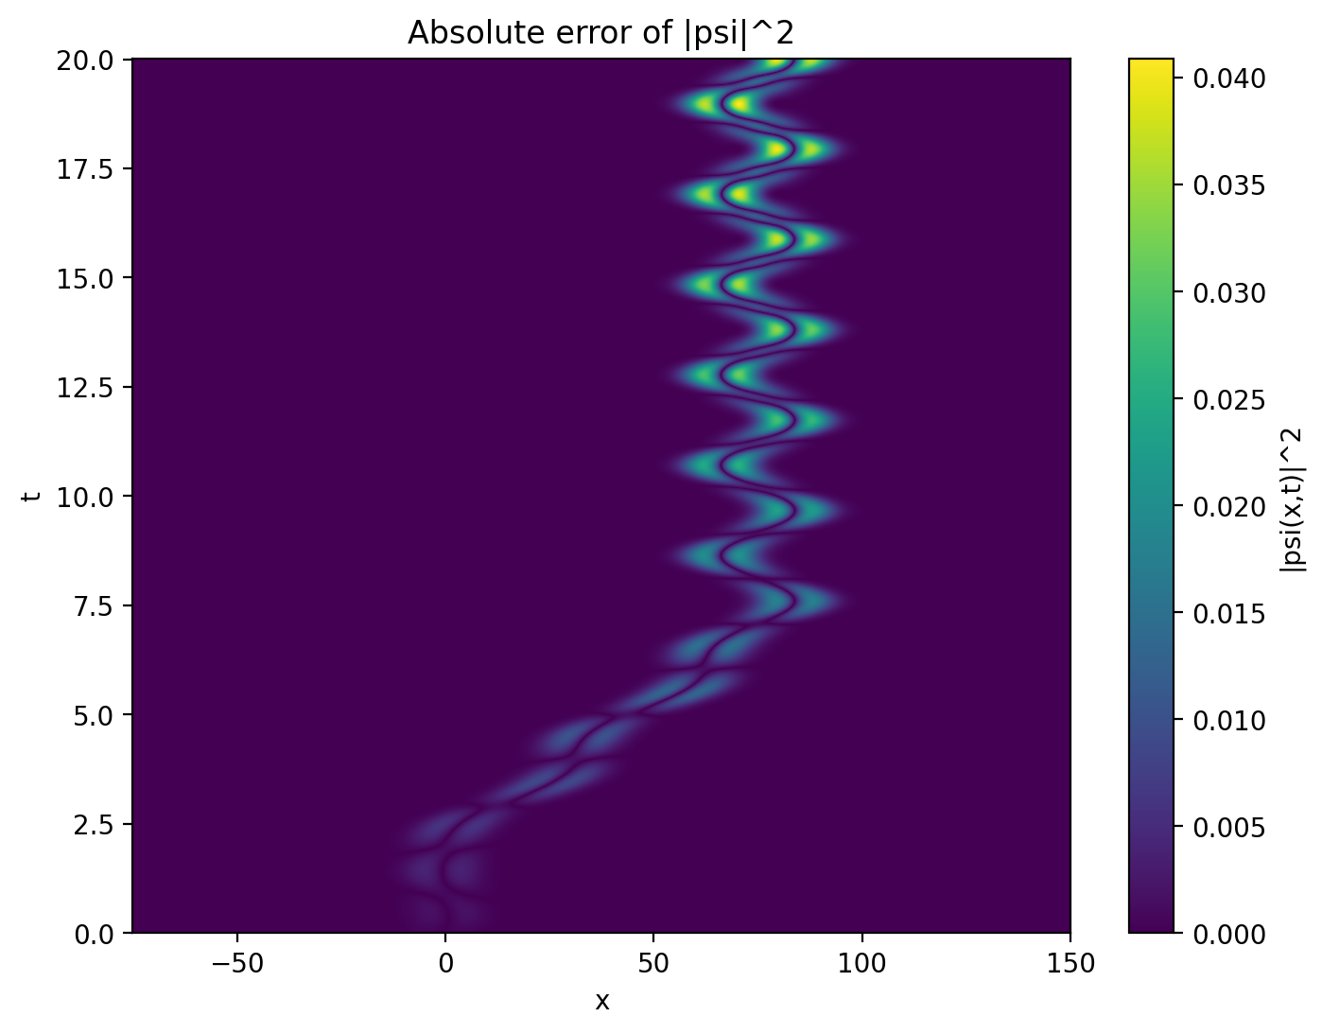
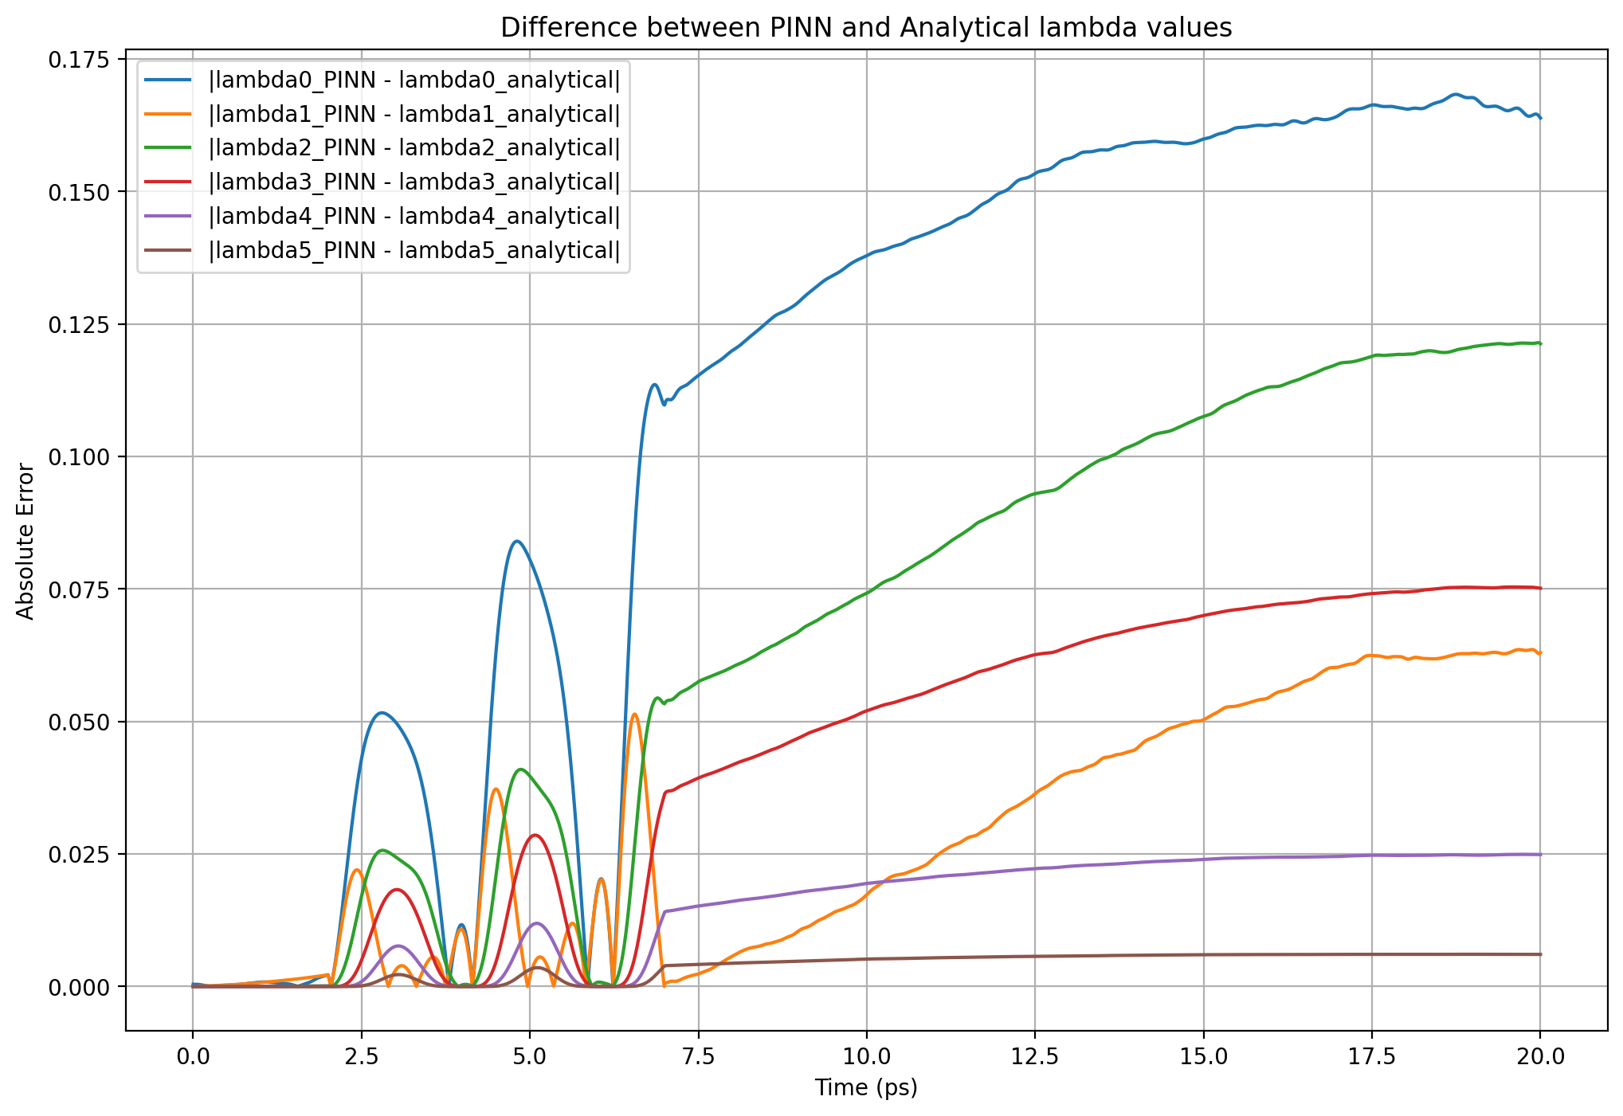

Slide 6

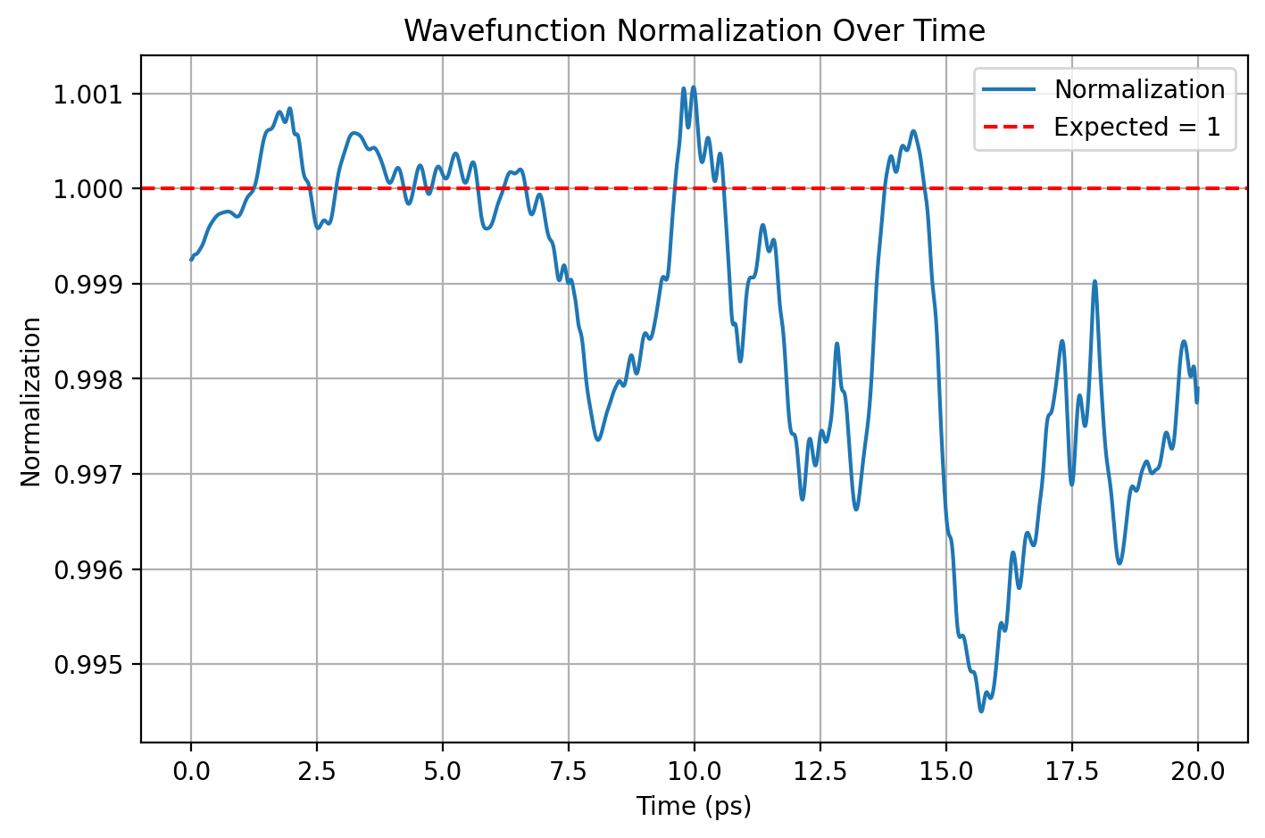
Model 2 – 20, 10000

Slide 7


Slide 8
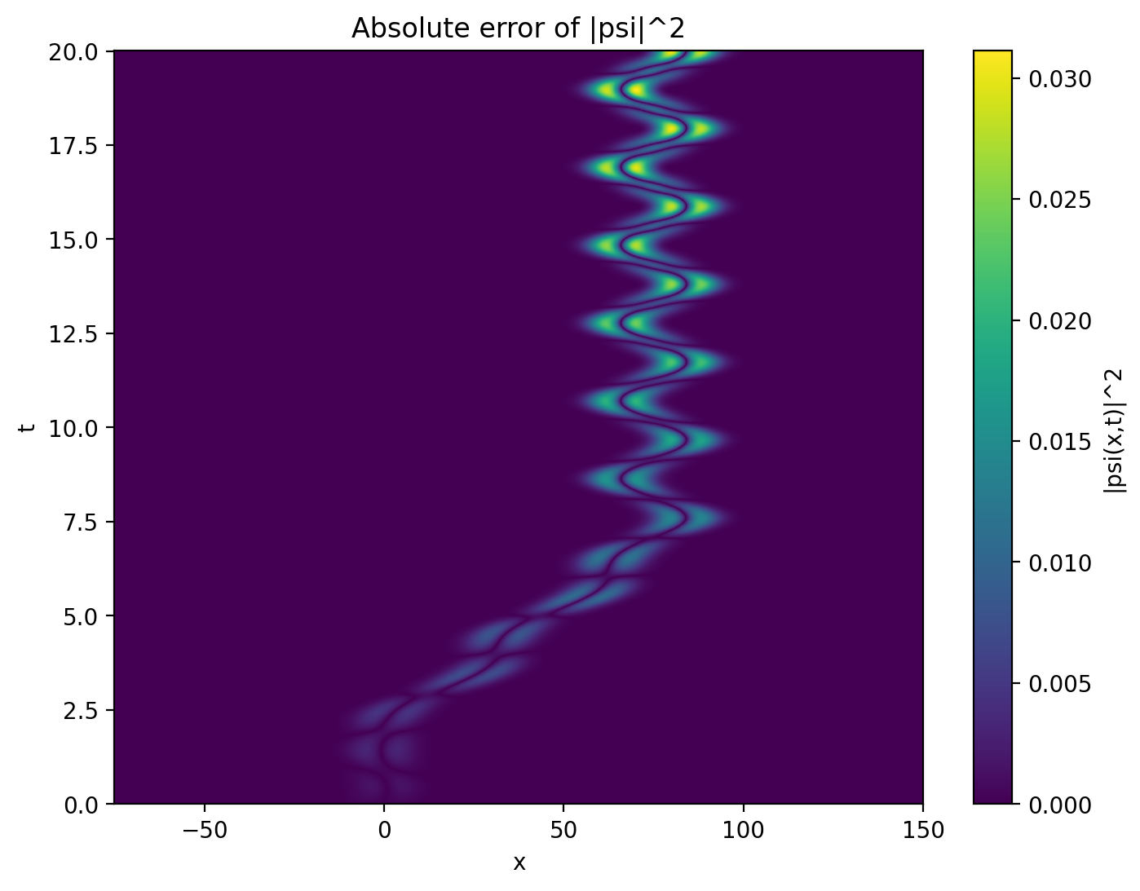
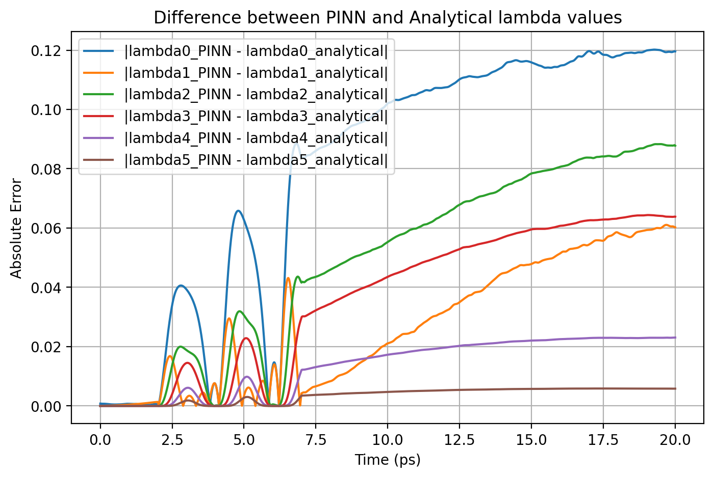

Slide 9

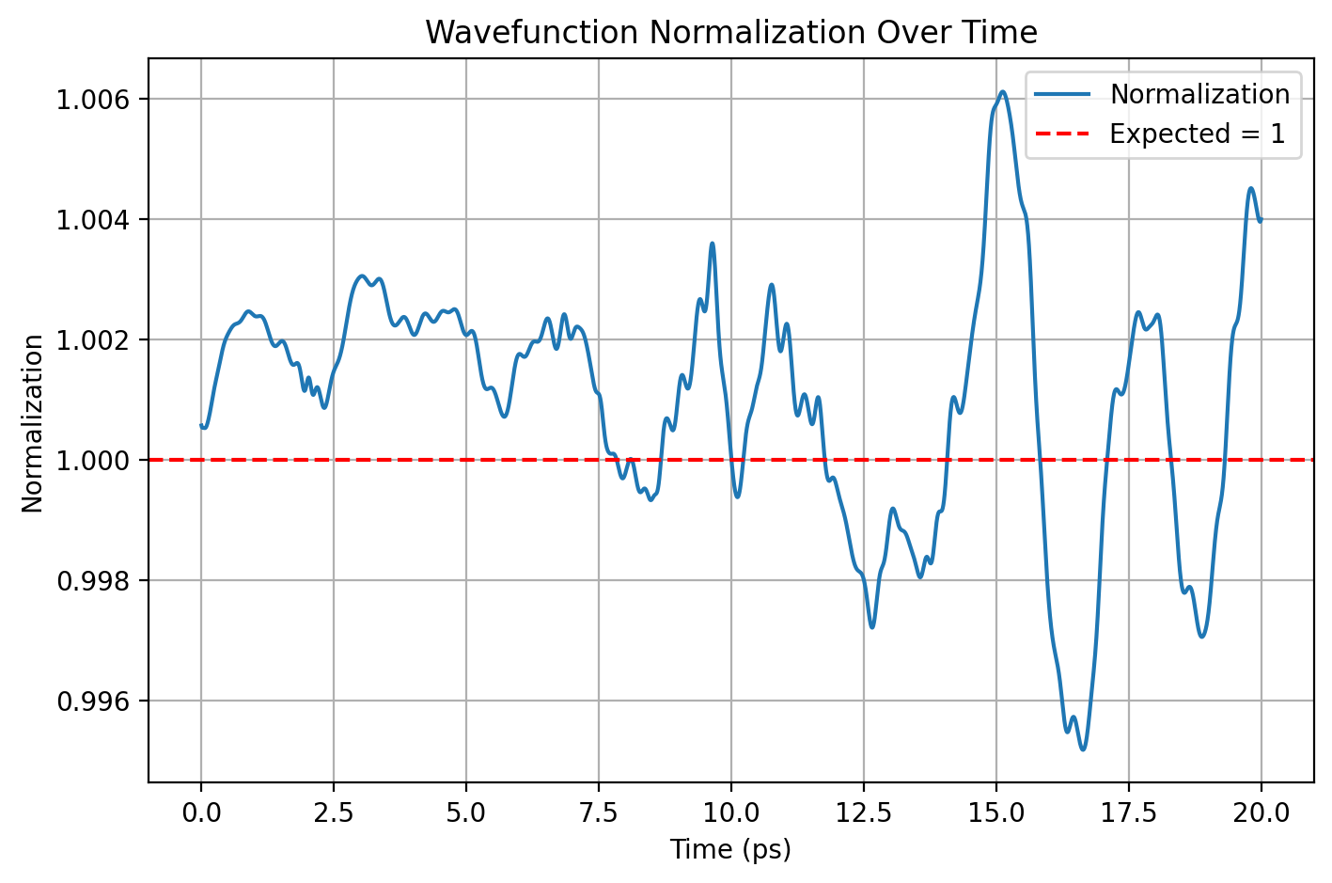
Model 3 – 100, 1000

Slide 10
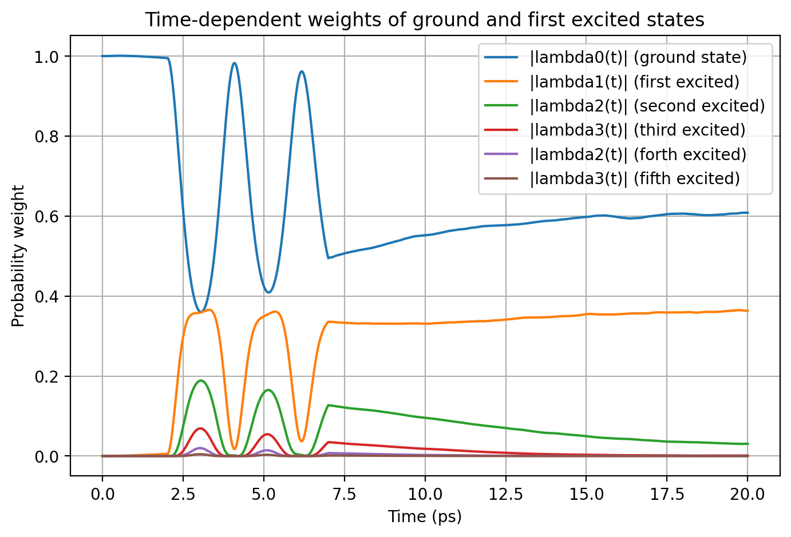

Slide 11
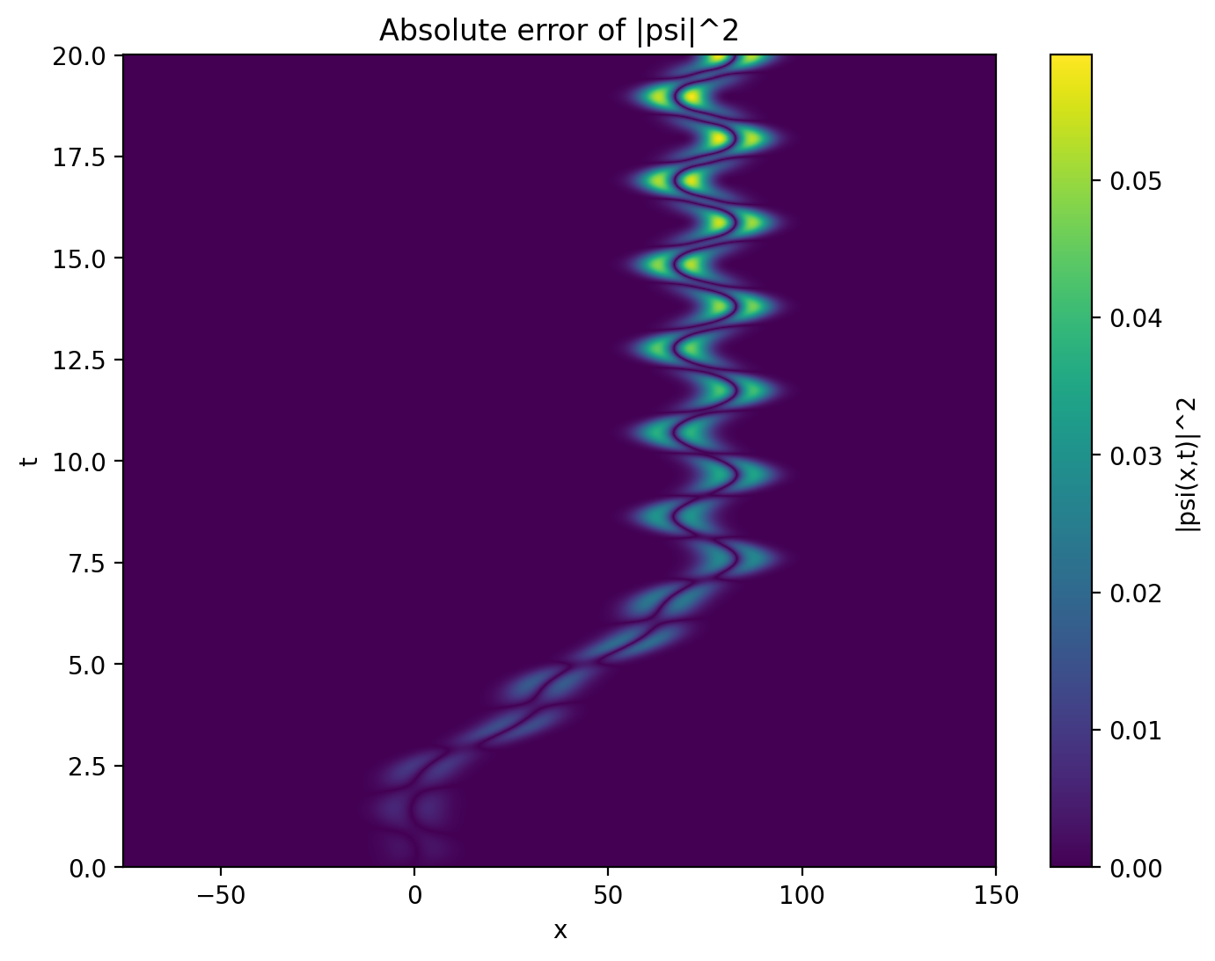
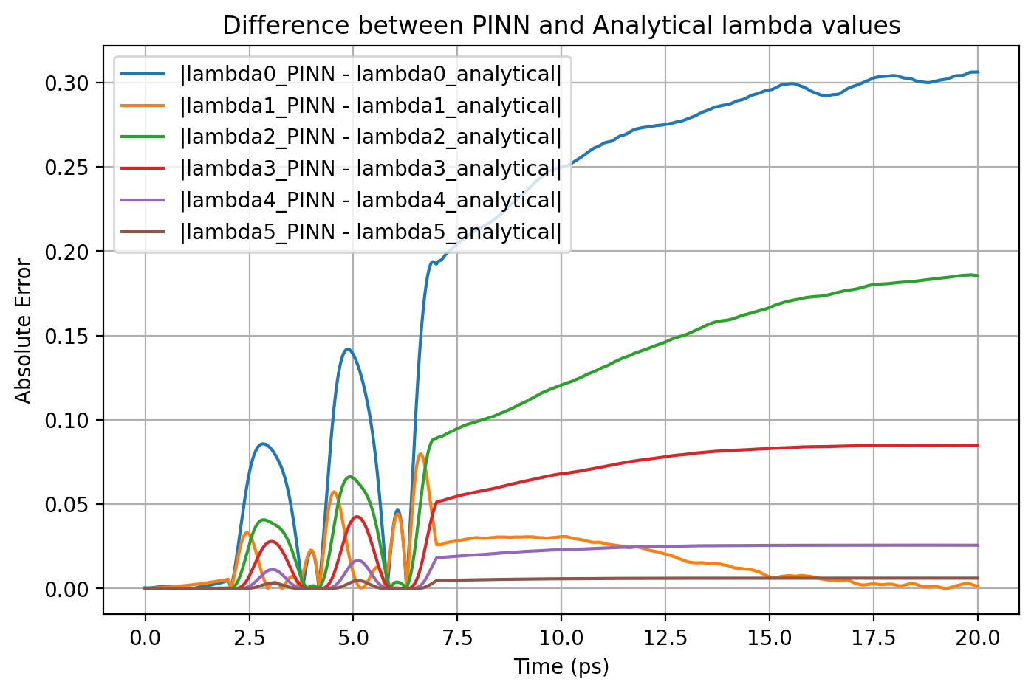

Slide 12

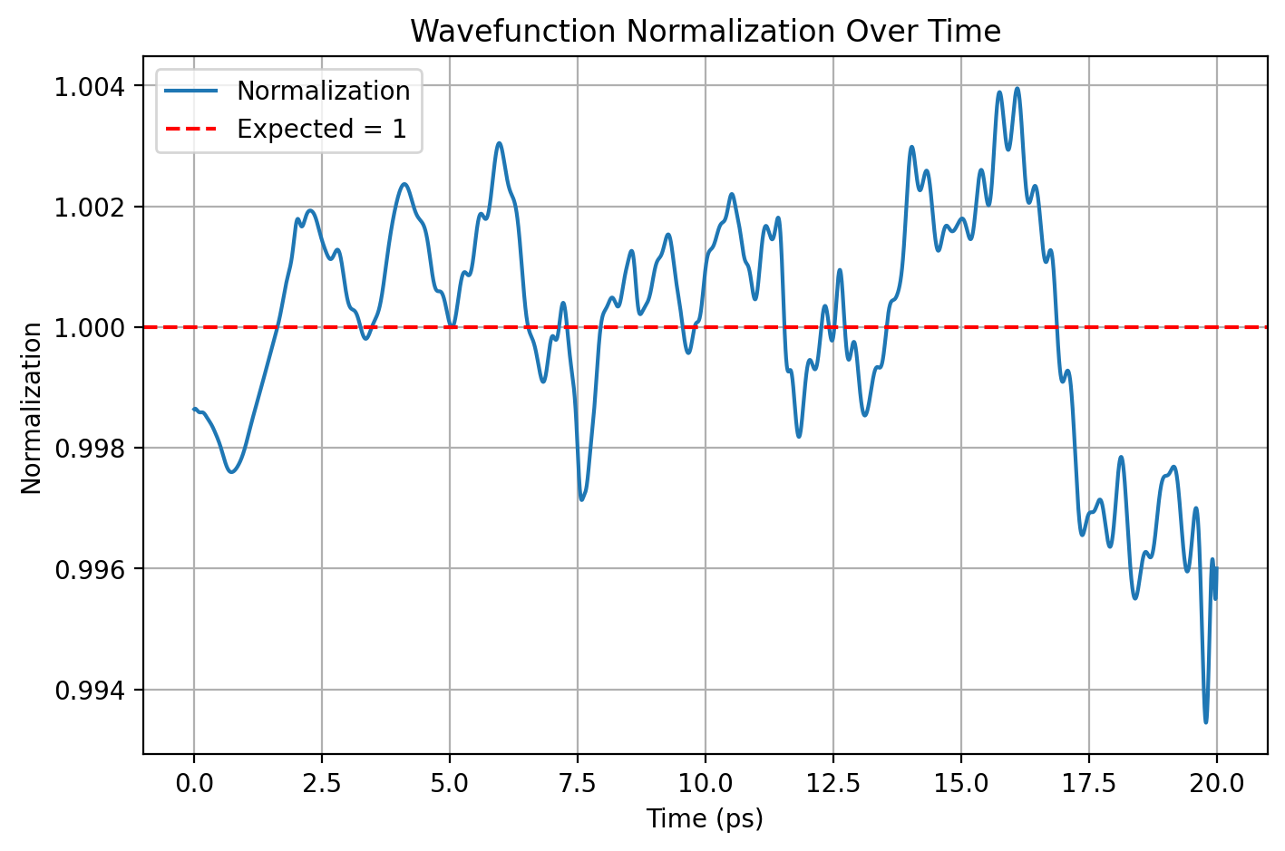
Model 4 – 10, 1000

Slide 13
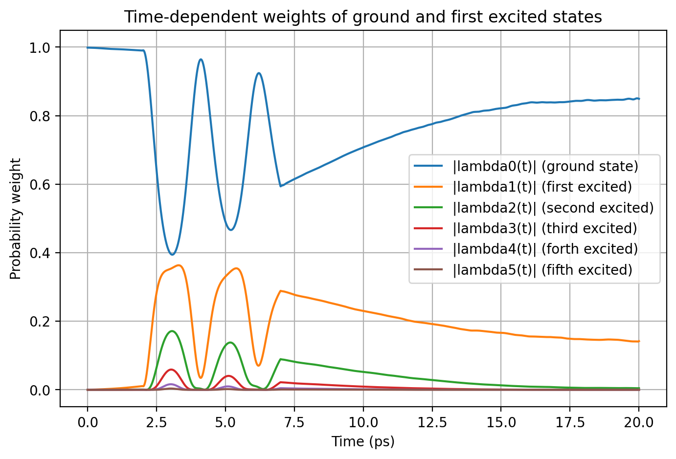

Slide 14
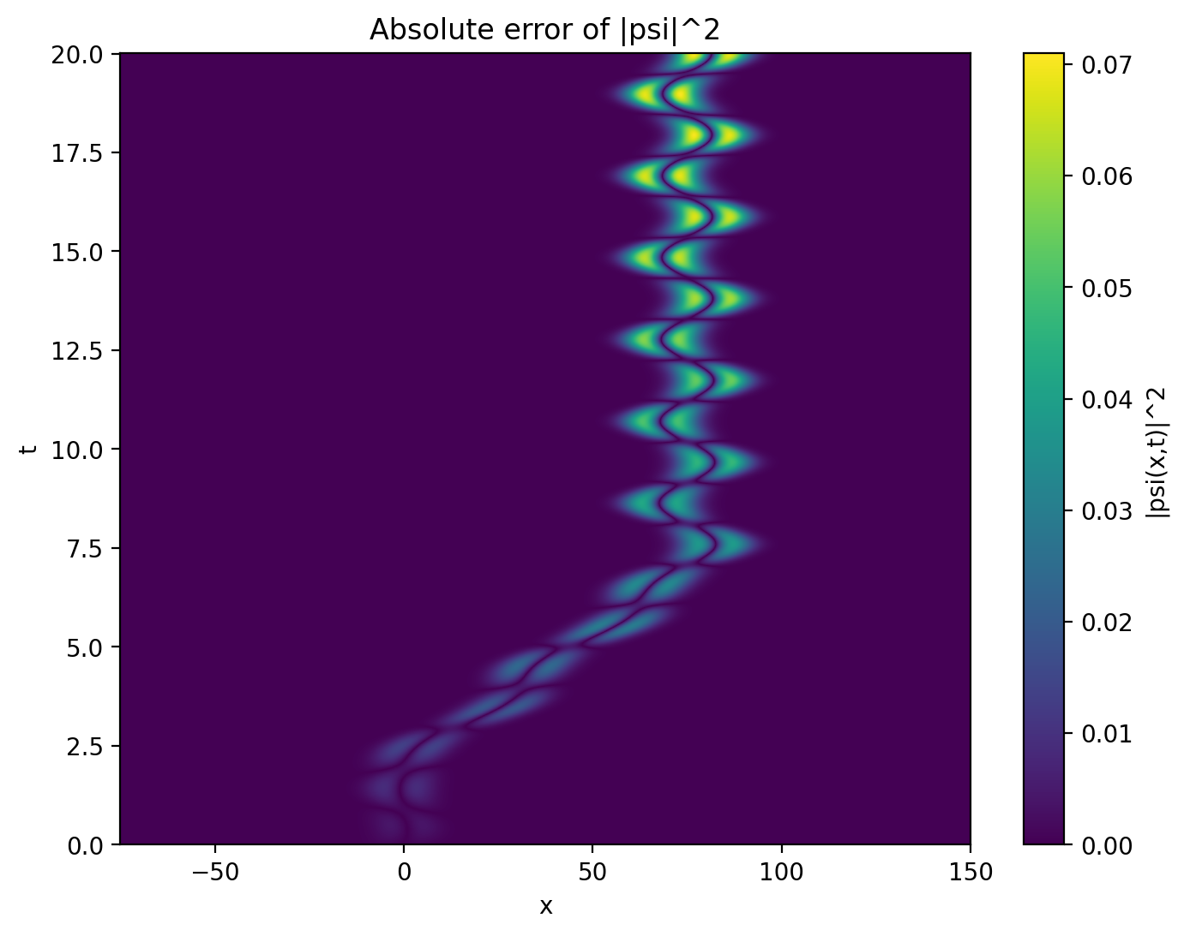
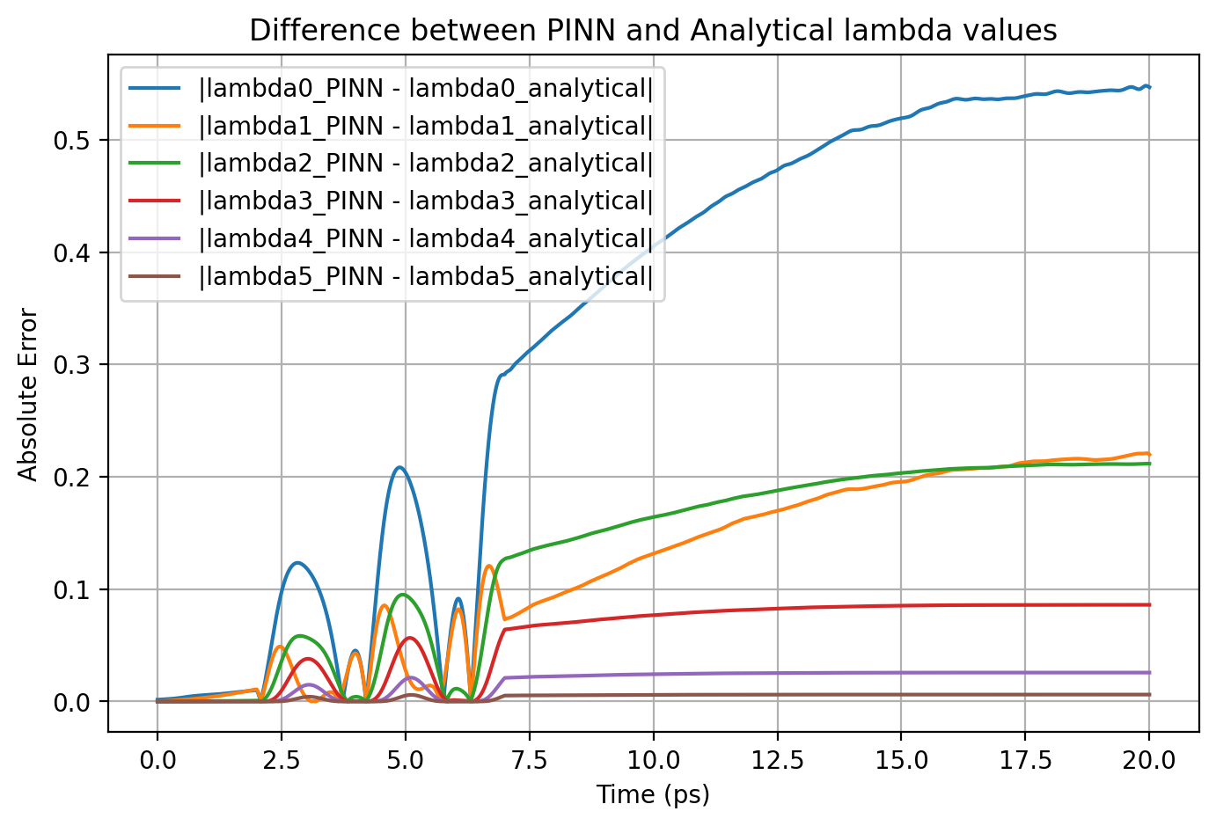

Slide 15

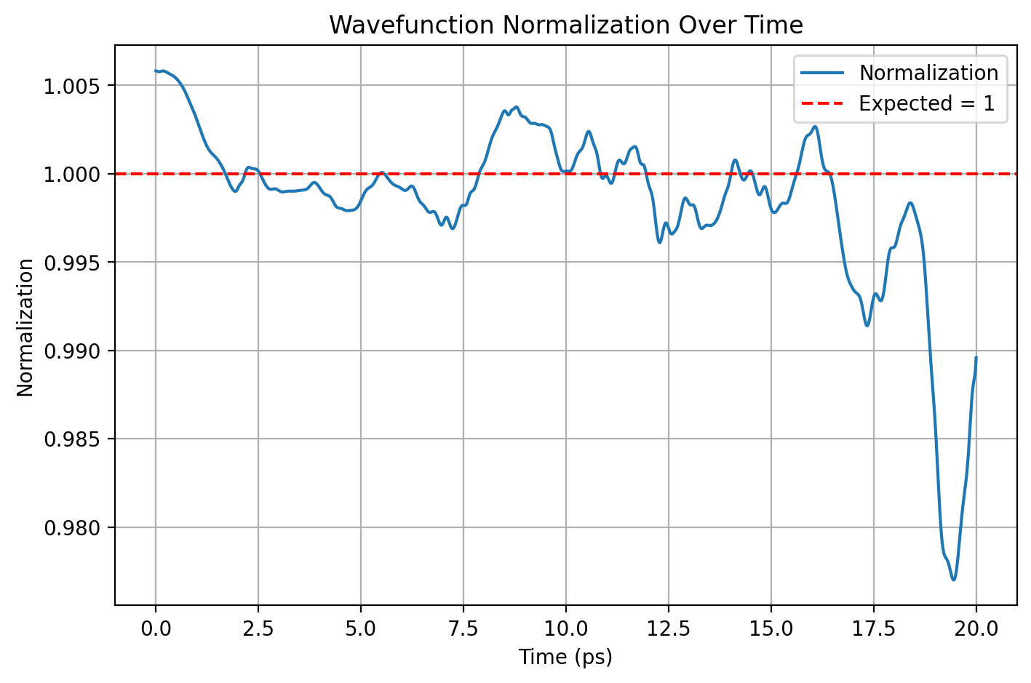
Model 5 – Less weight

Slide 16
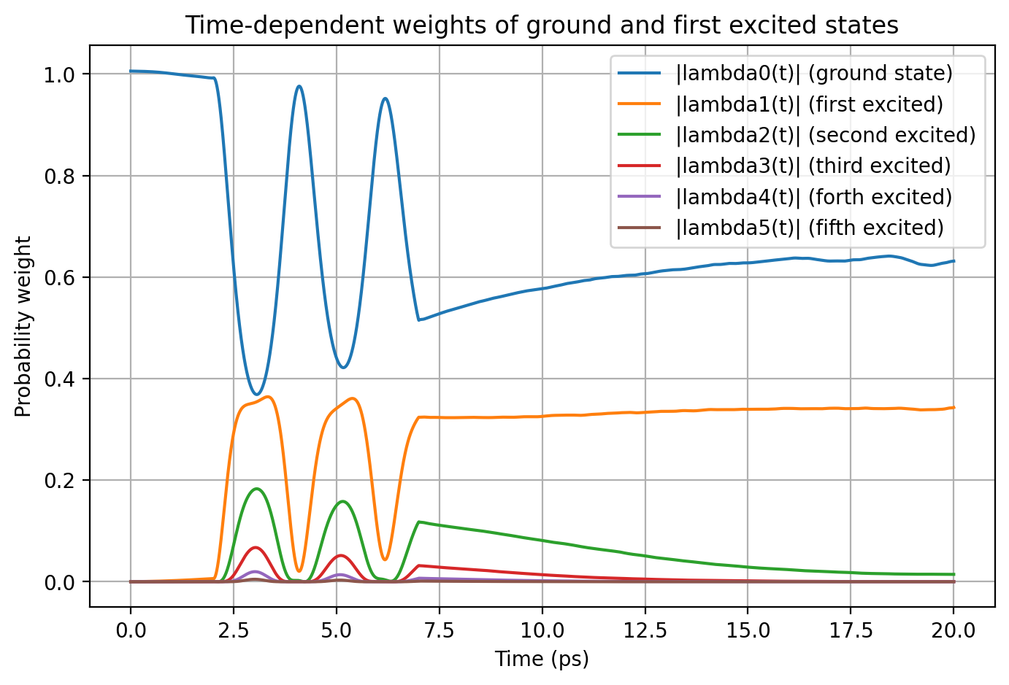

Slide 17

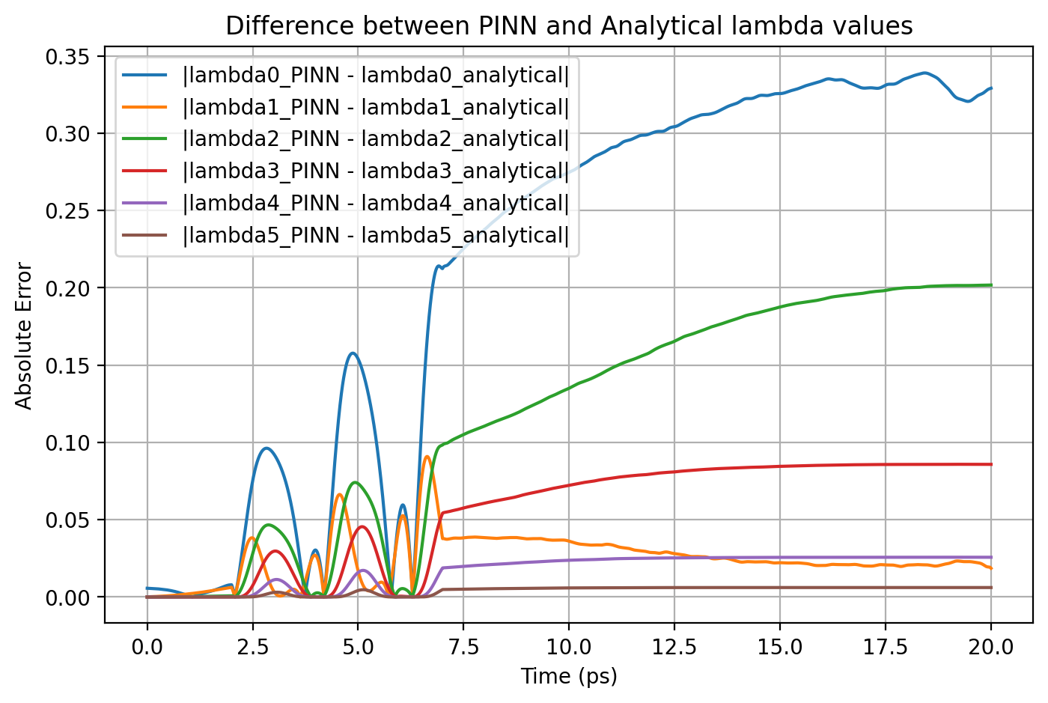

Slide 18
Best Norm Model
From previous models, the best model I found was model 2
Which is, norm loss using 20 t points and 10000 x points
But that model took longer time to train due to the increased number of t points!
So I took the second best model, which is model 1 as the current best norm model
I trained it again using 12 HL and 350k epochs

Slide 19

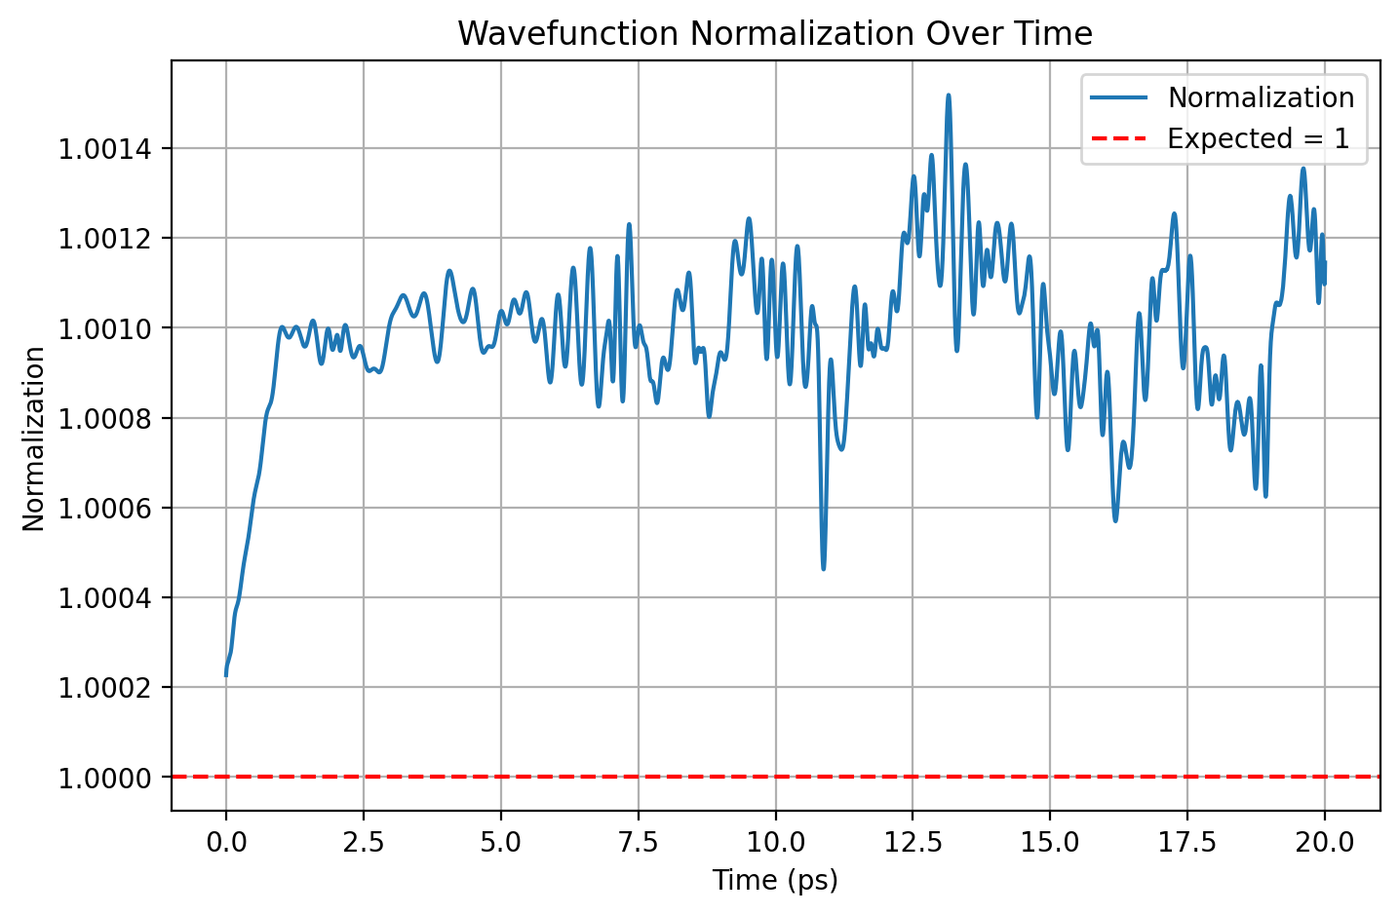

Slide 20
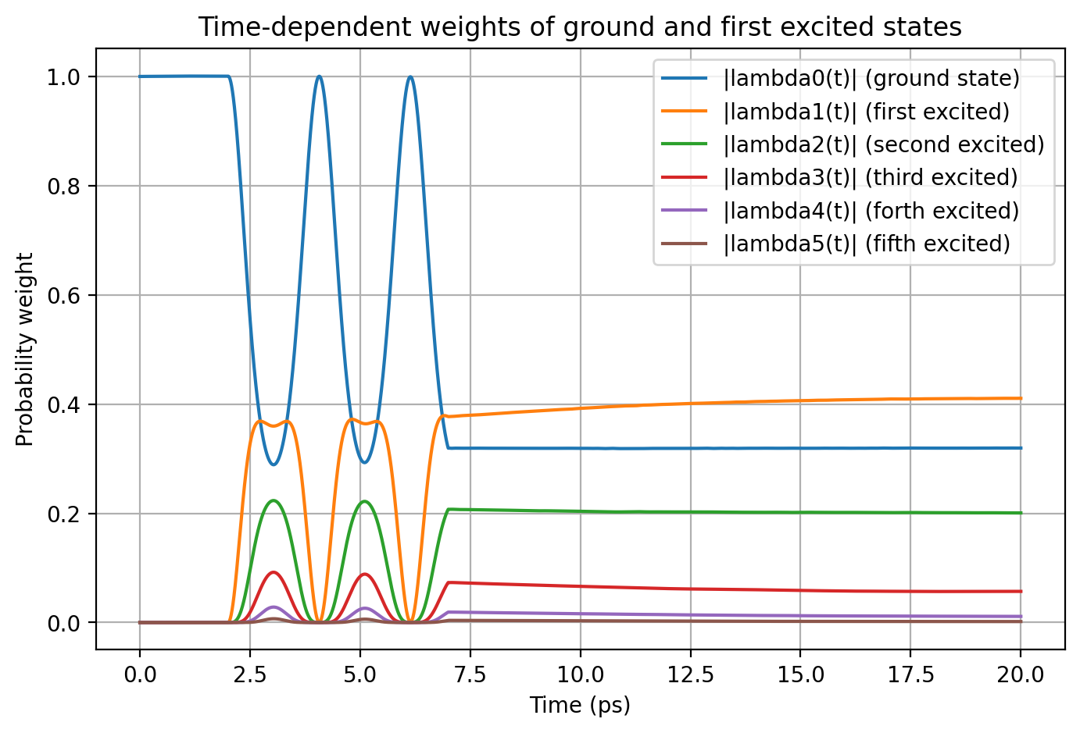

Slide 21

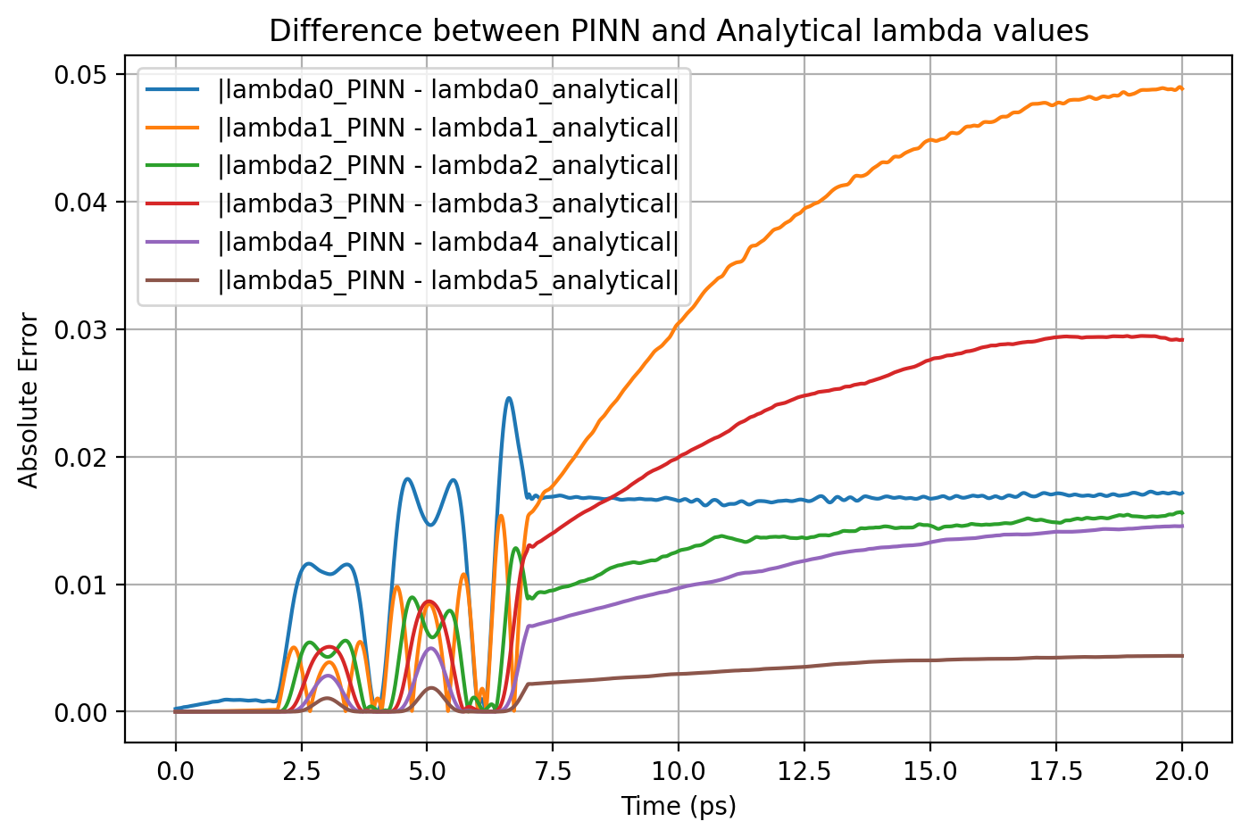

Slide 22
Norm Loss using 1 random point
Here, I calculated normalization loss using 1 random t point each iteration with 1000 x points

Slide 23

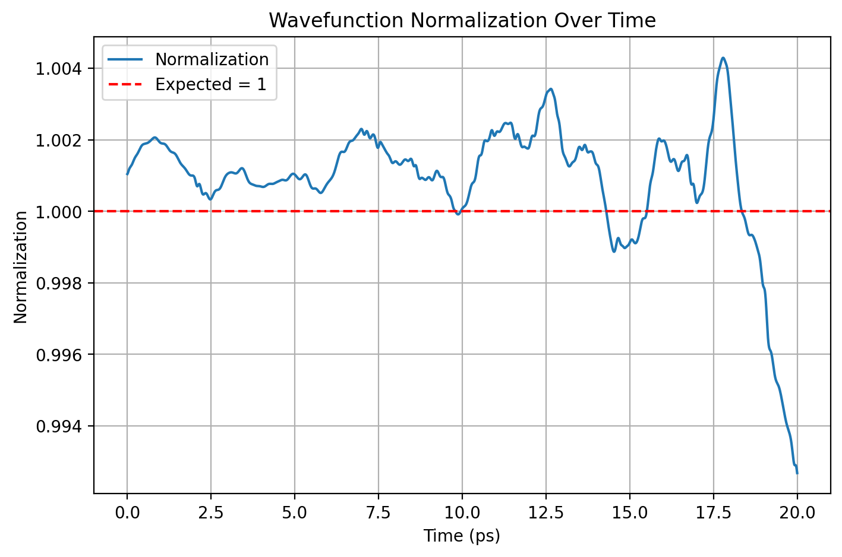

Slide 24
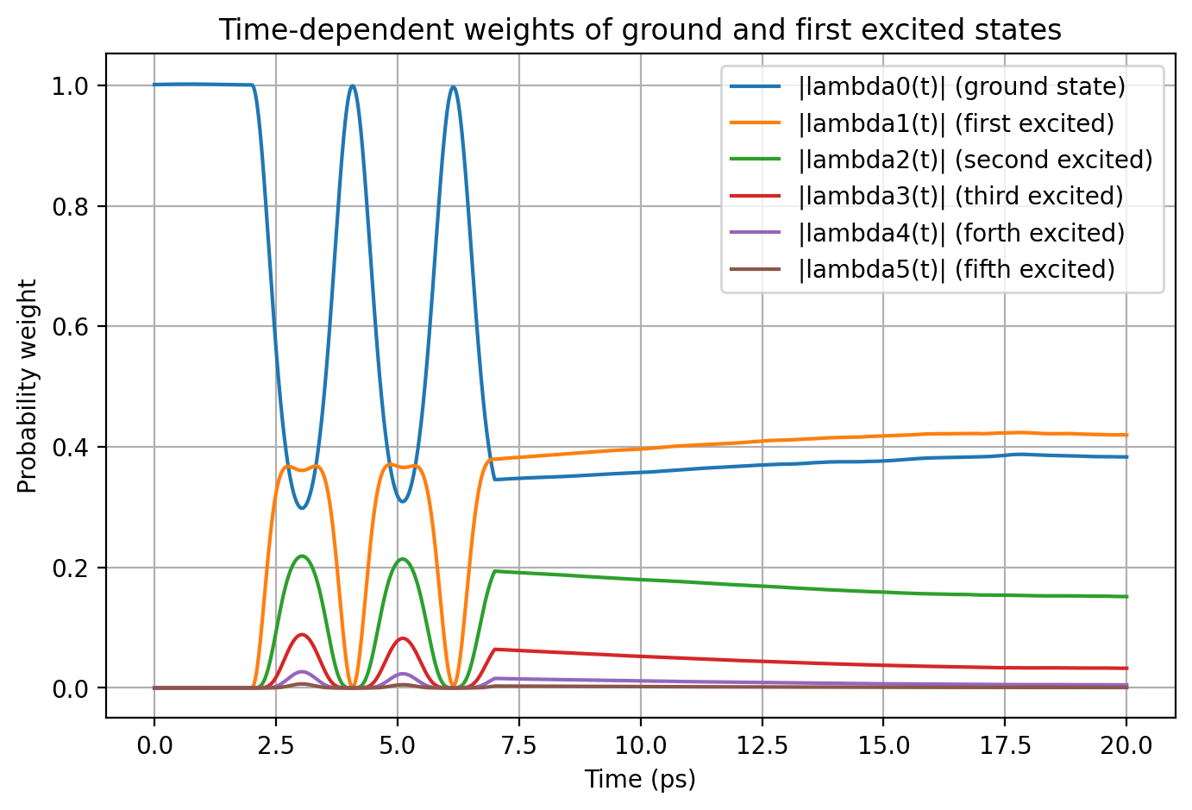

Slide 25

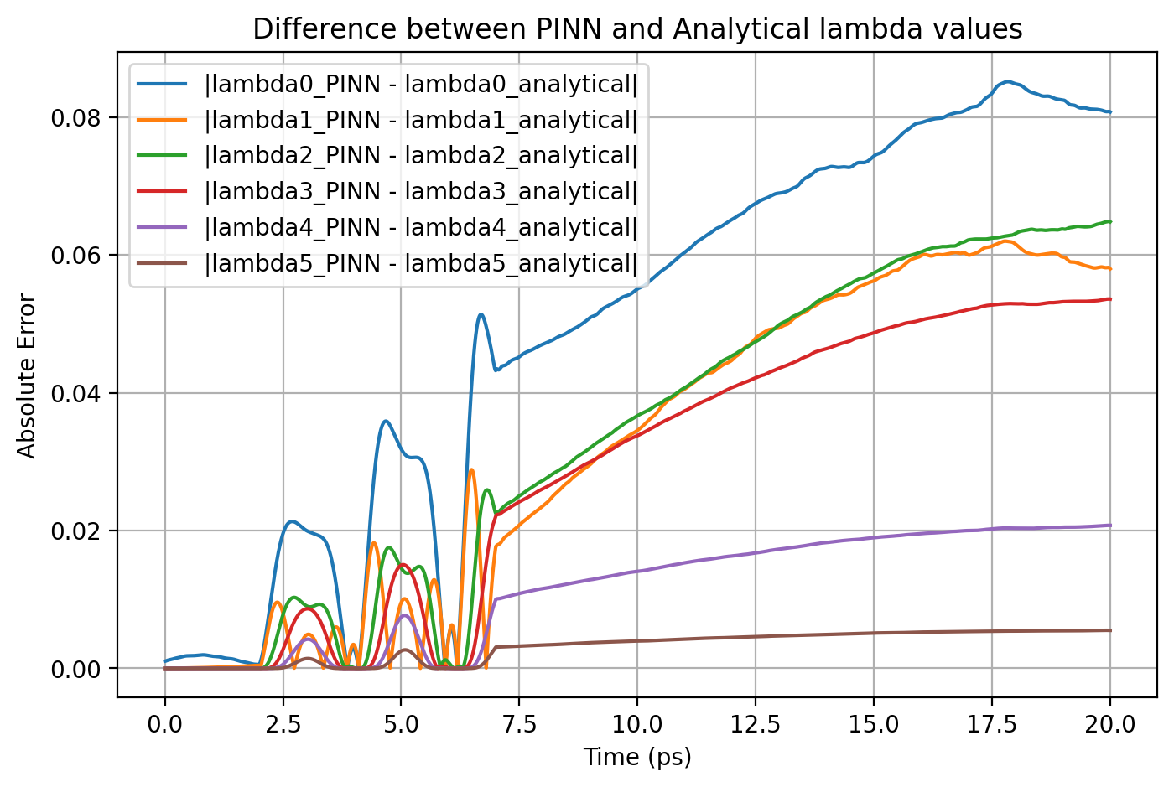

Slide 26
Norm + Causal
Here, I combined the configurations of my current best norm model and causal model

Slide 27
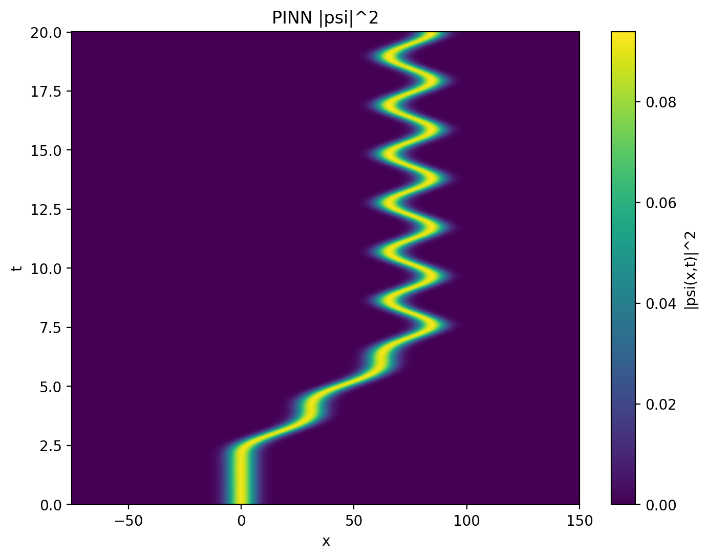
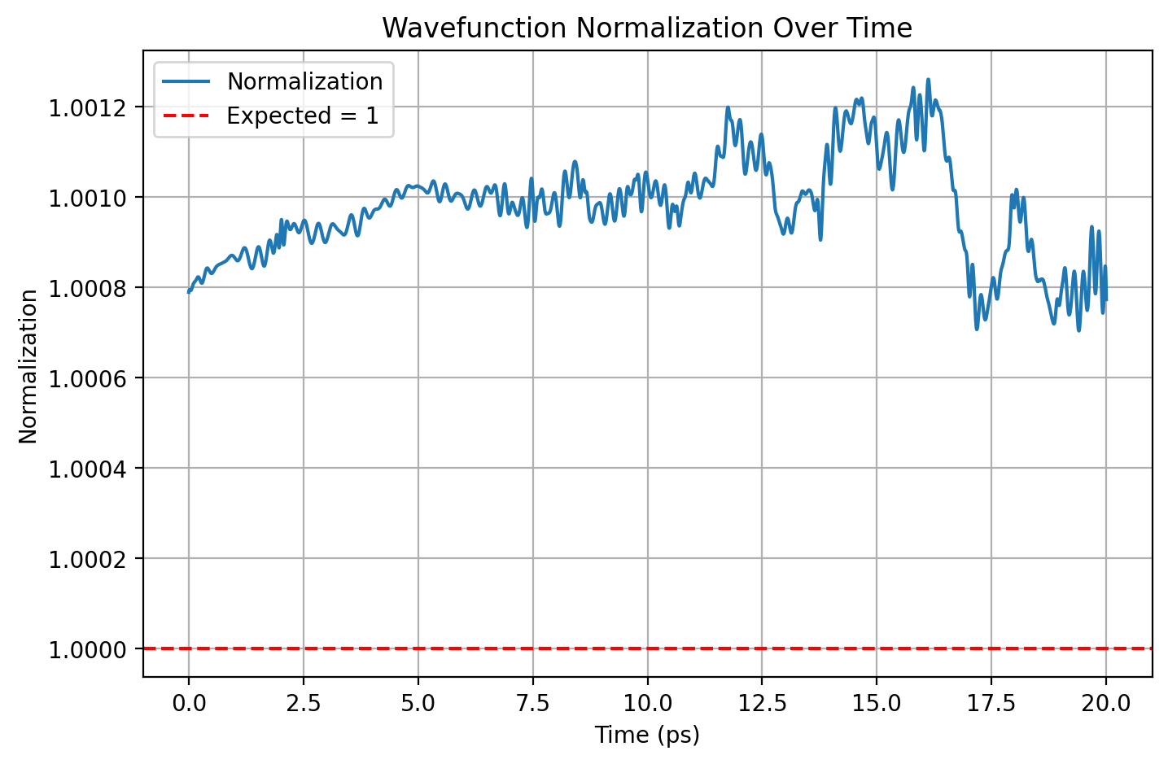

Slide 28
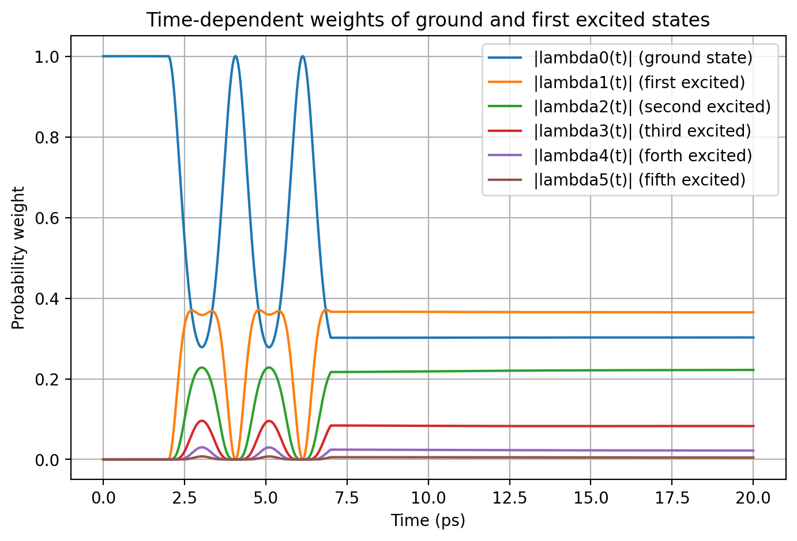

Slide 29
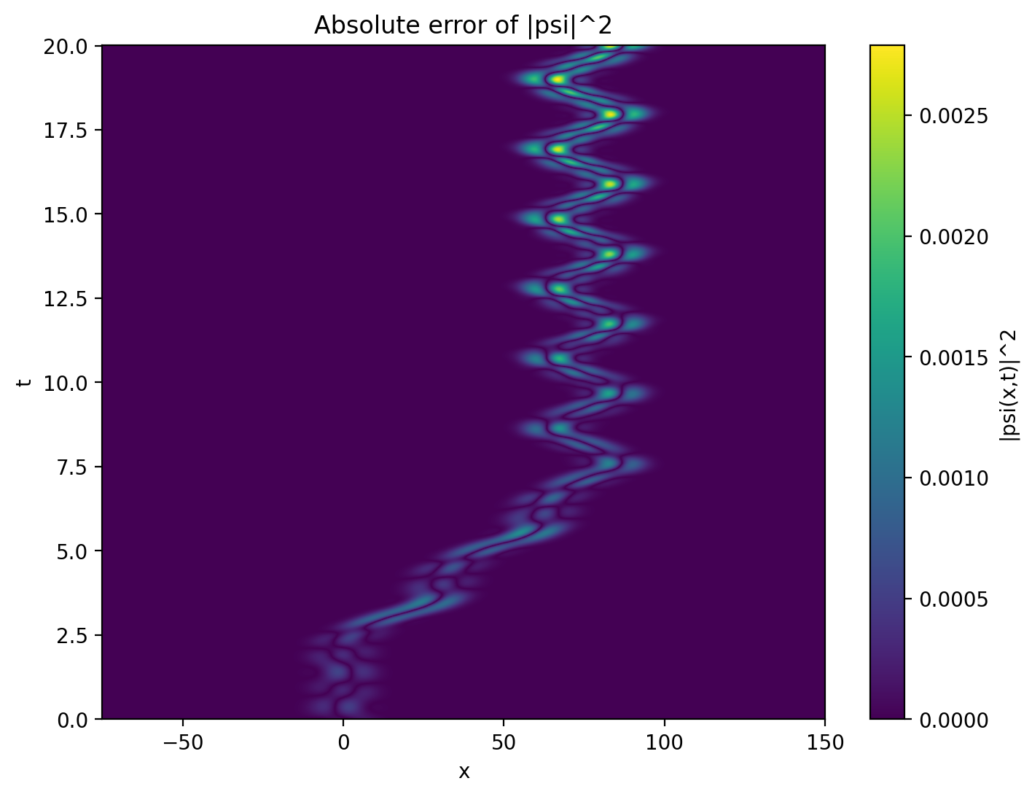
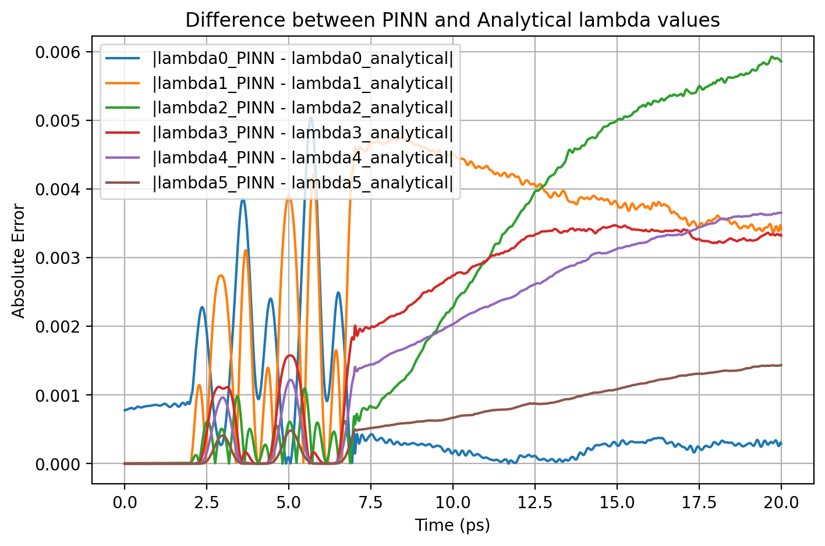

Slide 30
Previous Causal Model: For reference
I am attaching the best causal model from the last couple of weeks for reference

Slide 31

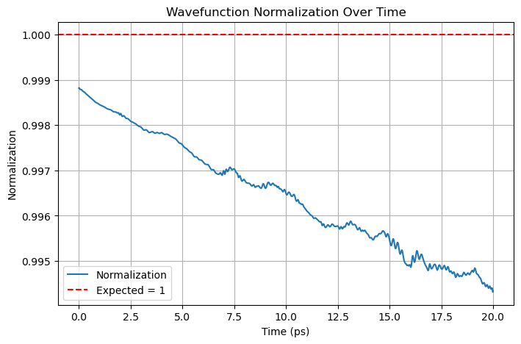

Slide 32
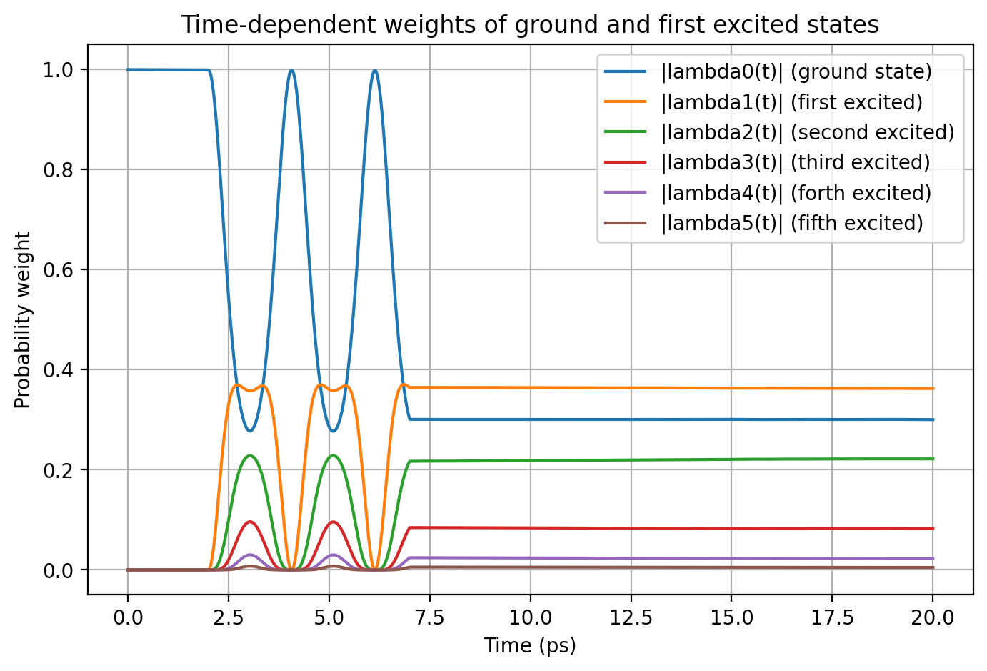

Slide 33

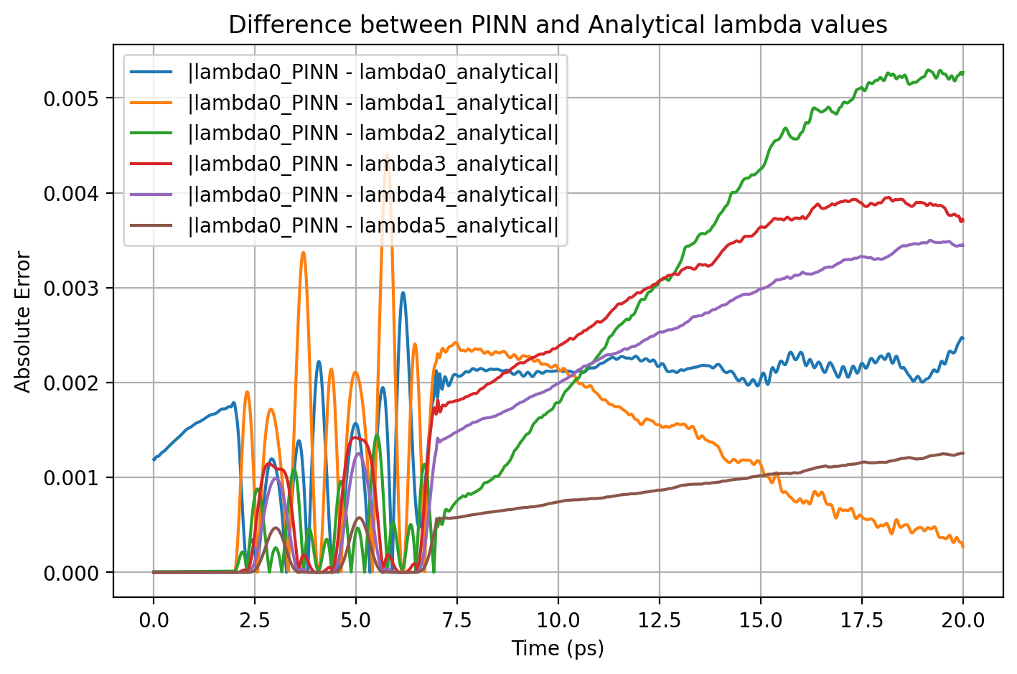

Slide 34
.end

