Slide 1
Meeting - 05/05/2025

Slide 2
LBFGS
Improve the efficiency of PINN models (ti)
Broyden–Fletcher–Goldfarb–Shanno (BFGS) optimisation algorithm
Second order optimisation algorithm → Newton method → Quasi-Newton method → BFGS → LBFGS
It allows us to know both the direction to move (gradient descent) but also estimate how far to move in that direction

Slide 3
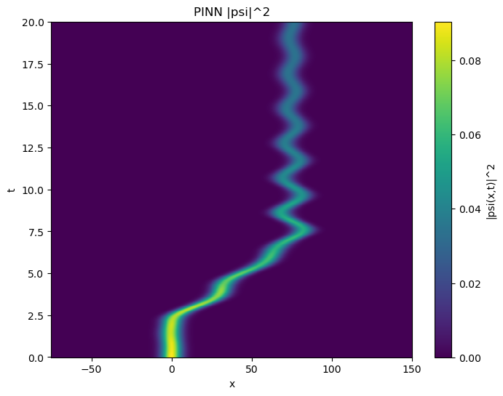
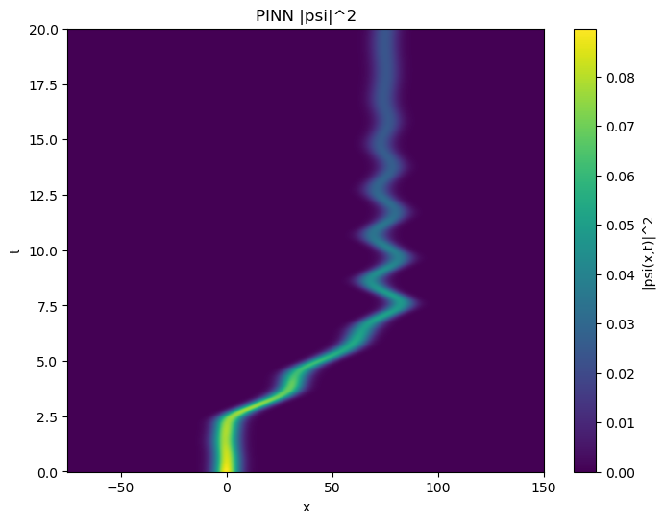
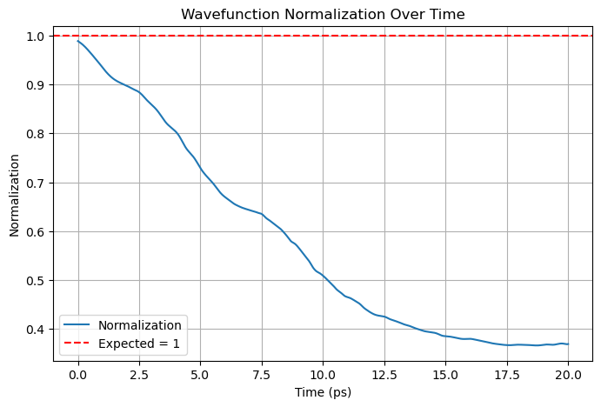
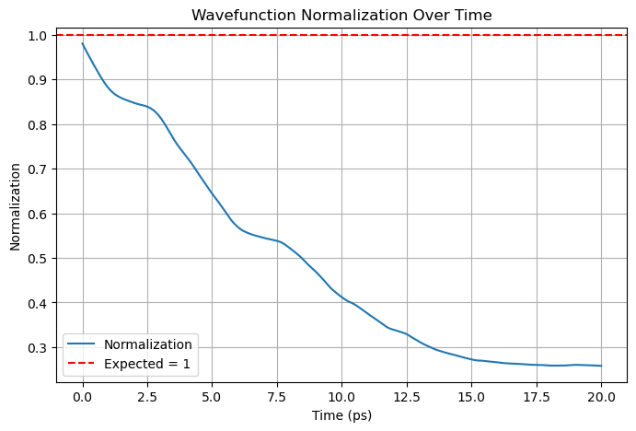

Slide 4
Training Points Generator
Experiment with random point generator
I usually generate random points for each iteration
  This will help the model to generalise to work for any set of points within the problem domain
  It will also help to prevent overfitting
  But it make it harder for the model to learn since the input points will be different for each iterations
But if I use the same set of random points for training, the model will overfit

Slide 5
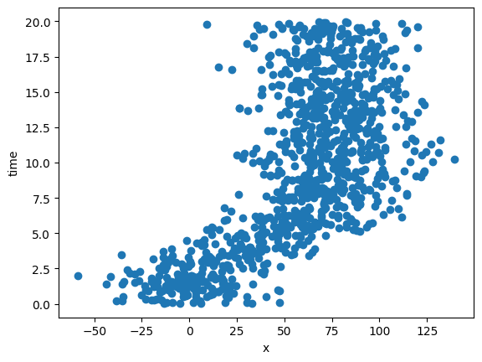

Slide 6
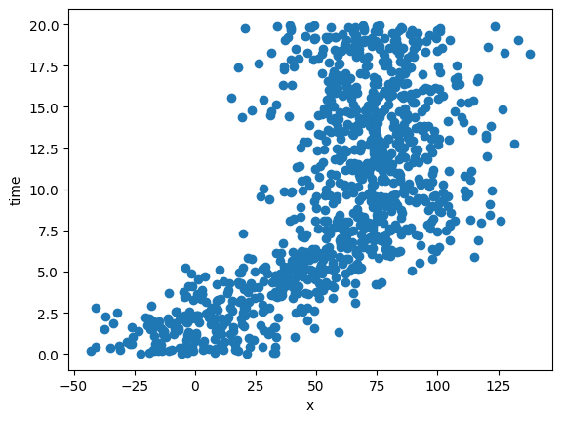
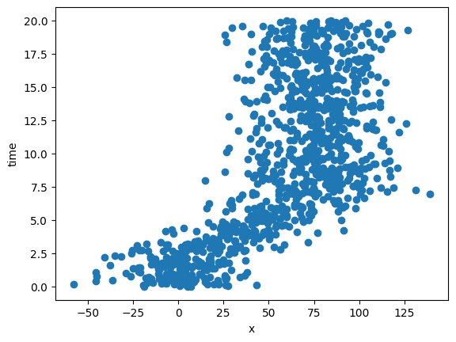
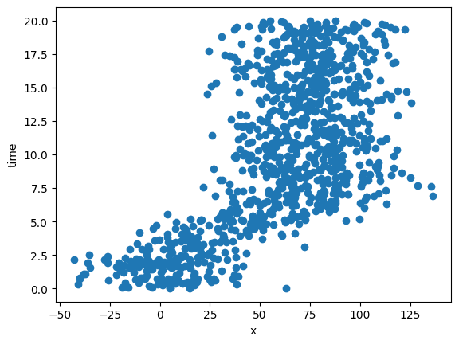
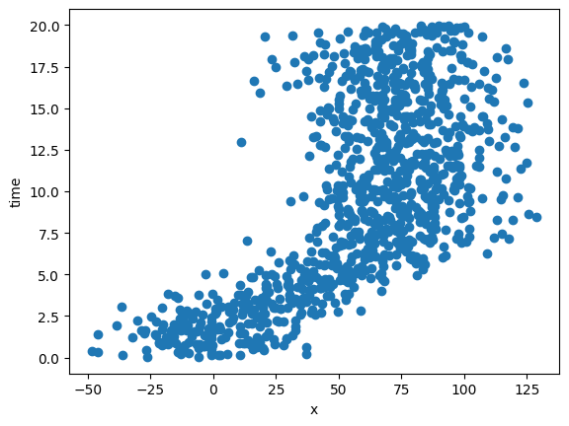

Slide 7
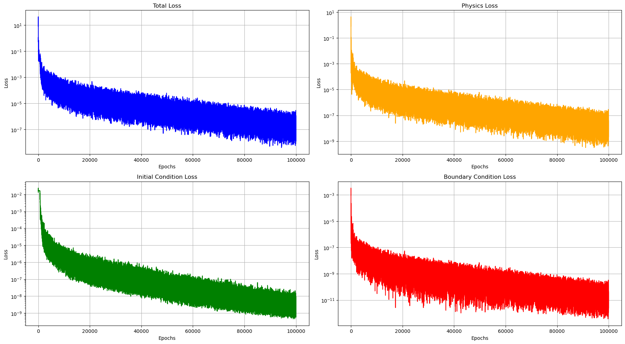

Slide 8
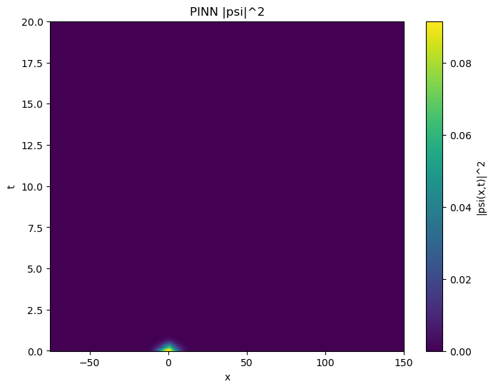
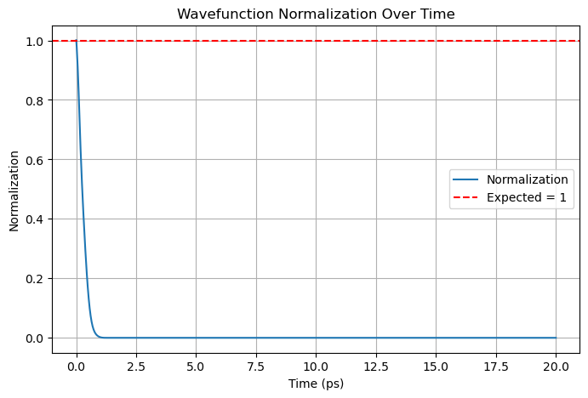

Slide 9
Hybrid Model
Create a model that can take vQD as input along with x and t
Model is trained for the range:
  x – -75 nm to 15 nm
  t – 0 ps to 20 ps
  vQD – 10 to 20

Slide 10
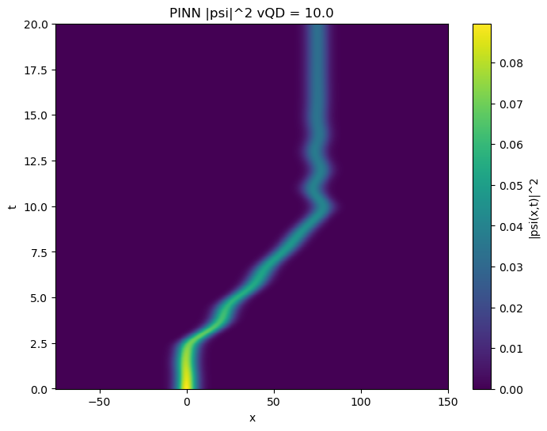
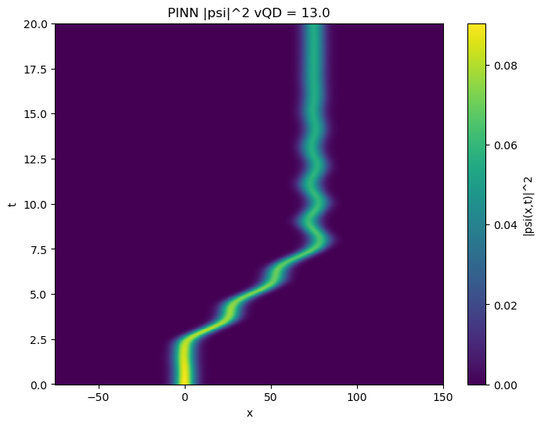

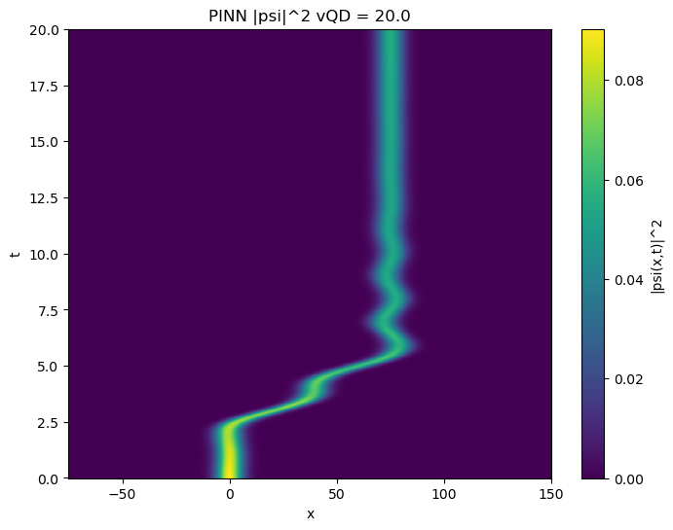

Slide 11
.end

