Slide 1
Physics-Informed Neural Networks to Solve the Many-Electron Time-Dependent Schrödinger Equation
Afthash Sahal Ubaid Puzhakkal
a1913863

Slide 2
The Problem: Solving many electron TDSE
The Schrödinger Equation describes how quantum systems (like electrons) evolve over time
It predicts how the state of particles changes based on forces acting on them (like electric fields, potentials)
The wavefunction, Ψ, contains all the measurable information about the particle at a given space and time, like energy, momentum, position, speed etc.
For a single electron, solving the equation is manageable. But for many electrons interacting together, solving it becomes complex.

Slide 3
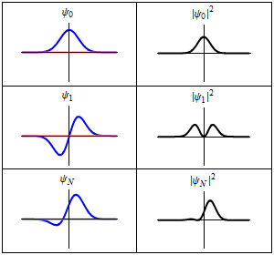
Research Question
Can Physics-Informed Neural Networks (PINNs) accurately and efficiently solve the many-electron time-dependent Schrödinger equation?
Can PINNs maintain accuracy over longer time?
How to modify PINNs to handle electron electron interactions?

Slide 4
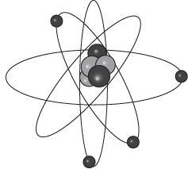
Research Approach
Single-electron time-independent one-dimensional model
Single-electron time-dependent one-dimensional models
  Moving quantum dot
  Double quantum dots and silicon charge qubits
Many electron models
  Quantum dot array

Slide 5
What Are Physics-Informed Neural Networks (PINNs)?
PINNs are special neural networks designed to solve partial differential equations (PDEs)
Instead of training on labeled examples, PINNs learn by making sure their predictions satisfy known physics laws
The training goal: Minimize how much the neural network “breaks” the physical law measured through the loss function
No labeled data is needed. Only the governing equation and an initial and boundary conditions are used.

Slide 6
PINNs vs Numerical Methods
Feature | PINNs | Analytical Methods
Grid-Free | Yes | No
Handles higher dimensions | Better | Poor (exponential scaling)
Accuracy | High (If well trained) | Limited to grid resolution
Computational Efficiency | Training takes time | Efficient for lower dimension
Generalisation | Yes | No

Slide 7

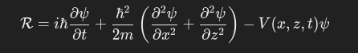
Loss Functions in PINN
Physics Loss ( LPDE ): Residual of the PDE we are trying to solve
Initial condition loss ( Linitial ): Model will be forced to match the predicted Ψ at t=0 with a predefined analytical initial condition
Boundary condition loss ( Lboundary ): Model will be forced to match the predicted wavefunction at spatial boundaries with a boundary condition value, zero in our case
Total Loss = LPDE + Linitial + Lboundary

Slide 8
Training Data: Random Points
Random points are sampled across the time and space domains
Model will be trained to minimise all the loss functions based on these points
Sampling method will be different for all three loss functions
Random points generation could follow Uniform, Normal or other distribution depending upon the problem complexity

Slide 9
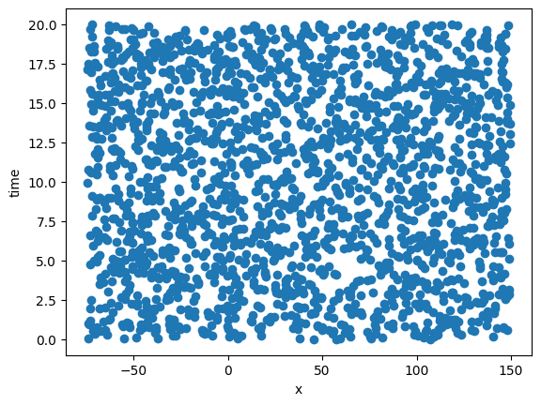
Physics Loss: Random Uniform Points

Slide 10
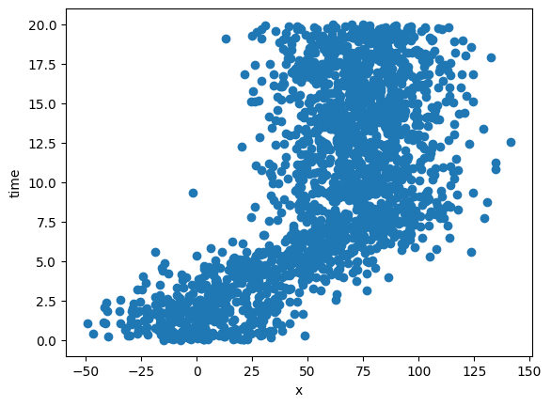
Physics Loss: Random Normal Points

Slide 11
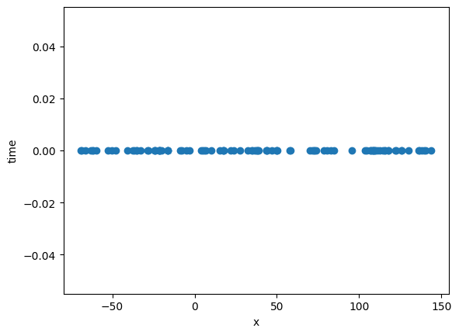
Initial Condition Loss: Random Points

Slide 12
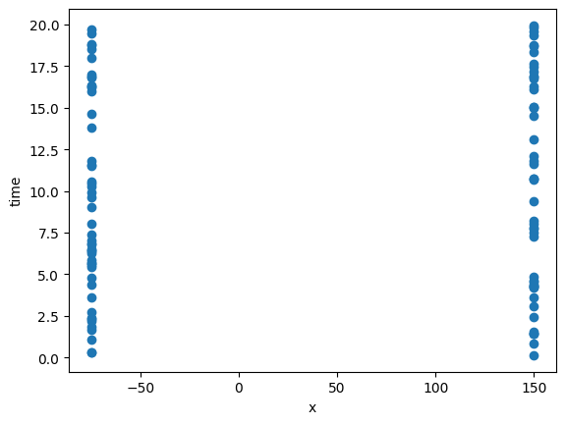
Boundary Condition Loss: Random Points

Slide 13
Testing Data: Analytical Solutions
Pre-existing analytical solution of the problem will be used to test the model performance
Analytical solution will be only used for testing
For more complex problems, analytical solution is either hard to solve or it does not exist
Other method to test the model is to check if the wavefunction created maintain normalisation through out the time domain

Slide 14
Progress on Model Development
Started by recreating a model from the paper Shah et al. 2022, single electron in 1D harmonic potential, using atomic units
Extended previous model with different initial conditions
Used actual units instead of atomic units
Single electron in a 1-D moving quantum dot

Slide 15
Recreating 1D Model (Atomic Units)
Started by recreating a model from the paper Shah et al. 2022, single electron in 1D harmonic potential, using atomic units
Atomic Units: m = 1, hbar = 1, ω = 1
Initial condition: Superposition of ground and first excited states
Mean square error (MSE) ≈ 10⁻⁵

Slide 16
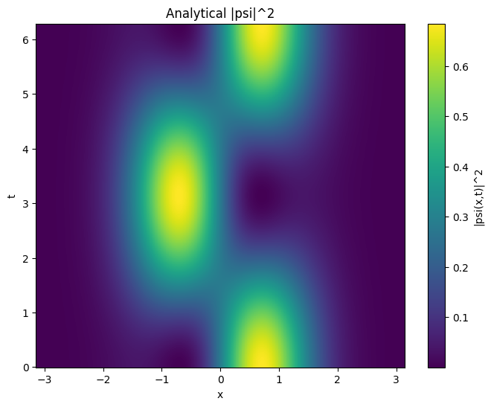


Slide 17
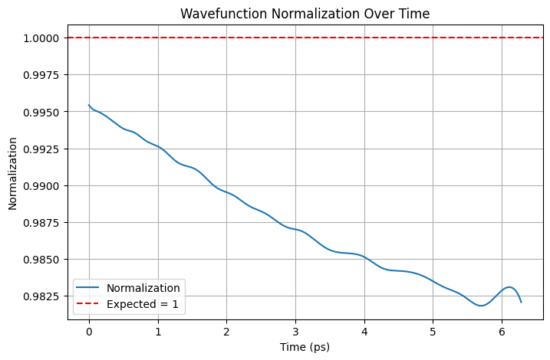

Slide 18
Testing different Initial conditions
Model trained with initial condition:
  Ground state alone
  First excited state alone
Observed better stability for ground state
  MSE ≈ 10⁻⁸
First excited state had slightly higher training error
  MSE ≈ 10⁻⁵

Slide 19
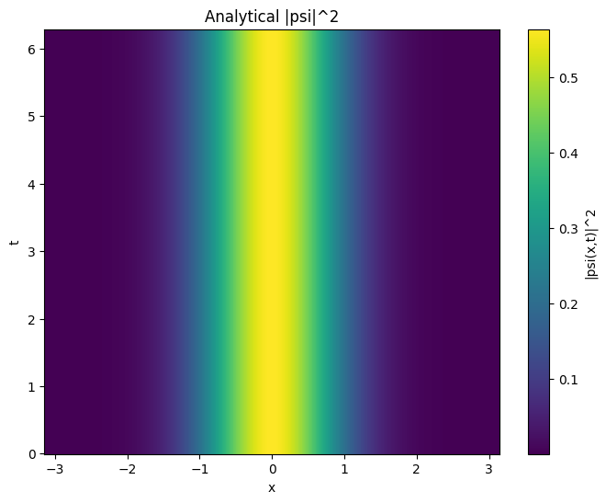
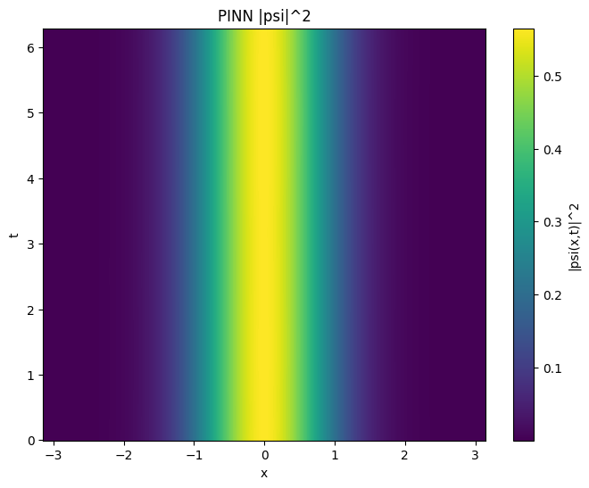
Initial Condition: Ground State

Slide 20
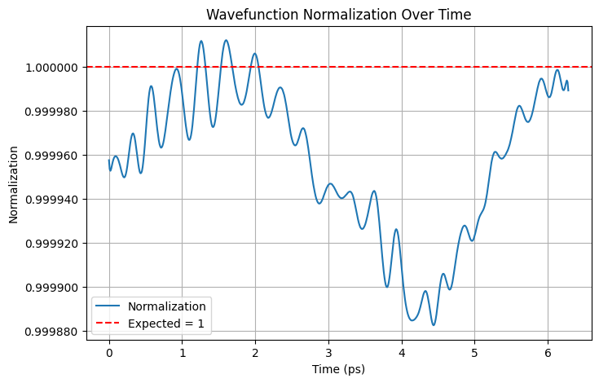
Initial Condition: Ground State

Slide 21
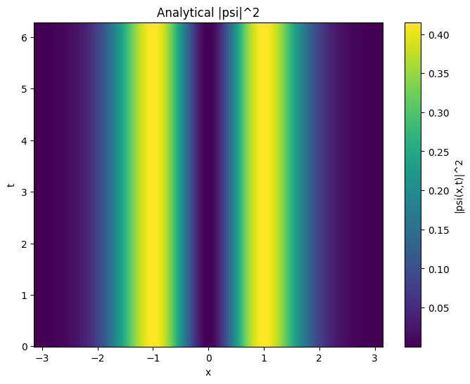
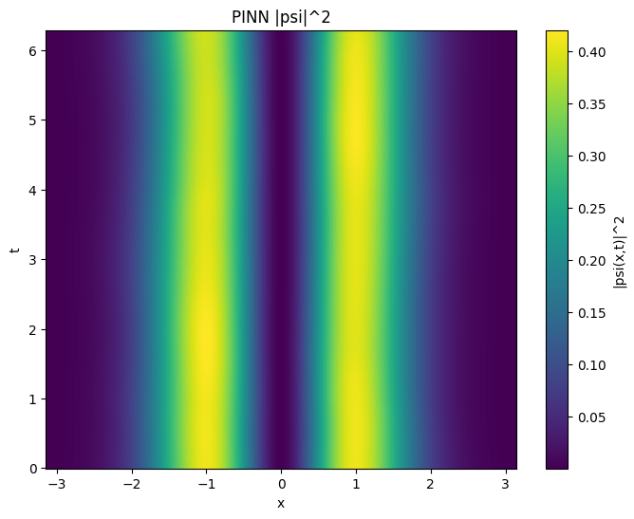
Initial Condition: First Excited State

Slide 22
Model with Physical Units
Trained the model using nm-ps-meV units
  hbar = 0.658 meV.ps
  me = 5.68 x 10⁻³ meV.ps²/nm²
  ω = 1 / hbar
  x in nm
  t in ps
Adjusted model architecture accordingly

Slide 23
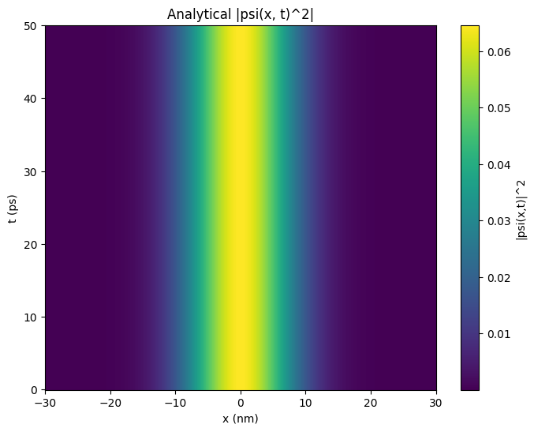
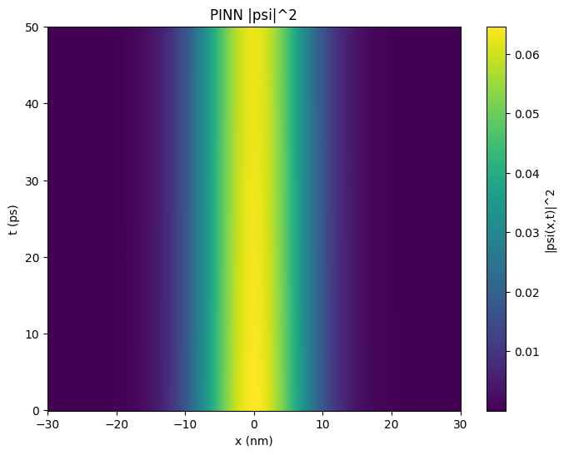

Slide 24
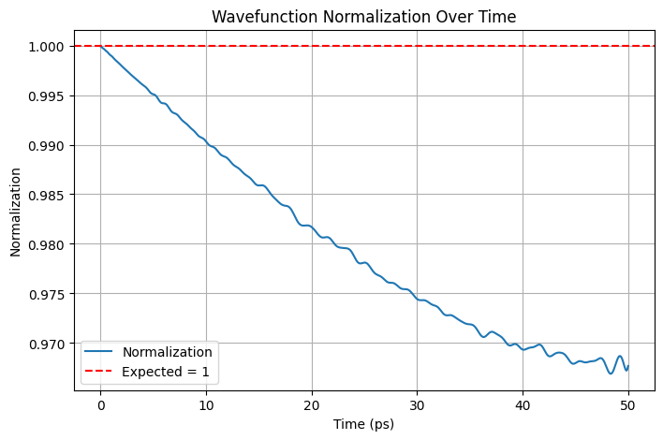

Slide 25
Moving Quantum Dot Model
Introduced time dependent quantum dot that move along the x axis
Quantum dot shift over time → electron follows the trap
Trained the PINN to follow the dynamic behaviour

Slide 26


Slide 28


Slide 29
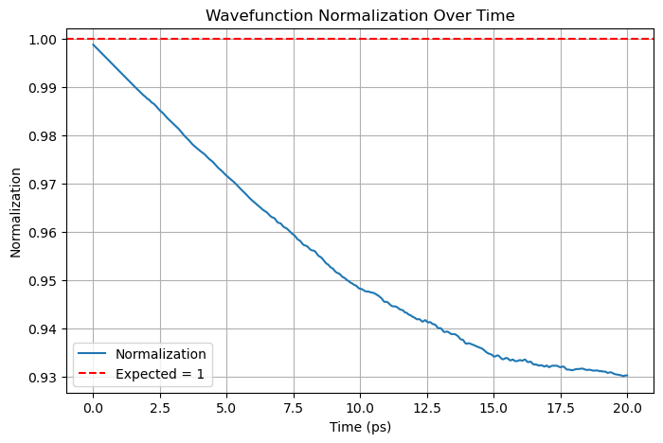

Slide 30
Conclusion
Successfully validated PINN using multiple 1D models
Correctly handled:
  Superposition of states
  Real physical units
  Moving quantum dot systems

Slide 31
Next Steps
Improve the stability of the moving quantum dot model
Improve the long time evolution stability
Create a more generalised quantum dot model where vQD can be given as an input
Explore 1D two electron model with and without electron electron interaction

Slide 32

Feedback Requested
Suggestions to improve long time training stability
Best practices to handle electron-electron interaction
Ideas to extend PINN to higher dimensional systems

Slide 33
.end

