Slide 1
Meeting - 26/05/2025

Slide 2
Causal Training
For last week, I trained the causal model using the fixed 64 sets of x and t points
This resulted in the causal model performing slightly worse when compared to non-causal model
So I tried again, this time random set of x and t points for each epoch (iteration)
This helped to achieve the best out of the causal training

Slide 3

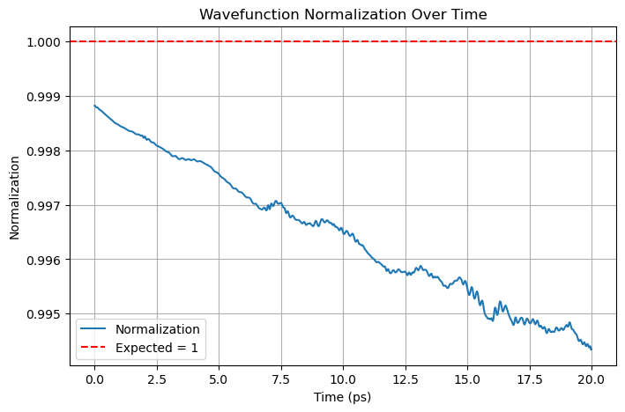

Slide 4
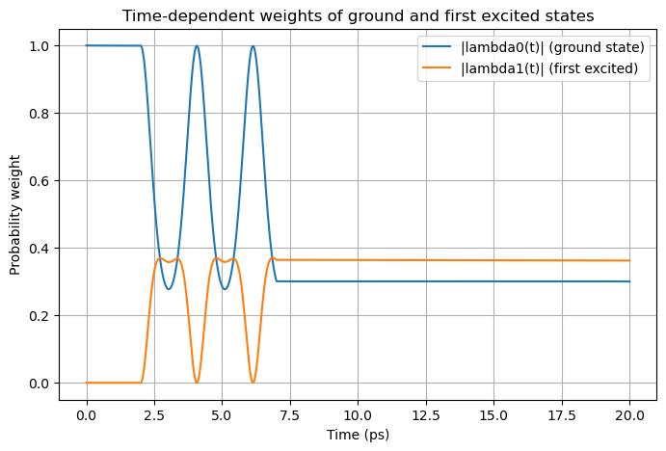

PINN
Crank-Nicholson

Slide 5
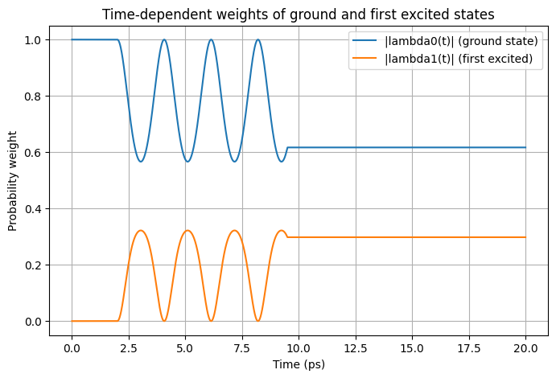
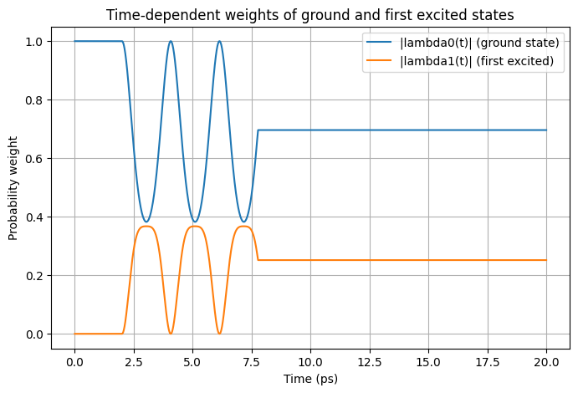
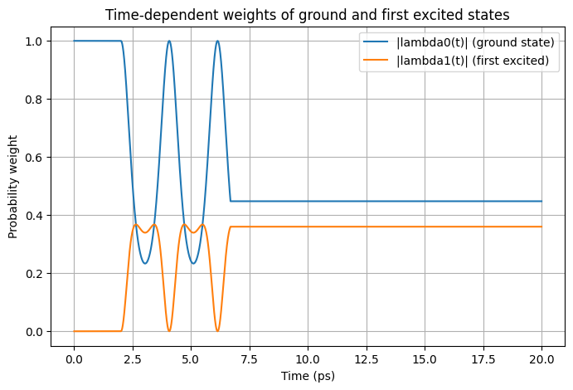
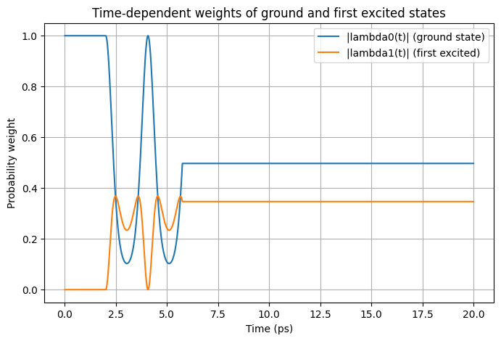
VQD = 10
VQD = 13
VQD = 16
VQD = 20

Slide 6
Causal Training - ω as input
Next, I applied the causal training method to my model where ω is also an input
The model showed clear improvement in performance
I tried to apply this same method for the model in which vQD is an input. But I couldn’t see any notable difference or improvement

Slide 7
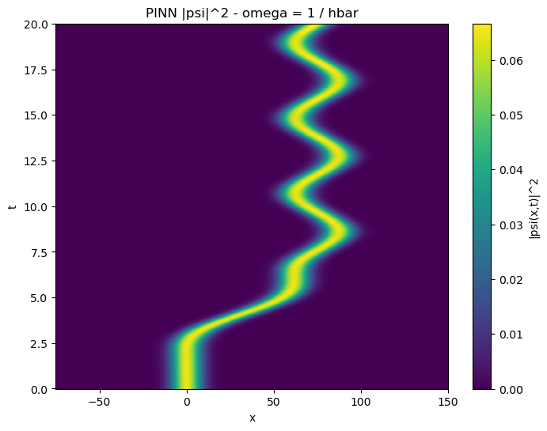


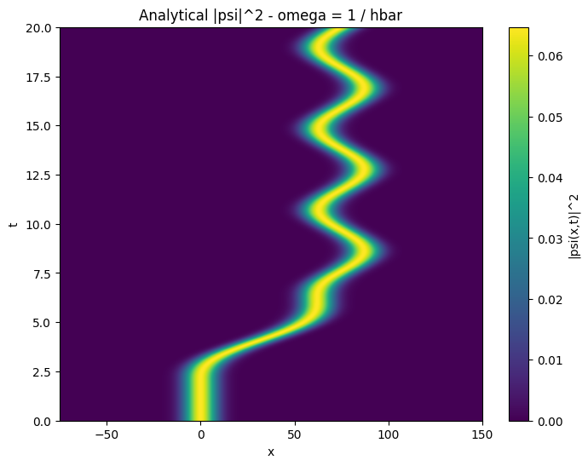



Slide 8


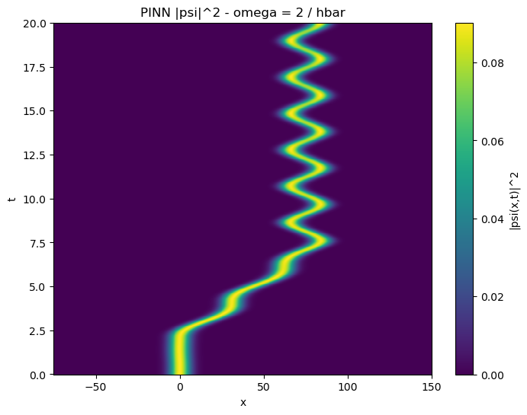


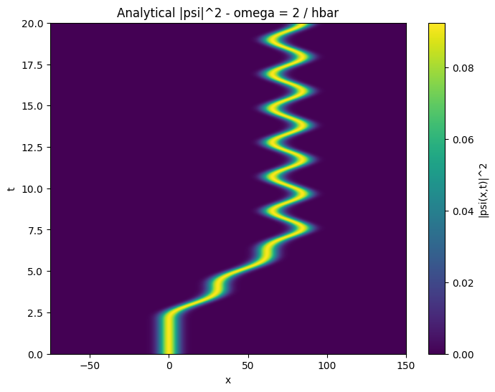

Slide 9
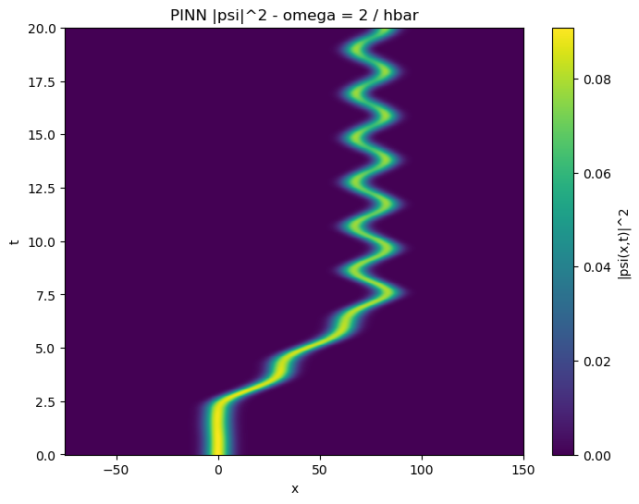
New Omega model
Old Omega model

Slide 10
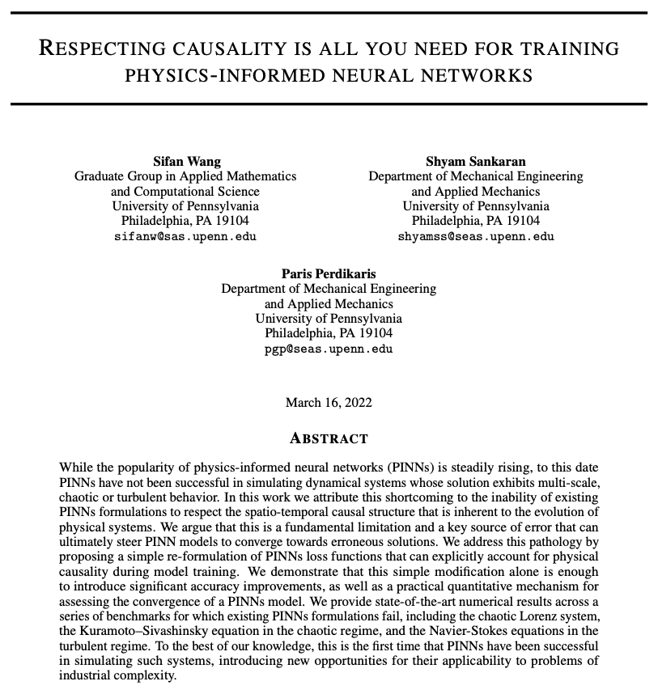

Slide 11
Exponentially weighted causal loss
Previously, we used a linear accumulation of causal loss
  L1 = L1; L2 = L1 + L2; L3 = L1 + L2 + L3 …
In the paper, they used an exponentially weighted causal loss
  L1 = 1 * L1
  L2 = exp(-εL1) * L2
  L3 = exp(-ε(L1 + L2)) * L3

Slide 12
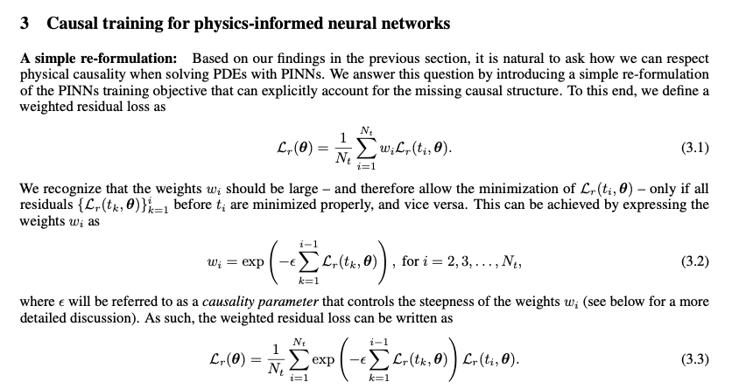

Slide 13
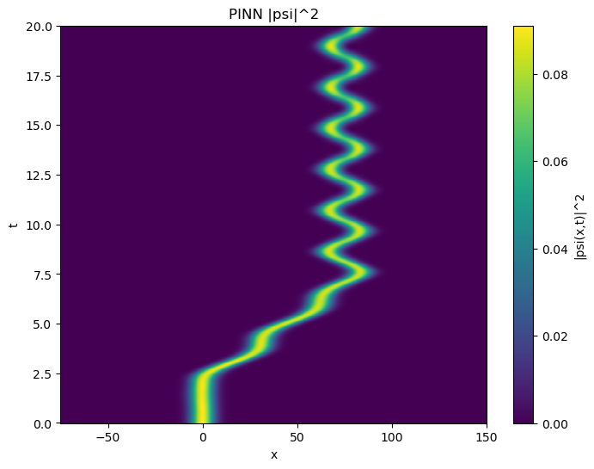
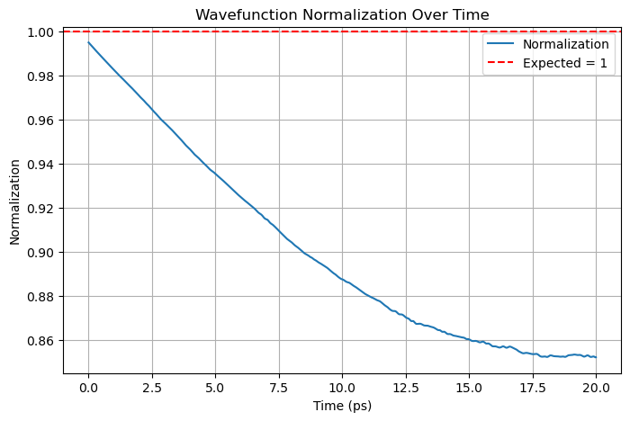
exp. Weight (from paper)
non exp. Weight

Slide 14
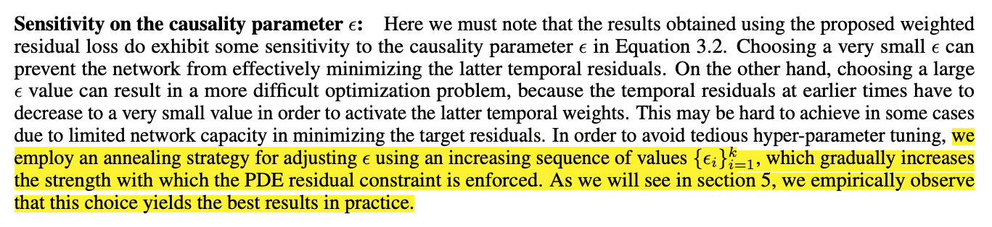

Slide 15
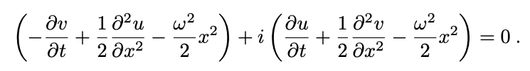
Accuracy of longer time
If you recall, this is our PDE residual:
If we write this in this form: na + i(nb), where n is scalar constant, and our goal is to reduce this to 0
Here, we have a risk of converging to zero solution. But by enforcing an analytical initial condition, we prevent this, at least for earlier times

Slide 16
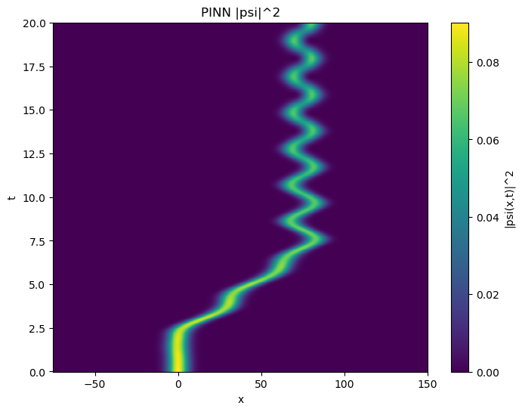
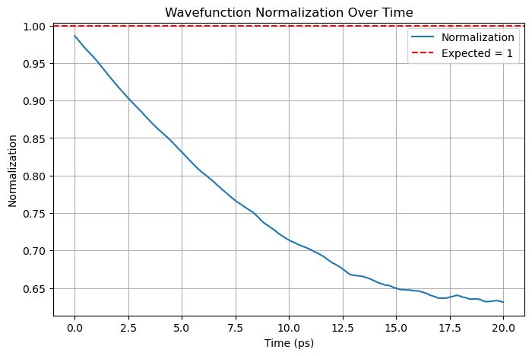

Slide 17
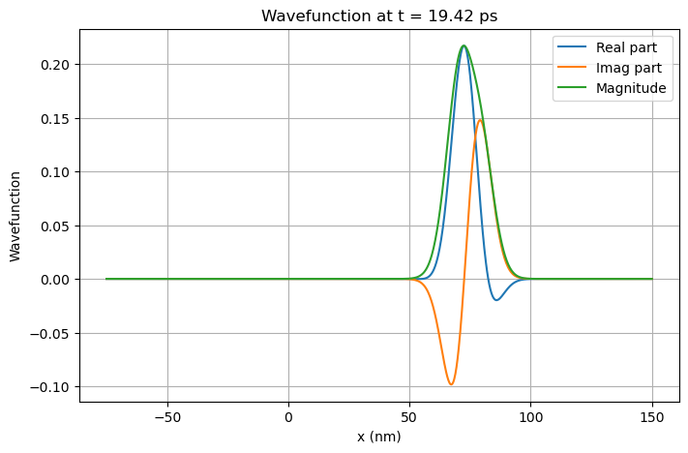
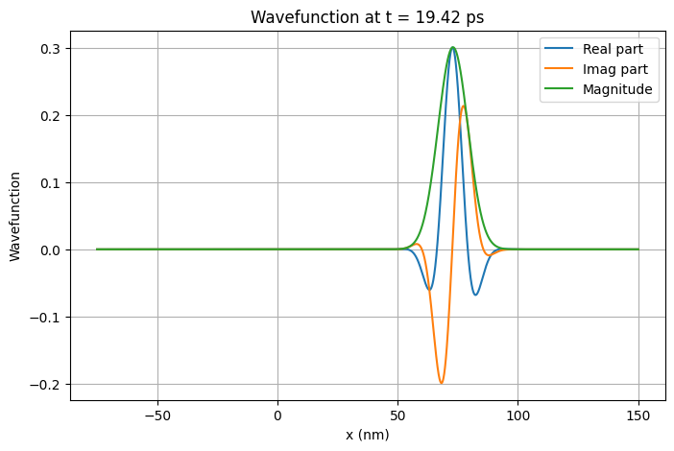
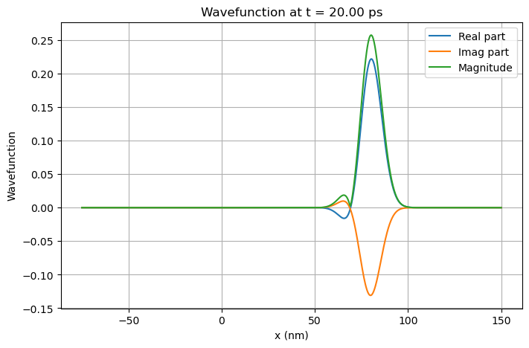
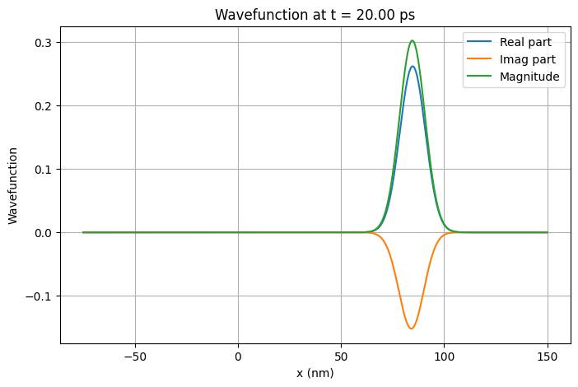

Slide 18

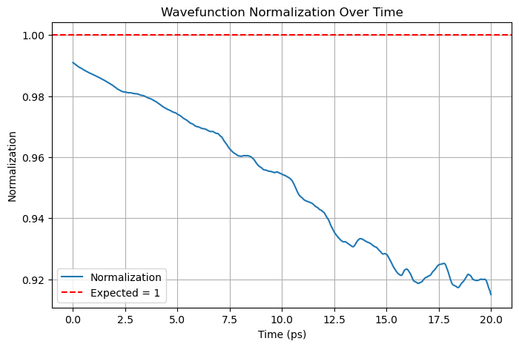

Slide 19
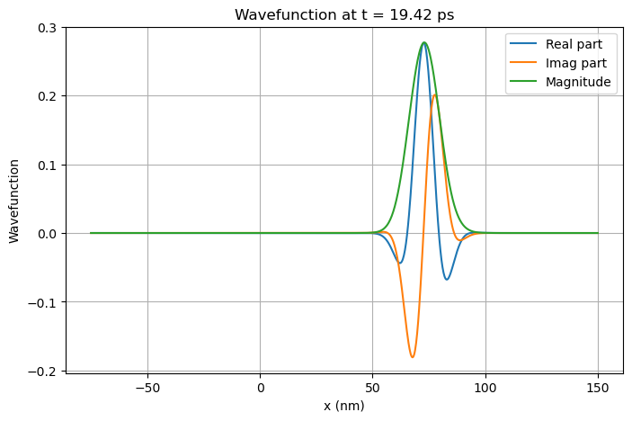
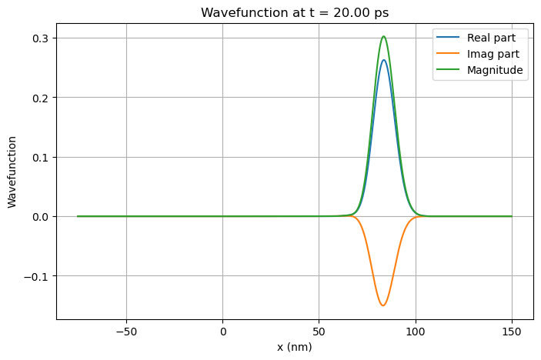

Slide 20
.end

