Slide 1
02/06/2025

Slide 2

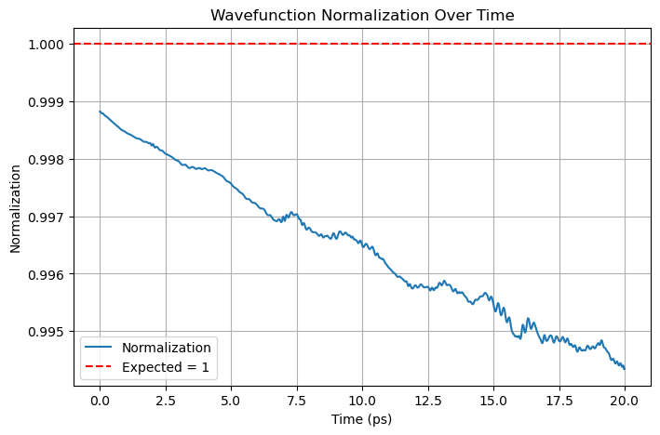
Current Best Model

Slide 3
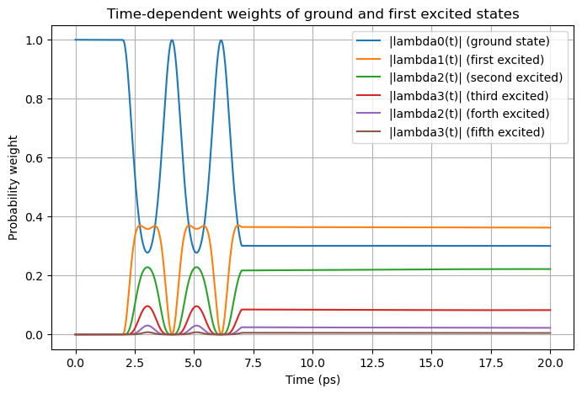

Slide 4
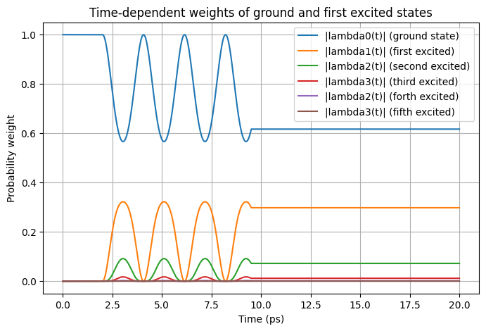
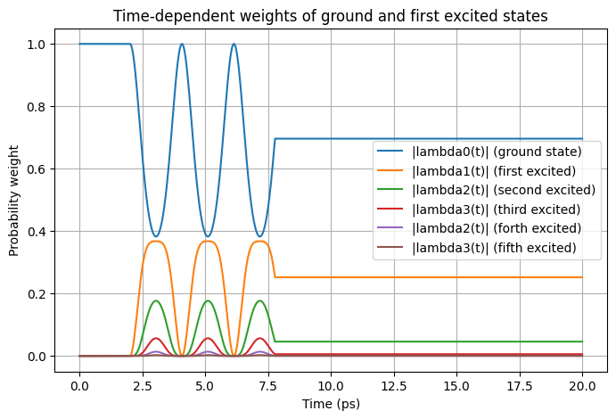
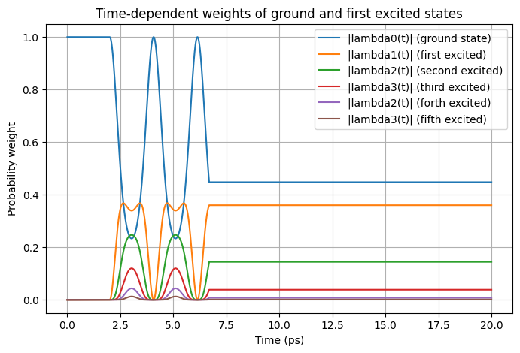
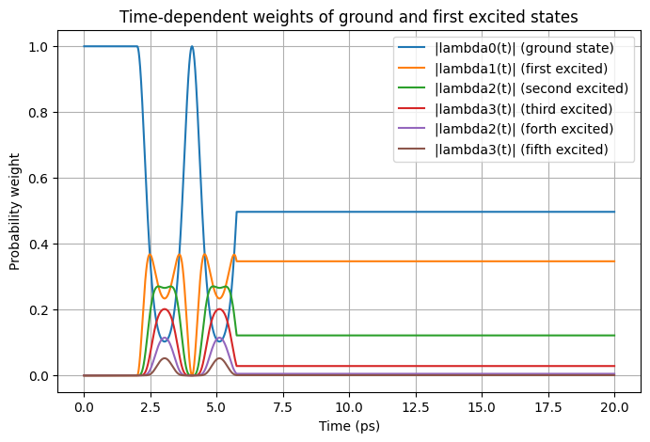
vQD = 13
ω = 2 / hbar
vQD = 10
ω = 2 / hbar
vQD = 20
ω = 2 / hbar
vQD = 16
ω = 2 / hbar

Slide 5
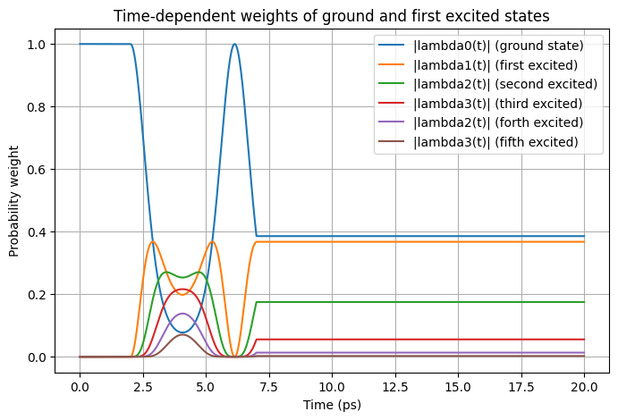
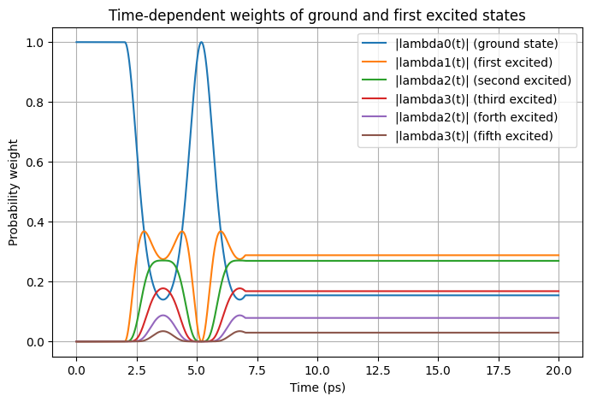
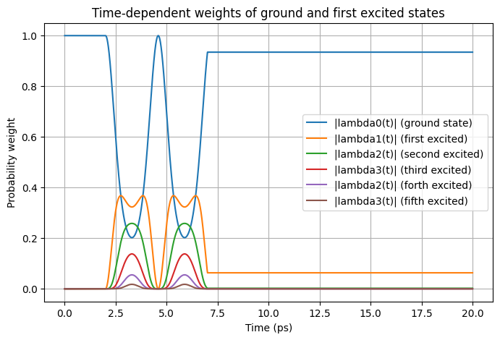
vQD = 15
ω = 1.3 / hbar
vQD = 15
ω = 1 / hbar
vQD = 15
ω = 1.6 / hbar
vQD = 15
ω = 2 / hbar

Slide 6

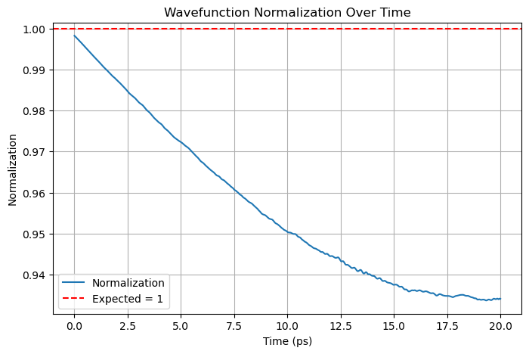
Causal Model

Slide 7
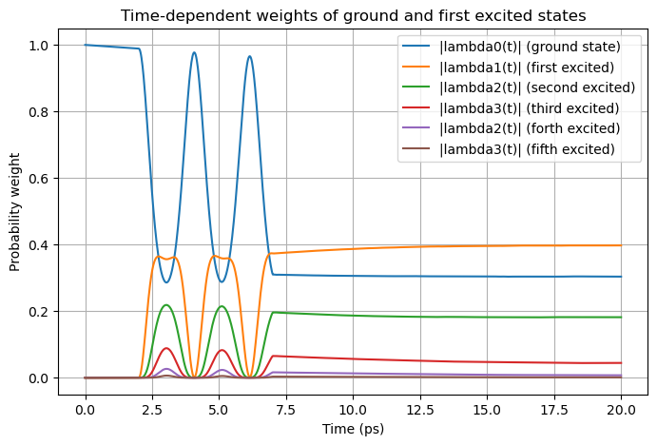

Slide 8
Normalization as a Loss
I couldn’t use simpson method inside the training loop so kept using the Monte Carlo method
I found out that the accuracy of Monte Carlo is better if I use 10000 x points to calculate the integral
Also, the accuracy (Monte Carlo) was better I used same equally spaced x points instead of random uniform points

Slide 9
Current best model

Slide 10
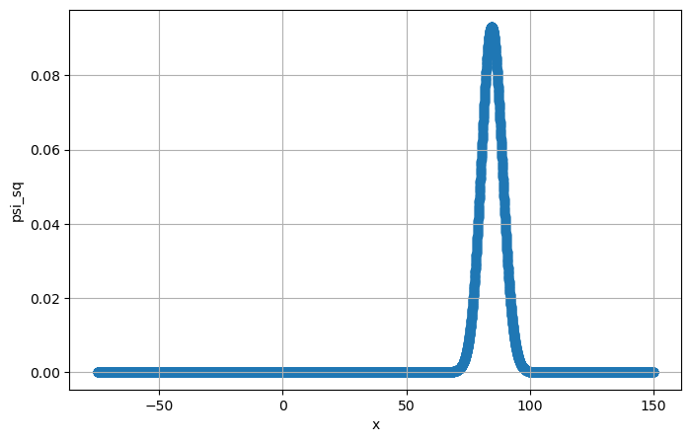
Ψ² at t = 20

Slide 11
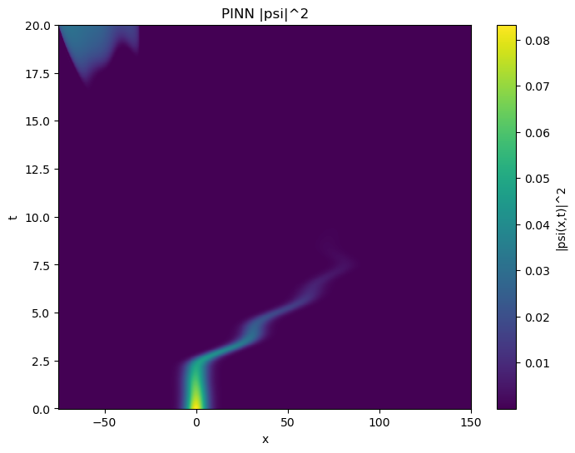
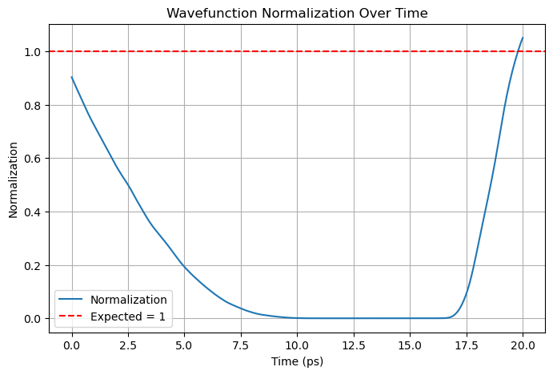
Normalization at t = 20

Slide 12
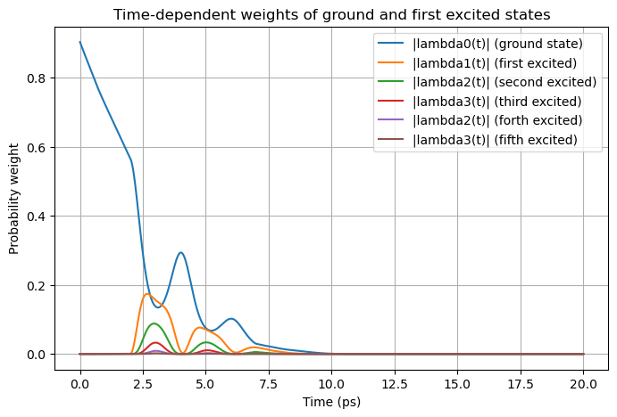

Slide 13
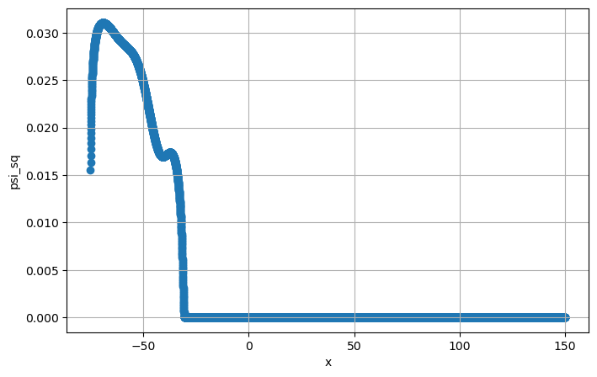
Ψ² at t = 20

Slide 14
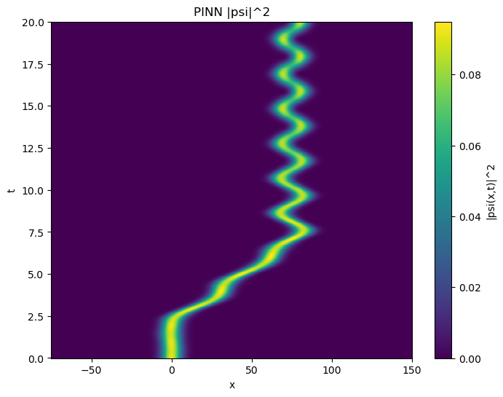
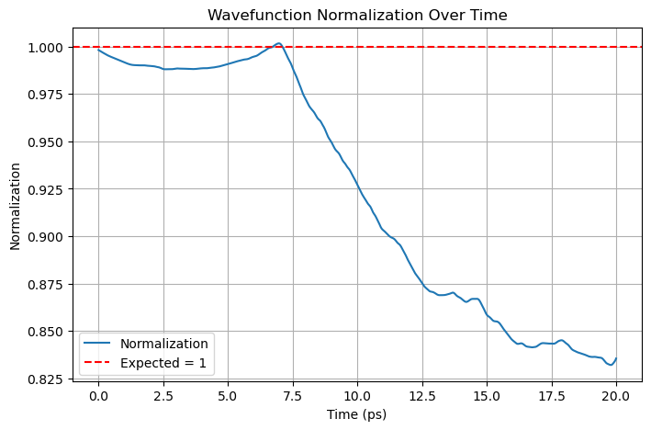
Normalization at t = 7

Slide 15
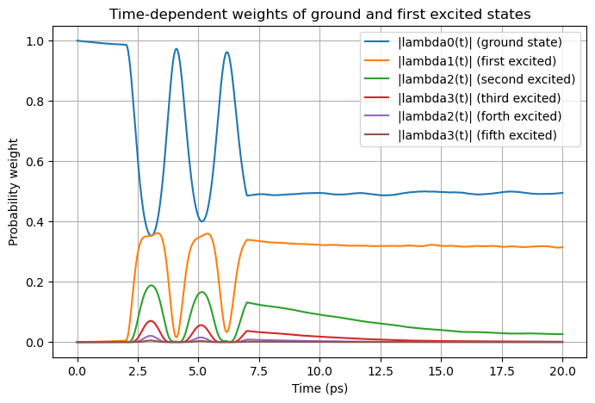

Slide 16
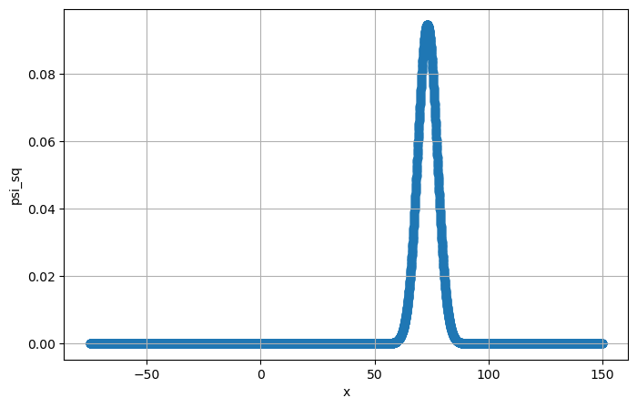
Ψ² at t = 7

Slide 17

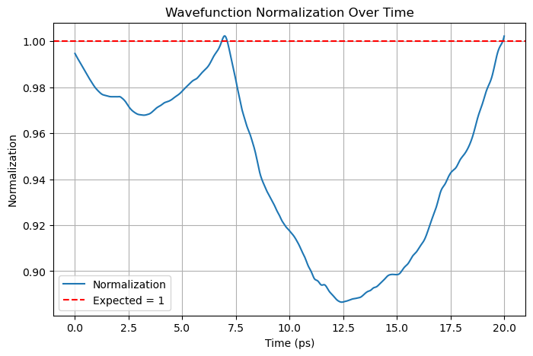
Normalization and t = 7 and 20

Slide 18
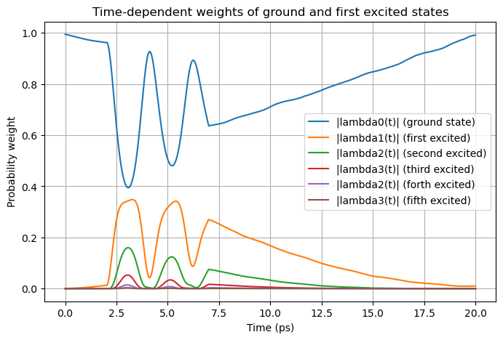

Slide 19


Ψ² at t = 7 and t = 20

Slide 20
.end

