Slide 1
Meeting - 21/04/2025

Slide 2
More points at t1 and t2
Increased the number of x and t points around t1 and t2
Runtime ≈ 4 hours

Slide 3


Slide 4
New Loss Function
I tried to create a new loss function that will enforce proper learning of the discontinuity
Loss condition 1, for t1 and t2:
Loss condition 2, for t1 and t2:
I only ran it for 4 hours

Slide 5
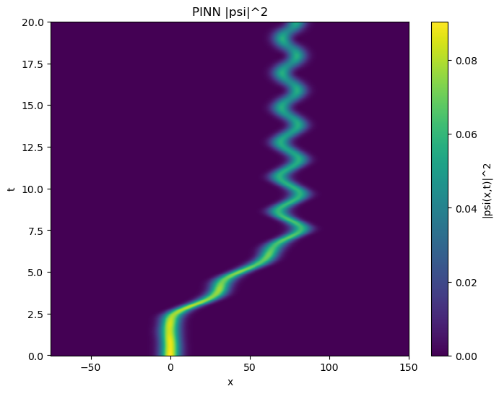

Slide 6
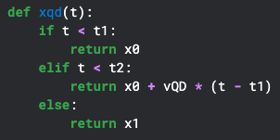
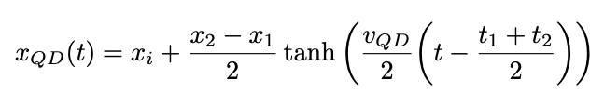
Continuous xQD
Equation 1
Equation 2

Slide 7
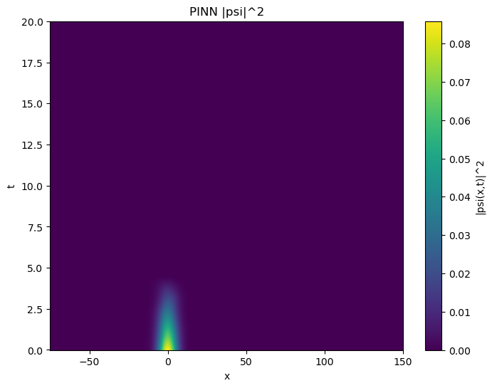

Slide 8
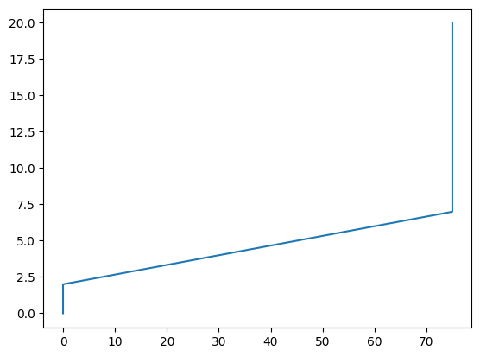

Slide 9
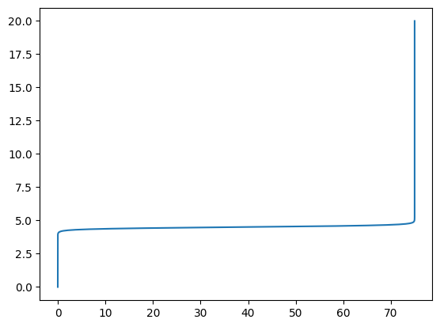

Slide 10
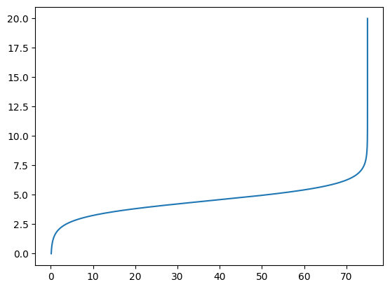

Slide 11
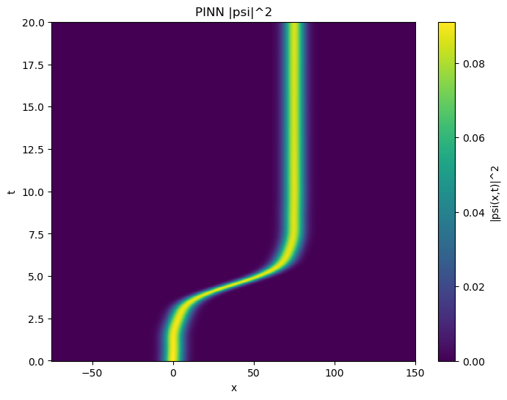

Slide 12
.end

