Slide 1
ML LIFECYCLE CAPSTONE · TECHNICAL DECK
Predicting Student
Dropout Risk
Binary classification on the UCI “Predict Students’ Dropout and Academic Success” dataset — problem framing through model explainability and fairness auditing.
Realinho et al., 2021 · UCI ML Repository · DOI 10.24432/C5MC89

Slide 2
STEP 1 · PROBLEM UNDERSTANDING & FRAMING
A retention problem, framed as classification
Business problem
TASK TYPE
Universities need to identify at-risk students early enough to provide targeted academic, financial, and counselling support — improving retention and allowing limited support resources to be allocated more effectively. Protecting revenue and rankings is a secondary consequence, not something this project measures directly.
Binary classification
Target = 1 (Dropout) vs 0 (Not Dropout, combining Enrolled and Graduate). Supervised, not clustering — every student already has a known, labeled outcome.
Data science problem
WHY NOT A CAUSAL CLAIM
Using demographic, admission, socioeconomic, and academic information available in the early stages of study, predict whether a student will ultimately drop out. Which variables truly qualify as “early-stage” is resolved explicitly in Step 3.
There is no intervention outcome data available, so the project cannot claim that flagging students will reduce dropout. Results are framed as supporting targeted intervention, not as a guaranteed reduction in dropout rate.
Student Dropout Prediction — Technical Deck
02

Slide 3
STEP 1 · SUCCESS METRICS
What “good” looks like
1
2
3
4
TECHNICAL
TECHNICAL
TECHNICAL
BUSINESS KPI
ROC-AUC
Dropout Recall
F1-score
Intervention Coverage
Overall discrimination ability across all thresholds
Missing an at-risk student costs more than a false alarm
Balances precision and recall for the Dropout class
Share of actual dropouts flagged for support at a chosen threshold
Student Dropout Prediction — Technical Deck
03

Slide 4
STEP 2 · DATA COLLECTION & UNDERSTANDING
4,424 students, 36 features, one clean source
4,424
36
0
0
Students
Raw features
Missing values
Duplicate rows
Source: Realinho et al. (2021), UCI ML Repository — DOI 10.24432/C5MC89, CC BY 4.0. Portuguese higher-education institution, 17 undergraduate courses. Combines demographics, socioeconomic data, application details, 1st/2nd-semester performance, and regional macroeconomic indicators.
TARGET DISTRIBUTION
18 categorical + 18 numerical features, plus the 3-class Target.
Student Dropout Prediction — Technical Deck
04

Slide 5
STEP 2–3 · DATA QUALITY & LEAKAGE
Outliers kept, leakage removed
IQR OUTLIER SCAN (18 NUMERICAL FEATURES)
2nd-semester grade
19.82%
LEAKAGE DECISION
12 curricular-unit features excluded
1st-semester grade
16.41%
1st-sem. credited units
13.04%
1st/2nd-semester credited, enrolled, evaluations, approved, grade, and without-evaluations counts describe academic activity that happens after enrollment.
2nd-sem. credited units
11.98%
Age at enrollment
9.97%
Macroeconomic indicators (unemployment, inflation, GDP) had 0 flagged outliers. Several flagged variables are zero-inflated, which causes IQR to flag legitimate values — so nothing was removed automatically.
Since the objective is early identification, these were removed to avoid temporal leakage — leaving 24 early-stage predictors from the original data.
Student Dropout Prediction — Technical Deck
05

Slide 6
STEP 3 · FEATURE ENGINEERING
Four domain-derived features
1
Age_Group
Under 20 (1,952) · 20–24 (1,334) · 25–29 (427) · 30+ (711)
2
Parental_Qualification_Same
Both parents share a qualification category: 1,956 yes / 2,468 no
3
Parental_Occupation_Same
Both parents share an occupation category: 1,752 yes / 2,672 no
4
Financial_Risk_Flag
Debtor OR tuition not up to date: 785 flagged / 3,639 not — combines two individually strong predictors
Modelling feature set after engineering: 28 features (19 categorical, 9 numerical).
Student Dropout Prediction — Technical Deck
06

Slide 7
STEP 3 · PREPROCESSING, SELECTION & DIMENSIONALITY REDUCTION
From 28 features to a lean, informative set
245
49
8 of 9
Processed columns
Selected via Mutual Information
PCA components (90% variance)
→
→
Numeric: median-imputed + standardized. Categorical: most-frequent-imputed + one-hot encoded.
Filter method retained the top 20% of 245 features. Tuition-fee status ranked among the strongest, alongside Financial_Risk_Flag, Age at enrollment, and Previous qualification grade.
Applied to the 9 standardized numerical features. 3 are binary engineered flags with limited shared variance, so most components are needed to reach 90%.
A 2D PCA projection shows substantial overlap between dropout and non-dropout students — no clean linear separability in just two dimensions.
Student Dropout Prediction — Technical Deck
07

Slide 8
STEP 4 · MODEL IMPLEMENTATION
Five models, evaluated on the same 885-student test set
Model | ROC-AUC | Dropout Recall | F1-score | Precision | Accuracy
XGBoost | 0.826 | 0.500 | 0.606 | 0.768 | 0.791
Logistic Regression | 0.818 | 0.486 | 0.603 | 0.793 | 0.794
Random Forest | 0.816 | 0.697 | 0.648 | 0.606 | 0.757
SVM | 0.814 | 0.669 | 0.637 | 0.607 | 0.755
Decision Tree | 0.793 | 0.514 | 0.598 | 0.716 | 0.779
Random Forest doesn’t top ROC-AUC, but it wins on the metric that matters most for this problem: it correctly identifies the highest share of students who actually drop out (Recall 69.7%), while keeping F1 highest and ROC-AUC competitive.
Student Dropout Prediction — Technical Deck
08

Slide 9
STEP 4 · TUNING & FINAL SELECTION
Why Random Forest, and why the untuned version
DROPOUT RECALL BY MODEL
HYPERPARAMETER TUNING
RandomizedSearchCV (20 combos × 5-fold CV) tuned n_estimators, max_depth, min_samples_leaf, and max_features. Best CV config scored F1 0.623, but only F1 0.644 on the held-out test set — marginally below the untuned baseline’s F1 0.648.
FINAL MODEL: RANDOM FOREST (BASELINE)
The baseline generalized better on unseen data than the tuned version — a strong CV score didn’t translate to better held-out performance, so it was retained.
Business KPI: 69.72% intervention coverage — 198 of 284 actual dropout students in the test set correctly flagged.
Student Dropout Prediction — Technical Deck
09

Slide 10
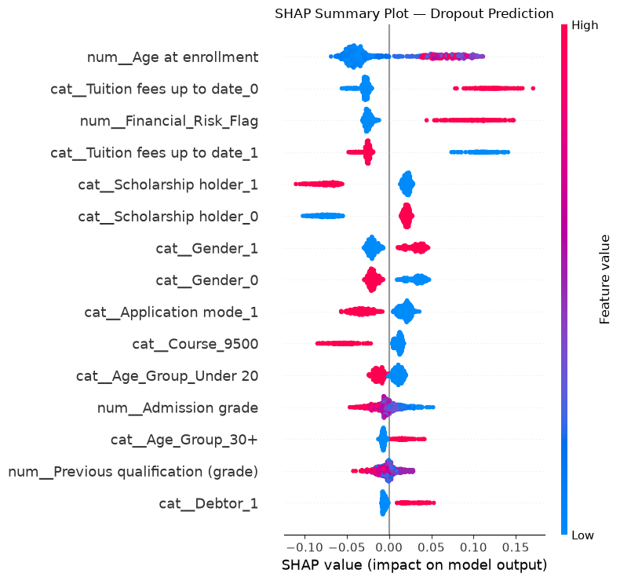
STEP 5 · MODEL EXPLAINABILITY
SHAP: what the model is actually reacting to
TOP DROPOUT-CLASS PREDICTORS
1
Age at enrollment
2
Tuition fees up to date
3
Financial_Risk_Flag
4
Scholarship holder
5
Gender
Older age at enrollment, tuition fees not being up to date, and not holding a scholarship were associated with higher predicted dropout risk. These are patterns the model learned — not evidence of causal relationships.
Student Dropout Prediction — Technical Deck
10

Slide 11
STEP 5 · BIAS & FAIRNESS AUDIT
Measurable disparities, read alongside real base rates
Gender
Age Group
Group | Actual | Predicted | Recall | FPR
Gender_1 (N=321) | 45.5% | 57.3% | 78.1% | 40.0%
Gender_0 (N=564) | 24.5% | 25.4% | 60.9% | 13.9%
Group | Actual | Predicted | Recall | FPR
Under 20 (N=412) | 20.4% | 14.3% | 38.1% | 8.2%
Middle / ref (N=323) | 35.0% | 44.6% | 74.3% | 28.6%
30+ (N=150) | 58.0% | 82.7% | 94.3% | 66.7%
0.320
2.26
0.172
Demographic Parity Diff.
Disparate Impact
Equal Opportunity Diff.
−.30 / +.38
.32 / 1.85
−.36 / +.20
Demog. Parity Diff. (vs ref)
Disparate Impact (vs ref)
Equal Opp. Diff. (vs ref)
The two groups have substantially different underlying dropout rates (45.5% vs 24.5%), so this shows outcome disparity — not proof of discriminatory bias.
Underlying dropout rates also range widely by age (20.4% to 58.0%), which should be read alongside these gaps.
Disparate-impact ratios fall outside the commonly referenced 0.8–1.25 range for both attributes — a useful warning signal, not a standalone determination of unfairness.
Student Dropout Prediction — Technical Deck
11

Slide 12
STEP 5 · LIMITATIONS & MITIGATIONS
Where this model needs care before deployment
Area | Issue | Potential mitigation
Class imbalance | 32.1% of the test set are actual dropouts | Class weighting, resampling, or threshold tuning
Fairness disparities | Outcomes differ by gender and age group | Subgroup monitoring, group-aware thresholds, reweighting
Data leakage | Features must exist before an intervention decision | Temporal validation, feature-availability documentation
Overfitting | CV F1 (0.623) differed from held-out test F1 (0.648) | Cross-validation, hold-out testing, ongoing monitoring
Sensitive features | Gender and age contribute to predictions | Compare performance/fairness with and without these features
REPRODUCIBILITY
Trained models, preprocessing artifacts, and selected feature lists are saved (models/, artifacts/) so every metric in this deck can be reproduced end to end.
Student Dropout Prediction — Technical Deck
12

