Slide 1

React Native an Introduction

Slide 2

hello.
Nov. 2016
I am Tom Haslam
I am here to give this presentation.
You can reach me at haslam.tom@gmail.com
Github: https://github.com/thaslam
Instagram: https://www.instagram.com/_tomhaslam/

Slide 3
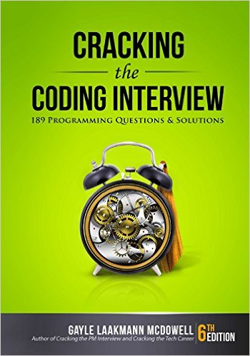
Looking to get into a software company?
I wanted to share this book that I came across.

Slide 4
We will do two things today…
Overview of React Native 20 minutes
Create a simple TicTacToe app 30 minutes
Code samples & this presentation can be found here:
https://github.com/thaslam/bscc

Slide 5

Created by Facebook
Cross Platform Mobile Framework
Released in 2015
React (2013) Paradigm to Native Dev
Adaptive Mobile Approach
“learn once,
write everywhere”

Slide 6

Supports iOS & Android

Slide 7
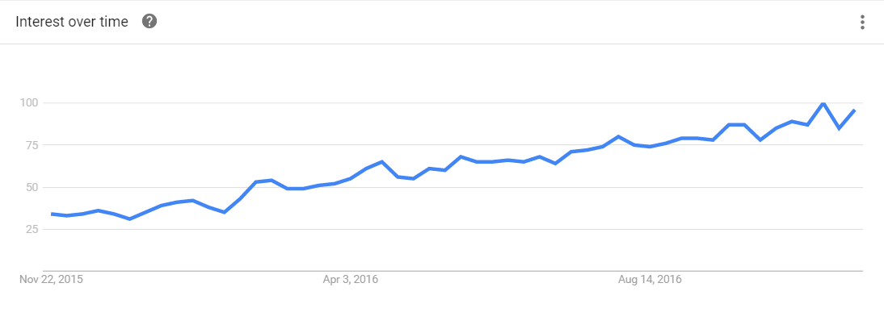
Google Trends
React Native since 2015

Slide 8
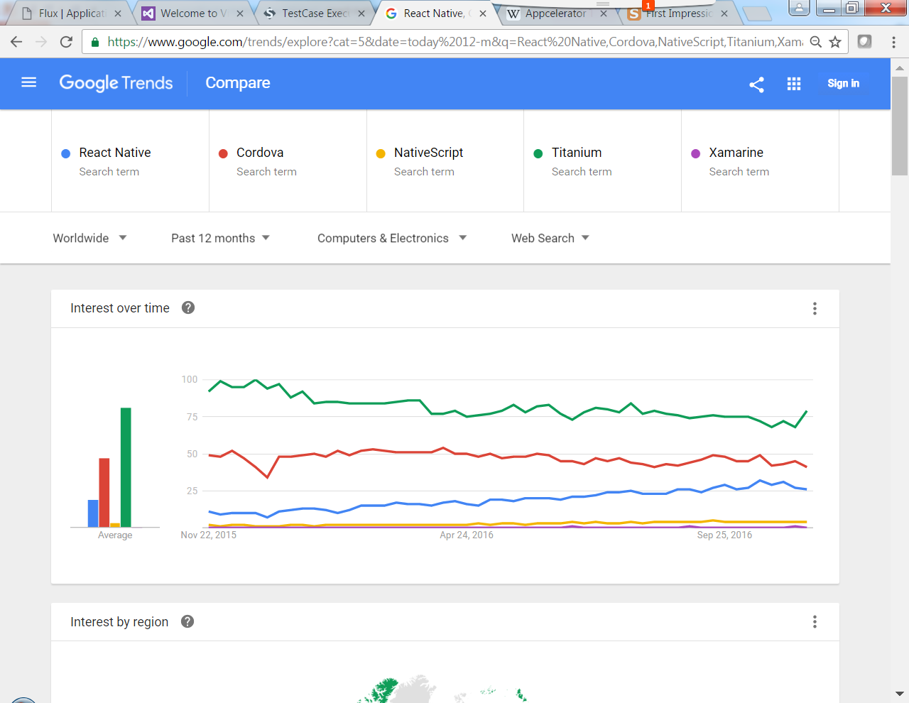
Google Trends

Slide 9
JavaScript / ES6
Based on React for Web
Objective-C / Java not a requirement
Ships with Babel Compiler

Slide 10
Here’s how it works
Native UI
JavaScriptCore
Application
Logic
Mobile OS
Functionality
Native API
When using Chrome debugging runs JS with Chrome (V8)
Node.js is used to build JavaScript
Bridge to Native with RCTRootView

Slide 11
Components
Main building blocks of React Native app
Each component keeps its own internal state
Each component can render a JSX view
Wrap Mobile OS UI and services
Promotes reuse and customization
Library of NPM components built by the community

Slide 12
JSX
XML–like syntax extension to ECMAScript
Create components via tags (sorta like HTML)
Not intended to be implemented by engines or browsers
Intended to be used by preprocessors
React has created a JSX transpiler

Slide 13
State
Functional in nature
Initialize state in the constructor
Unidirectional / one-way data binding
Call setState to change trigger view to re-render
constructor(props) {
super(props);
this.state = {error: false};
}
…
this.setState({ error: true });

Slide 14
Props
Most components can be customized when they are created, with different parameters. These creation parameters are called props.
Props are passed into a component
<Greeting name=‘Tom' />
render() {
return (
<Text>Hello {this.props.name}!</Text>
);
}

Slide 15
Pure Function
A pure function is a function where the return value is determined only by its input values, and which does not alter any external state. This has two important implications:
For a given input the function will always return the same result, no matter how many times it is called. This means that our application is completely predictable - if we know what inputs it will receive, we can be confident of the outputs.
Calling the function will not result in any observable side-effects. We can be certain that we will not experience any undesirable ‘emergent behavior’ arising from the interactions between different functions.

Slide 16
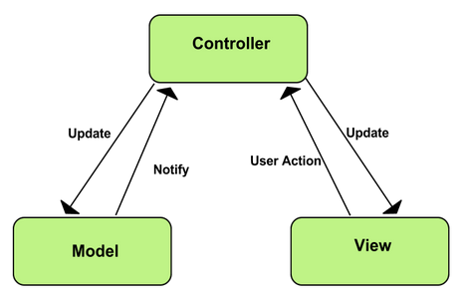
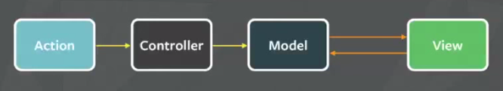
MVC Pattern
Subtle different flavors

Slide 17
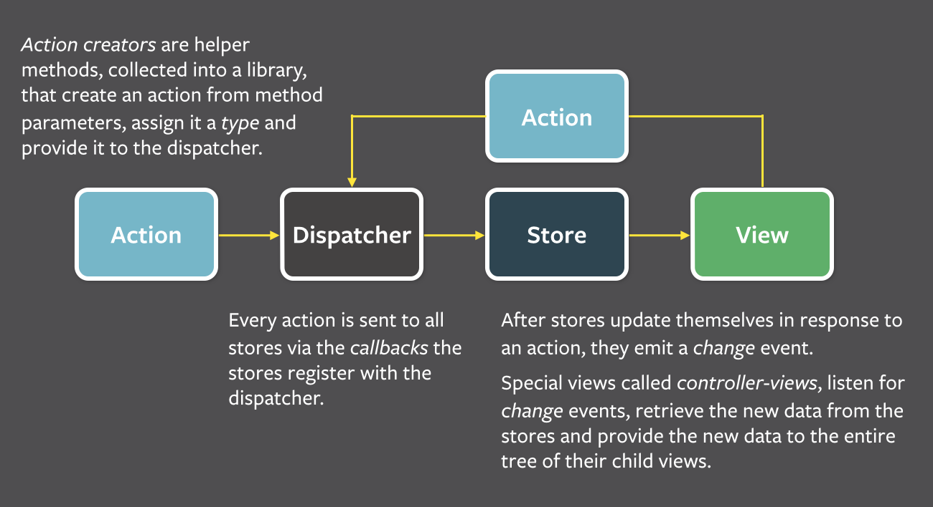
Flux Pattern

Slide 18
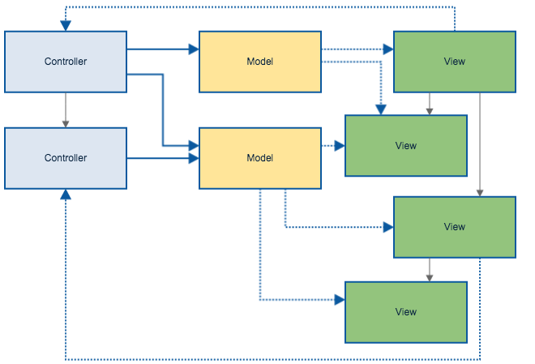
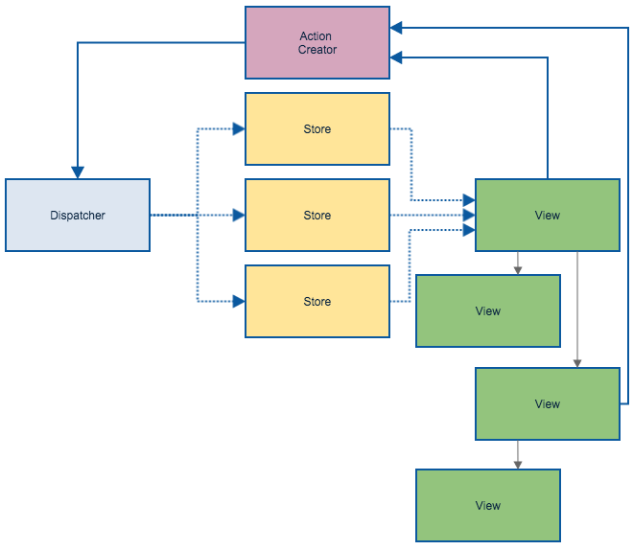
MVC
Flux

Slide 19
Redux.js
JS state container
Variation on Flux Architecture
Complements React view components
More popular than Flux.js
Helps write apps that behave consistently

Slide 20
The rest will be in code

Slide 21
thanks.

