Slide 1
Data Quality
Agenda
  Introduction
  BCBS 239 Principles
  Data Quality Dimension
  Data Quality Tools
  Data Quality Insights
  Data Quality Results
  Sample Report
Notes:
The Basel Committee on Banking Supervision (BCBS) is a committee of banking supervisory authorities that was established by the central bank governors of the Group of Ten countries in 1974, It provides a forum for regular cooperation on banking supervisory matters

Slide 2
Data Quality Introduction
What is Data Quality
  The degree to which data are accurate, complete, timely, valid and appropriate
Why Data Quality
  Data doesn’t have to be perfect, but rather, it needs to meet the requirements of whatever system utilizes else the result will be inaccurate
  Data may go wrong in many ways (some examples)
    Integrating with third party application
    Data from multiple sources
    Systems are set up differently in different parts of the world
  It is a part of regulatory requirement
  Meaningful Insights
Notes:
The Basel Committee on Banking Supervision (BCBS) is a committee of banking supervisory authorities that was established by the central bank governors of the Group of Ten countries in 1974, It provides a forum for regular cooperation on banking supervisory matters

Slide 3
BCBS 239 Principles - (Regulatory Requirement)
BCBS 239 is the Basel Committee on Banking Supervision's standard number 239 (published in 2013)
The standard is: "Principles for effective risk data aggregation and risk reporting“, this is to strengthen bank reporting practices
Implemented in Global Systemically Important Banks (G-SIB) and then followed by Domestic Systemically important Banks (D-SIB)
Listed 14 principles from five sections
  I. Overarching governance and infrastructure
  1. Governance
  2. Data architecture and IT infrastructure
  II. Risk data aggregation capabilities
  3. Accuracy and integrity (Validity)
  4. Completeness
  5. Timeliness
  6. Adaptability
  III. Risk reporting practices
  7. Accuracy
  8. Comprehensiveness (Completeness)
  9. Clarity and usefulness
  10. Frequency
  11. Distribution (Uniqueness)
  IV. Supervisory review, tools and cooperation
  12. Review
  13. Remedial actions and supervisory measures
  14. Home/host cooperation
  V. Implementation timeline and transitional arrangements
  Reference : https://en.wikipedia.org/wiki/BCBS_239
Notes:
The Basel Committee on Banking Supervision (BCBS) is a committee of banking supervisory authorities that was established by the central bank governors of the Group of Ten countries in 1974, It provides a forum for regular cooperation on banking supervisory matters

Slide 4






Data Quality Rules (Dimensions)
Some Examples to adherence to data quality minimum requirements
Completeness
Consistency
Accuracy
Validity
Timeliness
Uniqueness
Detect Missing Data
(file level record check, trending on period
Overlapping Elements Check
(parent and child records have consistent data)
Match Against Appropriate Source
(Reconciliation)
Master/Reference Data Checks
(conformance checks)
Delivery Check
(Service Level Monitoring)
Duplicate Check
(Should not be repeating values)
Mandatory Fields
(account # must be present)
Referential Consistency
(orphan record identification)
Default Value
(check default value usage)
Range Check
(Expected range in the data)
Date/Time
(correct file level date or time)
Data Volume Checks
(file level volume checks, size)
Conditional Field Check
(Element Level population relationships)
Onboarding Correctness
(Operational Changes)
Type Check
(format checks)
Aggregate Measure
(SUM of amount fields)
Conditional Value Check
(Element level value relation)

Slide 5
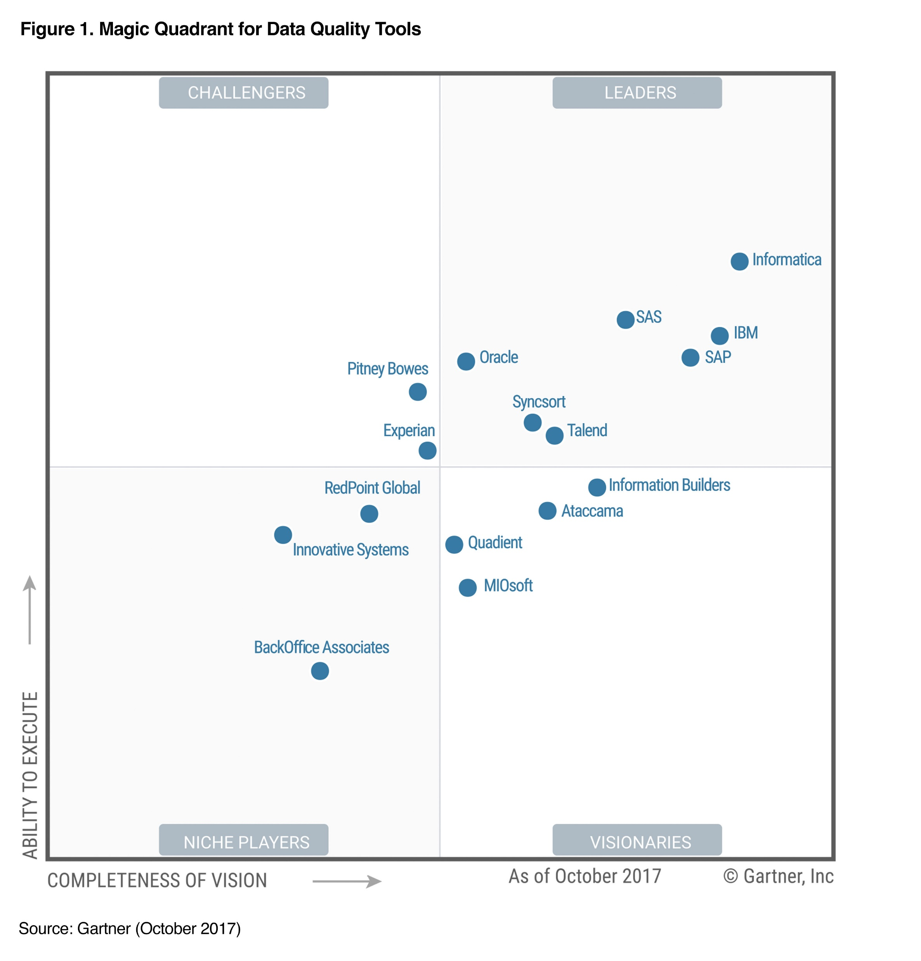
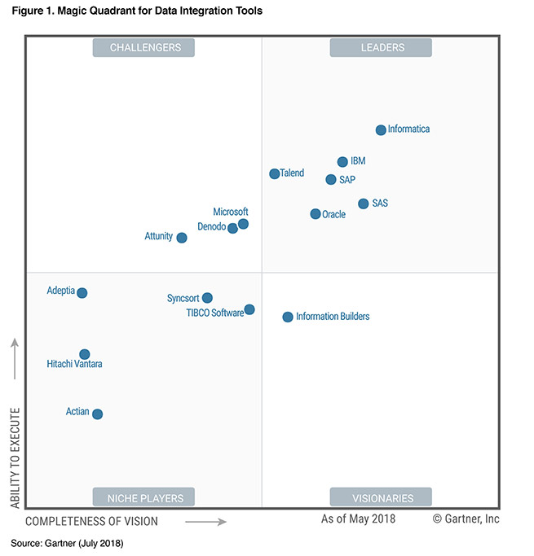
Data Quality Tools
Notes:
The Basel Committee on Banking Supervision (BCBS) is a committee of banking supervisory authorities that was established by the central bank governors of the Group of Ten countries in 1974, It provides a forum for regular cooperation on banking supervisory matters

Slide 6
Data Quality Insights
How much BALANCE_AMOUNT value because missing ISIN (International Securities Identification Number) has a missing or incorrect value
Understand the source of missing data and fix it in source level
Opportunity to find the Metadata and lineage information
Tools Usage on Data Quality
  Algorithms to guess the gender based on names
  USPS API to fix the incorrect US zip code address
  Data profiling
  Data cleansing Workflow
Notes:
The Basel Committee on Banking Supervision (BCBS) is a committee of banking supervisory authorities that was established by the central bank governors of the Group of Ten countries in 1974, It provides a forum for regular cooperation on banking supervisory matters

Slide 7
Data Quality Results and Control
Example 1
SOURCE/TABLE | CUSTOMER_TRANSACTION
PDE | BALANCE_AMOUNT
RULE | BALANCE_AMOUNT > 1
DIMESION | TARGET | THRESHOLD | THRESHOLD_ACTION
Completeness
Accuracy
Consistency
Validity | 99% | 2% | SEND_EMAIL
Timeliness
Uniqueness
Example 2
SOURCE/TABLE | DEBT_BALANCE
PDE | ISIN
RULE | SHOULD NOT BE NULL
DIMESION | TARGET | THRESHOLD | THRESHOLD_ACTION
Completeness | 98% | 1% | ABORT_SEND_EMAIL
Accuracy
Consistency
Validity
Timeliness
Uniqueness
Notes:
The Basel Committee on Banking Supervision (BCBS) is a committee of banking supervisory authorities that was established by the central bank governors of the Group of Ten countries in 1974, It provides a forum for regular cooperation on banking supervisory matters

