Slide 1
A Comprehensive Analysis of financial performance insights from a Leading Banks
Project Based experimental Learning program

Slide 2


Slide 3
Displayed by
Team Leader
Thasleema banu.A
Team members
Sangeetha.K
Divya prathikshi .D
Subhalakshmi.S

Slide 4
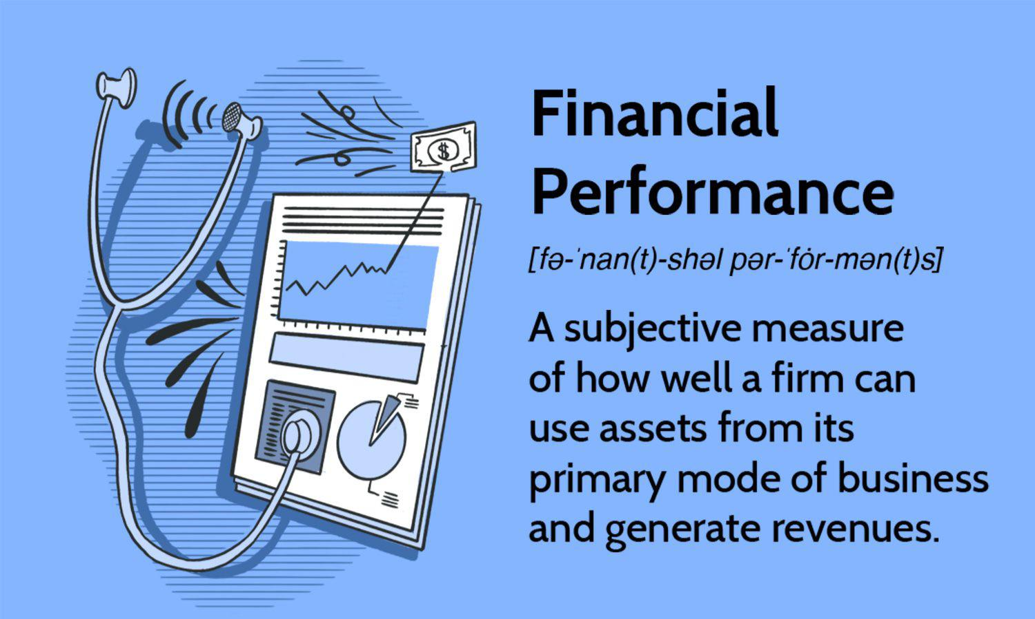
Financial performance

Slide 5
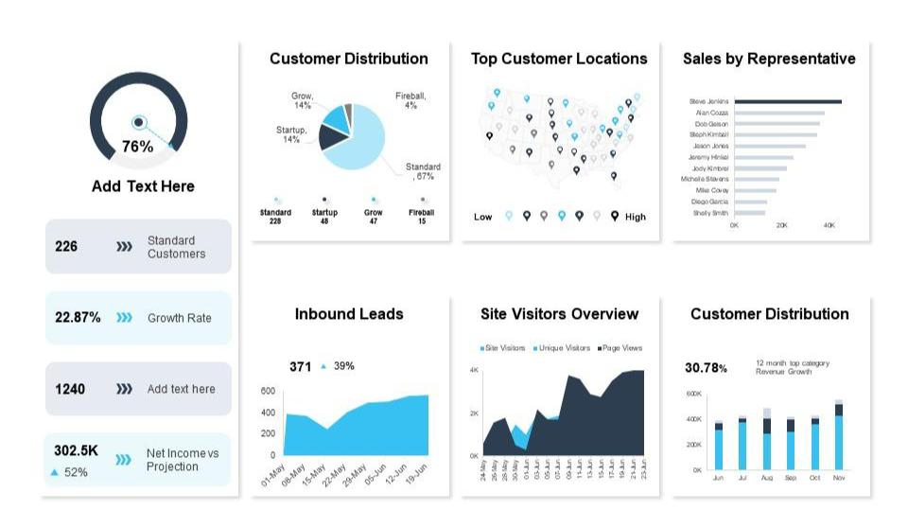
Financial performance insights from a Leading Banks

Slide 6
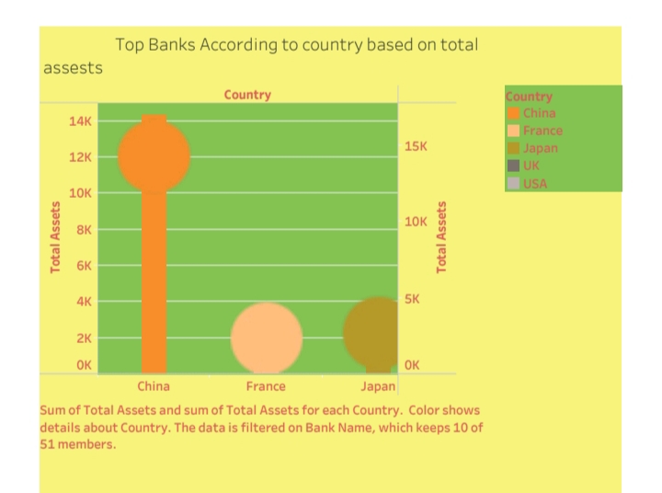
Top 10 countries as it’s proportion

Slide 7
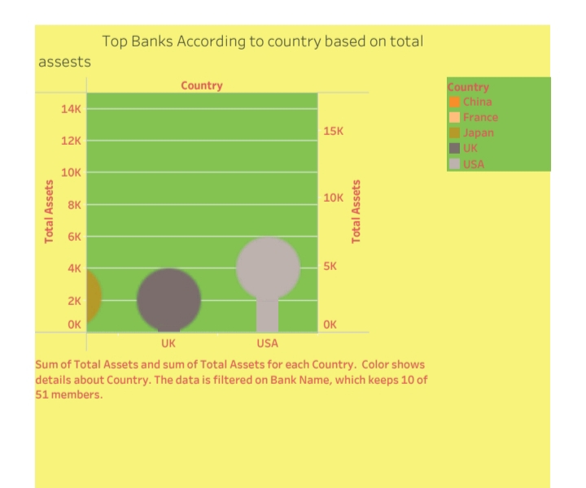
Top 10 countries as it’s proportion

Slide 8
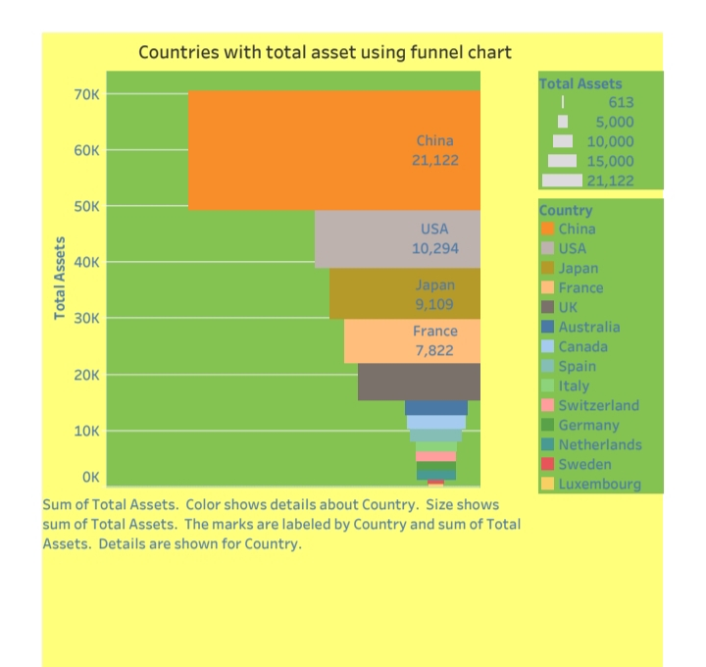
Top 10 countries as it’s proportion

Slide 9
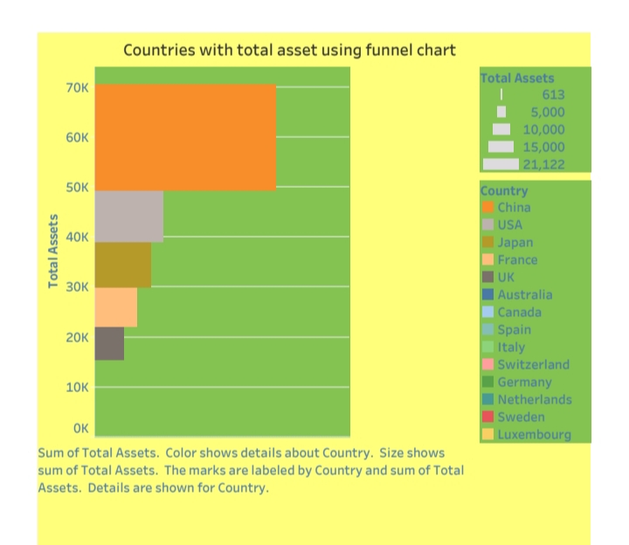
Top 10 countries as it’s proportion

Slide 10
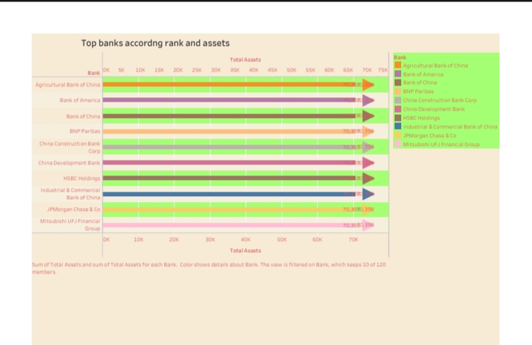
Top 10 countries as it’s proportion

Slide 11
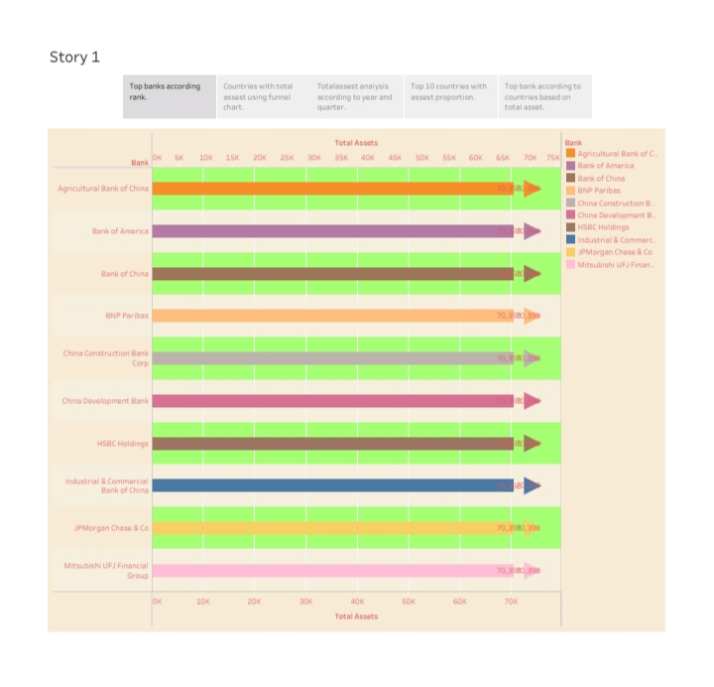
Top 10 countries as it’s proportion

Slide 12
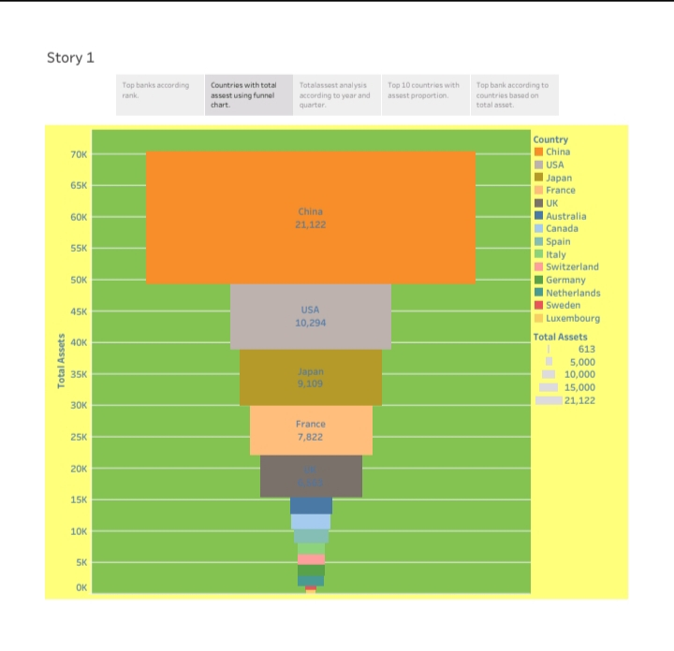
Top 10 countries as it’s proportion

Slide 13
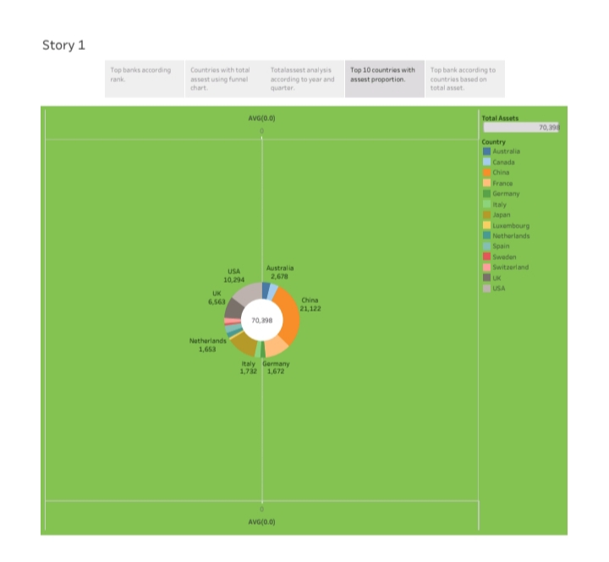
Top 10 countries as it’s proportion

Slide 14
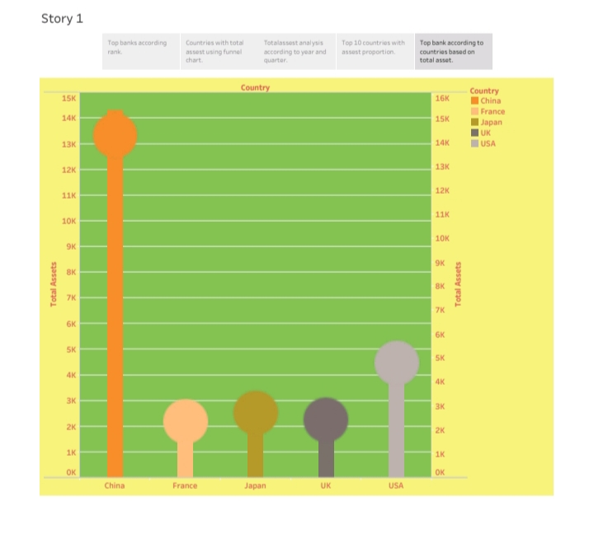
Top 10 countries as it’s proportion

Slide 15
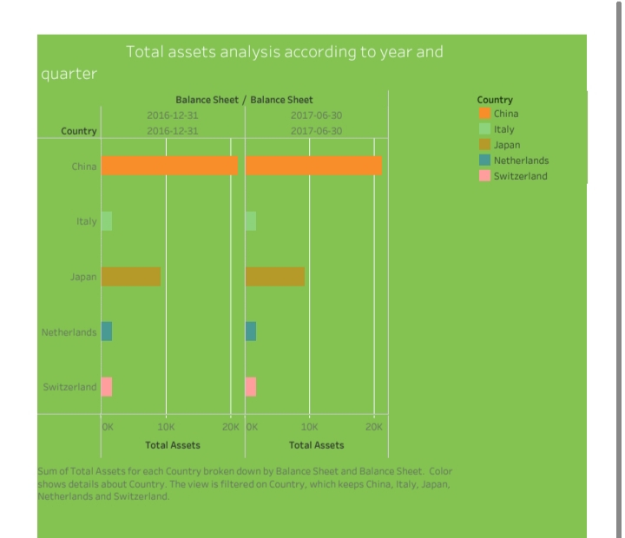
Top 10 countries as it’s proportion

Slide 16
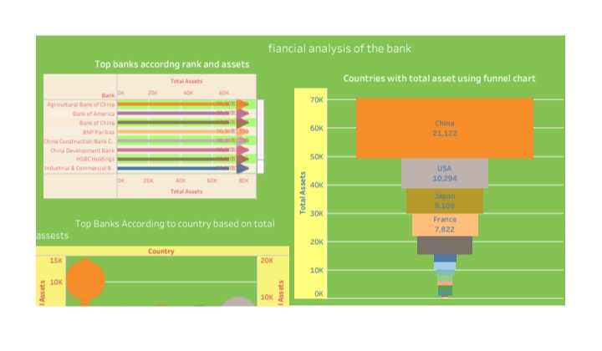
Top 10 countries as it’s proportion

Slide 17

Co – Operative Banks

Slide 18

Our gratitude knows no bounds

