Slide 1


Interactive Sales Dashboard
An Overview of Key Business Insights

Slide 2
Sales Performance Insights
Turning Raw Sales Data into Strategic Action
Visualizing Key Metrics: Leveraged sales data to build a dynamic dashboard that clearly presents high-level performance indicators such as total sales, total profit, and discounts offered — providing instant insight into business health.
Performance by Product Category: Analyzed sub-categories like Phones, Chairs, and Storage, which emerged as top contributors to sales. This helps identify high-performing product lines and areas needing attention.
Customer Segment Analysis: Segmented data by customer type — Consumer, Corporate, and Home Office. Corporate customers account for the highest sales share, revealing potential for targeted retention and upselling strategies.
Geographical Sales Insights: Mapped sales across East, West, Central, and South regions. East leads with the highest sales volume, while Central shows potential for growth, guiding regional focus for future campaigns.
Time-Series Trends: Included visual breakdowns of sales and profit over time. Year-wise growth from 2018 to 2021 shows consistent improvement, while daily sales tracking highlights seasonal trends and spikes.
Interactive Filtering: Integrated slicers and filters allow real-time drill-down by year, region, segment, and category — enhancing decision-making by offering flexible views for different business needs.

Slide 3
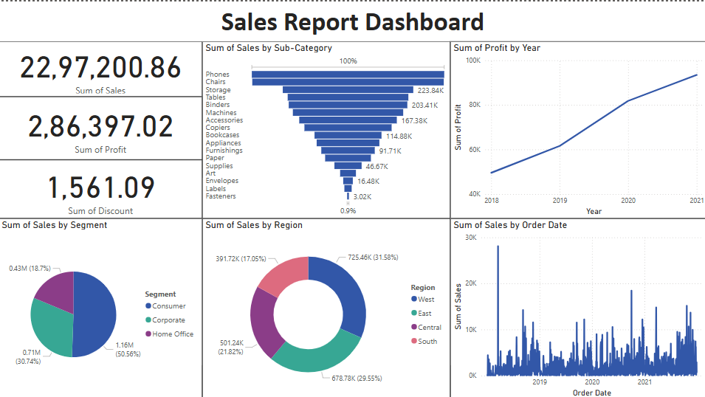

Slide 4
Dashboard Summary: Sales Performance Analysis
Overview:
This interactive dashboard provides a comprehensive analysis of the company’s sales, profit, product performance, and market reach, helping stakeholders make data-driven decisions
Key Metrics (KPIs)
Total Sales: ₹22,97,200.86
Total Profit: ₹2,86,397.02
Total Discount Given: ₹1,561.09
Geographical & Segment Analysis
Sales by Region:
Top Regions: East (31.58%) and South (29.55%) show the highest contribution to total sales.
West and Central regions have lower yet notable sales.
Sales by Segment:
Corporate (50.56%) leads, followed by Consumer (30.74%) and Home Office (18.7%), indicating stronger B2B sales performance.
Stakeholder Insights
Spot top-selling and low-performing product categories.
Evaluate which customer segments drive the most revenue.
Understand regional performance to plan marketing and inventory.
Use year-over-year growth to forecast and plan strategically.
Enable informed, data-driven business decisions through an easy-to-read interface.
Product Performance
Top Seller: Phones dominate the sub-category sales, followed by Chairs and Storage.
Sales Distribution: Significant difference between top and low-selling sub-categories.
Underperformers: Fasteners, Labels, and Envelopes show the lowest sales figures.
Time-Based Trends
Yearly Profit Trend:
Consistent profit growth observed from 2018 to 2021, reflecting successful sales strategies over time.
Sales Over Time:
Line chart for Order Date reveals fluctuating daily sales volume with seasonal spikes and promotional impact.

Slide 5
Thank You

