Slide 1
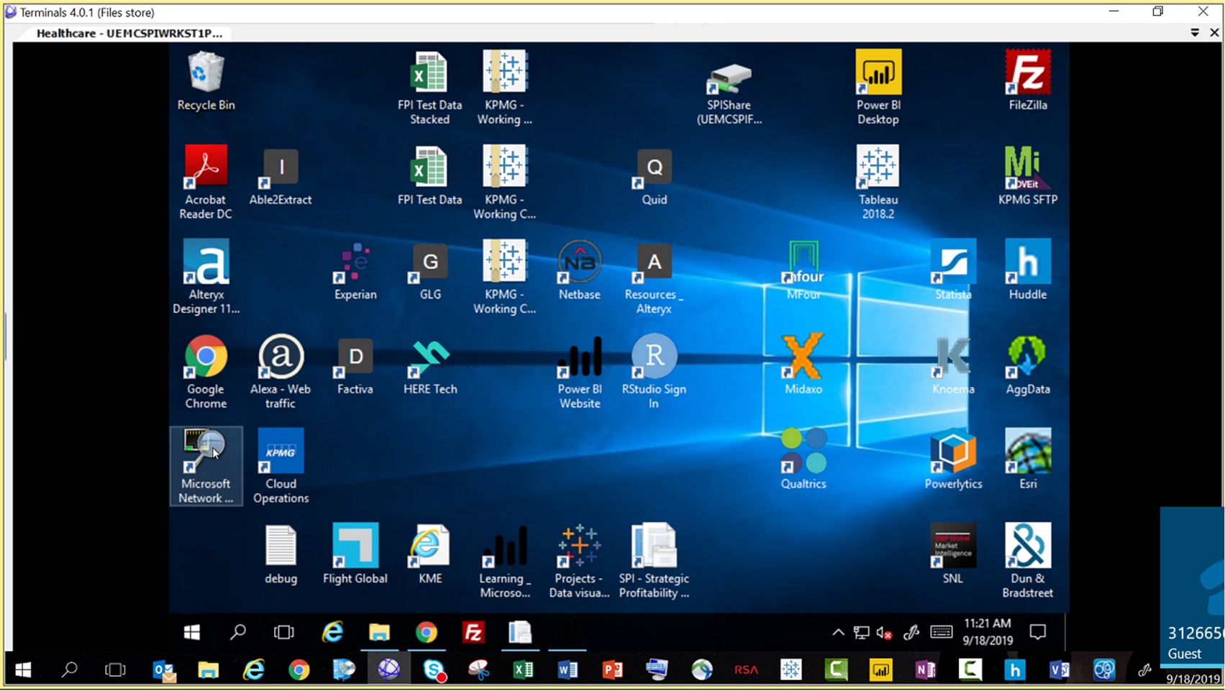

Slide 2
Welcome to the [brand] desktop environment
X
Close and directly access desktop
Learn and engage with analytics
Access 3rd-party software
Combining people, data, and tech to deliver leading insights at deal speed
Logo/ Image
Alteryx
About | Training | Video(s)
Questions
Tiles
Insights
Logo/ Image
Power BI
About | Training | Video(s)
Top issues clients face in the market
Industry-specific analytics use cases
Intelligence that drives decisions
View industry tiles
KPMG Tools (training required)
Logo/ Image
SPI
About | Training | Video(s)
TMT
Energy
Industrials
Consumer
Healthcare
FS
Logo/ Image
FPI
About | Training | Video(s)
Quick links
Intake form
List of data sources
Link 3
Link 4

Slide 3
Welcome to the [brand] desktop environment
X
Close and directly access desktop
Learn and engage with analytics
Access 3rd-party software
Combining people, data, and tech to deliver leading insights at deal speed
Logo/ Image
Alteryx
About | Training | Video(s)
Questions
Tiles
Insights
Logo/ Image
Power BI
About | Training | Video(s)
Top issues clients face in the market
Industry-specific analytics use cases
Intelligence that drives decisions
View industry tiles
KPMG Tools (training required)
Logo/ Image
SPI
About | Training | Video(s)
TMT
Energy
Industrials
Consumer
Healthcare
FS
Software / SaaS
Equipment / Hardware
Technical Professional Services
E-commerce
Telecom
Logo/ Image
FPI
About | Training | Video(s)
Internet/Transaction Services
Semi-conductor
Fintech
Media
Quick links
Intake form
List of data sources
Link 3
Link 4

Slide 4
X
Close and directly access desktop
TMT: Software / SaaS
Tiles
Market
Revenue
Cost
Capital
Contact TMT team
Headshot
Name
Title / Role
Email
Phone
Name
Name
Name
Name
Name
Name
Name
Name
Other TMT contacts
Contact 1
Contact 2
Contact 3
Name
Name
Name
Name
Name
Name
Name
Name
Resources
Training
Credentials
Videos
Name
Name
Name
Name

Slide 5
X
Close and directly access desktop
TMT: Software / SaaS
Tiles
Market
Revenue
Cost
Capital
Contact TMT team
General
Competitors
Size
Growth
Revenue
Headshot
Name
Title / Role
Email
Phone
Name
Name
Name
Name
Name
Name
Name
Name
Other TMT contacts
Contact 1
Contact 2
Contact 3
Name
Resources
Training
Credentials
Videos

Slide 6
X
Close and directly access desktop
TMT: Software / SaaS
Tiles
Market
Revenue
Cost
Capital
Contact TMT team
General
Competitors
Size
Growth
Revenue
Headshot
Name
Title / Role
Email
Phone
Name
Name
Name
Other TMT contacts
Contact 1
Contact 2
Contact 3
Resources
Training
Credentials
Videos

Slide 7
X
Close and directly access desktop
TMT: Software / SaaS
Tiles
Market
Revenue
Cost
Capital
Contact TMT team
General
Competitors
Size
Growth
Revenue
Headshot
Name
Title / Role
Email
Phone
[Name]
Client issue
Analytical process
Other TMT contacts
Contact 1
Contact 2
Contact 3
Type
Predictive
Description
Data required
Automation level
Low
Resources
Training
Credentials
Videos

