Slide 1

“FOOD DELEVERY WEBSITE & APPLICATION”
Task - 1

Slide 2
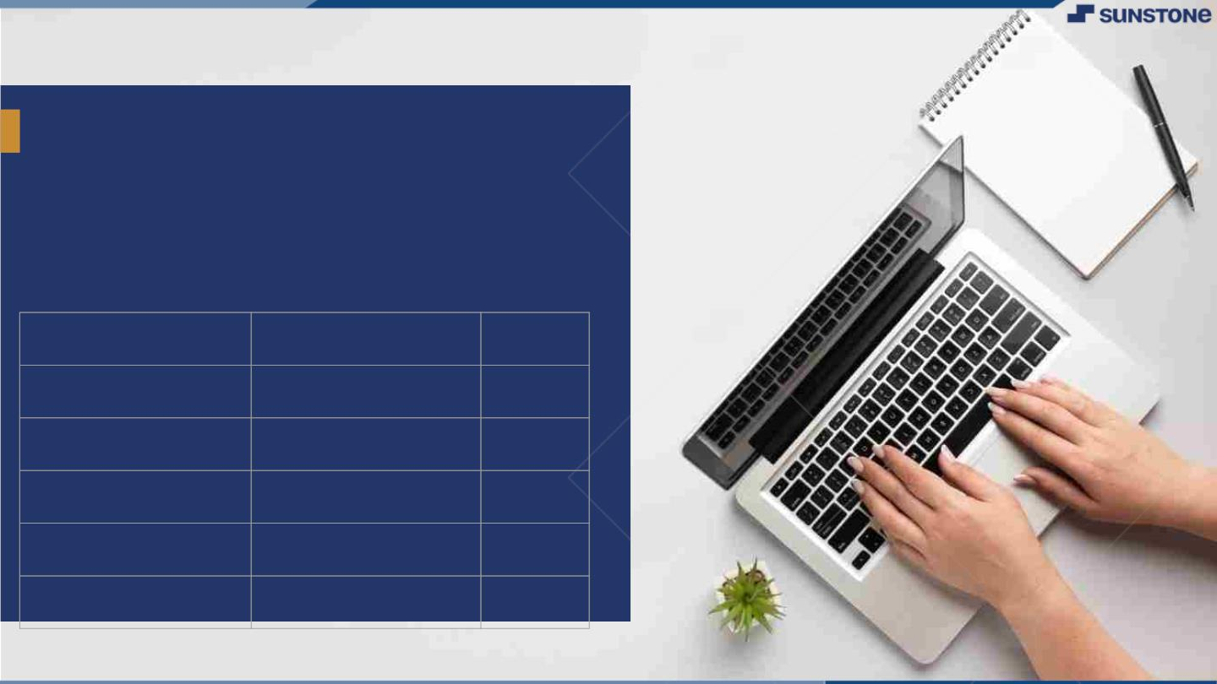
“FOOD DELEVERY WEBSITE & APPLICATION”
Your Project Introduction
The Online Food Ordering System allows the restaurant employees to easily manage the site content, most importantly the menu, themselves through a very intuitive graphical interface. Visitors to the site, once registered, are then able to easily navigate this menu, add food items to their order, and specify delivery options with only a few clicks, greatly simplifying the ordering process. Back in the restaurant, placed orders are promptly retrieved and displayed in an easily readable format for processing.
LMS Username
Name
Batch
Ammu.N
8
▪
Arthi.T
8
Thatchayani.G
8
Jaisree.N
8

Slide 3

Taskꢀ-ꢀ1
CreationꢀofꢀSRSꢀ&ꢀGithub
▪
▪
▪
CreateꢀSRSꢀ:ꢀ“FOOD DELEVERY WEBSITE & APPLICATION”
Creationꢀ&ꢀSet-upꢀofꢀGithubꢀaccount
Creationꢀ&ꢀHands-onꢀtoꢀvariousꢀcommandsꢀofꢀGitꢀBash
EvaluationꢀMetric:
● 100%ꢀCompletionꢀofꢀtheꢀaboveꢀtasks
Learning Outcome
▪
▪
▪
▪
Getꢀtoꢀknowꢀaboutꢀdifferentꢀlifecycleꢀmodels.
UnderstandingꢀimportanceꢀandꢀhowꢀtoꢀcreateꢀanꢀSRS
KnowingꢀvariousꢀcommandsꢀofꢀGithub
Understandingꢀagileꢀandꢀscrumꢀmanagementꢀtechniquesꢀforꢀefficientꢀproductꢀdevelopment

Slide 4
Step-WiseꢀDescription
Step 1:
A consumer will get recommendations of nearby restaurants or some special orders for the day. Right from restaurant selection to checkout and payment, the consumer is at the lead. The users know how to create a basket of the desired items in the food ordering app.
Step 2:
Once the items are in the cart, the user can review them and move to payment.
Step 3:
Once the order is final, the restaurant gets a notification and starts preparing the food. In your journey to make a food delivery app, it is also essential to know how to connect the user with the restaurant and the delivery guy.
Step 4:
After preparation, a delivery guy takes the order and delivers it to the customer on their specified address.
Summaryꢀofꢀyourꢀtask
The process consists of a customer choosing the restaurant of their choice, scanning the menu items, choosing an item, and finally choosing for pick-up or delivery. Payment is then administered by paying with a credit card or debit card through the app or website or in cash at the restaurant when going to pickup.

Slide 5
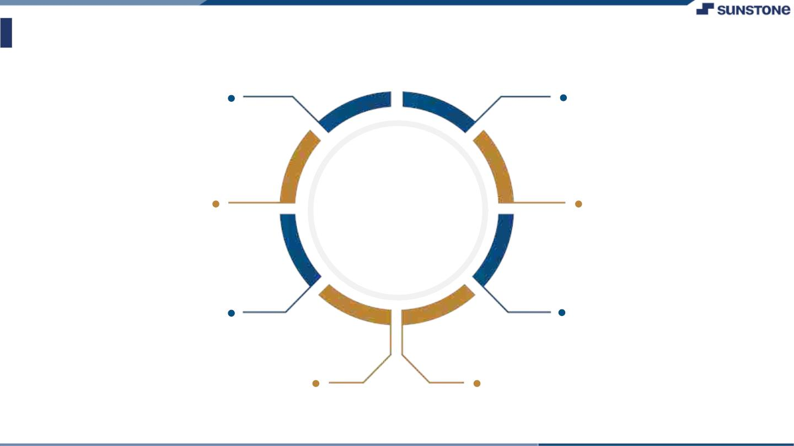
AssessmentꢀParameter
Gatherꢀrequirementsꢀforꢀtheꢀ
project
addꢀReadme.mdꢀfileꢀwithꢀ
descriptionꢀofꢀtheꢀproject
Prepareꢀdatabaseꢀdesignꢀ
schemas
Check-List
Commitꢀallꢀchangesꢀwithꢀ"firstꢀ
commit"
Getꢀyourꢀinitialꢀprojectꢀ
Structureꢀready
createꢀaꢀrepositoryꢀonꢀgithubꢀ
realtedꢀtoꢀproject
Initiateꢀaꢀgitꢀrepository
Pushꢀyourꢀchangesꢀtoꢀgithub

Slide 6
1.Introduction 1.1 Purpose Food delivery apps are third-party delivery services hosted on mobile applications that restaurants or retailers partner with to showcase their menu and food offerings, allowing customers to order food and get it delivered to their doorstep.
Document Conventions
Entire document should be justified. Convention for Main title
Font face: Times New Roman
Font style: Bold
Font Size: 14
Convention for Sub title
Font face: Times New Roman
Font style: Bold
Font Size: 12
Convention for body Font face: Times New Roman
Font Size:12

Slide 7
1.3 Scope of Development Project Food Ordering app can sale Food product, preferred brands, kitchen needs, essential restaurant supplies and more, through this online, one stop Food store. It provides you with a convenient way to sale from your Food shopping app. You can use this app as one big super market app to sale product of your store. This app make easy for user to buy product from store with easy steps and store can get easy order.
Definitions, Acronyms and Abbreviations
JAVA -> platform independence
SQL-> Structured query Language
ER-> Entity Relationship
UML -> Unified Modeling Language
IDE-> Integrated Development Environment
SRS-> Software Requirement Specification
ISBN -> International Standard Book Number
IEEE ->Institute of Electrical and Electronics Engineers
References
1. Rahman H. (2019), A Review of the Usable Food Delivery Apps, International Journal of Engineering
Research & Technology (IJERT) ISSN: 2278-0181 Vol. 8 Issue 12, December-2019.
DOI: 10.17577/IJERTV8IS120052
2. M. Li, J. Zhang and W. Wang, "Task Selection and Scheduling for Food Delivery: A Game-Theoretic
Approach," 2018 IEEE Global Communications Conference (GLOBECOM), pp. 1-6 DOI: 10.1109/GLOCOM.2018.8647947

Slide 8
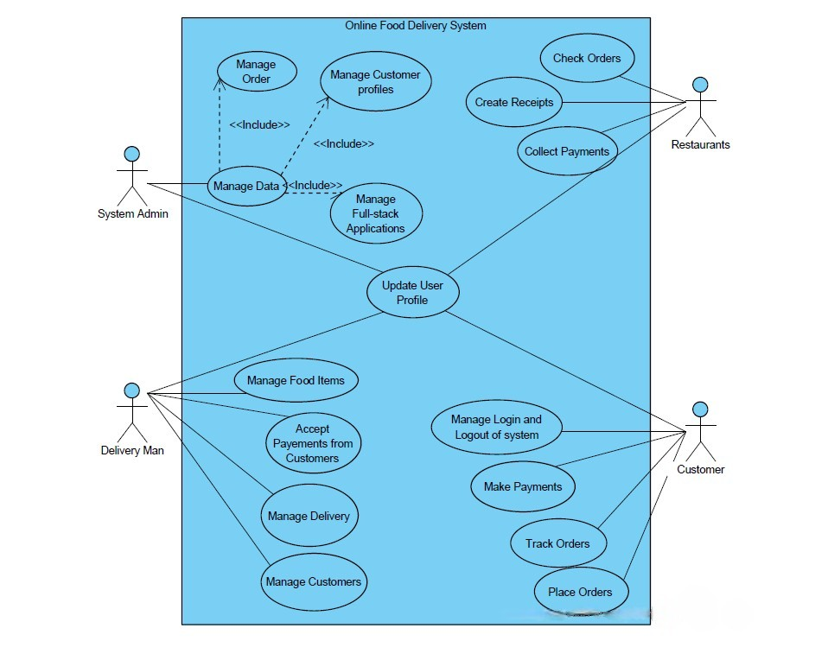
2.Overall Descriptions
Use case diagram for online food delivery system

Slide 9
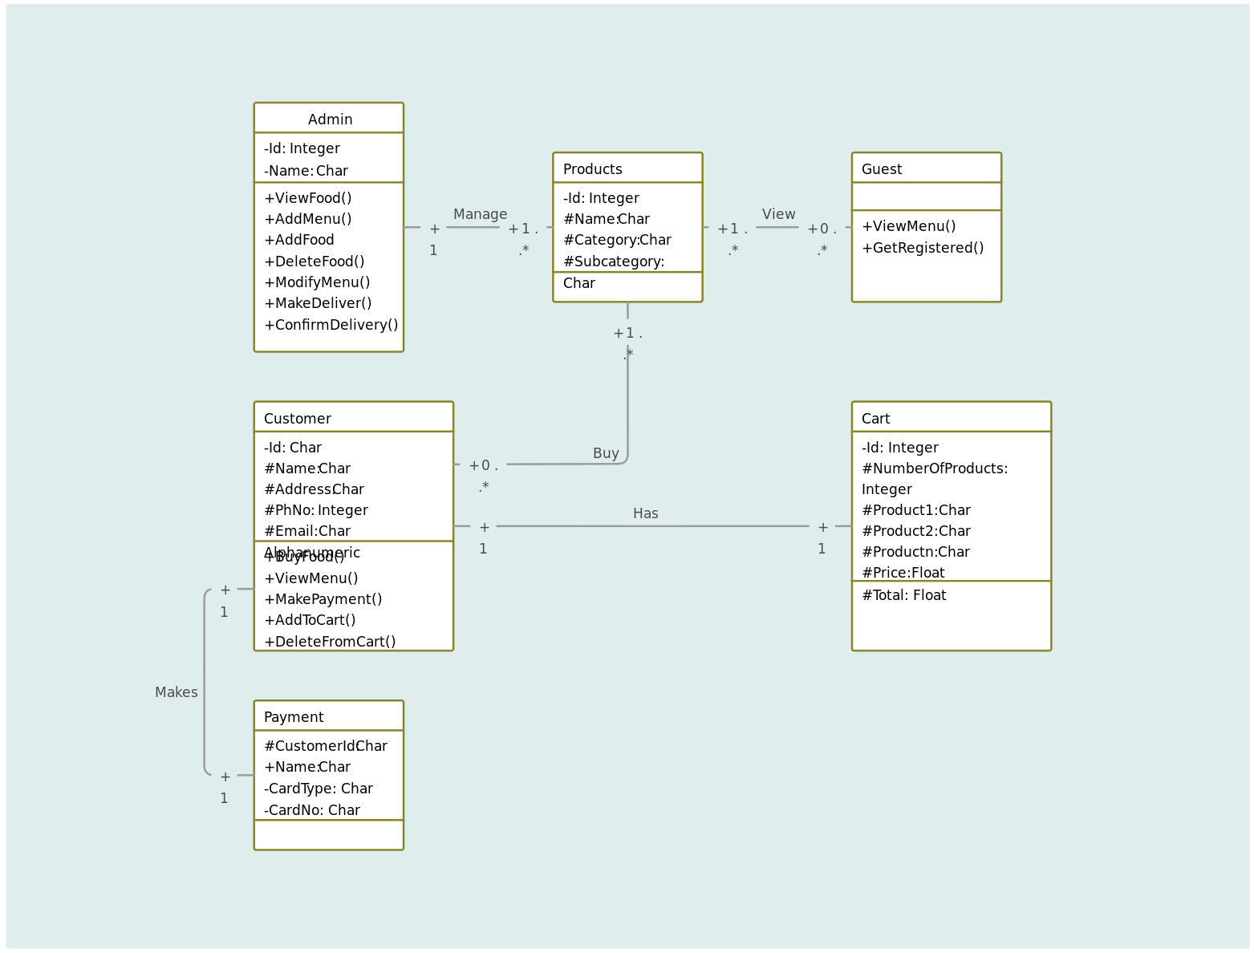
Class diagram

Slide 10
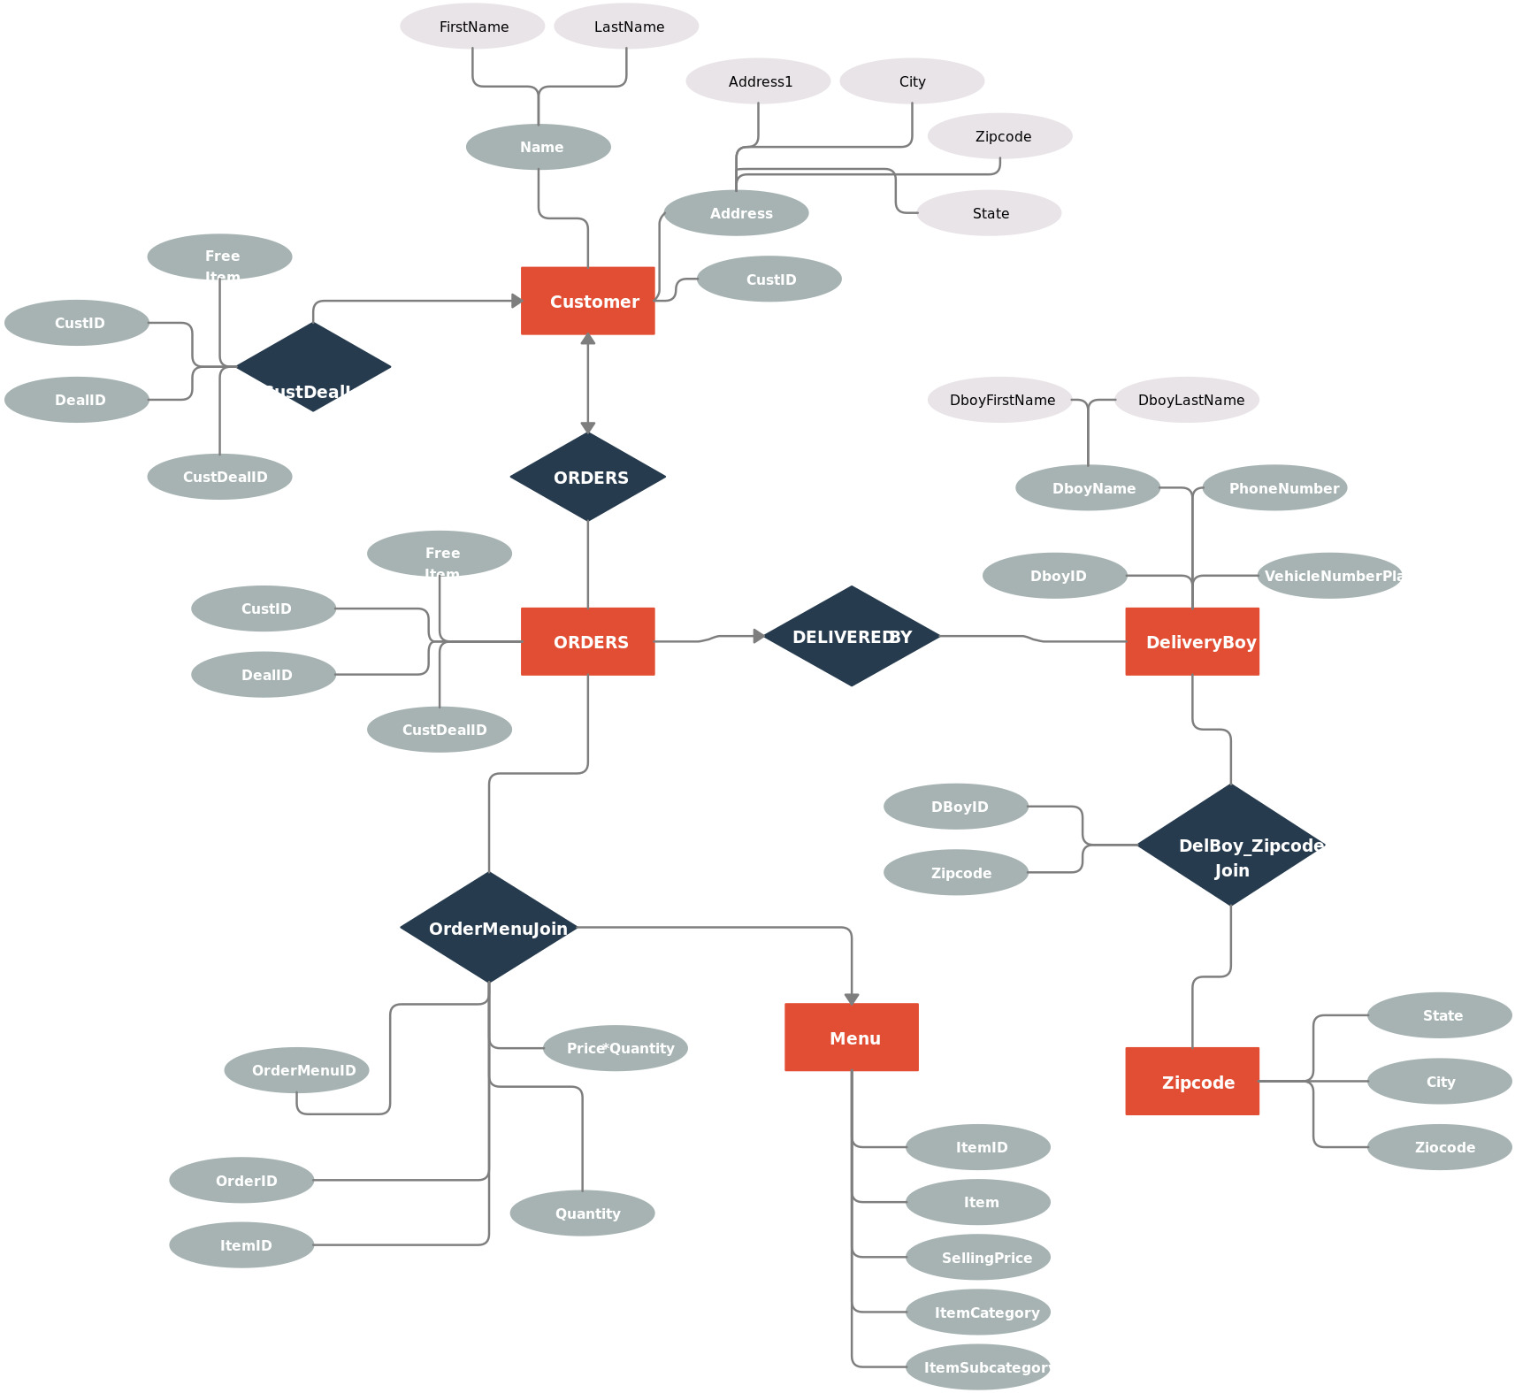
Product Function Entity Relationship Diagram of online food delivery system.

Slide 11
3. Functional Requirements 3.1 User Registration and Authentication Users can register and log in using email or social media accounts. User roles include customers and restaurant owners. Authentication and authorization mechanisms will be implemented. 3.2 Restaurant Listings Users can search for restaurants by location, cuisine, or restaurant name. Restaurant details include name, location, cuisine, ratings, and reviews.

Slide 12
3.3 Menu Management (Restaurant Owners) Restaurant owners can log in and manage their menus. Add, edit, or remove items from the menu. Set item prices and descriptions. 3.4 Ordering Process Customers can browse restaurant menus. Add items to the shopping cart. Review and modify the cart. Place orders, providing delivery details and payment information. 3.5 Order Tracking Users can track the status of their orders (e.g., order received, preparing, out for delivery). Receive notifications when the order status changes.

Slide 13
3.6 Payment Processing Securely process payments using a third-party payment gateway. 3.7 User Reviews and Ratings Users can leave reviews and ratings for restaurants. Reviews should include text comments and star ratings. 4. Non-Functional Requirements 4.1 Performance The website should load quickly and handle a large number of concurrent users. Response times for critical functions should be below predefined thresholds. 4.2 Security Implement encryption for user data and transactions. Protect against common web application security threats (e.g., SQL injection, cross-site scripting).

Slide 14
4.3 Usability The user interface should be intuitive and easy to navigate. Ensure accessibility compliance. 4.4 Scalability The system should be designed to scale horizontally to accommodate increased user load. 4.5 Reliability The system should be highly available and minimize downtime. 5. Technical Requirements 5.1 Backend Develop the backend using Java. Use a relational database (e.g., MySQL) for data storage. Implement REST ful APIs for communication between the frontend and backend.
5.2 Frontend
Develop the frontend using HTML, CSS, JavaScript, and React.js.
Ensure cross-browser compatibility.
Implement responsive design for mobile devices.

Slide 15
6. Conclusion This Software Requirement Specification (SRS) serves as a foundational document for your food delivery website project. It should be continually updated and refined as the project progresses and requirements evolve.

Slide 16
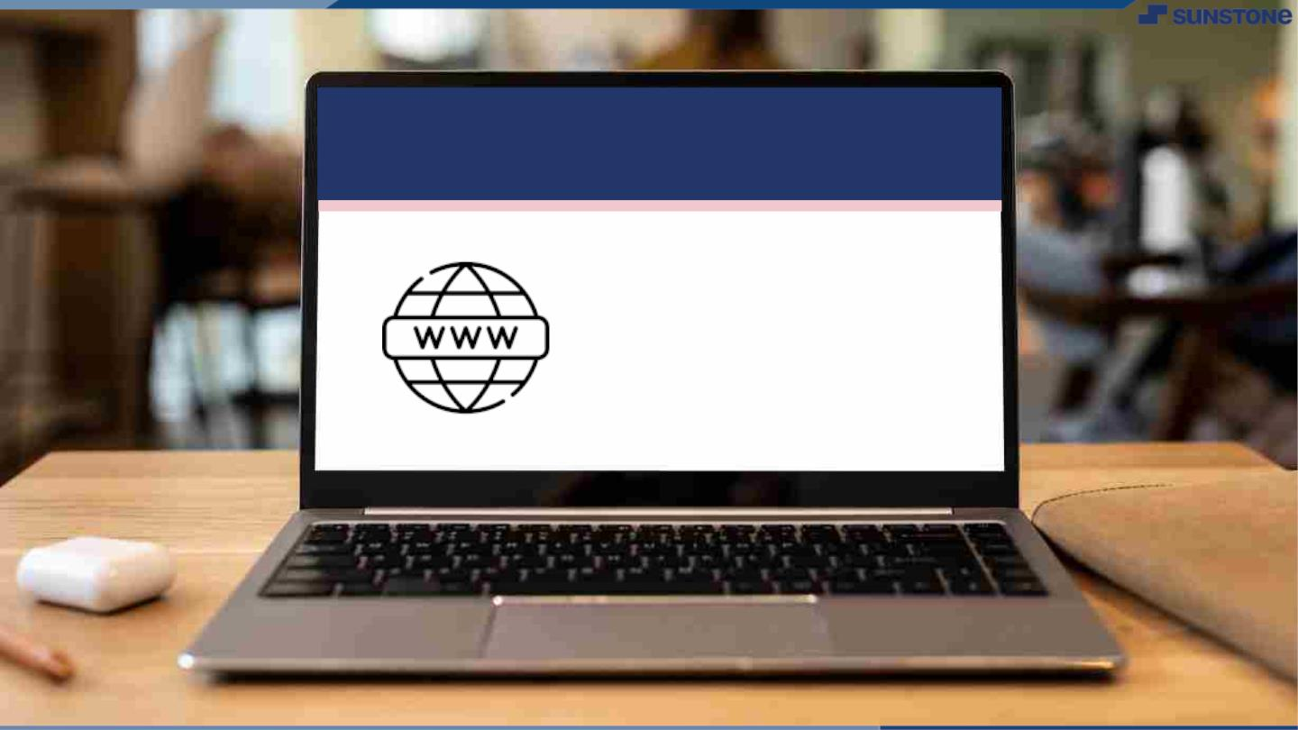
Submission Github
https://github.com/thatchayani22/NM-DSCET-GROUP-08.git

Slide 17


