Slide 1
State Spaces and Search
The process of finding a solution to a problem, represented by moving from an abstract state to another
Example: Cannibals and Missionaries Problem
There are 3 cannibals and 3 missionaries, all who have agreed they want to get to the other side of the river.
The boat can only carry two people from one side of the river to the other.
You don’t want to ever have more cannibals than missionaries on one side alone or the cannibals may eat the missionaries.

Slide 2

Cannibals and Missionaries
Can you find a solution where no missionaries are eaten?
Notation:
Left | Right
3C 3M B | 0C 0M
Start state: 3C and 3M on left, boat on left
Left | Right
3C 1M | 0C 2M B
2M take the boat to the right side

Slide 3
One Solution
Initial State: 3m3cb 0m0c
Send 2c: 3m1c 0m2cb
Return 1c 3m2cb 0m1c
Send 2c 3m0c 0m3cb
Return 1c 3m1cb 0m2c
Send 2m 1m1c 2m2cb
Return 1m1c 2m2cb 1m1c
Send 2m 0m2c 3m1cb
Return 1c 0m3cb 3m0c
Send 2c 0m1c 3m2cb
Return 1c 0m2cb 3m1c
Send 2c 0m0c 3m3cb

Slide 4
Cannibals and Missionaries Graph – Search Tree
1M
Left: 3C3MB
Right: 0C0M
1M
2C
1C1M
1C
Left: 3C2M
Right: 0C1MB
Left: 3C2M
Right: 0C1MB
Left: 2C3M
Right: 1C0MB
Left: 1C3M
Right: 2C0MB
Left: 2C2M
Right: 1C1MB
…
1M
1C
2C
1C
Left: 3C3MB
Right: 0C0M
Left: 3C3MB
Right: 0C0M
Left: 3C3MB
Right: 0C0M
Left: 2C3MB
Right: 1C0M
…
…
…
1C
2C
1M
Left: 1C3M
Right: 2C0MB
Left: 0C3M
Right: 3C0MB
Left: 2C2M
Right: 1C1MB

Slide 5
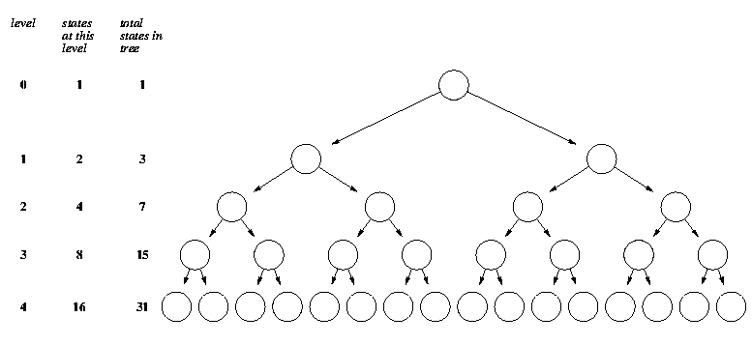
Exponential Growth!
Level 32: 4,294,967,295
Level 55: 18,014,398,509,482,000

Slide 6
Informed Search
The algorithms we just discussed are uniformed; they don’t have any measure as to how “good” a particular state is
Where’s the intelligence?
Informed search uses a heuristic
The heuristic is a cheap, easy to calculate estimate of how close a state is to the goal state
Comes from the Greek word “heuriskein” that means “to find”
Archimedes: “Heureka” for “I have found it”

Slide 7
Simple Heuristic – Total People on Right
Left: 3C3MB
Right: 0C0M
1M
2C
1C1M
1C
Left: 3C2M
Right: 0C1MB
Left: 2C3M
Right: 1C0MB
Left: 1C3M
Right: 2C0MB
Left: 2C2M
Right: 1C1MB
…
1M
1C
2C
1C
Left: 3C3MB
Right: 0C0M
Left: 3C3MB
Right: 0C0M
Left: 3C3MB
Right: 0C0M
Left: 2C3MB
Right: 1C0M
…
…
…
1C
2C
1M
Left: 1C3M
Right: 2C0MB
3
Left: 2C2M
Right: 1C1MB
2
2
Left: 0C3M
Right: 3C0MB

Slide 8
Classical Game Playing
Consider a 2 player game like chess
On average, about 35 moves can be made
Each half move made by a player is called a ply
If each player makes 50 moves, the number of states to search is 35¹⁰⁰ which is intractable to search to the end of the game
But we can search ahead as far as time allows and apply a heuristic to choose what seems like the best move at that point
Examples of heuristics:
Ratio of pieces; control of key board positions; weights for types of pieces
Must modify our algorithm to account for the adversarial nature of a two-player game

Slide 9
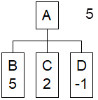
Minimax Algorithm
Look ahead from the current game state as many moves as possible in a depth-first manner. Apply the heuristic to these states and:
If it is our turn, choose the LARGEST heuristic value
Assumes bigger is better for us
If it is our opponents move, choose the SMALLEST heuristic value
Assumes smaller is worse for us and therefore better for our opponent
Looking
One ply ahead

Slide 10
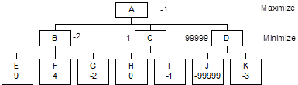
Minimax – Two Ply Ahead

Slide 11
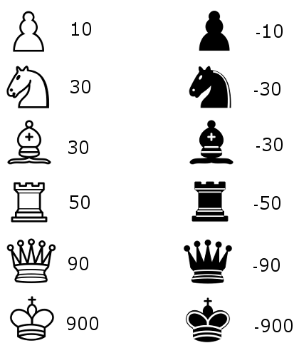
Chess Minimax Example
Heuristic = sum white + sum black

Slide 12
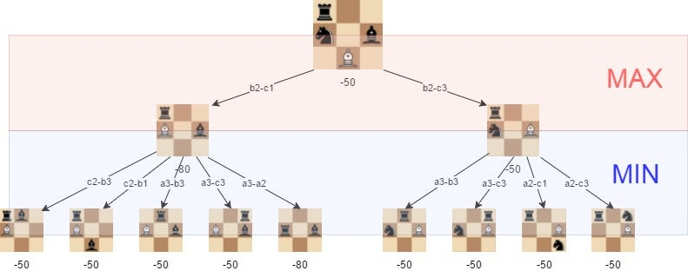
Chess Minimax Visualization

Slide 13
AI Game Examples
Samuel’s Checkers Program, 1950’s
Able to search 20 ply ahead
Heuristic: Weighted polynomial function Ax + By + Cz + …
x,y,z’s are variables calculated from the game and A, B, C’s are constants
He had up to 35 variables characterizing elements such as
Piece advantage
Denial of occupancy
Mobility
Control of center
Piece advancement
Early form of machine learning! Remembered lookahead values to increase the effective search depth

Slide 14
Stockfish
Best chess-playing program until Google’s AlphaZero
Looking 25 ply ahead not uncommon in around a minute
Heuristic components
Pieces weighted by type; e.g. queen = 10, pawn = 1
Piece placement, center squares good
Defending friendly pieces
Attacking important enemy pieces
Pawn formation
Stockfish doesn’t do this but many other games use Opening Book or Closing Book moves
Designed to run on distributed processors for increased speed

Slide 15
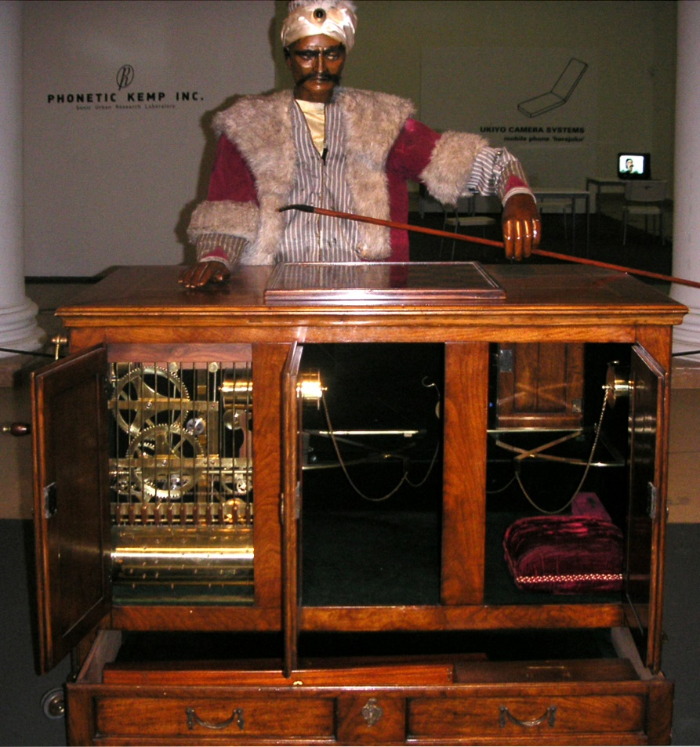
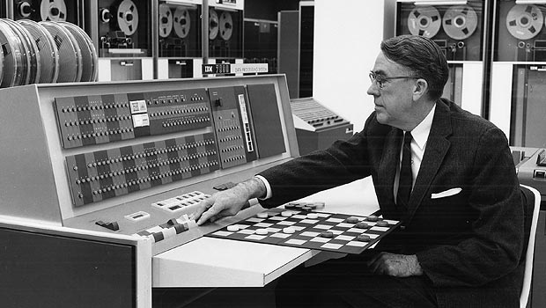
From the Archives of AI Game Playing
The Turk, late 1700’s-1800’s
Samuel’s Checkers Program, 1951

