Slide 1

Subscription Product Adoption: Strategic Merchant Targeting
Kushraj Bhatia

Slide 2

AGENDA
Business Objective & Approach
Data Quality & Assumptions
Understanding Subscription Winners (Who succeeds with subscription today?)
Identifying target Merchants (Who should adopt subscriptions?)
Scoring & Prioritizing Framework
Final Recommendations & Next Steps

Slide 3
THE CHALLENGE
Goal: Increase subscription product adoption among existing Stripe merchants
Context: Many merchants show recurring payment patterns but manually process them via Checkout/Payment Links
Opportunity: Automate recurring revenue for merchants = better experience + increased Stripe revenue
Key Question: Which existing merchants are most likely to benefit from and adopt subscriptions?

Slide 4
THREE-STAGE FRAMEWORK
Stage 1: Understand who CURRENTLY succeeds with subscriptions
  Analyze existing subscription users by industry, geography, business size
  Identify success patterns and merchant characteristics
Stage 2: Define "subscription-ready" criteria for non-subscribers
  Identify merchants with recurring transaction behavior
  Filter for meaningful scale and product familiarity
Stage 3: Build scoring system to prioritize targets
  Multi-dimensional scoring across 5 key factors
  Segment into actionable tiers (Perfect/Excellent/Good)

Slide 5
DATA CLEANING & VALIDATION
Key Issues Identified:
Merchant IDs: Removed 179 invalid IDs (0.76% of data)
  567 numeric-only IDs
  129 scientific notation IDs
Dates: Removed 26 invalid dates (0.11% of data)
Payment Records: Removed 11,327 records with invalid merchant IDs (0.72%)
Final Clean Dataset:
23,422 merchants
1,566,560 payment records
Zero null values
Date range: May 2041 - June 2042 (13 months)
** Images at end

Slide 6
PRODUCT VOLUME OVERLAP-KEY ASSUMPTION!
Critical Discovery:
77.7% of payment records show total_volume ≠ sum(subscription + checkout + payment_link)
Root Cause:
Products are NOT mutually exclusive (per documentation)
Implication:
Merchants can use multiple products for a single transaction
Decision:
Use total_volume as-is; product volumes represent overlapping usage, not components

Slide 7
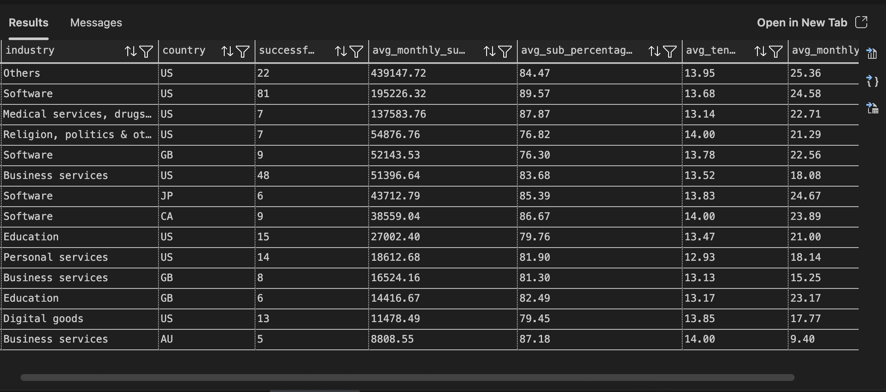
Who Succeeds with Subscriptions Today?
Key Findings:
Top Industry: US Software - 81 merchants, $195K/month avg subscription revenue
High Reliance: 84-90% of revenue from subscriptions once adopted
Geographic Concentration: US, GB, Japan lead adoption
Business Size: Small businesses dominate successful adoption

Slide 8
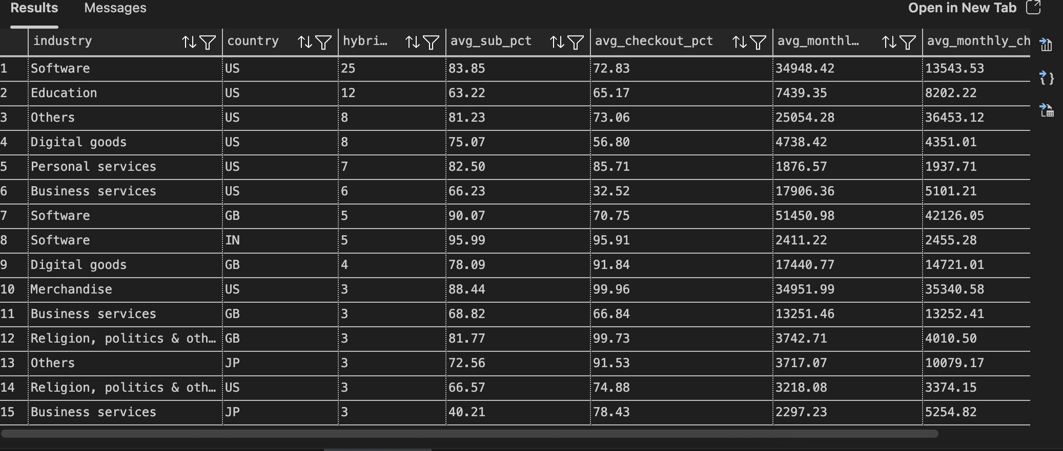
The Migration Path: Checkout → Subscription
Key Insight:
25 US Software merchants use BOTH Checkout (73%) AND Subscriptions (84%)
Product overlap validates gradual migration strategy
Merchants don't abandon Checkout when adopting Subscriptions
Implication: Existing Checkout users are ideal conversion candidates

Slide 9
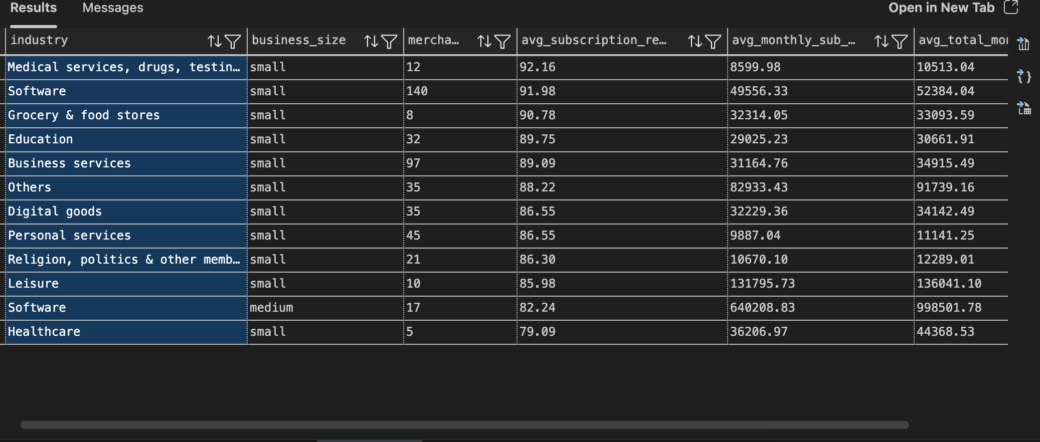
Subscription Becomes Essential
Key Insight:
Small businesses show 86-92% subscription reliance once adopted
Software: 92% reliance, $49,556/month avg revenue
Medical Services: 92% reliance, $8,600/month avg revenue
Takeaway: Once merchants adopt subscriptions, it becomes core to their business model

Slide 10
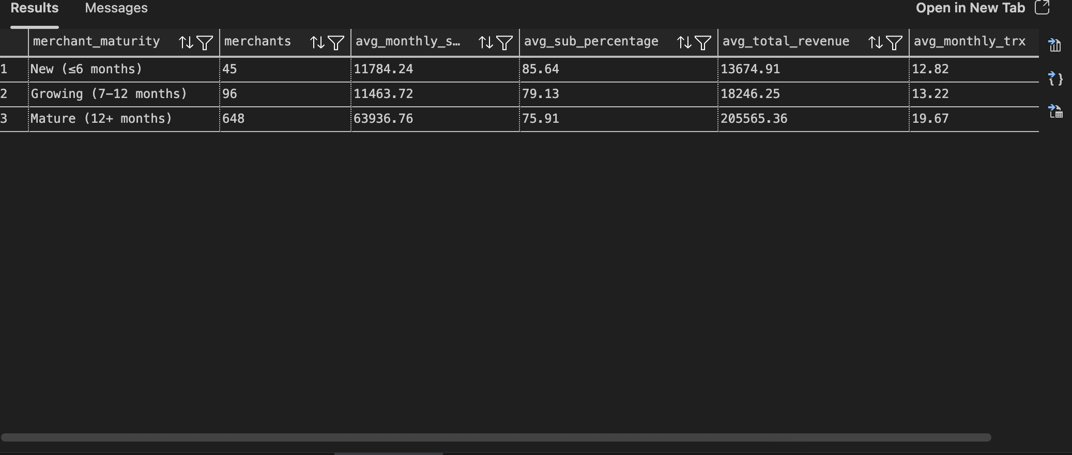
Timing the Outreach
Critical Insight:
Mature merchants (12+ months): $63,937/month subscription revenue
New merchants (≤6 months): $11,784/month subscription revenue
5.4X difference in subscription revenue by tenure
Implication: Target established merchants (6+ months), not brand new signups

Slide 11
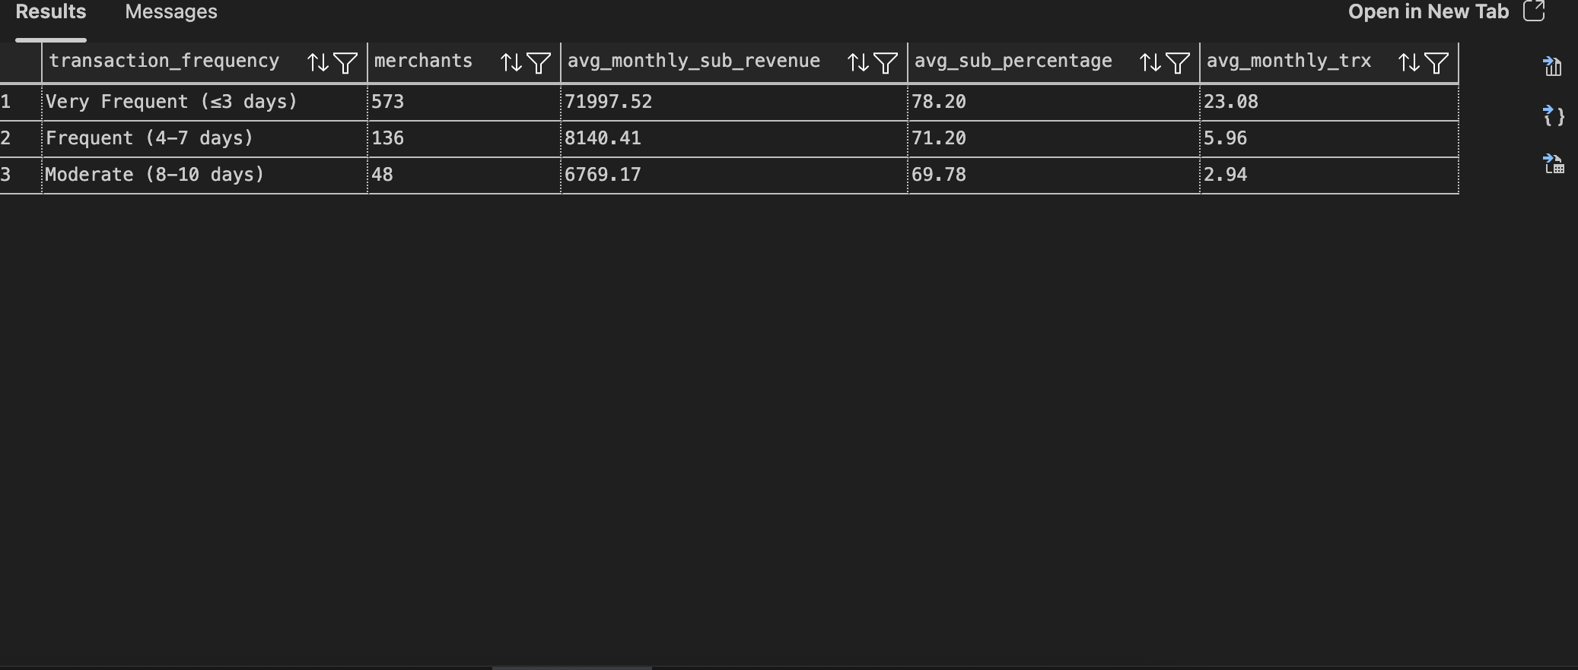
Transaction Frequency Predicts Success
Key Validation:
Very Frequent (≤3 days): 573 merchants, $71,998/month avg
Frequent (4-7 days): 136 merchants, $8,140/month avg
Moderate (8-10 days): 48 merchants, $6,769/month avg
Validates our targeting: Merchants with ≤10 days between transactions show subscription success

Slide 12
Target Criteria for Non-Subscribers
We created a VIEW (recurring_merchants) filtering for:
No Current Subscription Usage (subscription_volume = 0)
Recurring Transaction Behavior (≤10 days average between transactions)
Established Pattern (>10 total transactions in dataset)
Sufficient Scale (Meaningful transaction volume)
Rationale:
Subscriptions solve a problem for recurring revenue businesses
If they're manually processing recurring payments, they're ideal candidates
Filters ensure we target merchants with proven, sustainable patterns
Result: 7,819 qualifying merchants

Slide 13
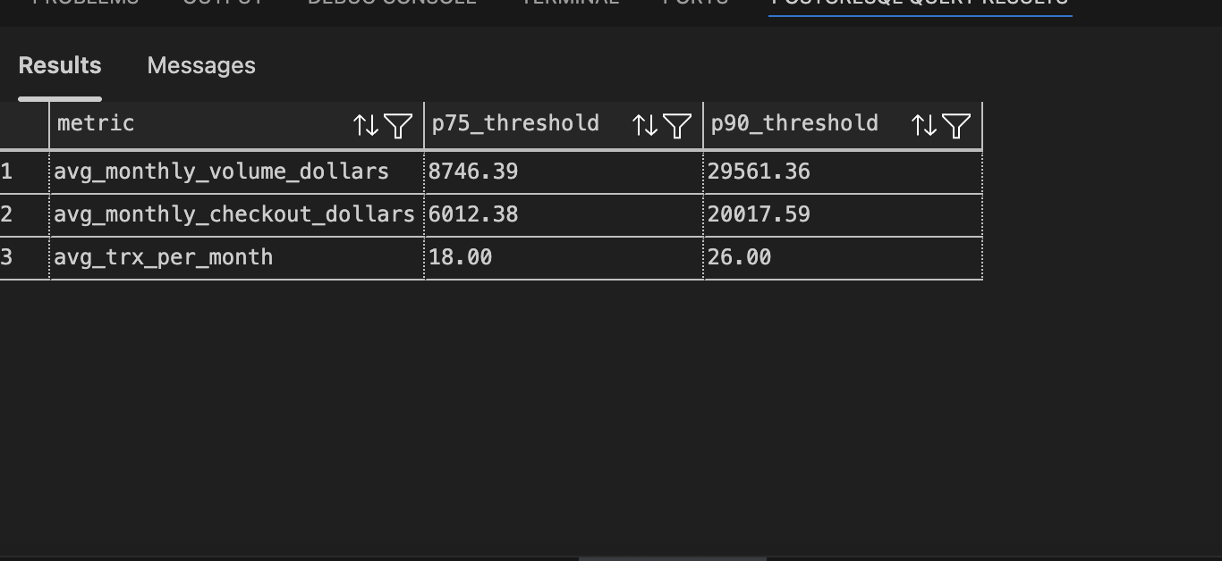
Data-Driven Threshold Selection
Scoring Philosophy:
Use percentile analysis on qualifying merchants, not arbitrary numbers
3 points = P90+ (top 10% performers)
2 points = P75+ (top 25% performers)
1 point = Everyone else
Thresholds:
Volume: P75 = $8,746/mo, P90 = $29,561/mo
Checkout: P75 = $6,012/mo, P90 = $20,018/mo
Transactions: P75 = 18/mo, P90 = 26/mo

Slide 14
FIVE-DIMENSIONAL SCORING FRAMEWORK
Scoring Philosophy:
Dimension | 3 Points | 2 Points | 1 Point
Volume Score | >= $30K/mo | >= $30K/mo | < $8.75K/mo
Checkout Score | >= $20K/mo | >= $6K/mo | < $6K/mo
Engagement Score | >= 12 months | >= 6 months | < 6 months
Frequency Score | <=5 days | <=7 days | <=10 days
Transaction Score | >=25/mo | >=15/mo | <15/mo
Segmentation | Score
Perfect Target | Score 12-15 (immediate focus)
Excellent Targets | Score 9-11 (secondary wave)
Good Targets | Score<9 (long tail opportunity)

Slide 15
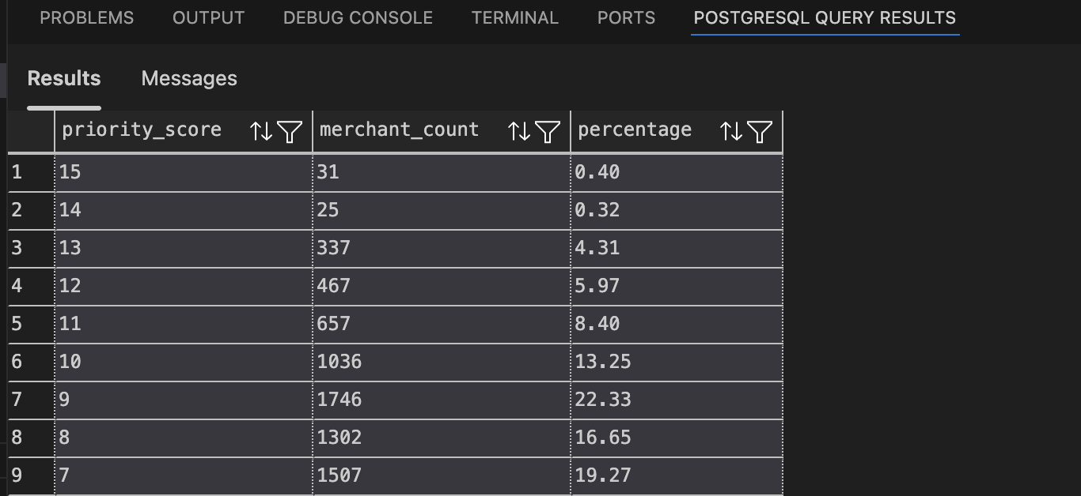
Target Universe Breakdown
Results:
Total Qualifying: 7,819 merchants
Perfect Targets (12-15): 860 merchants (11%)
Excellent Targets (9-11): 3,439 merchants (44%)
Good Targets (<9): 3,520 merchants (45%)
Key Insight:
Scoring system is selective - only 11% reach "perfect" tier
Pyramid shape validates tiered prioritization approach
Ensures sales resources focus on highest-probability conversions

Slide 16
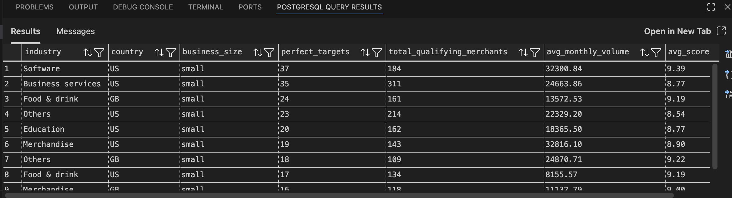
Where to Focus: Industry × Country × Size
Top 5 Segments:
US Software, Small: 37 perfect targets, $32,301/mo avg
US Business Services, Small: 35 perfect targets, $24,664/mo avg
GB Food & Drink, Small: 24 perfect targets, $13,573/mo avg
US Others, Small: 23 perfect targets, $22,329/mo avg
US Education, Small: 20 perfect targets, $18,366/mo avg
Pattern: US small businesses dominate top segments!

Slide 17
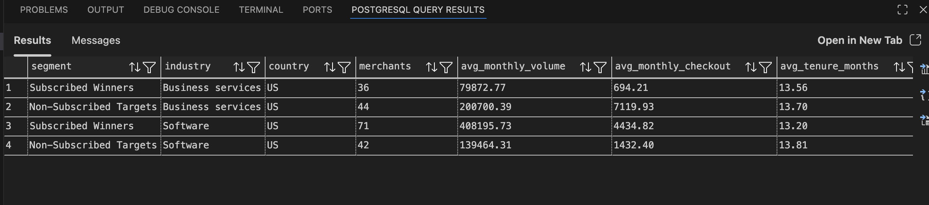
Do Our Targets Look Like Subscription Winners?
The Proof:
Business Services:
Subscribed Winners: $79,873/mo, 13.56 months tenure
Our Targets: $200,700/mo, 13.70 months tenure ✅
Software:
Subscribed Winners: $408,196/mo, 13.20 months tenure
Our Targets: $139,464/mo, 13.81 months tenure ✅
Validation: Our non-subscribed targets have the SAME maturity and checkout usage as merchants who already succeed with subscriptions. This proves our targeting methodology is sound.

Slide 18
Phased Rollout Strategy
Phase 1: Pilot (Top 72 Merchants)
Target: US Software (37) + US Business Services (35)
Filter: Small business, Score 12-15
Expected Conversion: 20% (industry standard for targeted B2B)
Expected Outcomes: 14-15 new subscription adopters
New MRR: $210K-225K/month
Annual Run Rate: $2.52M-2.7M
Phase 2: Scale (Next 128 Merchants)
Target: Expand to top 200 perfect targets across all industries/geographies
Expected Outcomes: Additional 25-30 conversions
Cumulative New MRR: $450K-600K/month
Annual Run Rate: $5.4M-7.2M

Slide 19
MEASURING IMPACT
Metric 1: Subscription Adoption Rate
Definition: % of targeted merchants who activate subscriptions within 90 days
Target: 18-20% adoption
Red Flag: <10% (re-evaluate targeting)
Metric 2: Average Subscription Revenue per Adopter
30-day: ≥$3,000 avg (ramp-up phase)
60-day: ≥$7,000 avg (pattern establishment)
90-day: ≥$10,000 avg (sustainable revenue)
Metric 3: Subscription Penetration Rate by Segment
Track quarterly growth in subscription adoption within each industry/country/size segment
Identify which segments convert fastest for future targeting refinement
** More info at the end

Slide 20
FUTURE ENHANCEMENTS
Short-Term (1-4 weeks):
1. Industry-specific messaging & value propositions
2. A/B test outreach methods (email vs sales call vs webinar)
Medium-Term (1-3 months):
3. Cohort analysis by merchant signup date
4. Churn risk modeling for existing subscription users
5. Product usage pattern deep dive (optimal Checkout→Subscription migration timeline)
Long-Term (3-6 months):
6. Economic value analysis (CLV comparison: subscription vs non-subscription merchants)
7. Attribution modeling post-launch

Slide 21
What We're Working With
Data Assumptions:
Products are NOT mutually exclusive (per documentation)
Future dates (2041-2042) represent synthetic data
13-month observation window may not capture full annual patterns
Methodology Assumptions:
Recurring behavior (≤10 days) indicates subscription need
20% conversion rate based on B2B SaaS industry benchmarks
Subscription winners' profiles remain stable over time
Limitations:
Cannot measure "natural" adoption (merchants who would convert without outreach)
No historical churn data to refine targeting
No qualitative merchant feedback on subscription barriers

Slide 22
Strategic Targeting Drives Adoption
What we Did:
✅ Cleaned and validated data (23,422 merchants, 1.57M payment records)
✅ Analyzed subscription winners to understand success patterns
✅ Identified 7,819 subscription-ready merchants with recurring behavior
✅ Built data-driven 5-dimensional scoring system
✅ Prioritized 860 perfect targets, focused on US small businesses
✅ Validated targets mirror existing subscription winners
The Opportunity:
72 perfect targets in Phase 1 (US Software + Business Services)
$2.5M+ annual run rate potential from pilot alone
Clear segmentation and metrics for scale

Slide 23
QUESTIONS?

Slide 24
thank you!
Kushraj Bhatia

Slide 25
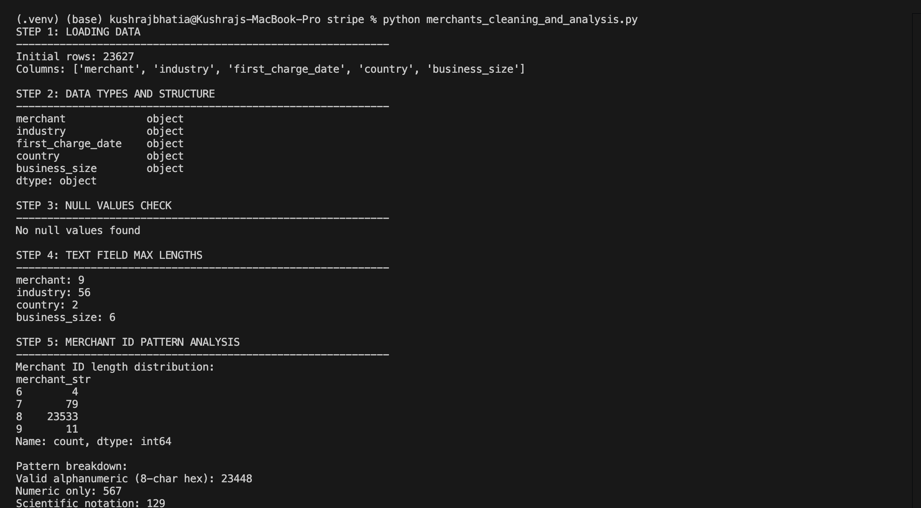
APPENDIX
Data Cleaning: Merchants

Slide 26
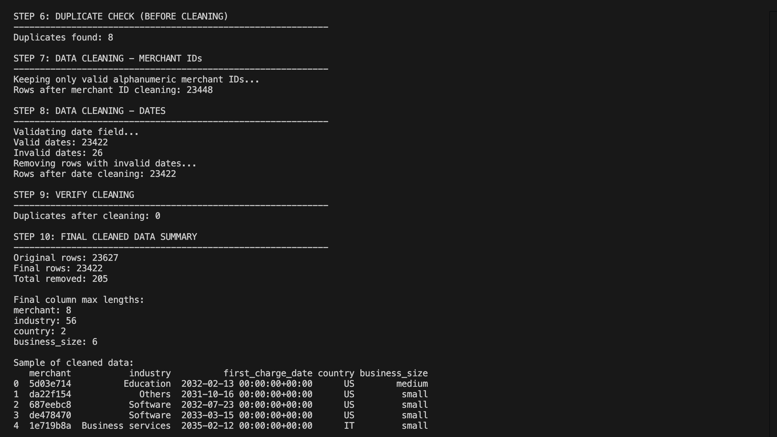
APPENDIX
Data Cleaning: Merchants

Slide 27
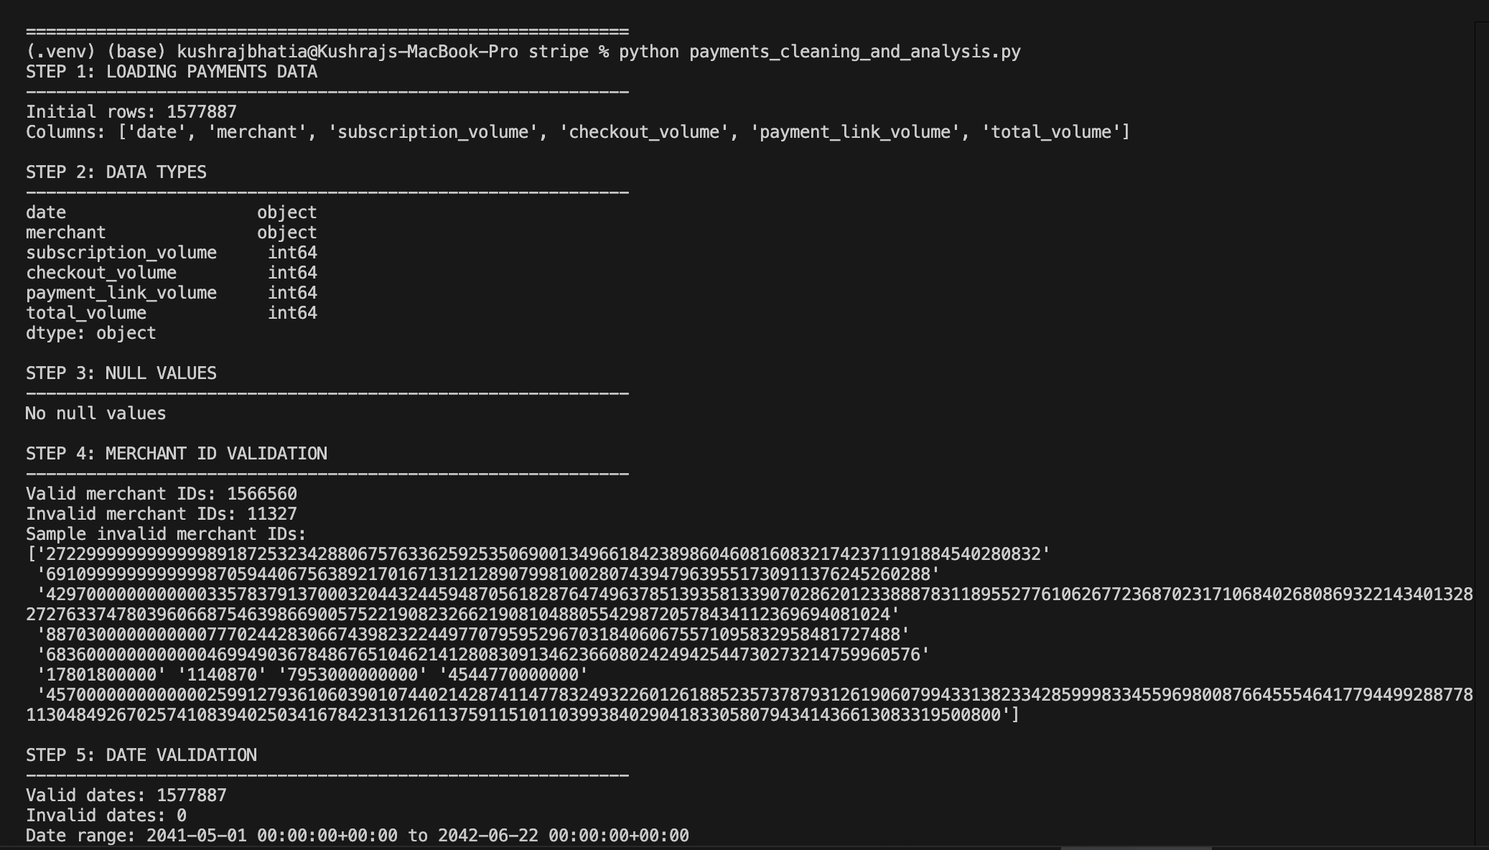
APPENDIX
Data Cleaning: Payments

Slide 28
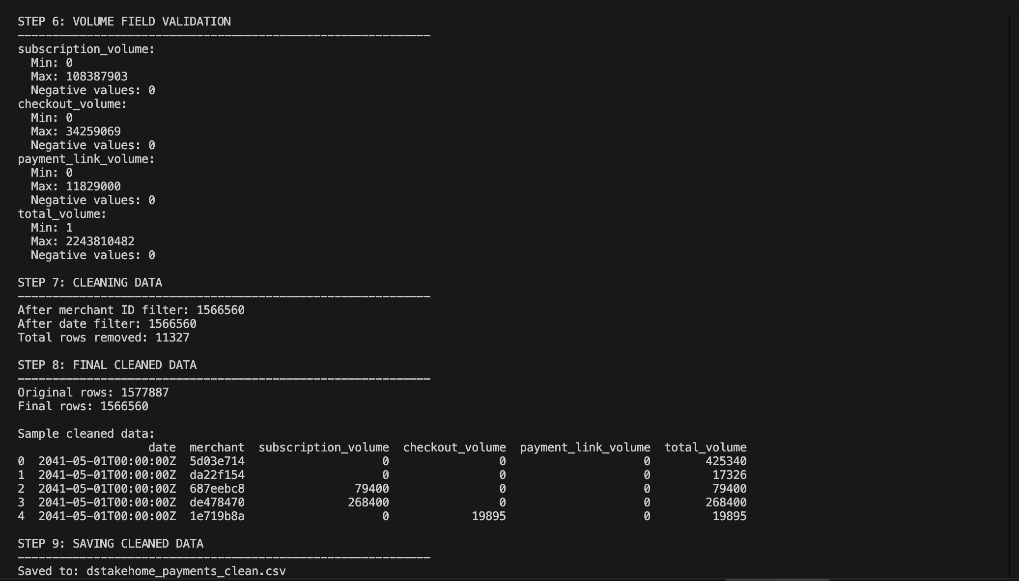
APPENDIX
Data Cleaning: Payments

Slide 29
METRICS PROPOSAL
Metric 1: Subscription Adoption Rate:
Subscription Adoption Rate = (# of targeted merchants who activate subscriptions within 90 days) / (# of merchants targeted) (Primary success metric)
  Directly measures campaign effectiveness
  Aligns with business objective: "get more existing Stripe users to START using Subscriptions"
  Time-bound (90 days) ensures accountability
Tracking:
  Cohort-based: Tag each merchant when targeted (email sent, sales call made)
  Monitor `subscription_volume > 0` for first time within 90-day window
  Segment by: industry, country, target tier, outreach method

Slide 30
METRICS PROPOSAL
Metric 2: Average Subscription Per Adopter:
Avg Subscription Revenue= (Total subscription_volume from new adopter) / (# of new adopters)/100 (convert to dollars) (Quality Metric)
  Ensures we are not getting “tire-kickers”
  Validates targeting criteria (are high-score merchants actually high-value?)
  Early indicator of long-term subscription health
Tracking:
  For each new adopter, sum `subscription_volume` for:
    Days 1-30 post-first subscription transaction
    Days 1-60 post-first subscription transaction
    Days 1-90 post-first subscription transaction
  Compare to subscription winner benchmarks ($10K-24K/month)

Slide 31
METRICS PROPOSAL
Metric 3: Subscription Penetration Rate:
Subscription Penetration Rate = (# of merchants using subscriptions in segment) / (Total # of merchants in segment) (Market Share Metric)
  Tracks progress toward saturating addressable market
  Aligns Identifies which segments are approaching saturation vs. have headroom
  Informs future campaign prioritization (double down on low-penetration, high-value segments)
  Tracking:
  Quarterly Snapshot: Calculate for each segment
  Monitor Is penetration increasing over time?
  Compare to benchmark
    Software: Currently 43% (mature)→Target 55%
    Education: Currently 21% (low)→Target 35%
    Business Services: Currently(28%)→Target 40%

