Slide 1
Amazon Web Services Identity Access Management (IAM) Console
Jonathan Hernandez
IS607 Fall 2016 Semester

Slide 2
Introduction
The AWS IAM console is a feature of AWS that lets users add, modify and view users, groups, roles, policies, account settings and credential reports.
The AWS IAM user/administrator can control who has access to what be it a EC2 instance, s3 bucket, billing etc.
Access to the IAM console should be limited to account administrators or super users of your AWS environment and access should be provided with proper security and caution.

Slide 3
AWS Users
To be able to access the AWS environment for your specified account number, you need to setup users in AWS IAM to even log in to your Cloud.
The way you do this is by adding users (duh).
In this case, I have a AWS environment and as root, I will add users by going to All Services → Security, Identity & Compliance → IAM

Slide 4
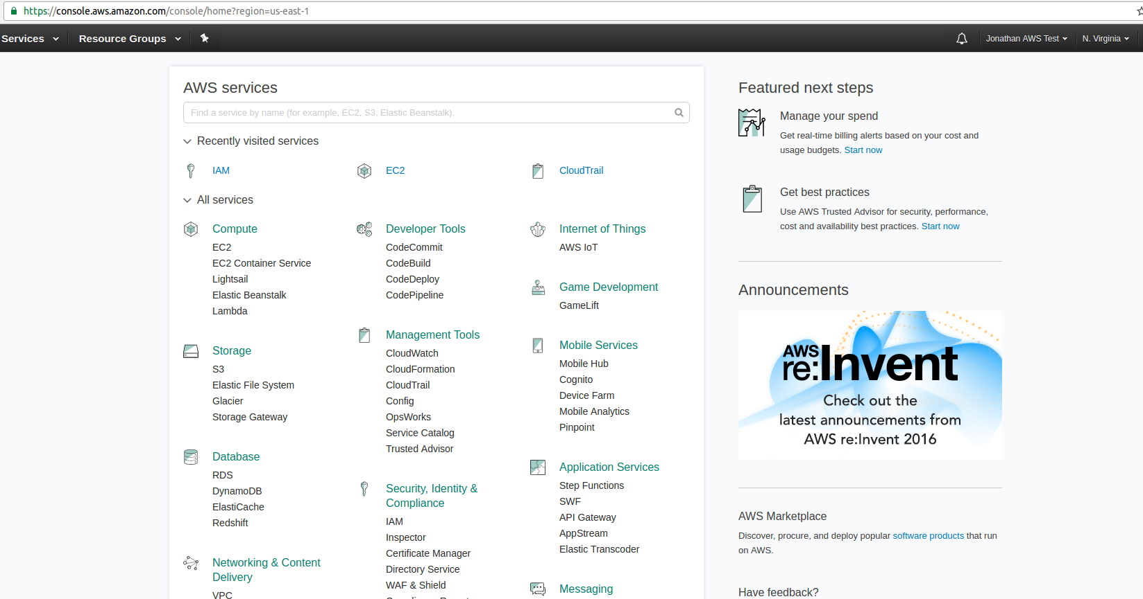
The AWS Console

Slide 5
AWS Users
When you go to the users page, you’ll see all the list of users, number of groups, if they have a password, last sign in, access keys, creation time.
To add a user, click “Add user”. Select the username, type of access (password or access keys or both)

Slide 6
AWS Users (continued)
You can then choose to add them to a group or create a new group for them to be in if you like.
Cloning other user permissions is also allowed in the 2nd step and attaching policies is also doable.
Review your steps and once everything is verified, click create user to make your account.
The information will show you in the complete step the user(s) you created, the passwords, access keys and an option to send emails to the user.

Slide 7
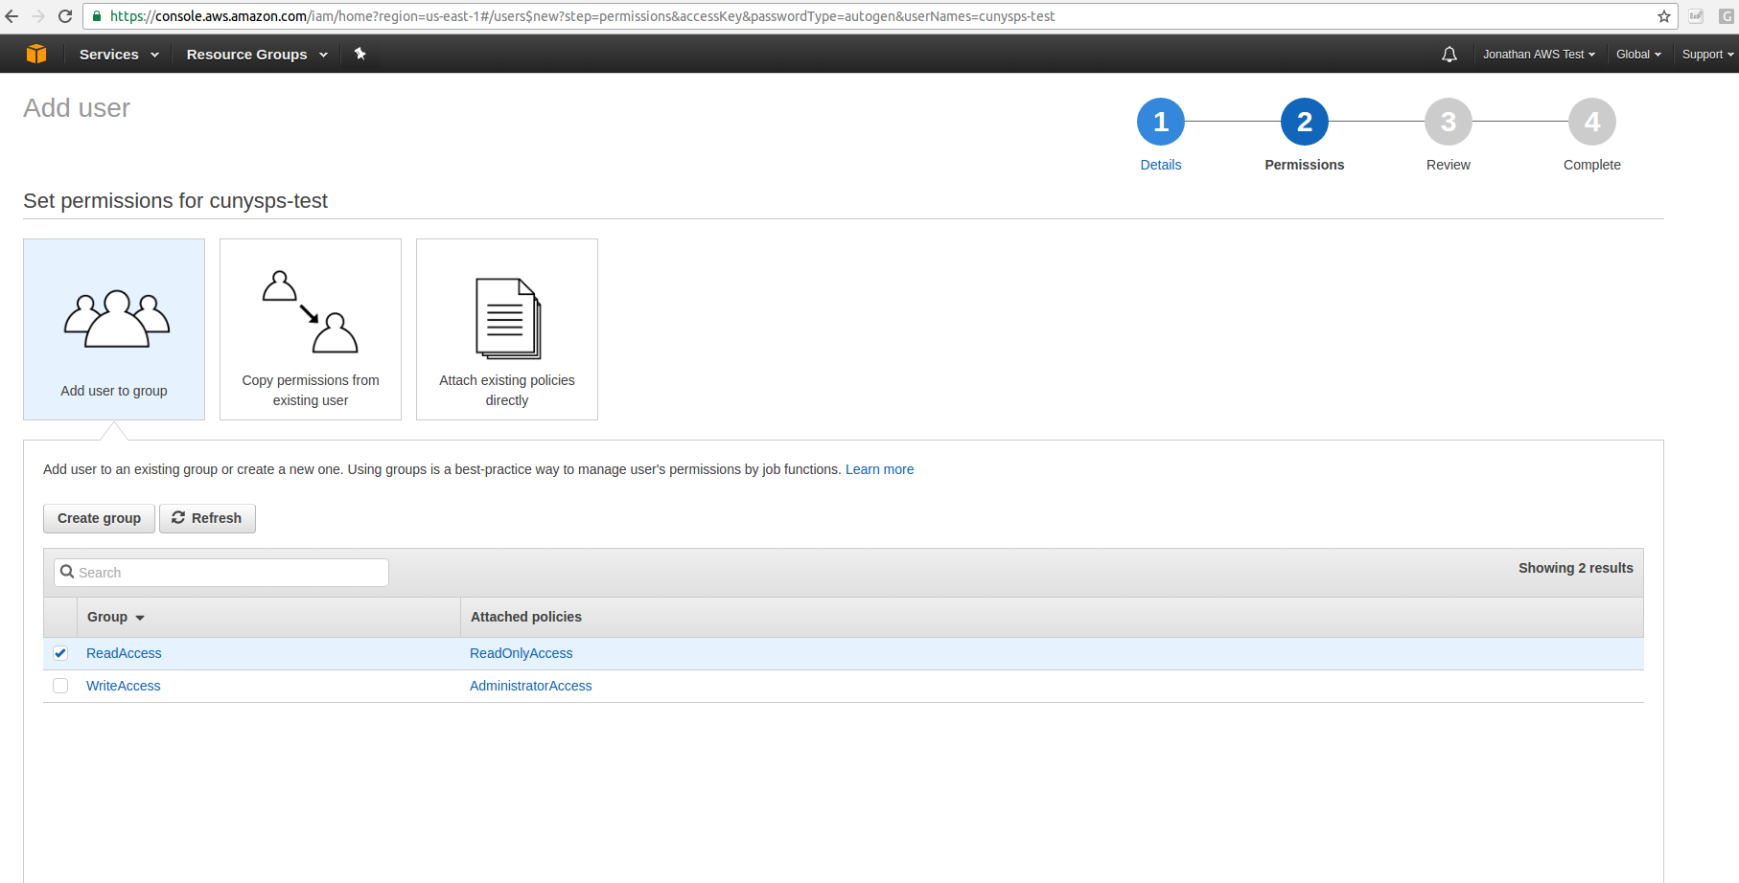
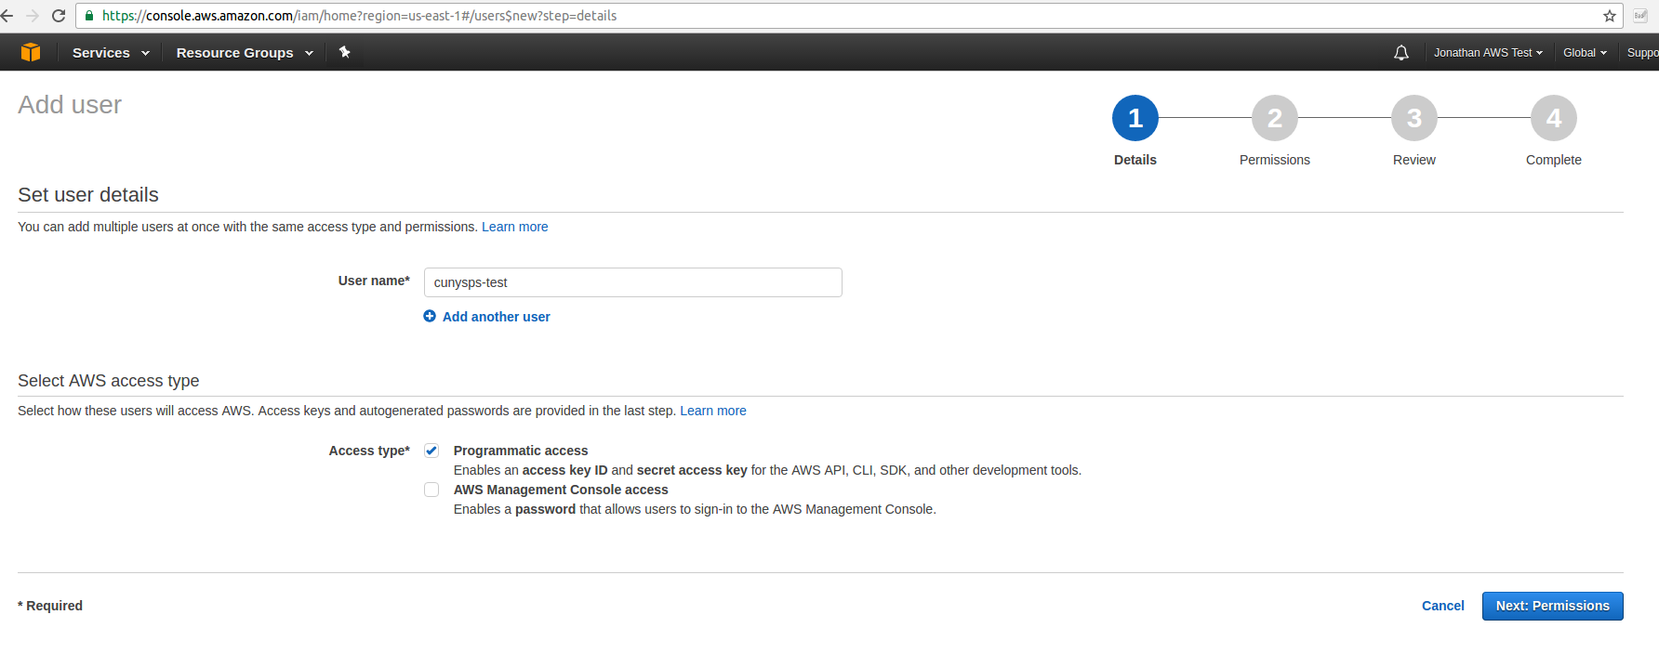
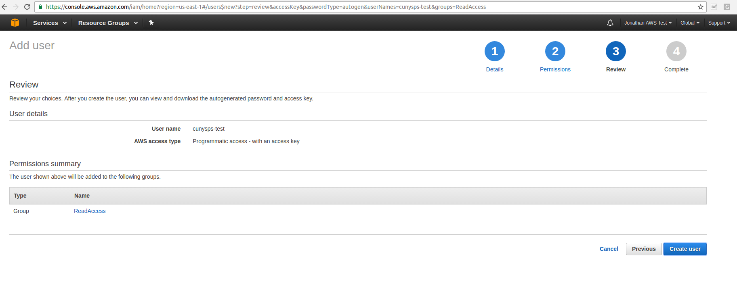
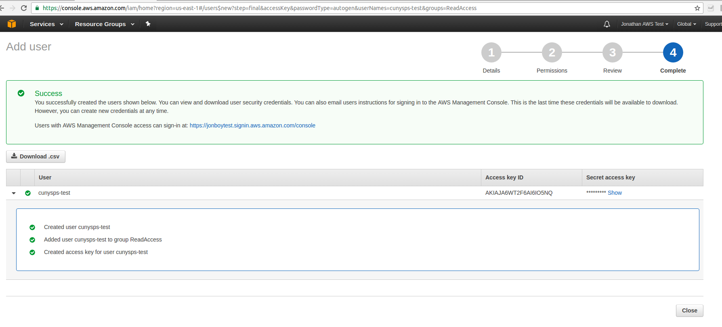
AWS Users Step-by-Step

Slide 8
AWS IAM Groups
AWS IAM groups are collection of IAM users. Groups are better suited for when you want several users to have access to a particular AWS item. If something has to change for all users, having them in groups can make it easier rather than operating on all AWS users.
An example would be adding a group for all users to have full access to s3 or read-only access to AWS ec2.
Groups can have policies attached to them governing the type of access users in that group can have.

Slide 9
AWS IAM Groups (Continued)
To add a user to a AWS group, go to the groups section, click on “create New Group”
Next, type in the name of the group.
The Attach Policy step is where the permission granting takes place, select the policies you want to attach be it predefined AWS policies or ones you custom-make.
Review the policies and the group name and make sure everything is good before creating your group.
There you have it; your group has been created; you can then modify it and add users to that group.

Slide 10
AWS IAM Policies
AWS Policies are the heart of IAM account administration and are defined by JSON like format.
You can choose to use AWS predefined policies or make your own.
When making your own, AWS IAM lets you either clone a existing AWS policy and then tailor it to fit your needs or has drop down selections to see what to allow and for what service and of course make your own.

Slide 11
When you look at the policy details, you can see the policy document which shows the permission as a JSON like format.
The Attached Entities show which user, group or role has the policy attached.
The Policy Versions show when a policy was updated. (you can only update a policy up to 5 times, otherwise you’ll have to make a new one)

Slide 12
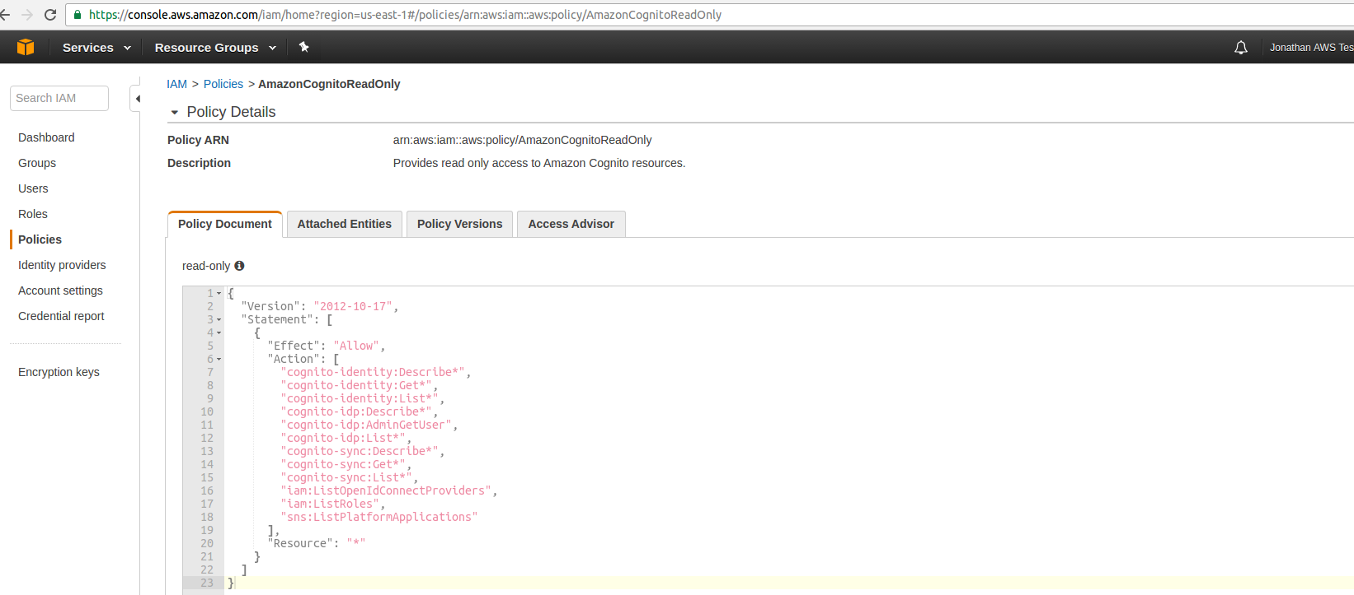

Slide 13
