Slide 1

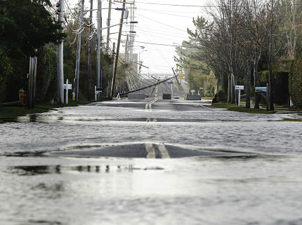
Overview
Wanted to address logistics of repair procedures
Previous literature doesn’t address road network in conjunction with power grid
Need to assess importance of coordinating repairs for effective power restoration

Slide 2
Interacting Networks
Can’t solve together—multiobjective and computationally difficult
Solve roads-> solve power conditional on the road schedule
Solve power with assumed working roads (delay to get roads ahead)
Solve power with assumed damaged roads that aren’t repaired
Solve power without modeling road networks and post process into a feasible schedule

Slide 3
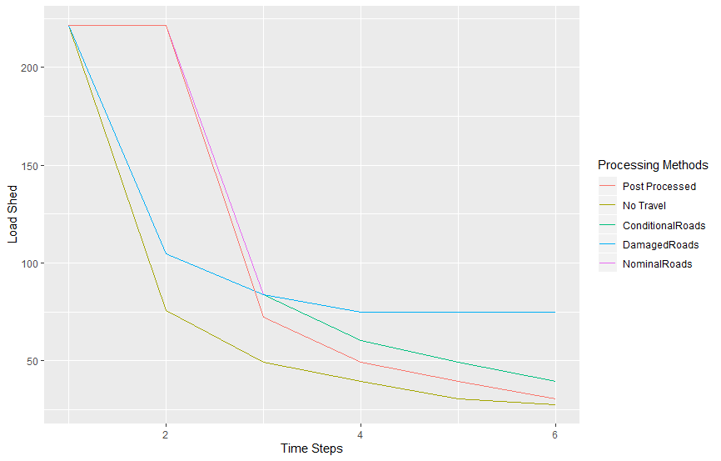
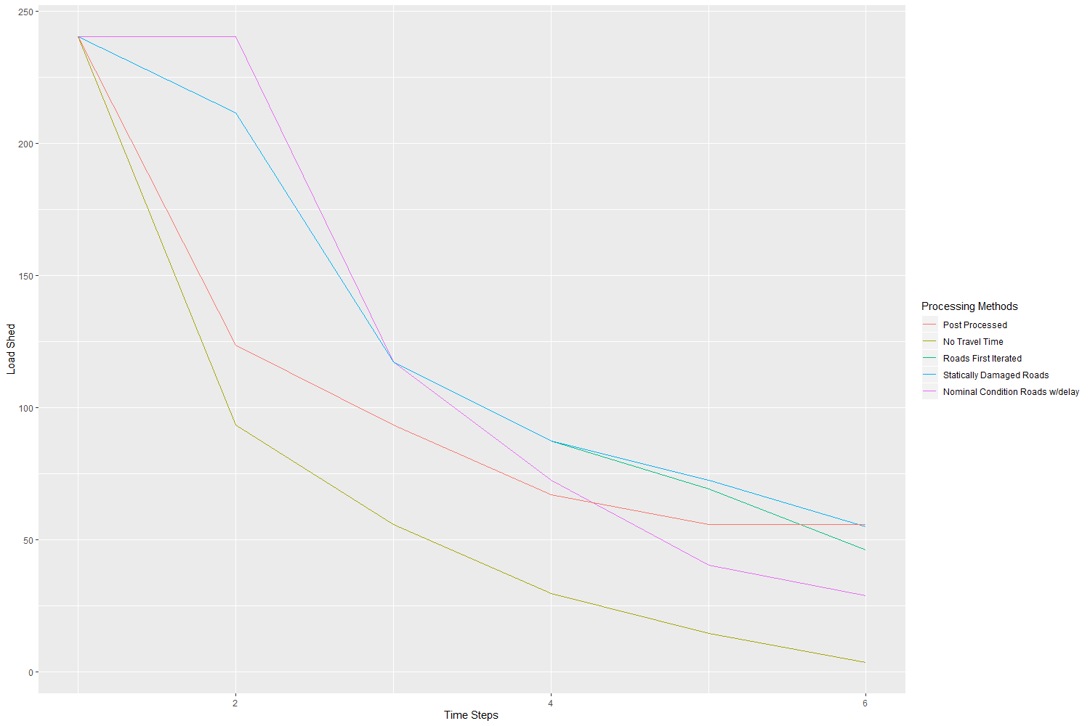
Sample Results of two repair cases on IEEE 30 bus

Slide 4
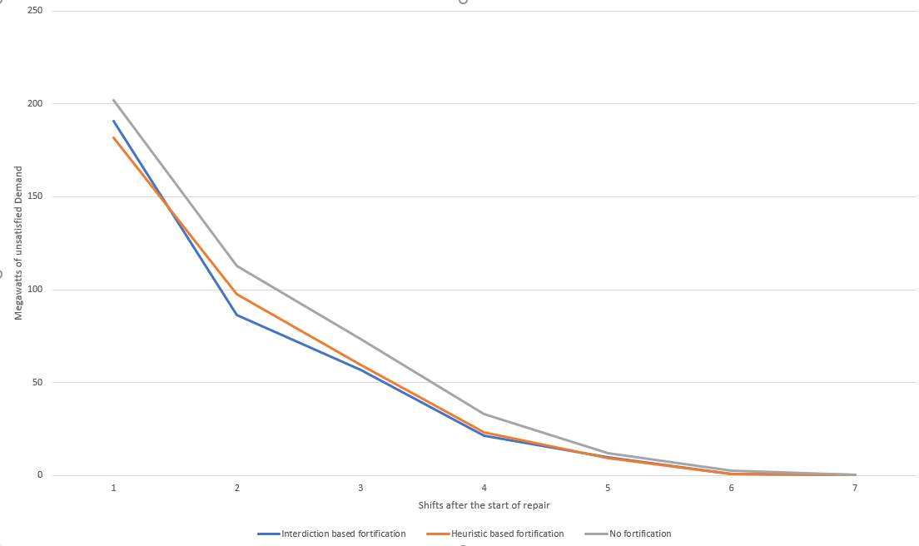
Resilience with Repair
Resilience based on hardening power lines and substations
Requires solving interdiction problem to decide fortifications
Compare to heuristics
Use repair curve to assess impact rather than just initial loss of power service
Useful to plan long term resilience

