Slide 1

February 2020
Joint repair of power and road networks
Brian French
Grad Student, The University of Texas at Austin

Slide 2

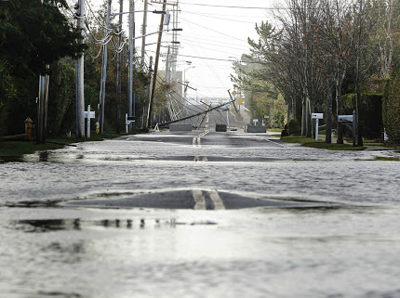
Background
Wanted to address logistics of repair procedure
Previous literature doesn’t address road network in conjunction with power grid
Need to coordinate repairs for effective power restoration

Slide 3
Existing Literature
Based in interdiction modeling of damaged DC grid (Salmeron & Wood ‘04)
Power repair with routing elements (Bent, Van Hentenryck, and Coffrin ‘11)
No current literature considers interaction between road repair and power repair

Slide 4
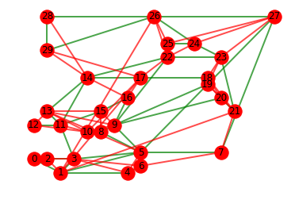
Modeling the power grid
Using DC approximation—linear program
IEEE standard grids 30 and 57 bus
Roads modeled with an overlaid Watts-Strogatz network
IEEE Bus 30 in green with roads in Red

Slide 5
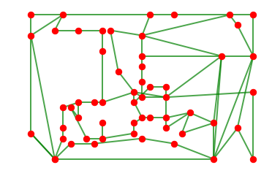
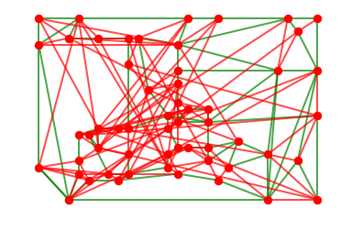
57 bus shown with and without roads

Slide 6
Modeling logistics (Road)
Solve a routing problem at each shift to find path of roads to clear
Clearing represents digging drainage for light flooding and clearing debris
Goal is to maximize length of usable road
Variation of the rural postman problem

Slide 7
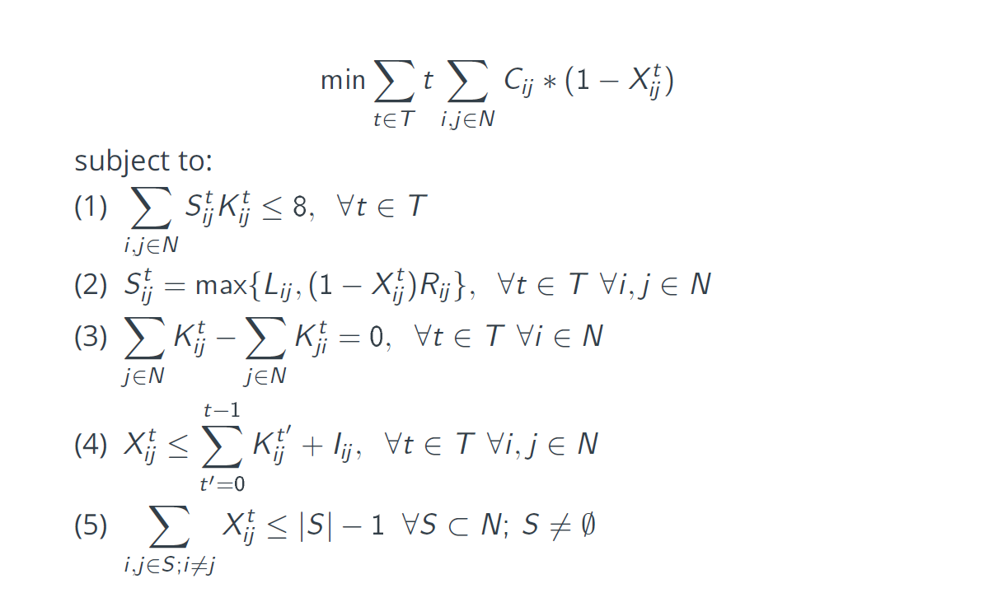
Road Model
Objective: minimize time weighted length of non-functional road subject to:
Each route has to be less than the 8 hour shift length
The length of a road depends if it’s been cleared or not
Tours have to be connected
A road can only be marked as cleared if it’s been cleared or it started cleared
No subtours

Slide 8
Modeling Logistics (Power)
Maximize Satisfied demand
Subject to viable schedule for the shift of repair operations
DCPF model for power flow
Approximation using spanning tree for routing for the sake of runtime
State of the road network is an input to the model

Slide 9
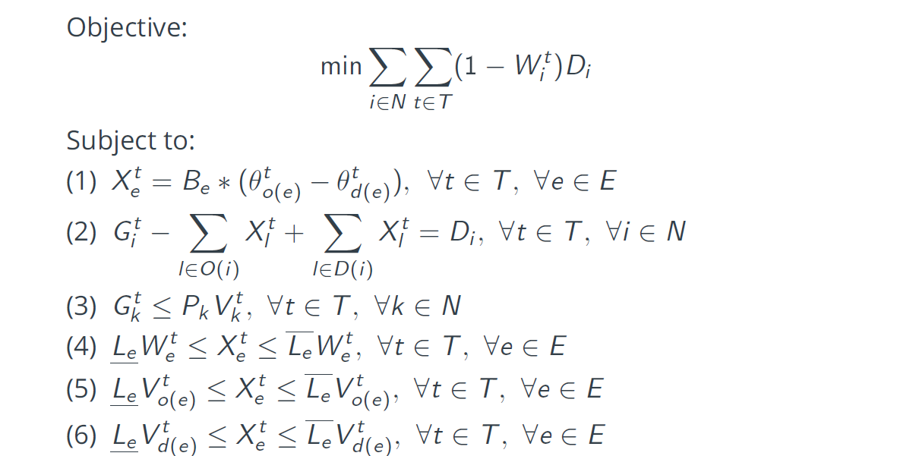
Power Model
Objective: Minimize unsatisfied demand
Subject to
Phase angle DC approximation
Flow balance at each node
Generation limits
4-6) line limits

Slide 10
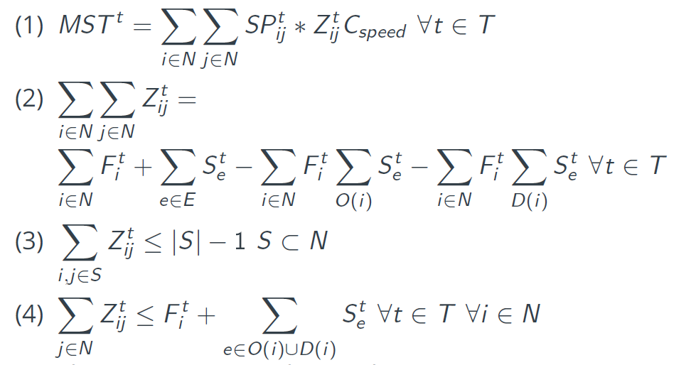
Power model continued
Subject to:
Defines the length of a minimum spanning tree
Dictates the number of elements in the minimum spanning tree based on planned repairs
No subtours in the tree
A node can only be in the tree if there’s a repair going on at that node

Slide 11
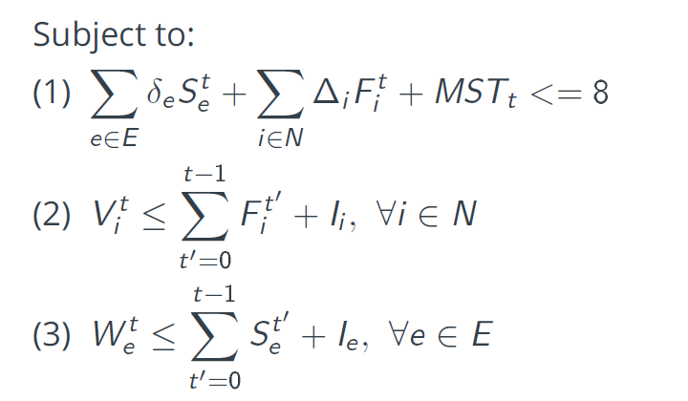
Power Model (continued)
1)Schedule for repairs has to fit in the shift
2) A node can only be marked as working if it’s been repaired or it was working at the start
3) A line can only be marked as working if it’s been repaired or it was working at the start

Slide 12
Interacting Networks
Can’t solve together—multiobjective and computationally difficult
Solve roads-> solve power
Solve power with assumed working roads (delay to get roads ahead)
Solve power with assumed damaged roads
Solve power without modeling and post process

Slide 13
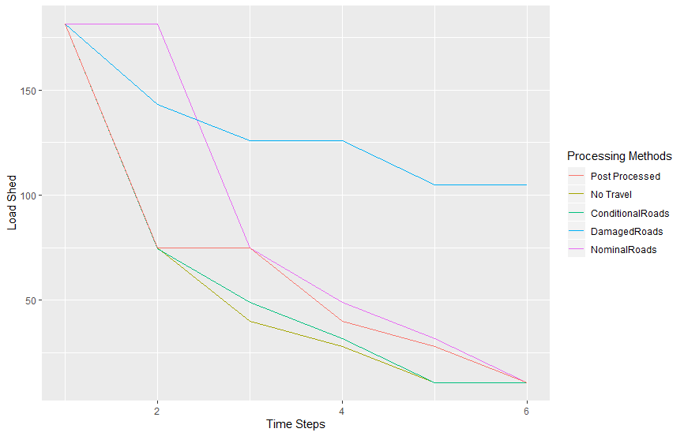
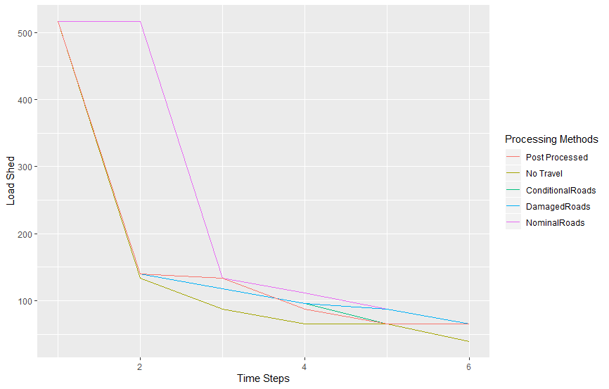
Sample Results

Slide 14
Next Directions
Resilience based on hardening lines
Requires solving interdiction problem to decide fortifications
Microgrid impacts on repair
Stochastic optimization based on real topology/hurricanes

