Slide 1
Capstone Project
Predicting 10-Year Risk of Coronary Heart Disease
BY
IBUKUNOLUWA JOHNSON

Slide 2
TOP PERFORMERS
FEATURES
NEXT STEPS

Slide 3

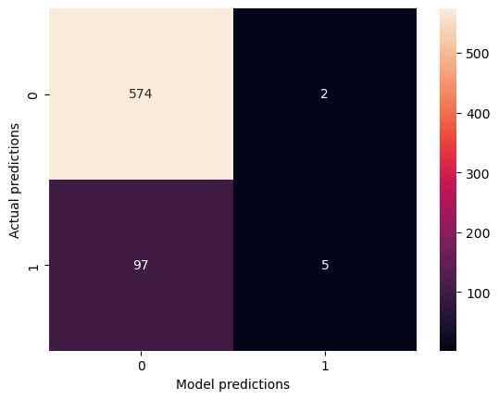
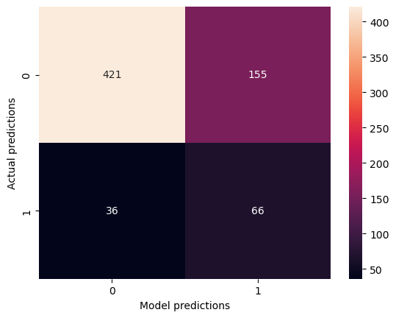

MODEL EVALUATION
Post-tuning
TOP 13 FEATURES ONLY
BASELINE
85% accuracy
71% PRECISION, 5%RECALL (POSITIVE CASES)
correctly IDENTIFIES most non-CHD cases but performs poorly in detecting CHD cases
72% accuracy
30% PRECISION, 65%RECALL (POSITIVE CASES)
performs better at DETECTING CHD cases
74% ACCuracy
31% PRECISION, 60%RECALL (POSITIVE CASES)
HAS MORE BALANCE TOWARDS DETECTING CHD AND NON-CHD CASES

Slide 4
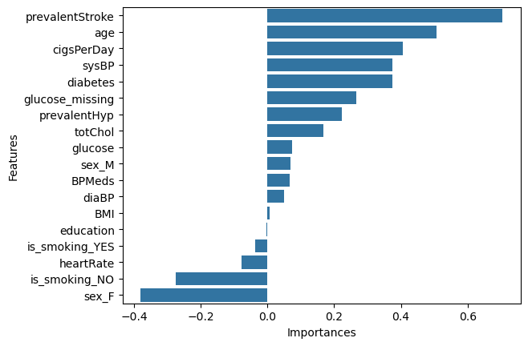
FEATURE RANKING
History of stroke, age, rate of smoking, blood pressure and diabetes are the major features affecting prediction of 10Year CHD risk in the model
Top features needed for overall prediction

Slide 5
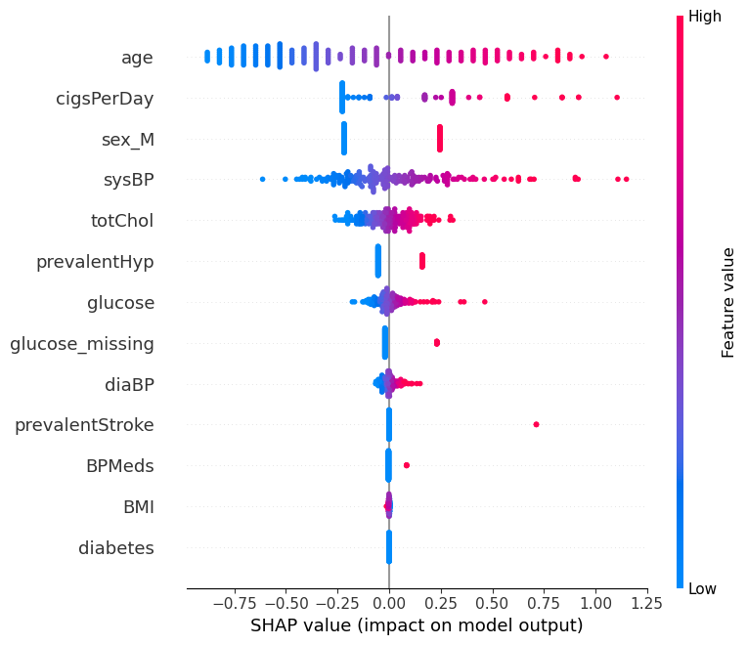
FEATURE EFFECT ON MODEL OUTPUT
Older people are at higher risk of CHD
Elevated smoking rates, blood pressure, cholesterol and glucose increase the average person's risk of CHD.
Use of blood pressure medication is associated with a higher risk of CHD
Individuals with history of stroke or hypertension have an increased risk of CHD

Slide 6
Next Steps
Possible improvements (e.g., feature engineering, model ensembling)
Deployment via API, dashboard or embedded in communication tools
Data collection for continued learning
THANK YOU

