Slide 1
Section 2 Schema

Slide 2
Salesmen (table)
Employee_id (Primary Key)
Salesperson (Foreign Key)
First_name
Last_name
Manager
Manager_id
Store_location
Team
Phone
Cars (table)
Serial_number (Primary Key)
Weight
Manufacturer
Price
Model_Name
Characterisitics (Foreign Key)
Transactions (table)
Transaction_id (Primary Key)
Salesperson (Foreign Key)
Customer_name
Customer_phone
Transaction_date
Characterisitics(Foreign Key)
One to Many
One to many

Slide 3
Creating Tables -- 1
CREATE TABLE IF NOT EXISTS Salesmen(
Employee_id serial PRIMARY KEY,
Salesperson VARCHAR ( 50 ) UNIQUE NOT NULL,
First_name VARCHAR ( 50 ) NOT NULL,
Last_name VARCHAR ( 50 ) NOT NULL,
Manager VARCHAR ( 50 ) NOT NULL,
Manager_id VARCHAR ( 50 ) NOT NULL,
Store_location VARCHAR ( 50 ) NOT NULL,
Team VARCHAR ( 50 ) NOT NULL,
Phone VARCHAR ( 50 ) UNIQUE NOT NULL
);

Slide 4
Creating Tables -- 2
CREATE TABLE IF NOT EXISTS Cars(
Serial_number BIGSERIAL PRIMARY KEY,
Weight INTEGER NOT NULL,
Price INTEGER NOT NULL,
Manufacturer VARCHAR ( 50 ) NOT NULL,
Model_name VARCHAR ( 50 ) NOT NULL,
Characteristics VARCHAR ( 255 ) NOT NULL
);

Slide 5
Creating Tables -- 3
CREATE TABLE IF NOT EXISTS Transactions(
Transaction_id serial PRIMARY KEY,
Salesperson VARCHAR (50) REFERENCES salesmen(salesperson),
Customer_name VARCHAR ( 50 ) NOT NULL,
Customer_phone VARCHAR ( 50 ) NOT NULL,
Transaction_date TIMESTAMP NOT NULL,
Serial_number BIGINT REFERENCES cars(Serial_number)
);

Slide 6
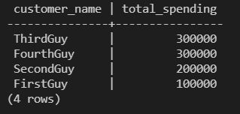
SQL Queries
/* SQL Query 1*/
SELECT Transactions.Customer_name, SUM(Cars.Price) AS Total_Spending
FROM Transactions
INNER JOIN Cars
ON Cars.Serial_number = Transactions.Serial_number
GROUP BY Transactions.Customer_name
ORDER BY SUM(Cars.Price) DESC
;

Slide 7
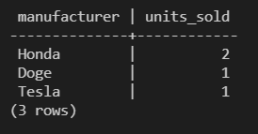
SQL Queries
/*SQL Query 2*/
SELECT Cars.Manufacturer, COUNT(Transactions.Serial_number) AS Units_sold
FROM Transactions
INNER JOIN Cars
ON Cars.Serial_number = Transactions.Serial_number
WHERE Transaction_date >= date_trunc('month', CURRENT_DATE)
GROUP BY Cars.Manufacturer
ORDER BY Units_sold DESC
;

