Slide 1

Data engineering – system design
Section 3 – prepared by chan yao kuan

Slide 2
Background
Company Profile
Main Business : Processing Images
Examples: SenseTime, Descartes Lab, Phillips
Two Separate Web Applications: 1) Collects Images Uploaded by Customers, 2) Provides Stream of images using Kafka stream
Use Case: Save Processed Images for 7 Days + BI Warehouse on Number +Type of Image+ Customer Type

Slide 3
Key concepts of system design
Latency
Throughput
Bandwidth
Vertical , Horizontal, Auto Scaling
Key Reference: https://medium.com/backendarmy/introduction-to-system-architecture-design-fcd4f327b6c9

Slide 4
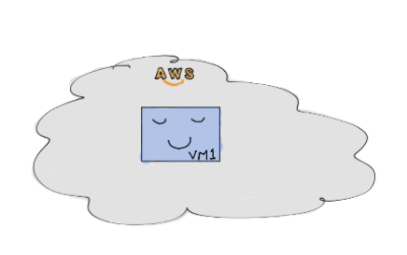
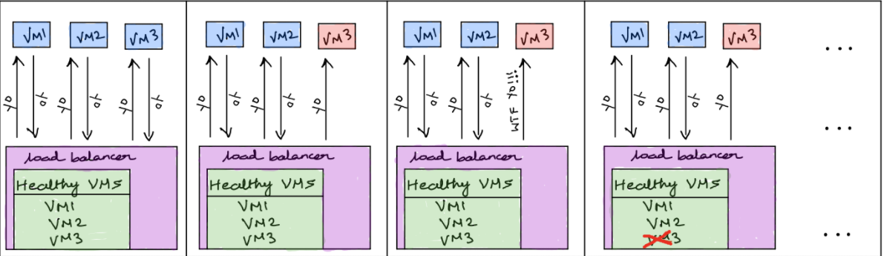
Components
Virtual Machine
Load Balancer
Database
Cache

Slide 5
Database types
Non relational DB
Column Oriented: Cassandra, Clickhouse -> Semi –structured OLAP transactions
Document Oriented: MongoDB -> Schema can change
Graph Oriented: Amazon -> Data represented as nodes
KeyValue Oriented: Redis -> Data stored as hashmaps/dictionaries
Relational DB
Postgres, MySQL, OracleDB

Slide 6
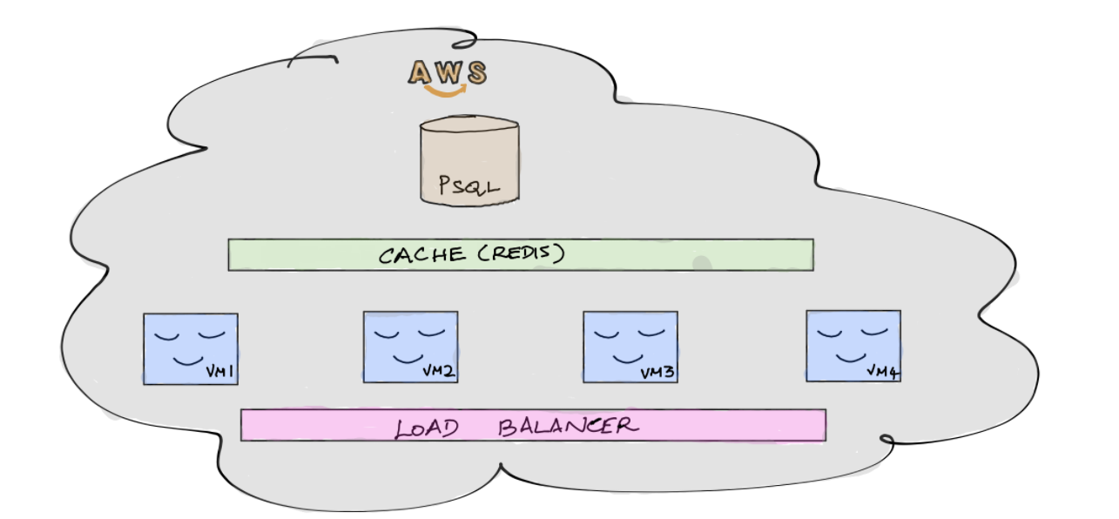
Simplified system design

Slide 7
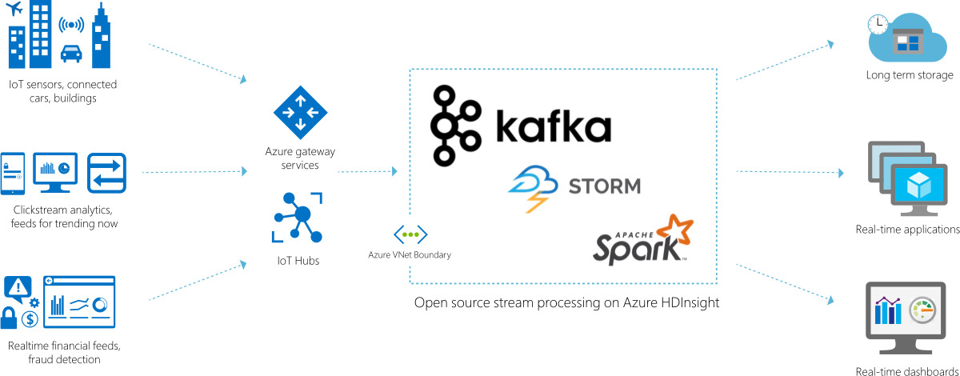
Proposal #1 azure ecosystem
Key Requirements:
Kafka Stream
Non Relational DB
7 Days Archive
BI Warehouse

Slide 8
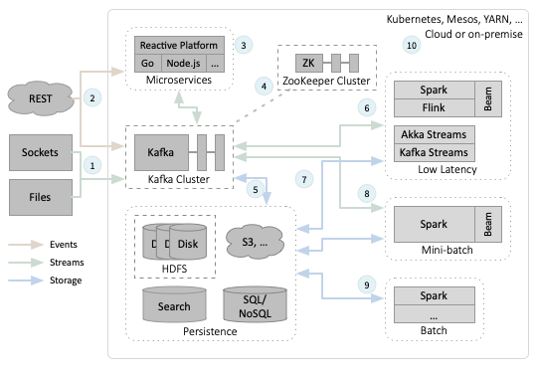
Proposal #2 Apache Ecosystem
Key Technologies:
Apache ZooKeeper
Apache Spark
Apache Kafka
Kubernetes
Amazon S3

Slide 9
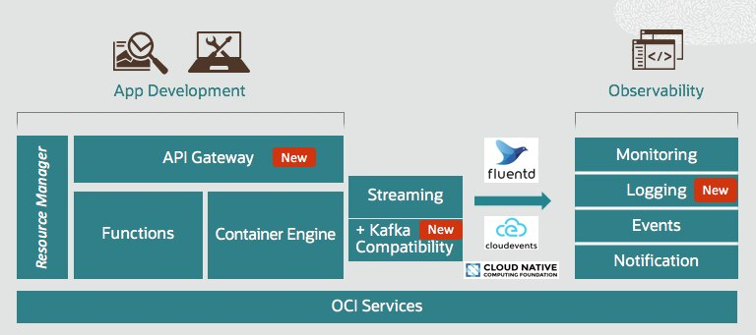
Proposal #3 oracle ecosystem

Slide 10
Assumptions made
Assumption 1: Public cloud is much more cost effective than private cloud.
Assumption 2: The cloud is less expensive than traditional on-premise computing.
Assumption 3: The only way to be in the cloud is to have applications built natively for the cloud.

Slide 11
Conclusion
For the use case at hand: Recommendation for Proposal #1 Using Azure EcoSystem due to the requirements posted, Microsoft has better BI and Analytics Streaming services for Analysis of types and numbers and customers for the company.

