Slide 1

5-Leaf Clover*
Some things just get lost in translation.
*Not as lucky as you'd think.

Slide 2
Overview
Minimize human input to create a dynamic synergy of code. (Just kidding.)
Basic idea: make the computer do most of the work
Use the Java API to our advantage – rather than re-implementing it in C++, we would let our translator translate it into something usable.
When possible, avoid using datastructures to store data – use the call stack to resolve dependencies (when we meet a dependency, resolve it entirely before completing dependent class).
Abstract everything into its smallest parts so that it knows how to take care of itself without outside involvement.

Slide 3
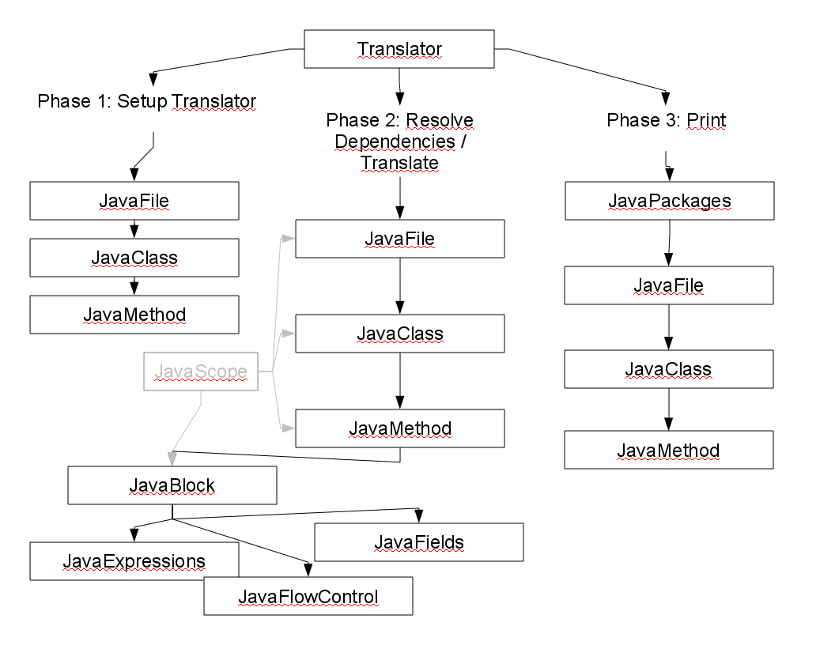
Basic Layout

Slide 4
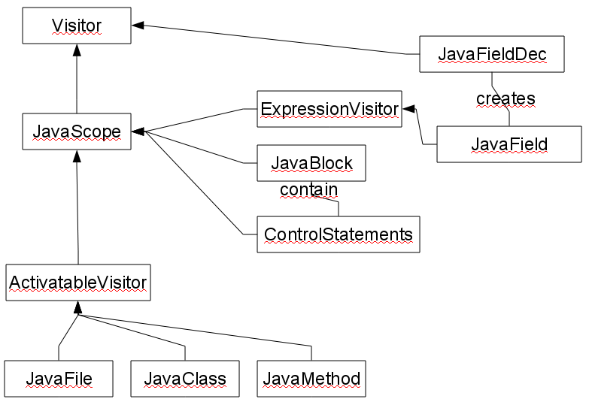
Class Structure

Slide 5
Code Reuse
A synonym for copy-and-paste?
Everything started off great.
...until about 6 days ago...then it hit us that we have a presentation.
Since then, our code has doubled in size.
We found out that JavaExpressions come in all sorts of shapes and sizes.
We found out that coding at 2am always leads to bad decisions.
We found out that Courant is open 24/7.

Slide 6
Code Reuse
A synonym for copy-and-paste?
Dependency resolution is quite hard
Printing is half the battle
Strings really need a replace(String, String) method
ArrayLists works as queues, too.....

Slide 7
The Future
A complete re-write is in the works
Taking everything we noticed about the idiosyncrasies of Java and applying them to some new framework
Get a plan together before we dive head-in.
The hardest part: getting method calls right,

