Slide 1

4-Leaf Clover
Ode to hours of sleep lost:
A tale of translating.

Slide 2
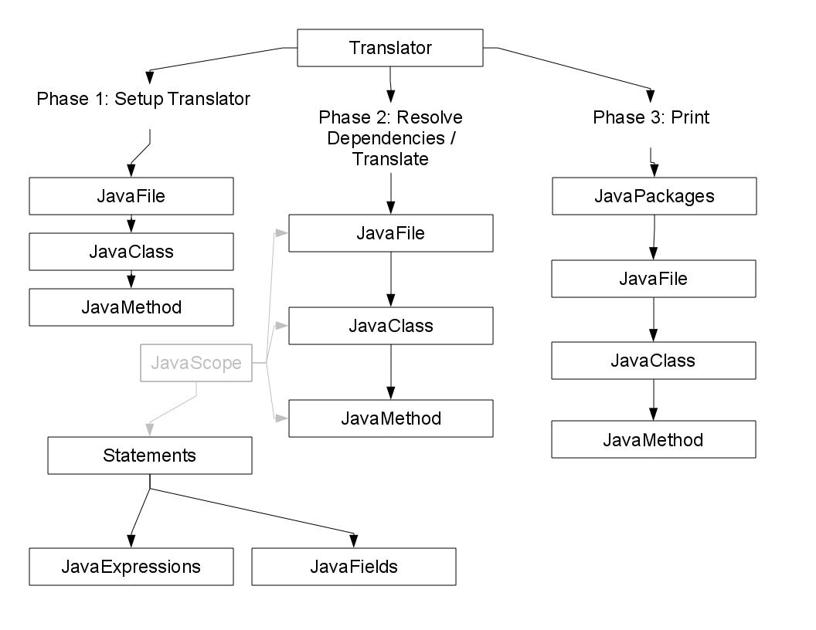
Basic Layout
Our biggest change: We knew where to take it, and we were able to make it much stronger and robust

Slide 3
Object to ∞
Name mangling – overloading methods and field inheritance
Method chaining – you know what this is
Inheritance (it's implied)
Testing – how test cases saved our asses

Slide 4
Trial & Error
Statements: try with finally; jumping declarations in switch
Identifiers and SelectionExpression – best not to see how they're made
SelectionExpression: differences between static accesses in Java and C++
Arrays – built-in support for Java arrays
Garbage collection: __this in constructors
Managing a code base of this size and keeping everything in order was....impossible
gdb – thank you

Slide 5
Cool Extras
Implementation of some standard Java libraries, specifically: ArrayList
main(String[] args)
super()

Slide 6
Demo
What did we get on Grimm's test cases? Just watch!

