Slide 1
Kafka
Thathsara Raviraj

Slide 2
With Org Growth
Your microservices communication get complicated.
At that point it is very hard to handle and maintain the microservices communication.
Their protocol, Data Format and Data Schema are different.
Source System
Source System
Source System
Source System
Source System
Target System
Target System
Target System
Target System
Target System

Slide 3
What Kafka Does
It decouples the systems.
Source System
Source System
Source System
Source System
Kafka – Distributed Message System
Target System
Target System
Target System
Target System

Slide 4
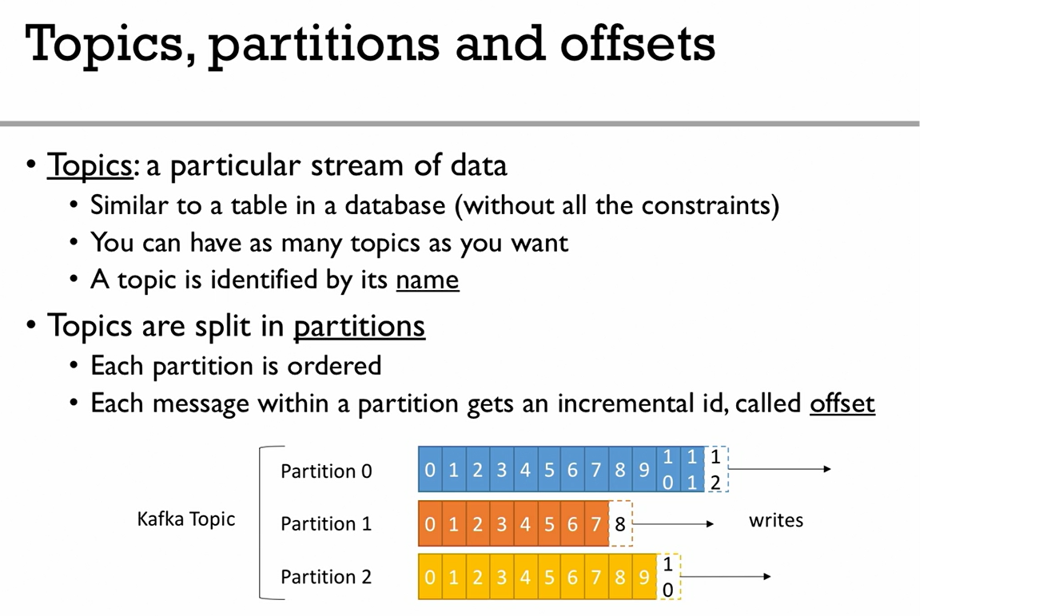

Slide 5
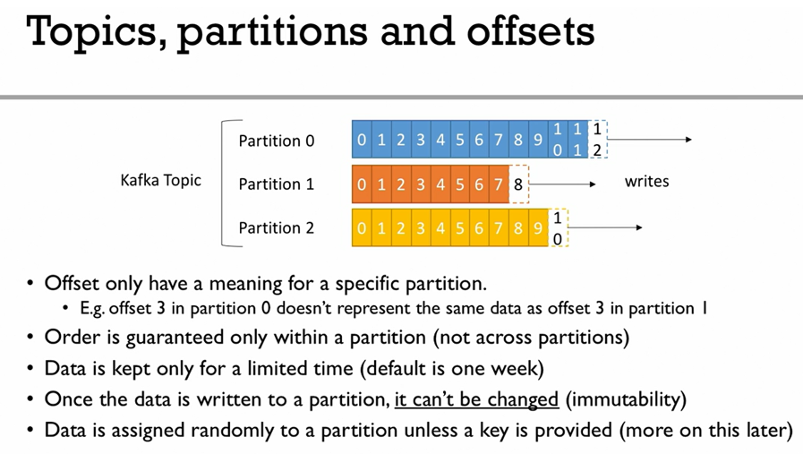

Slide 6
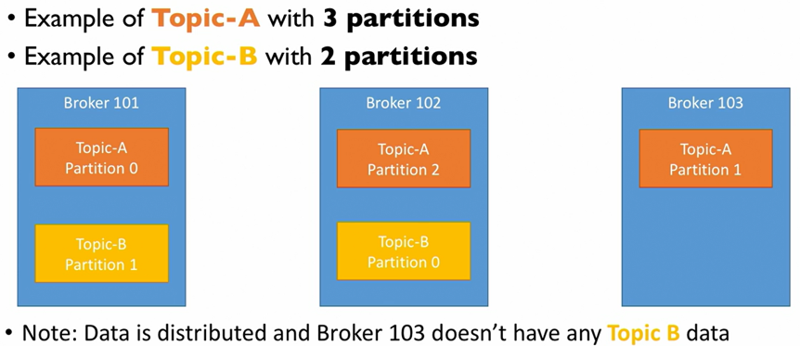
Broker
Kafka Cluster can have multiple brokers.
Each Broker has a identical number.
Each Broker contains certain topic partitions.
When you connected to a broker, you are connected to the entire cluster.

Slide 7
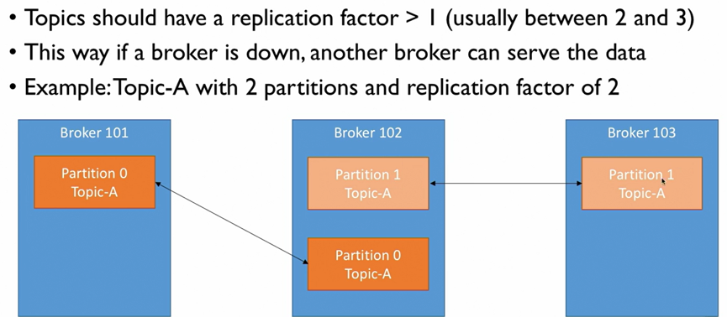
Topic Replication
At a given time, only one broker can be a leader to a given partition. Only the leader will receive and serve data.

Slide 8
Load Balance By Producers
Producers write to topics.
Producer automatically knows which broker and partition to write.
Unless you send a message key (string, number), producer will balance the load with round robin pattern among the brokers. If key is there, all the messages will go to the same partition.
Producer has a Ack mechanism built in.
Ack=0 – producer wont wait for the leader broker’s acknowledgement (possible data loss).
Ack=1 – producer will wait for the leader ack (lesser data loss).
Ack=all – producer wait for both leader and replica ack (no data loss).

Slide 9
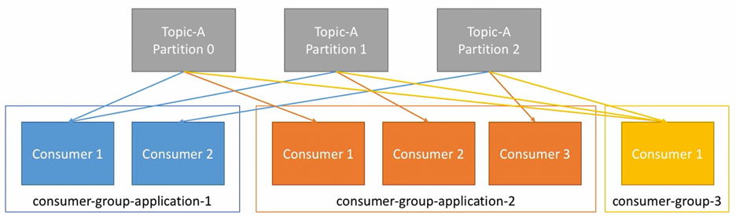
Consumers
Read data from Topics.
Consumer knows which broker to read from.
Data is read in order within each partition (offset order).
Consumers have a group.
Each consumer within a group will read data from exclusive partitions.
If Consumers > Partitions, some consumers will be inactive.

