Slide 1

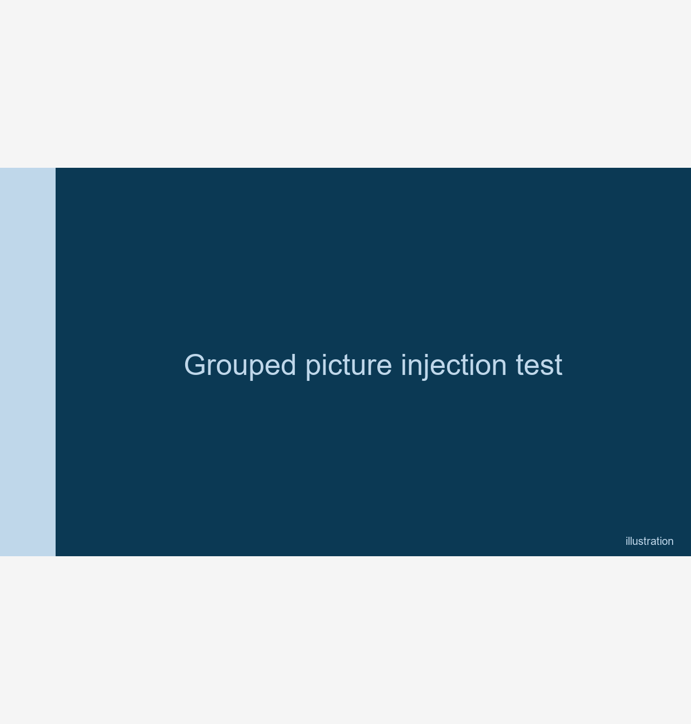

Test
Grouped picture injection test

