Slide 1
slide-deck-composer
A
B
C
A clone-and-inject engine for real .pptx decks, hardened one real bug at a time
This template has been created by Slidesgo

Slide 2
What changed after the first ship
 | 70K years ago | Mercury is a small planet
 | 600K years ago | Earth is the planet with life
 | 2M years ago | Jupiter is a huge gas giant
Grouped shapes: text and pictures nested inside a group are now real, scorable candidates, not invisible
A custom layout: any real template shape becomes usable, not just the 6 named ones
Per-shape font resolution: checks a shape's real font, not just the theme's declared one
Real ECMA-376 schema validation: 24 real XSD files, not 7 self-authored guesses
This template has been created by Slidesgo

Slide 3
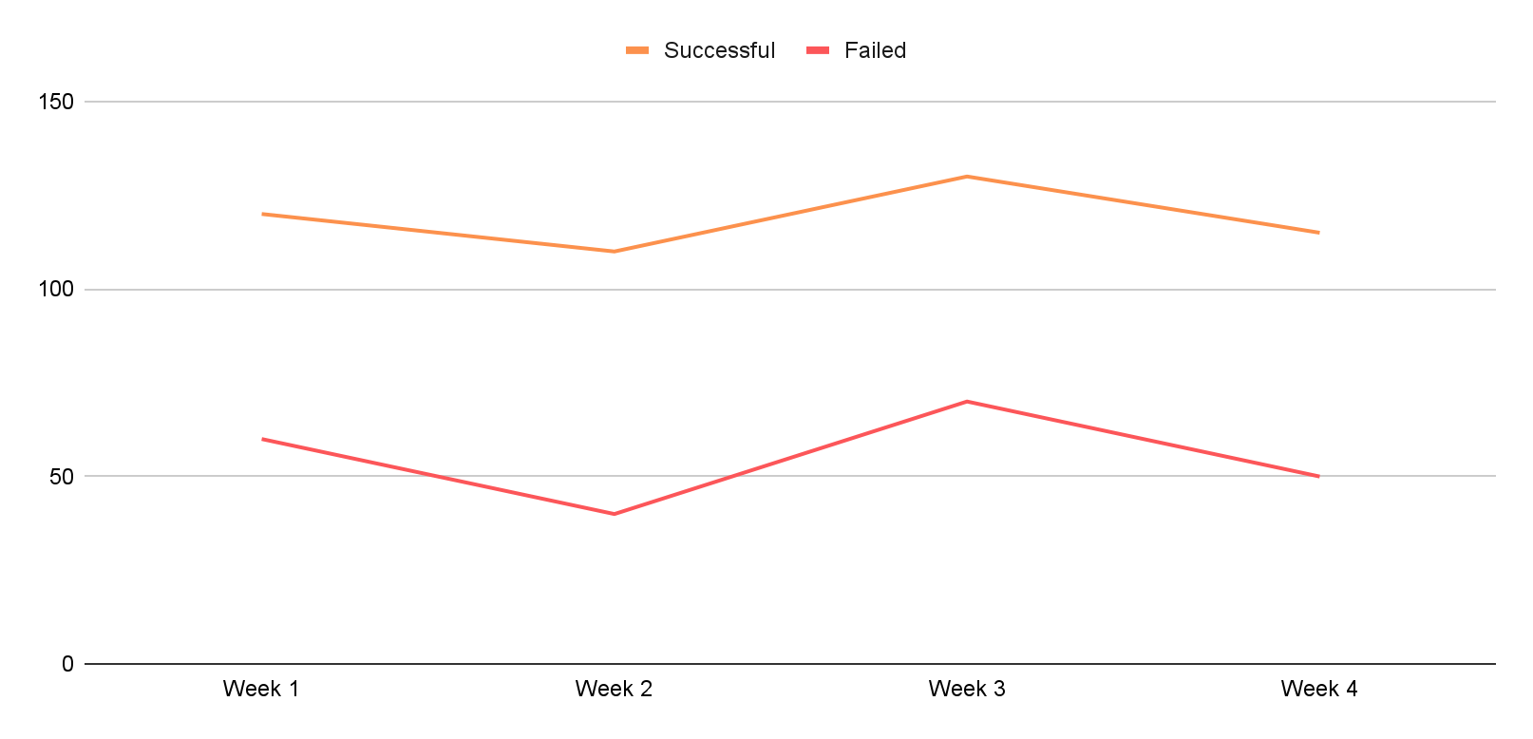
Four rounds, each earning the next
 | Success | Failed
Group A | 75 | 30
Group B | 60 | 40
Group C | 100 | 50
Group D | 90 | 40
Group E | 150 | 60
Four hardening rounds, one real deck compiled and rendered each time
01
02
03
v0.1-0.3: clone-and-inject engine, 6 layouts, Vietnamese font-safety, font-size balancing
v0.4: real OOXML group support -- text and pictures nested in a group finally became visible
v0.5: a cold agent's real client brief found 2 real bugs no self-test had caught
v0.6-0.7: per-shape font resolution, then real ECMA-376 schema validation
This template has been created by Slidesgo

Slide 4
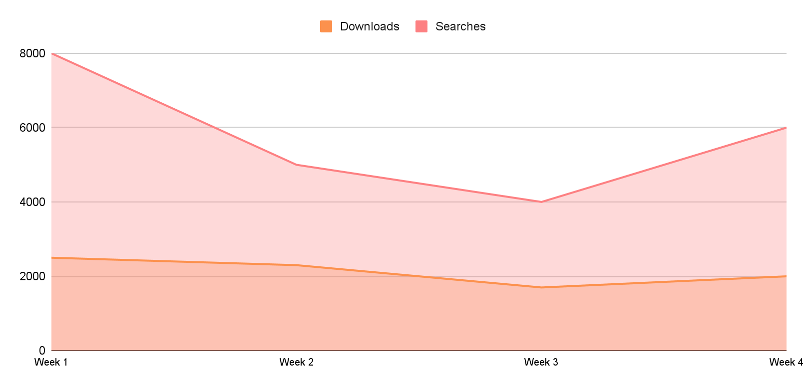
Every number here is real
Layout types available
Real bugs found and fixed
Schema checks passed
Templates in the test corpus
7
13
24/24
149
+1 custom
3 rounds
0 false positives
real files
Grouped shapes were invisible to this engine until v0.4 -- real templates hide content in them
A cold agent chose the custom layout for 5 of 9 slides on its first real client brief
Font safety used to check only the theme -- a real template's font hid one layer deeper
Every fix here was verified by rendering the output, not by trusting a clean report
This template has been created by Slidesgo

Slide 5
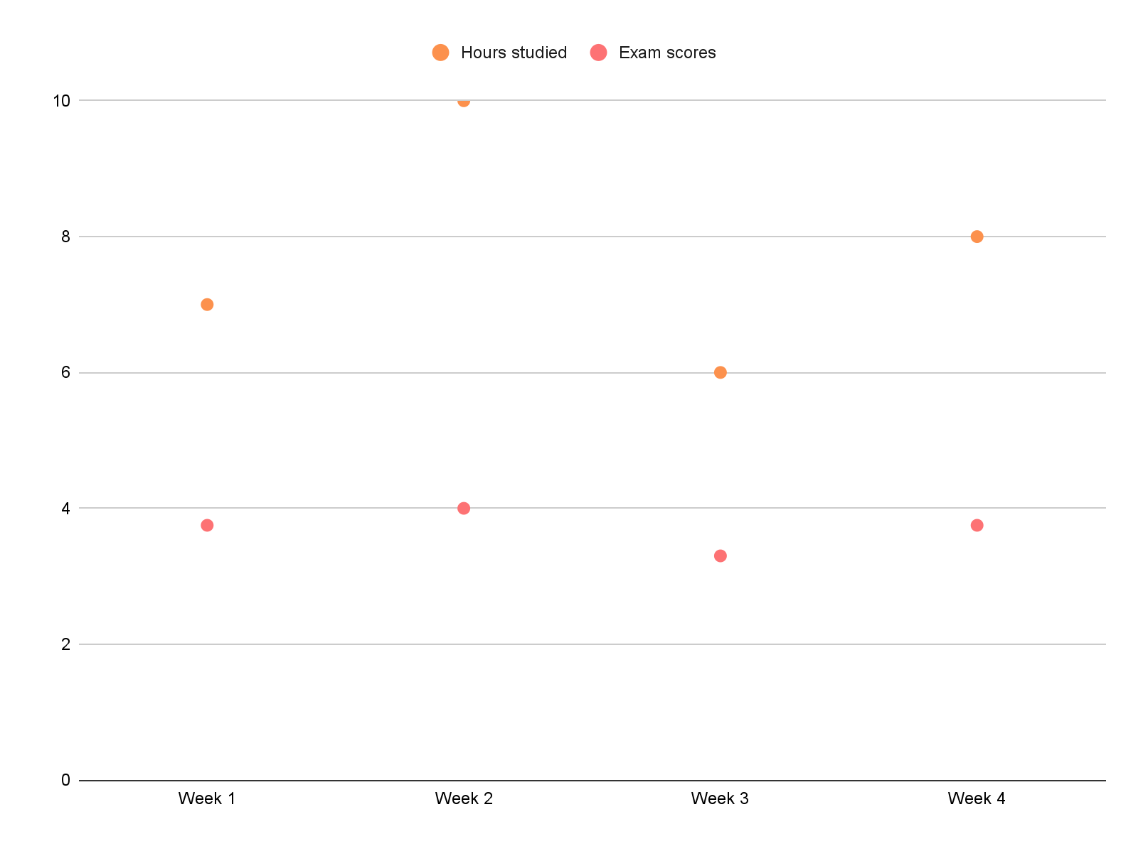
Two things this build got right
Verify before trusting
Every claim in this deck was rendered and looked at, not assumed from a JSON report
A cold agent with a real brief found two real bugs no self-test caught
Infrastructure, not judgment
A thumbnail grid, not a heuristic guessing the right slide
shape_roles scores real geometry; the agent decides which slide actually fits
This template has been created by Slidesgo

Slide 6
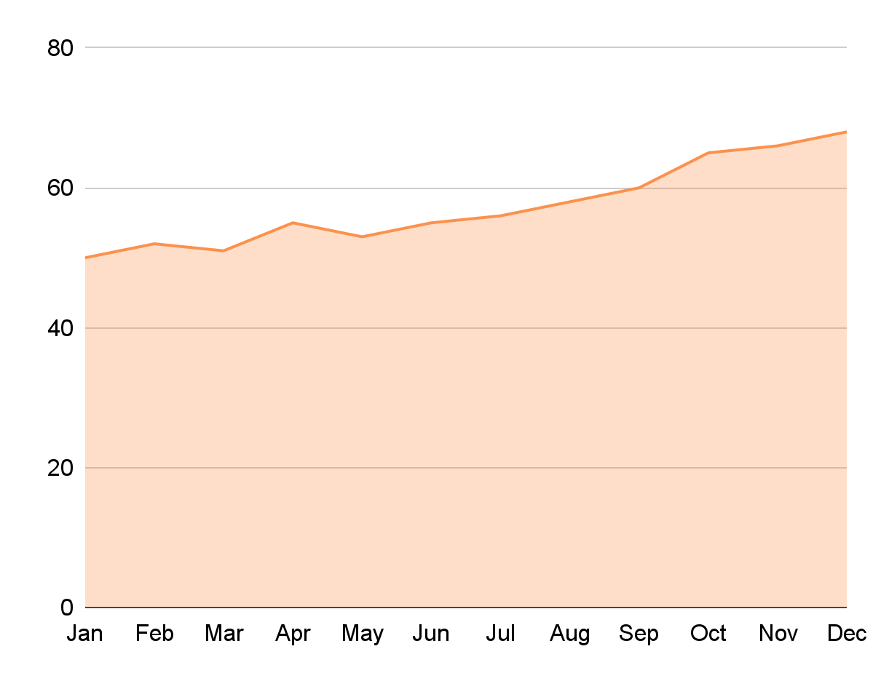
One working, audited skill beats ten unused ones in the registry
 | Our company | Competitor
Product service | Eco-friendly | Smart features
Market share | 25% regionally | 40% nationally
Growth | 18% growth | 12% growth
Target audience | Homeowners | Tech-savvy
Marketing | Digital campaigns | TV ads
CSAT | High satisfaction | High satisfaction
Strengths | Brand loyalty | Established brand
Weakness | Limited product | Higher pricing
This template has been created by Slidesgo

Slide 7
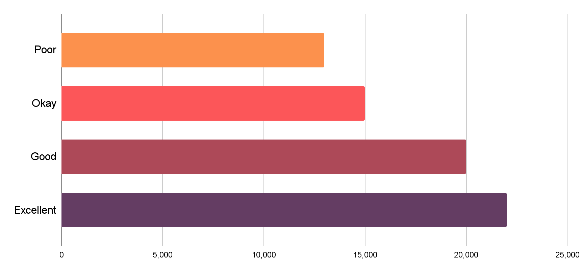
What's next
Poor
Okay
Good
Excellent
Layout coverage for stat callouts and icon grids -- now that custom has proven exactly where the real demand is
This template has been created by Slidesgo

