Slide 1
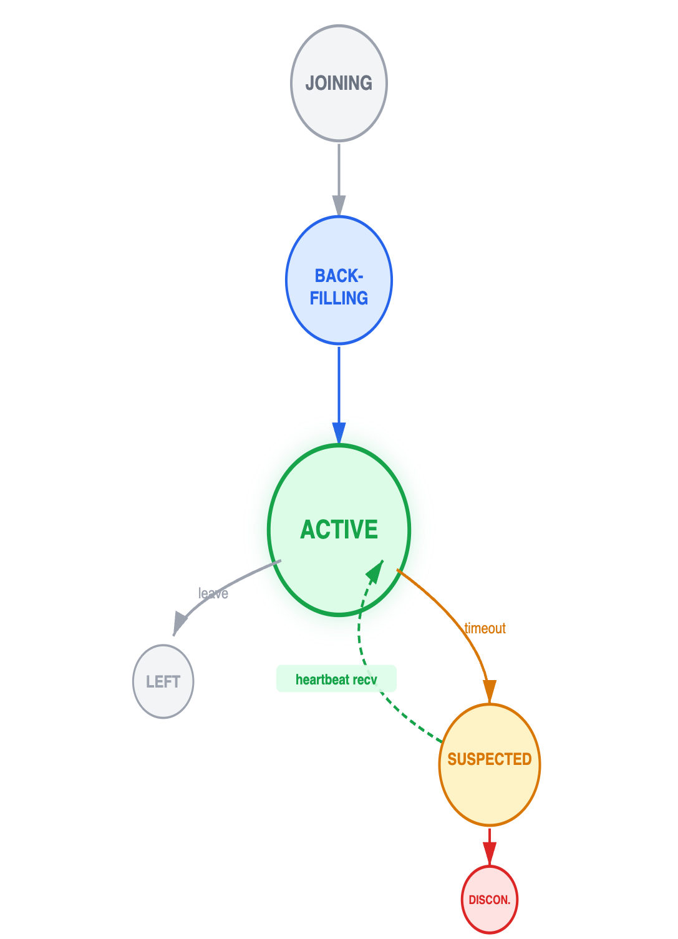
PEER
ARCHITECTURE
BOOTSTRAP FLOW
DISCOVERY
UI / Security
MembershipSer
EventLog
Snapshot
BroadcastNode
Network Peers
JOIN_REQUEST
connect(user, seed_ip)
PublicFacade
AppendOnly
Materialized view
Distribution transport
JOIN / GOSSIP / HB
Plaintext-signed + own pubkey
& MEMBERSHIP
INTEGRATION CONTRACTS
pre_verify_hook
Himanshu · Abhishek · Asim · Ali
DISTRIBUTION
SECURITY
TOFU: register pubkey from envelope
Rides BroadcastNode — no own socket
send_to_peer for JOIN handshake
broadcast for gossip + heartbeats
pre_verify_hook for trust-on-first-use
Asymmetric per-peer pubkeys (group key retired)
Pubkey in JOIN_ACCEPTED → encrypt ready
TOFU: register pubkey from first envelope
JOIN_REQUEST plaintext only (known limit)
JOIN_ACCEPTED
PeerChat · May 2026
Coordinator logs event, gossips out
MEMBERSHIP STATES
JOINING
JOIN_RESPONSE
HISTORY
UI
Encrypted event-log replay → joiner
BACKFILLING
register_history_handler() callback API
BACKFILL_STARTED → BACKFILLING state
complete_history_backfill() → ACTIVE
Auto-promote fallback for demo/testing
connect(username, seed_ip) entrypoint
Empty seed_ip = seed mode, else joiner
Membership events → peer_registry mutations
Synchronous bootstrap completes in ≤5s
→ ACTIVE
ACTIVE
Backfill done; chat fan-out enabled
SUSPECTED
GOSSIP & PRESENCE TIMERS
LEFT
KEY FAILURES → FIXES
5s
15s
15s
1s
DISCONNECTED
✗ Dual transport port collision
✗ JOIN_RESPONSE dropped—missing pubkey
Heartbeat
Suspect
Dead
Tick
✓ Consolidated onto BroadcastNode (one port)
✓ pre_verify_hook: register before verify
KNOWN LIMITATIONS
133
JOIN_REQUEST is plaintext-signed (TOFU)
lan_ip heuristic: wrong NIC on multi-interface hosts
No NAT traversal or TLS on the WS layer
One room per process (room_id constructor-fixed)
Synchronous subscriber dispatch can block callbacks
✗ SUSPECTED state never cleared
✗ get_lan_ip chose wrong NIC
AUTOMATED TESTS · 3 SUITES
✓ presence-tick thread at 1s interval
✓ Hostname fallback; bind-vs-advertise planned

