Slide 1
PI KAPPA PHI DATABASE
Created by
Mark Aaron Sansgaard, Joshua Dayan, Andy Yang

Slide 2
Background
Was a concept for Pi Kappa Phi – Mark is in charge of roster info.
Previously used Excel spreadsheets to track members.
Mark needed a more detailed method for storing and retrieving information – many members, many attributes.

Slide 3
Why a database?
Although the Excel files were functional, they weren't very practical.
An efficient system for storage and retrieval.
Database system to model the complexities of greek life.
No front end, ideally only one person will be accessing the database.

Slide 4
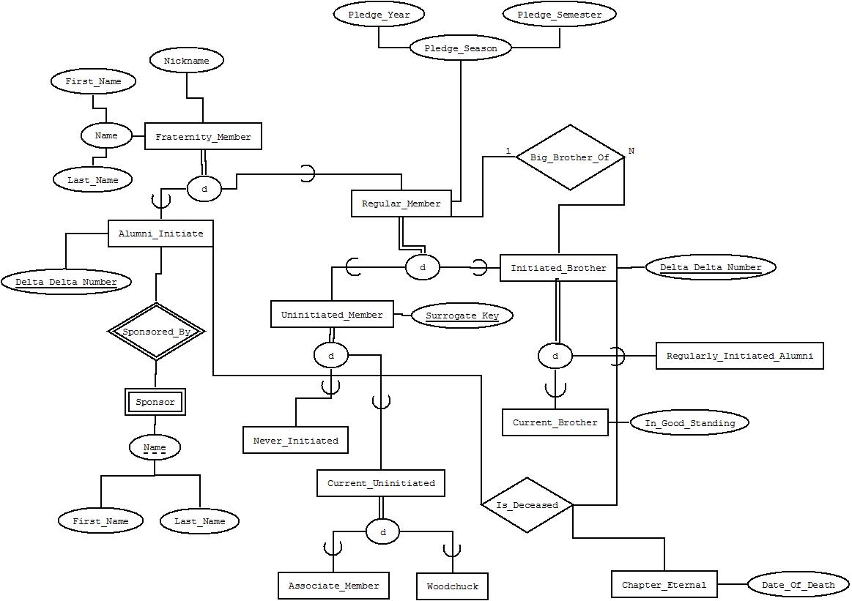
EERD

Slide 5
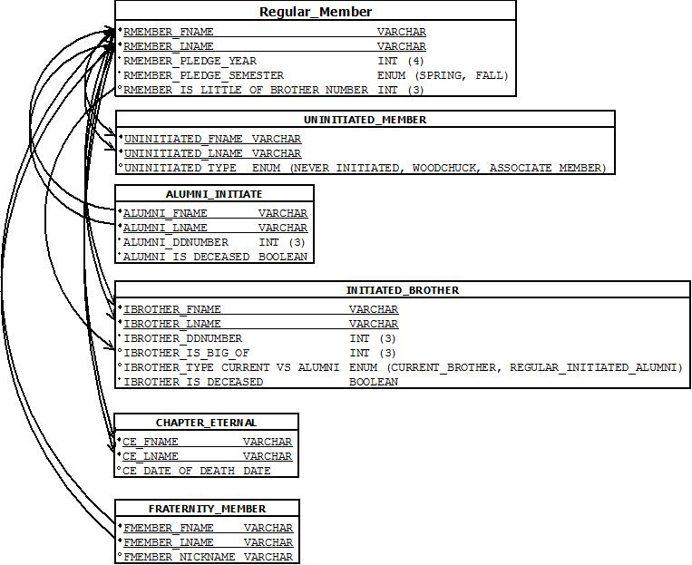
Schema

Slide 6
Complications
Primary Keys:
  Delta Delta Numbers
  First Name, Last Name
Volume of data:
  Possible Discrepancies
Complex relationships:
  Woodchuck, Initiated, Alumni, etc.
  Big Brother / Little Brother relationship

Slide 7
Sample Query 1
Find the first and last names of all members whose pledge season was in the fall of 2009.
SELECT `RMEMBER_FNAME` AS 'FIRST NAME', `RMEMBER_LNAME` AS 'LAST NAME'
FROM REGULAR_MEMBER
WHERE `RMEMBER_PLEDGE_YEAR` =2009 AND `RMEMBER_PLEDGE_SEMESTER` = 'FALL'

Slide 8
Sample Query 2
Find the number of deceased members.
SELECT COUNT( * ) AS 'NUMBER OF DECEASED MEMBERS'
FROM CHAPTER_ETERNAL

Slide 9
Sample Query 3
Find the first and last name of the member whose grand little has a delta delta number of 751.
SELECT `IBROTHER_FNAME` AS 'FIRST NAME', `IBROTHER_LNAME` AS 'LAST NAME'
FROM INITIATED_BROTHER
WHERE IBROTHER_IS_BIG_OF=(
SELECT `IBROTHER_DDNUMBER`
FROM INITIATED_BROTHER
WHERE IBROTHER_IS_BIG_OF = 751 )

Slide 10
Sample Query 4
Return all the initiated members and group them by their initiation semesters.
SELECT `RMEMBER_FNAME` AS 'FIRST NAME', `RMEMBER_LNAME` AS 'LAST NAME', `RMEMBER_PLEDGE_YEAR` AS 'PLEDGE YEAR', `RMEMBER_PLEDGE_SEMESTER` AS 'PLEDGE SEMESTER'
FROM REGULAR_MEMBER
GROUP BY `RMEMBER_PLEDGE_YEAR`, `RMEMBER_PLEDGE_SEMESTER`

Slide 11
Sample Query 5
Find the delta delta number of the member whose nickname is “Friendzone’.
SELECT `IBROTHER_DDNUMBER` AS 'DELTA DELTA NUMBER'
FROM INITIATED_BROTHER, FRATERNITY_MEMBER
WHERE `IBROTHER_FNAME` = `FMEMBER_FNAME` AND `IBROTHER_LNAME` = `FMEMBER_LNAME` AND `FMEMBER_NICKNAME` = 'FRIENDZONE'

Slide 12
Sample Query 6
Return all of the big/ little brother pairs between initiated brothers and regular members.
SELECT `IBROTHER_FNAME` AS 'BIG FIRST', `IBROTHER_LNAME` AS 'BIG LAST', RMEMBER_FNAME AS 'LITTLE FIRST', RMEMBER_LNAME AS 'LITTLE LAST'
FROM INITIATED_BROTHER INNER JOIN REGULAR_MEMBER
ON INITIATED_BROTHER.IBROTHER_DDNUMBER = REGULAR_MEMBER.RMEMBER_IS_LITTLE_OF_BROTHER_NUMBER

Slide 13
Sample Query 7
List all of the active Woodchucks.
SELECT `UNINITIATED_FNAME` AS 'FIRST NAME', `UNINITIATED_LNAME` AS 'LAST NAME'
FROM UNINITIATED_MEMBER
WHERE `UNINITIATED_TYPE` = 'WOODCHUCK'

Slide 14
Sample Query 8
Find all the information about the member Mark Sansgaard.
SELECT `RMEMBER_FNAME` AS 'FIRST NAME', `RMEMBER_LNAME` AS 'LAST NAME', `RMEMBER_PLEDGE_YEAR` AS 'PLEDGE YEAR', `RMEMBER_PLEDGE_SEMESTER` AS 'PLEDGE SEMESTER', `RMEMBER_IS_LITTLE_OF_BROTHER_NUMBER` AS 'LITTLE OF'
FROM REGULAR_MEMBER
WHERE `RMEMBER_LNAME` = 'SANSGAARD' AND `RMEMBER_FNAME` = 'MARK'

Slide 15


