Slide 1
Think Like A Programmer
Nick Debeurre

Slide 2
Agenda
Think Like a Programmer
Fundamentals
Time to Run Your First Program
Tic-Tac-Toe Build Along
Hangman Self-Exploration Challenge

Slide 3
Before We Start
My name is Nick
I am Miss Audrey’s husband
I am an AI software engineer at Qualcomm
Coding may seem scary but I am here to help you ☺
If you feel confused, stuck, scared, or have a question, raise your hand

Slide 4
Part 1
Think Like a Programmer

Slide 5
Why You Should Learn to Code
Computers are everywhere
Computers work quickly – much faster than humans
Computers cannot
Act on their own
Make things from scratch
Learning to code is learning to communicate with your computer
Programming is digital freedom

Slide 6
What is Programming?
Programming is telling a computer what to do
Programs are like recipes for the computer to “cook” from
Think of a restaurant:
The chef creates a recipe for a dish
When a customer orders the dish, the chef uses the recipe to make it
Now, the chef doesn’t need to make the dish from scratch every time
Programming is similar:
You create a program for a task and save it in a file
When you want your computer to perform the task, you run the program

Slide 7
Part 2
Fundamentals

Slide 8
Types, Variables, and Reserved Words
Types are different kinds of information the computer can store
Integer (int) → a positive or negative whole number, for example 1
String (str) → a word, for example ‘bread’
Boolean (bool) → True or False
Variables are how you define changing information for a computer
secret_word = ‘fancy sauce’
my_fav_color = ‘green’
Reserved words are part of the programming language and cannot be used as variables
action = pet() if dog.is_friendly() else look()

Slide 9
Control Structures and Operators
Control structures are building blocks that can be used to control the flow of the program
Loops
while True
for item in list
Conditionals
If → else if → else
Functions
myFunction()
Operators are symbols that perform operations
Some examples include +, -, =, ==

Slide 10
Object Oriented Programming
Object-oriented programming (OOP) is a way of writing programs where you use digital objects to organize and handle information
Consider a car
How do you steer?
How do you stop and go?
Let’s think about the important sub-components of a car
Steering Wheel
Pedals
Engine
Now let’s see it in code!
Notes:
Car.py

Slide 11
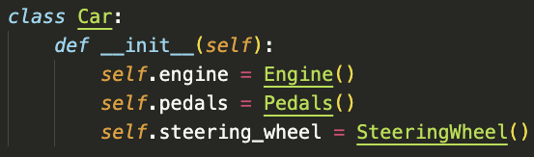
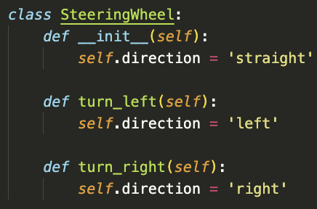
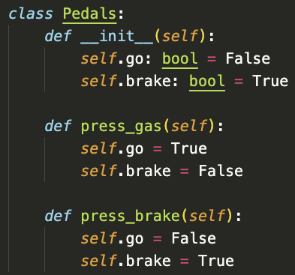
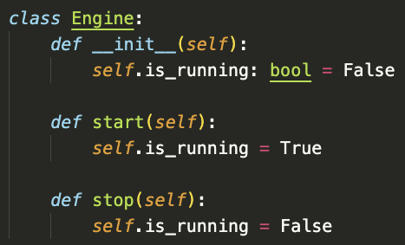

Slide 12
Part 3
Time to run your first program!

Slide 13
Hello World
Step 1: Make a workspace
Create folder on the desktop called [name]_workspace
Step 2: Open a terminal
Press cmd + space to open the search bar
Type ‘terminal’ and open the application
Step 3: Visual Studio Code (VS Code)
Go to applications and open Visual studio code
Right click in the workspace and click add folder
Choose your workspace from the Desktop
Step: 4 Make a new file
Right click on the directory in VS Code
Click ‘New File…’
Name it hello_world.py
Step 5: Add your code
name = ‘name’
print(’Hello World! My name is ’ + name + ‘.’)
Step 6: Run the code
run ‘python hello_world.py’
You should see the output “Hello World! My name is name.”

Slide 14
Part 4
Tic Tac Toe

Slide 15
Part 5
Hangman

Slide 16
Different Languages
Many types of languages to serve different purposes
Two main categories are compiled and interpreted
Compiled programs are ready to run
Interpreted programs are run on-the-fly
Let’s go back to the kitchen:
Compiled programs are like a frozen meal you made ahead of time and reheat
Interpreted programs are like a recipe you pickup and prepare from scratch
C and Python are two common languages
C is compiled, runs faster, and takes up less space, but it is harder to learn, understand, and use
Python is easy to learn, understand, and use but it is interpreted, runs more slowly, and takes up more space
Notes:
(We will be using Python, but I encourage you to explore C is python is interesting to you)

