Slide 1
Context

Slide 2
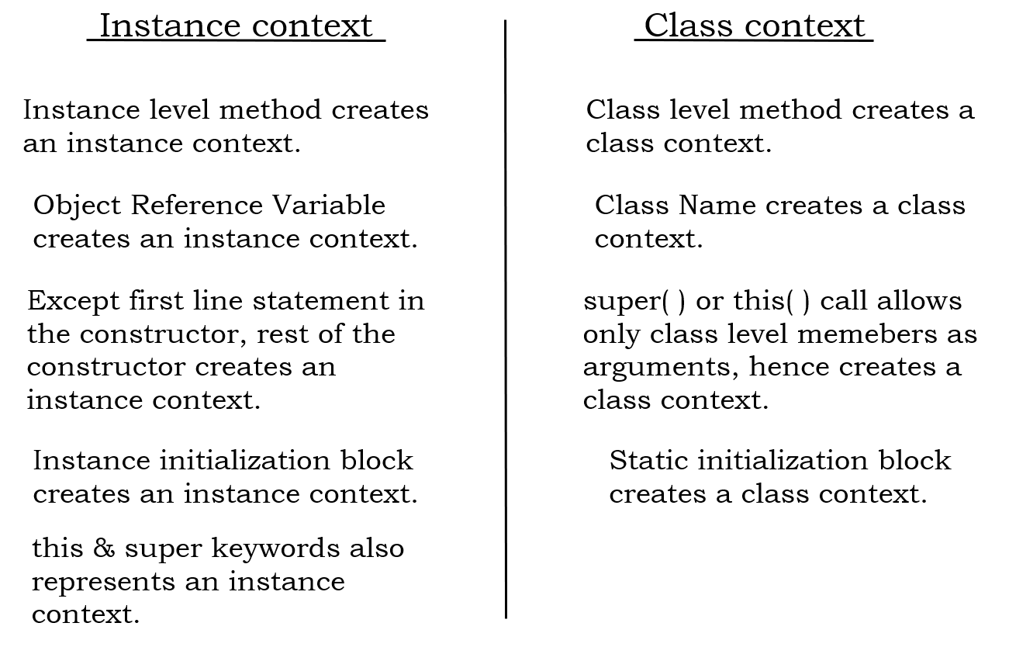

Slide 3
