Slide 1
Frontend
.

Slide 2
What is Front End development?
Front End development and Front End programming languages create what a user interacts with
HTML, CSS, and JavaScript are the three Front End languages
Each language has a specific function
Helps create the user experience within a browser
Requires creative, technical, and communication skills
Employment and salary projections are promising

Slide 3
Front End languages
HTML5, CSS, and JavaScript are the backbone of Front End development
Front End languages have changed and improved over time
Developers use frameworks and code libraries for efficiency
Also known as frontend languages or front-end languages

Slide 4
HTML
HTML (HyperText Markup Language) is the most basic building block of the Web. It defines the meaning and structure of web content. Other technologies besides HTML are generally used to describe a web page's appearance/presentation (CSS) or functionality/behavior (JavaScript).
"Hypertext" refers to links that connect web pages to one another, either within a single website or between websites. Links are a fundamental aspect of the Web. By uploading content to the Internet and linking it to pages created by other people, you become an active participant in the World Wide Web.
HTML uses "markup" to annotate text, images, and other content for display in a Web browser. HTML markup includes special "elements" such as <head>, <title>, <body>, <header>, <footer>, <article>, <section>, <p>, <div>, <span>, <img>, <aside>, <audio>, <canvas>, <datalist>, <details>, <embed>, <nav>, <output>, <progress>, <video>, <ul>, <ol>, <li> and many others.

Slide 5
CSS
Cascading Style Sheets (CSS) is a stylesheet language used to describe the presentation of a document written in HTML or XML (including XML dialects such as SVG, MathML or XHTML). CSS describes how elements should be rendered on screen, on paper, in speech, or on other media.
CSS is among the core languages of the open web and is standardized across Web browsers according to W3C specifications.

Slide 6
JAVASCRIPT
JavaScript (JS) is a lightweight, interpreted, or just-in-time compiled programming language with first-class functions. While it is most well-known as the scripting language for Web pages, many non-browser environments also use it, such as Node.js, Apache CouchDB and Adobe Acrobat. JavaScript is a prototype-based, multi-paradigm, single-threaded, dynamic language, supporting object-oriented, imperative, and declarative (e.g. functional programming) styles.

Slide 7
Bootstrap
Bootstrap is the most popular HTML, CSS and JavaScript framework for developing a responsive and mobile friendly website.
It is absolutely free to download and use.
It is a front-end framework used for easier and faster web development.
It includes HTML and CSS based design templates for typography, forms, buttons, tables, navigation, modals, image carousels and many others.
It can also use JavaScript plug-ins.
It facilitates you to create responsive designs.

Slide 9
What is a Back End development?
A Back End dev uses a set of Back End developer languages to bring the Front End language of a developer to life. While a Front End dev creates the user experience within a browser, the Back End dev is creating the logic that makes those requests a reality. In some ways, a Back End dev is creating the brains and logic of the website
Back End devs can be more technical and organized, but they are still a part of a larger team. While they need to know how to create the logic that efficiently pulls the data to fulfill a request, they also need to communicate their needs and potential limitations to the Front End dev. They are also responsible for maintaining this logic system. Back End devs are working with databases, servers, an application programming interface (API) that creates a structure for component interaction and the integration of all these processes.

Slide 10
Back End languages
Ruby, Python, and PHP are popular Back End languages
Back End languages are used to fulfill requests created by the user
Back End languages retrieve information from a database stored in a server that’s then processed through an application
Also known and backend languages or back-end languages

Slide 11
JAVA
Java is a class-based, object-oriented programming language that is designed to have as few implementation dependencies as possible. It is a general-purpose programming language intended to let application developers write once, run anywhere (WORA),[17] meaning that compiled Java code can run on all platforms that support Java without the need for recompilation.[18] Java applications are typically compiled to bytecode that can run on any Java virtual machine (JVM) regardless of the underlying computer architecture. The syntax of Java is similar to C and C++, but has fewer low-level facilities than either of them. The Java runtime provides dynamic capabilities (such as reflection and runtime code modification) that are typically not available in traditional compiled languages.
simple, object-oriented, and familiar.
robust and secure.
architecture-neutral and portable
high performance.
interpreted, threaded, and dynamic.

Slide 12
Java EE
The Java EE stands for Java Enterprise Edition, which was earlier known as J2EE and is currently known as Jakarta EE. It is a set of specifications wrapping around Java SE (Standard Edition). The Java EE provides a platform for developers with enterprise features such as distributed computing and web services. Java EE applications are usually run on reference run times such as microservers or application servers. Examples of some contexts where Java EE is used are e-commerce, accounting, banking information systems.
Java EE facilitates development of large scale applications.
EE is built upon Java SE. It provides functionalities like web applications, and Servlets.
Java EE is a structured application with a separate client, business, and Enterprise layers.
It is mainly used for developing web applications.
Suitable for experienced Java developers who build enterprise-wide applications.
It provides user authentication.

Slide 13
JAVA SE VS JAVA EE
JAVA SE
JAVA EE
When most people think of the Java programming language, they think of the Java SE API. Java SE's API provides the core functionality of the Java programming language. It defines everything from the basic types and objects of the Java programming language to high-level classes that are used for networking, security, database access, graphical user interface (GUI) development, and XML parsing.
In addition to the core API, the Java SE platform consists of a virtual machine, development tools, deployment technologies, and other class libraries and toolkits commonly used in Java technology applications.
The Java EE platform is built on top of the Java SE platform. The Java EE platform provides an API and runtime environment for developing and running large-scale, multi-tiered, scalable, reliable, and secure network applications.

Slide 14
JSP
Java Server Pages (JSP) is a server-side programming technology that enables the creation of dynamic, platform-independent method for building Web-based applications. JSP have access to the entire family of Java APIs, including the JDBC API to access enterprise databases.
t stands for Java Server Pages.
It is a server side technology.
It is used for creating web application.
It is used to create dynamic web content.
In this JSP tags are used to insert JAVA code into HTML pages.
It is an advanced version of Servlet Technology.
It is a Web based technology helps us to create dynamic and platform independent web pages.

Slide 15
Servlet
Servlets provide a component-based, platform-independent method for building Webbased applications, without the performance limitations of CGI programs. Servlets have access to the entire family of Java APIs, including the JDBC API to access enterprise databases.
Servlet is a technology which is used to create a web application.
Servlet is an API that provides many interfaces and classes including documentation.
Servlet is an interface that must be implemented for creating any Servlet.
Servlet is a class that extends the capabilities of the servers and responds to the incoming requests. It can respond to any requests.
Servlet is a web component that is deployed on the server to create a dynamic web page.

Slide 16
My Sql 8.0
MySQL is the most popular Open Source Relational SQL Database Management System. MySQL is one of the best RDBMS being used for developing various web-based software applications. MySQL is developed, marketed and supported by MySQL AB, which is a Swedish company.
Relational Database System: Like almost all other database systems on the market, MySQL is a relational database system.
Client/Server Architecture: MySQL is a client/server system.
SQL compatibility: MySQL supports as its database language -- as its name suggests – SQL (Structured Query Language).

Slide 17
Ajax
AJAX stands for Asynchronous JavaScript and XML. AJAX is a new technique for creating better, faster, and more interactive web applications with the help of XML, HTML, CSS, and Java Script.
AJAX is a web browser technology independent of web server software.
Conventional web applications transmit information to and from the sever using synchronous requests. It means you fill out a form, hit submit, and get directed to a new page with new information from the server.With AJAX, when you hit submit, JavaScript will make a request to the server, interpret the results, and update the current screen. In the purest sense, the user would never know that anything was even transmitted to the server.
A user can continue to use the application while the client program requests information from the server in the background.

Slide 18
MVC Archirtecture
The Model-View-Controller (MVC) is an architectural pattern that separates an application into three main logical components: the model, the view, and the controller. Each of these components are built to handle specific development aspects of an application. MVC is one of the most frequently used industry-standard web development framework to create scalable and extensible projects.

Slide 19
MVC Components
Following are the components of MVC −

Slide 20
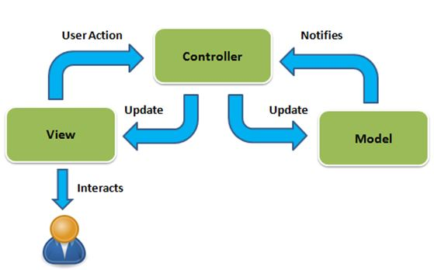

Slide 21
Model
The Model component corresponds to all the data-related logic that the user works with. This can represent either the data that is being transferred between the View and Controller components or any other business logic-related data. For example, a Customer object will retrieve the customer information from the database, manipulate it and update it data back to the database or use it to render data.

Slide 22
View
The View component is used for all the UI logic of the application. For example, the Customer view will include all the UI components such as text boxes, dropdowns, etc. that the final user interacts with.

Slide 23
Controller
Controllers act as an interface between Model and View components to process all the business logic and incoming requests, manipulate data using the Model component and interact with the Views to render the final output. For example, the Customer controller will handle all the interactions and inputs from the Customer View and update the database using the Customer Model. The same controller will be used to view the Customer data.

Slide 24
JDBC
JDBC API is a Java API that can access any kind of tabular data, especially data stored in a Relational Database. JDBC works with Java on a variety of platforms, such as Windows, Mac OS, and the various versions of UNIX.
JDBC stands for Java Database Connectivity, which is a standard Java API for database-independent connectivity between the Java programming language and a wide range of databases.
Making a connection to a database.
Creating SQL or MySQL statements.
Executing SQL or MySQL queries in the database.
Viewing & Modifying the resulting records.

Slide 25
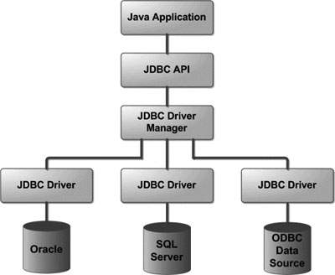

Slide 26
Apache Tomcat
The Apache Tomcat® software is an open source implementation of the Java Servlet, JavaServer Pages, Java Expression Language and Java WebSocket technologies. The Java Servlet, JavaServer Pages, Java Expression Language and Java WebSocket specifications are developed under the Java Community Process.
The Apache Tomcat software is developed in an open and participatory environment and released under the Apache License version 2. The Apache Tomcat project is intended to be a collaboration of the best-of-breed developers from around the world.

