Slide 1
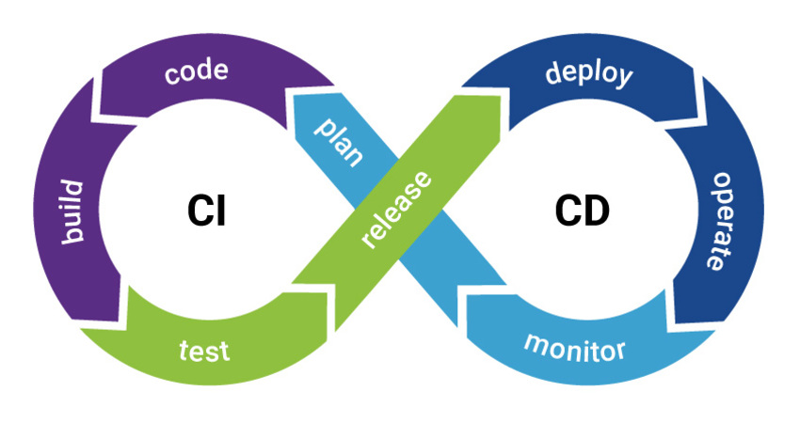
CICD Fundamentals & Business Benefits

Slide 2
Overview
What is CI/CD
CI/CD pipeline
What are the business benefits of CICD
Current Pain Points
CICD Solution

Slide 3
What is CICD
The CI/CD is one of the best practices for DevOps teams to implement, for delivering code changes more frequently and reliably
CI/CD consist of three major concepts
Continuous Integration
Continuous Deployment
Continuous Delivery

Slide 4
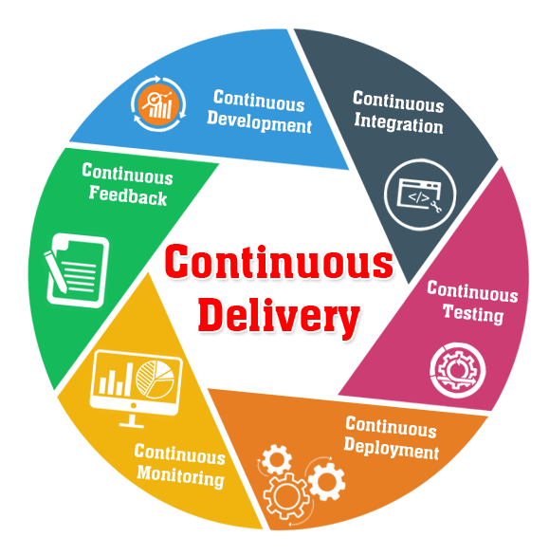
Continuous Integration
Continuous Integration describes the process of merging developer branches to the main branch several times a day. CI puts an emphasis on test automation and finally generates a high quality, deployable artifact.
Continuous Deployment
Continuous Deployment extends Continuous Delivery in such a way that it allows frequent automated deployments without any human interaction. Typical phases in Continuous Deployment are Infrastructure Provisioning, Smoke Testing, Production Deployments and automated Rollbacks.
Continuous Delivery
In addition to Continuous Integration, Continuous Delivery makes sure that changes of a software product can be released quickly to customers in an automated way and at any point in time.

Slide 5
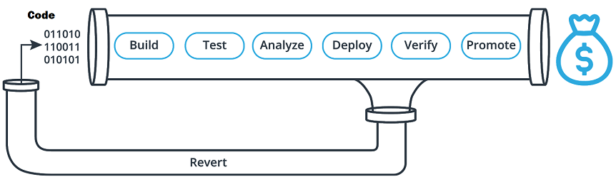
CI/CD Pipeline
CI/CD pipelines are a series of steps that must be completed to deliver a new release.
The CI/CD pipeline typically breaks down into the following stages:
Build
Test
Analyze
Deploy
Verify
Promote

Slide 6

What are the Business Benefits of CI/CD?
CICD is able to catch unit test. Hence less bugs in production and less time in testing. This Avoids Cost
CICD is able to catch compile errors after merge. Hence less developer time on issues from new developer code. This Reduces cost.

Slide 7

CICD is able to detect security vulnerabilities. This prevent embarrassing or costly security holes and Avoids cost.
CICD is able to automate infrastructure creation leading to less human error and faster deployments. This Saves money
CICD is able to automate infrastructure cleanup leading to less infrastructure costs from unused resources. This Saves Money by reducing extra infrastructure costs.
CICD gives us faster and more frequent production deployments and new value-generating features are released more quickly. Hence, Increase Revenue

Slide 8

CICD allows us to deploy in production without manual checks. Features will take less time to go to market. Hence, Increase Revenue
CICD can perform automated smoke tests. we would have reduced downtime from a deploy-related crash or major bug. Hence, Protecting Revenue
CICD is able to automate rollback triggered by job failure. we could have quick undo to return production to working state. Hence, Protecting Revenue

Slide 9

Our Current Pain Points
Our release process is manual and error-prone this always leads to delays of production deployments and affects release time lines.
Poor Release quality, no code consistency and no proper backout or rollback mechanisms
Complex deployments - Only a chosen few experts are able to understand the whole process.
Infrastructure creation and clean up is manual
Inconsistent environment configurations
Conflicting goals between dev and ops

Slide 10

CI/CD Solution
Smaller code changes are simpler and deployments are automated and have fewer unintended consequences.
Fault isolation is simpler and quicker. Detecting the root cause of a fault and then pointing out the exact location of the fault is one of the most proclaimed benefits of CI/CD.

Slide 11
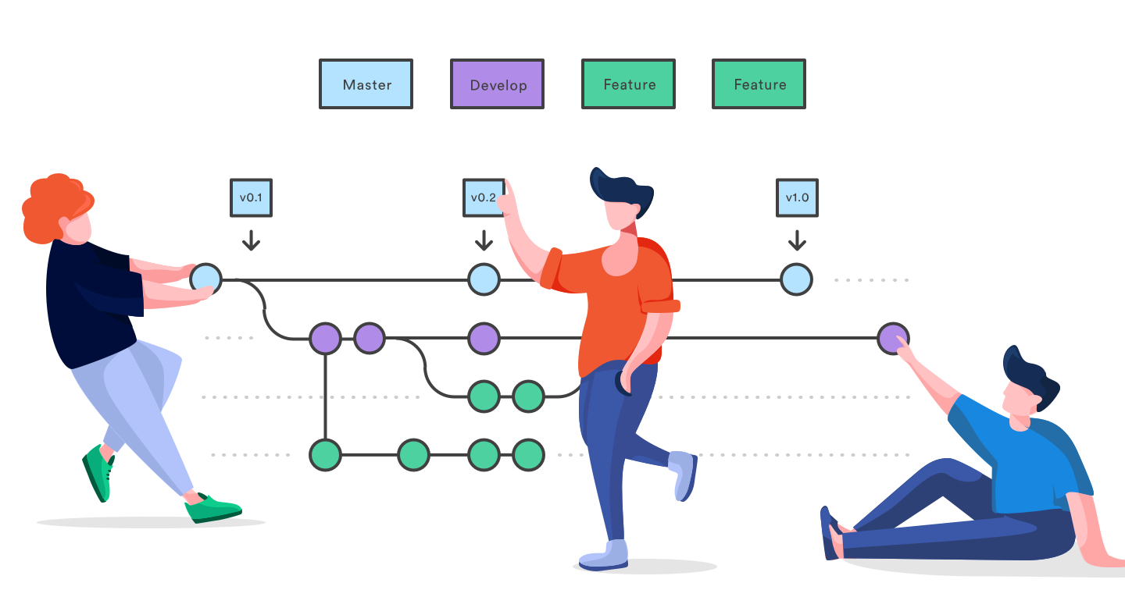
A CI/CD pipeline enables developers to integrate their code into a common repository in small batches. Through this repository, developers can share their builds with the entire team rather than working in isolation. Now, the whole team can collaborate for thorough detection and fixation of the most severe bugs and also the roll back mechanism is well defined.
Using CI/CD, you can improve test reliability to a great extent. Since specific and atomic changes are introduced to the system, it allows developers or QAs to add more relevant positive and negative tests for the changes. This testing is also referred to as ‘Continuous Reliability’ within a CI/CD pipeline.

Slide 12
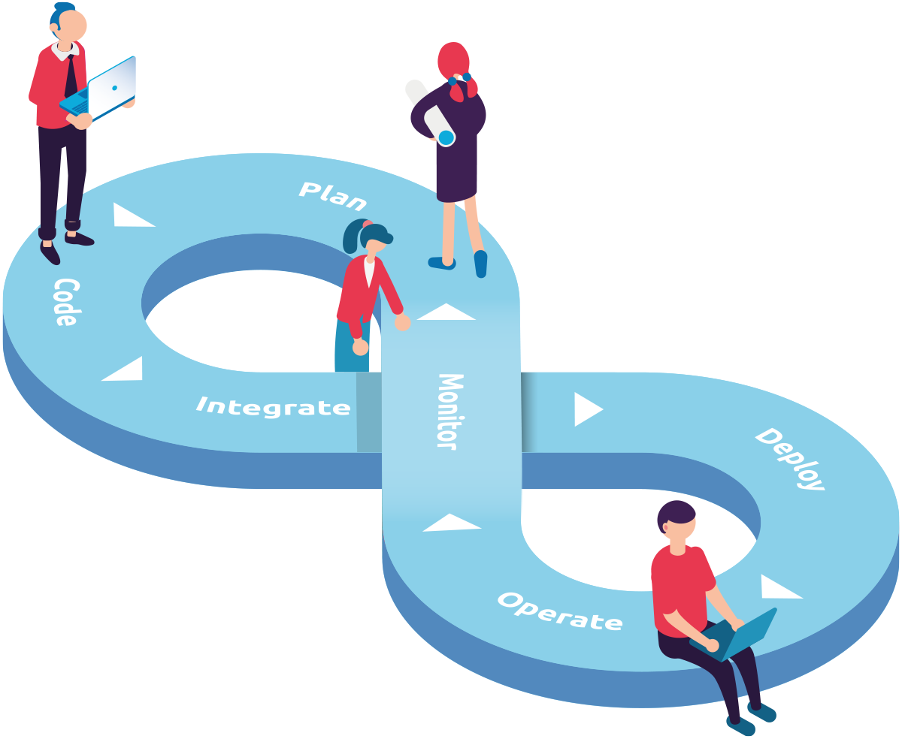
CI/CD improves overall communication and accountability between team members. It does so by becoming a common framework for all developers, QAs, and product managers working on a particular project.
CICD is able to automate infrastructure creation leading to no human error or Inconsistent environment configurations and faster deployments.
End-user involvement and feedback during continuous development leads to usability improvements. You can add new requirements based on customer’s needs on a daily basis.

