Slide 1
Superstore Data Analysis
Visual Storytelling with Power BI

Slide 2
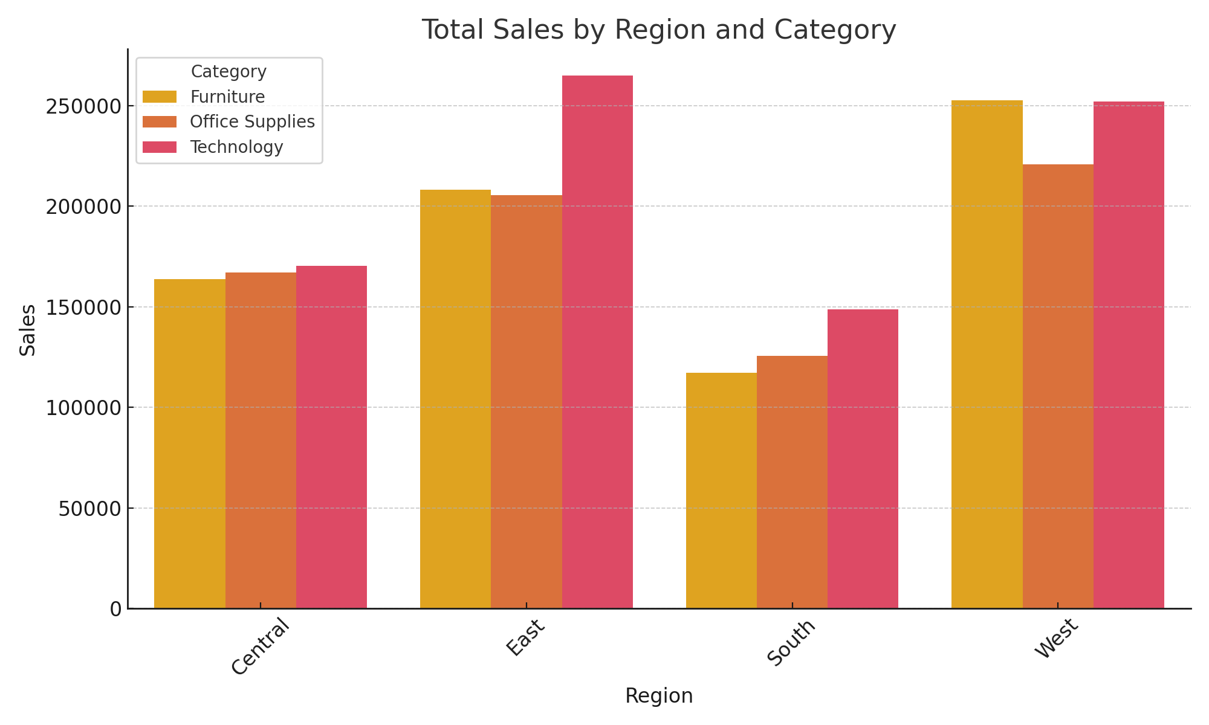
Sales by Region and Category

Slide 3
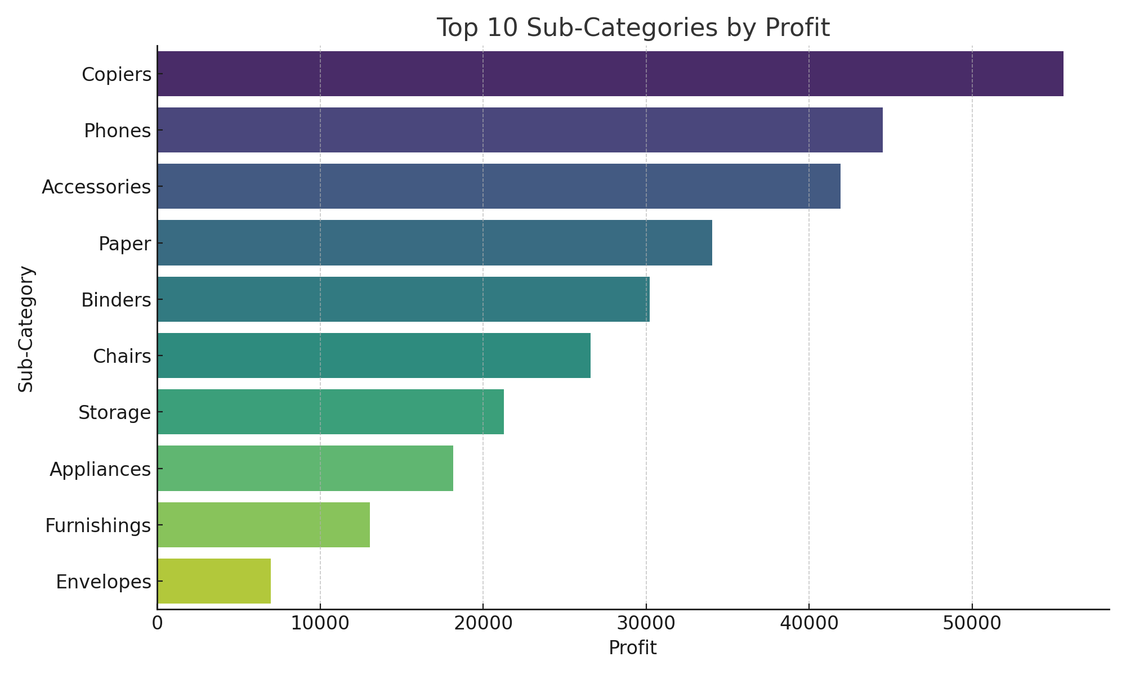
Top 10 Sub-Categories by Profit

Slide 4
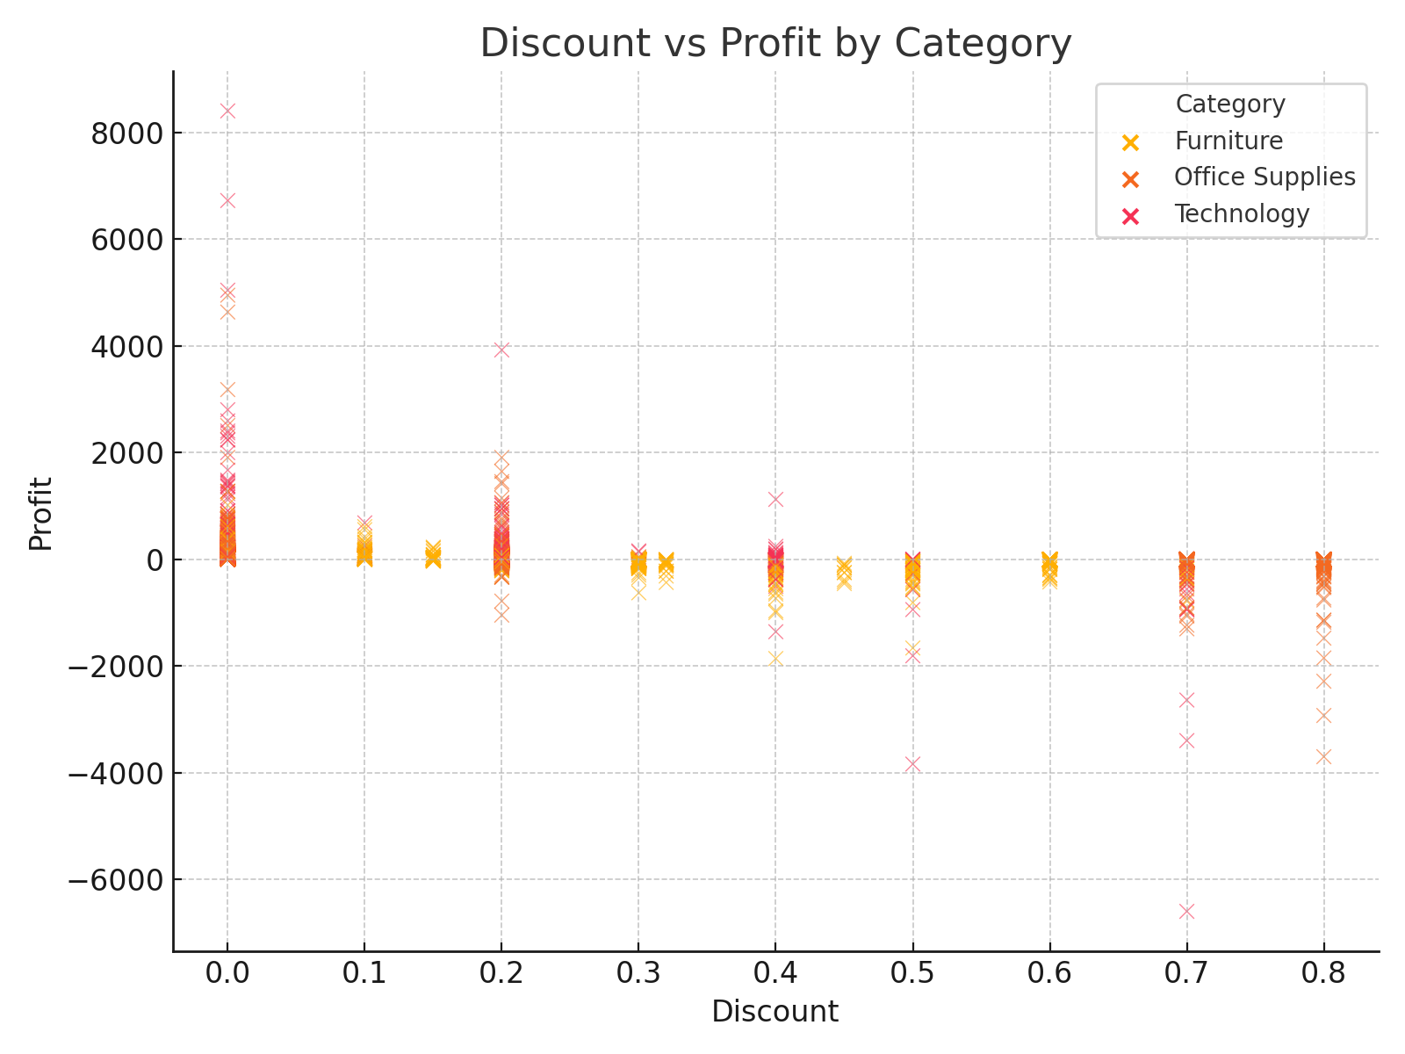
Discount vs Profit by Category

Slide 5
Key Insights
- The West region leads in sales across most categories.
- Technology sub-categories are consistently profitable.
- High discounts tend to reduce profit, especially in Furniture.
- Office Supplies shows variable profitability with increasing discounts.

